Slide 1


Front End Engineering-II
G12-FE-PID-17
Team Details: Arjun Sharma : 2410990941
Ankush : 2410990923
Amit : 2410990918
Abhinandan : 2410990894
Faculty Coordinator : Md. Shadab Ansari
Chitkara University Institute of Engineering and Technology, Chitkara University, Punjab

Slide 2

Table Of Contents
Introduction
Problem Statement
Technical Details
Technical Details – React Integration
Key Features
Project Highlights
Bonus Features
Conclusion

Slide 3


Introduction
EduTrack – Smart Student Management System
~EduTrack is a modern, web-based student management platform designed to streamline academic, administrative, and institutional data handling. Built using React + Vite, it provides a clean, responsive, and highly interactive interface for students, faculty, and administrators.
~The platform centralizes essential educational data—such as attendance, grades, courses, and notifications—into a single, secure system. EduTrack focuses on automation, data accuracy, and real-time visibility, ensuring a smooth digital experience for educational institutions.

Slide 4
Problem Statement
Traditional educational institutions struggle with:
~Slow and manual updates of student records
~Fragmented data across multiple systems
~Difficulty tracking student progress
~No central dashboard for students or faculty
~Lack of timely notifications for exams, fees, and attendance
~Limited reporting tools for administrators
~Poor data security and role-based access
EduTrack addresses these issues by offering a fully digital, centralized platform with structured data, secure access control, and automated workflows.

Slide 5
Technical Details
Frontend
~React.js (v18) – Component-based UI
~Vite – Ultra-fast development bundler
~HTML5, CSS3, JavaScript ES6+
~React Router DOM – Multi-page navigation
~React Hook Form + Yup – Form handling & validation
~Chart.js + react-chartjs-2 – Interactive graphs
Backend (Future-ready / Optional)
Node.js + Express or Firebase (Authentication + hosting)
Database (Optional/Future Scope)
MySQL / Firebase Firestore
Authentication
Email/Password
Role-based access support

Slide 6
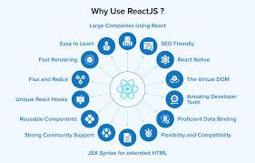

Technical Details-React Integration
~Entire UI is built using React components
~Uses Vite for fast builds and HMR
~Entry point: index.html → main.jsx → App.jsx
~Folder structure includes:
/components → Reusable UI components
/pages → Dashboard, Students, Courses, etc.
/hooks → Form & validation logic
/assets → Images, icons
~State handled using React Hooks
~All forms validated using Yup schemas

Slide 7
Key Features
Student Features
Dashboard Overview: Attendance, grades, fees, notifications
Responsive UI: Works flawlessly on mobile, tablet, and desktop
Profile Management: Update personal details
Downloadable Records: Report cards & fee receipts
Exam and Fee Alerts: Real-time reminders
Admin Features
Centralized Student Management
Course & Faculty Management
Add/Update/Delete Records
Role-Based Access Control
Automated Reports: Attendance, performance, finances
Analytics Dashboard with Charts

Slide 8
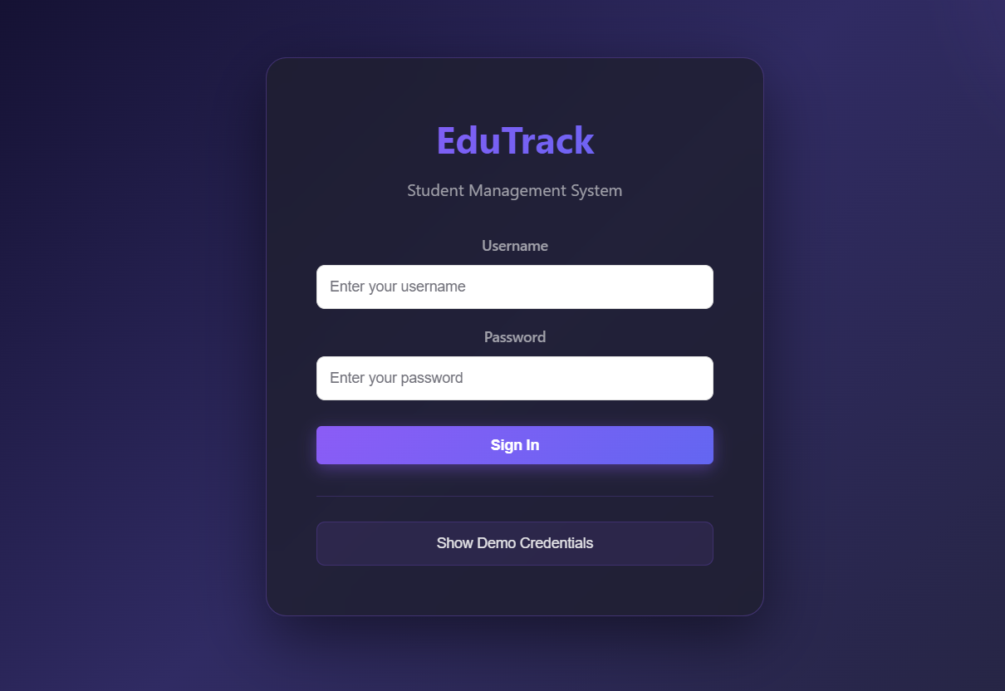
Project Highlights
~Fast Performance: Optimized with Vite + modular React components
~High Accuracy: Validated inputs, low redundancy
~Modern UI/UX: Clean layout, mobile friendly
~Better Security: Role-based permissions
~Visual Analytics: Charts for student performance
~Scalable Architecture: Easy to expand features

Slide 9
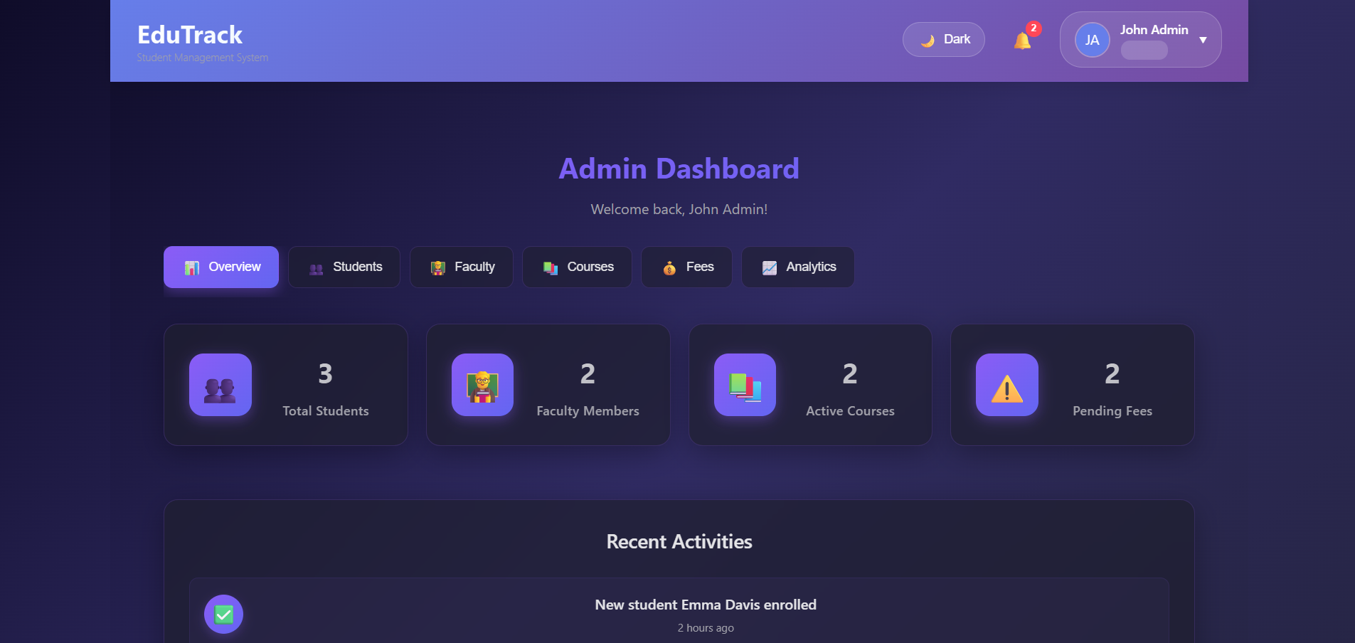
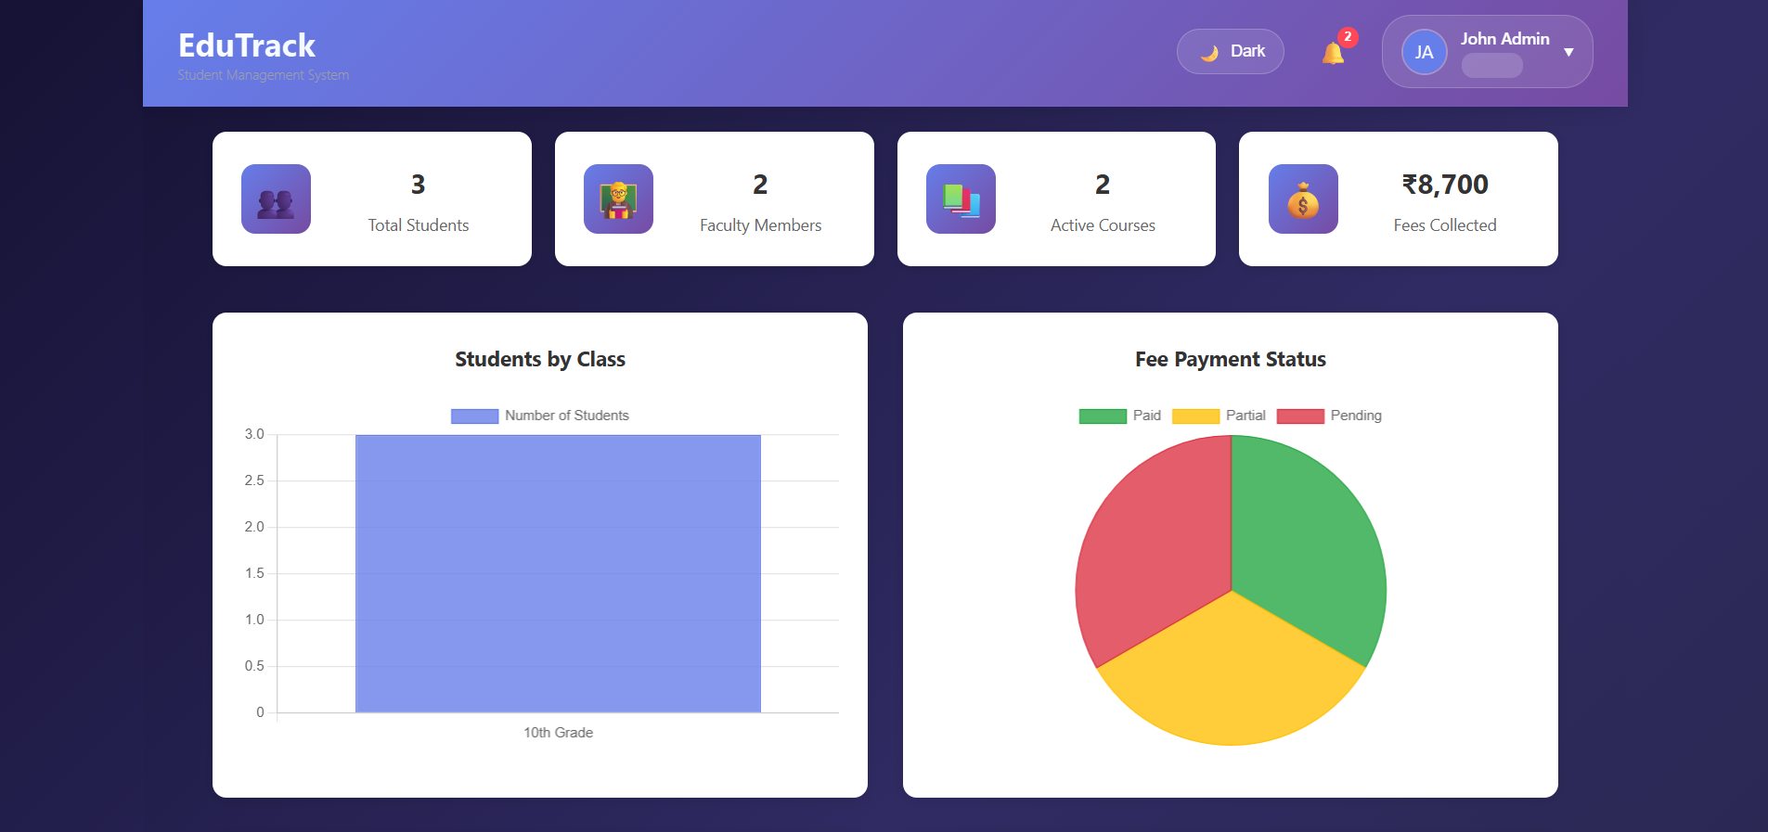
Project Highlights

Slide 10
Bonus Features
Bonus: Interactive Analytics Dashboard
~Student performance visualized with charts
~Attendance insights with weekly/monthly graphs
~Fee status heatmaps (future integration)
~Downloadable PDF reports

Slide 11
Conclusion
EduTrack successfully digitalizes the entire educational management workflow.
It enhances:
Efficiency – faster updates and easy data access
Transparency – real-time dashboards for all roles
Security – controlled access for students, faculty & admins
Automation – fewer manual errors, smooth operations
EduTrack proves to be a scalable, secure, and modern solution for educational institutions.

Slide 12
References/Link Used
https://geniusee.com/single-blog/key-features-of-school-management-software
https://itechindia.co/blog/features-of-student-management-system/
https://react.dev/
https://vitejs.dev/

Slide 13




