Slide 1
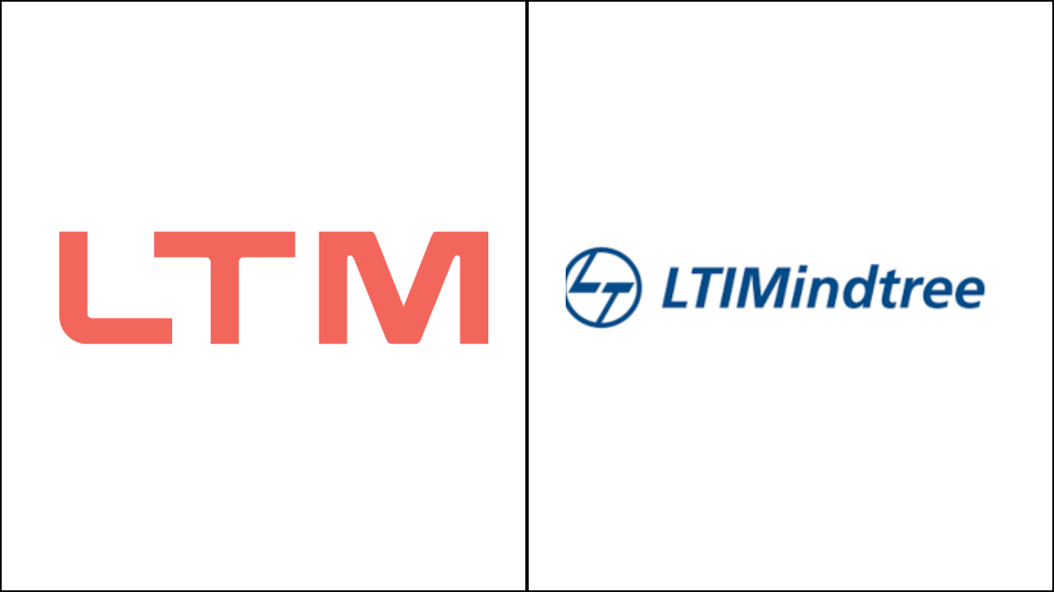
P1: Deterministic MCP-Driven AI Agents for Ball Bearing Vibration Diagnostics
P2: Edge-Optimized RAG and Localized Failure Mitigation for Automated Assembly Lines Using Quantized SLM
ZEROTH REVIEW
Presented By:
Arjun V P
T9987
VIT Chennai

Slide 2
Problem Statement :
  Industrial rotating machinery is highly susceptible to bearing faults, which can lead to unexpected downtime, reduced operational efficiency, and increased maintenance costs. Traditional AI-based diagnostic systems often rely on probabilistic outputs, making root-cause analysis less transparent and difficult to validate. This project aims to develop a Deterministic MCP (Model Context Protocol)-Driven AI Agent that can accurately detect and diagnose ball bearing health conditions from vibration signals while providing consistent, explainable, and reproducible fault identification results.
Objective :
  To develop a Deterministic MCP-Driven AI Agent using ISO standards that enables maintenance engineers and reliability teams to perform consistent, explainable, and accurate ball bearing fault diagnosis, reducing unplanned equipment failures and improving maintenance decision-making.
Dataset :
  NASA IMS Bearing Dataset
  3 run-to-failure experiments conducted on 4 bearings.
  Vibration signals collected at a 20 kHz sampling rate.
  Each recording contains 20,480 data points (1-second snapshot).
  Bearings operated at 2000 RPM under 6000 lbs load.
  Includes healthy, degrading, and failed bearing conditions for fault diagnosis and prognostics.
  Key Metrics: 20 kHz • 20,480 points/sample • 4 bearings • 3 test runs • 2000 RPM • 6000 lbs load

Slide 3
Technology Stack :
  Dataset: NASA IMS Bearing Dataset
  Programming: Python
  Data Processing: NumPy, Pandas
  Signal Processing: SciPy, FFT, Wavelet Analysis
  Machine Learning: Scikit-learn, XGBoost
  AI Agent Framework: MCP (Model Context Protocol)
  Visualization: Matplotlib, Seaborn
  Deployment: Edge Device / Local Server
Expected Outcome :
  Accurate detection of bearing health states (Healthy/Faulty).
  Explainable and deterministic fault diagnosis.
  Reduced unplanned maintenance and equipment downtime.
  Real-time vibration monitoring and decision support for maintenance teams.

Slide 4
Problem Statement :
  Automated assembly lines require rapid and reliable failure diagnosis to minimize downtime and maintain production efficiency. Cloud-based solutions can introduce latency and connectivity constraints, while traditional AI models may be too resource-intensive for edge deployment. There is a need for an edge-optimized, explainable system that can retrieve relevant failure knowledge and provide localized mitigation recommendations in real time.
Objective :
  To develop an Edge-Optimized RAG system using a Quantized Small Language Model (SLM) that assists maintenance operators and production engineers in identifying machine failures and recommending localized mitigation actions with low latency and minimal computational resources.
Dataset :
  AI4I 2020 Predictive Maintenance
  10,000 machine operation records with 14 attributes.
  Key sensor features: Air Temperature, Process Temperature, Rotational Speed, Torque, and Tool Wear.
  Includes Machine Failure labels and 5 failure modes: TWF, HDF, PWF, OSF, and RNF.
  Suitable for predictive maintenance, fault diagnosis, and failure classification tasks.
  Key Metrics: 10,000 Records • 14 Attributes • 5 Sensor Features • 5 Failure Modes.

Slide 5
Technology Stack :
  Dataset: AI4I 2020 Predictive Maintenance Dataset
  Programming: PythonML
  Frameworks: Scikit-learn, XGBoost
  RAG Components: LangChain / LlamaIndex
  Vector Database: FAISS
  SLM: Quantized Phi-3 Mini / TinyLlama (GGUF)
  Inference Engine: Ollama / llama.cpp
  Deployment: Edge Device (CPU-based)
Expected Outcome :
  Fast, low-latency failure diagnosis at the edge.
  Context-aware retrieval of maintenance knowledge.
  Automated mitigation recommendations for operators.
  Reduced dependency on cloud connectivity.
  Improved assembly-line uptime and operational efficiency.

Slide 6
THANK YOU!

