Slide 1


M.Tech/MCA Program
Advanced Industry Integrated Programs
Jointly offered by University and LTIMindTree
Review II
Deterministic MCP-Driven AI Agents for Ball Bearing Vibration Diagnostics
T9987
Arjun V P
VIT Chennai
Knowledge partner | Implementation partner

Slide 2
Deterministic MCP-Driven AI Agents for Ball Bearing Vibration Diagnostics
Introduction
Industrial rotating machinery is highly dependent on the reliable operation of rolling-element bearings.
Bearing faults can cause unexpected machine downtime, reduced efficiency, increased maintenance costs, and potential equipment failure.
Vibration analysis is a widely used technique for detecting and identifying bearing health conditions.
Traditional AI-based diagnostic systems may produce probabilistic predictions, making their reasoning difficult to validate and reproduce consistently.
This project proposes a Deterministic MCP (Model Context Protocol)-Driven AI Agent for reliable and explainable ball bearing fault diagnosis.
The system uses the NASA Bearing Dataset as the primary source of vibration data for developing and evaluating the diagnostic approach.

Slide 3
Deterministic MCP-Driven AI Agents for Ball Bearing Vibration Diagnostics
Objective
To develop a Deterministic MCP-Driven AI Agent for ball bearing health monitoring and fault diagnosis.
To analyze vibration signals and accurately identify different bearing health conditions.
To incorporate ISO-based standards and diagnostic principles into the analysis workflow.
To provide consistent, explainable, and reproducible fault identification rather than relying solely on probabilistic outputs.
To assist maintenance engineers and reliability teams in making informed maintenance decisions.
To reduce the risk of unplanned equipment failures, downtime, and unnecessary maintenance.

Slide 4
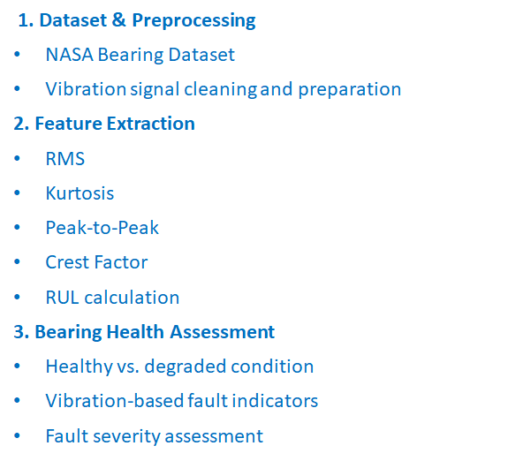
Deterministic MCP-Driven AI Agents for Ball Bearing Vibration Diagnostics
Modules to cover
4. Deterministic Diagnostic Engine
Rule/threshold-based decision logic
Consistent and reproducible diagnosis
ISO-based diagnostic criteria
5. MCP-Driven AI Agent
MCP tools and structured context
Agent-based diagnostic workflow
Explainable reasoning and fault identification
6. Results & Validation
Bearing fault classification
Diagnostic explanation
Accuracy and consistency evaluation

Slide 5
Deterministic MCP-Driven AI Agents for Ball Bearing Vibration Diagnostics
Methodology/Modeling Plan…. Calibri body -36
Calibri body 28

Slide 6
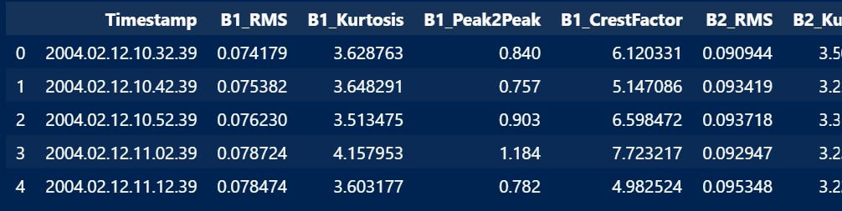
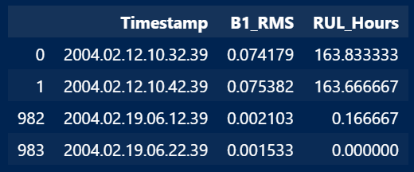
Deterministic MCP-Driven AI Agents for Ball Bearing Vibration Diagnostics
Data preprocessing & EDA
Resultant Feature Dataset
984 vibration files processed from the NASA Bearing Dataset.
Time-domain features extracted for each bearing:
  RMS — overall vibration energy
  Kurtosis — impulsive/fault-related behaviour
  Peak-to-Peak — vibration amplitude range
  Crest Factor — peak severity relative to RMS
Each record is associated with a timestamp and RUL (Remaining Useful Life) value.
The resulting structured dataset provides the input features for subsequent bearing health assessment and deterministic fault diagnosis.

Slide 7
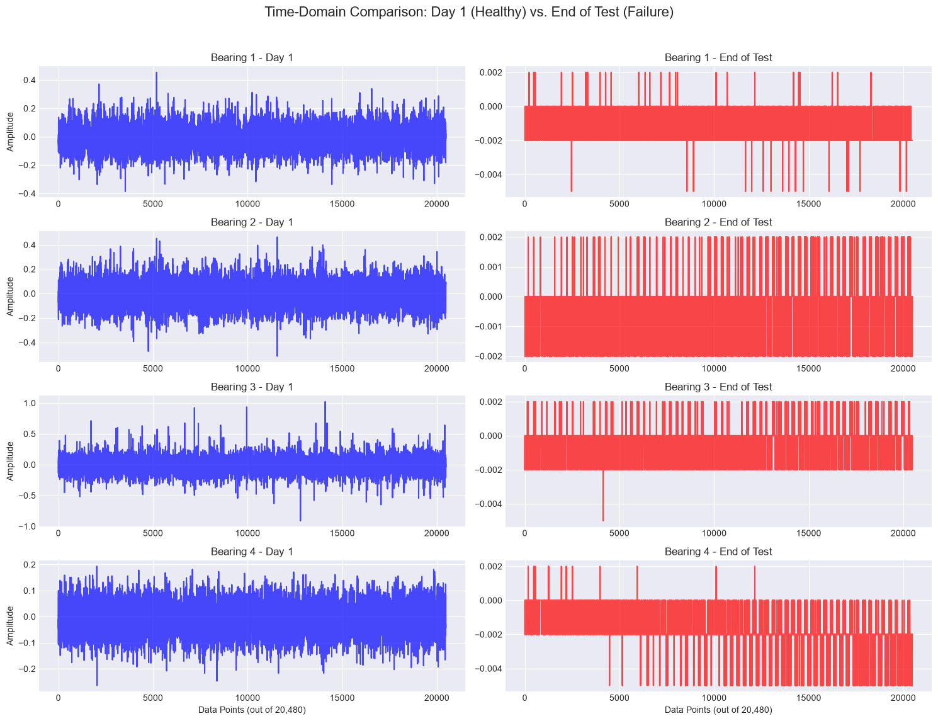
Deterministic MCP-Driven AI Agents for Ball Bearing Vibration Diagnostics
Data preprocessing & EDA

Slide 8
Deterministic MCP-Driven AI Agents for Ball Bearing Vibration Diagnostics
Approach/Algorithms/Tools
Component | Approach
Data processing | Timestamped vibration signal processing
Feature extraction | Statistical + frequency-domain features
Health assessment | Baseline deviation + degradation trajectory
RUL | Model-based prognosis + ML regression
Fault diagnosis | Vibration/frequency-domain analysis
Decision making | MCP tools + AI agent
Visualization | Real-time monitoring dashboard
Algorithms
RMS, Kurtosis, Peak-to-Peak, Crest Factor
FFT / frequency-domain analysis
Rolling median / smoothing
PCA-based health indicator
Exponential degradation modeling
XGBoost regression for RUL baseline
Future: fault classification and trajectory-aware RUL modeling

Slide 9
Deterministic MCP-Driven AI Agents for Ball Bearing Vibration Diagnostics
Project plan/milestones progress
Milestone | Status
NASA IMS dataset integration | ✅ Complete
Dataset validation & ingestion | ✅ Complete
Feature extraction pipeline | ✅ Complete
Processed feature dataset | ✅ Complete
Bearing observation layer | ✅ Complete
RUL target generation | ✅ Complete
Health/degradation baseline | ✅ Complete
FastAPI backend | ✅ Complete
Interactive monitoring dashboard | ✅ Complete
Initial RUL ML baseline | ✅ Completed / Under Evaluation
Improved RUL methodology | 🔄 In Progress
Frequency-domain fault diagnosis | ⏳ Planned
Fault classification | ⏳ Planned
MCP diagnostic tools | ⏳ Planned
Agentic orchestration | ⏳ Planned
Maintenance recommendation engine | ⏳ Planned
Test 1 & Test 3 validation | ⏳ Planned
Dockerized deployment | ⏳ Planned

Slide 10
Deterministic MCP-Driven AI Agents for Ball Bearing Vibration Diagnostics
Pipeline structure Calibri body -36
Calibri body 28

