Slide 1


M.Tech Program
Advanced Industry Integrated Programs
Jointly offered by University and LTIMindTree
Review 1
Deterministic MCP-Driven AI Agents for Ball Bearing Vibration Diagnostics
Arjun V P
T9987
VIT Chennai
Knowledge partner | Implementation partner

Slide 2
Deterministic MCP-Driven AI Agents for Ball Bearing Vibration Diagnostics
Introduction
Industrial rotating machinery is highly dependent on the reliable operation of rolling-element bearings.
Bearing faults can cause unexpected machine downtime, reduced efficiency, increased maintenance costs, and potential equipment failure.
Vibration analysis is a widely used technique for detecting and identifying bearing health conditions.
Traditional AI-based diagnostic systems may produce probabilistic predictions, making their reasoning difficult to validate and reproduce consistently.
This project proposes a Deterministic MCP (Model Context Protocol)-Driven AI Agent for reliable and explainable ball bearing fault diagnosis.
The system uses the NASA Bearing Dataset as the primary source of vibration data for developing and evaluating the diagnostic approach.

Slide 3
Deterministic MCP-Driven AI Agents for Ball Bearing Vibration Diagnostics
Objective
To develop a Deterministic MCP-Driven AI Agent for ball bearing health monitoring and fault diagnosis.
To analyze vibration signals and accurately identify different bearing health conditions.
To incorporate ISO-based standards and diagnostic principles into the analysis workflow.
To provide consistent, explainable, and reproducible fault identification rather than relying solely on probabilistic outputs.
To assist maintenance engineers and reliability teams in making informed maintenance decisions.
To reduce the risk of unplanned equipment failures, downtime, and unnecessary maintenance.

Slide 4
Deterministic MCP-Driven AI Agents for Ball Bearing Vibration Diagnostics
Scope
Analysis: Signal preprocessing, feature extraction, condition assessment, and bearing fault identification.
Fault Diagnosis: Classification of bearing health conditions based on characteristic vibration patterns and degradation behavior.
AI Agent: Development of a deterministic MCP-based workflow for structured and repeatable diagnostic reasoning.
Standards: Use of relevant ISO standards for vibration measurement, evaluation, and machine condition monitoring.
Output: A clear diagnostic result with an explainable and reproducible basis for the identified bearing condition.
Application: Supporting predictive maintenance and reliability-centered decision-making for rotating machinery.

Slide 5
Deterministic MCP-Driven AI Agents for Ball Bearing Vibration Diagnostics
Literature Review
Study | Method / Focus | Key Finding
Randall & Antoni (2011) – Rolling element bearing diagnostics—A tutorial | Vibration-based bearing diagnostics | Established vibration analysis and characteristic fault frequencies as fundamental tools for bearing fault detection.
Lei et al. (2013) – A review on machinery fault diagnosis based on hybrid intelligent systems | Intelligent fault diagnosis | Demonstrated the growing role of machine learning and intelligent systems in automated machinery fault diagnosis.
Khan & Yairi (2018) – A review on the application of deep learning in system health management | Deep learning for PHM | Showed that deep learning can automatically learn useful features from condition-monitoring data, reducing dependence on manual feature engineering.
Explainable AI for Bearing Fault Prognosis Using Deep Learning Techniques (2022) | Explainable deep learning + NASA/IMS dataset | Demonstrated deep-learning-based bearing prognosis while emphasizing the importance of interpretability; used run-to-failure vibration data from the IMS bearing dataset. (PubMed Central (PMC))
Prawin (2025) – Deep learning neural networks with input processing for vibration-based bearing fault diagnosis under imbalanced data conditions | CNN/LSTM + vibration signals | Found that hybrid CNN-LSTM approaches can improve bearing diagnosis, including on the NASA IMS dataset, while addressing imbalanced data challenges. (Sage Journals)

Slide 6
Deterministic MCP-Driven AI Agents for Ball Bearing Vibration Diagnostics
Summary of Literature Review
Vibration analysis is a proven method for detecting bearing faults.
ML/DL techniques improve automated fault classification using vibration signals.
The NASA/IMS dataset is widely used for bearing diagnosis and prognostics.
Recent research highlights the need for explainable AI in maintenance decisions.
Research Gap: Existing approaches lack deterministic, reproducible, and standards-based diagnostic reasoning.
Proposed Solution: A Deterministic MCP-Driven AI Agent for consistent and explainable bearing fault diagnosis.

Slide 7
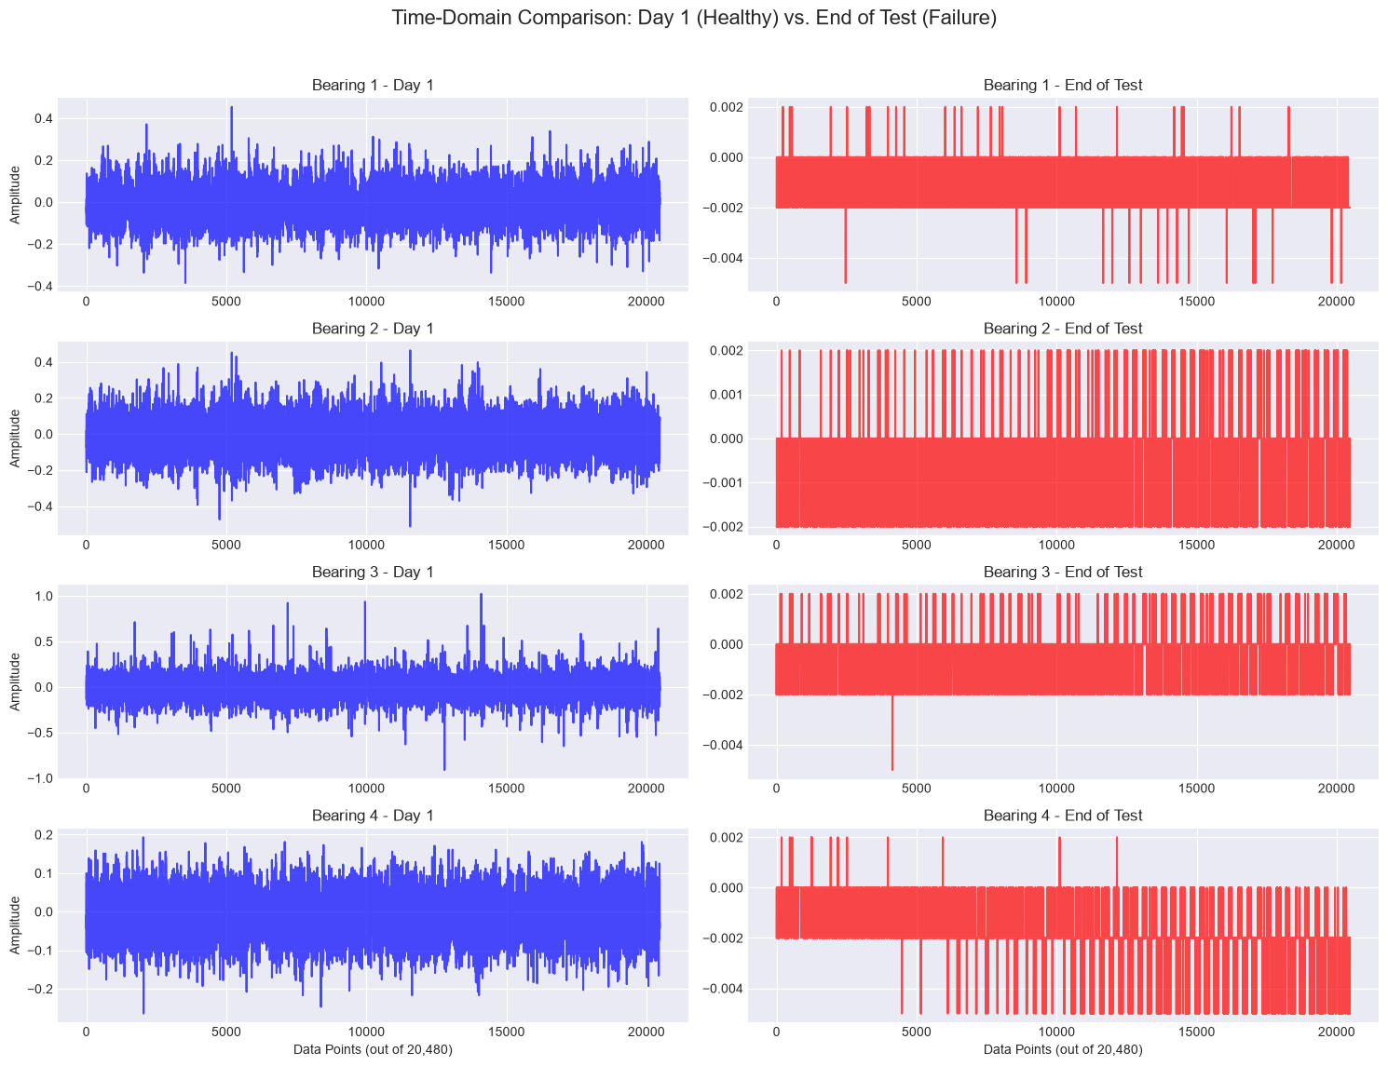
Deterministic MCP-Driven AI Agents for Ball Bearing Vibration Diagnostics
Exploratory Data Analysis

Slide 8
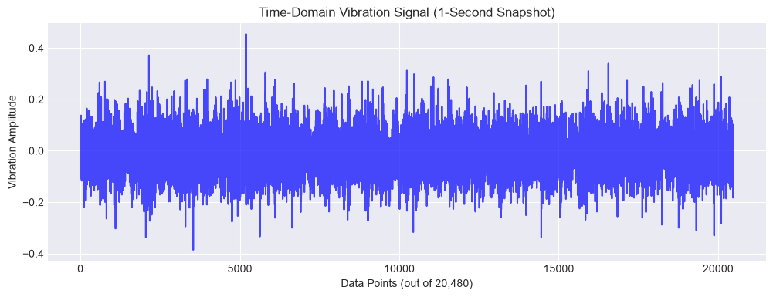
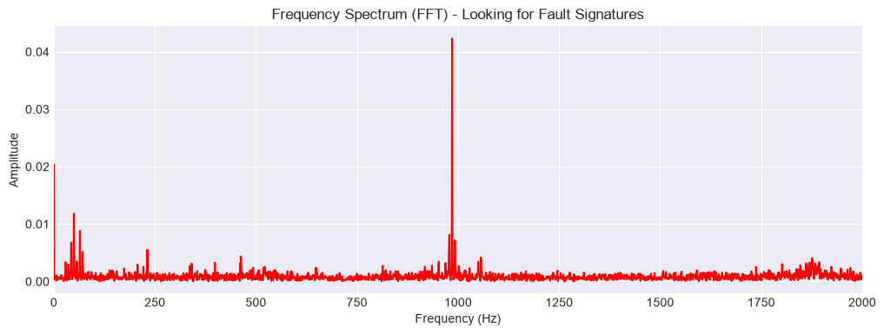
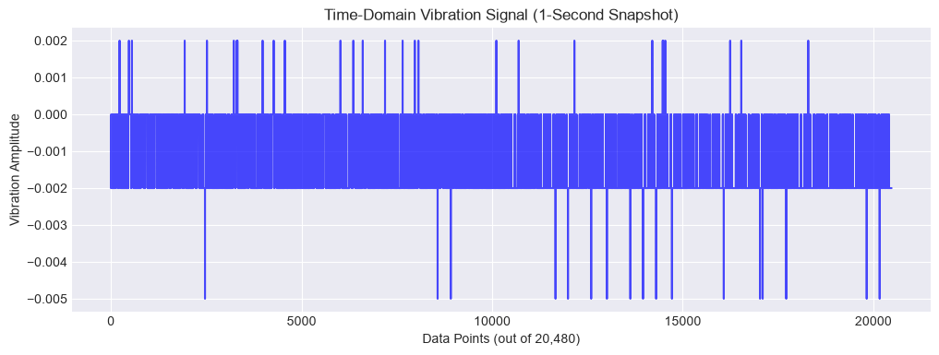
Deterministic MCP-Driven AI Agents for Ball Bearing Vibration Diagnostics
Exploratory Data Analysis

Slide 9
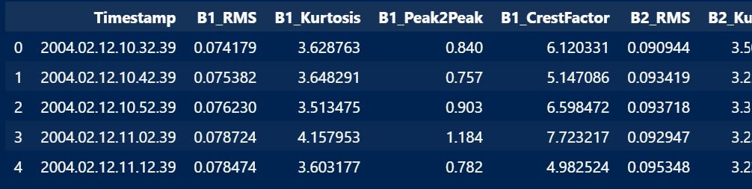
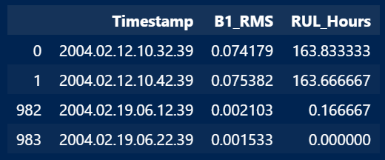
Deterministic MCP-Driven AI Agents for Ball Bearing Vibration Diagnostics
Exploratory Data Analysis
Resultant Feature Dataset
984 vibration files processed from the NASA Bearing Dataset.
Time-domain features extracted for each bearing:
  RMS — overall vibration energy
  Kurtosis — impulsive/fault-related behaviour
  Peak-to-Peak — vibration amplitude range
  Crest Factor — peak severity relative to RMS
Each record is associated with a timestamp and RUL (Remaining Useful Life) value.
The resulting structured dataset provides the input features for subsequent bearing health assessment and deterministic fault diagnosis.

Slide 10
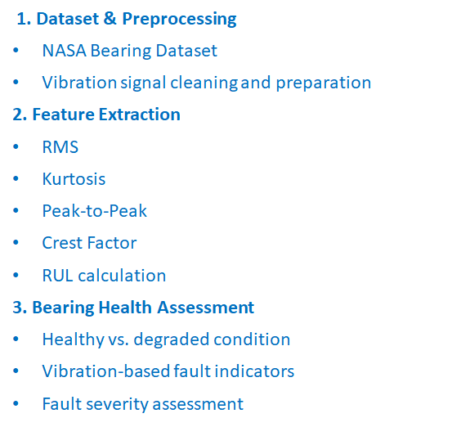
Deterministic MCP-Driven AI Agents for Ball Bearing Vibration Diagnostics
Modules to cover
4. Deterministic Diagnostic Engine
Rule/threshold-based decision logic
Consistent and reproducible diagnosis
ISO-based diagnostic criteria
5. MCP-Driven AI Agent
MCP tools and structured context
Agent-based diagnostic workflow
Explainable reasoning and fault identification
6. Results & Validation
Bearing fault classification
Diagnostic explanation
Accuracy and consistency evaluation

Slide 11
M.Tech Program
Advanced Industry Integrated Programs
Jointly offered by University and LTIMindTree
Review 1
Edge-Optimized RAG and Localized Failure Mitigation for Automated Assembly Lines Using Quantized SLM
Arjun V P
T9987
VIT Chennai
Knowledge partner | Implementation partner

Slide 12
Edge-Optimized RAG and Localized Failure Mitigation
Introduction
Automated assembly lines require rapid and reliable failure diagnosis to minimize downtime.
Machine failures can reduce production efficiency, equipment availability, and operational reliability.
Cloud-based AI solutions may introduce latency, connectivity, and data-dependency constraints.
Large AI models can also be resource-intensive for edge deployment.
This project proposes an Edge-Optimized RAG system to provide localized, knowledge-grounded failure diagnosis.
The system aims to assist operators with real-time failure identification and mitigation recommendations.

Slide 13
Edge-Optimized RAG and Localized Failure Mitigation
Objective
To develop an Edge-Optimized Retrieval-Augmented Generation (RAG) system for machine failure diagnosis.
To use a Quantized Small Language Model (SLM) suitable for resource-constrained edge devices.
To retrieve relevant failure knowledge and maintenance information from a local knowledge base.
To provide localized mitigation recommendations based on the identified failure.
To minimize latency, computational requirements, and dependence on cloud connectivity.
To support maintenance operators and production engineers in real-time decision-making.

Slide 14
Edge-Optimized RAG and Localized Failure Mitigation
Scope
Dataset: AI4I 2020 Predictive Maintenance Dataset with 10,000 machine records and 14 attributes.
Input Parameters: Temperature, rotational speed, torque, tool wear, and machine operating conditions.
Failure Analysis: Classification of TWF, HDF, PWF, OSF, and RNF failure modes.
Knowledge Retrieval: Retrieve relevant failure information and maintenance actions from a local knowledge base.
Edge AI: Use a quantized SLM to reduce memory and computational requirements.
Output: Failure identification with localized mitigation recommendations.
Application: Real-time support for automated assembly-line maintenance.

Slide 15
Edge-Optimized RAG and Localized Failure Mitigation
Literature Review
Study | Focus | Key Finding
Lewis et al. (2020) | Retrieval-Augmented Generation | RAG improves generation by grounding responses in retrieved external knowledge.
Guu et al. (2020) | Retrieval-Augmented Language Models | Demonstrated improved knowledge-intensive task performance using retrieved information.
Lewis et al. (2021) | RAG applications | Showed the usefulness of retrieval-based generation for knowledge-intensive applications.
Dettmers et al. (2023) | Quantized LLMs / QLoRA | Demonstrated that quantization can significantly reduce memory requirements while retaining useful model performance.
Edge AI / TinyML research | On-device intelligence | Highlights low latency, reduced connectivity dependence, and resource efficiency as major advantages of edge deployment.

Slide 16
Edge-Optimized RAG and Localized Failure Mitigation
Summary of Literature Review
RAG improves AI responses by grounding generation in retrieved domain knowledge.
Quantization enables language models to operate with significantly lower memory requirements.
Edge-based AI provides advantages in latency, connectivity independence, and data locality.
Existing work largely studies RAG and edge AI independently.
Research Gap: Combining RAG with a quantized SLM for localized, real-time industrial failure mitigation remains an important application area.

Slide 17
Edge-Optimized RAG and Localized Failure Mitigation
Exploratory Data Analysis
Dataset contains 10,000 records and 14 features, with no missing values.
Five specific failure modes are analyzed: TWF, HDF, PWF, OSF and RNF.
Sensor telemetry includes temperature, rotational speed, torque and tool wear.
Correlation analysis identifies relationships among the machine's physical operating parameters.
Torque vs. RPM analysis helps identify operating regions associated with mechanical failures.
The dataset is highly imbalanced: 9,652 healthy records vs. 348 failure records across the five failure classes.

Slide 18
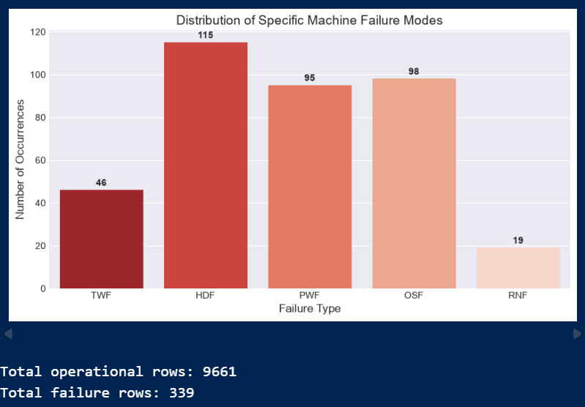
Edge-Optimized RAG and Localized Failure Mitigation
Exploratory Data Analysis

Slide 19
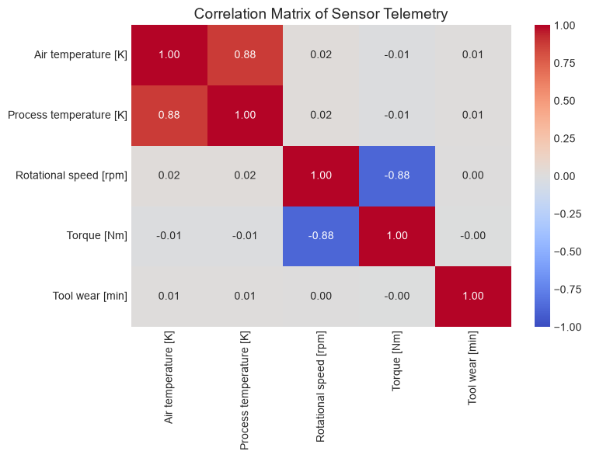
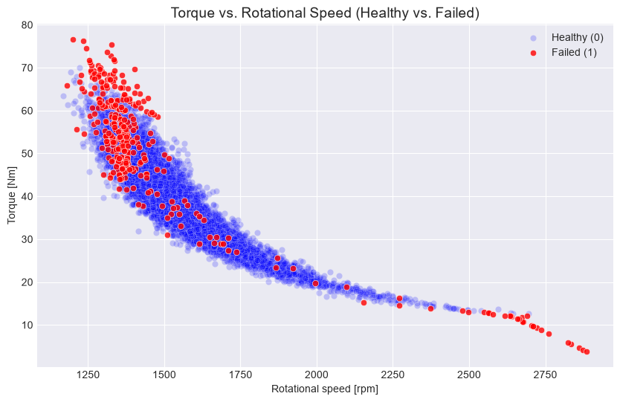
Edge-Optimized RAG and Localized Failure Mitigation
Exploratory Data Analysis

Slide 20
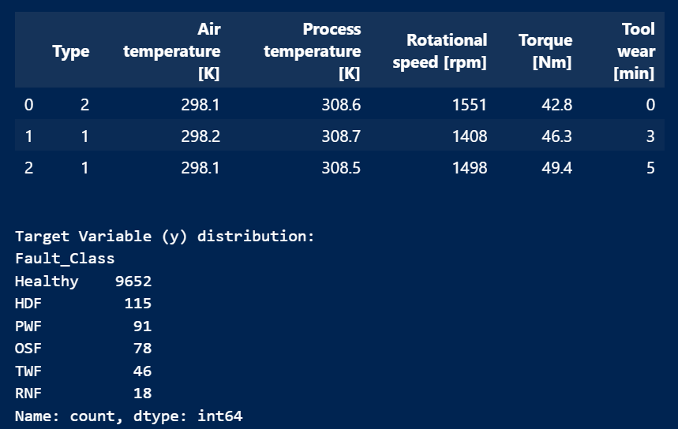
Edge-Optimized RAG and Localized Failure Mitigation
Exploratory Data Analysis
Resultant Feature Dataset
Raw machine telemetry was converted into a structured modelling dataset.
Irrelevant identifiers such as UDI and Product ID were removed.
Machine Type was converted into a numerical representation for modelling.
The original failure indicators were consolidated into a single Fault_Class target.
Final classes include:
  Healthy — 9,652
  HDF — 115
  PWF — 91
  OSF — 78
  TWF — 46
  RNF — 18

Slide 21
Edge-Optimized RAG and Localized Failure Mitigation
Modules to cover
1. Data Preparation
AI4I dataset → cleaning → preprocessing
↓
2. Failure Classification
Healthy / HDF / PWF / OSF / TWF / RNF
↓
3. Knowledge Base
Failure descriptions → causes → maintenance procedures
4. Retrieval System
Query → relevant failure knowledge
↓
5. Quantized SLM
Retrieved context → grounded response
↓
6. Edge Deployment
Low-latency diagnosis → localized mitigation recommendation
Machine Data → Failure Detection → Knowledge Retrieval → Quantized SLM → Diagnosis + Mitigation

