Slide 1


M.Tech Program
Advanced Industry Integrated Programs
Jointly offered by University and LTIMindTree
Review II
Deterministic MCP-Driven AI Agents for Ball Bearing Vibration Diagnostics
Arjun V P
T9987
VIT Chennai
Knowledge partner | Implementation partner

Slide 2
Deterministic MCP-Driven AI Agents for Ball Bearing Vibration Diagnostics
Introduction
Industrial rotating machinery is highly dependent on the reliable operation of rolling-element bearings.
Bearing faults can cause unexpected machine downtime, reduced efficiency, increased maintenance costs, and potential equipment failure.
Vibration analysis is a widely used technique for detecting and identifying bearing health conditions.
Traditional AI-based diagnostic systems may produce probabilistic predictions, making their reasoning difficult to validate and reproduce consistently.
This project proposes a Deterministic MCP (Model Context Protocol)-Driven AI Agent for reliable and explainable ball bearing fault diagnosis.
The system uses the NASA Bearing Dataset as the primary source of vibration data for developing and evaluating the diagnostic approach.

Slide 3
Deterministic MCP-Driven AI Agents for Ball Bearing Vibration Diagnostics
Objective
To develop a Deterministic MCP-Driven AI Agent for ball bearing health monitoring and fault diagnosis.
To analyze vibration signals and accurately identify different bearing health conditions.
To incorporate ISO-based standards and diagnostic principles into the analysis workflow.
To provide consistent, explainable, and reproducible fault identification rather than relying solely on probabilistic outputs.
To assist maintenance engineers and reliability teams in making informed maintenance decisions.
To reduce the risk of unplanned equipment failures, downtime, and unnecessary maintenance.

Slide 4
Deterministic MCP-Driven AI Agents for Ball Bearing Vibration Diagnostics
Python Modules
DATA
data.py → ingestion & validation
FEATURES
features.py → RMS, Kurtosis, P2P, Crest Factor
build_features.py → processed feature dataset
HEALTH
health.py → baseline deviation & degradation index
PROGNOSTICS
rul.py → RUL target
rul_model.py → RUL prediction
APPLICATION
api.py → FastAPI backend
frontend/ → engineer monitoring dashboard
AGENTIC LAYER
MCP Tools → diagnostics & prognostics
AI Agent → tool orchestration & maintenance decisions

Slide 5
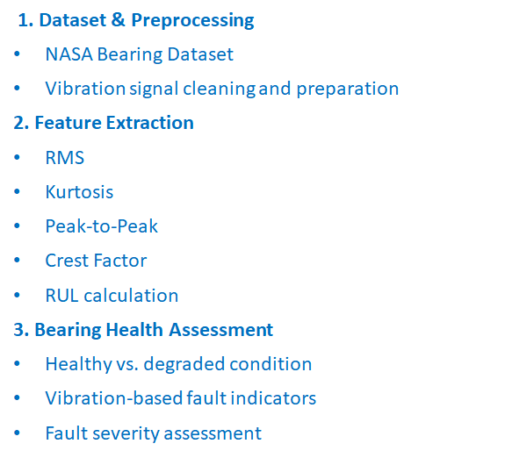
Deterministic MCP-Driven AI Agents for Ball Bearing Vibration Diagnostics
Modules to cover
4. Deterministic Diagnostic Engine
Rule/threshold-based decision logic
Consistent and reproducible diagnosis
ISO-based diagnostic criteria
5. MCP-Driven AI Agent
MCP tools and structured context
Agent-based diagnostic workflow
Explainable reasoning and fault identification
6. Results & Validation
Bearing fault classification
Diagnostic explanation
Accuracy and consistency evaluation

Slide 6
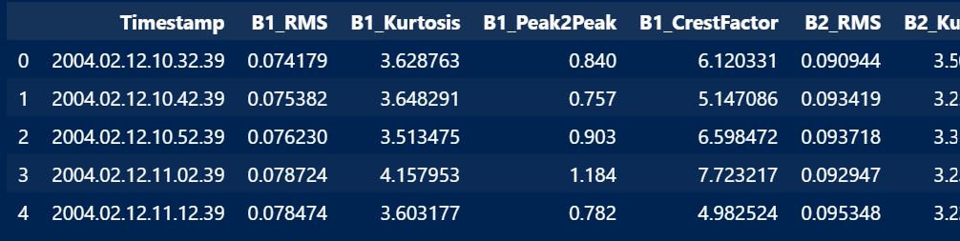
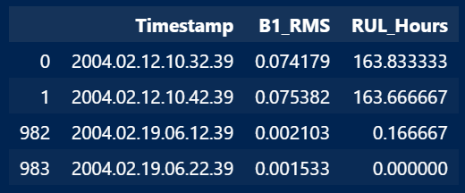
Deterministic MCP-Driven AI Agents for Ball Bearing Vibration Diagnostics
Data preprocessing & EDA
Resultant Feature Dataset
984 vibration files processed from the NASA Bearing Dataset.
Time-domain features extracted for each bearing:
  RMS — overall vibration energy
  Kurtosis — impulsive/fault-related behaviour
  Peak-to-Peak — vibration amplitude range
  Crest Factor — peak severity relative to RMS
Each record is associated with a timestamp and RUL (Remaining Useful Life) value.
The resulting structured dataset provides the input features for subsequent bearing health assessment and deterministic fault diagnosis.

Slide 7
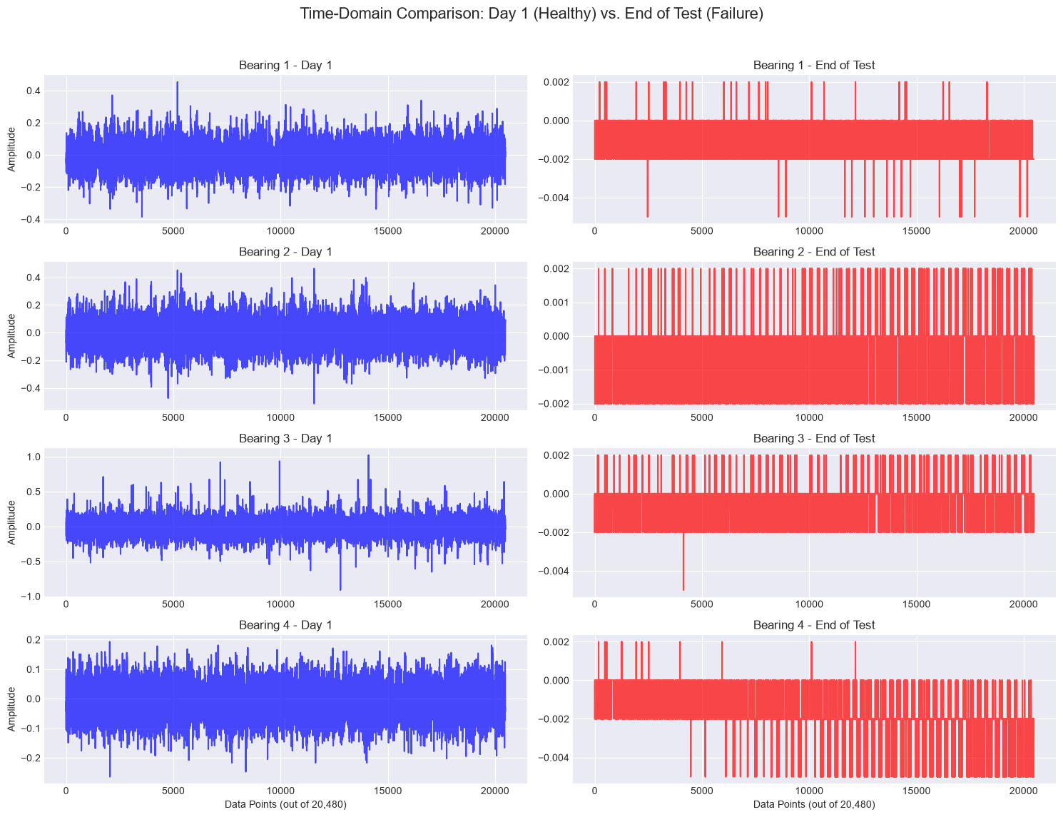
Deterministic MCP-Driven AI Agents for Ball Bearing Vibration Diagnostics
Data preprocessing & EDA

Slide 8
Deterministic MCP-Driven AI Agents for Ball Bearing Vibration Diagnostics
Approach/Algorithms/Tools
Component | Approach
Data processing | Timestamped vibration signal processing
Feature extraction | Statistical + frequency-domain features
Health assessment | Baseline deviation + degradation trajectory
RUL | Model-based prognosis + ML regression
Fault diagnosis | Vibration/frequency-domain analysis
Decision making | MCP tools + AI agent
Visualization | Real-time monitoring dashboard
Algorithms
RMS, Kurtosis, Peak-to-Peak, Crest Factor
FFT / frequency-domain analysis
Rolling median / smoothing
PCA-based health indicator
Exponential degradation modeling
XGBoost regression for RUL baseline
Future: fault classification and trajectory-aware RUL modeling
Tools / Technologies
Python: NumPy, Pandas, SciPy
ML: Scikit-learn, XGBoost, Joblib
Backend: FastAPI, Uvicorn
Frontend: HTML, CSS, JavaScript, Chart.js
Agentic: MCP, LLM orchestration
Development: Git/GitHub, VS Code

Slide 9
Deterministic MCP-Driven AI Agents for Ball Bearing Vibration Diagnostics
Project plan/milestones progress
1. Data & Feature Foundation
NASA IMS bearing dataset integrated
Data ingestion and validation completed
Vibration feature extraction pipeline implemented
2. Health Monitoring
Bearing degradation / health assessment developed
FastAPI backend implemented
Interactive bearing-monitoring dashboard completed
3. Prognostics & Diagnosis
RUL estimation baseline developed and evaluated
Degradation-trajectory-based RUL approach being refined
Frequency-domain fault diagnosis in progress
4. Agentic Intelligence
MCP diagnostic tools
LLM-based agent orchestration
Maintenance recommendation generation
Validation across Test 1, Test 2 and Test 3
Dockerized deployment
Current Status
Working foundation: Data → Features → Health → API → Dashboard
Current focus: Reliable RUL + fault diagnosis → MCP Agent

Slide 10
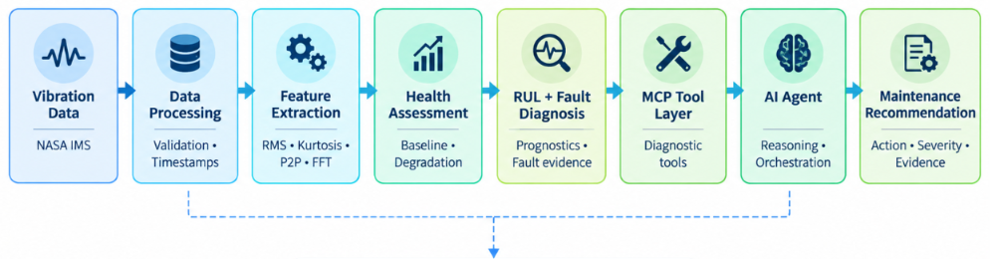

Deterministic MCP-Driven AI Agents for Ball Bearing Vibration Diagnostics
Pipeline structure

Slide 11
M.Tech Program
Advanced Industry Integrated Programs
Jointly offered by University and LTIMindTree
Review II
Edge-Optimized RAG and Localized Failure Mitigation for Automated Assembly Lines Using Quantized SLM
Arjun V P
T9987
VIT Chennai
Knowledge partner | Implementation partner

Slide 12
Edge-Optimized RAG and Localized Failure Mitigation
Introduction
Automated assembly lines require rapid and reliable failure diagnosis to minimize downtime.
Machine failures can reduce production efficiency, equipment availability, and operational reliability.
Cloud-based AI solutions may introduce latency, connectivity, and data-dependency constraints.
Large AI models can also be resource-intensive for edge deployment.
This project proposes an Edge-Optimized RAG system to provide localized, knowledge-grounded failure diagnosis.
The system aims to assist operators with real-time failure identification and mitigation recommendations.

Slide 13
Edge-Optimized RAG and Localized Failure Mitigation
Objective
To develop an Edge-Optimized Retrieval-Augmented Generation (RAG) system for machine failure diagnosis.
To use a Quantized Small Language Model (SLM) suitable for resource-constrained edge devices.
To retrieve relevant failure knowledge and maintenance information from a local knowledge base.
To provide localized mitigation recommendations based on the identified failure.
To minimize latency, computational requirements, and dependence on cloud connectivity.
To support maintenance operators and production engineers in real-time decision-making.

Slide 14
Edge-Optimized RAG and Localized Failure Mitigation
Python Modules
DATA
validation.py → data quality & label consistency checks
ai4i2020.csv → industrial machine telemetry dataset
INGESTION
loader.py → document loading & metadata extraction
ingest.py → chunking, embeddings & Chroma indexing
MACHINE LEARNING
train.py → failure & fault-mode model training
predictor.py → machine failure probability & diagnosis
RAG
machine_condition.py → ML output → retrieval query
retriever.py → semantic retrieval & fault-aware reranking
GENERATION
generator.py → local SLM inference
Ollama → evidence-grounded maintenance report
APPLICATION
main.py → FastAPI backend
frontend/ → maintenance monitoring dashboard
CONFIGURATION
config.yaml → models, retrieval, chunking & runtime settings
requirements.txt → project dependencies

Slide 15
Edge-Optimized RAG and Localized Failure Mitigation
Modules to cover
1. Data Preparation
AI4I dataset → cleaning → preprocessing
↓
2. Failure Classification
Healthy / HDF / PWF / OSF / TWF / RNF
↓
3. Knowledge Base
Failure descriptions → causes → maintenance procedures
4. Retrieval System
Query → relevant failure knowledge
↓
5. Quantized SLM
Retrieved context → grounded response
↓
6. Edge Deployment
Low-latency diagnosis → localized mitigation recommendation
Machine Data → Failure Detection → Knowledge Retrieval → Quantized SLM → Diagnosis + Mitigation

Slide 16
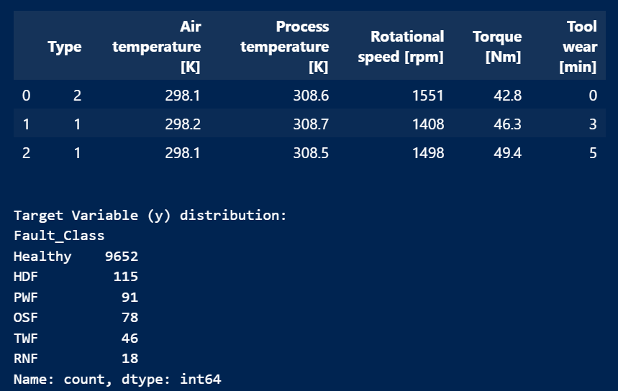
Edge-Optimized RAG and Localized Failure Mitigation
Exploratory Data Analysis
Resultant Feature Dataset
Raw machine telemetry was converted into a structured modelling dataset.
Irrelevant identifiers such as UDI and Product ID were removed.
Machine Type was converted into a numerical representation for modelling.
The original failure indicators were consolidated into a single Fault_Class target.
Final classes include:
  Healthy — 9,652
  HDF — 115
  PWF — 91
  OSF — 78
  TWF — 46
  RNF — 18

Slide 17
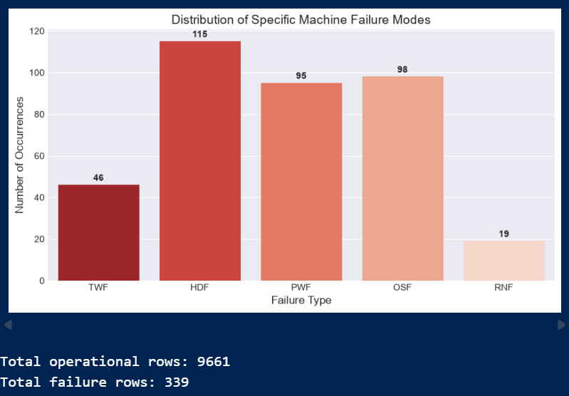
Edge-Optimized RAG and Localized Failure Mitigation
Exploratory Data Analysis

Slide 18
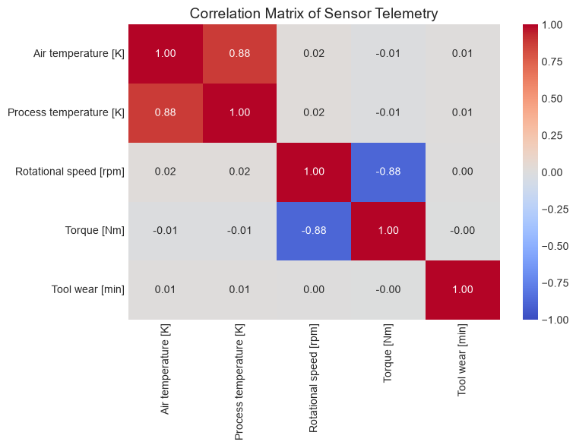
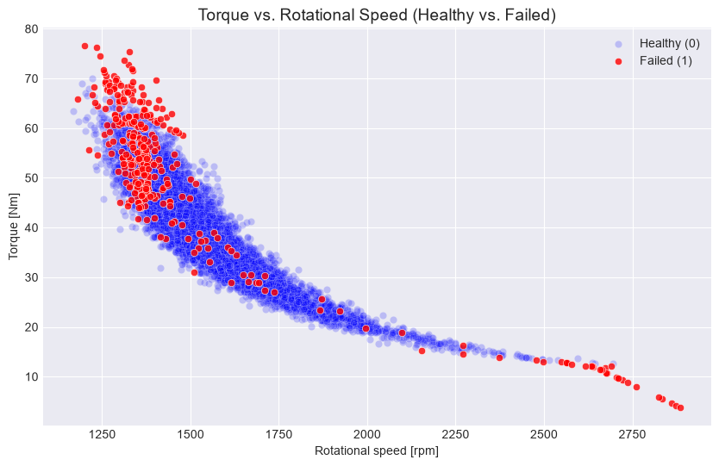
Edge-Optimized RAG and Localized Failure Mitigation
Exploratory Data Analysis

Slide 19
Edge-Optimized RAG and Localized Failure Mitigation
Approach/Algorithms/Tools
Component | Approach
Data Processing | AI4I-2020 telemetry validation & preprocessing
Failure Prediction | Random Forest classification
Fault Diagnosis | One-vs-Rest fault classification
RAG Ingestion | Document chunking + metadata extraction
Retrieval | Semantic search + fault-aware reranking
Report Generation | Local SLM with retrieved evidence
Application | FastAPI + maintenance dashboard
Algorithms
Random Forest for machine failure prediction
One-vs-Rest classification for failure modes
F2-score threshold tuning to prioritize failure recall
Recursive character text splitting for document chunking
Semantic similarity retrieval using vector embeddings
Metadata/fault-aware reranking and source diversification
Retrieval-Augmented Generation (RAG) for maintenance report generation
Tools / Technologies
Python: Pandas, NumPy, Scikit-learn, Joblib
RAG: LangChain, Chroma, Ollama
Models: Random Forest, nomic-embed-text, local SLM
Backend: FastAPI, Uvicorn
Frontend: HTML, CSS, JavaScript
Development: VS Code, Git/GitHub

Slide 20
Edge-Optimized RAG and Localized Failure Mitigation
Project plan/milestones progress
1. Data & ML Foundation
AI4I-2020 industrial machine dataset integrated
Data validation and label-consistency checks completed
Random Forest failure prediction implemented
Fault-mode classification and threshold tuning completed
2. RAG Knowledge Base
Industrial maintenance corpus created and organized
Document ingestion and metadata extraction implemented
Chroma vector database populated using local embeddings
Semantic retrieval + fault-aware reranking implemented
3. ML → RAG → SLM Pipeline
Machine-condition pipeline developed
ML prediction converted into condition-specific retrieval queries
Relevant maintenance evidence retrieved from Chroma
Local SLM integrated for maintenance report generation
4. Application & Final Refinement
FastAPI backend implemented
Interactive maintenance dashboard completed
End-to-end analysis workflow functional
Current focus: SLM grounding, evaluation and final demonstration
Current Status
Working foundation: Data → ML → RAG → SLM → API → Dashboard
Final focus: Reliability → Evaluation → Edge performance → Review demo

Slide 21
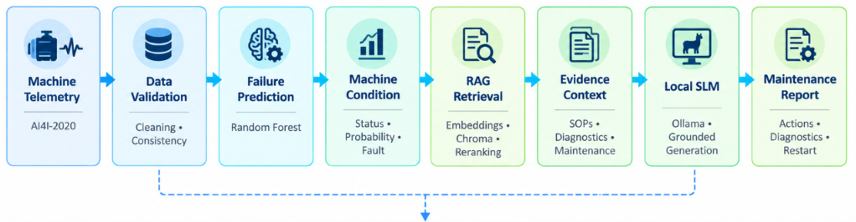

Edge-Optimized RAG and Localized Failure Mitigation
Pipeline structure

