Slide 1


M.Tech Program
Advanced Industry Integrated Programs
Jointly offered by University and LTIMindTree
Review 1
Deterministic MCP-Driven AI Agents for Ball Bearing Vibration Diagnostics
Arjun V P
T9987
VIT Chennai
Knowledge partner | Implementation partner

Slide 2
Deterministic MCP-Driven AI Agents for Ball Bearing Vibration Diagnostics
Introduction
Industrial rotating machinery is highly dependent on the reliable operation of rolling-element bearings.
Bearing faults can cause unexpected machine downtime, reduced efficiency, increased maintenance costs, and potential equipment failure.
Vibration analysis is a widely used technique for detecting and identifying bearing health conditions.
Traditional AI-based diagnostic systems may produce probabilistic predictions, making their reasoning difficult to validate and reproduce consistently.
This project proposes a Deterministic MCP (Model Context Protocol)-Driven AI Agent for reliable and explainable ball bearing fault diagnosis.
The system uses the NASA Bearing Dataset as the primary source of vibration data for developing and evaluating the diagnostic approach.

Slide 3
Deterministic MCP-Driven AI Agents for Ball Bearing Vibration Diagnostics
Objective
To develop a Deterministic MCP-Driven AI Agent for ball bearing health monitoring and fault diagnosis.
To analyze vibration signals and accurately identify different bearing health conditions.
To incorporate ISO-based standards and diagnostic principles into the analysis workflow.
To provide consistent, explainable, and reproducible fault identification rather than relying solely on probabilistic outputs.
To assist maintenance engineers and reliability teams in making informed maintenance decisions.
To reduce the risk of unplanned equipment failures, downtime, and unnecessary maintenance.

Slide 4
Deterministic MCP-Driven AI Agents for Ball Bearing Vibration Diagnostics
Scope
Analysis: Signal preprocessing, feature extraction, condition assessment, and bearing fault identification.
Fault Diagnosis: Classification of bearing health conditions based on characteristic vibration patterns and degradation behavior.
AI Agent: Development of a deterministic MCP-based workflow for structured and repeatable diagnostic reasoning.
Standards: Use of relevant ISO standards for vibration measurement, evaluation, and machine condition monitoring.
Output: A clear diagnostic result with an explainable and reproducible basis for the identified bearing condition.
Application: Supporting predictive maintenance and reliability-centered decision-making for rotating machinery.

Slide 5
Deterministic MCP-Driven AI Agents for Ball Bearing Vibration Diagnostics
Literature Review
Study | Method / Focus | Key Finding
Randall & Antoni (2011) – Rolling element bearing diagnostics—A tutorial | Vibration-based bearing diagnostics | Established vibration analysis and characteristic fault frequencies as fundamental tools for bearing fault detection.
Lei et al. (2013) – A review on machinery fault diagnosis based on hybrid intelligent systems | Intelligent fault diagnosis | Demonstrated the growing role of machine learning and intelligent systems in automated machinery fault diagnosis.
Khan & Yairi (2018) – A review on the application of deep learning in system health management | Deep learning for PHM | Showed that deep learning can automatically learn useful features from condition-monitoring data, reducing dependence on manual feature engineering.
Explainable AI for Bearing Fault Prognosis Using Deep Learning Techniques (2022) | Explainable deep learning + NASA/IMS dataset | Demonstrated deep-learning-based bearing prognosis while emphasizing the importance of interpretability; used run-to-failure vibration data from the IMS bearing dataset. (PubMed Central (PMC))
Prawin (2025) – Deep learning neural networks with input processing for vibration-based bearing fault diagnosis under imbalanced data conditions | CNN/LSTM + vibration signals | Found that hybrid CNN-LSTM approaches can improve bearing diagnosis, including on the NASA IMS dataset, while addressing imbalanced data challenges. (Sage Journals)

Slide 6
Deterministic MCP-Driven AI Agents for Ball Bearing Vibration Diagnostics
Summary of Literature Review
Vibration analysis is a proven method for detecting bearing faults.
ML/DL techniques improve automated fault classification using vibration signals.
The NASA/IMS dataset is widely used for bearing diagnosis and prognostics.
Recent research highlights the need for explainable AI in maintenance decisions.
Research Gap: Existing approaches lack deterministic, reproducible, and standards-based diagnostic reasoning.
Proposed Solution: A Deterministic MCP-Driven AI Agent for consistent and explainable bearing fault diagnosis.

Slide 7
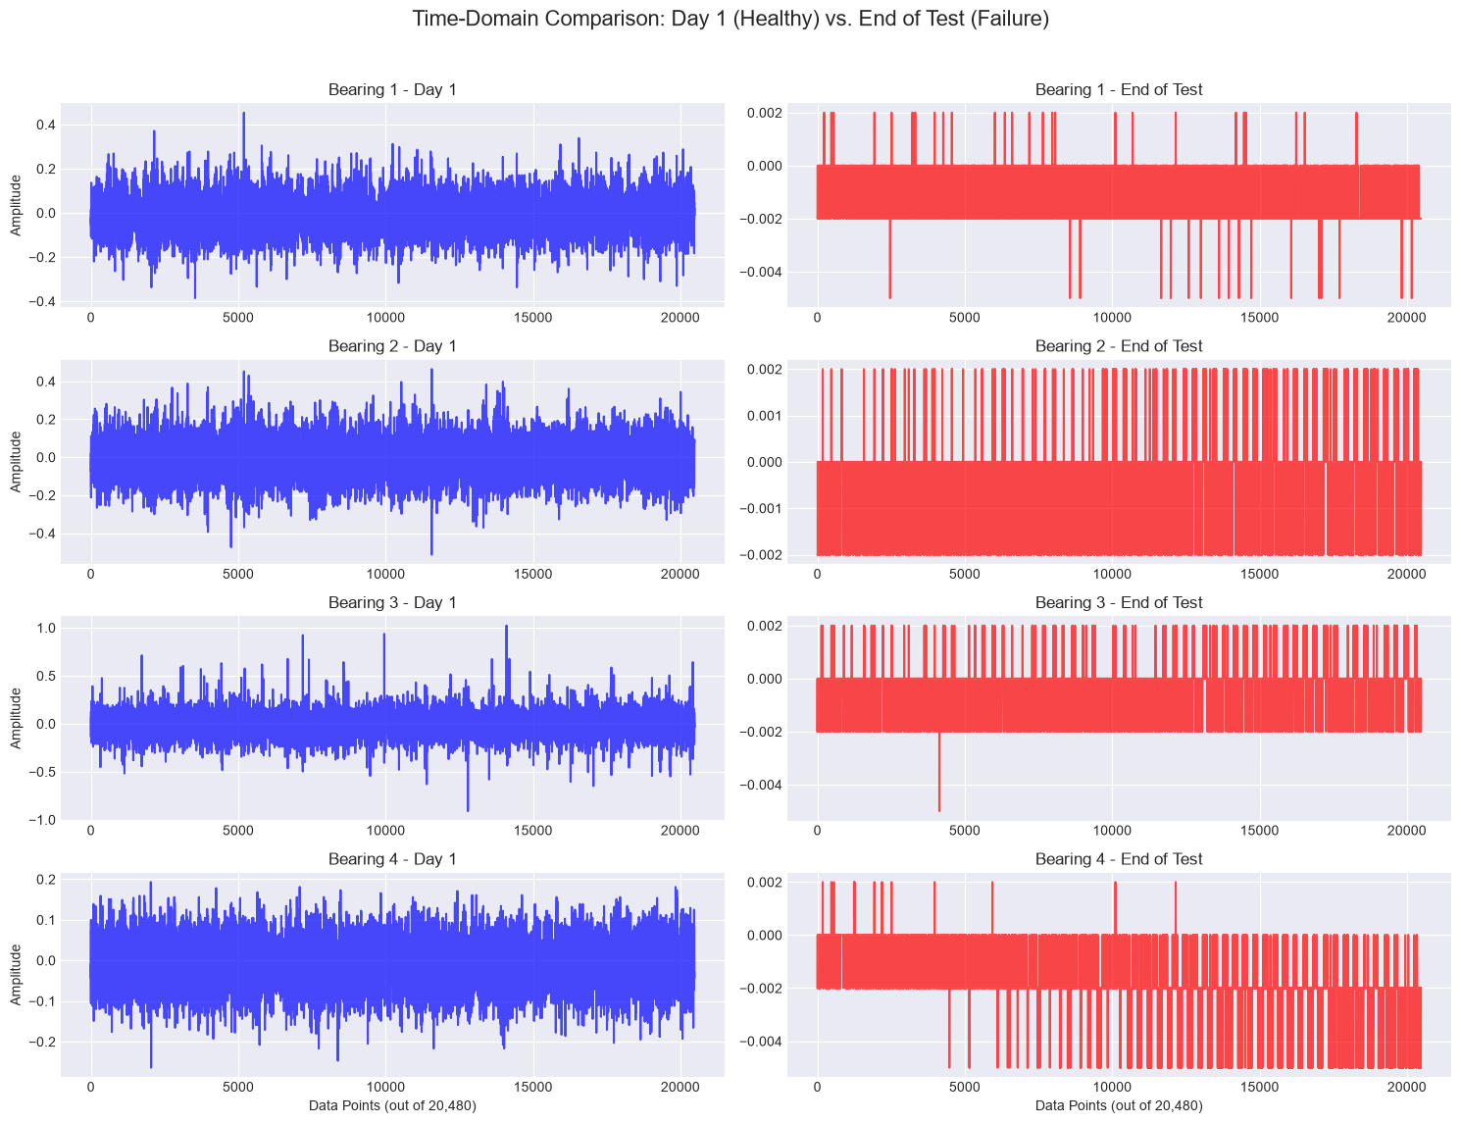
Deterministic MCP-Driven AI Agents for Ball Bearing Vibration Diagnostics
Exploratory Data Analysis

Slide 8
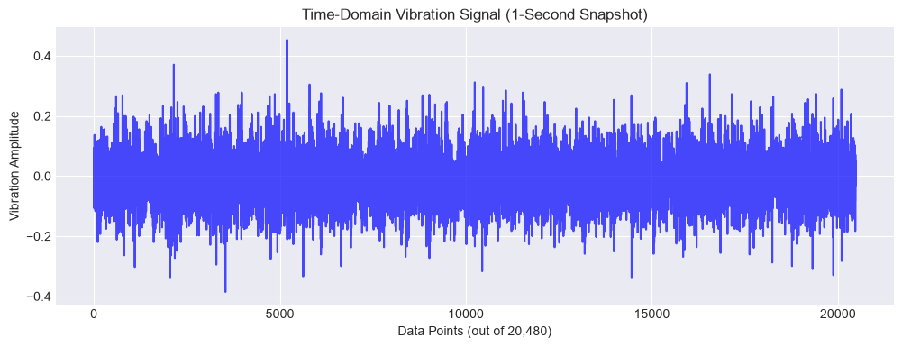
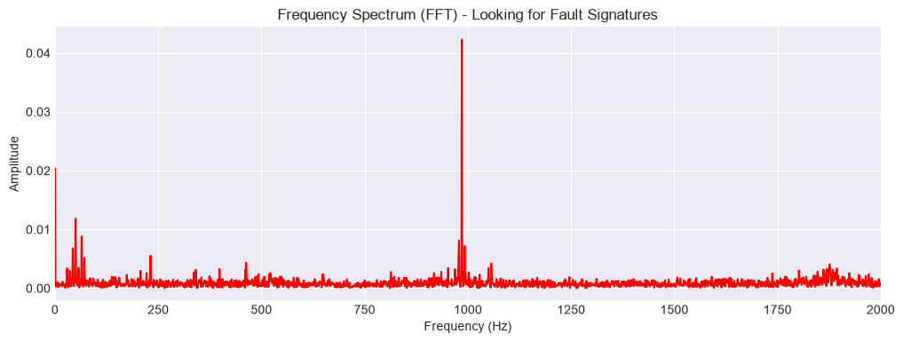
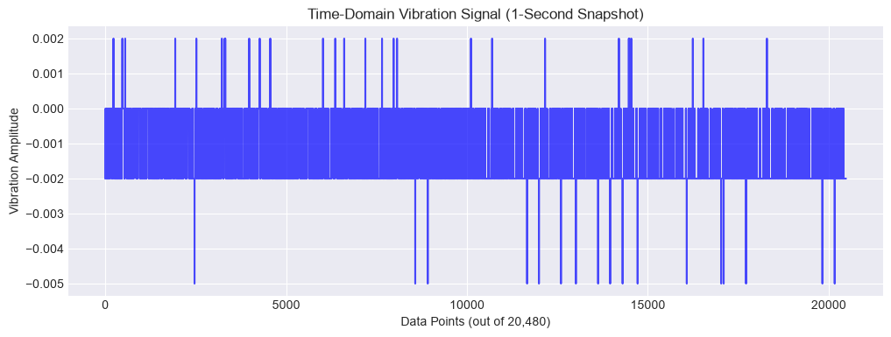
Deterministic MCP-Driven AI Agents for Ball Bearing Vibration Diagnostics
Exploratory Data Analysis

Slide 9
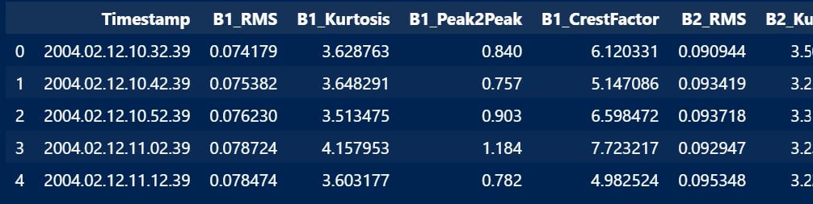
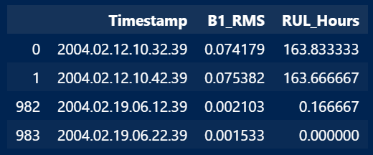
Deterministic MCP-Driven AI Agents for Ball Bearing Vibration Diagnostics
Exploratory Data Analysis
Resultant Feature Dataset
984 vibration files processed from the NASA Bearing Dataset.
Time-domain features extracted for each bearing:
  RMS — overall vibration energy
  Kurtosis — impulsive/fault-related behaviour
  Peak-to-Peak — vibration amplitude range
  Crest Factor — peak severity relative to RMS
Each record is associated with a timestamp and RUL (Remaining Useful Life) value.
The resulting structured dataset provides the input features for subsequent bearing health assessment and deterministic fault diagnosis.

Slide 10
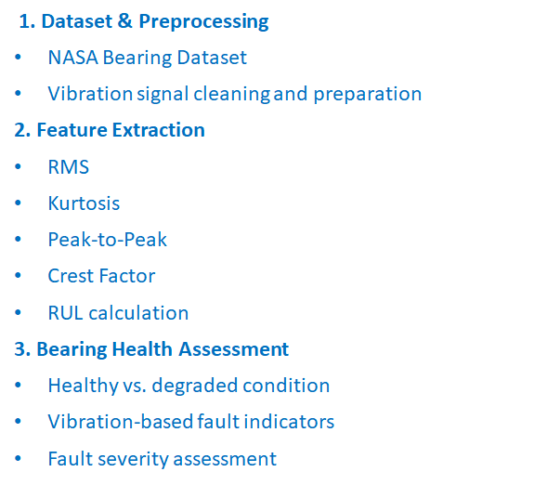
Deterministic MCP-Driven AI Agents for Ball Bearing Vibration Diagnostics
Modules to cover
4. Deterministic Diagnostic Engine
Rule/threshold-based decision logic
Consistent and reproducible diagnosis
ISO-based diagnostic criteria
5. MCP-Driven AI Agent
MCP tools and structured context
Agent-based diagnostic workflow
Explainable reasoning and fault identification
6. Results & Validation
Bearing fault classification
Diagnostic explanation
Accuracy and consistency evaluation

