Slide 1
Legal Retrieval System Evaluation
Child Protection & Child Rights Laws

Slide 2
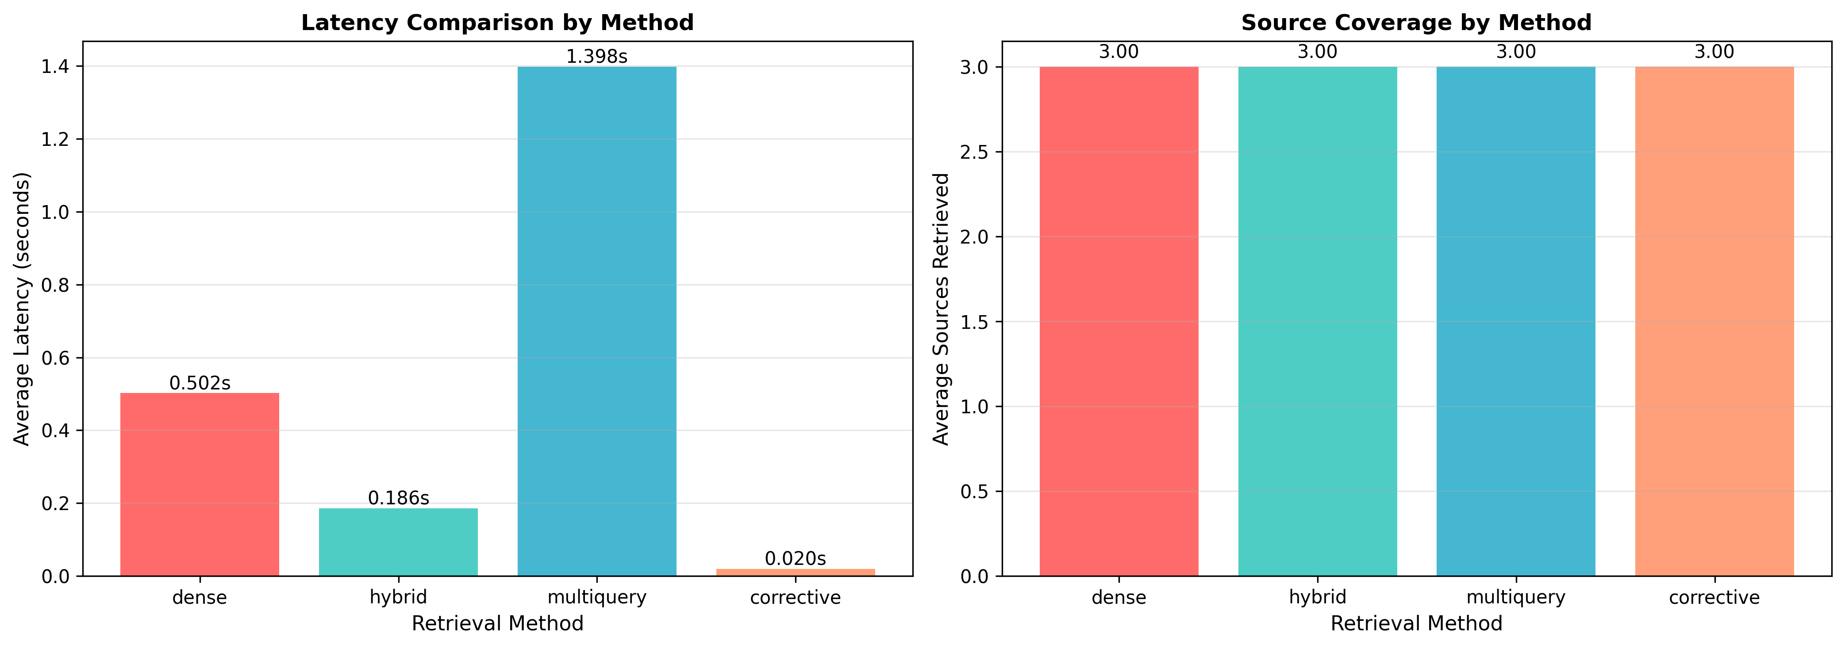
Retrieval Method Performance Comparison

Slide 3
Legal Retrieval System Evaluation
Child Protection & Child Rights Laws

Slide 4
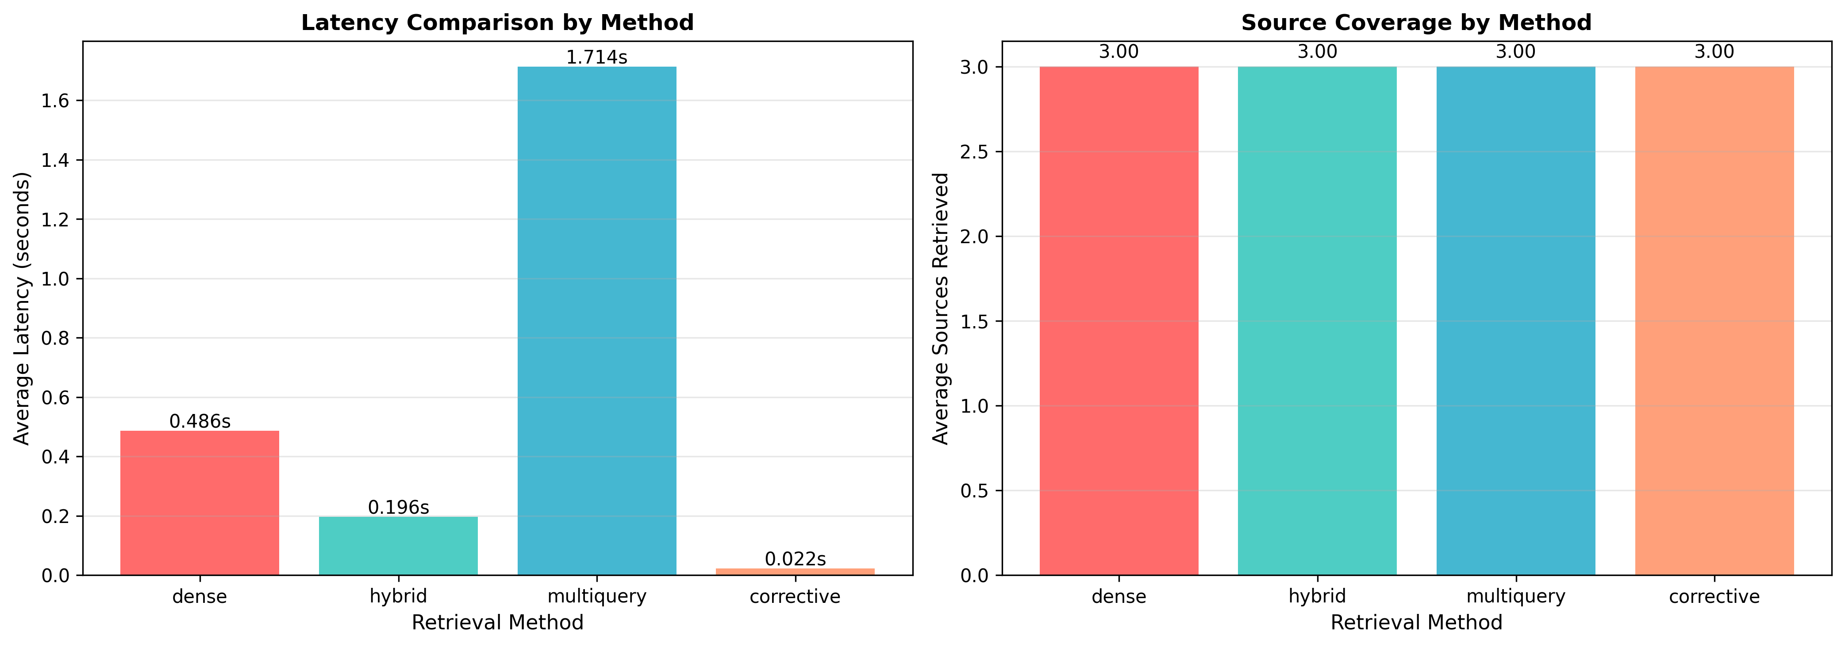
Retrieval Method Performance Comparison

