Slide 1


M.Tech Program
Advanced Industry Integrated Programs
Jointly offered by University and LTIMindTree
Review 1
Edge-Optimized RAG and Localized Failure Mitigation for Automated Assembly Lines Using Quantized SLM
Arjun V P
T9987
VIT Chennai
Knowledge partner | Implementation partner

Slide 2
Edge-Optimized RAG and Localized Failure Mitigation
Introduction
Automated assembly lines require rapid and reliable failure diagnosis to minimize downtime.
Machine failures can reduce production efficiency, equipment availability, and operational reliability.
Cloud-based AI solutions may introduce latency, connectivity, and data-dependency constraints.
Large AI models can also be resource-intensive for edge deployment.
This project proposes an Edge-Optimized RAG system to provide localized, knowledge-grounded failure diagnosis.
The system aims to assist operators with real-time failure identification and mitigation recommendations.

Slide 3
Edge-Optimized RAG and Localized Failure Mitigation
Objective
To develop an Edge-Optimized Retrieval-Augmented Generation (RAG) system for machine failure diagnosis.
To use a Quantized Small Language Model (SLM) suitable for resource-constrained edge devices.
To retrieve relevant failure knowledge and maintenance information from a local knowledge base.
To provide localized mitigation recommendations based on the identified failure.
To minimize latency, computational requirements, and dependence on cloud connectivity.
To support maintenance operators and production engineers in real-time decision-making.

Slide 4
Edge-Optimized RAG and Localized Failure Mitigation
Scope
Dataset: AI4I 2020 Predictive Maintenance Dataset with 10,000 machine records and 14 attributes.
Input Parameters: Temperature, rotational speed, torque, tool wear, and machine operating conditions.
Failure Analysis: Classification of TWF, HDF, PWF, OSF, and RNF failure modes.
Knowledge Retrieval: Retrieve relevant failure information and maintenance actions from a local knowledge base.
Edge AI: Use a quantized SLM to reduce memory and computational requirements.
Output: Failure identification with localized mitigation recommendations.
Application: Real-time support for automated assembly-line maintenance.

Slide 5
Edge-Optimized RAG and Localized Failure Mitigation
Summary of Literature Review
RAG improves AI responses by grounding generation in retrieved domain knowledge.
Quantization enables language models to operate with significantly lower memory requirements.
Edge-based AI provides advantages in latency, connectivity independence, and data locality.
Existing work largely studies RAG and edge AI independently.
Research Gap: Combining RAG with a quantized SLM for localized, real-time industrial failure mitigation remains an important application area.

Slide 6
Edge-Optimized RAG and Localized Failure Mitigation
Exploratory Data Analysis
Dataset contains 10,000 records and 14 features, with no missing values.
Five specific failure modes are analyzed: TWF, HDF, PWF, OSF and RNF.
Sensor telemetry includes temperature, rotational speed, torque and tool wear.
Correlation analysis identifies relationships among the machine's physical operating parameters.
Torque vs. RPM analysis helps identify operating regions associated with mechanical failures.
The dataset is highly imbalanced: 9,652 healthy records vs. 348 failure records across the five failure classes.

Slide 7
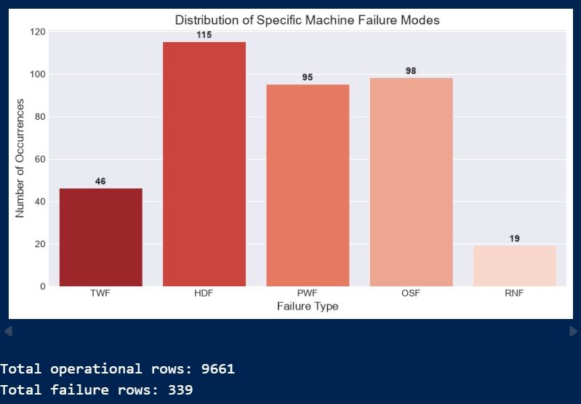
Edge-Optimized RAG and Localized Failure Mitigation
Exploratory Data Analysis

Slide 8
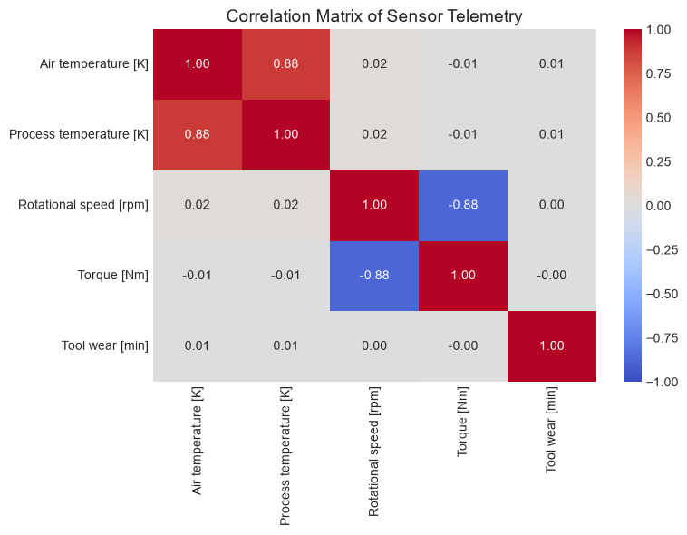
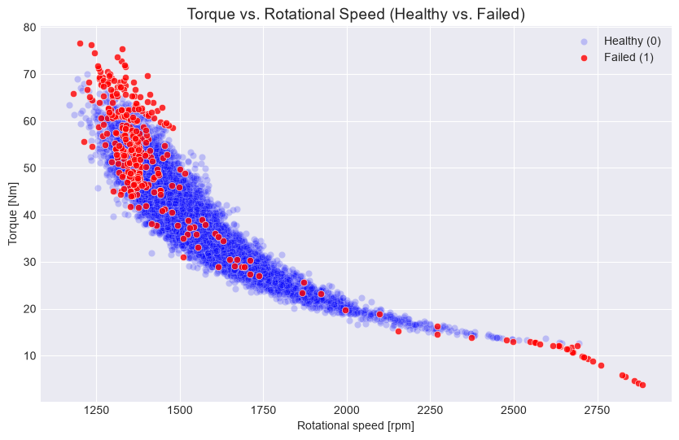
Edge-Optimized RAG and Localized Failure Mitigation
Exploratory Data Analysis

Slide 9
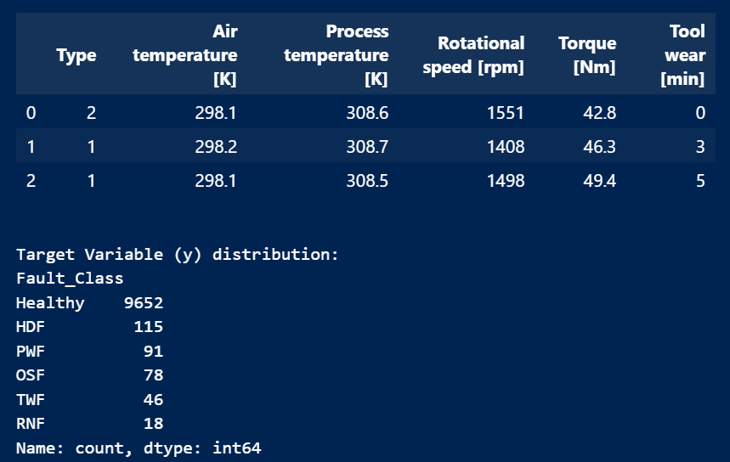
Edge-Optimized RAG and Localized Failure Mitigation
Exploratory Data Analysis
Resultant Feature Dataset
Raw machine telemetry was converted into a structured modelling dataset.
Irrelevant identifiers such as UDI and Product ID were removed.
Machine Type was converted into a numerical representation for modelling.
The original failure indicators were consolidated into a single Fault_Class target.
Final classes include:
Healthy — 9,652
HDF — 115
PWF — 91
OSF — 78
TWF — 46
RNF — 18

Slide 10
Edge-Optimized RAG and Localized Failure Mitigation
Modules to cover
1. Data Preparation AI4I dataset → cleaning → preprocessing
↓
2. Failure Classification Healthy / HDF / PWF / OSF / TWF / RNF
↓
3. Knowledge Base Failure descriptions → causes → maintenance procedures
4. Retrieval System Query → relevant failure knowledge
↓
5. Quantized SLM Retrieved context → grounded response
↓
6. Edge Deployment Low-latency diagnosis → localized mitigation recommendation
Machine Data → Failure Detection → Knowledge Retrieval → Quantized SLM → Diagnosis + Mitigation

Slide 12
Edge-Optimized RAG and Localized Failure Mitigation
Literature Review
Study | Focus | Key Finding
Lewis et al. (2020) | Retrieval-Augmented Generation | RAG improves generation by grounding responses in retrieved external knowledge.
Guu et al. (2020) | Retrieval-Augmented Language Models | Demonstrated improved knowledge-intensive task performance using retrieved information.
Lewis et al. (2021) | RAG applications | Showed the usefulness of retrieval-based generation for knowledge-intensive applications.
Dettmers et al. (2023) | Quantized LLMs / QLoRA | Demonstrated that quantization can significantly reduce memory requirements while retaining useful model performance.
Edge AI / TinyML research | On-device intelligence | Highlights low latency, reduced connectivity dependence, and resource efficiency as major advantages of edge deployment.

