Slide 1
Role of Women in STEM
Science • Technology • Engineering • Mathematics
Arjun Singh
25LBCS6004
B.TECH CSE (Cloud Computing)

Slide 2

Introduction
Women play a vital role in STEM fields.
They contribute to scientific discoveries and innovation.
Greater participation improves diversity and creativity.

Slide 3
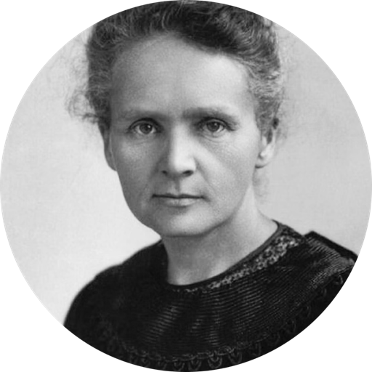
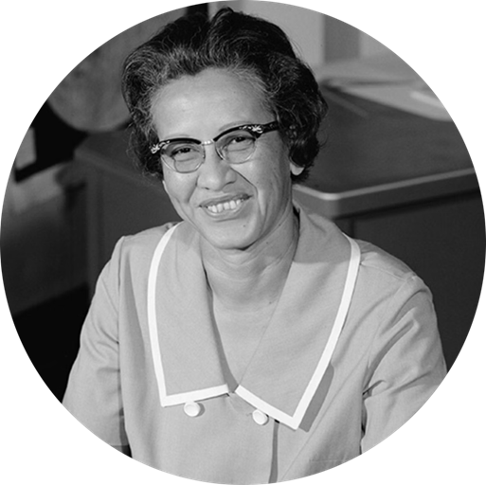


Famous Women in STEM
Gagandeep Kang
(Add Photo)
Marie Curie
Nobel Prize-winning physicist and chemist who discovered radium and polonium. First woman to win a Nobel Prize.
Katherine Jhonson
Mathematician whose calculations were critical to NASA's early space missions . Her story inspired the film “Hidden Network”.
Kalpana Chawla
First Indian-American woman astronaut who flew on the Space Shuttle. Her legacy continues to inspire aspiring aerospace engineer.
Gagandeep Kang
Leading Indian virologist who developed India's first rotavirus vaccine, saving countless children's lives worldwide.

Slide 4

Challenges Faced by Women
Gender stereotypes in technical fields.
Pay gap between men and women.
Limited leadership opportunities.
Lack of representation.

Slide 5
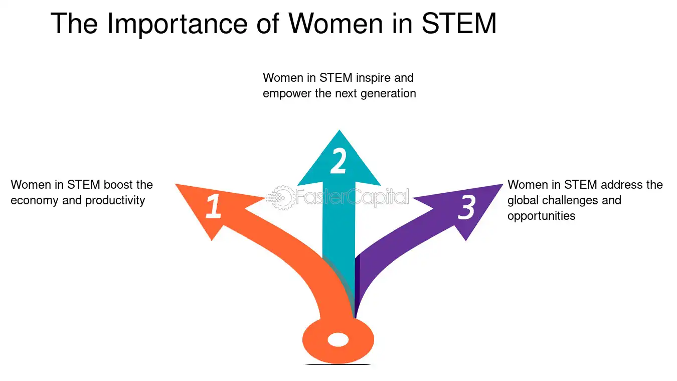
Importance of Women in STEM
Encourages innovation and creativity
Improves problem‑solving.
Promotes equality and
Empowerment Inspires young
girls to pursue science.

Slide 6
Conclusion
Women have made significant contributions to STEM.
Equal opportunities and mentorship are essential.
Supporting women in STEM creates a better future.

