Slide 1

CLOUD COMPUTING
Compute Virtualization - Types of Hypervisors
Dr. Prafullata Kiran Auradkar
Department of Computer Science and Engineering
Acknowledgements:
Significant information in the slide deck presented through the Unit 2 of the course have been created by Dr. H.L. Phalachandra and would like to acknowledge and thank him for the same. There have been some information which I might have leveraged from the content of Dr. K.V. Subramaniam’s lecture contents too. I may have supplemented the same with contents from books and other sources from Internet and would like to sincerely thank, acknowledge and reiterate that the credit/rights for the same remain with the original authors/publishers only. These are intended for classroom presentation only.

Slide 2
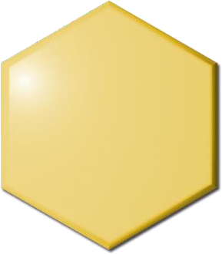

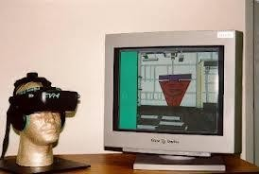
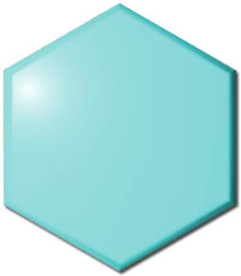

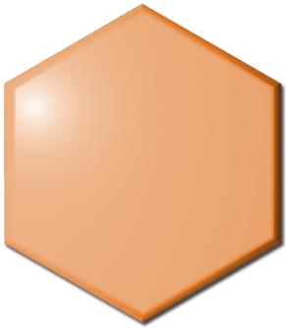

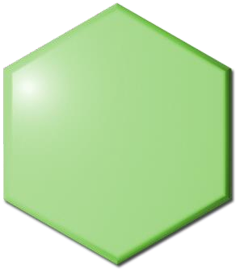

CLOUD COMPUTING
What is Virtualization?
Virtualization is a technique of abstracting physical resources (this could be compute, memory, storage disks, networking) in to a logical view
Virtualization increases utilization
and capability of the IT infrastructure
Virtual Memory
Each application sees its own logical memory, independent of physical memory
Simplifies resource management by pooling and sharing resources
Virtual
Each application sees its own logical network, independent of physical network
Networks
Significantly reduces downtime both
Planned and unplanned
Virtual Servers
Each application sees its own logical server, independent of physical servers
Improves performance of IT infrastructure
Virtual
Storage
Each application sees its own logical storage, independent of physical storage

Slide 3
CLOUD COMPUTING
Compute Virtualization : Its relationship to Cloud Computing
Compute (sometimes also known as Server) virtualization :
  Can be considered as a framework or methodology of dividing the resources of a computer/server into multiple execution environments
  Its achieved by applying one or more concepts or technologies such as hardware and software partitioning, time-sharing, partial or complete machine simulation, emulation, quality of service, and many others.
  Can be looked at as a practice of presenting and partitioning computing resources in a logical way
rather than partitioning according to physical reality
VM (or a Virtual Machine) is the coarse granular view of the Virtual Compute at the next abstract level, and is logically identical to a Physical machine with an ability to run an OS
Virtualization enables sharing of the same physical resources across different users and is a key technology
for Cloud Computing
VM which uses this virtualization technology is one of the prominent ways in which compute resources are provisioned in a cloud environment

Slide 4
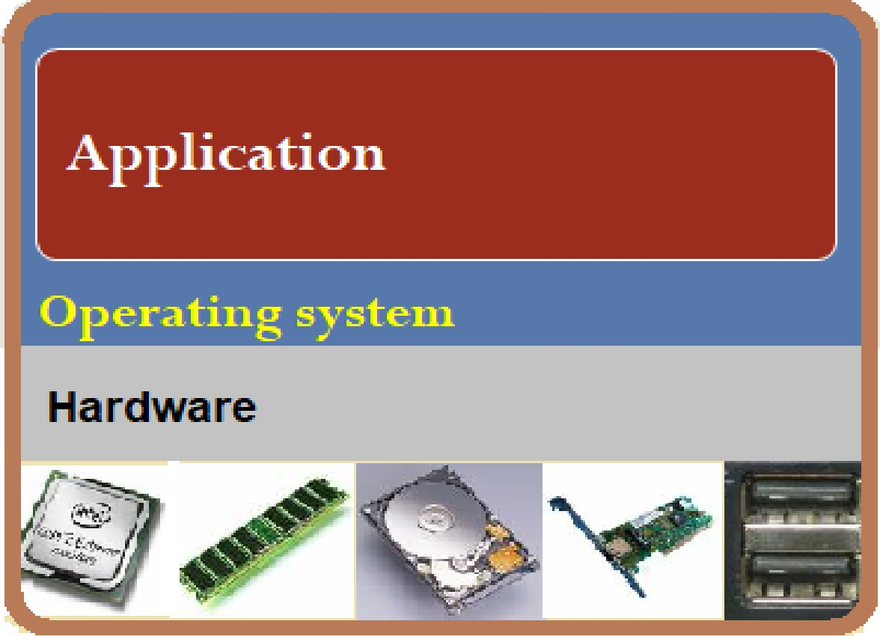
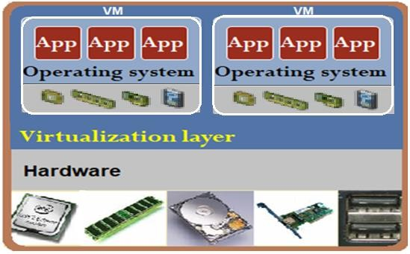
CLOUD COMPUTING
Traditional computer without virtualization (bare metal) & After Virtualization
Before Server Virtualization: After Server Virtualization::
Application 1
Application 2
Application
Operating system
Single operating system image per machine
Software and hardware tightly couple
OS handles the bare hardware (CPU, memory, and I/O) directly.
Running multiple applications on same machine can create conflicts
Underutilized resources
Virtual Machines (VMs) break dependencies between operating system and hardware
Manages operating system and application as single unit by
encapsulating them into VMs
Strong fault and security isolation
Hardware-independent

Slide 5
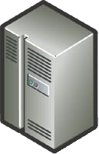



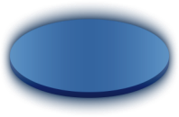


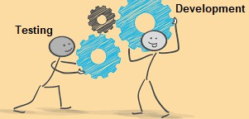






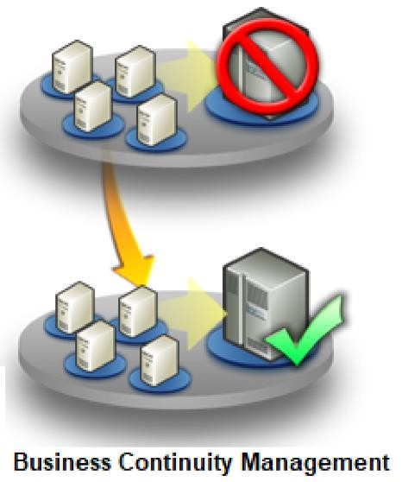
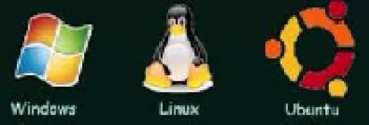
CLOUD COMPUTING
Compute Virtualization : Why VM
Server consolidation
Workload mobility
Development and test
Business Continuity Management
Support OS diversity
Security/Isolation
High Availability/Load Balancing
Rapid provisioning
Encapsulation
Lower Costs
Increase hardware utilization by running multiple
applications in isolation on same physical server
Move applications from one server to another
Easily provision virtual resources for test and
Ability to granularly live-migrate a VM to other
servers which are part of a Business Continuity
Can run both Linux and Windows on same
Hypervisor separates the VMs from eacWh ootrhkelor ad isolates
Ability to live-migrate a VM to other physical server
On demand provisioning of hardware resources
The execution environment of an application is encapsulated
within VM
Increased Efficiencies, flexibility and responsiveness
dev
physical
Cons^{en}o^{v}li^{ir}dºa^{n}t^{m}io^{e} h/w
and
n_{n}t
VMs from H/W
Mobility

Slide 6
CLOUD COMPUTING
Compute Virtualization : How is this implemented?
Typically, a layer of software that provides the illusion of a “real” machine to multiple instances of “virtual machines is traditionally called a Virtual Machine Monitor (VMM) or a “Hypervisor”
Hardware-level virtualization inserts the VMM (or the virtualization layer) between real hardware and traditional operating systems. This VMM directly interacts with the Hardware and thus is also called Bare Metal VMM or Hypervisor of Type 1.
VMM manages the hardware resources of a computing system. Each time
programs access the hardware, the VMM captures the process
VMM acts as a traditional OS & leading to three requirements for a VMM:
  VMM should provide an environment for programs which is essentially identical to the original machine.
  Programs running in this environment should show at worst, only
minor reduction in performance.
  VMM should be in complete control of the system resources.
E.g. Xen, VMWare ESX server, IBM CP/CMS, Windows Virtualization (2008)
Guest VM | Guest VM | Guest VM
VMM
Hardware

Slide 7
CLOUD COMPUTING
Compute Virtualization : How is this implemented? - II
This VMM when implemented on top of the OS as in the figure would typically be called as Hosted VMM or Hosted Hypervisor or Hypervisor of Type 2
VMM maintains a software level representation of physical hardware and interposes on the operations and redirects it as per the policies
E.g. VMWare workstation or Oracle VirtualBox
VMM could also be implemented as part of the OS too.
E.g. KVM (Kernel Based Virtual Machine) for Linux
Guest VM | Guest VM | Guest VM
VMM
Host OS
Hardware

Slide 8
CLOUD COMPUTING
Compute Virtualization : How is this implemented? - III
VMM implementation when supporting both the bare-metal and as a hosted application on top of the OS as in the figure would typically be called as Hybrid VMM or Hybrid Hypervisor
E.g. MS Virtual Server, MS Virtual PC
Host VM | Guest VM | Guest VM
VMM | VMM
 | Host OS
Hardware

Slide 9
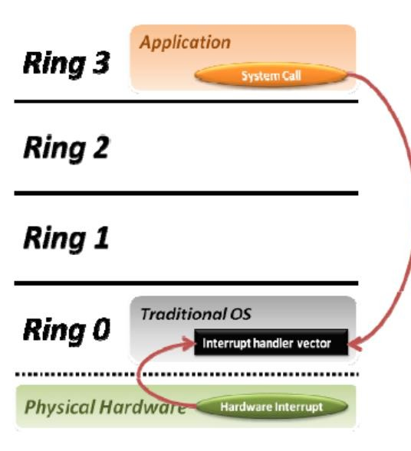
CLOUD COMPUTING
Physical Machine (setting the context from the OS last Sem)
Privilege Rings
Physical machines have real hardware resources like CPU, memory, I/O etc.
These are managed/orchestrated into a single execution environment by the OS by having
Exclusive access to these hardware resources through some hardware interfaces
Uses instructions defined by the ISA (ISA-instruction set architectures) for the specific CPU architecture eg. X86
Memory
I/O
OSes provide dual modes, with the privileged or Kernel mode (Ring 0) having access to the
physical resources (with operations like I/O instructions and Halt instructions, Turn off all Interrupts, Set the Timer, Context Switching, Clear the Memory or Remove a process from the Memory) and a non-privileged mode (or also know as Ring 3 or User mode, where safe instructions (like Load, store instructions Add, Subtract etc.) are supported
The User mode can do some of the IO and other actions only by invoking system calls. These system calls when executed, first sets mode bit to 0 (supervisory mode) and then executes the call. On completion of the action and before exiting from the I/O system call, it sets the bit to one (user mode) and transfers control back to user process. This approach is used as a means of not giving the supervisory control to any user process.

Slide 10
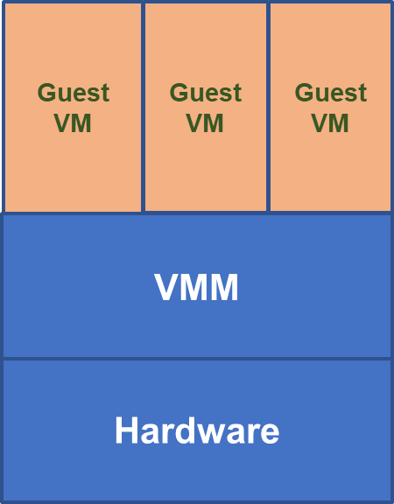
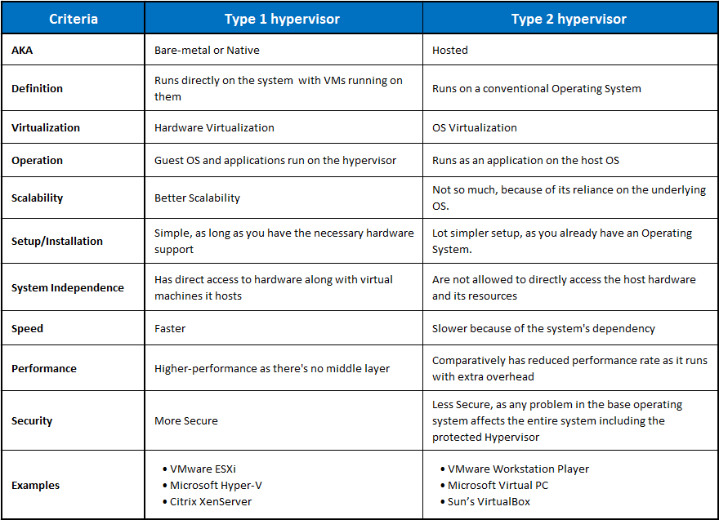
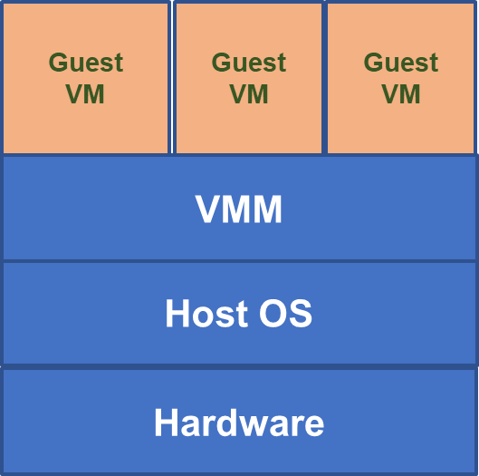
CLOUD COMPUTING
Hypervisor Type 1 vs. Type 2
Type 1
Type 2

Slide 11
CLOUD COMPUTING
Additional references
What is a Hypervisor? https://www.vmware.com/topics/glossary/content/hypervisor https://youtu.be/EvXn2QiL3gs https://www.vmware.com/topics/glossary/content/bare-metal-hypervisor
Types of hypervisor https://www.youtube.com/watch?v=dckSc61WS6w Bare metal vs hypervisor
https://blog.servermania.com/bare-metal-vs-hypervisor-which-is-right-for-your-project/

Slide 12
THANK YOU
Prafullata Kiran Auradkar
Department of Computer Science and Engineering
prafullatak@pes.edu

Slide 13
CLOUD COMPUTING
Paravirtualization and Transparent Virtualization
Dr. Prafullata Kiran Auradkar
Department of Computer Science and Engineering
Acknowledgements:
Significant information in the slide deck presented through the Unit 2 of the course have been created by Dr. H.L. Phalachandra and would like to acknowledge and thank him for the same. There have been some information which I might have leveraged from the content of Dr. K.V. Subramaniam’s lecture contents too. I may have supplemented the same with contents from books and other sources from Internet and would like to sincerely thank, acknowledge and reiterate that the credit/rights for the same remain with the original authors/publishers only. These are intended for classroom presentation only.

Slide 14
CLOUD COMPUTING
Context of different types of Virtualization
Applications based on their functioning call different instructions as part of execution, where some of the instructions modify part of machines resources. These instructions (also called privileged instructions) can harm the system when executed maliciously or when improperly used
These applications or User processes are not trusted with executing these privileged instructions, and will need to be run with privileges assigned by the OS.
Typically the OS is responsible for managing the hardware and, to ensure these privileged instructions are safely executed, uses four instruction execution privilege rings- Ring 0, 1, 2, and 3 as offered by traditional x86 processor, with ring 0 having the highest privileges as needed for the privileged instructions and ring 3 where applications are run with minimal privileges.
When any privileged instructions is executed in the user mode by an application, they will trap .. Aka.. they will not be executed, and will be treated as an illegal instruction, and the Hardware traps .. in a sense the operating system is alerted and the machine is forced into system mode (moved to ring 0) whereby it executes some code of the operating system to deal with the situation.
Hypervisors facilitating the Virtualizations, will manage the interactions of multiple VMs (running different OS’es) with the Hardware, by handling both the privileged and non-privileged instructions and use the traps generated for the privileged instructions.
Unfortunately based on the CPU architectures, not all of these privileged instructions are virtualizable leading to different approaches for Virtualization to support, like the Full or transparent virtualization where the hardware I/O is emulated or a paravirtualization for performance and other considerations.

Slide 15
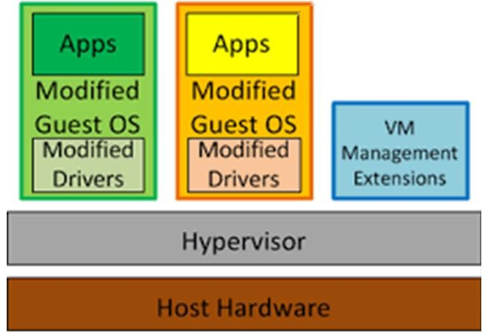
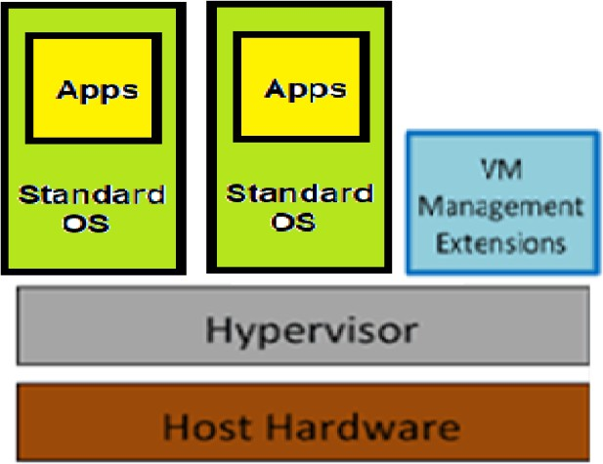
Paravirtualization
CLOUD COMPUTING
Other types of Virtualization
It’s a virtualization technique that presents a software interface to VMs that is similar but not identical to that of the underlying hardware
OS to be explicitly ported to run on top of the VMM/Hypervisor
  Xen
VMM provides APIs for guest OS
Useful if source code of OS is modifiable
  IBM: MVS, VM
  Linux
  Microsoft: Windows
Full (transparent) virtualization
Provides complete simulation of the underlying hardware
OS runs without modification
  Oracle Virtual Box

Slide 16
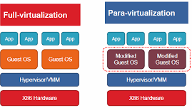
CLOUD COMPUTING
More details of Full and Para Virtualization
Full virtualization architecture intercepts & emulates privileged and sensitive instructions at runtime
Para-virtualization handles these privileged and sensitive instructions at compile time of the guest OS.
  The guest OS kernel is modified to replace privileged and sensitive instructions with hypercalls to
the hypervisor or VMM.
  Xen assumes such a para-virtualization architecture.

Slide 17
CLOUD COMPUTING
Paravirtualization Overview
Performance degradation is a critical issue of a virtualized system.
  No one wants to use a VM if it is much slower than using a physical machine.
  Para-virtualization attempts to reduce the virtualization overhead, and thus improve performance by modifying the guest OS kernel and putting any requests on the applications.
Modify the guest OS (used with paravirtualization) so that it interfaces better with the hypervisor
Access non-virtualizable OS instructions using hypervisor APIs (hypercall) which are special I/O APIs (does not emulate hardware I/O)
This would support improved performance
There is no requirement for modification of user applications for performance in an paravirtualized VM with modified OS

Slide 18
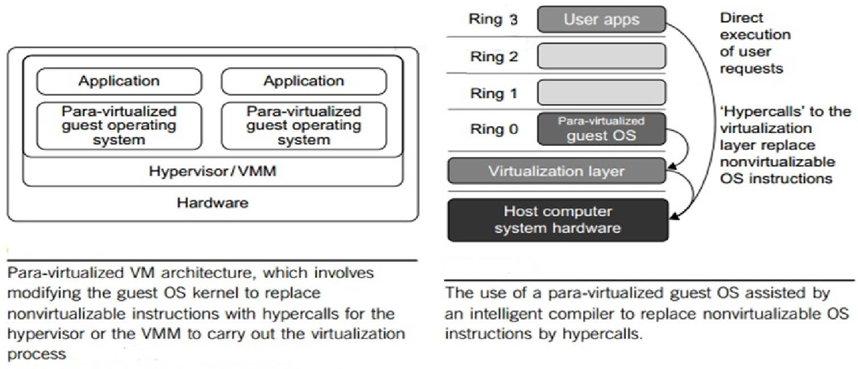
CLOUD COMPUTING
Paravirtualization Architecture

Slide 19
CLOUD COMPUTING
Paravirtualization with Guest OS Compiler Support
The guest OS running in a guest domain may run at Ring 1 instead of at Ring 0.
  This implies that the guest OS may not be able to execute some privileged and sensitive instructions.
The privileged instructions are implemented by hypercalls to the hypervisor.
The guest OS is compiled with changes, replacing some of these privileged instructions with hypercalls to
the hypervisor
After replacing the instructions with hypercalls, the modified guest OS emulates the behavior of the original guest OS.
On an UNIX system, a system call involves an interrupt or service routine. The hypercalls apply a dedicated service routine.
Xen assumes such a para-virtualization architecture.

Slide 20
CLOUD COMPUTING
Paravirtualization Illustration with Memory handling
Xen writeable page tables :
Guest OS has page tables initially as readable.
GuestOS
Guest OS has enabled writeable page tables option
Guest OS tries to write to the guest page tables and generates a trap
Xen based on the trap makes that guest page table
page temporarily writeable
Read Access
Guest OS
Page Table
Write Access
Hypercall
VMM will update PT
But removes the page from the physical page table
Re-starts guest
Guest can continue to modify guest page table and at completion generates a trap which will generate a trigger to Xen
Xen then updates the physical page table (Played back
in the real environment)
Direct Access
VMM
Virtual to Physical Page Table

Slide 21
CLOUD COMPUTING
Paravirtualization Example (Cont.)
Suppose Guest OS wants to start Oracle; Oracle needs 1GB of virtual memory
Page table stores mapping of virtual memory to physical memory
  Assuming 4K as page size, there are 1GB/4K = 250,000 page table entries
Under pure trap and emulate virtualization, there will be a trap for each entry
  250,000 traps

Slide 22
CLOUD COMPUTING
Paravirtualization Example (Cont.)
Since we need a page table with 250,000 entries, the page table itself is stored in memory
  Suppose we need 4MB for the page table
  This is 4MB/4K = 1000 pages
With Xen writeable page table support
  The first time the guest OS tries to write a page in the page table, there will be a trap
  Xen will remove page from page table
  After that, the guest OS can modify entries in page as needed
  When completed; guest OS will call Xen API
  Xen will validate page table entries and put page back in page table
So using hypercalls, the performance got significantly improved with the reduction of need of handling
of the following number of traps
1000 traps vs 250,000 traps

Slide 23
CLOUD COMPUTING
Paravirtualization Issues and Advantages
First, its compatibility and portability may be in doubt, because it must support the un-modified OS as well.
Second, the cost of maintaining para-virtualized OSes is high, because they may require deep OS kernel modifications.
Finally, the performance advantage of para-virtualization varies greatly due to workload variations.
Advantages
Compared with full virtualization, para-virtualization is relatively easy and more practical.
The main problem in full virtualization is its low performance in binary translation. To speed up binary translation is difficult. Therefore, many virtualization products employ the para-virtualization architecture.
The popular Xen, KVM, and VMware ESX are good examples.

Slide 24
CLOUD COMPUTING KVM
This is a Linux para-virtualization system—a part of the Linux version 2.6.20 kernel.
Memory management and scheduling activities are carried out by the existing Linux kernel. The KVM does the rest, which makes it simpler than the hypervisor that controls the hardware.
KVM is a hardware-assisted para-virtualization tool, which improves performance and supports unmodified guest OSes such as Windows, Linux, Solaris, and other UNIX variants.

Slide 25
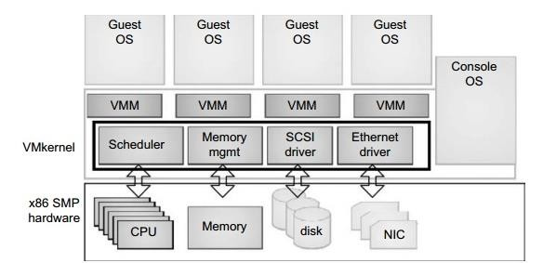
CLOUD COMPUTING
VMware ESX Server architecture using Para-Virtualization
ESX is a VMM or a hypervisor for bare-metal x86 symmetric multiprocessing (SMP) servers.
It accesses hardware resources such as I/O directly and has complete resource management control.
To improve performance, the ESX server employs a para-virtualization architecture in which the VM kernel interacts directly with the hardware without involving the host OS.
https://www.brainkart.com/article/Para-Virtualization-with-Compiler-Support_11336/

Slide 26

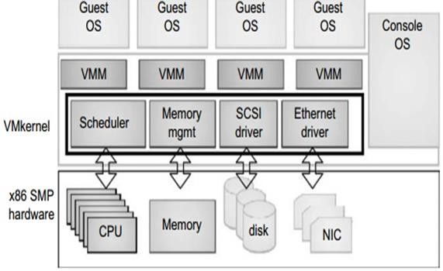
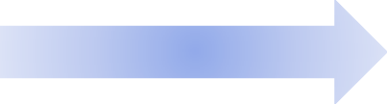

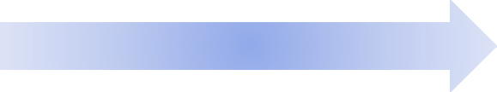
CLOUD COMPUTING
VMware ESX Server architecture using Para-Virtualization (Cont.)
The VMM layer virtualizes the physical hardware resources such as CPU, memory, network and disk controllers, and human interface devices. Every VM has its own set of virtual hardware resources.
Virtualization Layer
The resource manager allocates CPU, memory disk,
and network bandwidth and maps them to the
Resource Manager
virtual hardware resource set of each VM created.
Hardware Interface Components
Hardware interface components are the device
drivers and the VMware ESX Server File System.
The service console is responsible for booting the system, initiating the execution of the VMM and resource manager, and relinquishing control to those layers. It also facilitates the process for system administrators.
An ESX-enabled server consists of four components: a virtualization layer, a resource manager, hardware interface components, and a service console.

Slide 27
CLOUD COMPUTING
Summary
Transparent virtualization
  Trap-and-emulate (to be discussed in detail in the next lecture)
  Binary translation
Paravirtualization
Example: Page tables
  Transparent: shadow page tables (to be discussed in detail under Memory virtualization)
  Paravirtualization: special page table APIs (Xen)

Slide 28
CLOUD COMPUTING
Additional References
Para vs Full vs Transparent virtualization https://www.geeksforgeeks.org/difference-between-full-virtualization-and-paravirtualization/ https://www.vmware.com/content/dam/digitalmarketing/vmw are/en/pdf/techpaper/VMware_paravirtualization.pdf

Slide 29
THANK YOU
Prafullata Kiran Auradkar
Department of Computer Science and Engineering
prafullatak@pes.edu

Slide 30
CLOUD COMPUTING
Virtualization Software Techniques Trap & emulate, binary translation
Dr. Prafullata Kiran Auradkar
Department of Computer Science and Engineering
Acknowledgements:
Significant information in the slide deck presented through the Unit 2 of the course have been created by Dr. H.L. Phalachandra and would like to acknowledge and thank him for the same. There have been some information which I might have leveraged from the content of Dr. K.V. Subramaniam’s lecture contents too. I may have supplemented the same with contents from books and other sources from Internet and would like to sincerely thank, acknowledge and reiterate that the credit/rights for the same remain with the original authors/publishers only. These are intended for classroom presentation only.

Slide 31
CLOUD COMPUTING
Direct Execution (Recap)
Idea: Run most instructions of the VM directly on the hardware
Advantage: Performance close to native execution
Challenge: How to ensure isolation/protection ?
If all instructions of the VM are directly executed then VMM has no control !
Where the original intent for a VMM and VM is to run an unmodified guest OS on the VM as if it were executing directly on the hardware, an alternative is to modify the guest OS replacing hard to virtualize instructions and/or providing more convenient abstractions especially of IO devices. Paravirtualization often results in more efficient code, but of course limits the range of usable guest OSs and the convenience of their use.

Slide 32
CLOUD COMPUTING
Direct Execution + Trap and Emulate (Recap)
Idea:
Trap to hypervisor when the VM tries to execute an instruction that could change the state of the system/take control (i.e., impact safety/isolation).
Emulate execution of these instruction in hypervisor
Direct execution of any other innocuous instructions on h/w that cannot impact other VMs or the
hypervisor

Slide 33
CLOUD COMPUTING
Virtualization (Types) - Recap
Paravirtualization
It’s a virtualization technique that presents an software interface to VMs that is similar but not identical to that of the underlying hardware
OS to be explicitly ported to run on top of the VMM/Hypervisor
  Xen
VMM provides APIs for guest OS
Useful if source code of OS is modifiable
  IBM: MVS, VM
  Linux
  Microsoft: Windows
Full (transparent) virtualization
Provides complete simulation of the underlying hardware
OS runs without modification
  VMWare
  kvm

Slide 34
CLOUD COMPUTING
How to do Trap and Emulate?
Generally two categories of instructions(assembly):
  User instructions:
    Typically compute instructions
e.g. add, mult, ld, store, jmp
System instructions:
  Typically for system management
e.g. iret, invlpg, hlt, in, out
invlpg— priviledged instruction to invalidate TLB Entries

Slide 35
CLOUD COMPUTING
How to do Trap and Emulate? (Cont.)
Two modes of CPU operation:
User mode (in x86-64 typically ring 3)
Privileged mode (in x86-64 ring 0)
Attempt to execute system instructions in user mode generates trap/general protection fault (gpf) System state:
Example, control registers like cr3
Access to system state in user mode trigger gpf
Idea:
Run the VM in user mode (ring 3), while the hypervisor in privileged mode (ring 0)
Anytime VM tries to execute a system instruction or tries to access system state, trap to VMM

Slide 36
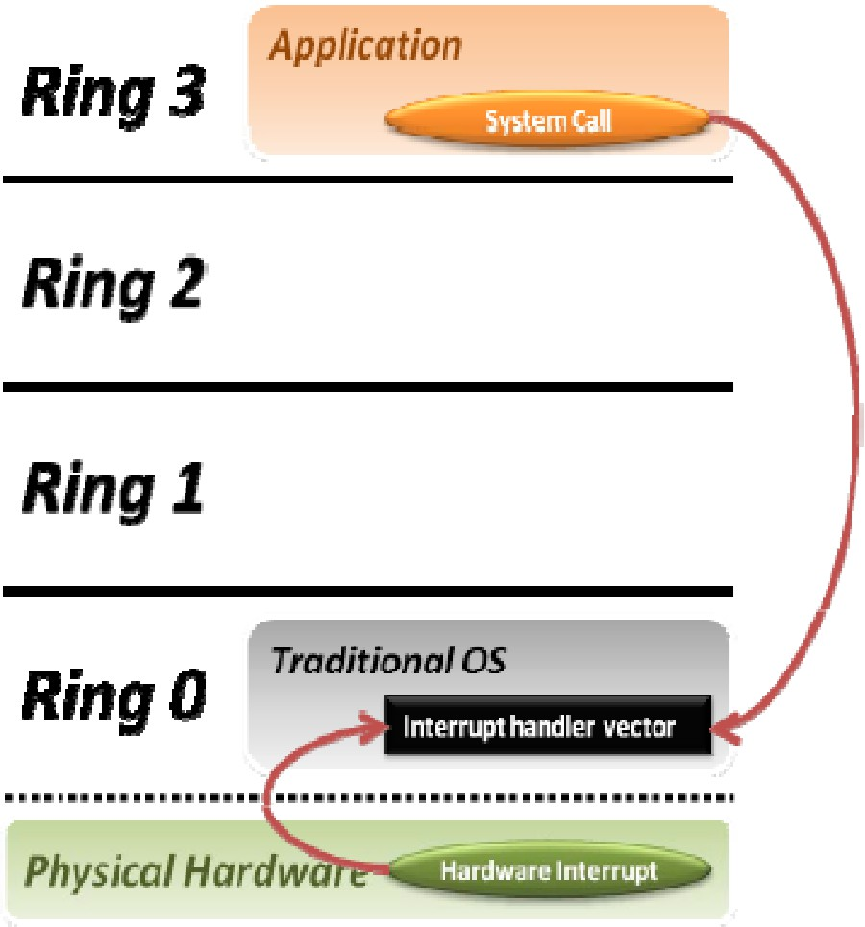
CLOUD COMPUTING
Trap and Emulate
Privilege Rings in Hardware
  Ring 0,1,2,3 in x86 CPUs
Typically OS runs in high privilege mode (Ring 0)
User applications run in Ring 3 (less privilege)
But with a VMM (functioning like OS), the
VMM runs in ring 0
Which ring does Guest OS run in?
Guest OS will need to run with privileges but not fully privileged like host OS/VMM
  Guest OS will also need to be protected from guest
apps which would be in ring 3
  Typically would run in Ring 1 and traps to VMM – at 0

Slide 37
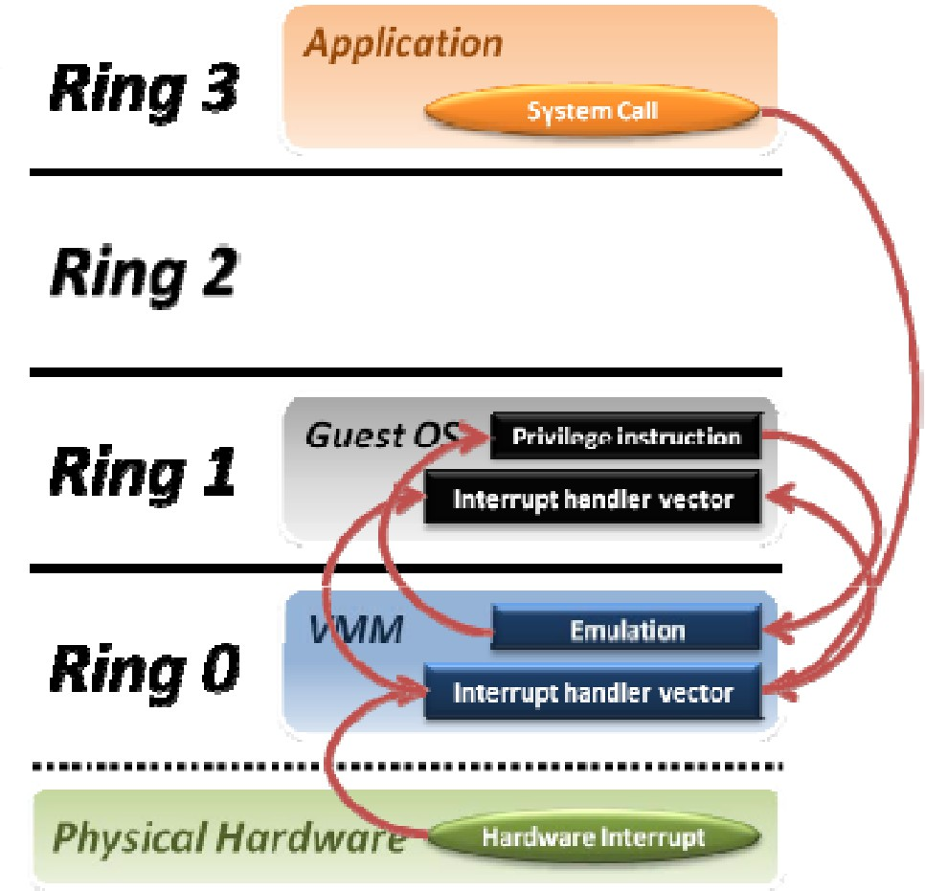
CLOUD COMPUTING
Trap and Emulate Contd.
If Guest application has to handle syscall/interrupt
  Special trap instr (int n), traps to VMM
  VMM doesn’t know how to handle trap
  VMM jumps to guest OS trap handler
  Trap handled by guest OS normally
Guest OS performs return from trap
  Privileged instr, traps to VMM
  VMM jumps to corresponding user process
Any privileged action by guest OS traps to VMM
Example: set IDT, set CR3, access hardware
  emulated by VMM
  Then go back to the Guest OS
Guest Application

Slide 38
CLOUD COMPUTING
Issues/Problems with Trap and Emulate Virtualization technique
1. Performance Overhead
E.g. trapping privileged instructions
Trap costs may be high
Not all architectures support it
  x86 architecture was easily or not completely virtualizable and needed workarounds
  Depends on the fact that executing an instruction at a lower privilege than required will cause a trap to the VMM.
Recent x86 systems try to facilitate virtualization by dealing with the sensitive instructions that are not privileged and by facilitating memory management with hardware. They have introduced a new mode, root mode. Now the mode will consist of the usual four levels paired with a normal/root mode. All sensitive instructions cause transfer to the root mode.

Slide 39
CLOUD COMPUTING
Issues/Problems with Trap and Emulate Virtualization technique
Some x86 instructions which change hardware state (sensitive instructions) run in both privileged and unprivileged modes
  Will behave differently when guest OS is in ring 0 vs in less privileged ring 1
  OS behaves incorrectly in ring1, will not trap to VMM
Example: popf (pop flags)
    Can be used in user mode to change ALU flags
    Can be used in privileged mode to change system state flag (e.g., interrupt delivery flag)
    Trouble: No trap if popf is attempted to alter interrupt flag in user mode --- CPU just ignores it !
      Behavior sensitive instruction but is not privileged
Example: pushf
    simply reveals that the kernel is running in user mode
  There were about 17 such instructions in x86 E.g. SGDT, SIDT, SLDT, SMSW, PUSHF, POPF, LAR, LSL,
VERR, VERW, POP, PUSH, CALL, JMP, INT, RET, STR, MOV in the initial architecuture
  X86 ISA (pre-2005) does not meet the Popek & Goldberg requirements for virtualization

Slide 40
CLOUD COMPUTING
Problems with Trap and Emulate Virtualization technique
Guest OS may realize it is running at lower privilege level
  Some registers in x86 reflect CPU privilege level (code segment/CS)
In trying to keep the Guest OS at the lower privileged level, memory protection is another challenge as physical memory is a shared resource.
  So may need to not allow Guest OS to directly allow memory access and map fake physical pages needing two levels of virtual address translation.
  Virtual page to fake physical page and then the fake physical page to real machine frame/page.
Makes it complex to handle this.

Slide 41
CLOUD COMPUTING
Trap and Emulate technique : Exercise
Guest OS (e.g., Linux) is trying to define new page gvp for process
VM – Running a Guest OS
Guest Page Table
It finds an unused page gpp in VM memory
It tries to load (gvp,gpp) into page table
hpp is a free physical page
What happens?
Guest Physical Mem (Fake or Imaginary)
gpp
Guest Virtual Memory
gvp
Guest Ph page | Guest Virtual page
gpp | gvp
Physical Memory
hpp
VMM/Host Page Tables
Guest Physical page | Actual/Host Physical page

Slide 42
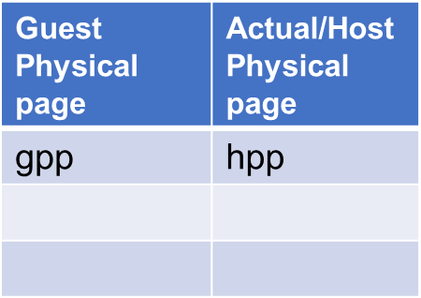
CLOUD COMPUTING
Trap and Emulate Exercise Solution
1. Guest OS tries to modify page tables so that gvp
points to gpp
VM – Running a Guest OS
Physical Memory
hpp
2. Hypervisor traps this privileged instruction
Guest Page Table
Guest Physical Mem (Fake or Imaginary)
gpp
Guest Virtual Memory
gvp
Actual Physical Page | Guest Virtual page
hpp | gvp
Guest
Ph page V
p
Guest
irtual
age
3. Hypervisor maps (if not already done) gpp to a
host physical page hpp
gpp g
vp
4. Loads the Guest page table to get gvp
to point to hpp by copying it from VMM/Host
page table. (to enhance usability)
VMM/Host Page Tables
Other page table operations (e.g., read) have to be trapped as well
We have skipped TLB manipulation
As an implementation the new Page table in Green is also called Shadow Paging/Page table

Slide 43
CLOUD COMPUTING
Why did these problems crop up during Virtualization &
What is Strictly Virtualizable
Why these problems?
  OSes not developed to run at a lower privilege level
  Instruction set architecture of x86 is not easily virtualizable (x86 wasn’t designed with
virtualization in mind)
A processor or mode of a processor is strictly virtualizable if, when executed in a lesser privileged mode:
  all instructions that access privileged state should trap
  all instructions either trap or execute identically Again this another operational definition.
This idea behind strictly virtualizable is whether trap and emulate will work.

Slide 44
CLOUD COMPUTING
Binary Translation Technique
Binary translation is one specific approach to implementing full virtualization that does not require hardware virtualization features -say like the VT instructions for x86 which support the 17 non virtualization instructions for trap and emulation.
Not having support of the VT instructions limit the public IaaS VMs to be virtualizable further by
Users .. Say like EC@ instance being virtualized further.
Binary translation involves the hypervisor examining the virtual guest code for "unsafe or sensitive" but unprivileged instructions, and translating these into "safe" or privileged equivalents, and then
executing the translated code
Thus in this approach, since there is no sensitive unprivileged instructions (because they got
translated) there is no need for a trap to be generated and handled
This helps in the Transparent or full virtualization technique
Supports virtualization of x86 architecture
Similar technique was used in DEC, but was used for Virtualization as we see by VMWare
Conceptually simple
E.g. Replacing the popf instruction with trap to kernel and emulation

Slide 45
CLOUD COMPUTING
Binary Translation Technique - Functioning
The monitor inspects the next sequence of instructions. An instruction sequence is typically defined as the next basic block, that is all instructions up to the next control transfer instruction such as a branch. Such a code will be executed from start to finish by the CPU and hence is ideal for translation. Post this there is a call-out to other pieces of code which will need to be emulated.
Each instruction is translated and the translation is copied into a translation cache.
Instructions are translated as follows:
  Instructions which pose no problems can be copied into the translation cache with modification. We call
these “ident” translations.
  Some simple dangerous instructions can be translated into a short sequence emulation code and directly into the translation cache. This is known as “inline” translation. An example is the modification of the Interrupt Enable flag.
  Other dangerous instructions need to be performed by emulation code in the VMM for which calls are to
be made which are called “Call-outs”. An example of these is a change to the page table base.

Slide 46
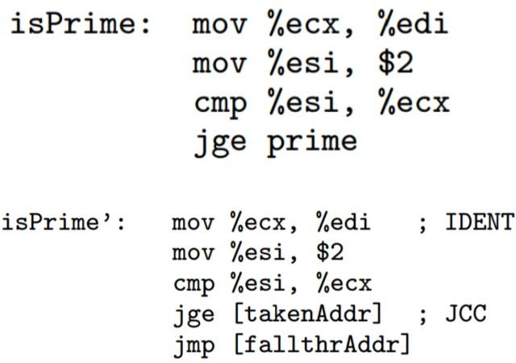
CLOUD COMPUTING
Binary Translation Complexities
Control flow changes
  Translation can change addresses of instructions
  Branches have to be re-translated
  Keep track of branch addresses
Each translator invocation consumes one Translation Unit (TU) and
produces one compiled code fragment (CCF)
https://systems-seminar-uiuc.github.io/fall20/content/VMM.pdf
http://www.cs.toronto.edu/~demke/2227/S.14/Papers/p2-adams.pdf

Slide 47
CLOUD COMPUTING
Additional references
Binary Translation, Trap & Emulate https://www.sciencedirect.com/topics/computer-science/binary-translation
http://www.cs.cmu.edu/~410-f06/lectures/L31_Virtualization.pdf

Slide 48
THANK YOU
Prafullata Kiran Auradkar
Department of Computer Science and Engineering
prafullatak@pes.edu

Slide 49
CLOUD COMPUTING
Hardware Virtualization
Dr. Prafullata Kiran Auradkar
Department of Computer Science and Engineering
Acknowledgements:
Significant information in the slide deck presented through the Unit 2 of the course have been created by Dr. H.L. Phalachandra and would like to acknowledge and thank him for the same. There have been some information which I might have leveraged from the content of Dr. K.V. Subramaniam’s lecture contents too. I may have supplemented the same with contents from books and other sources from Internet and would like to sincerely thank, acknowledge and reiterate that the credit/rights for the same remain with the original authors/publishers only. These are intended for classroom presentation only.

Slide 50

CLOUD COMPUTING
Slides Credits for all PPTs of this course
The slides/diagrams in this course are an adaptation, combination, and enhancement of material from the following resources and persons:
Slides of Prof Arkaprava Basu and Prof Sorav Bansal
Some slides, conceptual text and diagram from Scott Devine, Vmware
Text book and Reference books prescribed in the syllabus
Other Internet sources

Slide 51
CLOUD COMPUTING
Techniques to virtualize x86
Paravirtualization: rewrite guest OS code to be virtualizable
  Guest OS won’t invoke privileged operations, makes “hypercalls” to VMM
  Needs OS source code changes, cannot work with unmodified OS
  Example: Xen hypervisor
Full virtualization: CPU instructions of guest OS are translated to be virtualizable
  Sensitive instructions translated to trap to VMM
  Dynamic (on the fly) binary translation, so works with unmodified OS
  Higher overhead than paravirtualization
  Example: VMWare workstation

Slide 52
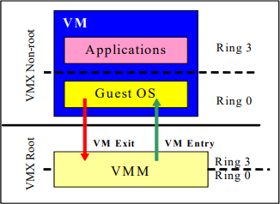
CLOUD COMPUTING
Techniques to virtualize x86 (Cont.)
Hardware assisted virtualization: Eg. KVM in Linux
  CPU has a special VMX mode of execution
  Two kinds of VMX transitions: VMX Root and VMX Non-Root
    X86 has 4 rings in both VMX root and Non-root modes
VMM enters VMX mode to run guest OS in (special) ring 0
Exit back to VMM on triggers (VMM retains control)
Processor behavior in VMX non-root operation is restricted and modified to facilitate virtualization. Instead of their ordinary operation, certain instructions (such as the new VMCALL instruction) and events cause VM exits to the VMM. Because these VM exits replace ordinary behavior, the functionality of software in VMX non-root operation is limited. It is this limitation that allows the VMM to retain control of processor resources.

Slide 53
Workaround for x86-32: Paravirtualization
CLOUD COMPUTING
Co-design of guest OS and hypervisor
  Advantage: Simplicity, work around corner cases
  Disadvantage: Need modified guest OS
  Example: Xen hypervisor
Trick to virtualize x86-32:
  Block all 17 instructions that are sensitive but not privileged
    Just modify the guest OS to #undef them
  Instead provide hypercalls from guest OS to VMM
    Hypercalls are like system calls but from guest OS to VMM

Slide 54
CLOUD COMPUTING
Hardware assisted virtualization: Intel VT-x/AMD-v for x86-64
Two challenges of virtualizing x86-64 ISA: How to hide system/privileged state from the VM?
How to ensure a VM cannot directly change system state (e.g., interrupt flags) of the processor?

Slide 55
Hardware assisted virtualization (Cont.)
CLOUD COMPUTING
Solution idea:
  Two new modes of operation: root and non-root
    Each mode has complete set of execution rings (0-3)
    New instructions to switch between modes
  H/W state is duplicated for each operation mode
  Hypervisor runs in root mode and VMs in non-root
mode
  When any “sensitive” instruction executed in non-root mode it either (1) executed by processor on duplicated state or (2) trap to hypervisor

Slide 56
CLOUD COMPUTING
Hardware assisted virtualization (Cont.)
VM 0
VM 1
Non- root mode
Ring 3
Ring 3
Guest app
Guest app
Ring 2
Ring 2
Ring 1
Ring 1
Ring 0
Guest OS
Ring 0
Guest OS
Ring 3
(Legacy/un-virtualized) User program
Root mode
Ring 2
Ring 1
Ring 0
Hypervisor/VMM

Slide 57
CLOUD COMPUTING
Using Intel VT-x/AMD-v (KVM way)
VMM initializes/modifies VMCS
VMM executes vmlaunch/vmresume instr.
The VM runs until it hits a vmexit condition
VMM analyzes and takes
action on vmexit
Non- root mode
Ring 3
Guest app
Ring 2
Ring 1
Ring 0
Guest OS
vmexit
vmlaunch/ vmresume
Root mode, ring 0
vmread
vmwrite
VMM
Memory
VMCS

Slide 58
CLOUD COMPUTING
Current status of H/W assist
Almost all VMMs make use of h/w assist today
KVM is integrated part of Linux and makes heavy use of h/w assist
Even Xen and VMWare workstation uses it

Slide 59
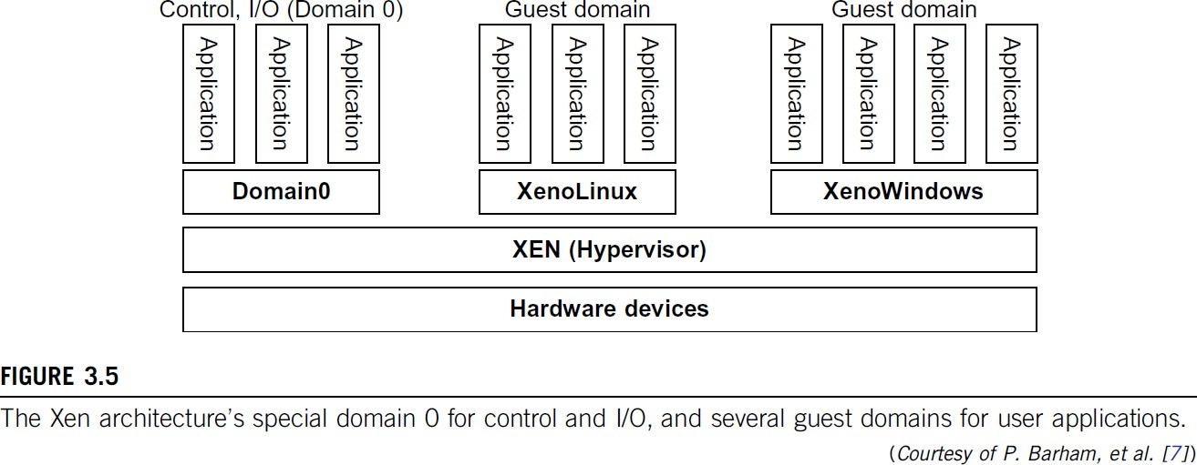
CLOUD COMPUTING
Xen architecture
Paravirtualization hypervisor
VMs called domains
Dom0
  Special domain
  Based upon Linux
  Handles all I/O
  Windows: uses filter drivers
Xen hypervisor
  All functions other than I/O
  Trap and emulate
  Binary translation
    Sensitive instructions replaced by
hypervisor calls

Slide 60
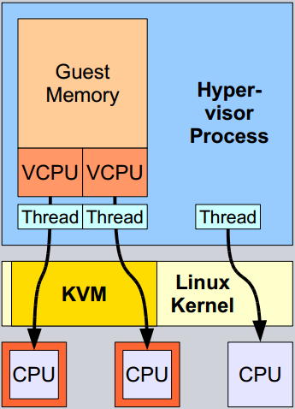
CLOUD COMPUTING
KVM Architecture – Processor Support
Extends Linux kernel to add hypervisor functionality
  Leverage Linux code for scheduling, paging, …
  Uses VT-x, EPT
Each VM appears as a Linux process

Slide 61
CLOUD COMPUTING
Additional Reading
www.vmware.com/pdf/asplos235_adams.pdf https://www.cse.iitb.ac.in/~cs695/slides_pdf/04-hwvirt-kvmqemu.pdf https://www.intel.com/content/dam/www/public/us/en/docu ments/white-papers/virtualization-tech-converged-application-platforms-paper.pdf

Slide 62
THANK YOU
Prafullata Kiran Auradkar
Department of Computer Science and Engineering
prafullatak@pes.edu

Slide 63
CLOUD COMPUTING
Virtualization – Memory and I/O
Dr. Prafullata Kiran Auradkar
Department of Computer Science and Engineering
Acknowledgements:
Significant information in the slide deck presented through the Unit 2 of the course have been created by Dr. H.L. Phalachandra and would like to acknowledge and thank him for the same. There have been some information which I might have leveraged from the content of Dr. K.V. Subramaniam’s lecture contents too. I may have supplemented the same with contents from books and other sources from Internet and would like to sincerely thank, acknowledge and reiterate that the credit/rights for the same remain with the original authors/publishers only. These are intended for classroom presentation only.

Slide 64















CLOUD COMPUTING
Recap of Virtualization in Un-virtualized system
Process A’s virtual address space
Process B’s virtual address space
Page table
Page table
Managed by the OS
Physical memory

Slide 65







CLOUD COMPUTING
Recap of Performing address translation in unvirtualized machine
VA
TLB
Virtual Address
Hit?
Miss?
PTW
PTW (Page Table Walking)
CR3
Page Table
Physical Address
PA

Slide 66
CLOUD COMPUTING
Page Walking (Recap)
Software page walker is a OS handler that walks the page table
  slower than hardware page table walker due to large address translation overhead
  Example: SPARC (Sun/Oracle Machines)
Hardware page walker generates load-like “instructions” to access page table
  Example: x86 and ARM processors
During the page walk, the page walker encounters physical addresses in CR3 register and in page table entries which point to the next level of the walk. The page walk ends when the data or leaf page is reached.
Address translation is a very memory intensive operation because the page walker must access the memory hierarchy many times. To reduce this overhead, processors automatically store recent translations in an internal translation look-aside buffer (TLB).

Slide 67
CLOUD COMPUTING
Requirement for memory virtualization
VMs or Guest OSes on VMs should not have direct access to physical memory
Hypervisor or the VMM should only manage the Host Physical memory
Guest OS should be fooled/or should be made to believe that its accessing the physical memory

Slide 68




























CLOUD COMPUTING
Virtualizing virtual memory
Managed by guest OS
Virtual Machine 1
Virtual Machine 2
App 1
App 2
App 1
App 2
Guest Page table
Guest physical memory
Managed by hypervisor
System (real)Physical memory
Hardware supported Extended Page Table (EPT)
or
Nested Page table

Slide 69






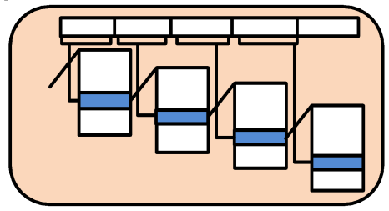
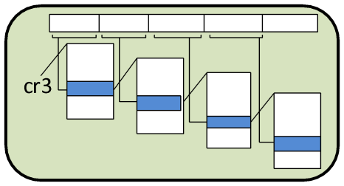
CLOUD COMPUTING
Virtualizing virtual memory (Cont.)
Guest Physical Address
System Physical Address
1
2
gVA
gPA
sPA
Guest
Page Table
Host/system
Page Table
Two levels of address translation on each memory access by an application running inside a VM

Slide 70
CLOUD COMPUTING
Implementing two level address translation
Shadow page table
  Each page table of the guest OS has a separate page table in the VMM corresponding to it, the VMM page table is called the shadow page table.
  Shadow paging was developed as a software-only technique to virtualize memory before hardware support was implemented.
Nested/Extended page table
  Hardware supported technique
  A additional page table is set up by the hypervisor to perform a second level address translation

Slide 71
CLOUD COMPUTING
Shadow page table
Idea: Let hypervisor “create” a shadow page table that maps guest VA to host PA directly
  Made by combining guest page table with system page table
  Hypervisor makes the cr3 point to the shadow page table
  A hardware or software page table walker (PTW) walks the shadow page table
  Control Register CR3 points to the root of page table
  Translation from Virtual Page Number (VPN) to Physical page frame number or fault occurs
Ref: https://www.cse.iitk.ac.in/users/biswap/CASS18/VM.pdf

Slide 72




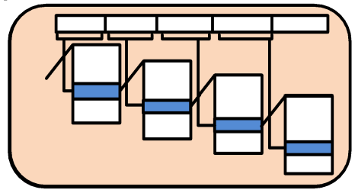
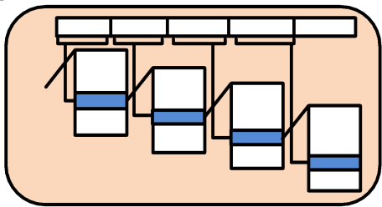
CLOUD COMPUTING
Shadow page table
Guest Physical Address
System Physical Address
1
2
gVA
gPA
sPA
Guest Page Table
Host/system Page Table
shadow version of page table derived from gPT.
hypervisor forces the processor to use sPT(shadow page table) to perform address
translation.
Shadow
Page Table

Slide 73
CLOUD COMPUTING
Shadow page tables
VMM maintains shadow page tables that map guest-virtual pages directly to machine pages.
Guest modifications to the guest Page tables (containing gVA->gPA) synced to VMM managed
Shadow Page tables (containing gVA->sPA).
  Guest OS page tables marked as read-only.
  Modifications of guest page tables by guest OS -> trapped to VMM.
  Shadow page tables synced to the guest OS page tables
Software-based techniques maintain a shadow version of page table derived from guest page table (gPT).
When the guest is active, the hypervisor forces the processor to use the shadow page table (sPT)
to perform address translation.
The sPT is not visible to the guest.

Slide 74


CLOUD COMPUTING
Shadow page tables (Cont.)
Set CR3 by guest OS (1)
Guest Page Table
Shadow Page Table
Guest
Page Table
Guest
Page Table
Virtual CR3
Real CR3
Shadow
Page Table
Shadow
Page Table

Slide 75

CLOUD COMPUTING
Shadow page tables (Cont.)
Set CR3 by guest OS (2)
Virtual CR3
Guest
Page Table
Guest
Page Table
Guest
Page Table
Real CR3
Shadow
Page Table
Shadow
Page Table
Shadow
Page Table

Slide 76
CLOUD COMPUTING
Challenge of Shadow page table
How to create a shadow page table?
  Anytime guest OS modifies guest page table hypervisor needs to update shadow page table
  Solution: Write protect guest page table
    Any write access to guest page table would generate page fault 🡪 trap to hypervisor
  Drawback: Many page faults for application that alters page tables
For every guest application there is one shadow page table
Every time guest application context switches trap to hypervisor to change cr3 to point to new shadow
page table
Maintaining consistency between guest page tables and shadow page tables leads to an overhead: VMM traps
Loss of performance due to TLB flush on every “world-switch”.
Memory overhead due to shadow copying of guest page tables.

Slide 77
CLOUD COMPUTING
Nested/Extended page table (Hardware Assisted)
Nested or Extended page table was introduced to avoid the software overheads of shadow paging.
In nested paging, uses an additional or nested page table (NPT) to translate guest physical address to system physical address and thus
guest will control its page tables
Differs from shadow paging, that ones nested pages are populated, the hypervisor does not need to intercept and emulate guest page table modifications
Both the guest and the hypervisor have their own copy of processor state like the CRO, CR3 etc.
The gPT set up by the guest OS maps guest virtual address to guest physical address. Nested page tables (nPT) setup by the Hypervisor, maps guest physical address to system physical address
When a guest attempts to reference memory using a virtual address, and nPT is enabled, the page walker to find the mapping, performs a two dimension walk using the gPT and the nPT to translate the guest virtual address to system physical address
Summarily
Idea : Make hardware aware of two levels of address translation the guest and nested page table
Make hardware page walker walk both guest page table and nested page table on a TLB miss 🡪 Two dimensional page walk
Two cr3s :
gCR3 🡪 gPT; nCR3 🡪 nPT
Eliminates the need of shadow page table
Ref: http://developer.amd.com/wordpress/media/2012/10/NPT-WP-1%201-final-TM.pdf

Slide 78
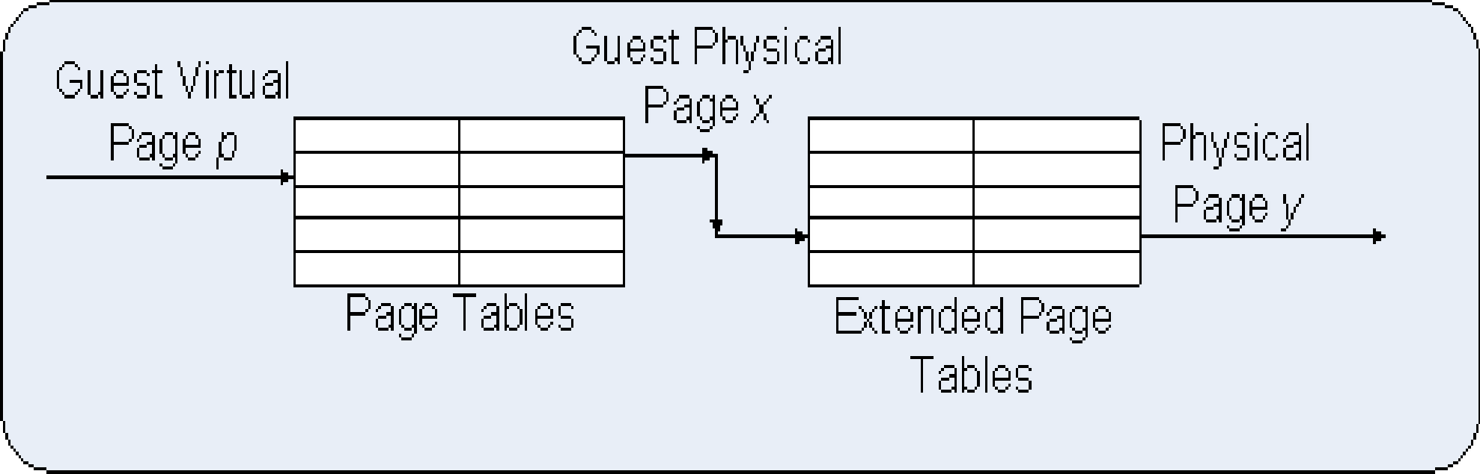
CLOUD COMPUTING
Extended page tables
Guest Virtual Page (gVP)
Guest Physical Page (gPP)
System (or Host) Physical Page
Guest Page Table (gPT)
Extended Page Table (EPT)
Guest manages page tables (one per process running on the VM)
Hypervisor manages Extended Page Tables (EPT)

Slide 79
CLOUD COMPUTING
EPT – Another Summary
CR3
EPT Base Pointer (EPTP)
Guest IA-32 Page Tables
Guest Physical Address
Extended Page Tables
Host Physical Address
when the guest removes a translation, it executes INVLPG to invalidate that translation in the TLB. The hypervisor intercepts this operation; it then removes the corresponding translation in sPT and executes INVLPG for the removed translation.
Guest Linear Address
Extended Page Table
A new page-table structure, under the control of the VMM
Defines mapping between guest- and host-physical addresses
EPT base pointer (new VMCS field) points to the EPT page tables
EPT (optionally) activated on VM entry, deactivated on VM exit
Guest has full control over its own IA-32 page tables
  No VM exits due to guest page faults, INVLPG, or CR3 changes
Virtual Machine Control Structure (VMCS) Field IDs used by the Hypervisor framework read and write functions.

Slide 80
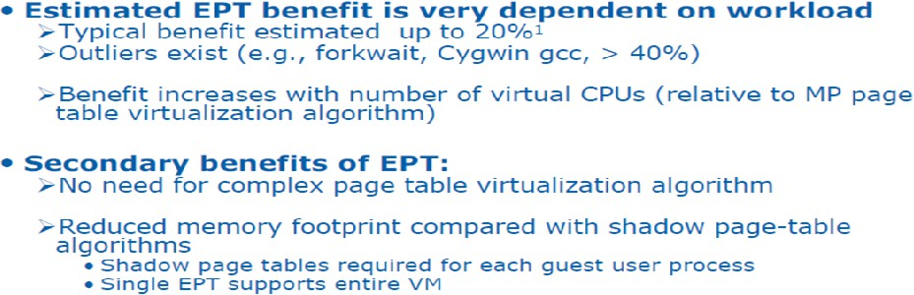
CLOUD COMPUTING
EPT (Extended Page Tables) : Performance
Summarily EPT improves Memory Virtualization Performance

Slide 81
CLOUD COMPUTING
I/O virtualization
I/O virtualization (IOV), or input/output virtualization, is technology that uses software to abstract upper-
layer protocols from physical connections or physical transports.
I/O virtualization involves managing the routing of I/O requests between virtual devices and the shared physical hardware.
Three ways to implement I/O virtualization:
  Full device Emulation
  Para-Virtualization
  Direct I/O
Full device emulation
  Full device emulates well-known, real-world devices.
    All the functions of a device or bus infrastructure, such as device enumeration, identification, interrupts, and DMA, are replicated in software.
    This software is located in the VMM and acts as a virtual device. The I/O access requests of the guest OS
are trapped in the VMM which interacts with the I/O devices.

Slide 82
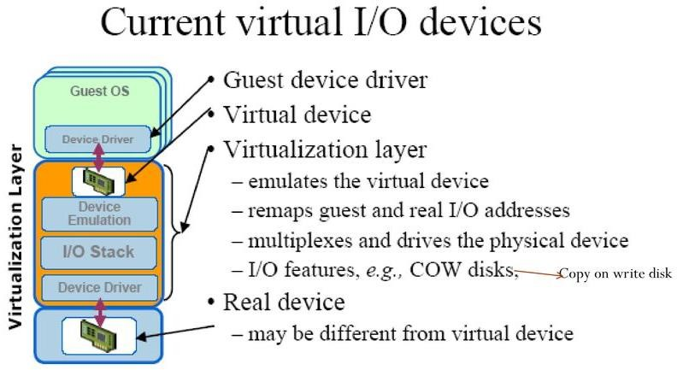
CLOUD COMPUTING
1. Full Device emulation for I/O Virtualization
Device emulation for I/O virtualization implemented inside the middle layer that maps real I/O devices into the virtual devices for the guest device driver to use.

Slide 83
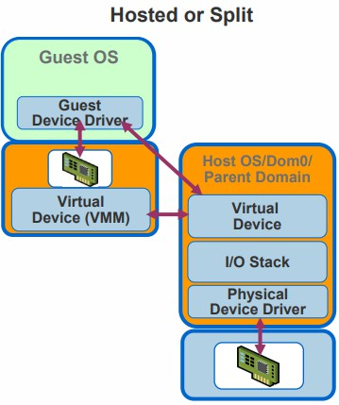
CLOUD COMPUTING
Para-I/O-Virtualization or Split Driver or Hosted I/O Virtualization
  It is also known as Hosted or the split driver model consisting of a frontend driver and a backend driver.
  The frontend driver is running in Domain U (User/Guest) and the backend driver is running in Domain 0. They interact with each other via a block of shared memory.
  The frontend driver manages the I/O requests of the guest OSes and the backend driver is responsible for managing the real I/O devices and multiplexing the I/O data of different VMs.
  Although para-I/O-virtualization achieves better device performance than full device emulation, it comes with a higher CPU overhead.
  Para virtualization method of I/O virtualization is typically used in
Xen

Slide 84
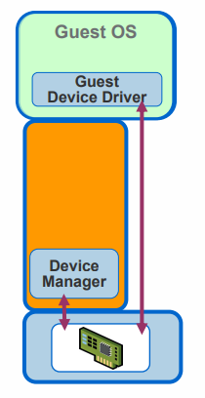
CLOUD COMPUTING
Direct I/O (or Passthrough) I/O Virtualization
  Direct I/O virtualization lets the VM access devices directly.
  It can achieve close-to-native performance without high CPU costs.
  Enables a device to directly DMA to/from host memory.
    This technique thus provides an ability to bypass the VMM’s I/O emulation layer and therefore shows improved throughput for the VM’s.
  The Intel VT-x technology allows a VM to have direct access to a physical address (if so
configured by the VMM).
  This ability allows a device driver within a VM to be able to write directly to registers IO device (such as configuring DMA descriptors).
  VT-d extensions add virtualization support to Intel chipsets that can assign specific I/O
devices to specific virtual machines
  The mechanism for doing direct assignment varies from one vendor to another. However, the basic idea is that
the VMM utilizes and configures technologies such as Intel VT-x and Intel VT-d to perform address translation
when sending data to and from an IO device.
    The main concern with direct assignment is that it has limited scalability, a physical device can only be
assigned to one VM.
Ref: https://virtualizationdeepdive.wordpress.com/about/6-2/
https://download3.vmware.com/vmworld/2006/tac0080.pdf

Slide 85
CLOUD COMPUTING
I/O virtualization : Advantages
Flexibility: Since I/O virtualization involves abstracting the upper layer protocols from the underlying physical connections, it offers greater flexibility in terms of hardware independence, utilization and faster provisioning in comparison with normal NIC and HBA cards.
Cost minimization: I/O virtualization methodology involves using fewer cables, cards and switch ports
without compromising on network I/O performance.
Increased density: I/O virtualization increases the practical density of I/O by allowing more connections to exist in a given space.
Minimizing cables: The I/O virtualization helps to reduce the multiple cables needed to connect servers to storage and network.

Slide 86
CLOUD COMPUTING
Additional References
https://www.cse.iitb.ac.in/~cs695/slides_pdf/06-memvirt.pdf https://www.cse.iitb.ac.in/~cs695/papers/iovirt.pdf

Slide 87
CLOUD COMPUTING
Xen I/O Virtualization
Xen does not emulate hardware devices
Exposes device abstractions for simplicity and performance
I/O data transferred to/from guest via Xen using shared-memory buffers
Virtualized interrupts: light-weight event delivery mechanism from Xen-guest
  Update a bitmap in shared memory
  Optional call-back handlers registered by O/S

Slide 88
THANK YOU
Prafullata Kiran Auradkar
Department of Computer Science and Engineering
prafullatak@pes.edu

Slide 89
CLOUD COMPUTING
Virtualization – Goldberg/Popek Principles
Dr. Prafullata Kiran Auradkar
Department of Computer Science and Engineering
Acknowledgements:
Significant information in the slide deck presented through the Unit 2 of the course have been created by Dr. H.L. Phalachandra and would like to acknowledge and thank him for the same. There have been some information which I might have leveraged from the content of Dr. K.V. Subramaniam’s lecture contents too. I may have supplemented the same with contents from books and other sources from Internet and would like to sincerely thank, acknowledge and reiterate that the credit/rights for the same remain with the original authors/publishers only. These are intended for classroom presentation only.

Slide 90
CLOUD COMPUTING
Background
We discussed Cloud Computing as a paradigm which provides large number of benefits as discussed earlier, where
  Computation happens somewhere in the cloud
  Scalable Resources are made available to applications as a Service and at different service levels
We also discussed that Virtualization is one of the fundamental technologies which enables Cloud Computing
Virtualisation divides the resources of a computer into multiple execution environments using partial or complete machine simulation or emulation and allows it to be shared between different tenants or users.
The typical granularity of the compute to which the resources of a single physical server is divided
would be a Virtual Machine
This is typically achieved using a layer of software, the Virtual Machine Manager or the hypervisor that provides illusion of a "real" machine to multiple instances of "virtual machines“

Slide 91
CLOUD COMPUTING
Background - 2
This hypervisor could run directly on the real hardware or it could run as an application on top of a host operating system
This VMM will perform the activities typically done by an OS and interfaces with the hardware and
the VMs on either side.
VMM or the Hypervisor uses two techniques “Trap and Emulate” and “Binary Translation” to function as the virtualization layer supporting the execution of a Guest Application, on a Guest OS on a VM.
“Trap and Emulate” of these two is more prevalent as we discussed till now, has a requirement that all sensitive instructions which needs emulation in the Hypervisor can be trapped.
Not all system architectures (e.g. the original x86 architecture) can support virtualization.
Gerald Popek and Robert Goldberg in 1974 defined the requirements for an architecture to efficiently support virtualization.

Slide 92
CLOUD COMPUTING
Popek and Goldberg principles : Terminologies
As part of their research work they
Set out a set of terminologies
  Virtual machine: Complete compute environment with its own isolated processing capabilities, memory and communication channels as created by the VMM.
    Virtual machine is an efficient isolated duplicate of the physical machine
  Virtual Machine Monitor (VMM)/Hypervisor: System software that creates and manages virtual machines that is
    Efficient : All safe guest instructions run directly on hardware
    Omnipotent: Only the VMM can manipulate sensitive state
    Undetectable: A guest cannot determine that it is running atop a VMM
  These are applicable for Third generation machines implying that the system has at least two operating modes user and supervisor with some instructions not available for user mode. Addressing is with respect
to a relocation register and the system has an ability to perform table look ups etc.
Ref: https://cis.temple.edu/~ingargio/cis307/readings/virtualization.html#:~:text=Privileged%20Instructions%3A%20instructions%20that%20if,%2CSIDT%2CSLDT%2CSMSW.

Slide 93
CLOUD COMPUTING
Popek and Goldberg principles : Essential Characteristics
They came up with a few essential characteristics or requirements for the VMM
  Equivalence: VMM provides an environment for programs which is essentially identical with the original machine, thus a program running on a VM should behave essentially identically to a program executing directly on the hardware (to indicate isolation from a protection perspective).
  Resource Control: The VMM must be in total control of the virtualized resources. This would mean programs running under the VMM should not have an ability to access a resource which is not explicitly allocated and VMM should have an ability to regain control of resources allocated.
  Efficiency: The great majority of the machine instructions must be executed without intervention of the VMM (i.e. without trap) or programs running in this environment show at worst only minor decreases in speed
Ref: https://cis.temple.edu/~ingargio/cis307/readings/virtualization.html#:~:text=Privileged%20Instructions%3A%20instructions%20that%20if,%2CSIDT%2CSLDT%2CSMSW.

Slide 94
CLOUD COMPUTING
Goldberg/Popek : Instructions
All instructions are bucketed into three types.
  Privileged Instructions : These instructions cause a trap if the processor is not in the privileged mode
  Sensitive Instruction : These access low-level machine states e.g. page tables, IO devices, privilege
bits, which needs to be managed by the control software (i.e. an OS or a VMM/Hypervisor)
    Behavior sensitive: Those whose behaviour or result depends on the mode or configuration of the hardware's mode. If guest OS executes these instructions at lower privilege levels, result will be wrong
      E.g of such instructions on x86 are POP, PUSH, CALL, JMP, INT n, RET, LAR, LSL, VERR, VERW, MOV.
    Control sensitive: those that attempt to change the configuration of resources in the system i.e. that modify the system registers.
      E.g. of such instructions in x86 are: PUSHF,POPF,SGDT,SIDT,SLDT,SMSW.
  Safe Instructions : Which are not sensitive

Slide 95
CLOUD COMPUTING
Popek and Goldberg : Theorems - 1
They also came up with a set of conditions which have been coded-in as a set of theorems, which are the requirements or conditions which could be used to determine or assure that an architecture is Virtualizable when building a system.
This depends on the relations between control-sensitive, behaviour-sensitive and privileged instructions. The main result of Popek and Goldberg's analysis can be expressed as follows.
Theorem 1: For any conventional third generation computer, a VMM may be constructed if the set of sensitive instructions for that computer is a subset of the set of privileged instructions.
  The theorem states that to build a VMM it is sufficient that all instructions that could affect the correct functioning of the VMM (sensitive instructions) always trap and pass control to the VMM.
  Non-privileged instructions must instead be executed natively (i.e., efficiently).
Ref: https://en.wikipedia.org/wiki/Popek_and_Goldberg_virtualization_requirements

Slide 96
CLOUD COMPUTING
Popek and Goldberg : Theorems (Cont.) - 2
(Cont.)
Theorem 2: A conventional third generation computer is recursively virtualizable if it is:
  virtualizable, and
  a VMM without any timing dependencies can be constructed for it.
If architectures cannot be virtualized in the classic way, use binary translation, which replaces the sensitive instructions that do not generate traps
Recursive virtualization is the ability to install a VM within a VM or the conditions under
which a VMM that can run on a copy of itself can be built.
Theorem 3: A hybrid virtual machine monitor may be constructed for any conventional third generation machine in which the set of user sensitive instructions are a subset of the set of privileged instructions.
Ref: https://en.wikipedia.org/wiki/Popek_and_Goldberg_virtualization_requirements

Slide 97
Does x86 support Popek-Goldberg virtualization?

Slide 98
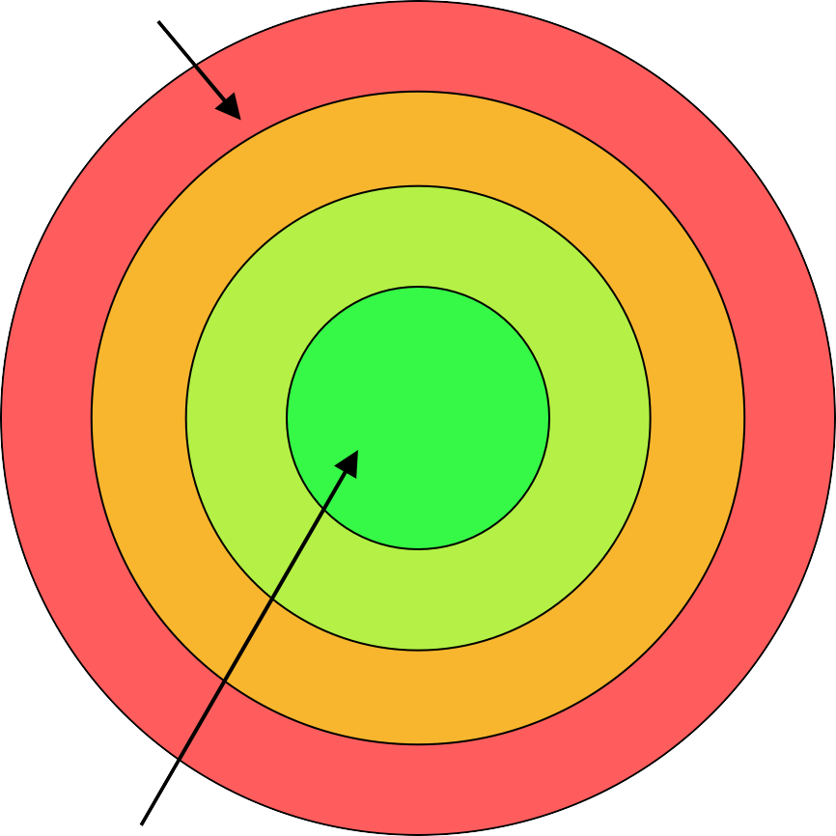
Observation 1: Only Ring 0 can invoke privileged instructions. Rings 1, 2, and 3 trap when invoking privileged instructions.
Observation 2: An x86 PTE only has a single bit to
Least privileged
indicate user/supervisor! The MMU maps Rings 0, 1, and 2 to “supervisor,” and Ring 3 to “user.”
Ring 3
Ring 2
Ring 1
The Normal x86 Setup
Intel originally Uthsoeurghatptphsat devicReindgriv3ers could be “isolated” here
However, “isolaNteod”thdirnivgers in RiRnginsg1 2or 2 can still access ring 0 memory pages, so isolation is weak_{N}in_{ot}p_{h}r_{i}a_{n}c_{g}tice with_{R}ou_{in}t_{g 1} additional segment-based protection (but segment support was dropped in x86-64)
Also, most non-x86^{O}ch^{S}ips only de^{R}fi^{i}n^{n}e^{g}t⁰wo
User-mode accessible?
Writeable?
Present?
•
Ring 0
•
PTE
 | 4KB-aligned physFrame addr
63
48 47
12 11
3 2 1 0
•
Most privileged
privilege levels, so portable OSes shouldn’t
x86 Rings
leverage Rings anxd862

Slide 99
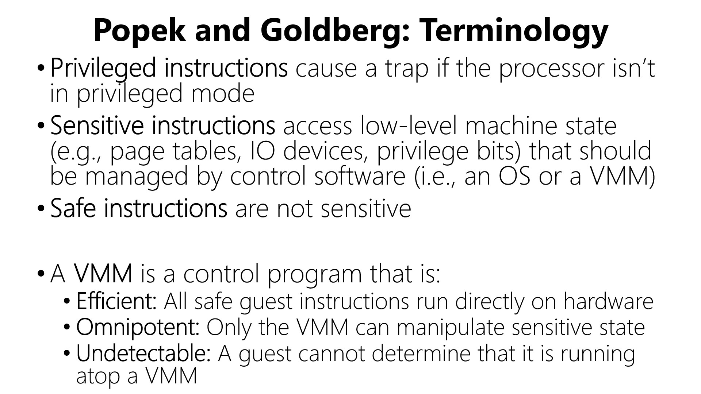

Guest apps
Ring 3
Guest OS
VMM
Ring 0
x86
Guest app executes syscall to read from keyboard
Hardware generates trap which is handled by VMM
VMM vectors control to guest OS’s interrupt handler
Guest OS tries to execute inb to read a key from the keyboard
Hardware traps to VMM
VMM executes real inb
Theorem: A virtual machine monitor can be constructed for architectures in which every sensitive instruction is privileged.

Slide 100

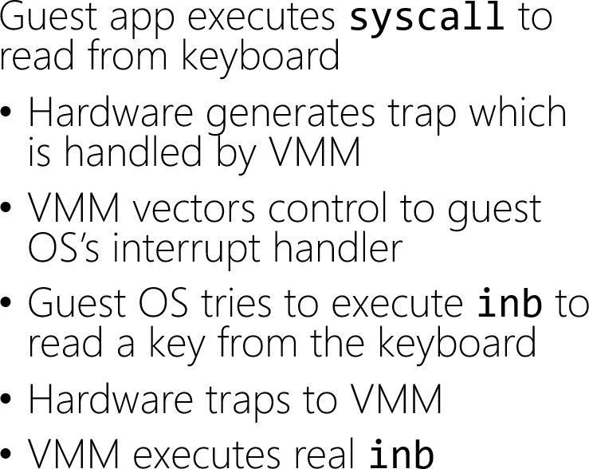
If the guest OS is mapped into the same address space as the guest apps, then the guest apps can read and write the guest OS’s state!
Guest apps
Ring 3
Guest OS
VMM
Ring 0
x86
VMM places result where the guest OS expects it to be
I still want isolation between the guest OS and the guest apps!
VMM vectors control back to the
guest OS
OS does some processing and then does an iret or sysexit
Hardware traps to VMM
VMM returns to user-mode

Slide 101
There’s another problem . . .

Slide 102
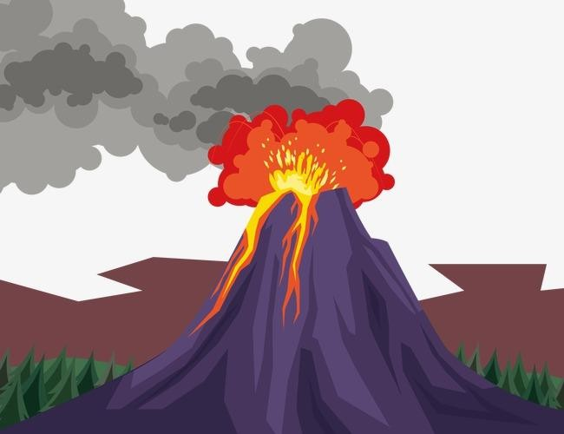
Theorem: A virtual machine monitor can be constructed for architectures in which every sensitive instruction is privileged.
For many years, x86 had sensitive instructions that weren’t privileged!

Slide 103
The x86 push instruction was not PG-virtualizable!
push can push a register value onto the top of the stack
  %cs register contains (among other things) 2 bits that represent the current privilege level
  A guest OS running in Ring 3 could push %cs and see that the privilege level isn’t Ring 0!
To be virtualizable, push should cause a trap when invoked from Ring 3, allowing the VMM to push a fake %cs value which indicates that the guest OS is running in Ring 0

Slide 104
The x86 pushf/popf instructions weren’t PG-virtualizable!
pushf/popf read/write the %eflags register using the value on the top of the stack
  Bit 9 of %eflags enables interrupts
  In Ring 0, popf can set bit 9, but in Ring 3, CPU silently ignores popf!
To be virtualizable, pushf/popf should cause traps in Ring 3
  Allows VMM to detect when guest OS wants to changes its interrupt level (meaning that the VMM should change which interrupts it forwards to the guest OS)
x86 had 17 non-PG-virtualizable instructions!
https://apps.dtic.mil/sti/pdfs/ADA423654.pdf

Slide 105
CLOUD COMPUTING
x86 architecture : Conformance to Popek & Goldberg requirements for virtualization
Summarily
X86 ISA does not meet the Popek & Goldberg requirements for virtualization
ISA contained 17+ sensitive , unprivileged instructions:
  SGDT, SIDT, SLDT, SMSW, PUSHF, POPF, LAR, LSL, VERR, VERW, POP, PUSH, CALL,
JMP, INT, RET, STR, MOV
Most simply reveal that the kernel is running in user mode
PUSHF
Some execute inaccurately
  POPF
Virtualization is now possible, but requires workarounds or the hardware enhancements

Slide 106
CLOUD COMPUTING
Additional Reading
https://enacademic.com/dic.nsf/enwiki/480245
https://www.cs.cmu.edu/~410-s14/lectures/L30_Virtualization.pdf
https://en.wikipedia.org/wiki/Popek_and_Goldberg_virtualization_requirements#:~:text= The%20Popek%20and%20Goldberg%20virtualization,for%20Virtualizable%20Third%20Ge neration%20Architectures%22.
https://blog.acolyer.org/2016/02/19/formal-requirements-for-virtualizable-third-
generation-architectures/
http://citeseerx.ist.psu.edu/viewdoc/download?doi=10.1.1.141.4815&rep=rep1&type=pdf
https://www.researchgate.net/publication/252019491_Recursive_virtual_machines_for_a dvanced_security_mechanisms

Slide 107
THANK YOU
Prafullata Kiran Auradkar
Department of Computer Science and Engineering
prafullatak@pes.edu

Slide 108
CLOUD COMPUTING
Virtualization – VM Migration
Dr. Prafullata Kiran Auradkar
Department of Computer Science and Engineering
Acknowledgements:
Significant information in the slide deck presented through the Unit 2 of the course have been created by Dr. H.L. Phalachandra and would like to acknowledge and thank him for the same. There have been some information which I might have leveraged from the content of Dr. K.V. Subramaniam’s lecture contents too. I may have supplemented the same with contents from books and other sources from Internet and would like to sincerely thank, acknowledge and reiterate that the credit/rights for the same remain with the original authors/publishers only. These are intended for classroom presentation only.

Slide 109
CLOUD COMPUTING
VM Migration
VM migration is the process of moving a virtual machine from one host to another.
There can be different kinds of migrations
  Cold migration –migrating a powered-off VM (migrations can be across different CPU families)
  Non-live(Off-line) VM Migration: Virtual machine at the source host is paused and then all states of source host is transferred to the target or destination host, and then working of virtual machine at the target host is resumed. This could have the drawback of a larger down time
  Live or Hot migration – migrates a powered-on VM with no disruption to service.
    including the memory content and all the information that define the virtual machine, such as BIOS, devices, MAC addresses, etc.
    There are no dropped network connections and applications continue to run uninterrupted.
    End users are not even aware that the VM has been migrated between two physical
eg. vSphere vMotion

Slide 110
CLOUD COMPUTING
VM Migration – Why?
Migrations are done for reasons such as
  Hardware Maintenance
    Migrates the VMs and the applications running on them to allow maintenance of the physical server
  Balancing of the workload
    Workload on a specific server or on few of the servers in the cluster of nodes can get unbalanced and live migrations are done to dynamically adjusting loads among nodes
  Scaling to a changing workload
    Changes in the workload or requirements of the Server may necessitate migration to a physical server which has the required resources needed
    By supporting automatic scale-up and scale-down of a virtual cluster
  Consolidating the Servers for utilization
    Effective and optimal utilization of Servers for cost

Slide 111
CLOUD COMPUTING
VM Migration - Why
Migrations are done for reasons such as (Cont.)
  Workload Mobility
    Applications based on the compliance requirements may need to move their VMs to different
machines or locations
  Performance
    Mapping VMs onto the most appropriate physical node having the necessary resources to
promote performance.
    Migrating to nodes from nodes whose resources are over-utilized or environments where networks are clogged to shorten the response time of systems.
  Energy efficiencies
    Given that sustainability is the need for all data center’s migrations are used to reduce the energy consumption (Servers, Zones, Airconditioning, Location)
  Availability Support, Business Continuity
    To support Availability requirements arising out of failures to equipment or environments

Slide 112
CLOUD COMPUTING
Non-Live or Cold migration process
Non live migration is easiest of the migration technique.
In this technique the current execution of VMs are suspended before migration and resumed after
the migration phase.
It is a simple technique as the service provided is stopped while migration process continues.
The state of VM does not resume on the destination server until the migration process completes.
Memory pages need to be migrated only once using this technique.
The migration time is also very short and predictable.
This technique simplifies the migration process but as the service provided is paused during the migration phase, application performance is degraded

Slide 113
CLOUD COMPUTING
Live migration process of VMs
Live migration is the current need in significant use case scenarios as significant number of applications and the services have availability expectations and Live migration supports offering of the same. In other words, the intention would be to migrate without impacting or even making aware the User application running on the VM.
The live migration of VMs allows workloads of one node to transfer to another node.
The considerations for choosing to migrate and where to migrate would be the cost or overhead
involved for the migration and the total time taken for migration.
VM migration is a resource-intensive procedure as VM’s continuously demand appropriate CPU cycles, cache memory, memory capacity, and communication bandwidth.
VM migration process typically degrades the performance of running applications and adversely affects efficiency of the data centers, particularly when Service Level Agreements (SLA) and critical business objectives are to be met.

Slide 114
CLOUD COMPUTING
Live VM migrations :
Live migration used in significant use case scenarios as this supports availability expectations needed for significant number of applications.
These are few objectives of Live migration
  Migrate by efficiently utilizing the bandwidth to optimize the application performance
  Minimize the application downtime
  Reducing the overall time required for transfer by maximum factor
  Summarily migrate without significantly impacting the User application running on the VM.
There are two technique of live migration
  Pre-copy technique
  Post-copy technique

Slide 115
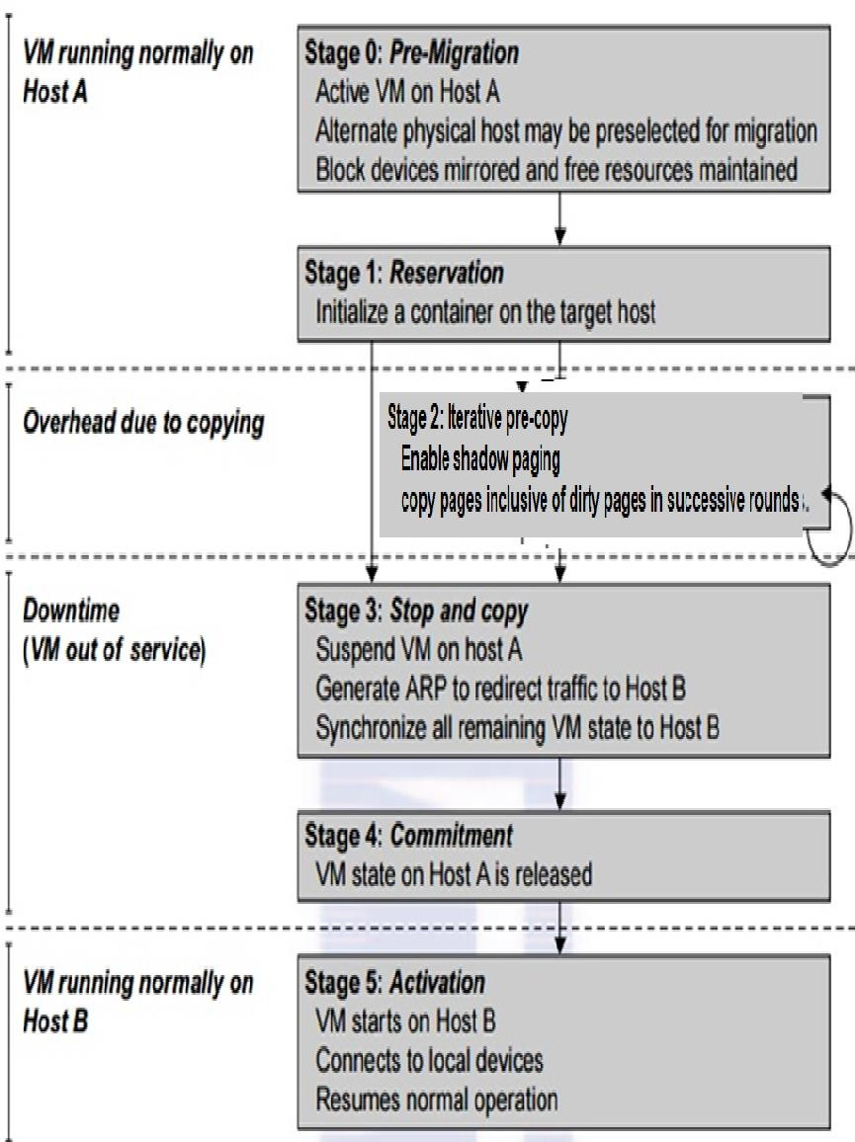
CLOUD COMPUTING
Live VM migrations : Pre-Copy technique - 1
In Pre-copy migration, VM will continue in running condition and the transfer of memory contents to the destination is done simultaneously. For pre-copy VM migration process there are mainly six stages
Selecting the destination host
Reservation of Resources
This step makes preparations for the migration, including determining
the migrating VM and the destination host.
Although users could manually make a VM migrate to an appointed host, in most circumstances, migration is automatically started by strategies such as load balancing and server consolidation.
Iterative pre-copying rounds
Since the whole execution state of the VM is stored in memory, sending the VM’s memory to the destination node ensures continuity of the service provided by V
All of the memory data is transferred in the first round, and then the migration controller recopies the memory data which is changed in the last round (dirty pages).
These steps keep iterating until 1) Fixed threshold is reached 2) the dirty portion of the memory is small enough to handle the final copy.
Although pre-copying memory is performed iteratively, the execution of programs is not obviously interrupted.
M.

Slide 116
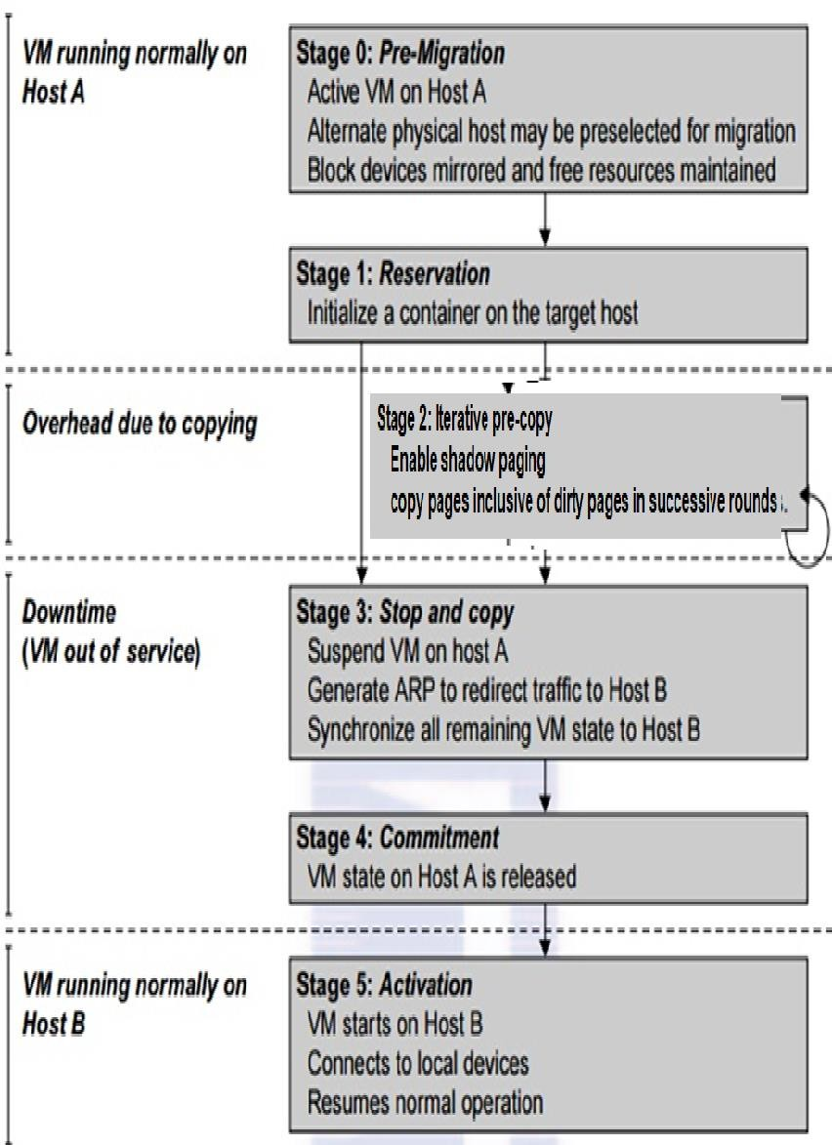
CLOUD COMPUTING
Live VM migrations : Pre-Copy technique - 2
Stop and transfer VM State
Suspend the VM and copy the last portion of the data. This happens when the last round’s memory data is transferred.
Other non-memory data such as CPU and network states should be sent as well. During this step, the VM is stopped and its applications will no longer run. This “service unavailable” time is called the
“downtime” of migration, which should be as short as possible so that
it can be negligible to users.
Commitment
VM activation at the destination server
Commit and activate the new host.
After all the needed data is copied, on the destination host, the VM reloads the states and recovers the execution of programs in it, and
the service provided by this VM continues.
Then the network connection is redirected to the new VM and the
dependency to the source host is cleared.
The whole migration process finishes by removing the original VM from the source host.

Slide 117
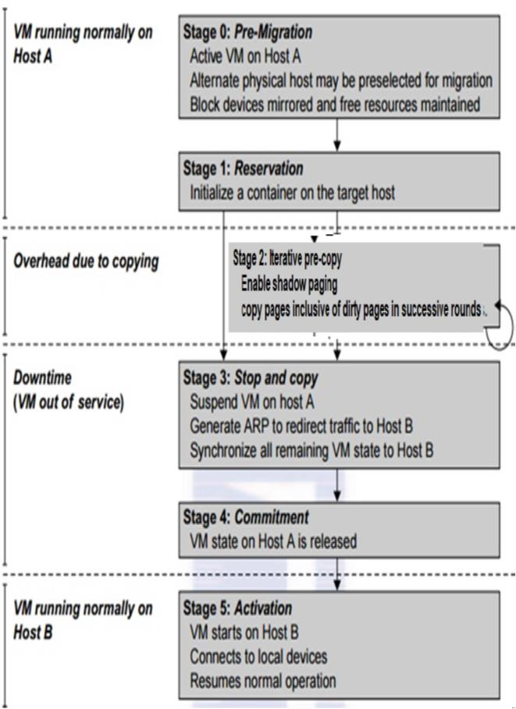
CLOUD COMPUTING
Live VM migrations : Pre-Copy technique - 3
Advantages :
Low VM downtime (required for copying the remaining dirty pages)
Pre copy migration is advantageous in cases of few memory transfers
Disadvantage :
Repeated copying of dirty pages can increase the whole migration time
This could result in greater transfer time and downtime in case of more memory transfers
E.g. KVM, Xen, and VMware hypervisor use the pre-copy technique for live VM migration.

Slide 118
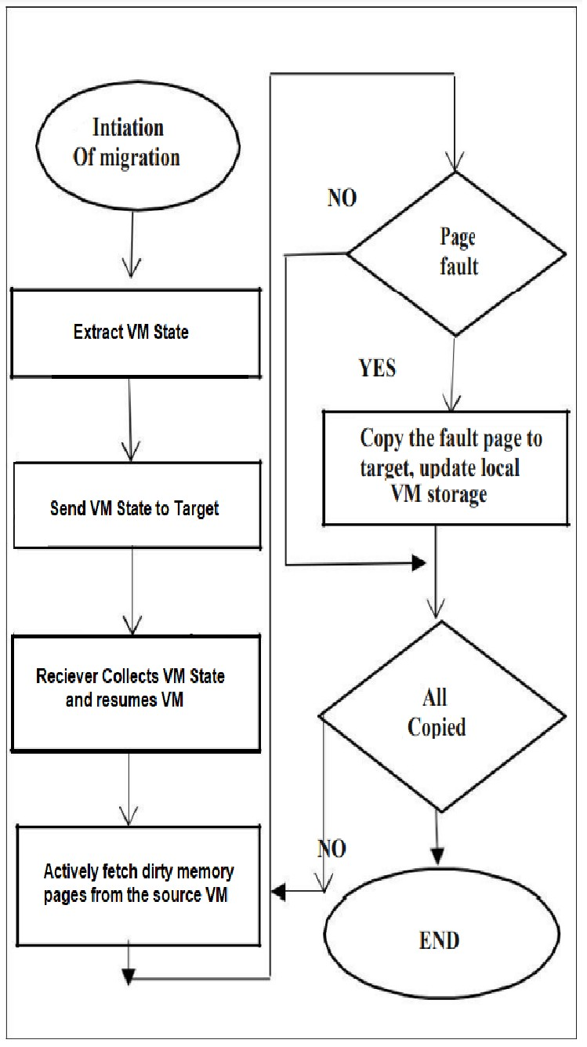
CLOUD COMPUTING
Live VM migrations : Post-Copy technique - 1
In post-copy migration technique, processor state is transferred to the destination server before memory content
The prior transfer of process states to the destination machine in this scheme enables the VM to resume instantly at the target machine.
The memory contents of VM are copied to destination from source while VM is
running on the target host almost at once.
Memory faults are generated for the memory pages that have not been fetched yet, and where the missing pages are to be fetched from source machine.
As excess and repetitive memory faults can result in significant disruption in the service quality, which is addressed by considering different techniques to lower the number of page faults.
E.g. Demand Paging, Active Push, Memory Prepaging
Demand paging: In this technique, when VM resumes on the target machine,
requesting memory pages for read/write operation results in page faults, the faulty pages are serviced by retransmission from the source server. This servicing of faulty pages degrades the application performance but provides a simple and slowest
option.

Slide 119
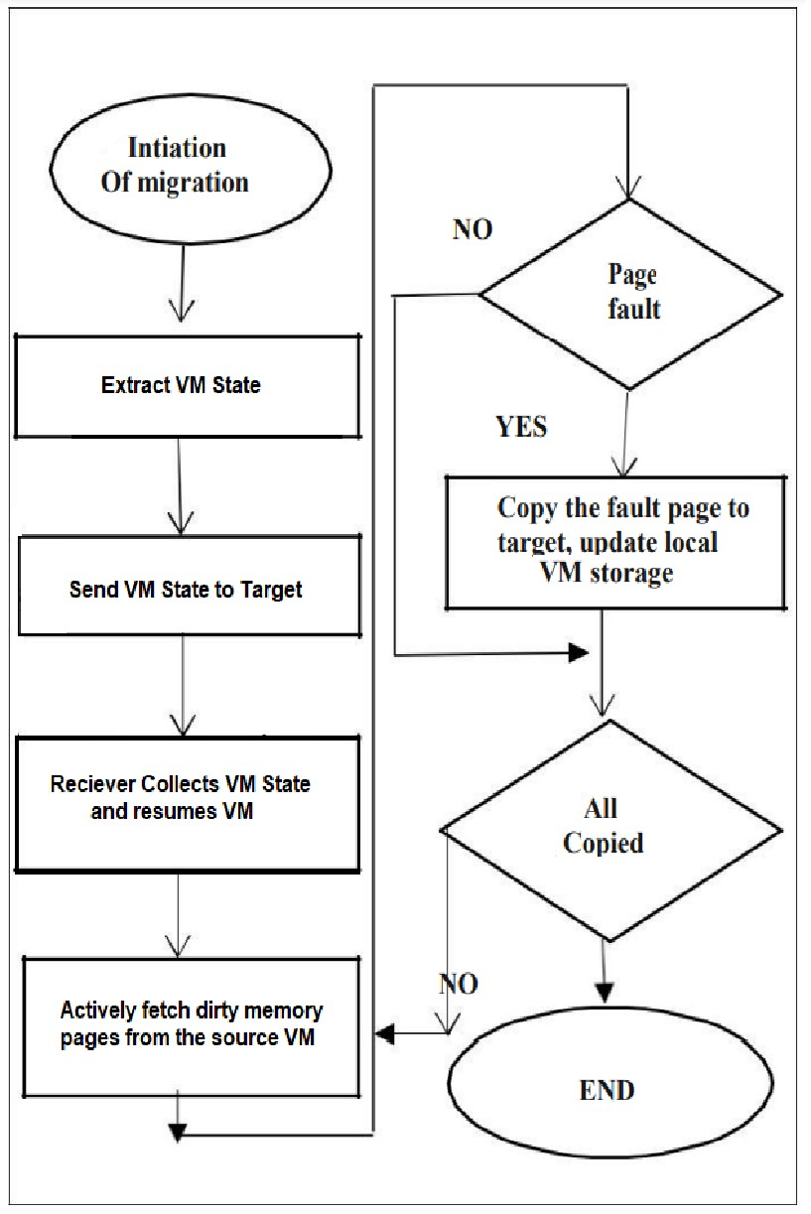
CLOUD COMPUTING
Live VM migrations : Post-Copy technique - 2
Active push: It removes residual dependencies from the source server and it pro-actively pushes the VM pages to destination server even when VM is running on the destination server. If a page fault occurs at destination VM then demand paging is used to deal with fault. Therefore, pages are sent only once either via active push or demand paging.
Memory prepaging approach assumes VM memory access in time and location and predicts the corresponding memory pages which has high demand probability and makes the page pushing to be more efficient and thus reducing memory faults
These could have their service downtimes and total migration times affected by similar page re-transmission.

Slide 120
CLOUD COMPUTING
Live VM migrations : Post-Copy technique - 3
Disadvantages
There is a challenge to reduce the overhead of Post copy migration technique occurs due to the generation of page faults at different time intervals during execution of VM at destination host. Each time, VM is suspended at destination host and waiting for re-transmission of required memory pages from source host to continue.
There is a need to minimize the amount of data transfer (memory pages and CPU state) over
the network, between clusters of hosts to save the money and time that is spent on network.
The repetition in page fault detection is a main drawback of post copy approach, it should be optimized to reduce the number of cycles of memory re-transmission from source host it will increase the reliability of post copy migration technique

Slide 121
CLOUD COMPUTING
Issues to be handled with VM migration : Memory Migration
Memory which needs to be migrated can be in a range of hundreds of megabytes to a few
gigabytes in a typical system today, and it needs to be done in an efficient manner.
The Internet Suspend-Resume (ISR) technique exploits temporal locality as memory states are likely to have considerable overlap in the suspended and the resumed instances of a VM. Temporal locality refers to the fact that the memory states differ only by the amount of work done since a VM was last suspended before being initiated for migration.
Implementations use a representation of a tree of small subfiles which exists with both the suspended and resumed VM Instances. This caching helps to send only those which have changed, but the downtime may be high.
Refs: https://www.brainkart.com/article/Migration-of-Memory,-Files,-and-Network-Resources_11346/ https://www.researchgate.net/publication/3958192_Internet_suspendresume

Slide 122
CLOUD COMPUTING
Issues to be handled with VM migration : File System Migration (Cont.)
To support VM migration, a system must provide each VM with a consistent, location-independent view of the file system that is available on all hosts.
This may be achieved by providing each VM with its own virtual disk which the file system is mapped to and transport the contents of this virtual disk along with the other states of the VM. The current large capacity disks may make it feasible to send it over the network.
Another way is to have a global file system across all machines where a VM could be located. This way removes the need to copy files from one machine to another because all files are network accessible.

Slide 123
CLOUD COMPUTING
Issues to be handled with VM migration : Network Migration (Cont.)
Migrating VM should maintain all open network connections without relying on forwarding
mechanisms on the original host or on support from mobility or redirection mechanisms.
To enable remote systems to locate and communicate with a VM, each VM must be assigned a virtual IP address known to other entities. This address can be distinct from the IP address of the host machine where the VM is currently located.
Each VM can also have its own distinct virtual MAC address.
The VMM maintains a mapping of the virtual IP and MAC addresses to their corresponding VMs.
In general, a migrating VM includes all the protocol states and carries its IP address with it.

Slide 124
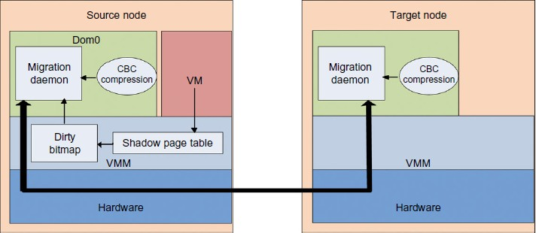
CLOUD COMPUTING
Example: Live migration of VM between two Xen-enabled hosts
Domain 0 (or Dom0) performs tasks to create, terminate, or migrate to another host. Xen uses a send/recv model to transfer states across VMs.

Slide 125
CLOUD COMPUTING
Live migration of VM between two Xen-enabled hosts explained
Migration daemons running in the management VMs are responsible for performing migration.
Characteristic Based Compression (CBC) algorithm compresses the memory pages adaptively.
  Adaptive compression is a type of data compression which changes compression algorithms based on the type of data being compressed.
Shadow page tables in the VMM layer trace modifications to the memory page in migrated VMs
during the precopy phase. Corresponding flags are set in a dirty bitmap
At the start of each precopy round, the bitmap is sent to the migration daemon. Then, the bitmap is cleared and the shadow page tables are destroyed and re-created in the next round.
The system resides in Xen’s management VM. Memory pages denoted by bitmap are extracted
and compressed before they are sent to the destination.
The compressed data is then decompressed on the target.

Slide 126
CLOUD COMPUTING
Additional Reading
https://www.cse.iitb.ac.in/~cs695/papers/livemigration.pdf
How to migrate on premise VM to AWS https://www.youtube.com/watch?v=GTHxL8U0PiI
How to migrate your VM to AWS
https://www.youtube.com/watch?v=_SpRpC2Ez9c

Slide 127
THANK YOU
Prafullata Kiran Auradkar
Department of Computer Science and Engineering
prafullatak@pes.edu

Slide 128
CLOUD COMPUTING
Lightweight virtualization – Containers, namespaces, cgroups
&
Deployment of cloud native applications through Docker, UnionFS
Dr. Prafullata Kiran Auradkar
Department of Computer Science and Engineering
Acknowledgements:
Significant information in the slide deck presented through the Unit 2 of the course have been created by Dr. H.L. Phalachandra and would like to acknowledge and thank him for the same. There have been some information which I might have leveraged from the content of Dr. K.V. Subramaniam’s lecture contents too. I may have supplemented the same with contents from books and other sources from Internet and would like to sincerely thank, acknowledge and reiterate that the credit/rights for the same remain with the original authors/publishers only. These are intended for classroom presentation only.

Slide 129
CLOUD COMPUTING
Containers – Definitions
Linux Containers or LXC is an operating-system-level virtualization method for running multiple isolated Linux systems (containers) which can run multiple workloads, on a control host running a single linux OS instance
LXC provides a virtual environment that has its own process and network space and does not create a full-fledged virtual machine.
LXC uses Linux kernel cgroups and namespace isolation functionality to achieve the same.
Motivation
VMs support the objective of virtualizing the physical systems and allowing multiple tenants/applications to be isolated and share the physical resources along with Access control
One of the challenges as observed is, this isolation achieved by or provided by VM is expensive
Traditional OSs supporting multiple application processes, but share a disk, with all the processes capable of seeing the entire filesystem with access control built on top, and also share a network.
Containers using a light weight mechanism, provide this virtualization extending the isolation provided by
our traditional OS
Lxc (tools) is an user space toolset for creating & managing Linux Containers – different from LXC Linux containers

Slide 130

CLOUD COMPUTING
Container Characteristics
Containers sit on top of a physical server and its host OS.
Each container shares the host OS kernel and, usually, the binaries and libraries too, but as read-only. This reduces the management overhead where a single OS needs to be maintained for bug fixes, patches, and so on.
Containers are thus exceptionally “light”—they are only megabytes in size and take just seconds to start, versus gigabytes and minutes for a VM.
  Container creation is similar to process creation and it has speed, agility and portability.
  Thus containers have higher provisioning performance

Slide 131

CLOUD COMPUTING
Containers (Cont.)
A basic computer stack running two programs that were started from the command line
Notice that the command-line interface, or CLI, runs in what is called user space memory, just like other programs that run on top of the operating system.
Ideally, programs running in user space can’t modify kernel space memory.
Broadly speaking, the operating system is the interface between all user programs and the hardware that the computer is running on.

Slide 132

CLOUD COMPUTING
Contrasting Containers vs VMs
Each VM includes a separate OS image, which adds overhead in memory and storage footprint.
Containers reduce management overhead as they share a common OS, only a single OS needs to be maintained for bug fixes, patches, and so on.
In terms of performance, VMs have to boot when provisioned
making it slower, and also have I/O performance overhead
Containers have higher performance as its creation is similar to process creation, so boots quickly and it has speed, agility and portability
VMs are more flexible as Hardware is virtualized to run
multiple OS instances.
Containers run on a single OS and also can support only Ubuntu containers of that type of OS where its running or containers cannot be of different OS variants
VMs consume more resources and come up slower than Containers which come up more quickly and consume fewer
resources

Slide 133

CLOUD COMPUTING
VM vs Docker
More resource usage | Less resource usage

Slide 134

CLOUD COMPUTING
Docker
Docker is an open platform tool which makes it easier to create, test, ship, deploy and to execute applications using containers.
Docker containers allow us to separate the applications from the infrastructure enabling faster deployment of applications/software
It significantly reduces the time between writing code and running it in
production by providing methodologies for shipping, testing and deploying code quickly
It can be considered as a tool that helps to package and run an application in a loosely isolated environment called a container.
It could be looked at as a PaaS product that uses OS level virtualization to deliver S/W
packages
Docker provides the isolation and security to allow many containers to run on a single server or virtual machine
Its typical to find between 8 -18 containers running simultaneously on a single server/VM

Slide 135
CLOUD COMPUTING
Docker (Cont.)
Containers created using Docker can contain everything needed to run an application, so you do not need to rely on what is currently installed on the host system
Docker allows these containers to be shared in a way that it would work identically.
Docker can be used with network applications such as web servers, databases, mail servers, with terminal applications like text editors, compilers, network analysis tools, and scripts.
  In some cases, it’s even used to run GUI applications such as web browsers and
productivity software.
Docker runs on Linux software on most systems.
  Docker is also available as a native application for both macOS and Windows
  Docker can run native Windows applications on modern Windows server machines.

Slide 136



CLOUD COMPUTING
Docker Benefits
Portability, Shipping Applications
Portability
Developers use Version Control Systems (VCS) like Git. DevOps also uses VCS for docs, scripts and Dockerfiles.
DevOps could use Dockerfile to describes how to build the image, and something like docker-compose.yml to describe how to orchestrate them.

Slide 137

CLOUD COMPUTING
Docker Architecture
Docker uses a client-server architecture.
The Docker client talks to the Docker daemon, which does the heavy lifting of building, running, and
distributing your Docker containers.
The Docker client and daemon can run on the same system, or you can connect a Docker client to a remote Docker daemon.
Docker client and daemon communicate using a REST API, over UNIX sockets or a network interface.
Another Docker client is Docker Compose, that lets you work with applications consisting of a set of containers.
Reference:https://docs.docker.com/get-started/overview/

Slide 138

CLOUD COMPUTING
Docker Architecture
The Docker daemon
The Docker daemon (dockerd) listens for Docker API requests and manages Docker objects such as images, containers, networks, and volumes.
A daemon can also communicate with other daemons to manage Docker services.
The Docker client
The Docker client (docker) is the primary way that many Docker users interact with Docker.
When you use commands such as docker run, the client sends these commands to ’dockerd’ (docker daemon), which carries them out.
The docker command uses the Docker API.
The Docker client can communicate with more than one daemon.

Slide 139
CLOUD COMPUTING
Docker Architecture
Docker Host
Docker Host has the Docker Daemon running and can host (like a private hub/registry) or connect (like to a public docker_hub/registry) to a Docker Registry which stores the Docker Images.
The Docker Daemon running within Docker Host is responsible for the Docker Objects images and
containers.
Docker Objects :
There are objects like
Images
Containers
Networks
Volumes
Plugins and other objects which are created and used while using docker.

Slide 140
CLOUD COMPUTING
Docker Objects : Images
Images : This is a read-only template with instructions for creating a Docker container. This could be based on another image (available in the registry) with additional customizations. Eg. Image for a Webserver .. Original image of Ubuntu customized with installation and configuration of the webserver which is created only as a read-only image which can be deployed and an application can be run in the same.
This is done using a Dockerfile a script file which defines the syntax to indicate steps needed to
create the image (and run using a run command).
Each instruction in a Dockerfile creates a layer in the image.
These Dockerfiles are distributed along with software that the author wants to be put into an image. In this case, you’re not technically installing an image. Instead, you’re following instructions to build an image.

Slide 141
CLOUD COMPUTING
Docker Objects : Images – More on Dockerfile
Distributing a Dockerfile is similar to distributing image files using your own distribution mechanisms. A common pattern is to distribute a Dockerfile with software from common version-control systems like Git.
  If you have Git installed, you can try this by running an example from a public repository:
    git clone https://github.com/dockerinaction/ch3_dockerfile.git
    docker build -t dia_ch3/dockerfile:latest ch3_dockerfile
In this example, you copy the project from a public source repository onto your computer and then build and install a Docker image by using the Dockerfile included with that project. The value provided to the -t option of docker build is the repository where you want to install the image.
Building images from Dockerfile is a light way to move projects around that fits into existing workflows. Could lead to an unfavourable experience in case of a drift in dependencies between the time when the Dockerfile was authored and when an image is built on a user’s computer.
Docker Images can be removed or cleaned up with
docker rmi dia_ch3/dockerfile
rm -rf ch3_dockerfile
Docker Commands – Video Ref: https://www.youtube.com/watch?v=nXV6qihj5uw

Slide 142



Slide 143


Slide 144


Slide 145


Slide 146



Slide 147

CLOUD COMPUTING
Docker Objects : Images - layers
Specification for a Docker Image is stored in Dockerfile
  Should be only one for a container
  Only the definition of the image
Image is built from Dockerfile
Specifies the read-only file systems in which various programs
are installed E.g. web server + libraries
Each instruction in a Dockerfile creates a layer in the image.
A layer is set of files and file metadata that is packaged and distributed as an atomic unit.
  Internally, Docker treats each layer like an image, and layers are often called intermediate images.
  You can even promote a layer to an image by tagging it.
  Most layers build upon a parent layer by applying filesystem changes to the parent.
  Whenever there is a change in the Dockerfile and the image is rebuilt, only the incremental changes are
rebuilt (making it light weight, small and fast when compared to other virtualized technologies)

Slide 148


CLOUD COMPUTING
Docker Objects : Images & Docker Registries
Image + temporary R/W file system
  Used as temporary storage
  Deleted when container is destroyed
Multiple containers can use the same image & their own
temporary storage
Docker registries:
A Docker registry stores Docker images.
Docker Hub is a public registry that anyone can use, and Docker is configured to look for images on Docker Hub by default.
You can even run your own private registry.
When you use the docker pull or docker run commands, the required images are pulled from your configured registry.
When you use the docker push command, your image is pushed to your configured registry.
https://docs.docker.com/storage/storagedriver/

Slide 149

CLOUD COMPUTING
Docker Objects : Containers
Docker Containers are the ready applications created from Docker Images. Or you can say they are running instances of the Images and they hold the entire package needed to run the application Or it could also be looked at as a runnable instance of an image Or an execution environment (sandbox).
We can create, start, stop, move, or delete a container using the Docker API or CLI.
A container can be connected to one or more networks. Storage could be attached to it, or even new image
could be created based on its current state.
A container is relatively well isolated from other containers and its host machine and this isolation can also be controlled. Processes in the container cannot access non-shared objects of other containers, and can only access a subset of the objects (like files) on the physical machine.
Docker creates a set of name spaces when a container is created. These namespaces restrict what the objects processes in a container can see e.g. a subset of files
A container is defined by its image and the configuration options provided to it when its created or started.
When a container is removed, any changes to its state that are not stored in persistent storage will disappear

Slide 150

CLOUD COMPUTING
Docker running three containers on a basic Linux computer system
Running Docker means running two programs in user space.
  The first is the Docker engine that should always be running.
  The second is the Docker CLI. This is the Docker program that users interact with to start, stop, or install software
Each container is running as a child process of the Docker engine, wrapped with a container, and the delegate process is running in its own memory subspace of the user space.
  Programs running inside a container can access only their own memory and resources as scoped by the container.
Docker can be looked at as a set of PaaS products that use OS-level virtualization to deliver software in packages called containers.

Slide 151


CLOUD COMPUTING
Running a program with Docker
What happens after running
docker run
The image itself is a collection
of files and metadata which includes the specific program to execute and other relevant
configuration details
  Running docker run a second time.
  The image is already installed, so Docker can start the new container right
away.

Slide 152

CLOUD COMPUTING
Namespaces – What’s in a Name in CS?
If you can’t name an object, you can’t access it. E.g. Web site – if name is hidden, can’t access
Paging : Processes can access only pages in its name spaces but cannot access physical page 1 (i.e. frame number 1 in
the diagram)
Namespaces are a feature of the Linux kernel that partitions kernel resources such that one set of processes sees one set of resources and another set of processes sees a different set of resources.
A namespace wraps a global system resource in an abstraction that makes it appear to the processes within the namespace that they have their own isolated instance of the global resource
The feature works by having the same namespace (with a name) for a group of resources and
processes, but those namespaces refer to distinct resources
A physical computer can have more than one namespaces (two or more)
All the resources that a process sees can be considered a namespace
  The files seen by a process is the file namespace
  The network connections are part of network namespace
Container Access is restricted to only subset of objects (e.g., files) on the physical machine using
these namespaces. Restriction is applied on what can be seen by the object processes in a container e.g.
  To restrict process (and container) to a subset of files use file namespace

Slide 153
CLOUD COMPUTING
Docker used Namespaces
Docker builds containers at runtime using 10 major system features. Docker commands can be used to illustrate and modify features to suit the needs of the contained software and to fit the environment where the container will run.
The specific features are as follows (a few of them are discussed in a little more detail):
  PID namespace—Process isolation through identifiers (PID number) – not aware of what happens outside its own processes
  UTS namespace—allows for having multiple hostnames on a single physical host - Host and domain name (as other things like IP can change)
  MNT namespace—isolate a set of mount points such that processes in different namespaces cannot view each others files. (almost like chroot) (Filesystem access & structure)
  IPC namespace—provides isolation to container process communication over shared
memory and having an ability to invite other processes to read from the shared memory
https://www.redhat.com/sysadmin/7-linux-namespaces

Slide 154
CLOUD COMPUTING
Docker used Namespaces (Cont.)
NET namespace—allow processes inside each namespace instance to have access to a new IP address along with the full range of ports - Network access and structure
USR namespace—provides user name-UID mapping isolating changes in names from the metadata within a container
chroot syscall—Controls the location of the filesystem root
cgroups—Controlling and accounting resources –rather than a hierarchical cgroup creation, there is a new cgroup with a root directory created to isolate resources and not allow navigation
CAP drop—Operating system feature restrictions
Security modules—Mandatory access controls
https://www.redhat.com/sysadmin/7-linux-namespaces

Slide 155


















CLOUD COMPUTING
Access Control of objects : Illustration of name space (in this case MNT)
Processes
  in container 1 can access
    Shared files in /usr
    Non-shared /mnt
    Cannot access /mnt2
  in container 2 can access
    Shared files in /usr
    Non-shared /mnt2
    Cannot access /mnt
These are two different namespaces
Container 1
Container 2
//
mmnntt
uussrr
mmnntt22
bbiinn
ssrrcc
ddiirr11
ddiirr22
DDiirr33

Slide 156





















CLOUD COMPUTING
Linux Filesystems before Namespaces
/ is the root file system
  Contains vmunix – the OS
  usr, bin, src are all subdirectories
O1, O2 are volumes containing different versions of an application (e.g., Oracle)
Mounted at /mnt and /mnt2
This namespace is visible to all processes
Access to files and directories controlled by access rights
/
mnt
usr
mnt2
bin
src
O1
O2
dir1
dir2
Dir3

Slide 157



















CLOUD COMPUTING
Linux Filesystems after Namespaces
File namespace: mount namespace
O1, O2 are volumes containing different versions
of an application (e.g., Oracle)
  Mounted at /mnt and /mnt2
This namespace is visible to all processes
Access to files and directories controlled by
access rights
Which namespace is process in?
/
mnt
mnt 2
usr
bin
src
O1
O2
Look at /proc/pid/ns
ls –l for /proc/pidx/mnt may show as below
(4026531840 is the namespace id)
dir1
dir2
dir3
lrwxrwxrwx. 1 mtk mtk 0 Jan 8 04:12 mnt -> mnt:[4026531840]

Slide 158



Slide 159
CLOUD COMPUTING
Illustration of Namespace Operations : E.g. MNT Namespace
Creation of Namespace
To create a namespace, must create a process with that namespace
pid = clone(childFunc, stackTop, CLONE_NEWNS | SIGCHLD, argv[1]);
Creates a new child, like fork()
NEWNS flag indicates that child has a new mount namespace
Child can do mount and umount to modify namespace
Programs to be joining into a namespace Allows program to join an existing namespace int setns
// namespace to join
// type of ns
int unshare (int flags); // which namespace
CLONE_NEWNS specifies mount namespace
Similar to clone(); allows caller to create a new namespace
(int fd,
int nstype);

Slide 160


Slide 161


Slide 162




Slide 163
CLOUD COMPUTING
UTS (Unix Time Sharing) Namespace
“global” (i.e. root) namespace
UTS NS
globalhost rootns.com
Per namespace
  Hostname
  NIS domain name (Network Information Service)
Reported by commands such as hostname
Processes in namespace can change UTS values – only reflected in the child namespace
Allows containers to have their own FQDN (Fully qualified Domain Name)
“green” namespace
UTS NS
greenhost greenns.org
“red” namespace
UTS namespace is about isolating hostnames.
The UTS namespace is used to isolate two specific elements of the system that relate to the uname system call.
The UTS(UNIX Time Sharing) namespace is named after the data structure used to
store information returned by the uname system call.
UTS NS
redhost
redns.com

Slide 164


Slide 165
CLOUD COMPUTING
NET namespace
It’s a virtual network barrier encapsulating a process to isolate its network connectivity (in/out) and resources (i.e. network interfaces, route tables and rules) from linux core and other processes.
It allow processes inside each namespace instance to have access to per namespace network objects
  Network devices (ethernets)
  Bridges
  Routing tables
  IP addresses
  ports
Various commands support network namespace such as ip
“global” (i.e. root) namespace
app3 IP:7000
NET NS
lo: UNKNOWN…
eth0: UP… eth1: UP… br0: UP…
app1 IP:5000 app2 IP:6000
“green” namespace
NET NS
lo: UNKNOWN…
eth0: UP…
app1 IP:1000 app2 IP:7000
“red” namespace
NET NS
lo: UNKNOWN…
eth0: DOWN…
eth1: UP
app1 IP:7000 app2 IP:9000

Slide 166



Slide 167


Slide 168


CLOUD COMPUTING
NET
A VETH (virtual Ethernet) configuration as shown can be used when namespaces need to communicate to the
main host namespace or between each other.
veths – create veth pair, move one inside the namespace and configure
Acts as a pipe between the 2 namespaces
The VETH (virtual Ethernet) device
is a local Ethernet tunnel.
Devices are created in pairs
Packets transmitted on one device in the pair are immediately received on the other device.
When either device is down, the link
state of the pair is down.
https://developers.redhat.com/blog/2018/10/22/introduction-to-linux-interfaces-for-virtual-networking

Slide 169

CLOUD COMPUTING
Filesystem root - chroot name space
The OS has a file system started at root
  /bin, and so on, contain programs and libraries
If you want to run a program which uses a different version of /bin and so on
This can be achieved using chroot
  Mount new /bin on some place (say /mnt)
  Issue chroot /mnt command
  command will then see the root as /mnt, not the real root
Using this technique, can give each process on system its own file system
Changes the root directory for currently running processes as well as it children for
Search paths
Relative directories
Often used when building system images
chroot to temp directory
Download and install packages in chroot
Compress chroot as a system root FS
Using chroot can be escaped given proper capabilities, thus pivot_root is often used instead
chroot; points the processes file system root to new directory
pivot_root; detaches the new root and attaches it to process root directory
pivot_root info at https://man7.org/linux/man-pages/man8/pivot_root.8.html

Slide 170



Slide 171
CLOUD COMPUTING
Cgroups (or Control groups)
Cgroup is a linux feature to limit, police, and account the resource usage for a set of processes. Docker uses cgroups to limit the system resources.
Cgroups - provides mechanisms (fine grain control) to allocate, monitor and limit resources such as CPU time, system memory, block IO or disk bandwidth, network bandwidth, or combinations of these resources — among user-defined groups of tasks (processes) running on a system.
Cgroups works on resource types. So it works by dividing resources into groups and then assigning tasks to those groups, deny access to certain resources, and even reconfigure our cgroups dynamically on a running system.
When you install Docker binary on a linux box like ubuntu it will install cgroup related packages
and create subsystem directories.
Hardware resources can be appropriately divided up among tasks and users, increasing overall efficiency.

Slide 172
CLOUD COMPUTING
Linux cgroups - Functionality
Access
  which devices can be used per cgroup
Resource limiting
  memory, CPU, device accessibility, block I/O, etc.
Prioritization
  who gets more of the CPU, memory, etc.
Accounting
  resource usage per cgroup
Control
  freezing & check pointing
Injection
  packet tagging

Slide 173

CLOUD COMPUTING
Linux cgroups - usage
cgroups are hierarchically structured where each of the groups are created for a
resource with a number.
Tasks are assigned to cgroups
Each cgroups has a resource limitation
There is a hierarchy for each resource

Slide 174

CLOUD COMPUTING
What resources can we limit?
All of the following can be limited for a Cgroup
Memory
CPU
Block IO
Devices (which of the devices and allowing creation of devices ..)
Network

Slide 175


CLOUD COMPUTING
cgroup Examples
Each cgroup has a resource limitation associated with it

Slide 176

CLOUD COMPUTING
What resources can we limit?
When a process creates a child process, the child process stays in the same cgroup
  Good for servers such as NFS
  Typical operation
    Receive request
    Fork child to process request
    Child terminates when request complete
    All children will have resource limitation of parent => the resource limitation of parent will apply to processing requests

Slide 177
Try the following on your docker command line:
docker run -d --name mycontainer --cpus="0.5" ubuntu sleep 1000 docker run -d --name mycontainer --memory=100m ubuntu sleep 1000 docker exec mycontainer cat /sys/fs/cgroup/cpu/cpu.cfs_quota_us
docker exec mycontainer cat /sys/fs/cgroup/memory/memory.limit_in_bytes
docker stats mycontainer docker rm -f mycontainer
Example With stress test:
docker run -d --name mem_test --memory=100m ubuntu sleep 1000
docker exec -it mem_test apt update && apt install -y stress
docker exec -it mem_test stress --vm 1 --vm-bytes 150m --timeout 30s (The container should be killed by the Out of Memory (OOM) killer.)
docker logs mem_test
docker ps -a | grep mem_test
(It should show Exited (137), meaning it was terminated due to OOM.)

Slide 178
CLOUD COMPUTING
Container Filesystem
Programs running inside containers know nothing about image layers.
From inside a container, the filesystem operates as though it’s not running in a container or
operating on an image.
From the perspective of the container, it has exclusive copies of the files provided by the image. This is made possible with something called a union filesystem (UFS).
Docker uses a variety of union filesystems and will select the best fit for your system.
A union filesystem is part of a critical set of tools that combine to create effective filesystem isolation.
The other tools are MNT namespaces and the chroot system call.

Slide 179
CLOUD COMPUTING
Union Filesystem
Union is a type of a filesystem that can create an illusion of merging contents of several directories (created in layers) into one without modifying its original (physical) sources which can be shown in single, merged view
Union file system operates by creating layers, making them very lightweight and fast.
Docker Engine uses UnionFS to provide the building blocks for containers.
Docker Engine can use multiple UnionFS variants, including AUFS, overlay2, btrfs, vfs, and DeviceMapper.
Reference:https://docs.docker.com/get-started/overview/
https://martinheinz.dev/blog/44

Slide 180
CLOUD COMPUTING
unionfs features - Layering
unionfs permits layering of file systems
/Fruits
/Fruits contains files Apple, Tomato
/Vegetables contains Carrots, Tomato
Apple
Tomatoes
mount –t unionfs –o dirs=/Fruits:/Vegetables none /mnt/healthy
/Vegetables
/mnt/healthy has 3 files – Apple, Tomato, Carrots
Tomato comes from /Fruits (1st in dirs option)
Carrots
Tomatoes
As if /Fruits is layered on top of /Vegetables
-o cow option on mount command enables copy on write
CoW layer
If change is made to a file
Original file is not modified
New file is created in a hidden location
/Fruits
Apple
Tomatoes
/Vegetables
If /Fruits is mounted ro (read-only), then changes will be recorded in a
temporary layer
Carrots
Tomatoes
http://www.linuxjournal.com/article/7714

Slide 181


Slide 182

CLOUD COMPUTING
Docker and UnionFS
Incremental Images
Union FS
  Files from separate FS (branches) can be overlaid
  Forming a single coherent FS
  Branches may be read-only or read-write
Docker Layers
Each layer is mounted on top of prior layers
First layer = base image (scratch, busybox,
ubuntu, …)
A read-only layer = an image
The top read-write layer = container
https://www.slideshare.net/cm13/introduction-to-docker-48784005

Slide 183
CLOUD COMPUTING
Weaknesses of Union Filesystem
Different filesystems have different rules about file attributes, sizes, names, and
characters.
Union filesystems are in a position where they often need to translate between the rules of different filesystems. In the best cases, they’re able to provide acceptable translations. In the worst cases, features are omitted.
Union filesystems use a pattern called copy-on-write, and that makes implementing
memory-mapped files (the mmap system call) difficult.
Most issues that arise with writing to the union filesystem can be addressed without changing the storage provider. These can be solved with volumes
The union filesystem is not appropriate for working with long-lived data or sharing data
between containers, or a container and the host.

Slide 184
CLOUD COMPUTING
Summary
Use namespaces for controlling resource access
  Docker has developed their own namespace technology called namespaces to provide the isolated workspace called the container.
  When you run a container, Docker creates a set of namespaces for that
container.
  These namespaces provide a layer of isolation.
Use cgroups for resource sharing

Slide 185

CLOUD COMPUTING
Container Software
Docker
AWS Fargate
Google Kubernetes Engine
Amazon ECS
LXC
Microsoft Azure
Google Cloud Platform
Core OS

Slide 186
CLOUD COMPUTING
Additional References
Containers vs VMs
https://www.redhat.com/en/topics/containers/containers-vs-vms
Docker container
https://www.simplilearn.com/tutorials/docker-tutorial/what-is-docker-container
https://www.xda-developers.com/best-docker-containers-for-developers/
Understanding Linux containers https://www.redhat.com/en/topics/containers
https://www.cio.com/article/2924995/what-are-containers-and-why-do-you-need-them.html

Slide 187
CLOUD COMPUTING
Additional Reading
https://access.redhat.com/documentation/en-US/Red_Hat_Enterprise_Linux/6/html/Resource_Management_Guide/sec-Relationships_Between_Subsystems_Hierarchies_Control_Groups_and_Tasks.html
https://en.wikipedia.org/wiki/Cgroups
https://www.youtube.com/watch?v=sK5i-N34im8
  Cgroups, namespaces and beyond: What are containers made from – Jerome Pettazzoni, Docker
https://www.youtube.com/watch?v=nXV6qihj5uw
https://access.redhat.com/documentation/en-US/Red_Hat_Enterprise_Linux/6/html/Resource_Management_Guide/sec-Relationships_Between_Subsystems_Hierarchies_Control_Groups_and_Tasks.html

Slide 188
THANK YOU
Prafullata Kiran Auradkar
Department of Computer Science and Engineering
prafullatak@pes.edu

Slide 189
CLOUD COMPUTING
Lightweight virtualization – Containers, namespaces, cgroups
&
Deployment of cloud native applications through Docker, UnionFS
Dr. Prafullata Kiran Auradkar
Department of Computer Science and Engineering
Acknowledgements:
Significant information in the slide deck presented through the Unit 2 of the course have been created by Dr. H.L. Phalachandra and would like to acknowledge and thank him for the same. There have been some information which I might have leveraged from the content of Dr. K.V. Subramaniam’s lecture contents too. I may have supplemented the same with contents from books and other sources from Internet and would like to sincerely thank, acknowledge and reiterate that the credit/rights for the same remain with the original authors/publishers only. These are intended for classroom presentation only.

Slide 190
CLOUD COMPUTING
Containers – Definitions
Linux Containers or LXC is an operating-system-level virtualization method for running multiple isolated Linux systems (containers) which can run multiple workloads, on a control host running a single linux OS instance
LXC provides a virtual environment that has its own process and network space and does not create a full-fledged virtual machine.
LXC uses Linux kernel cgroups and namespace isolation functionality to achieve the same.
Motivation
VMs support the objective of virtualizing the physical systems and allowing multiple tenants/applications to be isolated and share the physical resources along with Access control
One of the challenges as observed is, this isolation achieved by or provided by VM is expensive
Traditional OSs supporting multiple application processes, but share a disk, with all the processes capable of seeing the entire filesystem with access control built on top, and also share a network.
Containers using a light weight mechanism, provide this virtualization extending the isolation provided by
our traditional OS
Lxc (tools) is an user space toolset for creating & managing Linux Containers – different from LXC Linux containers

Slide 191
CLOUD COMPUTING
Container Characteristics
Containers sit on top of a physical server and its host OS.
Each container shares the host OS kernel and, usually, the binaries and libraries too, but as read-only. This reduces the management overhead where a single OS needs to be maintained for bug fixes, patches, and so on.
Containers are thus exceptionally “light”—they are only megabytes in size and take just seconds to start, versus gigabytes and minutes for a VM.
  Container creation is similar to process creation and it has speed, agility and portability.
  Thus containers have higher provisioning performance

Slide 192
CLOUD COMPUTING
Containers (Cont.)
A basic computer stack running two programs that were started from the command line
Notice that the command-line interface, or CLI, runs in what is called user space memory, just like other programs that run on top of the operating system.
Ideally, programs running in user space can’t modify kernel space memory.
Broadly speaking, the operating system is the interface between all user programs and the hardware that the computer is running on.

Slide 193
CLOUD COMPUTING
Contrasting Containers vs VMs
Each VM includes a separate OS image, which adds overhead in memory and storage footprint.
Containers reduce management overhead as they share a common OS, only a single OS needs to be maintained for bug fixes, patches, and so on.
In terms of performance, VMs have to boot when provisioned
making it slower, and also have I/O performance overhead
Containers have higher performance as its creation is similar to process creation, so boots quickly and it has speed, agility and portability
VMs are more flexible as Hardware is virtualized to run
multiple OS instances.
Containers run on a single OS and also can support only Ubuntu containers of that type of OS where its running or containers cannot be of different OS variants
VMs consume more resources and come up slower than Containers which come up more quickly and consume fewer
resources

Slide 194
CLOUD COMPUTING
VM vs Docker
More resource usage | Less resource usage

Slide 195
CLOUD COMPUTING
Docker
Docker is an open platform tool which makes it easier to create, test, ship, deploy and to execute applications using containers.
Docker containers allow us to separate the applications from the infrastructure enabling faster deployment of applications/software
It significantly reduces the time between writing code and running it in
production by providing methodologies for shipping, testing and deploying code quickly
It can be considered as a tool that helps to package and run an application in a loosely isolated environment called a container.
It could be looked at as a PaaS product that uses OS level virtualization to deliver S/W
packages
Docker provides the isolation and security to allow many containers to run on a single server or virtual machine
Its typical to find between 8 -18 containers running simultaneously on a single server/VM

Slide 196
CLOUD COMPUTING
Docker (Cont.)
Containers created using Docker can contain everything needed to run an application, so you do not need to rely on what is currently installed on the host system
Docker allows these containers to be shared in a way that it would work identically.
Docker can be used with network applications such as web servers, databases, mail servers, with terminal applications like text editors, compilers, network analysis tools, and scripts.
  In some cases, it’s even used to run GUI applications such as web browsers and
productivity software.
Docker runs on Linux software on most systems.
  Docker is also available as a native application for both macOS and Windows
  Docker can run native Windows applications on modern Windows server machines.

Slide 197
CLOUD COMPUTING
Docker Benefits
Portability, Shipping Applications
Portability
Developers use Version Control Systems (VCS) like Git. DevOps also uses VCS for docs, scripts and Dockerfiles.
DevOps could use Dockerfile to describes how to build the image, and something like docker-compose.yml to describe how to orchestrate them.

Slide 198
CLOUD COMPUTING
Docker Architecture
Docker uses a client-server architecture.
The Docker client talks to the Docker daemon, which does the heavy lifting of building, running, and
distributing your Docker containers.
The Docker client and daemon can run on the same system, or you can connect a Docker client to a remote Docker daemon.
Docker client and daemon communicate using a REST API, over UNIX sockets or a network interface.
Another Docker client is Docker Compose, that lets you work with applications consisting of a set of containers.
Reference:https://docs.docker.com/get-started/overview/

Slide 199
CLOUD COMPUTING
Docker Architecture
The Docker daemon
The Docker daemon (dockerd) listens for Docker API requests and manages Docker objects such as images, containers, networks, and volumes.
A daemon can also communicate with other daemons to manage Docker services.
The Docker client
The Docker client (docker) is the primary way that many Docker users interact with Docker.
When you use commands such as docker run, the client sends these commands to ’dockerd’ (docker daemon), which carries them out.
The docker command uses the Docker API.
The Docker client can communicate with more than one daemon.

Slide 200
CLOUD COMPUTING
Docker Architecture
Docker Host
Docker Host has the Docker Daemon running and can host (like a private hub/registry) or connect (like to a public docker_hub/registry) to a Docker Registry which stores the Docker Images.
The Docker Daemon running within Docker Host is responsible for the Docker Objects images and
containers.
Docker Objects :
There are objects like
Images
Containers
Networks
Volumes
Plugins and other objects which are created and used while using docker.

Slide 201
CLOUD COMPUTING
Docker Objects : Images
Images : This is a read-only template with instructions for creating a Docker container. This could be based on another image (available in the registry) with additional customizations. Eg. Image for a Webserver .. Original image of Ubuntu customized with installation and configuration of the webserver which is created only as a read-only image which can be deployed and an application can be run in the same.
This is done using a Dockerfile a script file which defines the syntax to indicate steps needed to
create the image (and run using a run command).
Each instruction in a Dockerfile creates a layer in the image.
These Dockerfiles are distributed along with software that the author wants to be put into an image. In this case, you’re not technically installing an image. Instead, you’re following instructions to build an image.

Slide 202
CLOUD COMPUTING
Docker Objects : Images – More on Dockerfile
Distributing a Dockerfile is similar to distributing image files using your own distribution mechanisms. A common pattern is to distribute a Dockerfile with software from common version-control systems like Git.
  If you have Git installed, you can try this by running an example from a public repository:
    git clone https://github.com/dockerinaction/ch3_dockerfile.git
    docker build -t dia_ch3/dockerfile:latest ch3_dockerfile
In this example, you copy the project from a public source repository onto your computer and then build and install a Docker image by using the Dockerfile included with that project. The value provided to the -t option of docker build is the repository where you want to install the image.
Building images from Dockerfile is a light way to move projects around that fits into existing workflows. Could lead to an unfavourable experience in case of a drift in dependencies between the time when the Dockerfile was authored and when an image is built on a user’s computer.
Docker Images can be removed or cleaned up with
docker rmi dia_ch3/dockerfile
rm -rf ch3_dockerfile
Docker Commands – Video Ref: https://www.youtube.com/watch?v=nXV6qihj5uw

Slide 208
CLOUD COMPUTING
Docker Objects : Images - layers
Specification for a Docker Image is stored in Dockerfile
  Should be only one for a container
  Only the definition of the image
Image is built from Dockerfile
Specifies the read-only file systems in which various programs
are installed E.g. web server + libraries
Each instruction in a Dockerfile creates a layer in the image.
A layer is set of files and file metadata that is packaged and distributed as an atomic unit.
  Internally, Docker treats each layer like an image, and layers are often called intermediate images.
  You can even promote a layer to an image by tagging it.
  Most layers build upon a parent layer by applying filesystem changes to the parent.
  Whenever there is a change in the Dockerfile and the image is rebuilt, only the incremental changes are
rebuilt (making it light weight, small and fast when compared to other virtualized technologies)

Slide 209
CLOUD COMPUTING
Docker Objects : Images & Docker Registries
Image + temporary R/W file system
  Used as temporary storage
  Deleted when container is destroyed
Multiple containers can use the same image & their own
temporary storage
Docker registries:
A Docker registry stores Docker images.
Docker Hub is a public registry that anyone can use, and Docker is configured to look for images on Docker Hub by default.
You can even run your own private registry.
When you use the docker pull or docker run commands, the required images are pulled from your configured registry.
When you use the docker push command, your image is pushed to your configured registry.
https://docs.docker.com/storage/storagedriver/

Slide 210
CLOUD COMPUTING
Docker Objects : Containers
Docker Containers are the ready applications created from Docker Images. Or you can say they are running instances of the Images and they hold the entire package needed to run the application Or it could also be looked at as a runnable instance of an image Or an execution environment (sandbox).
We can create, start, stop, move, or delete a container using the Docker API or CLI.
A container can be connected to one or more networks. Storage could be attached to it, or even new image
could be created based on its current state.
A container is relatively well isolated from other containers and its host machine and this isolation can also be controlled. Processes in the container cannot access non-shared objects of other containers, and can only access a subset of the objects (like files) on the physical machine.
Docker creates a set of name spaces when a container is created. These namespaces restrict what the objects processes in a container can see e.g. a subset of files
A container is defined by its image and the configuration options provided to it when its created or started.
When a container is removed, any changes to its state that are not stored in persistent storage will disappear

Slide 211
CLOUD COMPUTING
Docker running three containers on a basic Linux computer system
Running Docker means running two programs in user space.
  The first is the Docker engine that should always be running.
  The second is the Docker CLI. This is the Docker program that users interact with to start, stop, or install software
Each container is running as a child process of the Docker engine, wrapped with a container, and the delegate process is running in its own memory subspace of the user space.
  Programs running inside a container can access only their own memory and resources as scoped by the container.
Docker can be looked at as a set of PaaS products that use OS-level virtualization to deliver software in packages called containers.

Slide 212
CLOUD COMPUTING
Running a program with Docker
What happens after running
docker run
The image itself is a collection
of files and metadata which includes the specific program to execute and other relevant
configuration details
  Running docker run a second time.
  The image is already installed, so Docker can start the new container right
away.

Slide 213
CLOUD COMPUTING
Namespaces – What’s in a Name in CS?
If you can’t name an object, you can’t access it. E.g. Web site – if name is hidden, can’t access
Paging : Processes can access only pages in its name spaces but cannot access physical page 1 (i.e. frame number 1 in
the diagram)
Namespaces are a feature of the Linux kernel that partitions kernel resources such that one set of processes sees one set of resources and another set of processes sees a different set of resources.
A namespace wraps a global system resource in an abstraction that makes it appear to the processes within the namespace that they have their own isolated instance of the global resource
The feature works by having the same namespace (with a name) for a group of resources and
processes, but those namespaces refer to distinct resources
A physical computer can have more than one namespaces (two or more)
All the resources that a process sees can be considered a namespace
  The files seen by a process is the file namespace
  The network connections are part of network namespace
Container Access is restricted to only subset of objects (e.g., files) on the physical machine using
these namespaces. Restriction is applied on what can be seen by the object processes in a container e.g.
  To restrict process (and container) to a subset of files use file namespace

Slide 214
CLOUD COMPUTING
Docker used Namespaces
Docker builds containers at runtime using 10 major system features. Docker commands can be used to illustrate and modify features to suit the needs of the contained software and to fit the environment where the container will run.
The specific features are as follows (a few of them are discussed in a little more detail):
  PID namespace—Process isolation through identifiers (PID number) – not aware of what happens outside its own processes
  UTS namespace—allows for having multiple hostnames on a single physical host - Host and domain name (as other things like IP can change)
  MNT namespace—isolate a set of mount points such that processes in different namespaces cannot view each others files. (almost like chroot) (Filesystem access & structure)
  IPC namespace—provides isolation to container process communication over shared
memory and having an ability to invite other processes to read from the shared memory
https://www.redhat.com/sysadmin/7-linux-namespaces

Slide 215
CLOUD COMPUTING
Docker used Namespaces (Cont.)
NET namespace—allow processes inside each namespace instance to have access to a new IP address along with the full range of ports - Network access and structure
USR namespace—provides user name-UID mapping isolating changes in names from the metadata within a container
chroot syscall—Controls the location of the filesystem root
cgroups—Controlling and accounting resources –rather than a hierarchical cgroup creation, there is a new cgroup with a root directory created to isolate resources and not allow navigation
CAP drop—Operating system feature restrictions
Security modules—Mandatory access controls
https://www.redhat.com/sysadmin/7-linux-namespaces

Slide 216
CLOUD COMPUTING
Access Control of objects : Illustration of name space (in this case MNT)
Processes
  in container 1 can access
    Shared files in /usr
    Non-shared /mnt
    Cannot access /mnt2
  in container 2 can access
    Shared files in /usr
    Non-shared /mnt2
    Cannot access /mnt
These are two different namespaces
Container 1
Container 2
//
mmnntt
uussrr
mmnntt22
bbiinn
ssrrcc
ddiirr11
ddiirr22
DDiirr33

Slide 217
CLOUD COMPUTING
Linux Filesystems before Namespaces
/ is the root file system
  Contains vmunix – the OS
  usr, bin, src are all subdirectories
O1, O2 are volumes containing different versions of an application (e.g., Oracle)
Mounted at /mnt and /mnt2
This namespace is visible to all processes
Access to files and directories controlled by access rights
/
mnt
usr
mnt2
bin
src
O1
O2
dir1
dir2
Dir3

Slide 218
CLOUD COMPUTING
Linux Filesystems after Namespaces
File namespace: mount namespace
O1, O2 are volumes containing different versions
of an application (e.g., Oracle)
  Mounted at /mnt and /mnt2
This namespace is visible to all processes
Access to files and directories controlled by
access rights
Which namespace is process in?
/
mnt
mnt 2
usr
bin
src
O1
O2
Look at /proc/pid/ns
ls –l for /proc/pidx/mnt may show as below
(4026531840 is the namespace id)
dir1
dir2
dir3
lrwxrwxrwx. 1 mtk mtk 0 Jan 8 04:12 mnt -> mnt:[4026531840]

Slide 220
CLOUD COMPUTING
Illustration of Namespace Operations : E.g. MNT Namespace
Creation of Namespace
To create a namespace, must create a process with that namespace
pid = clone(childFunc, stackTop, CLONE_NEWNS | SIGCHLD, argv[1]);
Creates a new child, like fork()
NEWNS flag indicates that child has a new mount namespace
Child can do mount and umount to modify namespace
Programs to be joining into a namespace Allows program to join an existing namespace int setns
// namespace to join
// type of ns
int unshare (int flags); // which namespace
CLONE_NEWNS specifies mount namespace
Similar to clone(); allows caller to create a new namespace
(int fd,
int nstype);

Slide 224
CLOUD COMPUTING
UTS (Unix Time Sharing) Namespace
“global” (i.e. root) namespace
UTS NS
globalhost rootns.com
Per namespace
  Hostname
  NIS domain name (Network Information Service)
Reported by commands such as hostname
Processes in namespace can change UTS values – only reflected in the child namespace
Allows containers to have their own FQDN (Fully qualified Domain Name)
“green” namespace
UTS NS
greenhost greenns.org
“red” namespace
UTS namespace is about isolating hostnames.
The UTS namespace is used to isolate two specific elements of the system that relate to the uname system call.
The UTS(UNIX Time Sharing) namespace is named after the data structure used to
store information returned by the uname system call.
UTS NS
redhost
redns.com

Slide 226
CLOUD COMPUTING
NET namespace
It’s a virtual network barrier encapsulating a process to isolate its network connectivity (in/out) and resources (i.e. network interfaces, route tables and rules) from linux core and other processes.
It allow processes inside each namespace instance to have access to per namespace network objects
  Network devices (ethernets)
  Bridges
  Routing tables
  IP addresses
  ports
Various commands support network namespace such as ip
“global” (i.e. root) namespace
app3 IP:7000
NET NS
lo: UNKNOWN…
eth0: UP… eth1: UP… br0: UP…
app1 IP:5000 app2 IP:6000
“green” namespace
NET NS
lo: UNKNOWN…
eth0: UP…
app1 IP:1000 app2 IP:7000
“red” namespace
NET NS
lo: UNKNOWN…
eth0: DOWN…
eth1: UP
app1 IP:7000 app2 IP:9000

Slide 229
CLOUD COMPUTING
NET
A VETH (virtual Ethernet) configuration as shown can be used when namespaces need to communicate to the
main host namespace or between each other.
veths – create veth pair, move one inside the namespace and configure
Acts as a pipe between the 2 namespaces
The VETH (virtual Ethernet) device
is a local Ethernet tunnel.
Devices are created in pairs
Packets transmitted on one device in the pair are immediately received on the other device.
When either device is down, the link
state of the pair is down.
https://developers.redhat.com/blog/2018/10/22/introduction-to-linux-interfaces-for-virtual-networking

Slide 230
CLOUD COMPUTING
Filesystem root - chroot name space
The OS has a file system started at root
  /bin, and so on, contain programs and libraries
If you want to run a program which uses a different version of /bin and so on
This can be achieved using chroot
  Mount new /bin on some place (say /mnt)
  Issue chroot /mnt command
  command will then see the root as /mnt, not the real root
Using this technique, can give each process on system its own file system
Changes the root directory for currently running processes as well as it children for
Search paths
Relative directories
Often used when building system images
chroot to temp directory
Download and install packages in chroot
Compress chroot as a system root FS
Using chroot can be escaped given proper capabilities, thus pivot_root is often used instead
chroot; points the processes file system root to new directory
pivot_root; detaches the new root and attaches it to process root directory
pivot_root info at https://man7.org/linux/man-pages/man8/pivot_root.8.html

Slide 232
CLOUD COMPUTING
Cgroups (or Control groups)
Cgroup is a linux feature to limit, police, and account the resource usage for a set of processes. Docker uses cgroups to limit the system resources.
Cgroups - provides mechanisms (fine grain control) to allocate, monitor and limit resources such as CPU time, system memory, block IO or disk bandwidth, network bandwidth, or combinations of these resources — among user-defined groups of tasks (processes) running on a system.
Cgroups works on resource types. So it works by dividing resources into groups and then assigning tasks to those groups, deny access to certain resources, and even reconfigure our cgroups dynamically on a running system.
When you install Docker binary on a linux box like ubuntu it will install cgroup related packages
and create subsystem directories.
Hardware resources can be appropriately divided up among tasks and users, increasing overall efficiency.

Slide 233
CLOUD COMPUTING
Linux cgroups - Functionality
Access
  which devices can be used per cgroup
Resource limiting
  memory, CPU, device accessibility, block I/O, etc.
Prioritization
  who gets more of the CPU, memory, etc.
Accounting
  resource usage per cgroup
Control
  freezing & check pointing
Injection
  packet tagging

Slide 234
CLOUD COMPUTING
Linux cgroups - usage
cgroups are hierarchically structured where each of the groups are created for a
resource with a number.
Tasks are assigned to cgroups
Each cgroups has a resource limitation
There is a hierarchy for each resource

Slide 235
CLOUD COMPUTING
What resources can we limit?
All of the following can be limited for a Cgroup
Memory
CPU
Block IO
Devices (which of the devices and allowing creation of devices ..)
Network

Slide 236
CLOUD COMPUTING
cgroup Examples
Each cgroup has a resource limitation associated with it

Slide 237
CLOUD COMPUTING
What resources can we limit?
When a process creates a child process, the child process stays in the same cgroup
  Good for servers such as NFS
  Typical operation
    Receive request
    Fork child to process request
    Child terminates when request complete
    All children will have resource limitation of parent => the resource limitation of parent will apply to processing requests

Slide 238
Try the following on your docker command line:
docker run -d --name mycontainer --cpus="0.5" ubuntu sleep 1000 docker run -d --name mycontainer --memory=100m ubuntu sleep 1000 docker exec mycontainer cat /sys/fs/cgroup/cpu/cpu.cfs_quota_us
docker exec mycontainer cat /sys/fs/cgroup/memory/memory.limit_in_bytes
docker stats mycontainer docker rm -f mycontainer
Example With stress test:
docker run -d --name mem_test --memory=100m ubuntu sleep 1000
docker exec -it mem_test apt update && apt install -y stress
docker exec -it mem_test stress --vm 1 --vm-bytes 150m --timeout 30s (The container should be killed by the Out of Memory (OOM) killer.)
docker logs mem_test
docker ps -a | grep mem_test
(It should show Exited (137), meaning it was terminated due to OOM.)

Slide 239
CLOUD COMPUTING
Container Filesystem
Programs running inside containers know nothing about image layers.
From inside a container, the filesystem operates as though it’s not running in a container or
operating on an image.
From the perspective of the container, it has exclusive copies of the files provided by the image. This is made possible with something called a union filesystem (UFS).
Docker uses a variety of union filesystems and will select the best fit for your system.
A union filesystem is part of a critical set of tools that combine to create effective filesystem isolation.
The other tools are MNT namespaces and the chroot system call.

Slide 240
CLOUD COMPUTING
Union Filesystem
Union is a type of a filesystem that can create an illusion of merging contents of several directories (created in layers) into one without modifying its original (physical) sources which can be shown in single, merged view
Union file system operates by creating layers, making them very lightweight and fast.
Docker Engine uses UnionFS to provide the building blocks for containers.
Docker Engine can use multiple UnionFS variants, including AUFS, overlay2, btrfs, vfs, and DeviceMapper.
Reference:https://docs.docker.com/get-started/overview/
https://martinheinz.dev/blog/44

Slide 241
CLOUD COMPUTING
unionfs features - Layering
unionfs permits layering of file systems
/Fruits
/Fruits contains files Apple, Tomato
/Vegetables contains Carrots, Tomato
Apple
Tomatoes
mount –t unionfs –o dirs=/Fruits:/Vegetables none /mnt/healthy
/Vegetables
/mnt/healthy has 3 files – Apple, Tomato, Carrots
Tomato comes from /Fruits (1st in dirs option)
Carrots
Tomatoes
As if /Fruits is layered on top of /Vegetables
-o cow option on mount command enables copy on write
CoW layer
If change is made to a file
Original file is not modified
New file is created in a hidden location
/Fruits
Apple
Tomatoes
/Vegetables
If /Fruits is mounted ro (read-only), then changes will be recorded in a
temporary layer
Carrots
Tomatoes
http://www.linuxjournal.com/article/7714

Slide 243
CLOUD COMPUTING
Docker and UnionFS
Incremental Images
Union FS
  Files from separate FS (branches) can be overlaid
  Forming a single coherent FS
  Branches may be read-only or read-write
Docker Layers
Each layer is mounted on top of prior layers
First layer = base image (scratch, busybox,
ubuntu, …)
A read-only layer = an image
The top read-write layer = container
https://www.slideshare.net/cm13/introduction-to-docker-48784005

Slide 244
CLOUD COMPUTING
Weaknesses of Union Filesystem
Different filesystems have different rules about file attributes, sizes, names, and
characters.
Union filesystems are in a position where they often need to translate between the rules of different filesystems. In the best cases, they’re able to provide acceptable translations. In the worst cases, features are omitted.
Union filesystems use a pattern called copy-on-write, and that makes implementing
memory-mapped files (the mmap system call) difficult.
Most issues that arise with writing to the union filesystem can be addressed without changing the storage provider. These can be solved with volumes
The union filesystem is not appropriate for working with long-lived data or sharing data
between containers, or a container and the host.

Slide 245
CLOUD COMPUTING
Summary
Use namespaces for controlling resource access
  Docker has developed their own namespace technology called namespaces to provide the isolated workspace called the container.
  When you run a container, Docker creates a set of namespaces for that
container.
  These namespaces provide a layer of isolation.
Use cgroups for resource sharing

Slide 246
CLOUD COMPUTING
Container Software
Docker
AWS Fargate
Google Kubernetes Engine
Amazon ECS
LXC
Microsoft Azure
Google Cloud Platform
Core OS

Slide 247
CLOUD COMPUTING
Additional References
Containers vs VMs
https://www.redhat.com/en/topics/containers/containers-vs-vms
Docker container
https://www.simplilearn.com/tutorials/docker-tutorial/what-is-docker-container
https://www.xda-developers.com/best-docker-containers-for-developers/
Understanding Linux containers https://www.redhat.com/en/topics/containers
https://www.cio.com/article/2924995/what-are-containers-and-why-do-you-need-them.html

Slide 248
CLOUD COMPUTING
Additional Reading
https://access.redhat.com/documentation/en-US/Red_Hat_Enterprise_Linux/6/html/Resource_Management_Guide/sec-Relationships_Between_Subsystems_Hierarchies_Control_Groups_and_Tasks.html
https://en.wikipedia.org/wiki/Cgroups
https://www.youtube.com/watch?v=sK5i-N34im8
  Cgroups, namespaces and beyond: What are containers made from – Jerome Pettazzoni, Docker
https://www.youtube.com/watch?v=nXV6qihj5uw
https://access.redhat.com/documentation/en-US/Red_Hat_Enterprise_Linux/6/html/Resource_Management_Guide/sec-Relationships_Between_Subsystems_Hierarchies_Control_Groups_and_Tasks.html

Slide 249
THANK YOU
Prafullata Kiran Auradkar
Department of Computer Science and Engineering
prafullatak@pes.edu

Slide 250
CLOUD COMPUTING
DevOps
Dr. Prafullata Kiran Auradkar
Department of Computer Science and Engineering
Acknowledgements:
Significant information in the slide deck presented through the Unit 2 of the course have been created by Dr. H.L. Phalachandra and would like to acknowledge and thank him for the same. There have been some information which I might have leveraged from the content of Dr. K.V. Subramaniam’s lecture contents too. I may have supplemented the same with contents from books and other sources from Internet and would like to sincerely thank, acknowledge and reiterate that the credit/rights for the same remain with the original authors/publishers only. These are intended for classroom presentation only.

Slide 251
CLOUD COMPUTING
Definition
DevOps is a set of practices that combines software development and IT operations (development and operations) where each of them are independent specialist jobs.
It aims to shorten the system development life cycle (SDLC) and increase an organizational ability to deliver (Deploy and Support) applications and services
DevOps is complementary with Agile software development; several DevOps aspects came from Agile methodology

Slide 252

CLOUD COMPUTING
DevOps Definition (Cont.)
DevOps is a set of practices that automates the processes between software development and IT teams, in order that they can build, test, and release software faster and more reliably.
Operations Org
Development Org
Have quite different goals and incentives, which often conflicted with each other.
It follows Plan, Build, Deploy, Operate cycle.
Docker and Kubernetes are 2 of 10 most used DevOps tools now. Git is another one.

Slide 253
CLOUD COMPUTING
Motivational Problem
You have built and tested the containerized application
You learnt how to deploy your application using Docker
As customers require more features,
  What do you do?
Let’s look at some engineering issues
https://www.iltam.org/check_download_nopass.php?forcedownload=1&file=files/DevOpsconfpresentationSandrine1.pptx &no_encrypt=true&dlpassword=20426

Slide 254
CLOUD COMPUTING
SDLC – Software Development Life Cycle
Customer generates requirements
Do a design
Different teams work on different components
Integrated together
Then tested for
  Functionality
  Similarity to customer deployment
Then for deployment, need to talk to customers IT team.
  Manages deployment, scaling, run time issues with the application

Slide 255


CLOUD COMPUTING
Dev & Ops Typical Conversation
What are the dependencies?
No machines available…
Which DB?
High Availability?
Scalability?
Put the current release live, NOW!
It works on my machine We need this Yesterday
You are using the wrong version

Slide 256

CLOUD COMPUTING
Make the balance between Dev & Ops
In pre-cloud era, requires a lot of manual intervention like procuring machines, etc.
With cloud – automation is possible

Slide 257

CLOUD COMPUTING
Cloud SDLC
Customer generates requirements
Do a design
Different teams work on different components
Integrated together
Then tested for
DEV
OPS
Functionality
Similarity to customer deployment
Then for deployment, need to talk to cloud IT team.
  Handles deployment, scaling, monitoring
So, what are the challenges?

Slide 258
CLOUD COMPUTING
Advantages
Faster Time to Market – checkins more often, so can build and test more often.
Quality of Code/Release - improved because of frequent testing
Integration Often
Deploy Often – changes reach the customers often
Automated – Repeatable and faster
Every one is happy (Hopefully!!)

Slide 259




CLOUD COMPUTING
Automation : Principles of Continuous Delivery
Principle #1
Every build is a potential release
Principle #3 Automate wherever possible
Principle #4
Have automated tests you can trust
Principle #2 Eliminate manual bottlenecks

Slide 260

CLOUD COMPUTING
Keep it Simple
Reduce risk of Release
Make small changes and Test it every cycle
Small changes can make the difference for Ops & Dev

Slide 261

CLOUD COMPUTING
Automate all the things
Programming Model to enable scale
Manage source code
Reproducible Build
  Build on a Prod-Like environment
  No more “Works on my machine”
Test
  Testing reduces risks
  Make you more confident
Deploy
  Deploy to Dev
  Deploy to QA
  Deploy to Pre-Prod
  Prod

Slide 262

CLOUD COMPUTING
DevOps Pipeline
Typical pipeline for containerized applications might look like the following:
A developer pushes his/her code changes to Git.
The build system automatically builds the current version of the code and runs some sanity tests.
If all tests pass, the container image will be published into the central container registry.
The newly built container is deployed automatically to a staging environment.
The staging environment undergoes some automated acceptance tests.
The verified container image is deployed to production.

Slide 263
CLOUD COMPUTING
Continuous Development
This includes continuous code development, continuous integration and continuous Build
  Developers distributed across geographies
  Consistent coding style
  Need to keep the changes in sync
  Can’t rely on mailing individual changes
  Everyone needs to have a common view of the code.
Continuous integration (CI): the automatic merging of the code, Requires every module to compile (Build) correctly and then do sanity testing of developers’ changes against the mainline branch.
If you’re making changes on a branch that would break the build when merged to the mainline, continuous integration will let you know that right away, rather than waiting until you finish your branch and do the final merge.
Tool : Source Code Version Management Systems like git, ClearCase, Maven, ANT, Jenkins, Travis CI, or Drone are often used to automate build pipelines

Slide 264
CLOUD COMPUTING
Continuous Delivery / Continuous Testing / Continuous Deployment
Continuous delivery is the frequent shipping of sanitized builds to a given environment (such as test or
production) for automatic developments.
This could be done using tools like Jenkins the open source Java based application which automates many parts of the software delivery pipeline
Continuous Testing
Continuous testing is the process of executing predominantly automated tests as part of the software delivery pipeline for validating the code to ensure that the application works as envisaged and is free of bugs or defects and can be continuously deployed
These tests are typically designed to be executed with minimum wait times and provide the earliest possible feedback & support detection (or prevention) of the risks that are most critical for the business or organization that is associated with the software release candidate.
(Cont.)

Slide 265
CLOUD COMPUTING
Continuous Delivery / Continuous Testing / Continuous Deployment
Continuous testing (Cont.)
This would involve activities like
Copy individual binaries to staging environment to the right directories
Configure it correctly, ensure dependent libraries are installed
Execute different categories of the planned tests (e.g. Integration tests, functionality, performance or acceptance tests) (Could use tools like Junit, Selenium)
Generate reports
Continuous deployment (CD) is the automatic deployment of successful builds to production managed centrally.
Developers should be able to deploy new versions by either pushing a button, or merging a merge
request, or pushing a Git release tag.

Slide 266

CLOUD COMPUTING
Continuous Deployment (Cont.)
This is when the application is actually used
by the customer Setup the environment
Specify the type of infrastructure that you need in terms of machine types – Chef Provisioning (Machines, storage)
Consider Immutable infrastructure which
does not change enabling easier automation
Specify the configuration that you need – Puppet, Chef Recipe/Cookbooks
The set of docker images and their scaling
policy, setup load balancer etc.
Jenkins: Is the workflow
automation server
Tools
Tools to setup the infrastructure: Chef/Puppet/Kubernetes
Docker – create a docker image with all dependencies for each of the services

Slide 267
CLOUD COMPUTING
Jenkins
Jenkins is a very widely adopted CD tool. There is also a newer dedicated side project for running Jenkins in Kubernetes cluster, JenkinsX.
Jenkins is a self-contained, open source automation server which can be used to automate all sorts of tasks related to building, testing, and delivering or deploying software.
Jenkins can be installed through native system packages, Docker, or even run
standalone by any machine with a Java Runtime Environment (JRE) installed.

Slide 268
CLOUD COMPUTING
Additional References
https://www.guru99.com/jenkins-tutorial.html https://www.guru99.com/devops-tutorial.html
References: (useful for Cloud lab experiment) https://www.jenkins.io/doc/ https://www.jenkins.io/doc/book/pipeline/ https://jenkins-x.io/

Slide 269
THANK YOU
Prafullata Kiran Auradkar
Department of Computer Science and Engineering
prafullatak@pes.edu

Slide 270
CLOUD COMPUTING
Orchestration and Kubernetes
Dr. Prafullata Kiran Auradkar
Department of Computer Science and Engineering
Acknowledgements:
Significant information in the slide deck presented through the Unit 2 of the course have been created by Dr. H.L. Phalachandra and would like to acknowledge and thank him for the same. There have been some information which I might have leveraged from the content of Dr. K.V. Subramaniam’s lecture contents too. I may have supplemented the same with contents from books and other sources from Internet and would like to sincerely thank, acknowledge and reiterate that the credit/rights for the same remain with the original authors/publishers only. These are intended for classroom presentation only.

Slide 271

CLOUD COMPUTING
Container and Orchestration Recap - Basics
Containers offer a way to package code, a runtime, system tools, system libraries, and configs altogether. This shipment is a lightweight, standalone executable. This way, your application will behave the same every time no matter where it runs (e.g. Ubuntu, Windows, etc.).
Container orchestration automates the deployment, management, scaling, and networking of containers.This could involve deploying containers on a compute cluster consisting of multiple nodes
Container orchestration can be used in any environment where you use containers, to help deploy the same application across different environments without needing to redesign it.
Managing the lifecycle of containers with Orchestration supports DevOps teams to integrate into CI/CD workflows
Container Management tools extend lifecycle management capabilities to complex, multi-container workloads deployed on a cluster of machines
https://devopedia.org/container-orchestration

Slide 272

CLOUD COMPUTING
Container orchestration
Container orchestrator: Its a piece of centralized management software that allocates and schedules containers to run on a pool of servers (different machines in a cluster):
  Operations teams, too, find their workload greatly simplified by containers.
  Instead of having to maintain a sprawling estate of machines of various kinds,
architectures, and operating systems, all they have to do is run a container orchestrator
The terms Orchestration and Scheduling are often used loosely as synonyms.
Strictly though, orchestration in this context means coordinating and sequencing different activities in service of a common goal (like the musicians in an orchestra).
Scheduling means managing the resources available and assigning/deploying workloads where they can most efficiently be run.

Slide 273
CLOUD COMPUTING
Container orchestration (Cont.)
An important activity of container orchestration is cluster management: joining multiple physical or virtual servers into a unified, reliable, fault-tolerant, apparently seamless group.
Containers providing this computation environment is considered Immutable
  Immutable infrastructure is an infrastructure paradigm in which servers are never modified
after they’re deployed.
  If something needs to be updated, fixed, or modified in any way, new servers built from a common image with the appropriate changes are provisioned to replace the old ones.
  The benefits of an immutable infrastructure include more consistency and reliability in your infrastructure and a simpler, more predictable deployment process.
  It mitigates or entirely prevents issues that are common in mutable infrastructures, like configuration drift
  It also enables comprehensive deployment automation, fast server provisioning in a cloud
computing environment.

Slide 274
CLOUD COMPUTING
Container orchestration (Cont.)
Kubernetes is the most pervasive container orchestration platform to address these challenges.
  Kubernetes is an open-source container management (orchestration) tool.
  It’s container management responsibilities include container deployment, scaling &
descaling of containers & container load balancing.
  It lets you manage complex application deployments quickly in a predictable and reliable manner.

Slide 275
CLOUD COMPUTING
Container orchestration (Cont.)
Container orchestration is used to control and automate many tasks:
  Provisioning and deployment
  Configuration and scheduling
  Resource allocation between containers and manage the networking between them
  Container availability and redundancy management
  Scaling or removing containers based on balancing workloads across host infrastructure
  Load balancing and traffic routing
  Monitoring container and host health
  Configuring applications based on the container in which they will run
  Keeping interactions between containers secure
  Migration of containers from one host to another for supporting failures, shortage of resources etc.

Slide 276

CLOUD COMPUTING
Where does Container orchestration fit within the system stack?
Container Orchestration mediates between the apps/services and the container runtimes
Service Management: Labels (represents Key-Value pairs that are attached to objects such as pods and used to specify identifying attributes of objects) , groups (collection of related functionality), namespaces (a way to organize clusters into virtual sub-clusters), dependencies, load balancing, readiness checks.
Scheduling: Allocation, replication, (container)
resurrection, rescheduling, rolling deployment,
upgrades, downgrades.
Resource Management: Memory, CPU, GPU,
volumes, ports, IPs.

Slide 277

CLOUD COMPUTING
Container orchestration – Different Tools which support Orchestration
Docker Swarm: Provides native clustering functionality for Docker containers, which turns a group of Docker engines into a single, virtual Docker engine.
Google Container Engine: Google Container Engine, built on Kubernetes, can run Docker containers on the Google Cloud.
Kubernetes: An orchestration system for Docker containers. It handles scheduling and manages workloads based on user-defined parameters.
Amazon ECS: The ECS supports Docker containers and lets you run applications on a managed cluster of Amazon EC2 instances.

Slide 278


CLOUD COMPUTING
Kubernetes (also know as K8s) Basics
Kubernetes as seen earlier is a container or microservice platform that orchestrates computing, networking, and storage infrastructure workloads. Kubernetes extends how we scale containerized applications so that we can enjoy all the benefits of a truly immutable infrastructure
Understanding the K8S, will need the understanding the objects used as the building block of the application lifecycle. This . This include
1. Basic Building objects 2.
Controllers which are several higher-level abstractions Basic K8S objects include
ReplicaSet (RS). Ensures the desired amount of pod is what’s running.
Deployment. Offers declarative updates for pods in an RS.
StatefulSet. A workload API object that manages stateful applications, such as databases.
DaemonSet. Ensures that all or some worker nodes run a copy of a pod. This is useful for daemon applications like Fluentd.
Job. Creates one or more pods, runs a certain task(s) to completion, then deletes the pod(s)
Pod. A group of one or more containers.
Service. An abstraction that defines a logical set of pods as well as the policy and an endpoint for accessing them.
Volume. An abstraction that lets us persist data. (This is necessary because containers are ephemeral—meaning data is deleted when the container is deleted.)
Namespace. A segment of the cluster dedicated to a certain purpose, for example a certain project or team of devs. Typically used to create multiple virtual Kubernetes clusters within a single cluster
https://www.bmc.com/blogs/what-is-kubernetes/
http://kubernetes.io/docs/concepts/overview/what-is-kubernetes/

Slide 279
CLOUD COMPUTING
Kubernetes Building Blocks : Pod
Pod is a single or group of containers that share storage and network within a Kubernetes configuration, telling those containers how to behave.
These are group of containers which are running microservices, of an elastic application and which are communicating with each other (typically, in a non-containerized setup run together on one server).
Pods share storage, Linux namespaces, Cgroups, IP, port address space and can communicate with each other over localhost networking.
Each pod is assigned an IP address on which it can be accessed by other pods within a cluster. Applications within a pod have access to shared volumes – helpful for when you need data to persist beyond the lifetime of a pod.
The containers are co-located, hence share resources and are always scheduled together.
Pods are not intended to live long. They are created, destroyed and re-created on demand, based on the state of the server and the service itself.

Slide 280
CLOUD COMPUTING
Kubernetes Building Blocks : Pod (Cont)
A Pod is scheduled or assigned to a node by the scheduler and the kubelet starts creating containers for that Pod using a container runtime. There are three possible container states: Waiting, Running, and Terminated.
Pods follow a defined lifecycle, starting in the Pending phase, moving through Running if at least one of its primary containers starts OK, and then through either the Succeeded or Failed phases depending on whether any container in the Pod terminated in failure.
Pods are only scheduled once in their lifetime. Once a Pod is scheduled (assigned) to a Node, the Pod runs
on that Node until it stops or is terminated
Whilst a Pod is running, the kubelet is able to restart containers to handle some kind of faults. Within a Pod, Kubernetes tracks different container states and determines what action to take to make the Pod healthy again.
Volumes exists as long as that specific Pod (with that exact UID) exists unless its an persistent volume for shared storage between the containers
Pods do not, by themselves, self-heal. If a Pod is scheduled to a node that then fails, the Pod is deleted;
https://kubernetes.io/docs/concepts/workloads/pods/pod-lifecycle/

Slide 281
CLOUD COMPUTING
Kubernetes - Service
Services is coupling of a set of pods to a policy by which to access them. Services are used to expose containerised applications to originations from outside the cluster
Pods in a Kubernetes deployment are regularly created and destroyed, causing their IP addresses to change constantly. It will create discoverability issues for the deployed application, making it difficult for the application frontend to identify which pods to connect.
To address this K8s introduced the concept of a service, which is an abstraction on top of a number of pods which has a Virtual IP address assigned to it which is exposed and used by the service proxies running on top of it.
Other services communicate with the service via this Virtual IP address, and the service keeps
track of the changes in IP addresses and DNS names of the pods and map them to this virtual IP.
A Kubernetes service is a logical collection of pods in a Kubernetes cluster.
This is where we can configure load balancing for our numerous pods and expose them via a service.

Slide 282
CLOUD COMPUTING
Kubernetes Architecture
A K8S cluster is made of a
Master node, which exposes the API, schedules deployments, and generally manages the cluster. This is the entry point of all administrative tasks. The master node is the one taking care of orchestrating the worker nodes, where the actual services are running.
Worker nodes (multiple of them) can be responsible for container runtime, like Docker.
Master node components
These master node comprises of the following components :
  Kube-apiserver. Exposes the API is the entry points for all the REST commands used to control the cluster
  etcd. Key value stores all cluster data. (Can be run on the same server as a master node or on a dedicated cluster) It’s mainly used for shared configuration and service discovery with info like jobs being scheduled, created and deployed, pod/service details and state, namespaces and replication information
  Kube-scheduler. Has information on the resources available. Schedules new pods on worker nodes.
  Kube-controller-manager. Runs the controllers. Uses apiserver to watch the shared state of the cluster and makes corrective changes to the current state to change it to the desired one.
E.g. of a controller is the Replication controller, which takes care of the number of pods in the system as
configured by the user.

Slide 283

CLOUD COMPUTING
Kubernetes Architecture
Worker node components
Kubelet. Agent that gets the configuration of a pod from the apiserver and ensures that the described containers are up and running.
Kube-proxy. acts as a network proxy and a load balancer for a service on a single worker node. It takes care of the network routing for TCP and UDP packets..
Container runtime. Runs containers.

Slide 284
CLOUD COMPUTING
Kubernetes Functioning
Kubernetes, you will describe the configuration of an application using say a JSON file. The configuration file tells the configuration management tool where to find the container images, how to establish a network, and where to store logs.
When deploying a new container, the container management tool automatically schedules the deployment to a cluster and finds the right host, taking into account any defined requirements or restrictions. The orchestration tool then manages the
container’s lifecycle based on the specifications that were determined in the compose file.

Slide 285
CLOUD COMPUTING
Kubernetes Benefits
Horizontal scaling. Scale your application as needed from command line or UI.
Automated rollouts and rollbacks. Roll out changes in a controlled fashion while monitoring the health of
your application in the container and if something goes wrong, K8S automatically rolls back the change.
Service discovery and load balancing. Kubernetes can expose a containers using a DNS name or IP and based on the load, can do load balancing by distribute traffic.
Storage orchestration. Automatically mount local or public cloud or a network storage.
Secret and configuration management. Kubernetes lets you store and manage sensitive information, such as passwords, OAuth tokens, and SSH keys. You can deploy and update secrets and application configuration without rebuilding your container images, and without exposing secrets in your stack configuration.
Self-healing. The platform heals many problems: restarting failed containers, replacing and rescheduling
containers as nodes die, killing containers that don’t respond to your user-defined health check, and waiting
to advertise containers to clients until they’re ready.
Batch execution. Manage your batch and Continuous Integration workloads and replace failed containers.
Automatic binpacking. Automatically schedules containers based on resource requirements like CPU and memory which the containers need along with other constraints into the same host

Slide 286




Slide 287


Slide 288
THANK YOU
Prafullata Kiran Auradkar
Department of Computer Science and Engineering
prafullatak@pes.edu

