Slide 1

UHV
MY Ambition:
An Engineer’s & Entrepreneur’s Journey
Arjun Vitthal Mankuskar

Slide 2

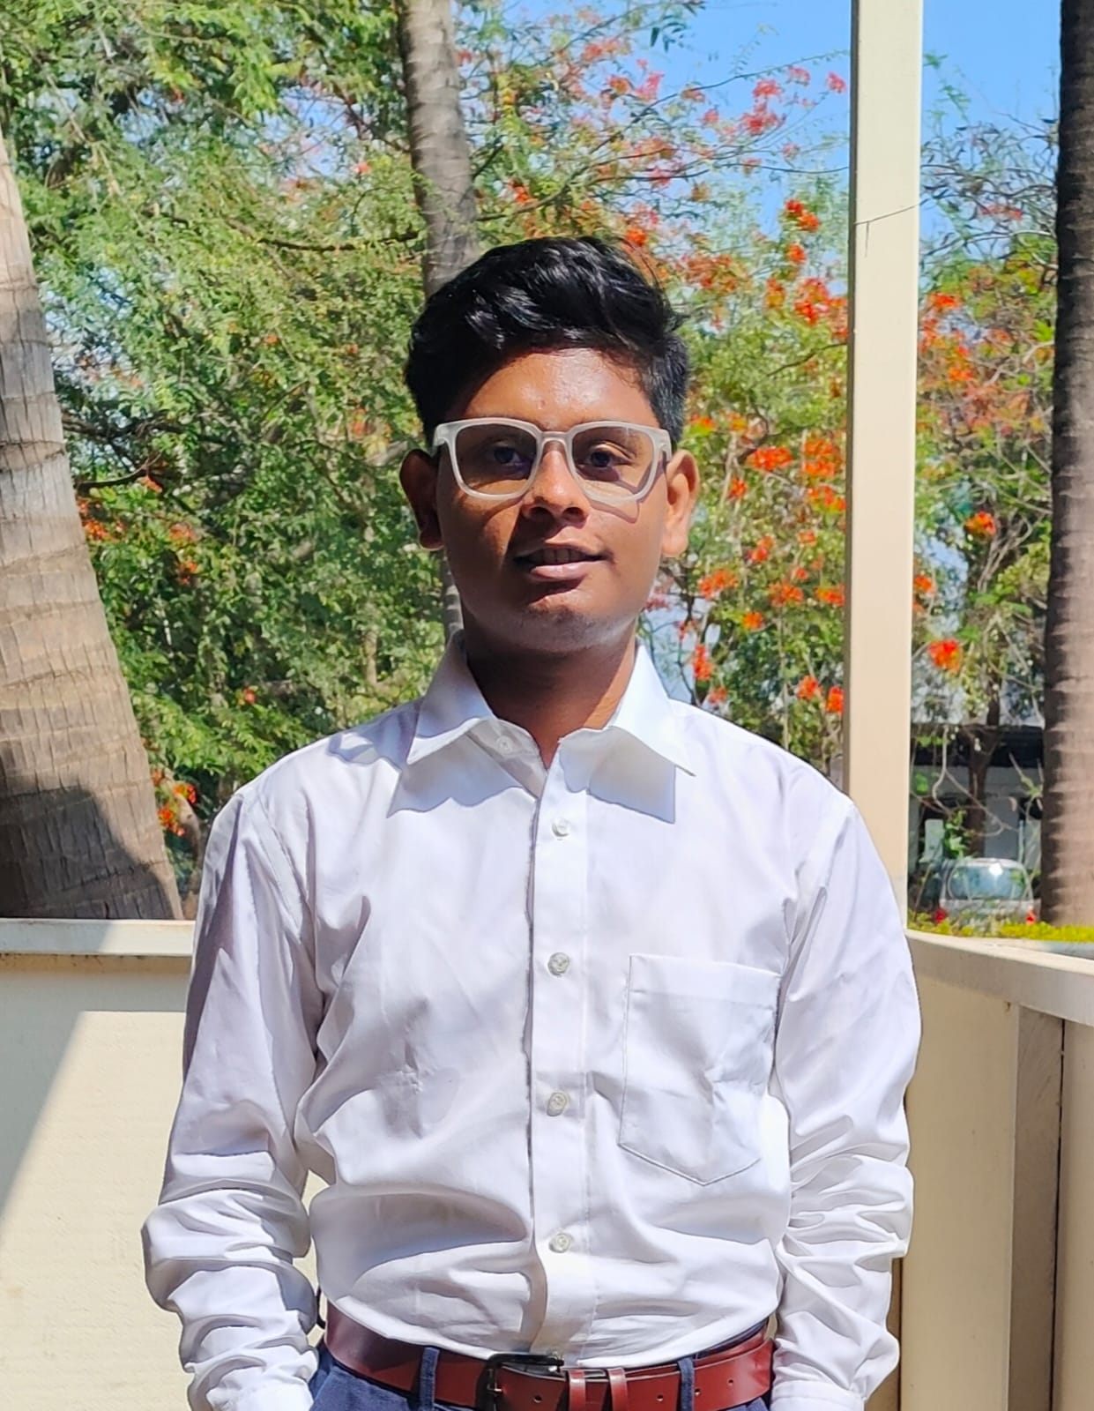
About Me: Arjun Vitthal Mankuskar
Hi, I'm Arjun. At my core, I'm a creative thinker who loves figuring out tough problems.
I'm also a huge technology enthusiast—I just love building new things.
I get a lot of my strength from my family. They've always supported me and taught me the value of learning. My dad is a gold businessman and my mom is a government teacher, and honestly, they're the best parents in the world.

Slide 3
My Ambition
I have two big goals that I'm really excited about.
Expert AI/ML Engineer
Build My Own Business
But I don't want to stop there. Just like my dad, I want to be a successful businessman, too.
For me, these two goals go hand-in-hand. I want to use my tech skills to build something new and create my own business.
This is the path that will help me achieve my personal dreams: to travel the whole world and, as a huge fan of cars and bikes, build my own collection.

Slide 4
Why This Ambition?
So, why these goals? It really comes down to two things.
Passion for Technology
Family Inspiration
First, I've just always been fascinated by technology. The idea of using AI to solve a real-world challenge genuinely excites me.
But the other, and bigger, part is my family. I grew up watching my dad run his own business and my mom dedicate herself to teaching. They both showed me what's possible with hard work and a clear purpose. My ambition is really a mix of my own passion for tech and the amazing example they set for me.

Slide 5
How I'll Get There
Here's my plan to make it all happen:
01
02
Learn Everything I Can
Get My Hands Dirty
First, I'm focused on finishing my education and really mastering all the skills I need for AI and Machine Learning.
I'm going to find internships and projects where I can use these skills in the real world and learn from people who are already doing it.
03
04
Learn the Business Side
Build My Future
Tech skills are one thing, but I'll also be learning about business principles—a lot of it from watching my dad.
The final step is to put it all together: use my tech and business knowledge to start my own projects and, eventually, my own company.

Slide 6
THANK YOU
Name: Arjun Mankuskar
PRN:202401110038
Branch: CSE (AIML)
Batch: A2

