Slide 1
Building a Web-Based Platform for Demonstrating Reflected and Stored XSS Attacks with Mitigations

Slide 2
Agenda
• Introduction
• XSS Overview
• Reflected XSS
• Stored XSS
• Project Implementation
• Mitigations
• Demo & Results
• Conclusion

Slide 3
Introduction
Cross-Site Scripting (XSS) is one of the most common web security issues.
It allows attackers to inject malicious scripts into websites.
This project demonstrates both reflected and stored XSS attacks along with their mitigations.

Slide 4
Types of XSS
• Reflected XSS – malicious input is reflected immediately in the response.
• Stored XSS – malicious input is stored in the database and affects all future visitors.

Slide 5
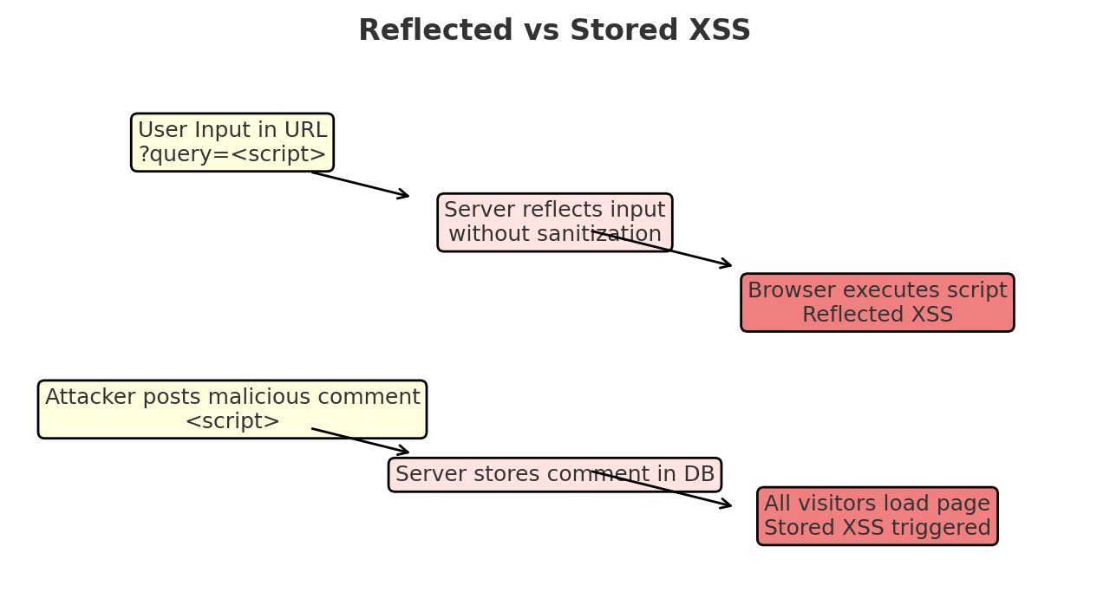

Slide 6
Project Overview
• Web-based demo platform built with Node.js + Express + EJS.
• Demonstrates both vulnerable and safe implementations.
• Teaches students how to exploit and then mitigate XSS.
• Includes guestbook (stored XSS) and search (reflected XSS).

Slide 7
Mitigations
• Input validation and sanitization
• Output encoding / escaping
• Content Security Policy (CSP)
• Use of secure libraries and frameworks
• Avoid inline JavaScript
• HTTP-only and SameSite cookies

Slide 8
Conclusion
• XSS is a critical web vulnerability.
• Reflected and Stored XSS were demonstrated.
• Mitigations show how to prevent attacks.
• Secure coding practices are essential.

