Slide 1


iDetect

Slide 2
Anomaly Detection
Anomaly detection finds unusual patterns in data, crucial for Industrial IoT's predictive maintenance.
Importance:
- Early Detection: Prevents major failures.
- Optimizes Efficiency: Saves costs and resources.
- Examples: Temperature, pressure, vibration irregularities.
Anomaly detection ensures seamless operations in industrial settings.

Slide 3
Anomaly Detection Essentials
Importance:
Prevent Disasters: Early intervention averts major issues.
Cost-Efficient: Reduces repair costs and operational expenses.
Boosts Security: Vital for cybersecurity and breach detection.
Data Precision: Accurate analysis through outlier identification.
Operational Streamlining: Automates identification, enhancing efficiency.
Use Cases:
Fraud Prevention
Network Security
Industrial Monitoring
Healthcare
Manufacturing QC

Slide 4
IoT based Anomaly Detection
Hardware Implementation
Machine Learning Model
Thermal Sensors: Collects real-time thermal data as publishers.
Broker: Facilitates communication, receives sensor data, and forwards it for analysis.
Connectivity: Utilized MQTT for efficient data exchange between sensors and broker.
One-Class SVM: Implemented One-Class Support Vector Machines for anomaly detection.
Feature Engineering: Extracted relevant features from IoT sensor data (temperature).
Model Training: Train the SVM model on historical IoT data for pattern recognition.

Slide 5
Hardware Implementation
Hardware Setup:
Raspberry Pi (Publisher): Collects data from Arduino board with gas and thermal sensors.
Arduino Board: Equipped with analog gas and thermal sensors.
ADC (Analog-to-Digital Converter): Converts analog sensor data to digital format for processing.
Connectivity: MQTT protocol used for communication between devices.
Software Components:
Broker: Facilitates data exchange between publisher (Raspberry Pi) and subscriber (Laptop).
ML Model Integration: Broker triggers the One-Class SVM model for real-time anomaly predictions.
Subscriber (Laptop): Receives analyzed data from the broker for monitoring and analysis.
Network Analysis:
Broker Perspective: Central point for gathering and analyzing data from multiple publishers.

Slide 6
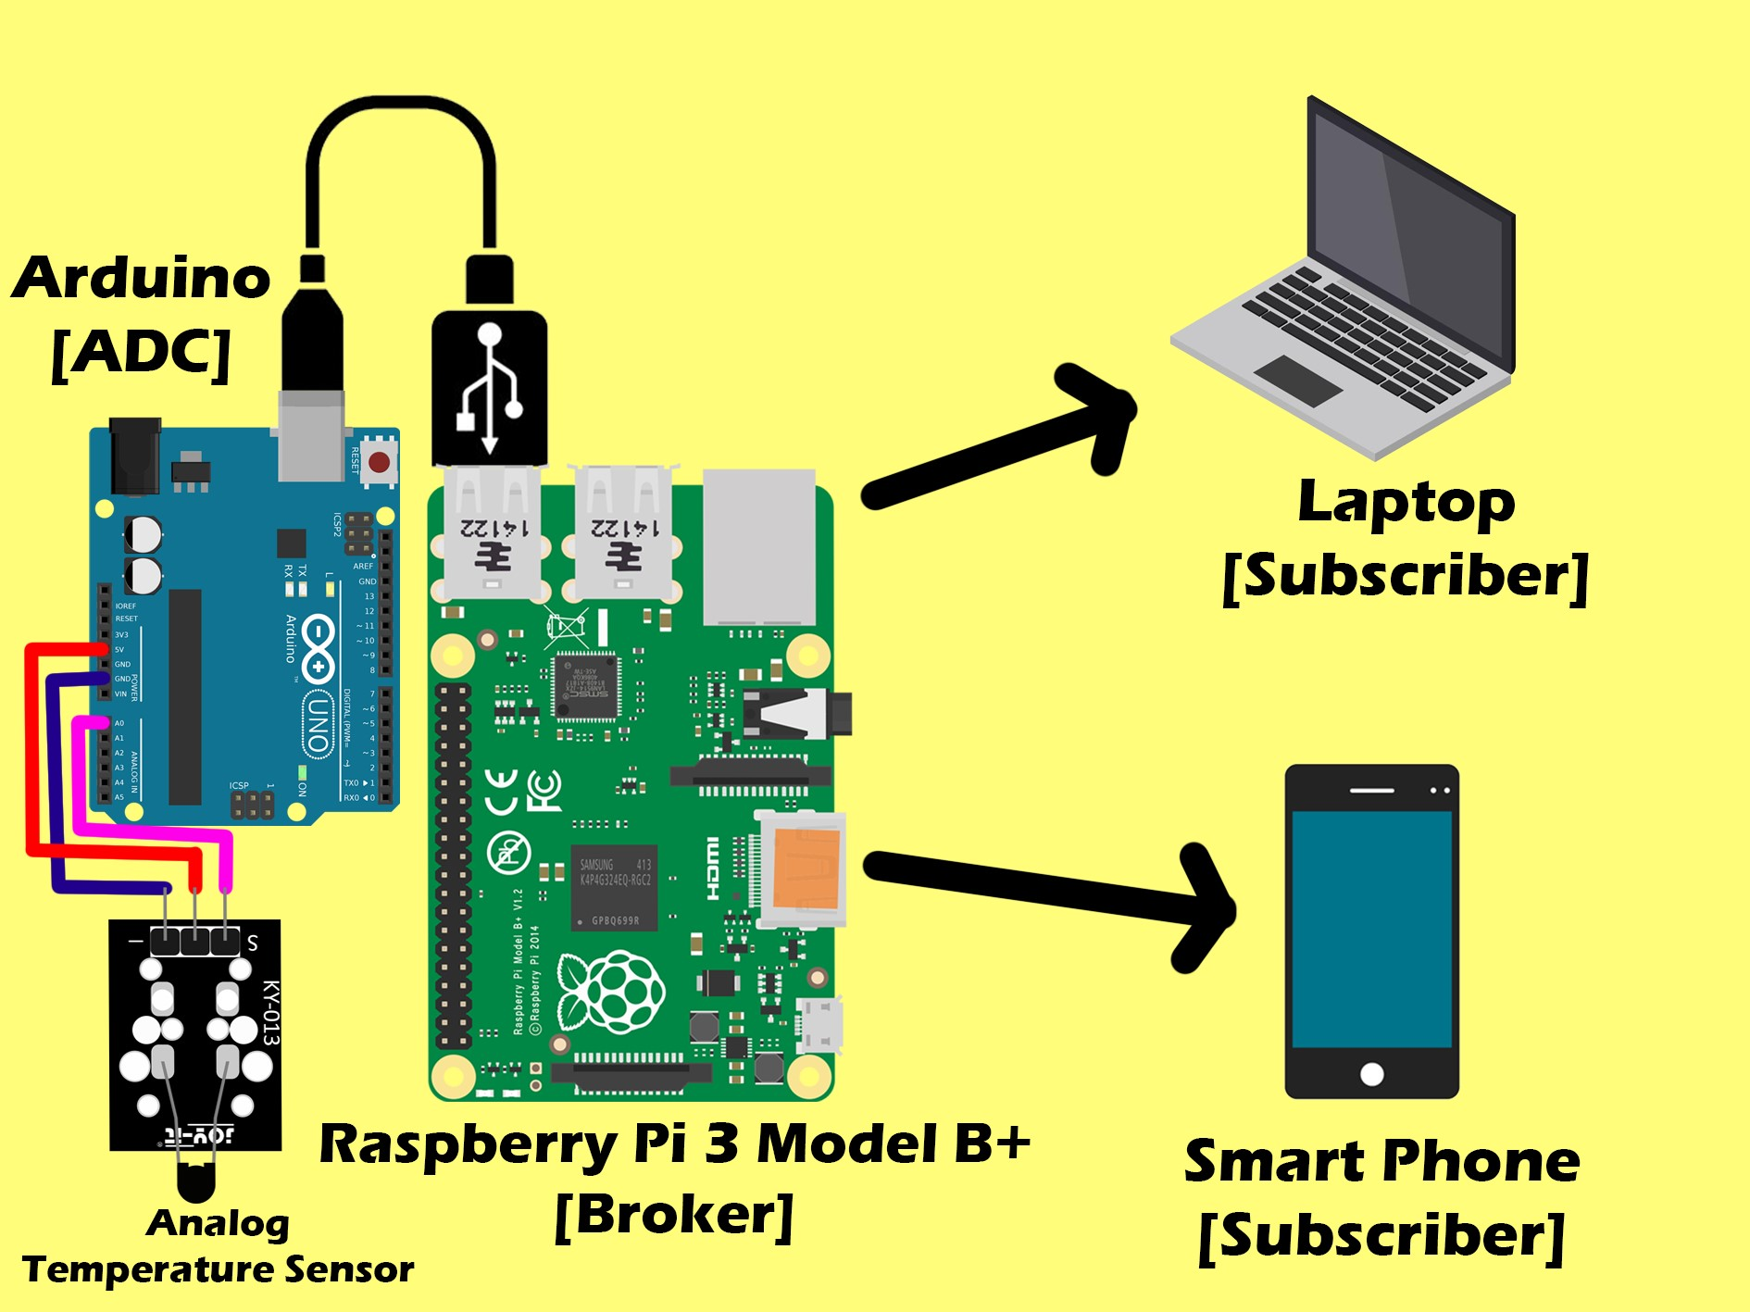

Slide 7
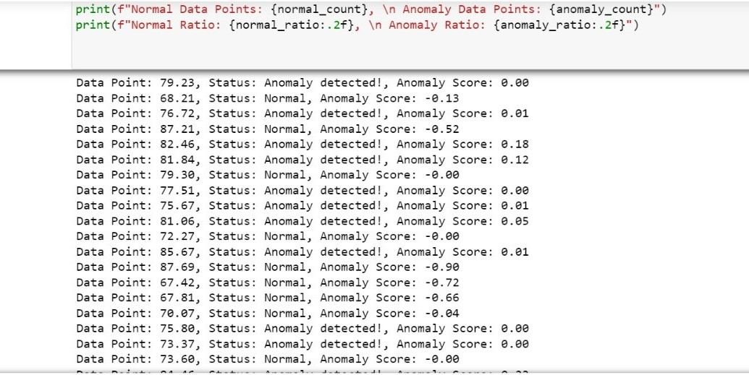
Machine Learning Model
One-Class Support Vector Machines
The One-Class SVM model, an unsupervised learning method provided by the Scikit-Learn library, has been employed.
Hyperparameters:
- The nu value is set to 0.2.
- The gamma value is set to 0.001.
This model utilizes the One-Class SVM algorithm to detect anomalies within the data.

Slide 8
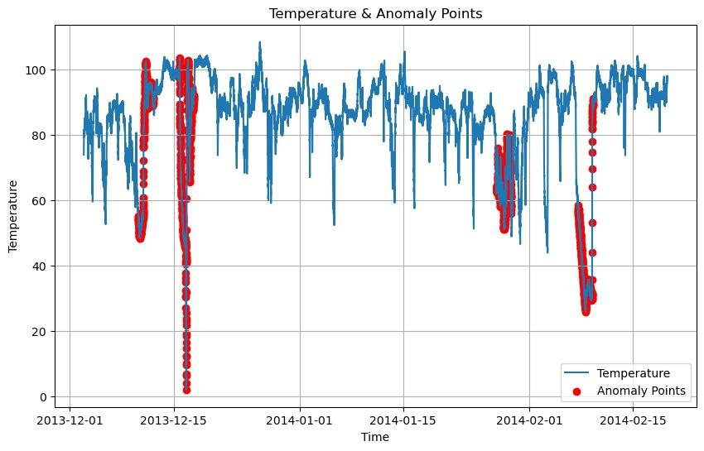
Data Visualization
Visualized average and total temperature values by month/year using Matplotlib.
Plotted minimum and maximum temperatures by year/month.
Created density graphs for temperature patterns by years and months.
Generated scatter plot differentiating anomalies (red dots) from normal data (blue lines).
Developed a daily average temperature graph.

Slide 9
Thank You

Slide 10
ARJUN GHOSHAL - 12021002011004 (CSBS, 3rd YEAR)
AYUSHMAN NANDI - 12021002018021 (CSBS, 3rd YEAR)
RAJDEEP DAS - 22022002018001 (CSBS, 3rd YEAR)
RIYA LAYEK - 12021002018004 (CSBS, 3rd YEAR)

