Slide 1
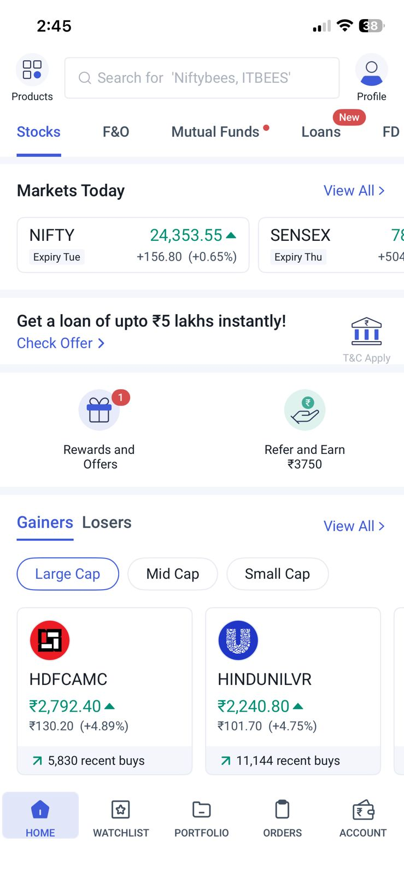
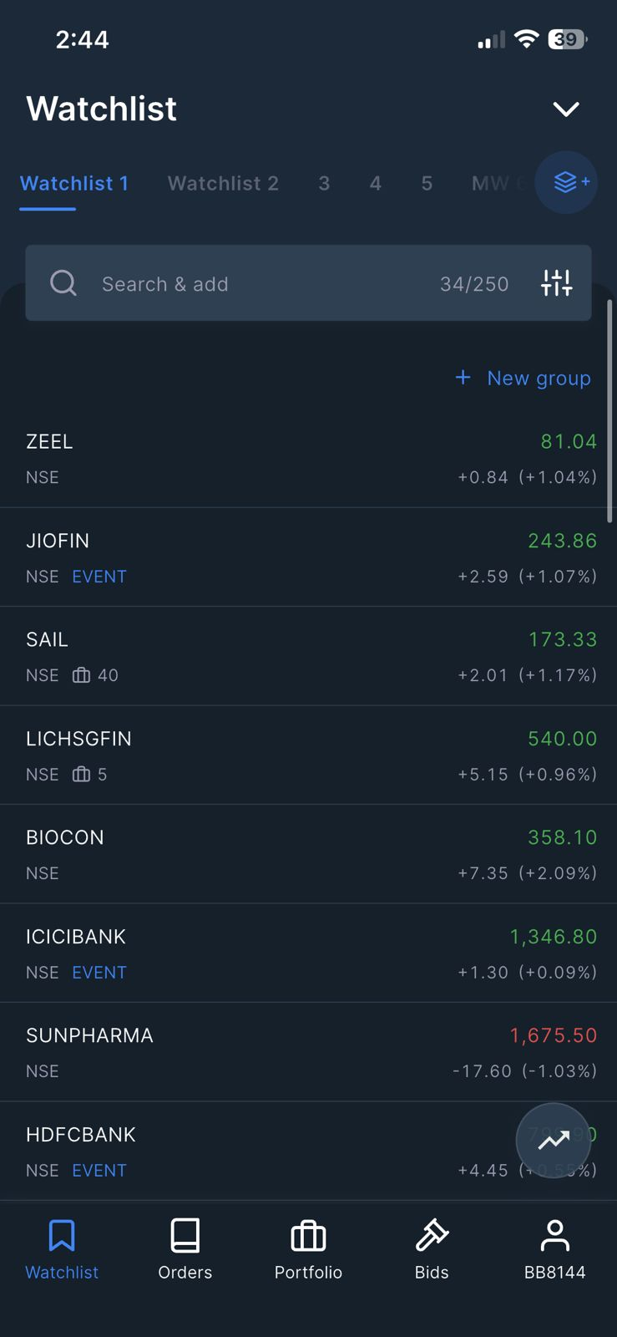
ZERODHA
KITE + COIN
UX Audit, Competitive Analysis
& Redesign Proposal
Why India's most trusted broker forces 13M+ users to juggle two apps — and how to fix it.
13M+
2
14
Zerodha users
Apps required
Steps to invest
Kite vs Angel One
April 2026 · UX Research & Design · Heuristic Evaluation + PRD

Slide 2
01 — PROBLEM STATEMENT
The Two-App Tax
Zerodha users who invest in both equities and mutual funds must operate two separate apps — Kite for stocks/ETFs and Coin for mutual funds — despite sharing a single demat account. Every major competitor has solved this. Zerodha has not.
Fragmented Portfolio
Broken Invest Flow
Duplicate Search
Mental Model Mismatch
No single view of total net wealth. Equity P&L in Kite, MF value in Coin. Users must mentally reconcile two screens.
14 screens + 1 mandatory app switch to invest in a stock and a SIP. Angel One achieves same in 7 screens, 0 switches.
No cross-instrument search. Typing 'HDFC' in Kite never shows HDFC Flexi Cap Fund. Two separate search paradigms.
Users think of one Zerodha account. The system presents two apps with different design languages and navigation patterns.
Hypothesis: Integrating Coin's MF functionality as a tab inside Kite will reduce task completion time by ≥40% and increase cross-product activation by ≥25%

Slide 3
02 — HEURISTIC EVALUATION
Nielsen's 10 Principles — Kite + Coin
Heuristic
Kite
Coin
Observation
Sev
H1 — Visibility of status
3/5
3/5
MF order status invisible from Kite. 'Processing' shows no ETA.
H2 — Match real world
3/5
2/5
One account, two apps — breaks user's mental model of their wealth.
H4 — Consistency & standards
3/5
2/5
'Portfolio' means different things in each app. Two search systems.
H5 — Error prevention
5/5
4/5
Kite's 'slide to buy' + OTP is excellent. Coin is good. ✓ Keep.
H6 — Recognition over recall
3/5
3/5
Kite finds MF in search but forces switch to Coin to invest.
H7 — Flexibility & efficiency
4/5
3/5
Kite has GTT/bracket orders for power users. Coin has no shortcuts.
H10 — Help & documentation
2/5
2/5
No in-context help for NAV, CAGR, Direct vs Regular. No tooltips.
Critical failures on H2 (mental model) and H4 (consistency) are the primary redesign drivers.

Slide 4
03 — USER JOURNEY MAP
Task: Invest ₹5,000 — ₹3,000 in HDFC Bank + ₹2,000 Parag Parikh SIP
ZERODHA (Kite + Coin) — 14 steps, 1 app switch
ANGEL ONE — 7 steps, 0 switches
1
2
3
4
5
6
⚡
1
2
3
4
Open Kite
Search HDFCBANK
Tap stock
Swipe → buy panel
Enter qty
Slide to buy + OTP
APP SWITCH → Coin
Open App
Search
Buy
Tap MF
7
8
9
10
11
12
✗
5
6
7
Re-orient to Coin UI
Search fund in Coin
Select Direct plan
Choose SIP type
Set ₹2,000 + date
Confirm + OTP
No unified view
Find Fund
SIP Amount
Invest
14 steps
vs
7 steps
1 app switch
vs
0 switches
~5–6 min
vs
~2–3 min

Slide 5
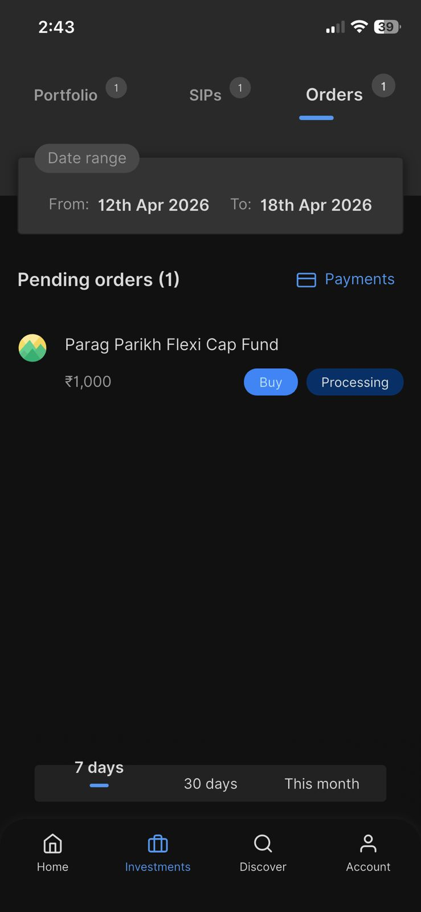
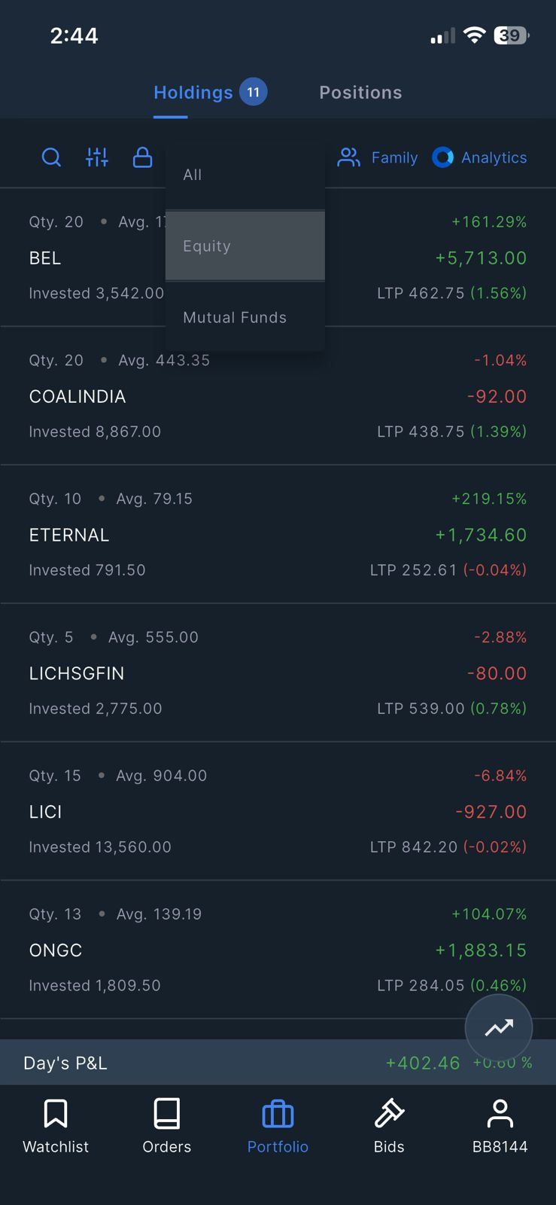
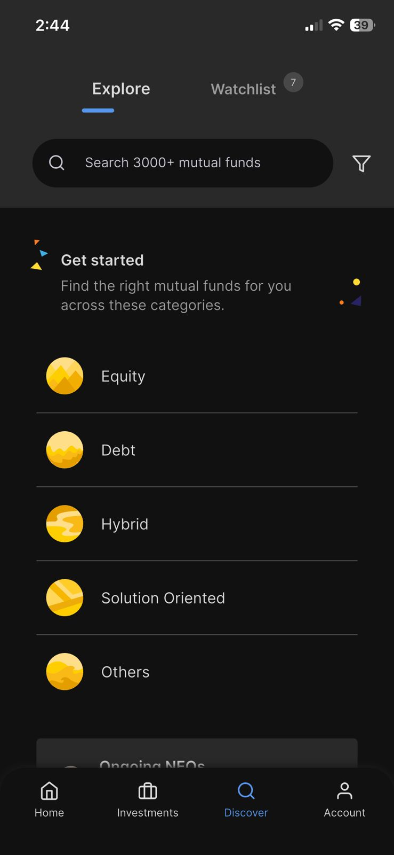
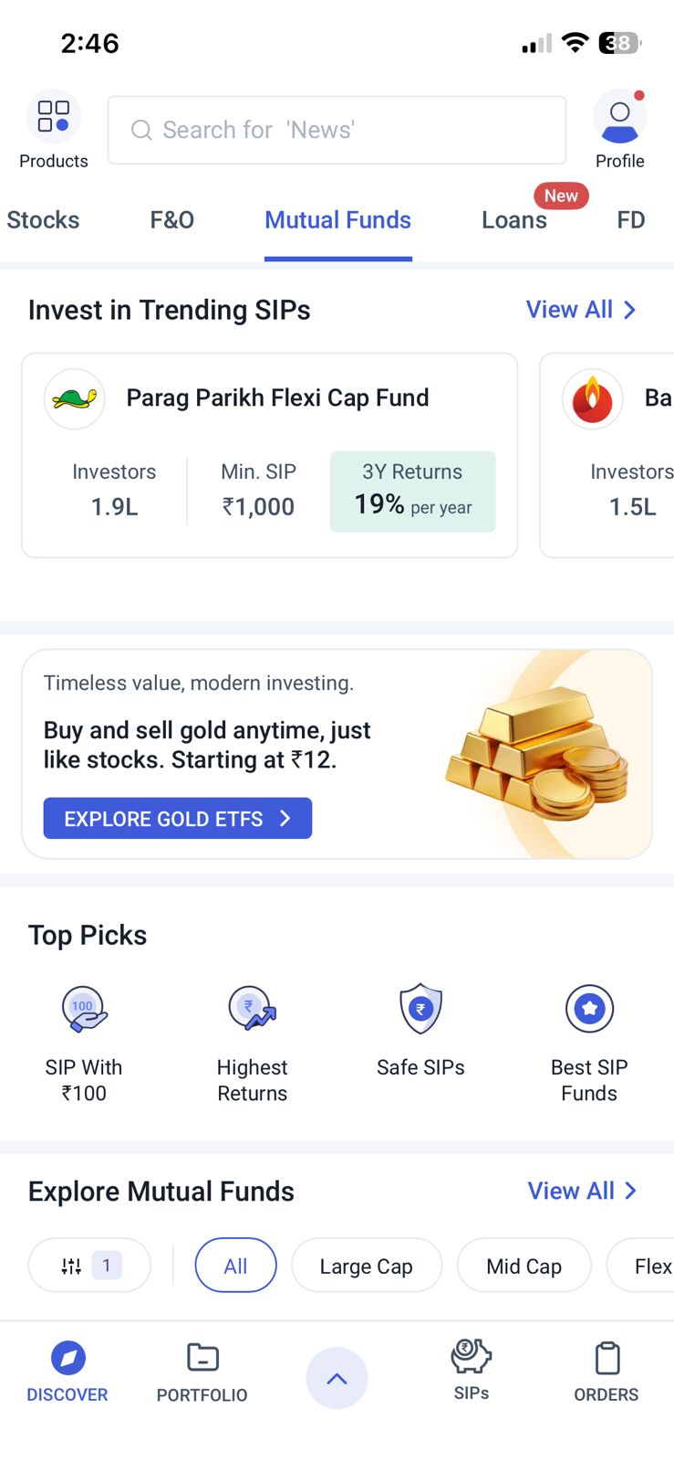
04 — EVIDENCE
App Screenshots — The Fragmented Experience vs The Benchmark
Kite — Watchlist
Coin
Kite — Holdings
Stocks only. No MF visible.
Equity only. MF missing from P&L.
← ZERODHA (fragmented: 2 apps, 2 portfolio views, 2 search systems)
← ANGEL ONE (unified: 1 app, 1 portfolio, 1 search)
Coin — Discover
Angel One — Home
Angel One — Mutual Funds
Separate app, different design language.
Stocks + MF + F&O in one place.
MF same app as stocks.

Slide 6
05 — COMPETITIVE ANALYSIS
Zerodha vs Angel One vs Groww vs Upstox — 8 Dimensions
Feature / Dimension
Zerodha
Angel One
Groww
Upstox
Single app — Stocks + MF
✗ Two apps
✓ Unified
✓ Unified
✓ Unified
Global search (stocks + MF)
✗ Separate
✓ Yes
✓ Yes
✓ Yes
Unified portfolio + P&L
✗ Two views
✓ Combined
✓ Combined
~ Partial
Stock charting depth
★★★★★ Best
★★★★ Good
★★ Basic
★★★★ Good
F&O tooling quality
★★★★★ Best
★★★ Good
★ None
★★★ Good
MF direct plan (0 commission)
✓ Direct
✗ Regular
✓ Direct
~ Partial
MF discovery UX
~ Adequate
✓ Good
★★★★★ Best
~ Adequate
UI design consistency
✗ Split
✓ Yes
✓ Best
✓ Yes
Key insight: Zerodha's F&O + charting tools are genuinely best-in-class. The redesign must add MF integration without touching these — an additive layer, not a rebrand.

Slide 7
06 — REDESIGN PROPOSAL
Surgical Integration — Coin inside Kite, Zero Trading Regression
9:41 ▲
Portfolio
← Parag Parikh Flexi Cap
🔍 Search stocks and funds
Overview
Holdings
Mutual Funds
Parag Parikh Flexi Cap
STOCKS
Total Portfolio Value
Direct · Growth · Equity
₹4,82,540
3Y: 19%/yr · 1.9L investors · Min SIP ₹1,000
HDFCBANK
₹1,346.80 ▲
← Grouped results:
Stocks + Funds
in one search
+0.09%
+₹4,028 +0.84% today
← Combined total:
Equity + MF P&L
in one screen
SIP
One-time
HDFCAMC
₹2,792.40 ▲
+4.89%
Asset Breakdown
Monthly Amount
MUTUAL FUNDS
₹ 2,000
← No redirect:
Invest in MF
directly in Kite
HDFC Flexi Cap
Invest
Equity 68%
MF 32%
Direct · Growth
Equity Holdings
Deduction Date
HDFC Mid-Cap
Invest
11 stocks
₹3,28,450
10th of every month
Direct · Growth
Mutual Funds
₹1,54,090
Start SIP →
1 fund + 1 SIP
Watch
Orders
Portfolio
Bids
Tax Summary (FY26): Est. LTCG ₹12,400 · STCG ₹3,200 →
No app switch needed — this is Kite
Watch
Orders
Portfolio
Bids
Watch
Orders
Portfolio
Bids
Screen 1: Unified Search
Screen 2: Portfolio Overview
Screen 3: Invest Flow (MF)

Slide 8
07 — BEFORE / AFTER
Invest ₹5,000 in Stock + SIP — Experience Comparison
BEFORE — Zerodha (Kite + Coin, current state)
AFTER — Unified Kite (proposed redesign)
14 screens to complete task
7 screens to complete same task
1 mandatory app switch mid-flow
0 app switches required
~5–6 min estimated time
VS
≤3 min estimated time
2 separate portfolio screens
1 unified Portfolio Overview
No combined P&L visible
Total P&L across equity + MF
2 separate search systems
1 global search: stocks + funds
Coin: different design language
Consistent Kite design throughout
Kite trading tools: PRESERVED ✓
Kite trading tools: PRESERVED ✓
−50% screens
−100% app switches
Task completion: 60% → 85%
+25% MF activation

Slide 9
08 — PRD SUMMARY
MoSCoW Requirements + KPIs
MUST HAVE
SHOULD HAVE
COULD HAVE
WON'T (v1)
• Unified Portfolio Overview tab
• Global search: stocks + MF
• Cross-instrument watchlist
• Full Coin deprecation
• MF tab in Kite Portfolio
• SIP manage from Kite
• Goal-based SIP wizard
• NPS/bonds/FD integration
• Invest in MF from Kite
• Asset allocation chart
• MF vs stock comparison
• F&O analytics changes
• Zero trading regressions
• Tax summary card (STCG/LTCG)
• Consolidated statement export
• Social/copy trading
• Combined equity + MF P&L
• SIP push notifications
• Liquidity score view
• New charting engine for MF
Metric
Baseline
Target
Method
Task completion (stock + SIP)
~60%
≥ 85%
Funnel analytics
Cross-product MF activation
0%
+25% MF via Kite
Order source tracking
Time-on-task
~5–6 min
≤ 3 min
Usability testing
Portfolio tab DAU
Low
+40%
Screen analytics
NPS post-launch
Baseline
+10 NPS pts
In-app survey (30d)

Slide 10
The Opportunity
Zerodha has the best stock trading tools in India.
Zerodha has the best MF direct platform in India.
They just never talked to each other.
Surgical
Additive
Unified
MF tab in existing Portfolio — no Kite redesign
Trading tools preserved exactly as-is
One search, one portfolio, one P&L
Zerodha Kite + Coin · UX Audit & Redesign · April 2026

