Slide 1

SENTIMENT ANALYSIS USING ENSEMBLE LEARNING
Final Review
Presented by
K. Arjun – 25B21CS078
K. Lokesh – 25B21CS080
M. Durga Prasad – 25B21CS079
N. Kalyan Venkat Reddy – 25B21CS075
Project Guide: Dr. B. Sindhu, Assistant Professor
Department of Computer Science and Engineering
Aditya University
B.Tech – Machine Learning | Academic Year 2026–2027
Notes:
Introduce the project, team and guide.

Slide 2
ABSTRACT
Sentiment analysis identifies the opinion expressed in text. This project classifies tweets as Positive, Negative or Neutral using the Twitter Entity Sentiment Analysis dataset from Kaggle. Tweets are cleaned and converted into numbers using Word-level and Character-level TF-IDF, so informal language and spelling variations are captured. A Random Forest of 100 decision trees is trained on these features, and a hybrid approach adds rule-based analysis to the prediction. The system is used through a Flask web interface and reaches 90.94% accuracy on 12,225 unseen test tweets.
74,682 → 61,121
15,000
100
90.94%
records before / after cleaning
Word + Character TF-IDF features
decision trees in the forest
test accuracy (macro F1 0.91)
Technologies: Python · Pandas · NumPy · NLTK · Scikit-learn · Joblib · Flask · HTML/CSS
Notes:
Summarise: dataset, TF-IDF features, Random Forest of 100 trees, hybrid rules, Flask app, 90.94% accuracy.

Slide 3
INTRODUCTION
Social media holds a huge amount of opinion-based text.
Sentiment analysis tells whether a text is positive, negative or neutral.
Reading thousands of tweets manually is slow, so automatic classification is needed.
Machine learning learns sentiment patterns from labelled text.
Text must be converted into numbers (TF-IDF) before a model can learn from it.
Random Forest is an ensemble of many decision trees that gives more reliable predictions.
A hybrid approach adds rule-based analysis on top of the ML prediction.
Our system combines preprocessing, TF-IDF, Random Forest and a simple Flask web interface.
WHY ENSEMBLE LEARNING?
A single tree can overfit noisy text. A Random Forest trains many trees on different samples and features; their errors are partly uncorrelated, so combining them by majority vote reduces variance and improves generalisation.
Notes:
Explain why sentiment analysis is needed and why ensembles are more reliable than a single tree.

Slide 4
PROBLEM STATEMENT
Social media creates huge amounts of unstructured text; reading every tweet manually is slow and difficult.
Existing systems mostly use lexicon-based methods or a single classifier such as Naive Bayes or Logistic Regression.
Limitations of existing systems
Difficult to detect sentiment in sarcastic or ambiguous tweets.
Lexicons and rules need continuous updating.
1
2
Slang, abbreviations and misspellings reduce accuracy.
A single model can overfit or underfit on noisy social media text.
3
4
PROBLEM
How can we automatically classify tweet text into Positive, Negative and Neutral sentiment using an ensemble machine learning approach that handles informal language, slang and spelling variations?
Goal: a trained model and a web page that return Positive, Negative or Neutral for any tweet instantly.
Notes:
State the four limitations of existing systems and read the problem statement.

Slide 5
PROPOSED SOLUTION & OBJECTIVES
PROPOSED SOLUTION
An ensemble-learning sentiment analysis system that learns patterns from labelled tweets: preprocessing, Word and Character TF-IDF feature extraction, Random Forest training, hybrid rule-based + ML prediction, and a Flask web interface to show the result. Word features capture vocabulary; character features handle slang and spelling variations; the forest votes; rules refine the final label.
OBJECTIVES
Collect and prepare the Twitter sentiment dataset.
Clean and preprocess the tweet text.
1
2
Convert text to numbers using TF-IDF.
Use Word-level and Character-level features.
3
4
Train a Random Forest classifier.
Predict sentiment for unseen text.
5
6
Improve prediction with rule-based analysis.
Provide a simple interface to enter text and see the result.
7
8
Notes:
Walk through the proposed solution and the eight objectives.

Slide 6
SYSTEM ARCHITECTURE
USER (web browser) – enters a tweet or sentence
FLASK WEB INTERFACE (HTML + CSS)
text box · Analyze Sentiment button · example inputs · prediction card
PREDICTION MODULE (predict.py) – loads saved model and vectorizers (Joblib)
Text preprocessing
→
Word + Character TF-IDF
→
Random Forest (100 trees)
→
Rule-based analysis
OUTPUT – final sentiment: Positive | Negative | Neutral
The same preprocessing and the saved vectorizers are reused at prediction time, so a new tweet is transformed exactly like the training data.
Notes:
Explain the layers: browser, Flask page, prediction module (four steps), output.

Slide 7
PROJECT WORKFLOW
DATA
Steps 1 - 3
→
FEATURES
Steps 4 - 6
→
MODEL
Steps 7 - 9
→
OUTPUT
Steps 10 - 11
1. Dataset
Kaggle, 74,682 tweets
4. Word TF-IDF
10,000 word features
7. Train-Test Split
80% train / 20% test
10. Hybrid Rule Analysis
rules confirm or adjust the label
2. Data Processing
drop missing, keep 3 classes → 61,121
5. Character TF-IDF
5,000 character features
8. Random Forest
100 trees, majority vote
11. Final Sentiment
Positive | Negative | Neutral
3. Text Preprocessing
lowercase, URLs, mentions, symbols, spaces
6. Feature Combination
15,000 features per tweet
9. Model Prediction
class chosen by the forest
Steps 1–8 build and save the model; steps 9–11 are repeated for every text entered by a user.
Notes:
Eleven steps in four groups. Steps 1-8 build the model, steps 9-11 run for each user input.

Slide 8
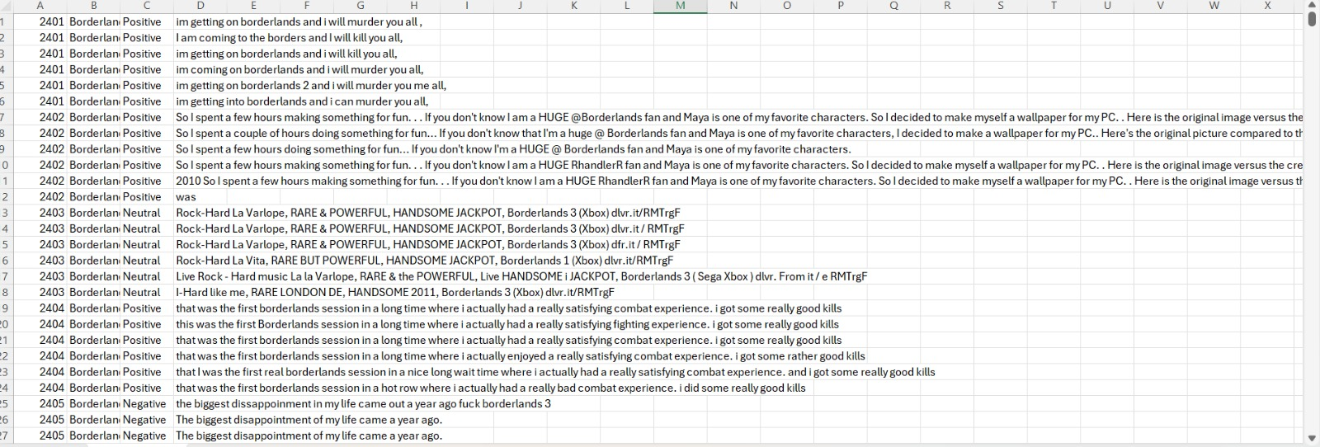
DATASET
Dataset: Twitter Entity Sentiment Analysis
Source: Kaggle
Records: 74,682 → 61,121 after cleaning
Fields: Tweet ID, Entity, Sentiment, Tweet
Classes: Positive, Negative, Neutral
Data observations (sample rows)
• Rows share one Tweet ID with near-duplicate wording
• Some labels look questionable for the text
• Classes are fairly balanced (36.6% / 33.8% / 29.6%)
Notes:
74,682 raw records, 61,121 after cleaning. Mention near-duplicate rows and possible label noise.

Slide 9
DATA PROCESSING
PROCESSING STEP
EXAMPLE (tweet after each step)
Input tweet
I LOVE this GAME!! @Xbox https://t.co/a1b2
1. Remove missing tweets
(rows without tweet text are dropped)
2. Convert to lowercase
i love this game!! @xbox https://t.co/a1b2
3. Remove URLs
i love this game!! @xbox
4. Remove user mentions
i love this game!!
5. Remove unwanted characters
i love this game
6. Normalize extra spaces
i love this game
7. Select sentiment classes
i love this game → Positive (kept)
Steps 1 and 7 remove 13,561 records: 74,682 − 13,561 = 61,121 cleaned tweets. Stop-words are not removed, so negations such as “not” stay in the text. The same function is applied to training data and to every user input so the model always sees text in the same form.
Notes:
Go through the seven steps using the example tweet; 13,561 records removed in total.

Slide 10
FEATURES & MODEL IMPLEMENTATION
FEATURE EXTRACTION
RANDOM FOREST CLASSIFIER
Word TF-IDF – 10,000 features
An ensemble of decision trees. Each tree votes and the majority class becomes the prediction.
Word and phrase patterns; more weight to important, less common words
Number of trees
100
Character TF-IDF – 5,000 features
Maximum depth
None
Character patterns; helps with spelling variations and informal text
Class weights
balanced
Random seed
42
Train / test split
80% / 20%
Combined feature matrix
61,121 × 15,000
Training samples
48,896
Test samples
12,225
TF-IDF(t, d) = tf(t, d) × log( N / df(t) ) Gini impurity G = 1 − Σ pk² Prediction ŷ = majority vote of the 100 trees
Trained model and both vectorizers are saved with Joblib and loaded by predict.py for new text. A rule-based layer then confirms or adjusts the prediction.
Notes:
Word TF-IDF 10,000 + character TF-IDF 5,000 = 15,000 features. Forest: 100 trees, balanced class weights, seed 42.

Slide 11
IMPLEMENTATION
Component | Technology
Programming Language | Python
Data Processing | Pandas, NumPy
Text Processing | NLTK / Regular Expressions
Feature Extraction | TF-IDF (Scikit-learn)
Machine Learning | Scikit-learn
Model | Random Forest
Model Saving | Joblib
Web Interface | Flask
Frontend | HTML, CSS
IDE / OS | VS Code; Windows 10 / Linux / macOS
Main Project Files
app.py
Flask application
predict.py
loads model, predicts
preprocess.py
text cleaning steps
train_model.py
TF-IDF, training, saving
models/
saved model + vectorizers
templates/
HTML pages
Runs on a standard PC (Intel Core i3/i5, 8 GB RAM, 64-bit OS); all tools are free and portable across Windows, Linux and macOS.
Notes:
Technology stack and the role of each project file.

Slide 12
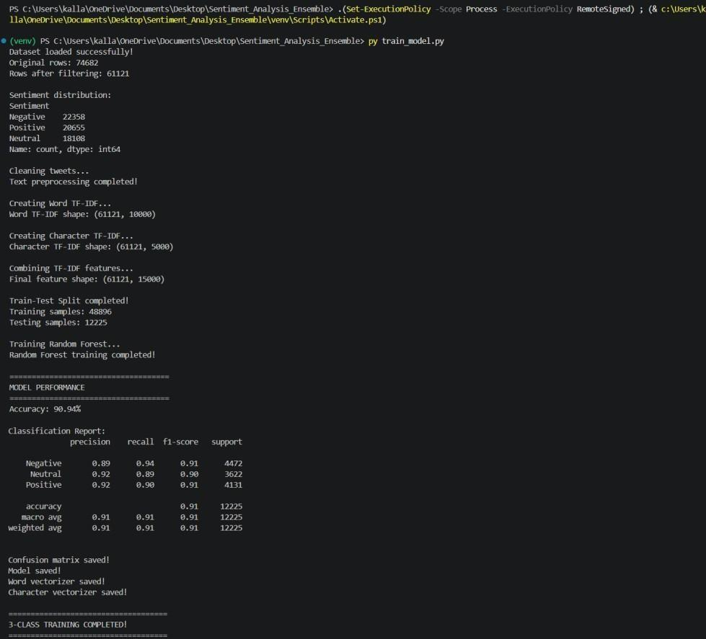
MODEL TRAINING OUTPUT
What the output shows
Original rows
74,682
Rows after filtering
61,121
Feature shape
61,121 × 15,000
Training samples
48,896
Testing samples
12,225
Accuracy
90.94%
train_model.py: loads the data, cleans tweets, builds Word + Character TF-IDF, splits 80/20, trains the Random Forest, prints the report and saves the model and vectorizers.
Notes:
The training script output: counts, shapes, split, accuracy and saved files.

Slide 13
RESULTS
90.94%
Class | Precision | Recall | F1 | Support
Positive | 0.92 | 0.90 | 0.91 | 4,131
Negative | 0.89 | 0.94 | 0.91 | 4,472
Neutral | 0.92 | 0.89 | 0.90 | 3,622
Macro avg | 0.91 | 0.91 | 0.91 | 12,225
test accuracy on 12,225 unseen tweets
All three classes perform at a similar level (F1 0.90–0.91); macro and weighted averages are both 0.91.
Negative has the highest recall (0.94) but the lowest precision (0.89): some other tweets are also labelled Negative.
Neutral has the lowest recall (0.89), a common difficulty because neutral text lies between the polar classes.
Notes:
Accuracy 90.94% on 12,225 test tweets; discuss per-class precision, recall and F1.

Slide 14
CONFUSION MATRIX
Actual \ Predicted | Irrelevant | Negative | Neutral | Positive
Irrelevant | 2,020 | 180 | 176 | 199
Negative | 29 | 4,106 | 177 | 160
Neutral | 27 | 231 | 3,177 | 187
Positive | 29 | 221 | 203 | 3,678
How to read it
Diagonal = correct
2,020 · 4,106 · 3,177 · 3,678 tweets were classified correctly.
Largest confusions
Neutral → Negative: 231
Positive → Negative: 221
Positive → Neutral: 203
Row totals
Negative 4,472 · Neutral 3,622 · Positive 4,131 tweets.
Rows = actual class, columns = predicted class. Darker cells hold more tweets.
In every row the diagonal cell is the largest, so each class is predicted correctly more often than any other class.
Notes:
Read the matrix: rows are actual classes, columns are predicted classes; the diagonal is correct predictions and the off-diagonal cells show which classes are confused.

Slide 15
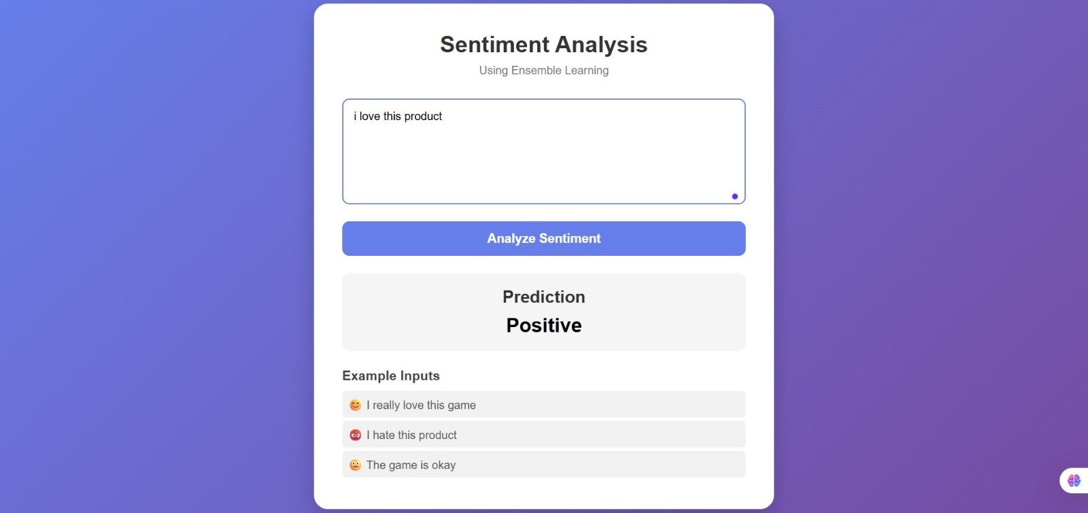
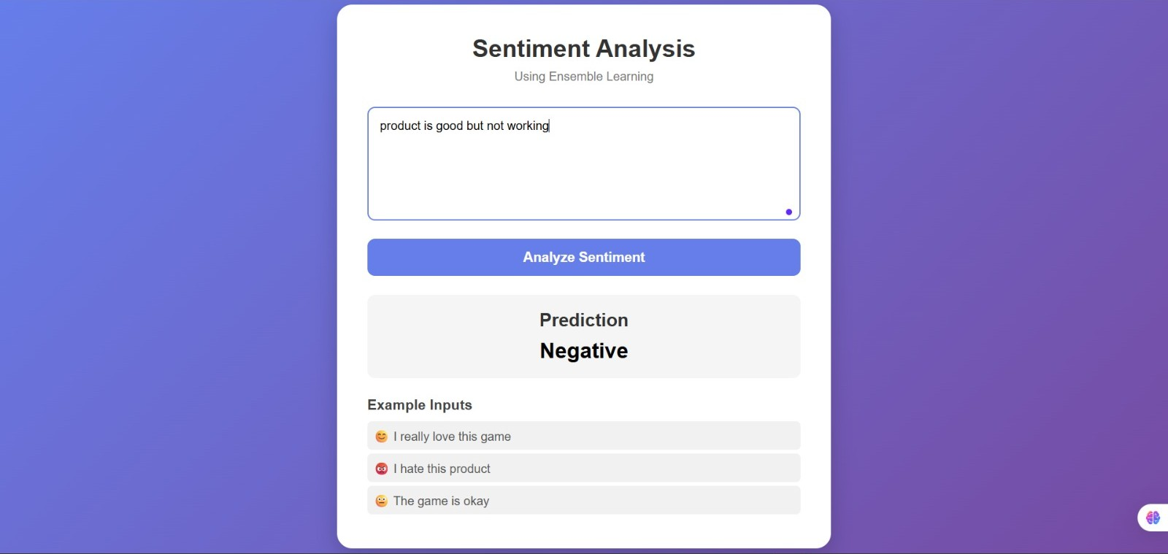
APPLICATION OUTPUT & TESTING
“i love this product” → Positive
“product is good but not working” → Negative
Input (unseen text) | Predicted | Source
I really love this game | Positive | Reported
I hate this product | Negative | Reported
The game is okay | Neutral | Reported
i love this product | Positive | Screenshot
product is good but not working | Negative (mixed sentiment) | Screenshot
Tested on the running Flask app with the same saved model and vectorizers used in normal operation.
Every tested sentence received the expected label, including the mixed-sentiment sentence (“not” is kept in the text).
The interface shows the label only (no confidence score).
Notes:
Show the two application screenshots and the test sentences; all gave the expected labels.

Slide 16
CONCLUSION & LIMITATIONS
CONCLUSION
LIMITATIONS
A machine-learning sentiment analysis system was developed and tested.
Tweets are cleaned, then represented by Word + Character TF-IDF.
Random Forest (100 trees) reaches 90.94% accuracy on 12,225 unseen tweets.
Macro precision, recall and F1 are all 0.91.
A hybrid rule layer and a Flask interface make it usable by anyone.
One Random Forest with a rule layer; no other classifiers compared.
Effect of the rule-based layer not measured separately.
Single 80/20 split; no cross-validation.
Near-duplicate rows and noisy labels in the dataset.
Sarcasm and mixed opinions remain hard; video-game tweets only.
Label only, no confidence score.
Overall: the project is a working foundation for automated sentiment analysis, with a trained model and a web interface that anyone can use.
Notes:
Conclude and state honest limitations: single model, no cross-validation, noisy labels.

Slide 17
THANK YOU
Any Questions?
Sentiment Analysis Using Ensemble Learning
Notes:
Thank the audience and invite questions.

