Slide 1
TABLEAU

Slide 2
Types of Joins supported by Tableau
There are 4 types of joins :
1.Inner :
When you use an inner join to combine tables, the result is a table that contains values that have matches in both tables.
2.Left :
The result is a table that contains all values from the left table and corresponding matches from the right table.

Slide 3
3.Right :
The result is a table that contains all values from the right table and corresponding matches from the left table.
4.Full Outer :
The result is a table that contains all values from both tables.

Slide 4
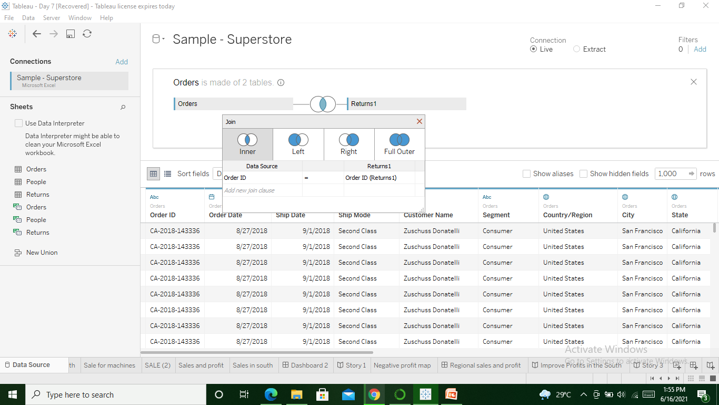

Slide 5
Difference between Tableau Public & Tableau Desktop
TABLEAU DESKTOP :
The Tableau Desktop is data visualization software that lets you see and understand data in minutes. The professional version of this can transform, process and store huge volumes of data which is responsible for all the data-driven decision making of an organization.
Nobody can see your reporsts unless you share the access.
Tableau public does not support Live connection to any data source

Slide 6
TABLEAU PUBLIC :
The Tableau Public is essentially a free version of Tableau visualization software. It allows you to use most of the software functions. You can create visualizations and connect to CSV, Text and Excel documents. However, the largest difference is that Tableau Public does not allow you to save your workbooks locally.
All the reports are Public once they are published.

Slide 7
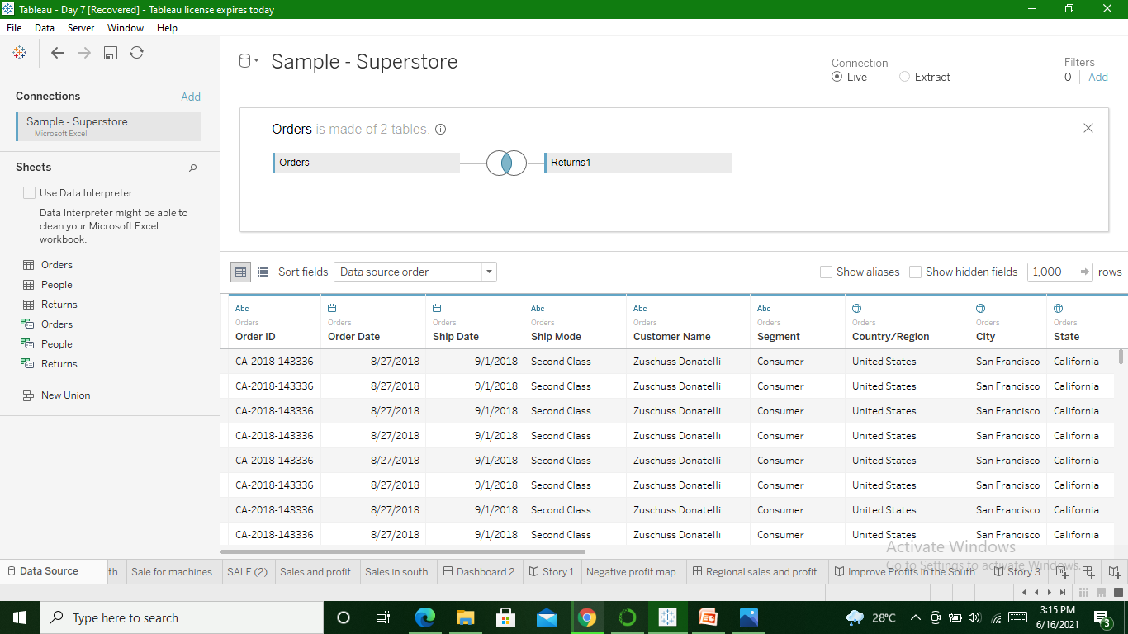
Different types of connections provided by Tableau
2 types of connections provided
1.Live 2.Extract

Slide 8
Live Connection
When the data we are going to work on is residing at a remote place and updating at every moment. In that case it is not possible to copy that data into local system.
So in that case tableau has provided us with live connection. Under this we connect to particular database and work on particular dynamic database from our tableau desktop

Slide 9
Extract Connection
Under this connection we copy particular database into our local system and work on that particular database from tableau desktop

