Slide 1
TABLEAU

Slide 2
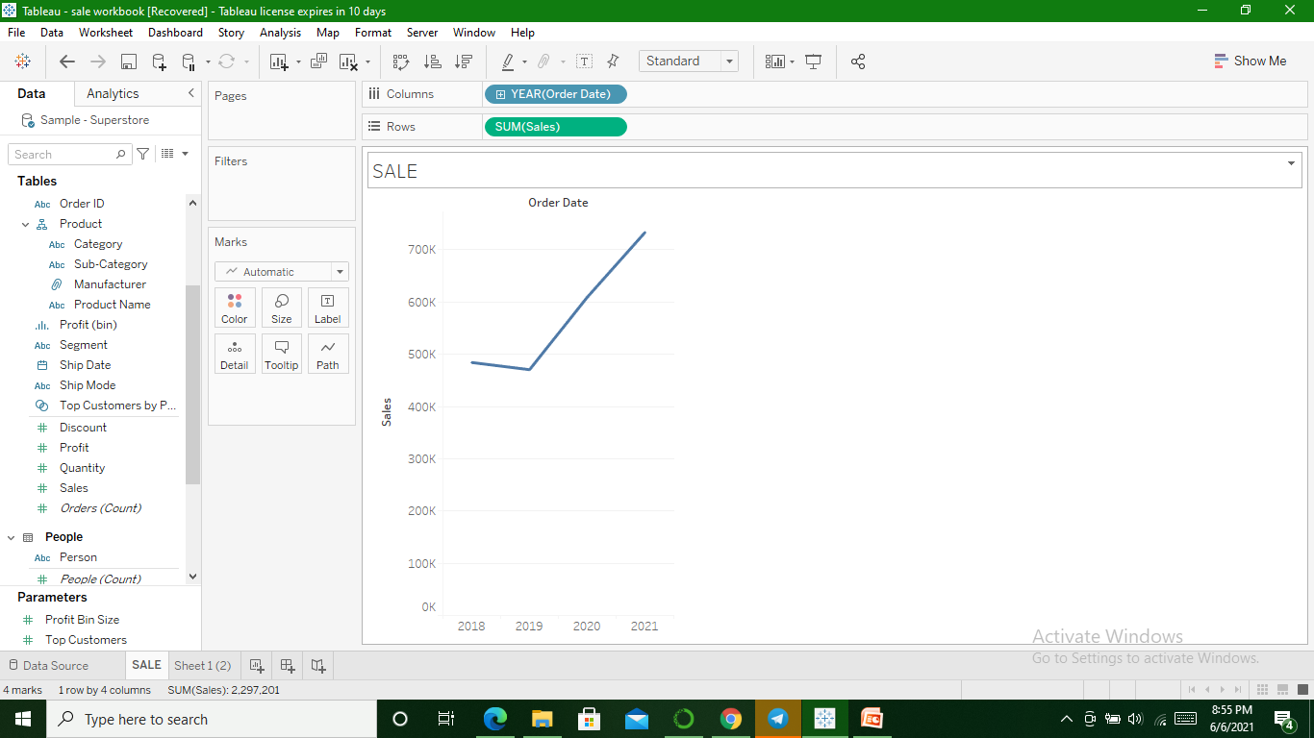
Sales for every year

Slide 3
DIMENSION & MEASURE
Dimension represented by blue color & Measure by green color
Dimensions are Qualitative values
Measures are continuous values which can be used for calculations like profit,loss.

Slide 4
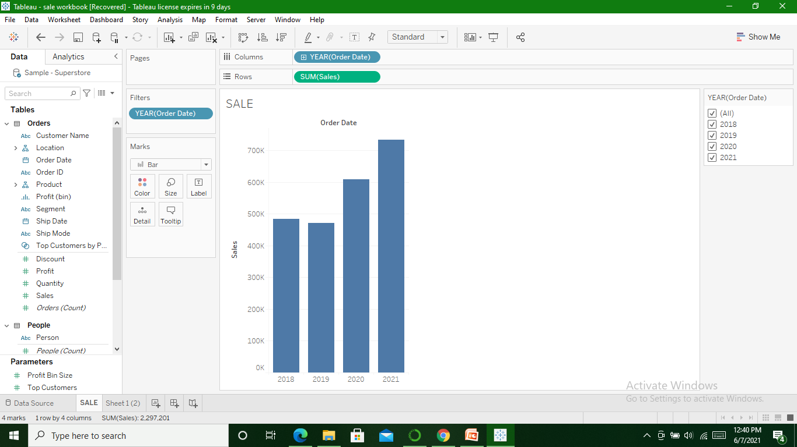
BAR Graph

Slide 5
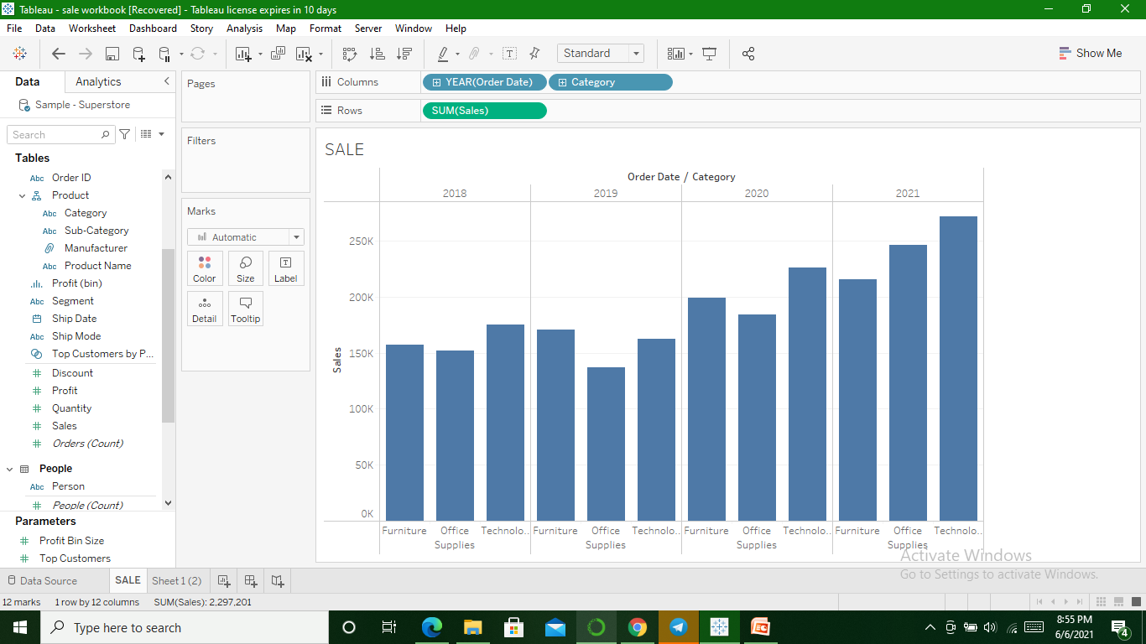
Category Wise(drag & drop)

Slide 6
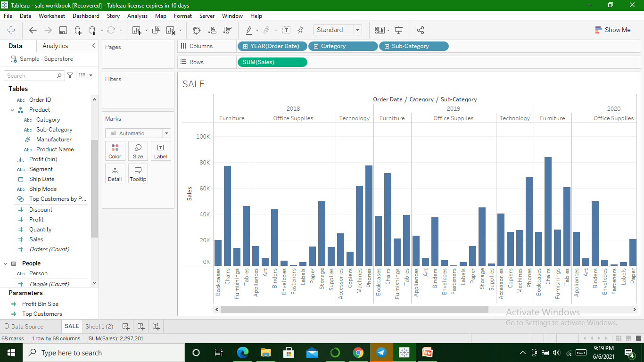
Sub-Category

Slide 7
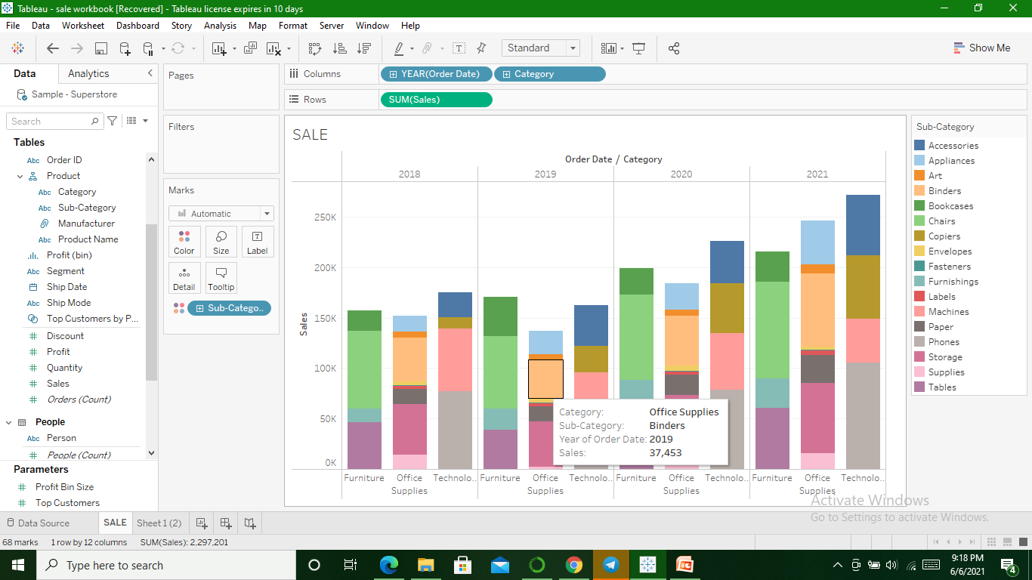
Using Colour card(drag needed type to color card and choose color)

