Slide 1
TABLEAU

Slide 2
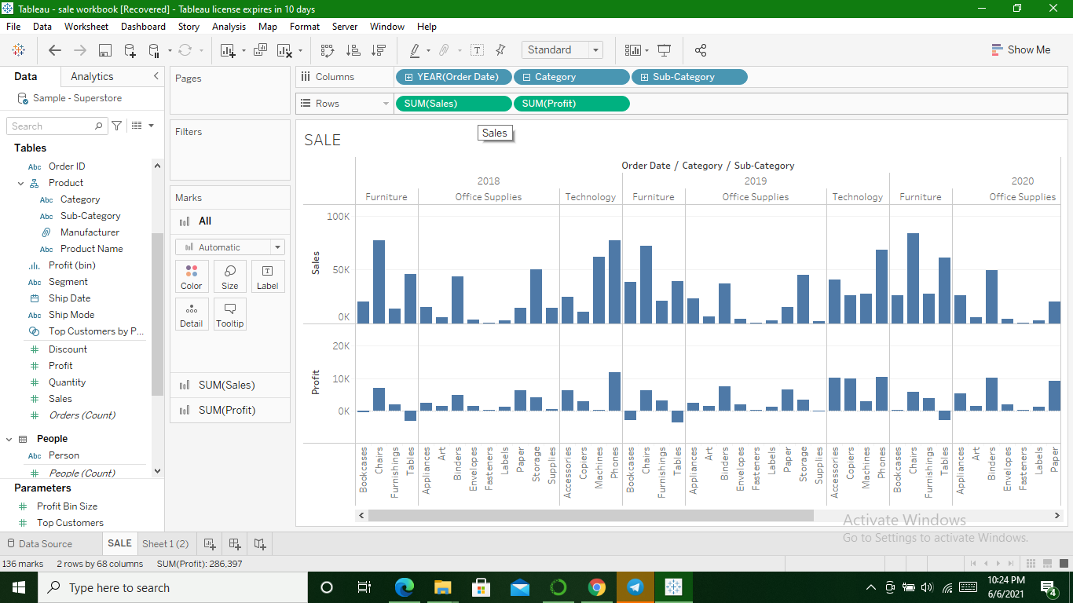
Profit and sales for each subcategory and category of Product

Slide 3
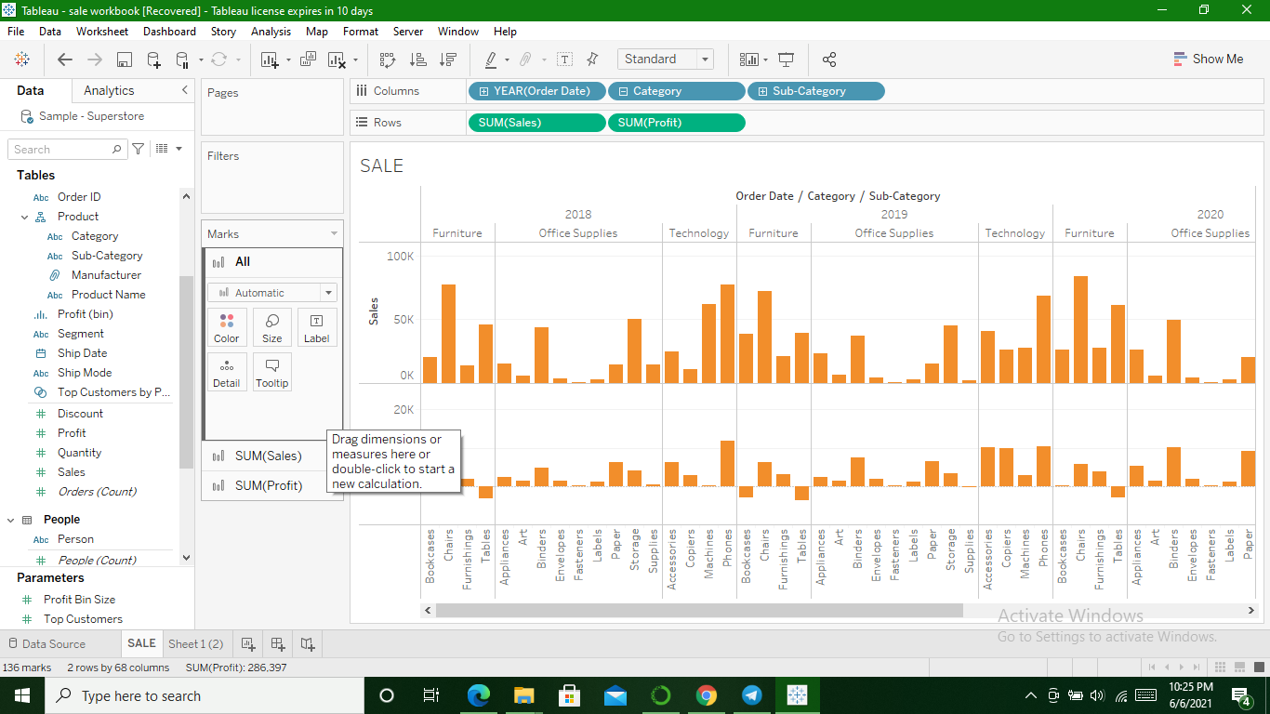
Change Color from marks card

Slide 4
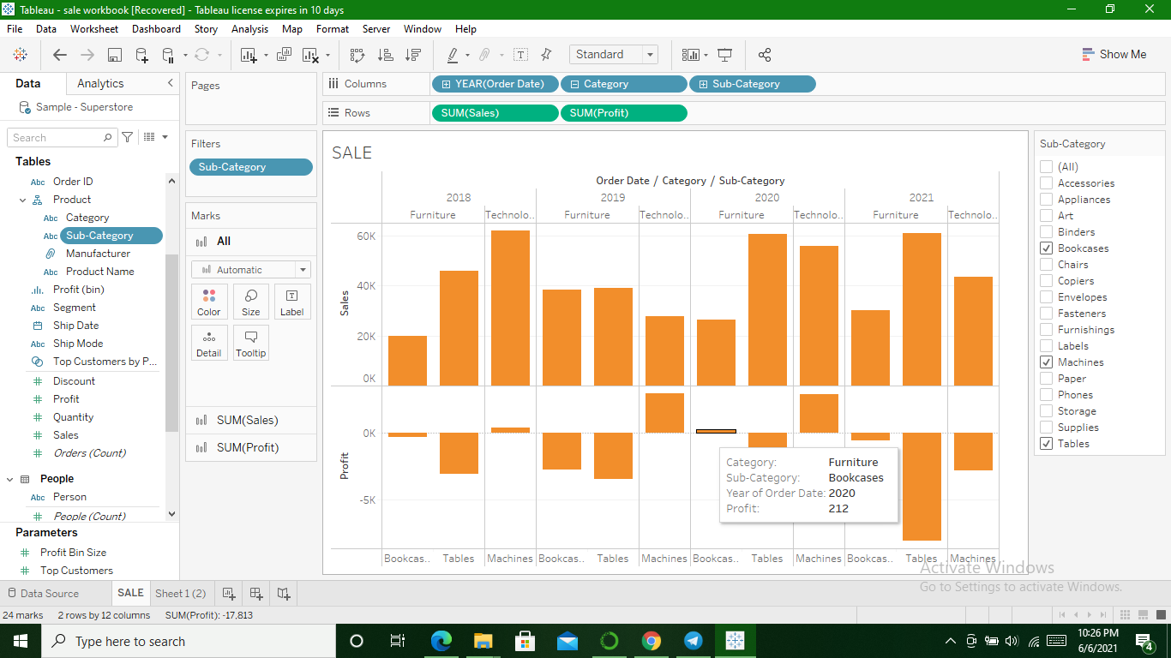
Using Filter Card

Slide 5
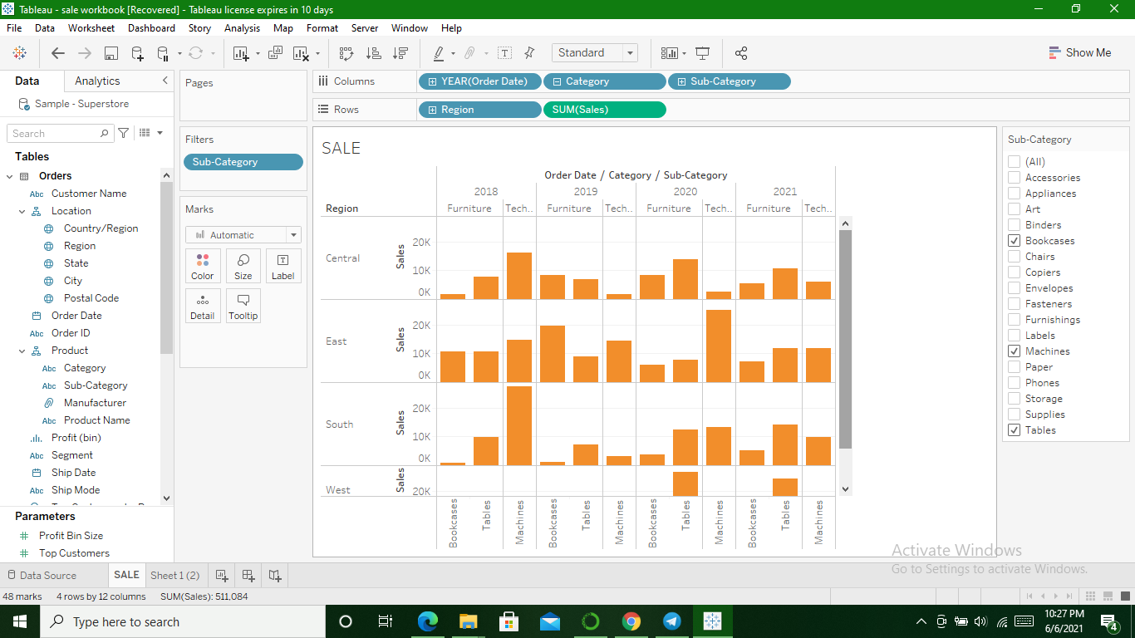
Sales Region Wise

Slide 6
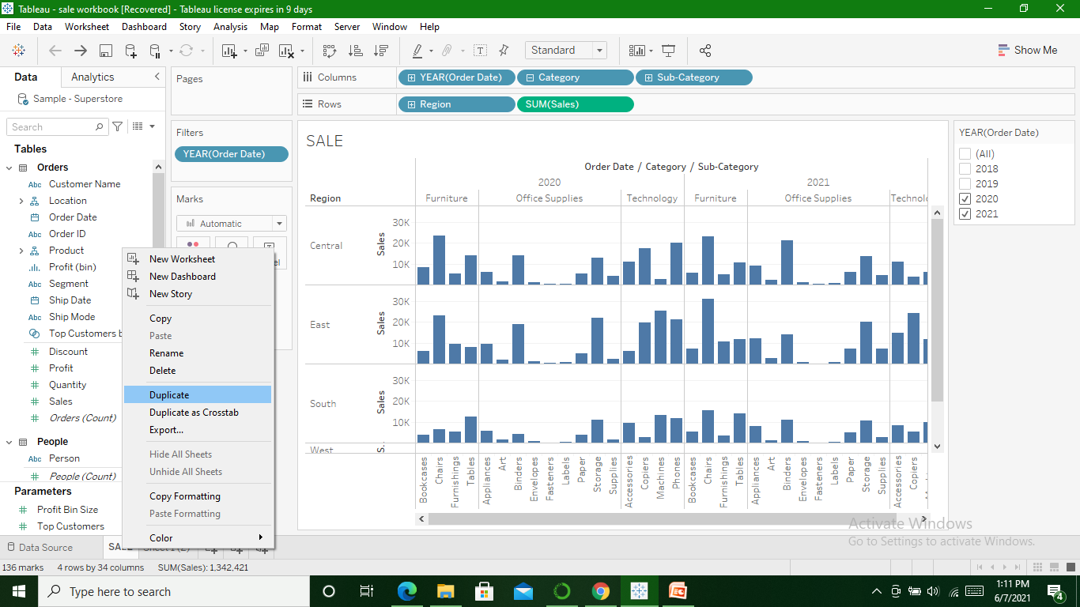
Duplicating worksheet & checking sales region wise for machine sub-category

Slide 7
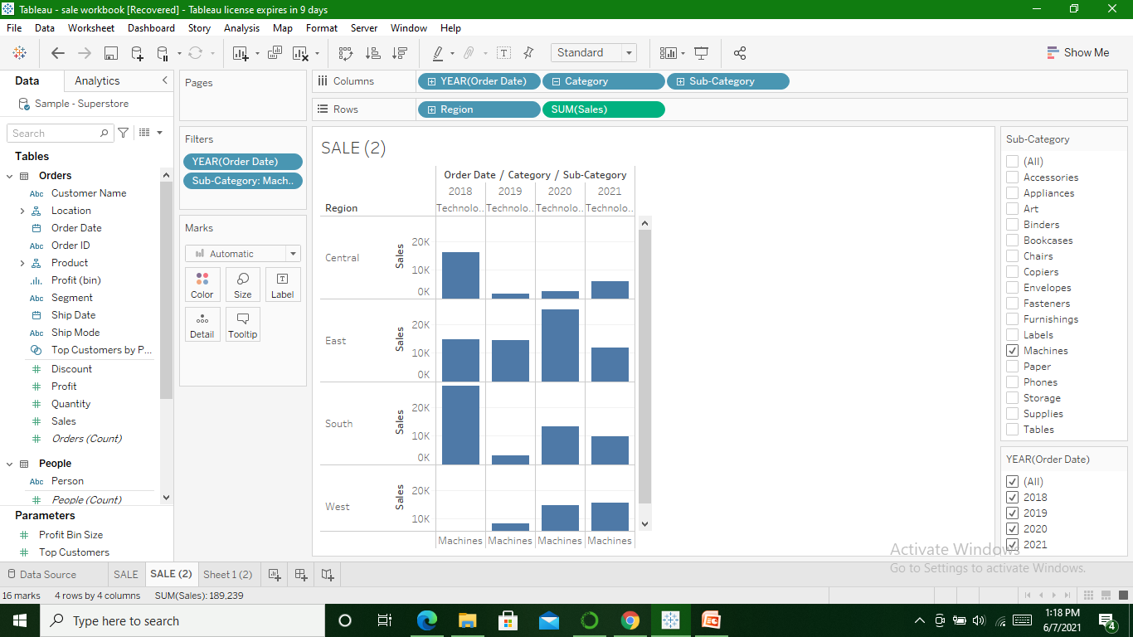

Slide 8
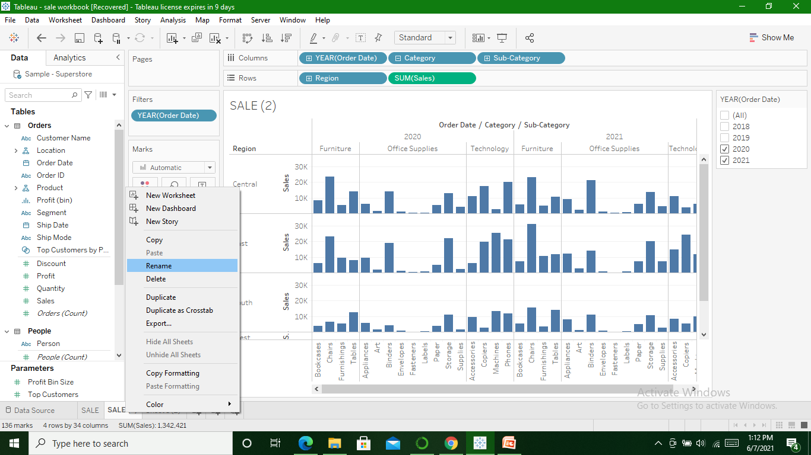
Rename

Slide 9
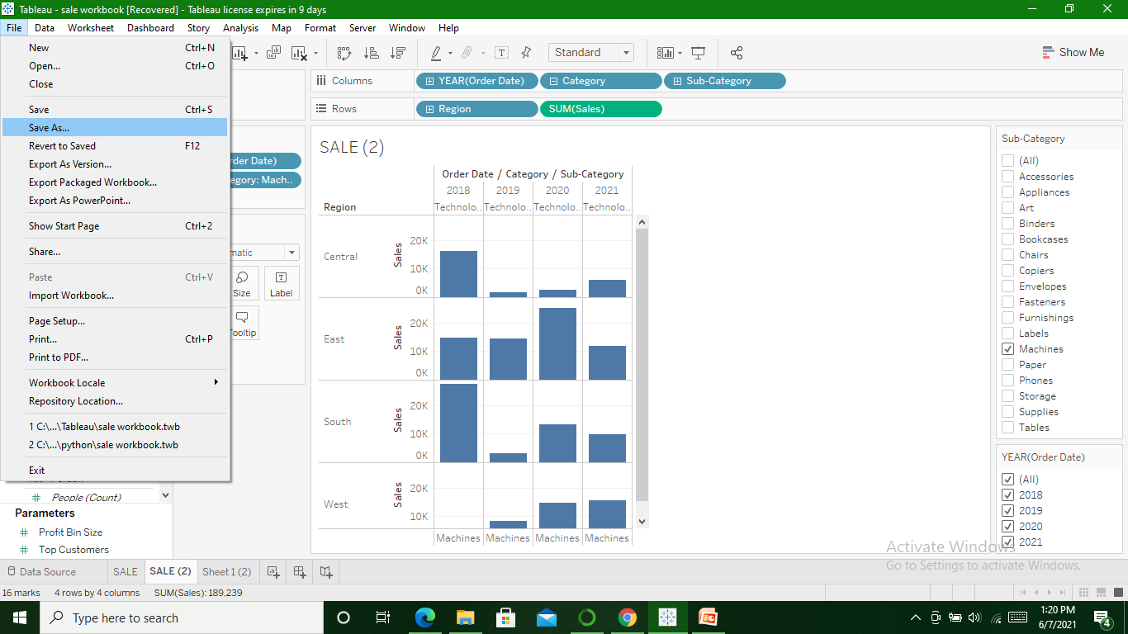
Save

