Slide 1
TABLEAU

Slide 2
What is Tableau?
BI tools are types of software used to gather, process, analyze, and visualize large volumes of past, current, and future data in order to generate actionable business insights, create interactive reports, and simplify the decision-making processes.
Tableau is a visual analytics platform transforming the way we use data to solve problems—empowering people and organizations to make the most of their data.

Slide 3
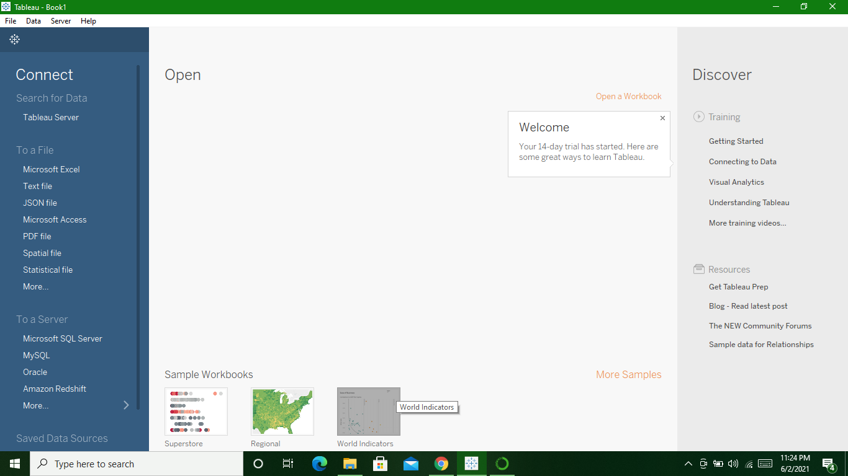
Tableau Start Page

Slide 4
Tableau Architecture
Tableau
Create
Share
Tableau Desktop
Tableau Server
Tableau Online
Reader

Slide 5
Steps of Process of BI Project
1.Business Understanding :
Understand the business for which it has been initiated.
2.Data Understanding :
See whether Data strong enough to make decision, whether Data is long or short.
3.Data Preperation :
Correcting wrong data and removing duplicates.

Slide 6
4.Modeling :
Work on formulas and functions to create columns. Used for data modeling
5.Evaluation :
Reports generated. If Report that is generated is unable to take decision that impact business then report is failed
6.Deployment :
If succesfull then Deploy

