Slide 1
TABLEAU-Story

Slide 2
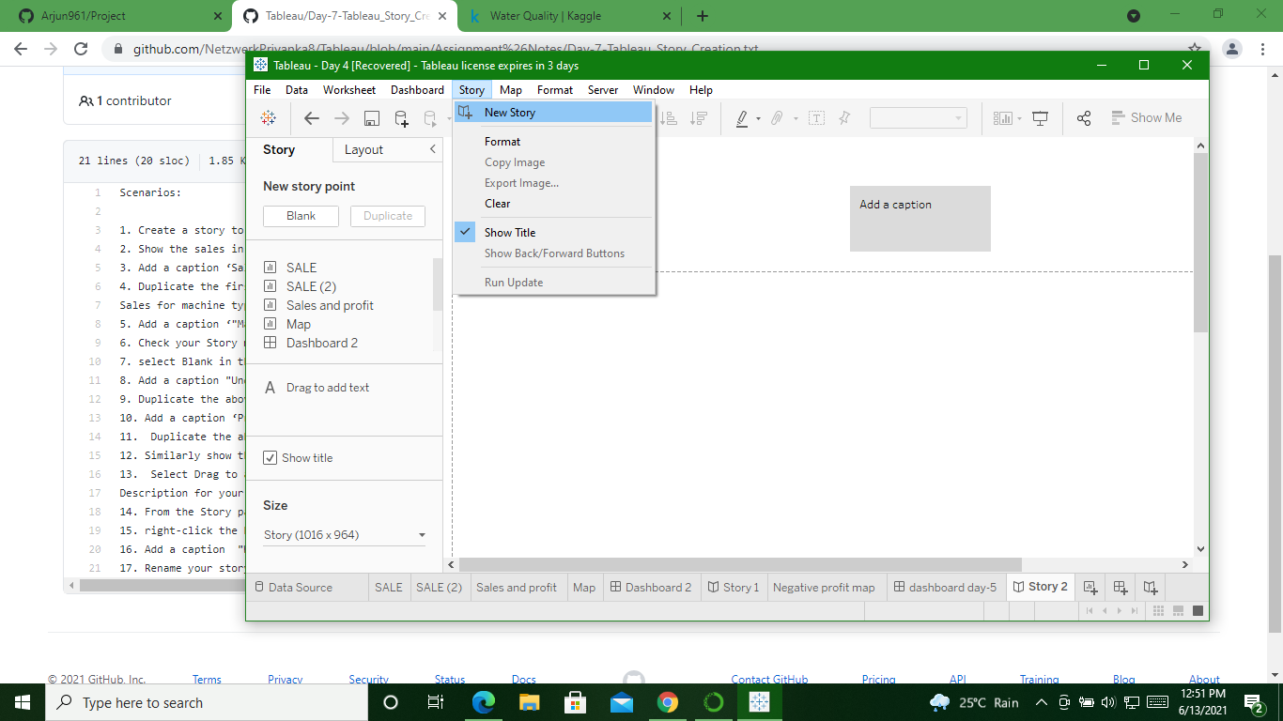
Create a Story

Slide 3
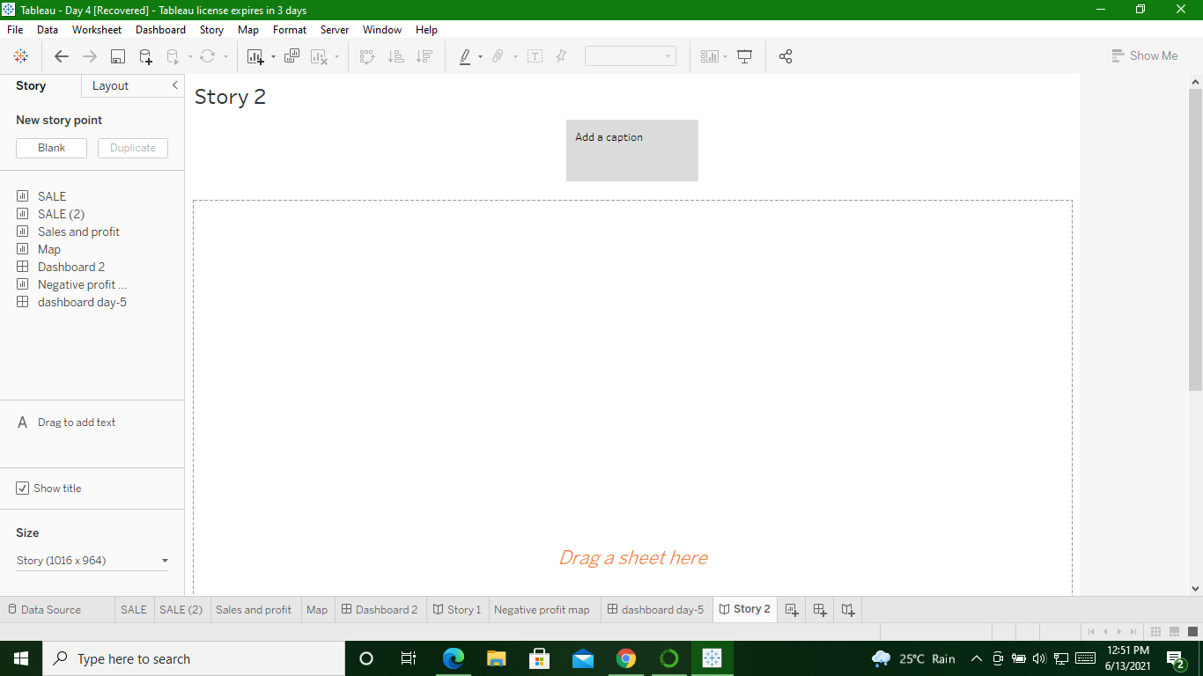

Slide 4
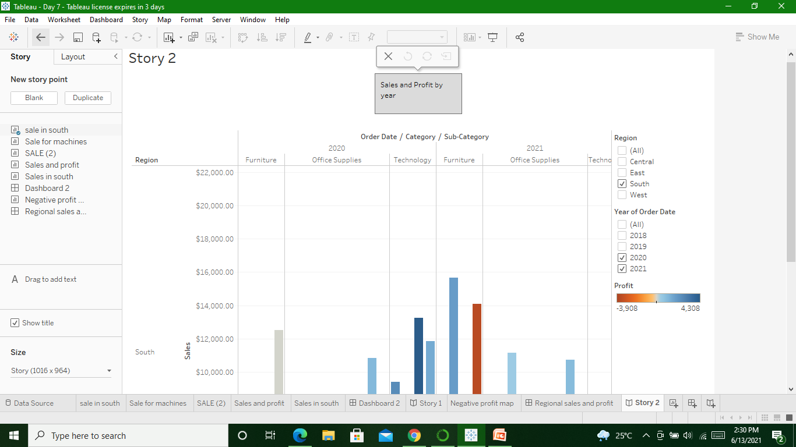
Show sales in your south worksheet in your story & add caption

Slide 5
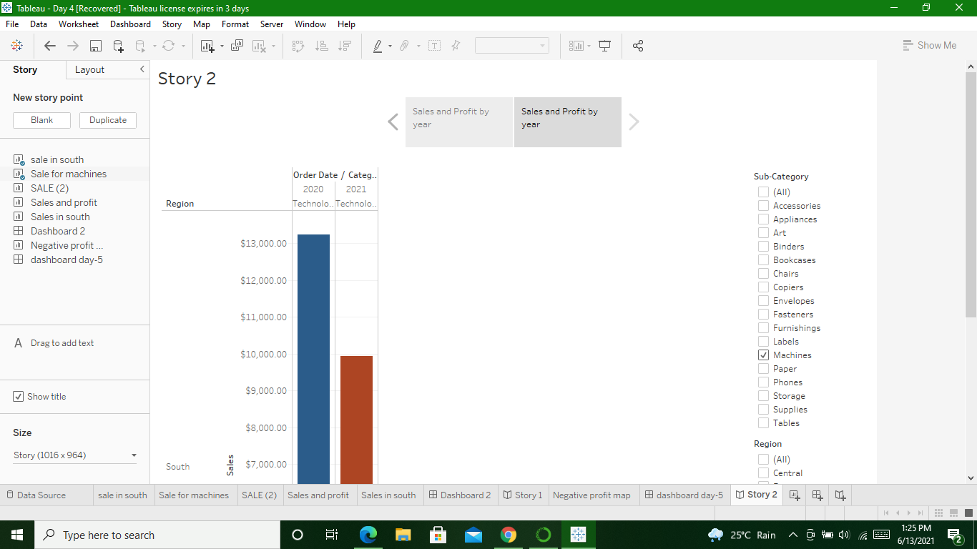
Duplicate caption and show sales for machine subcategory

Slide 6

Check Story mini toolbar

Slide 7
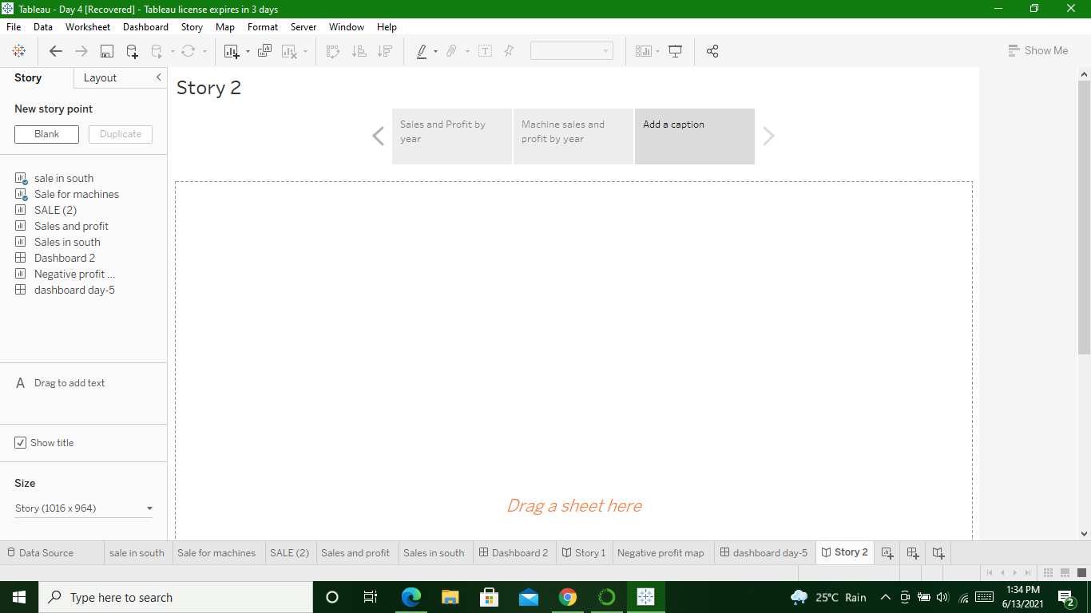
Select Blank in the Story pane,then drag and drop dashboard

Slide 8
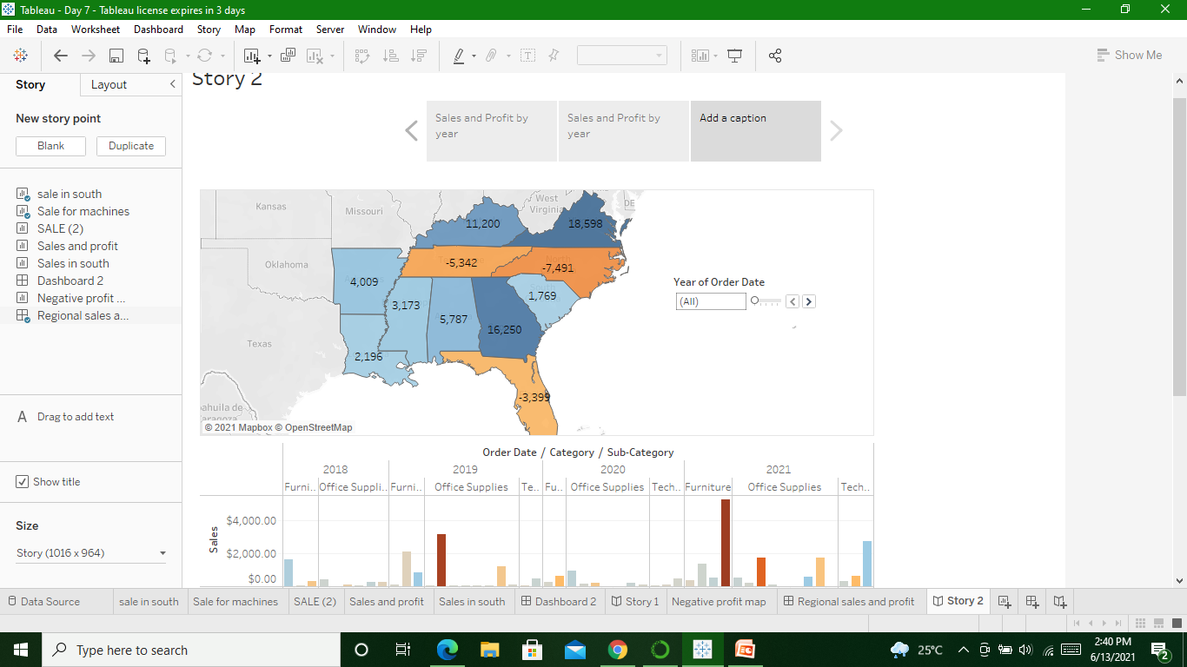

Slide 9

Add caption

Slide 10
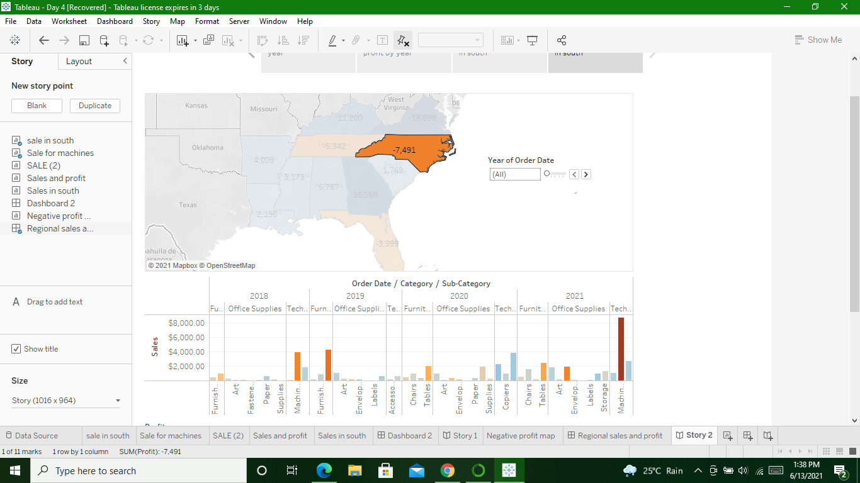
Duplicate caption & show result for north carolina for all years

Slide 11
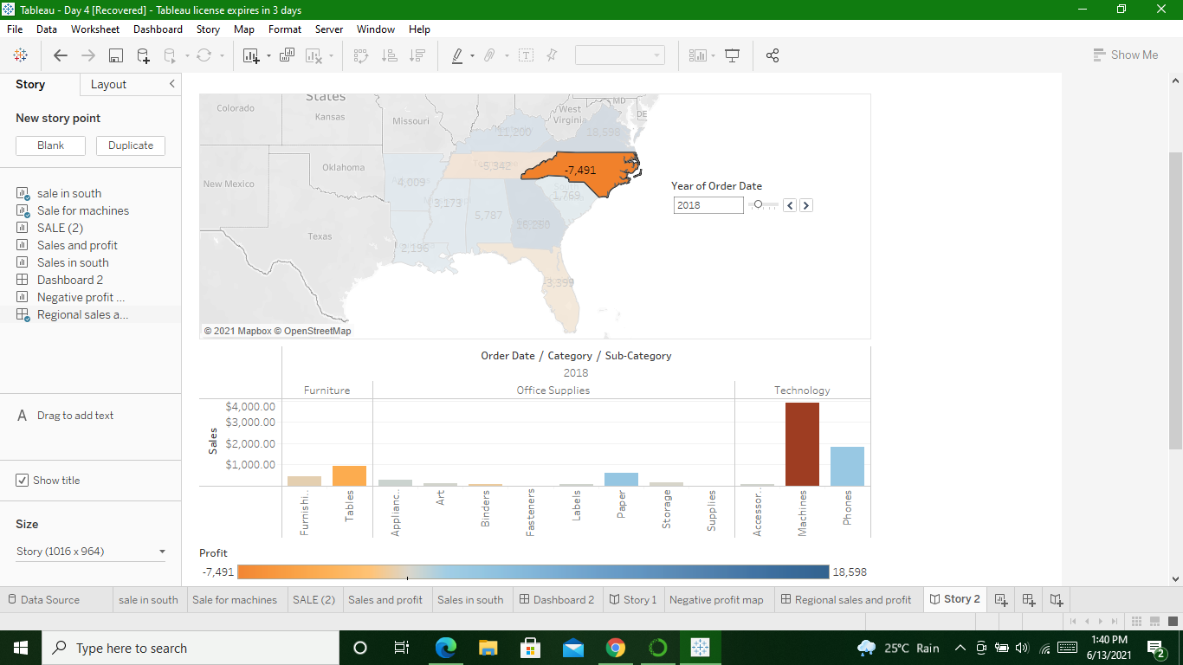
For year 2018

Slide 12
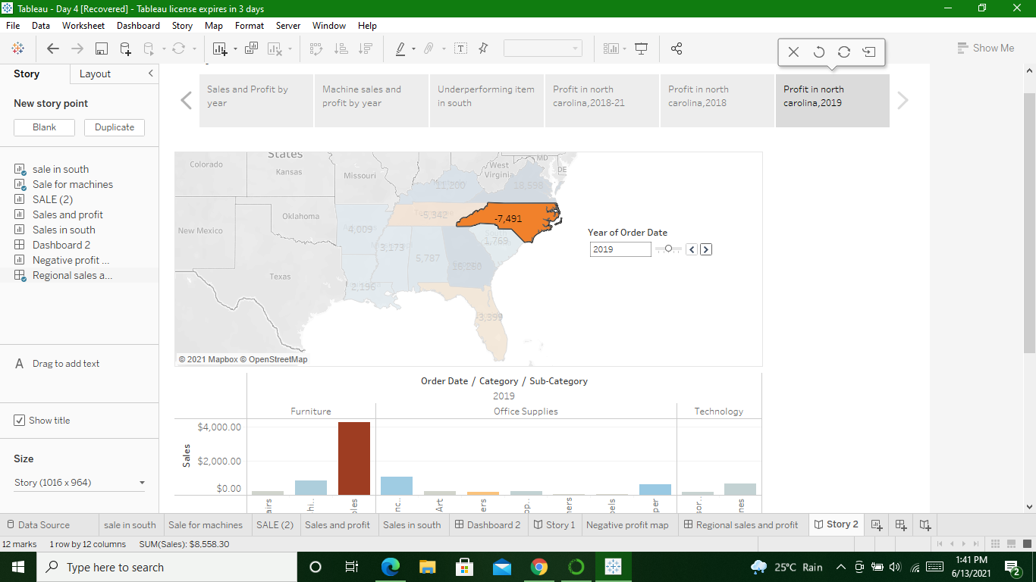
For year 2019

Slide 13
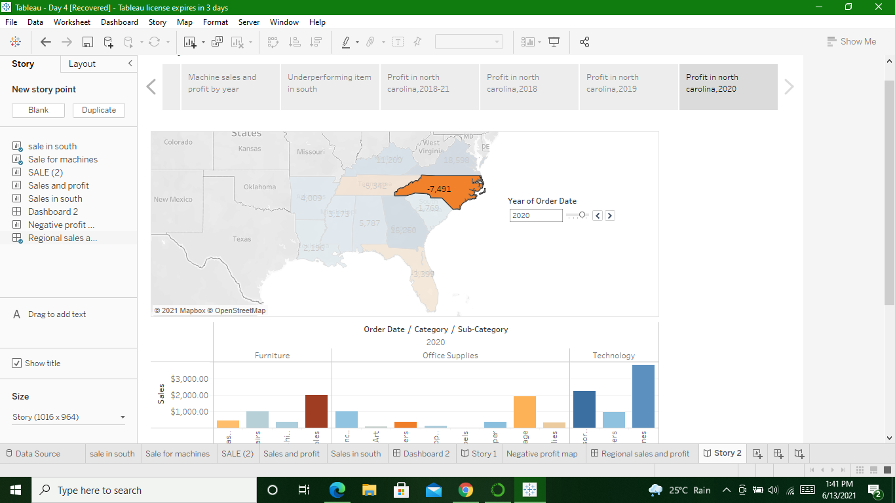
For year 2020

Slide 14
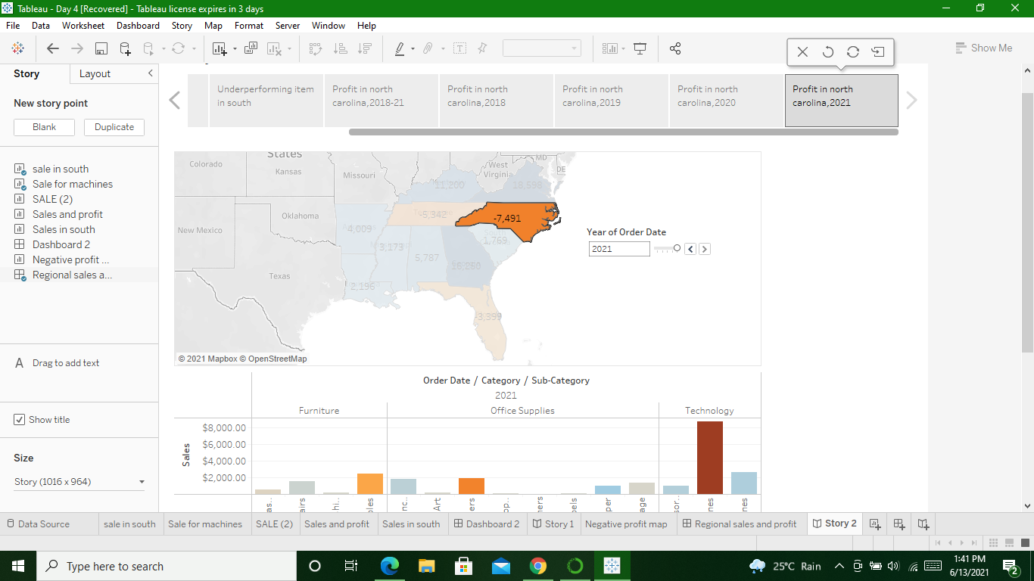
For year 2021

Slide 15
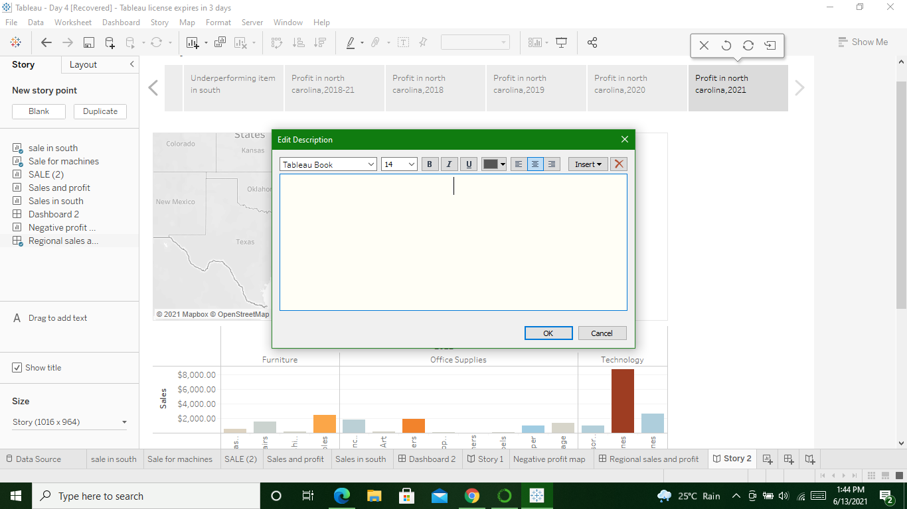
Select Drag to add text & enter a description for your dashboard

Slide 16
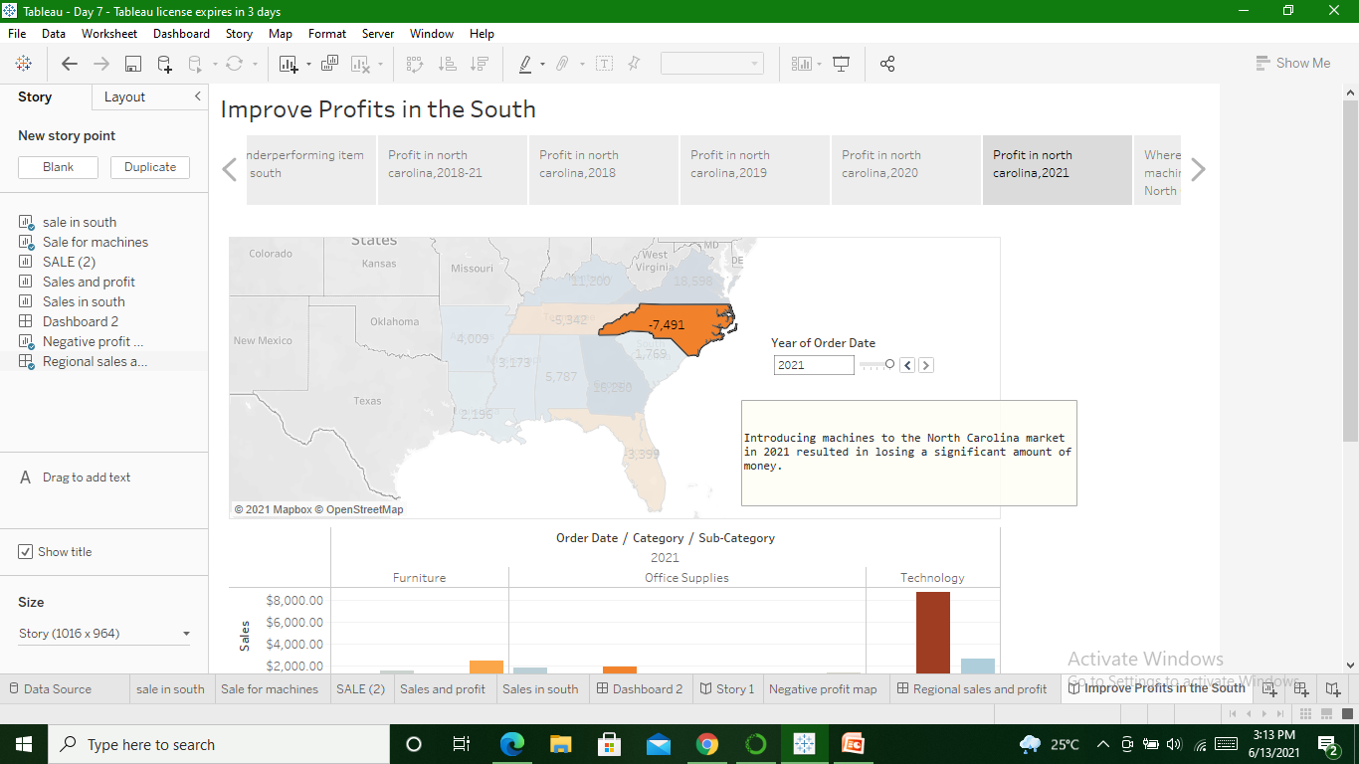

Slide 17
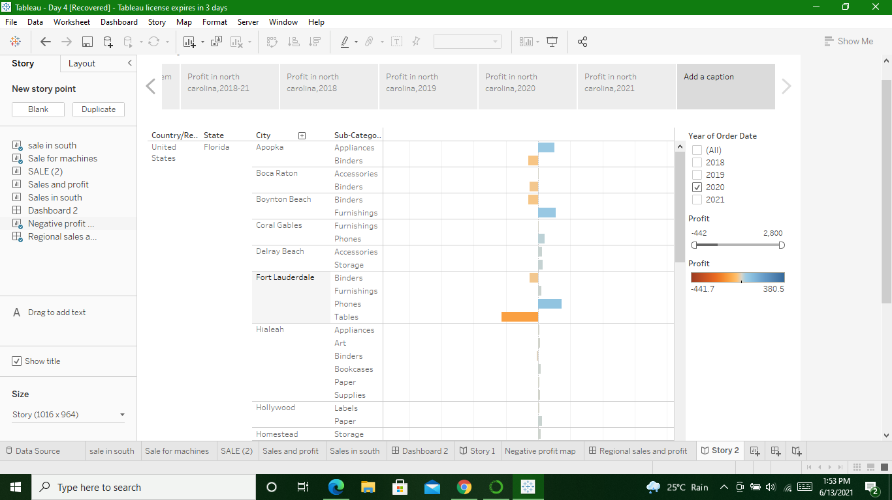
Click Blank and drag Negative Profit Bar

Slide 18
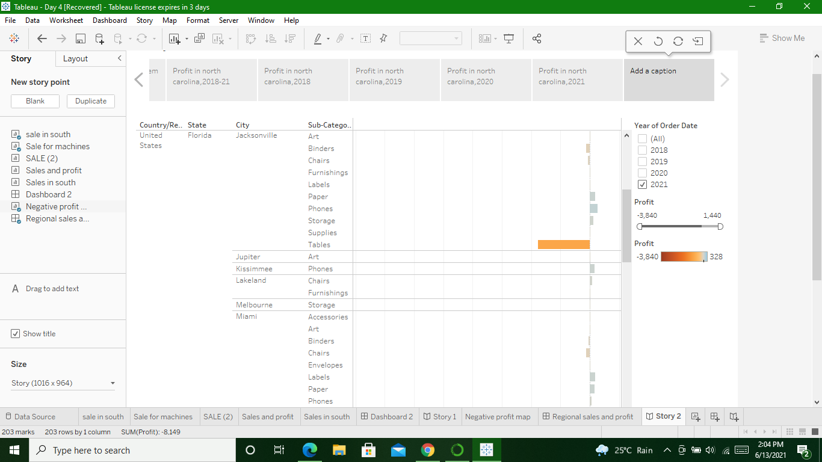
Filter for year 2021

Slide 19
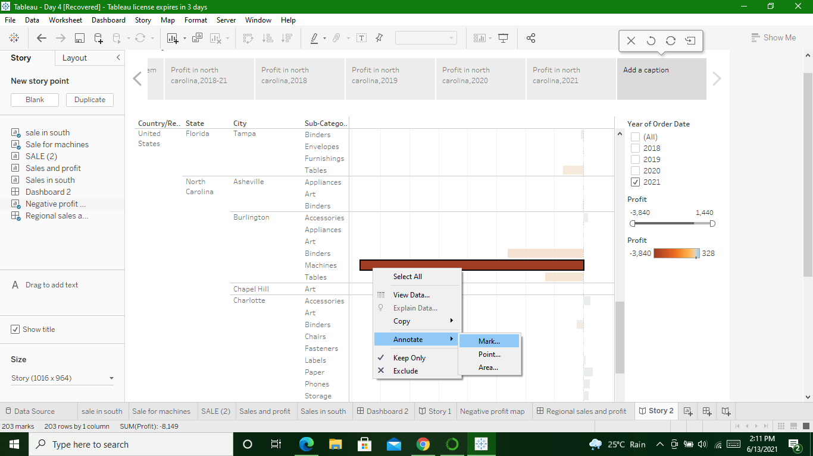
Right-click the Burlington mark (the bar) and select Annotate > Mark

Slide 20
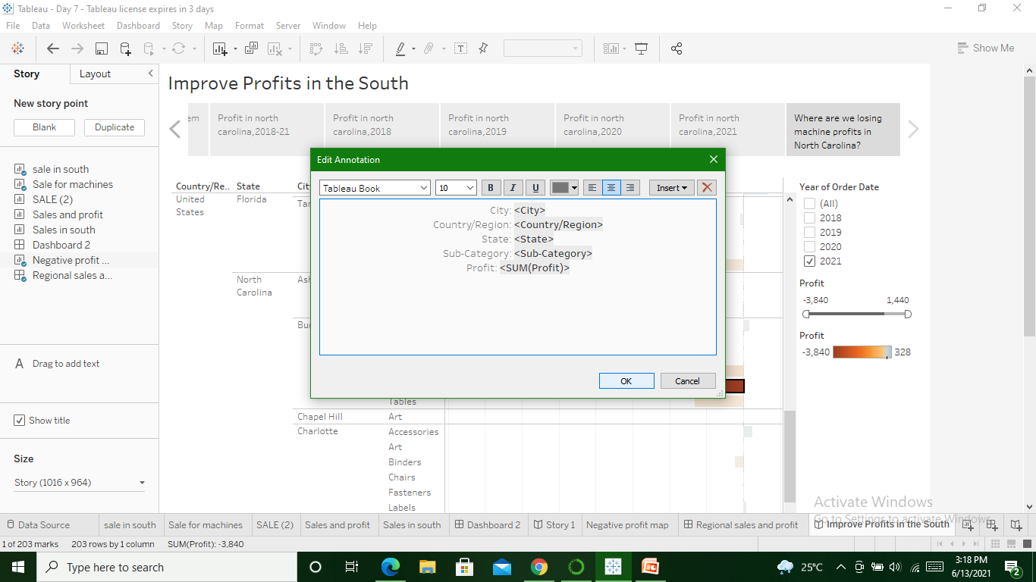
In the Edit Annotation dialog box type: "Machines in Burlington lost nearly $4,000 in 2021."

Slide 21
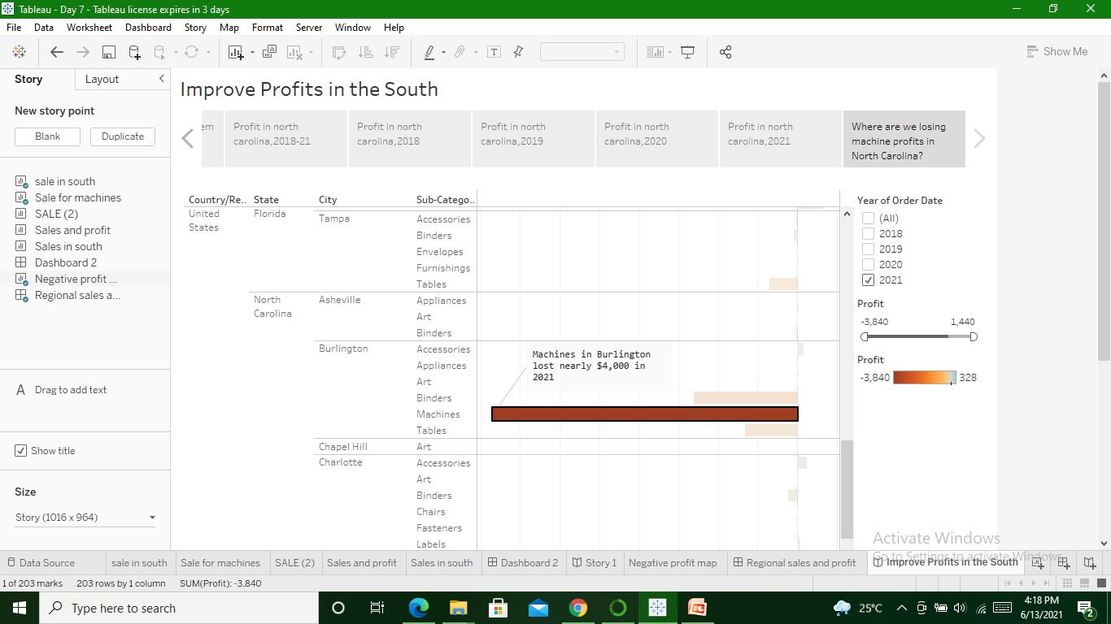

Slide 22
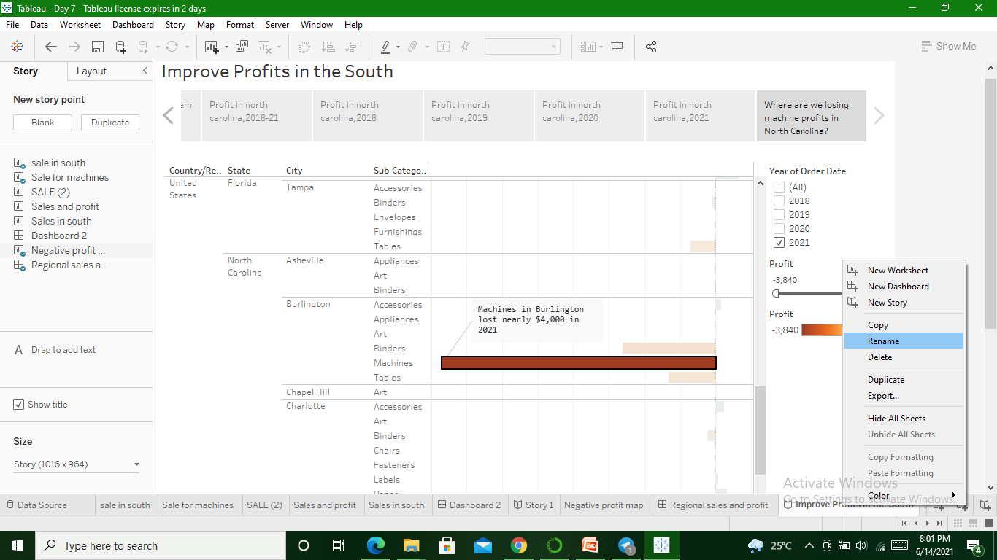
To Rename

