Slide 1
TABLEAU

Slide 2
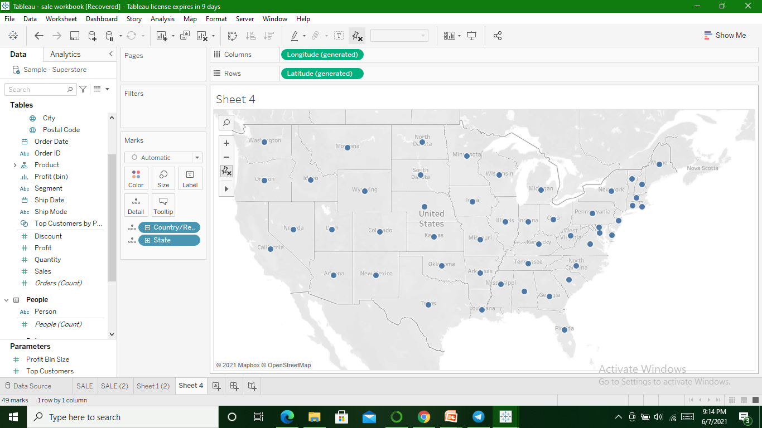
Map view to represent all the States with Country

Slide 3
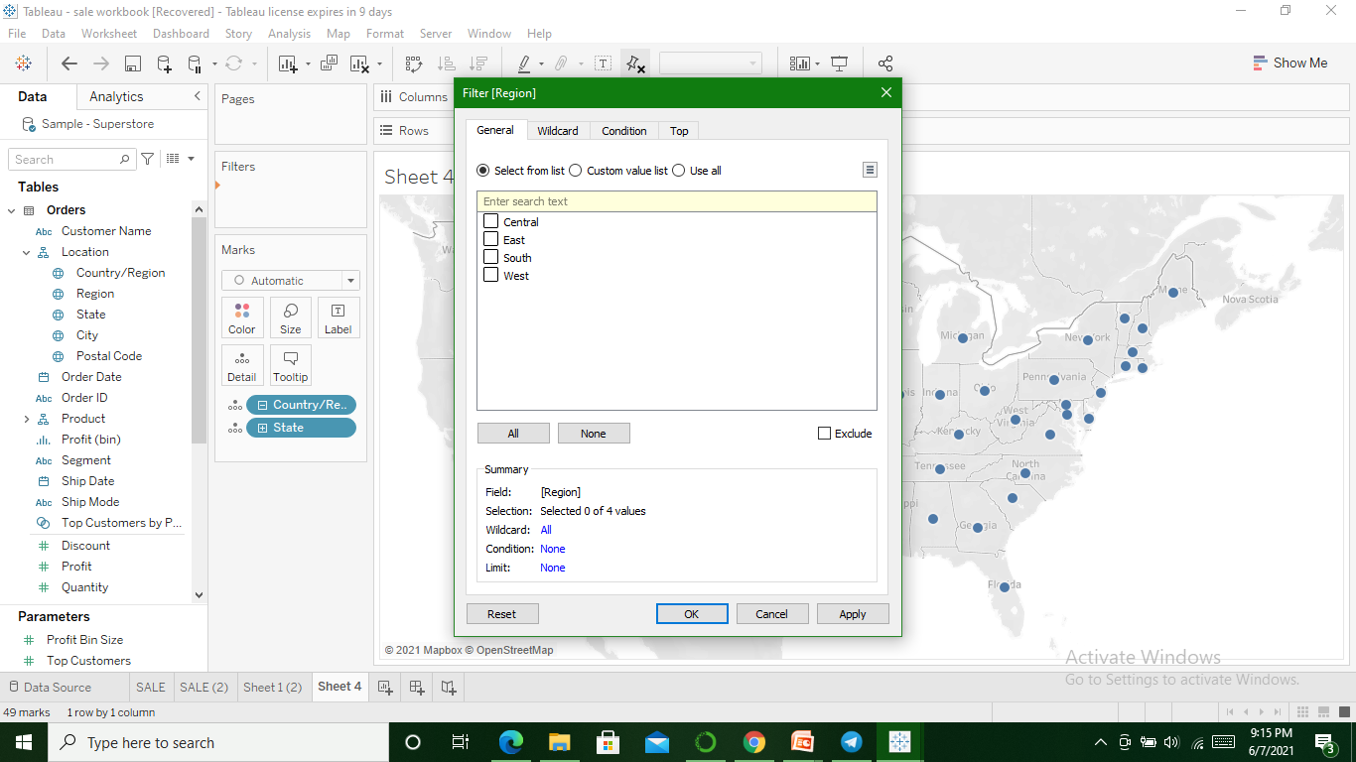
Map for South Region(Filter)

Slide 4


Slide 5
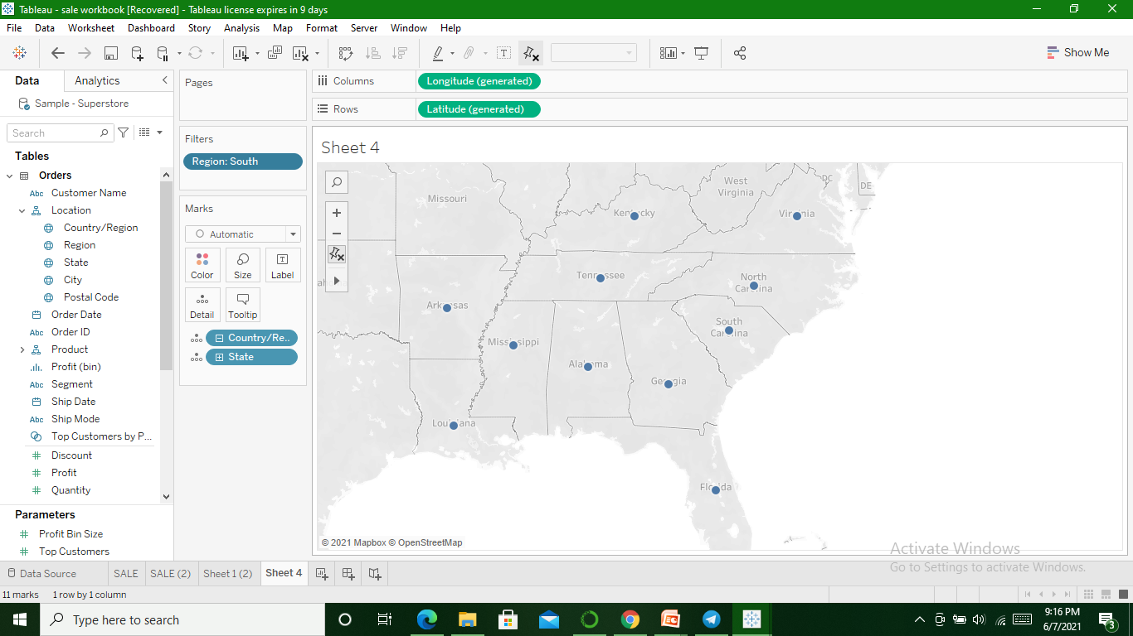

Slide 6
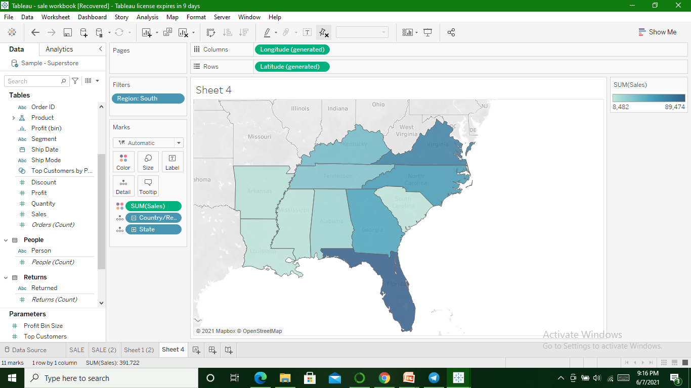
Sales for South Region

Slide 7
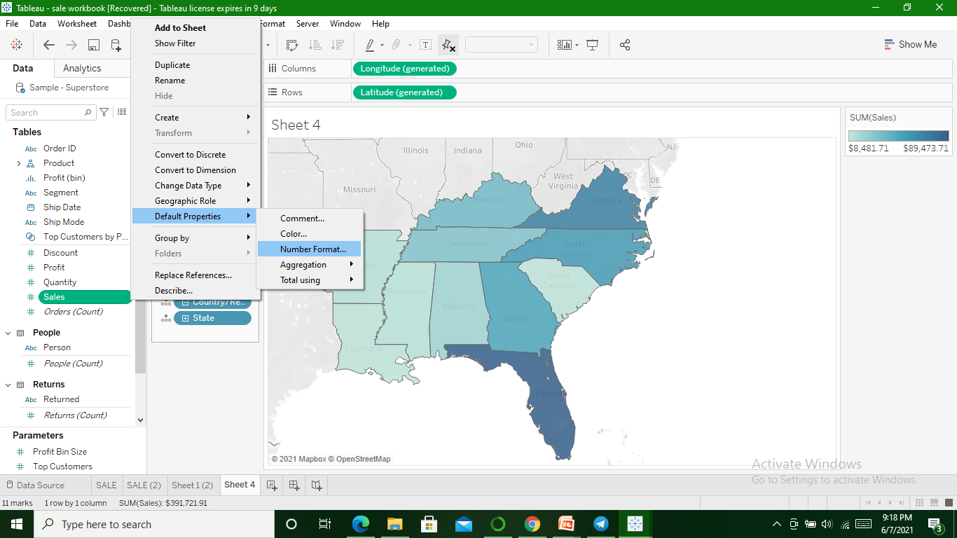
To represent Sales in USD

Slide 8
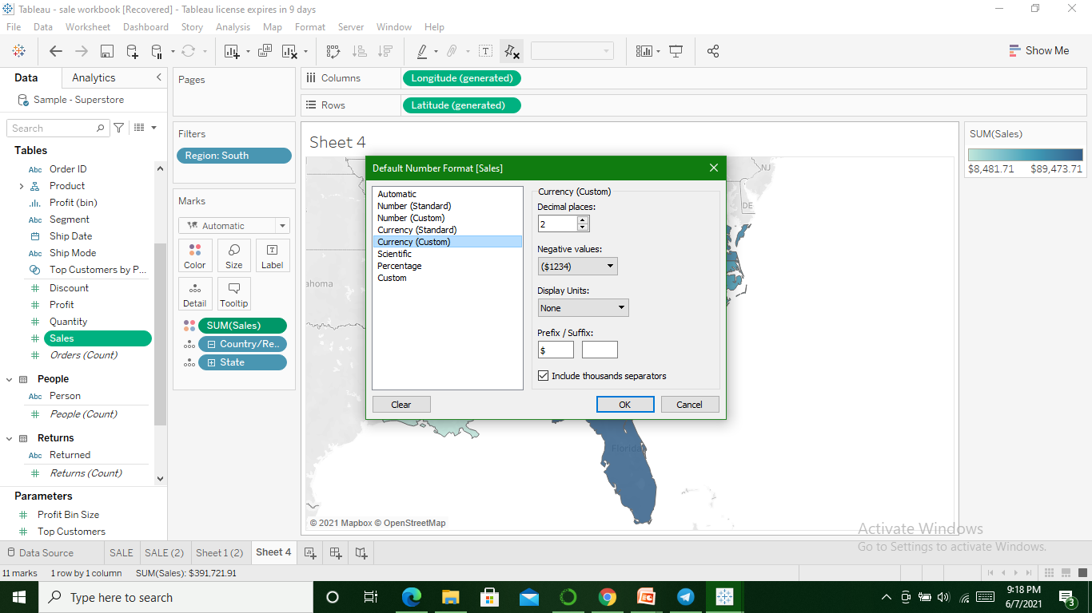

Slide 9
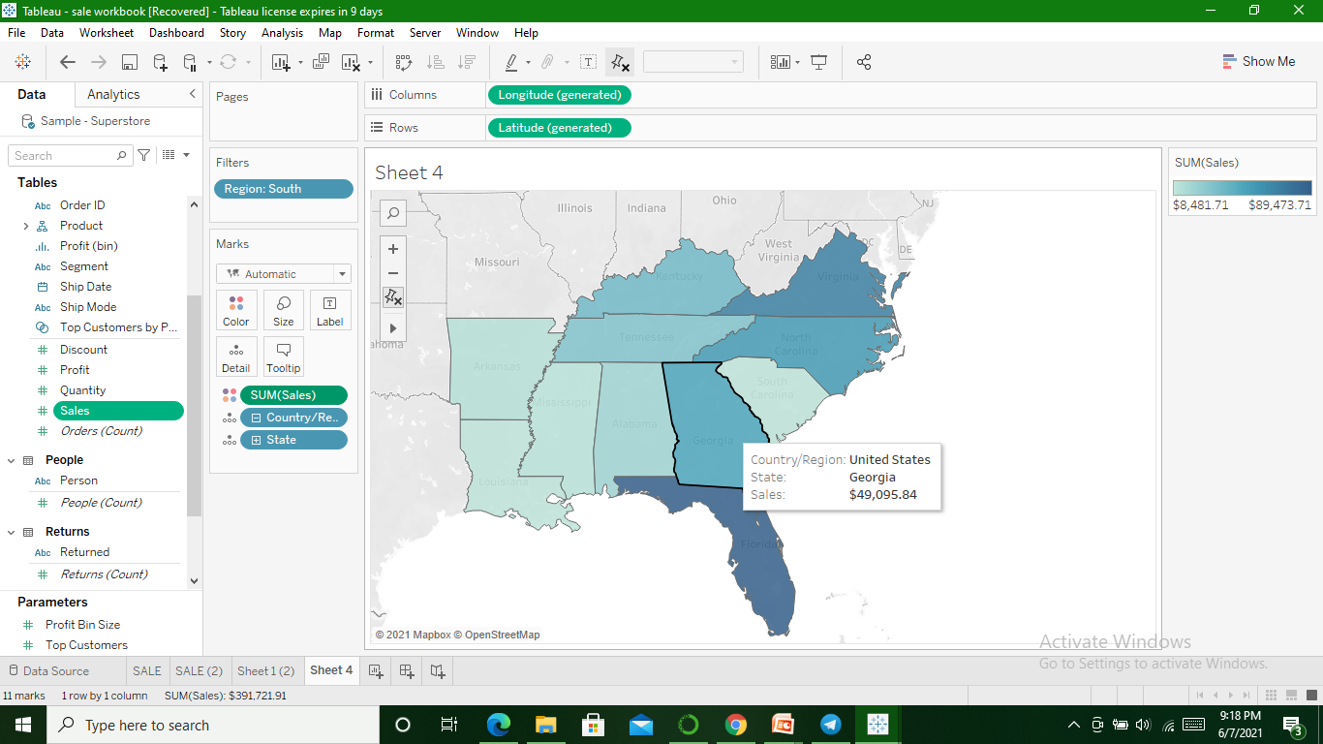

Slide 10
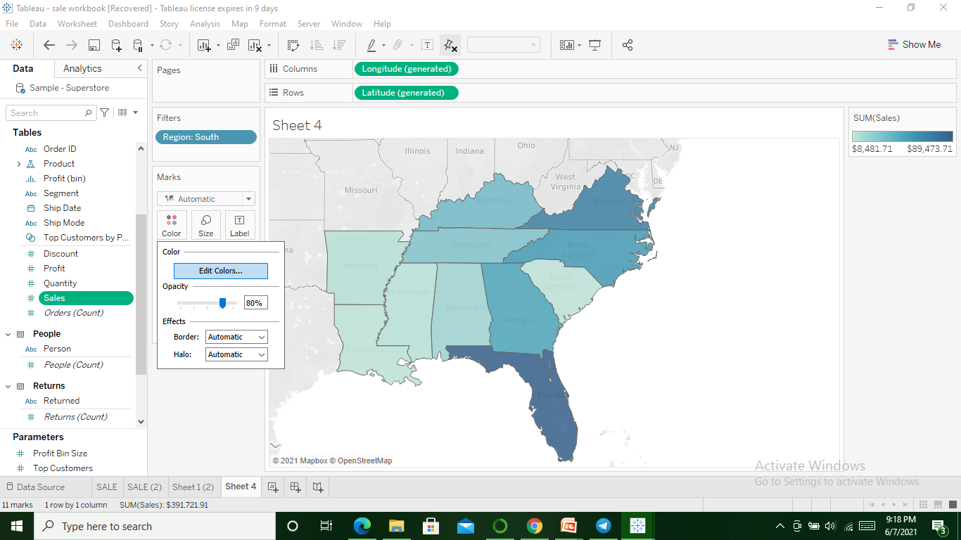
Color changing

Slide 11
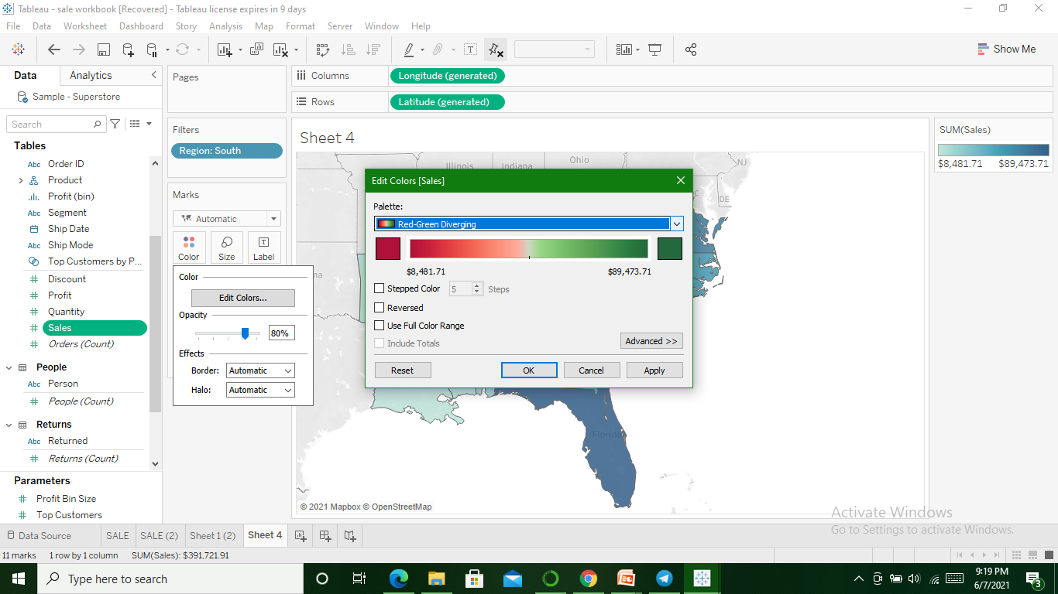

Slide 12
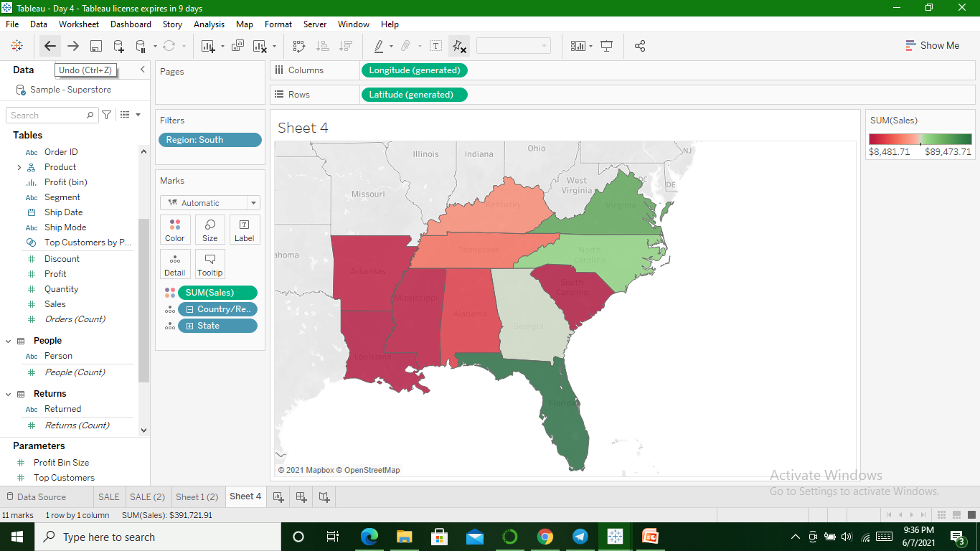

Slide 13
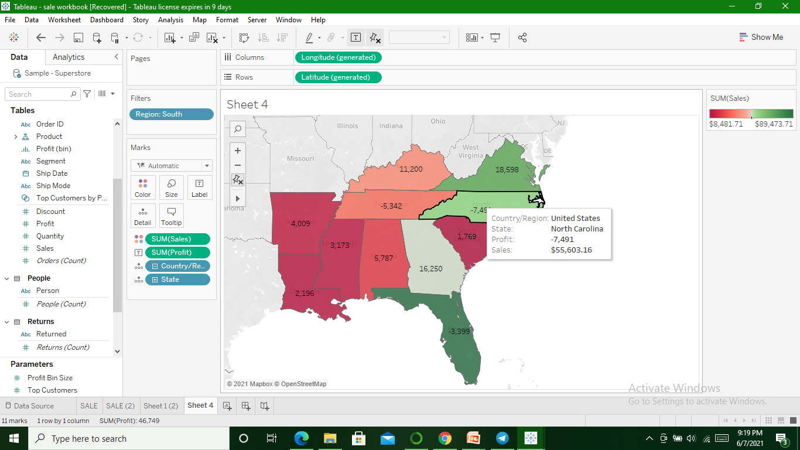
Profit for all States in South

Slide 14
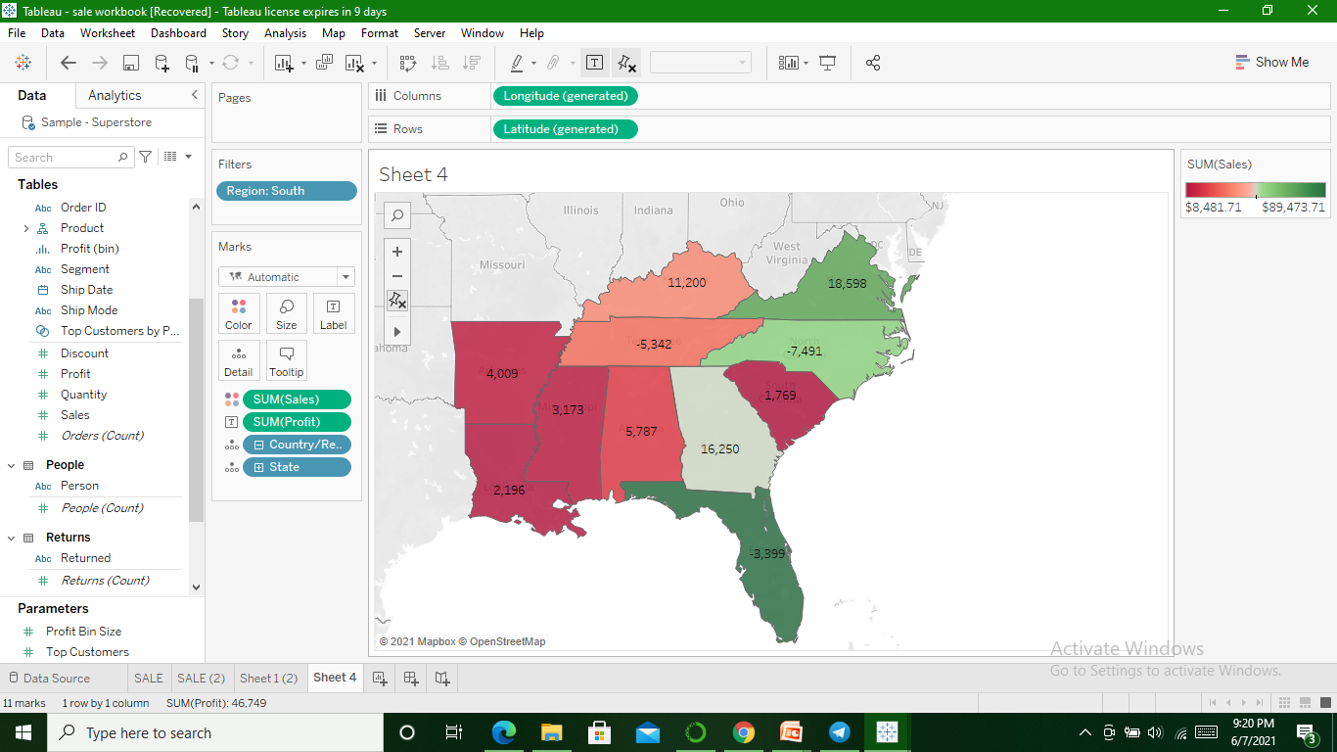
State having Negative Profit

Slide 15
United States = -7,491
Tenessee = -5,342
Florida = -3,399

