Slide 1
TABLEAU

Slide 2
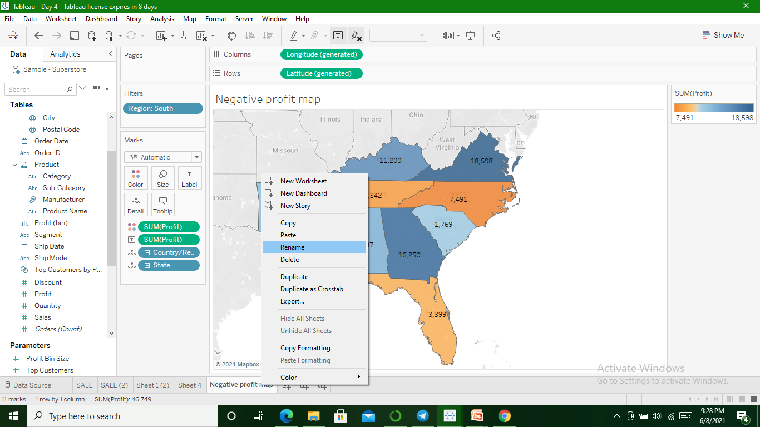
Duplicate worksheet & rename as negative profit Map

Slide 3
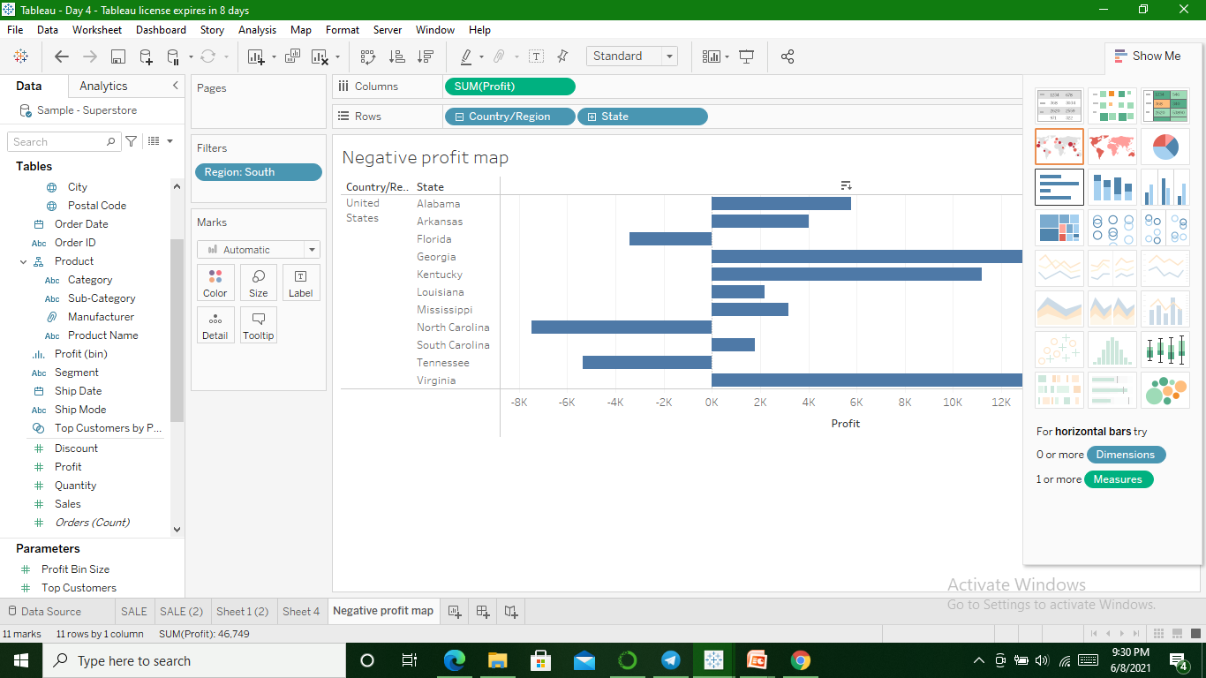
Map in horizontal Bar format

Slide 4
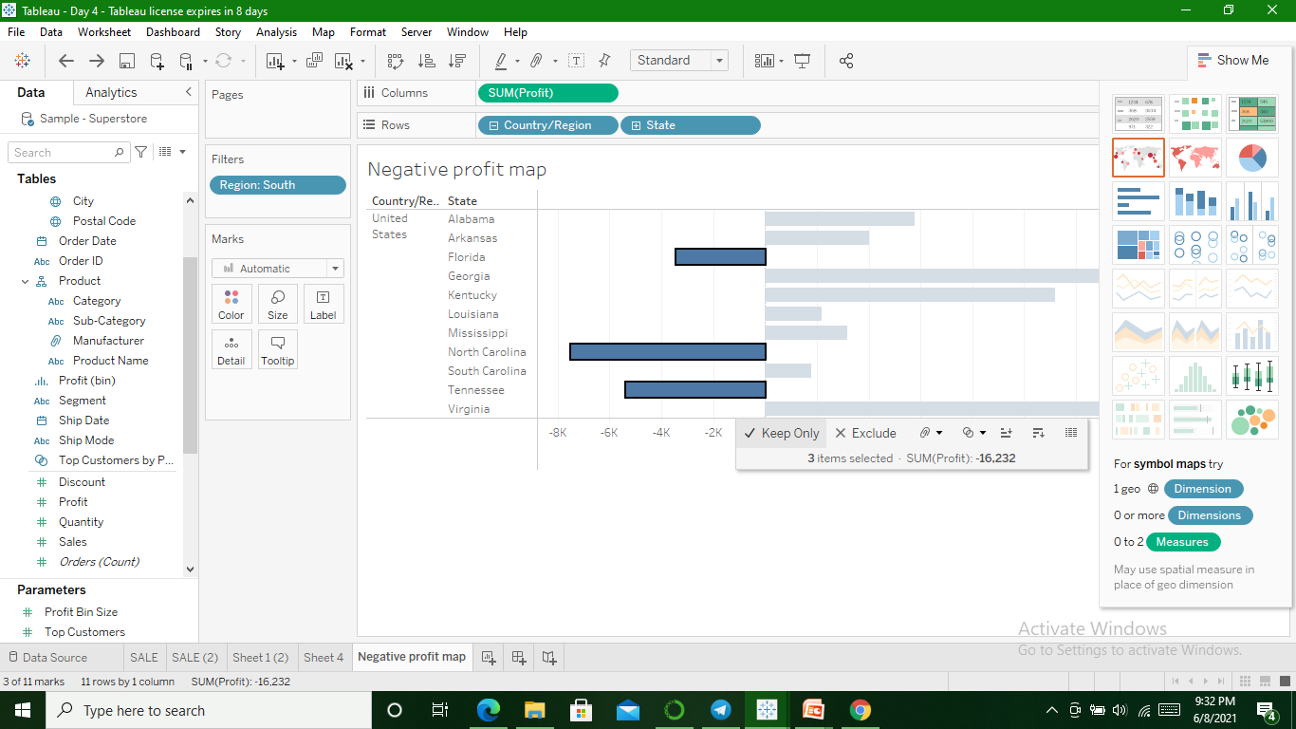
States having negative profit in Bar

Slide 5
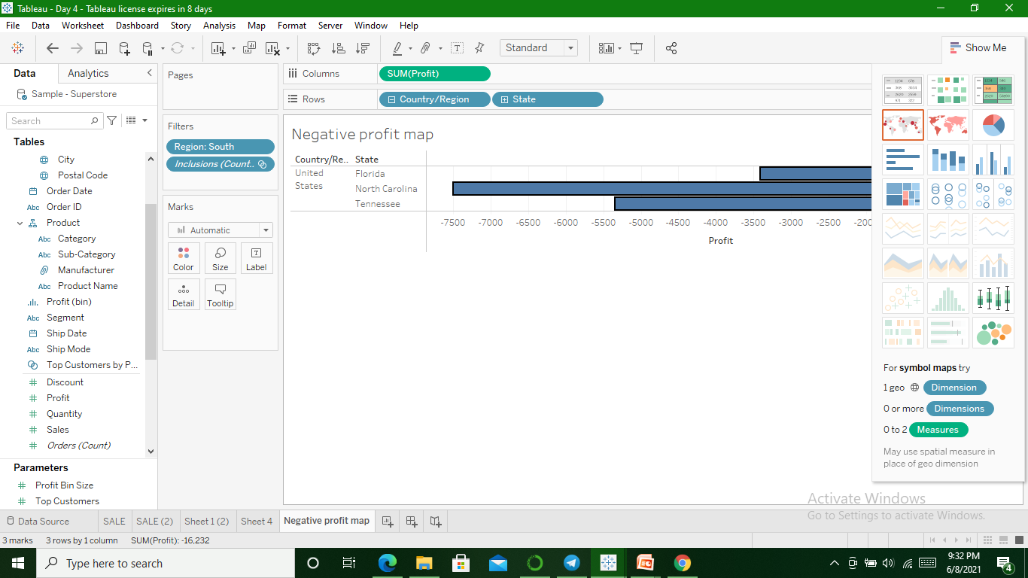

Slide 6
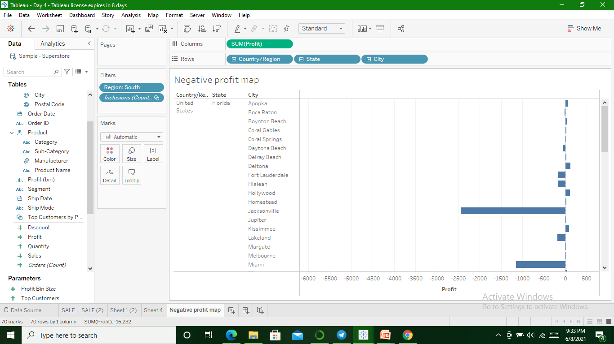
Plus icon on State field to get city level details

Slide 7
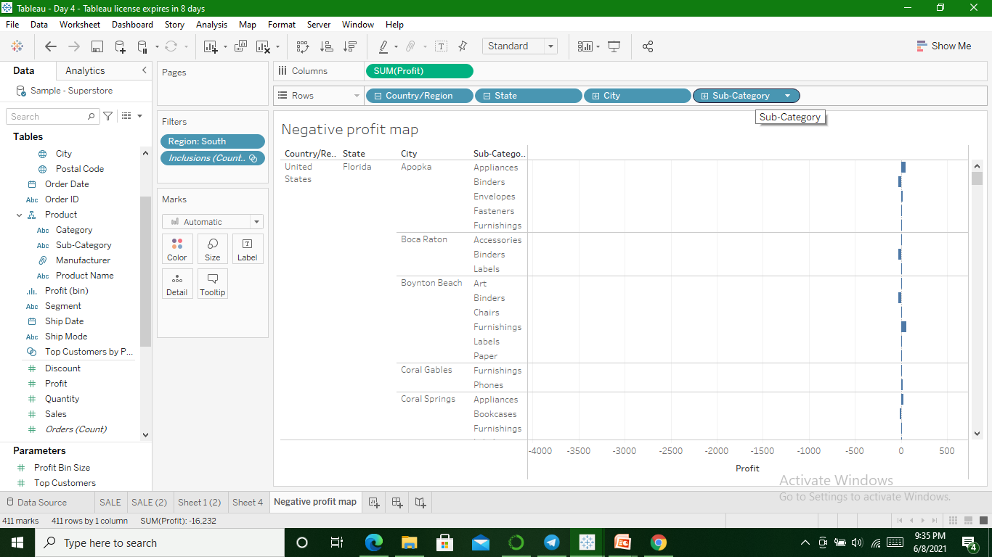
Profit subgategory wise

Slide 8
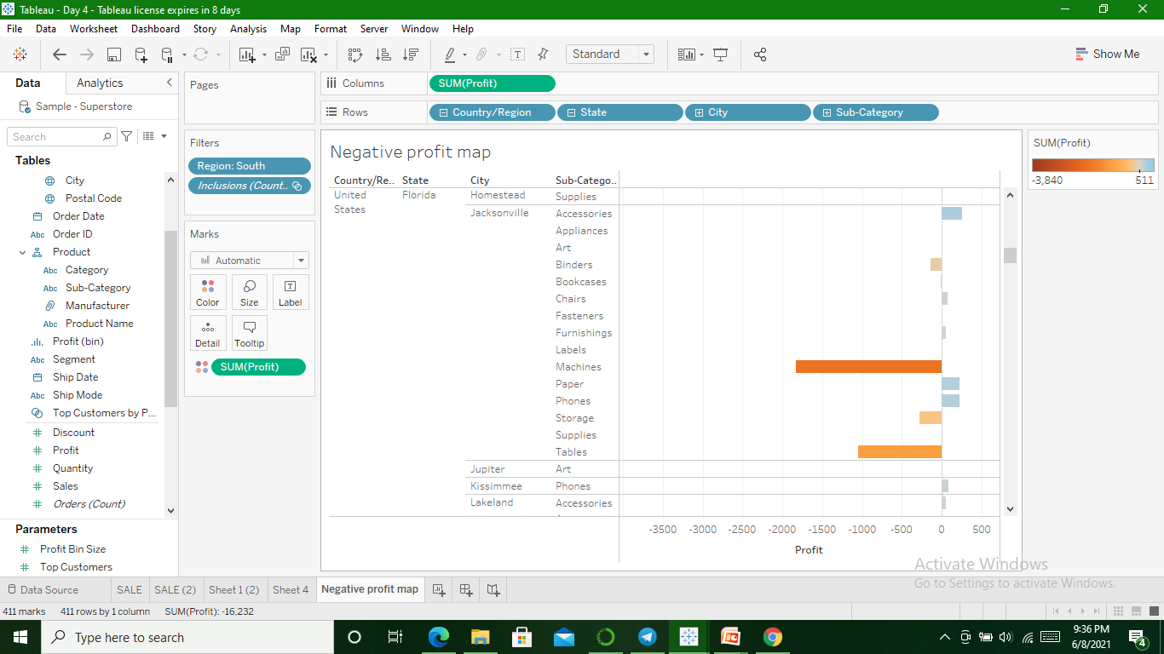
Profit in different color

Slide 9
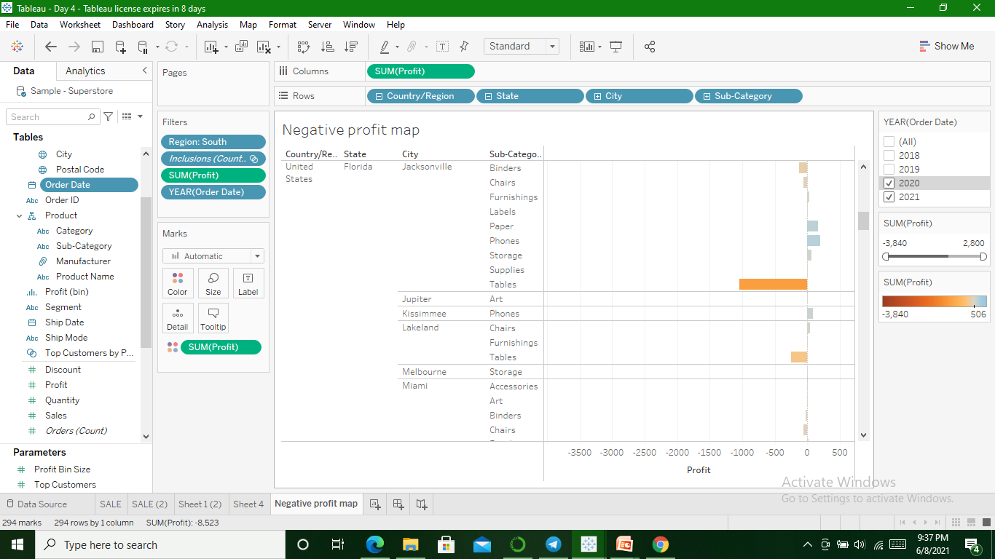
Profit in 2020 & 2021(using filter)

Slide 10
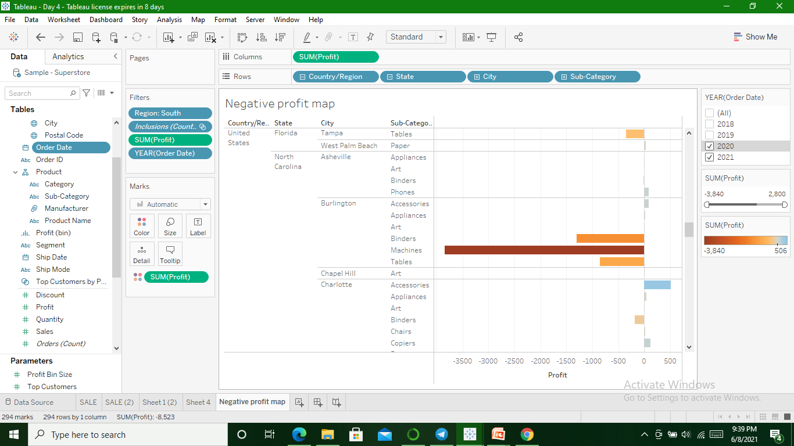
Meaningful information & suggestion to increase profit

Slide 11
In Burlington City of North Carolina State machine,binders & Table having huge negative profit. So either stop sales for those subcategories in particular city or concentrate on techniques to increase their sales.

