Slide 1
TABLEAU

Slide 2
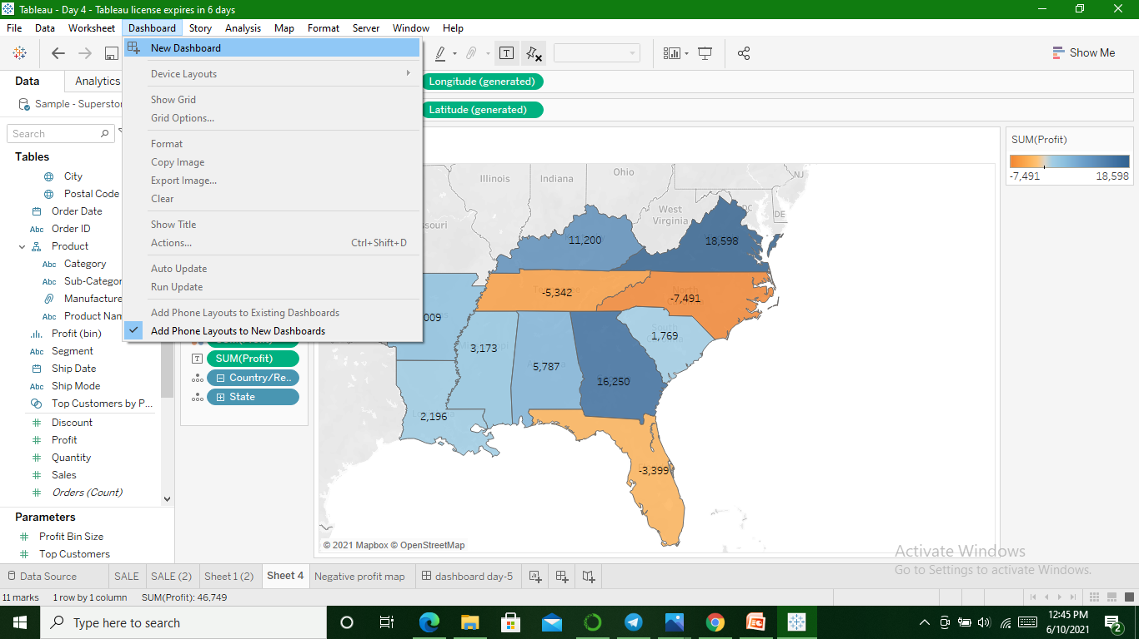
Build a Dashboard

Slide 3
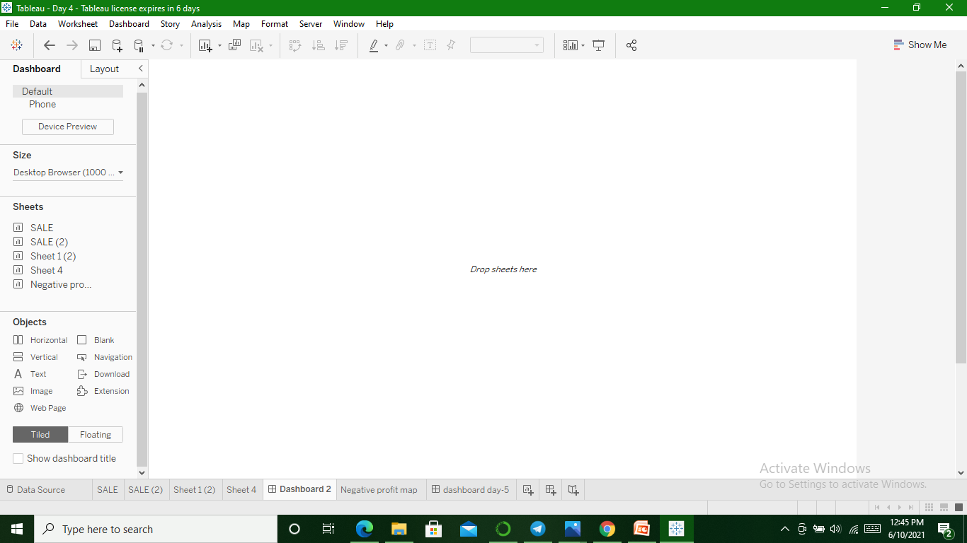

Slide 4
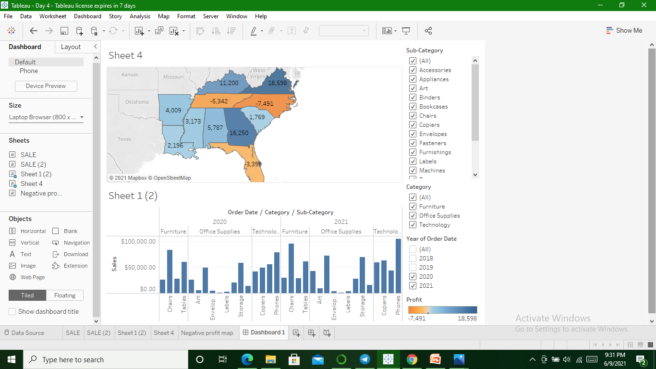

Slide 5
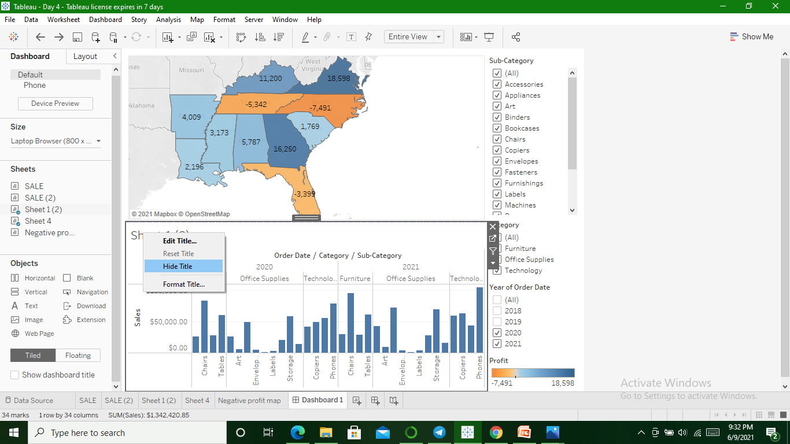
Arranging Dashboard(hide titles)

Slide 6
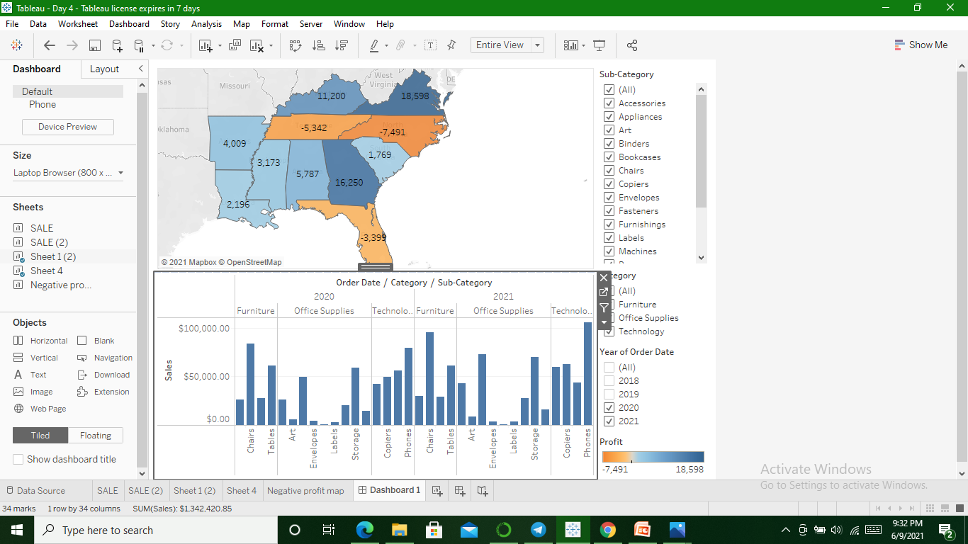

Slide 7
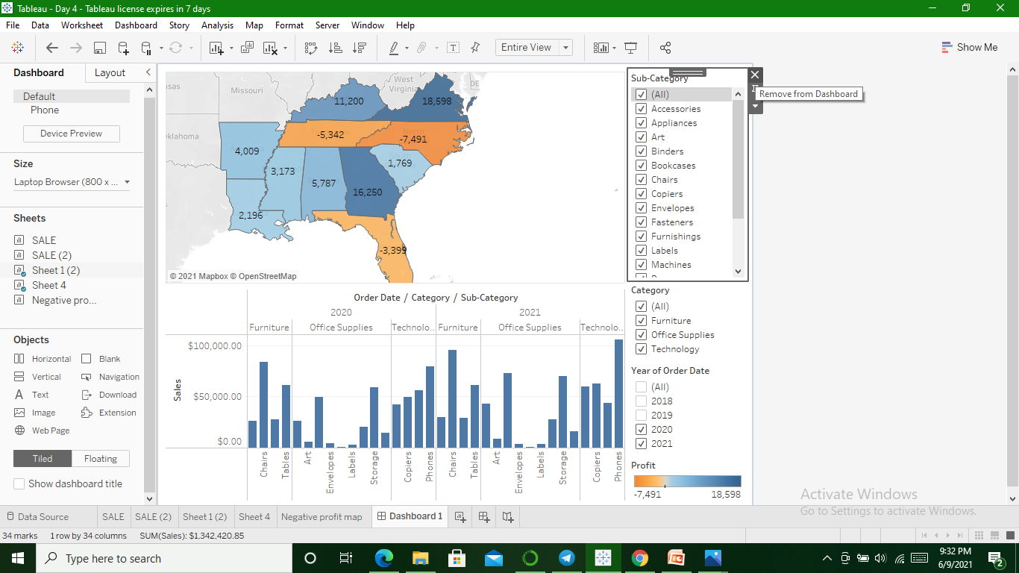
Remove the filter options to vacate space

Slide 8
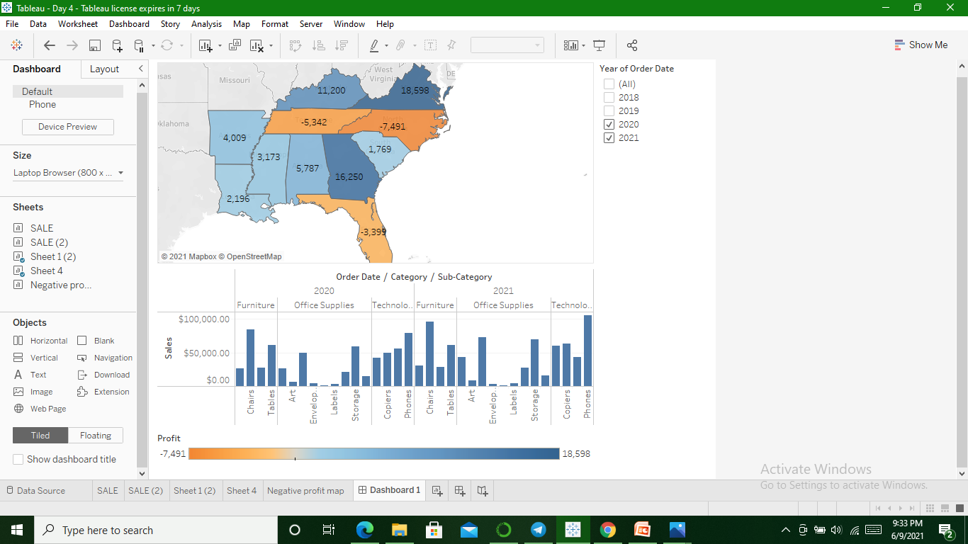

Slide 9
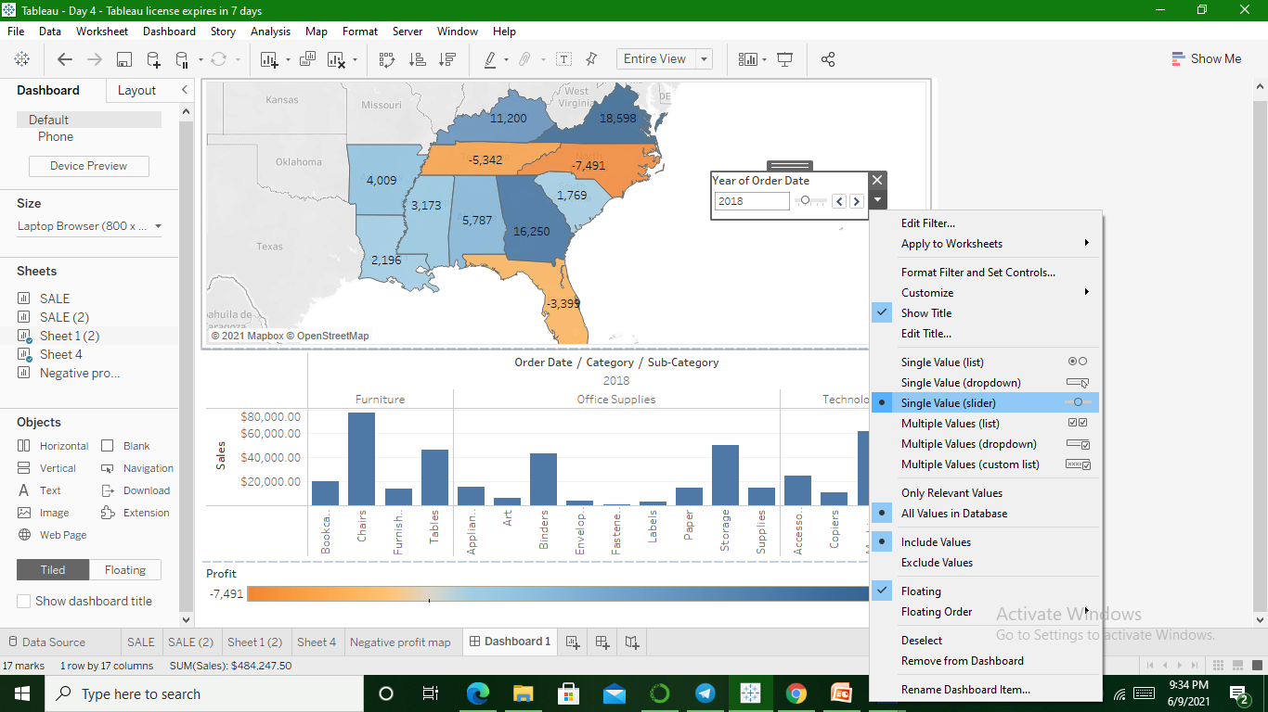
Removing Year filter options and converting to User friendly

Slide 10
Drag profit legend to south of sales

Slide 11
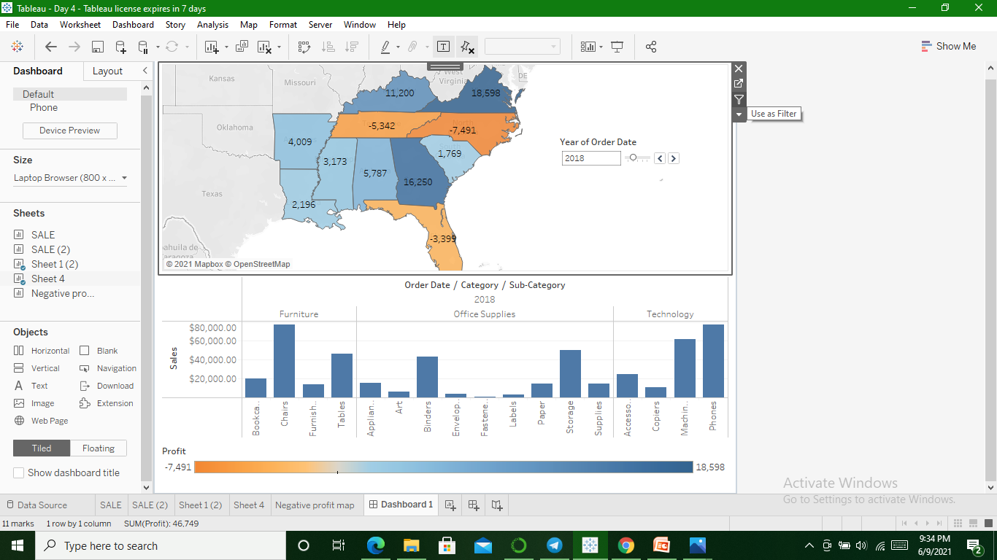
Make your Dashboard interactive

Slide 12
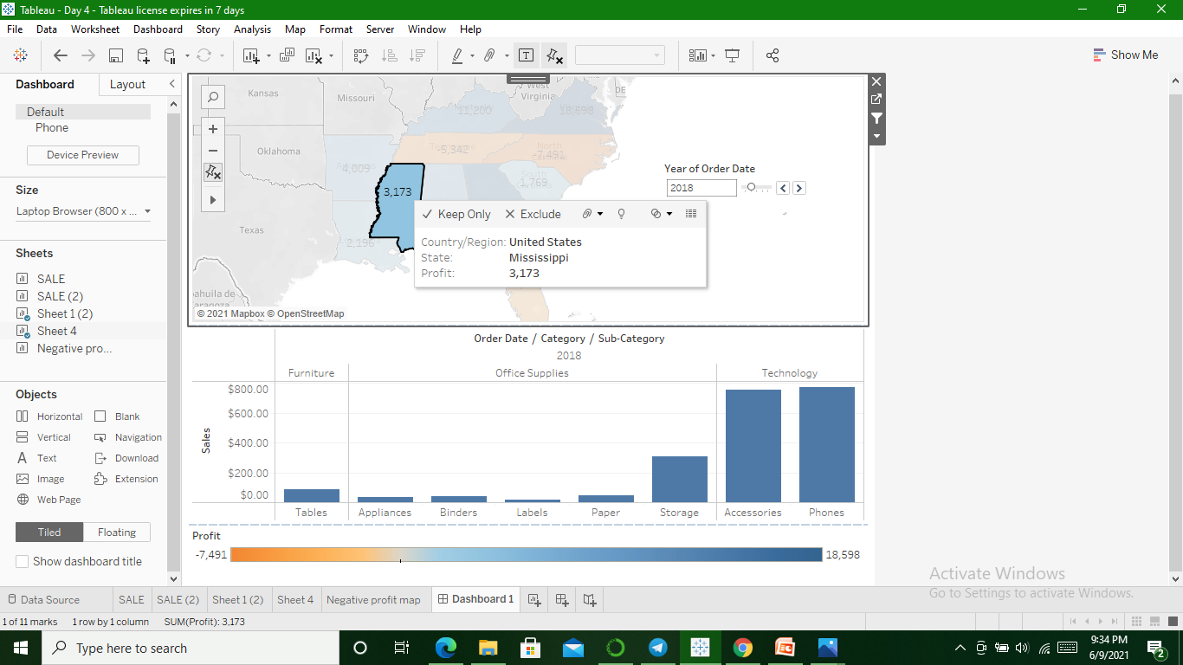

Slide 13
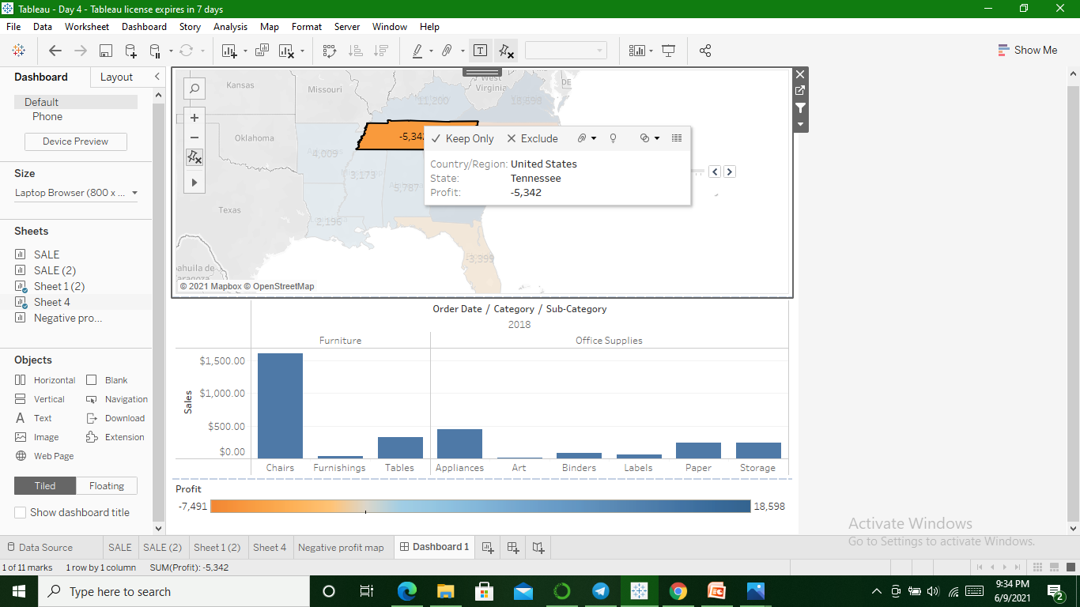

Slide 14
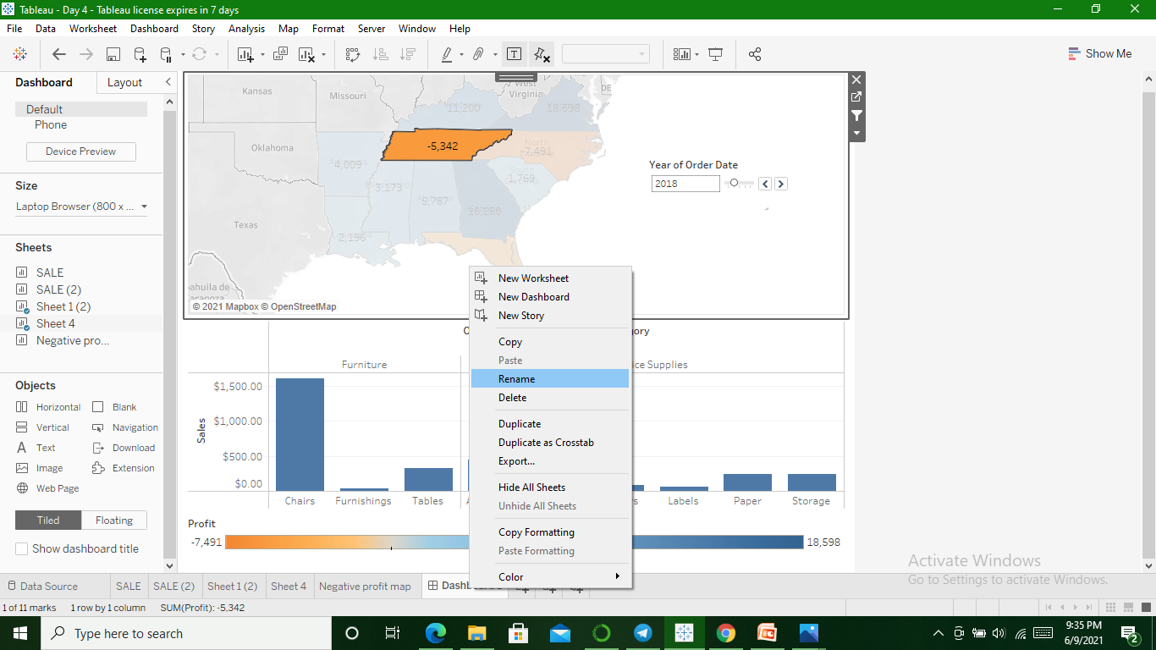
To Rename Dashboard

