Slide 1
FINAL DEFENCE · BACHELOR OF COMPUTER APPLICATION
36
SignSathi
Real-Time Nepali Sign Language Recognition App
Devanagari consonants
Fingerspelling to Nepali text and speech, fully on-device for Android
Arjun Raj Acharya & Asha Mohan Tamang
Supervisor: Mr. Santosh Neupane
Xavier International College · Tribhuvan University
Notes:
Introduce the project: SignSathi is a mobile app that recognises Nepali Sign Language fingerspelling from a live camera and turns it into Nepali text and speech, entirely on the phone.

Slide 2
Problem and objectives
The problem
Our objectives
Deaf people in Nepal struggle to communicate with those who do not know Nepali Sign Language. Interpreters are scarce in hospitals, schools, offices and public services. Existing NSL research chases accuracy but rarely delivers a real-time, offline mobile tool.
Recognise NSL characters from live camera input in real time
Build a user-friendly mobile app that outputs Nepali text and speech
Evaluate reliability through performance measures and testing
Notes:
Problem: communication gap and few interpreters. Gap in literature: lightweight, real-time, offline NSL recognition on mobile. Three objectives from the report.

Slide 3
How SignSathi works
1
2
3
4
5
Camera
MediaPipe
MLP classifier
Stabiliser
Speech
Live frames from the phone camera
Hand detected; 21 landmarks, 63 x-y-z values
78-feature vector to one of 36 characters (TFLite)
Character confirmed across consecutive frames; pauses form words
Nepali text shown, then spoken with text-to-speech
Everything runs on the device: no server, no internet. Built with Flutter and Dart, MediaPipe, TensorFlow Lite and Android text-to-speech.
Method: Waterfall with iterative model and app development
Notes:
Walk left to right through the pipeline. Stress that hand detection happens first, so the classifier only sees hand-structure features, not the whole camera frame.

Slide 4
Key features
1
Recognise
2
Stabilise
3
Compose
36 Devanagari consonants from live fingerspelling
Only consistent predictions are accepted, so no flicker or repeats
Characters become words and sentences using signing pauses
4
Speak
5
Offline and private
6
Data collector
Recognised Nepali text played aloud on request
Inference on-device; camera data never leaves the phone
Companion app to capture, crop, label and export the dataset
Notes:
Six capabilities. The data collector is a separate Flutter app used to build the 7,200-image dataset.

Slide 5
Dataset and features
17
36
78
images collected with a purpose-built capture app
Devanagari consonant classes
features per hand, built from 21 landmarks
From landmarks to a 78-feature vector
63 raw values (21 landmarks × x, y, z) become joint positions, fingertip distances and finger-bending information
Normalised to reduce the effect of hand position, camera distance and lighting; 80/20 train-test split
Notes:
The dataset was collected with our own app: MediaPipe checks hand presence and quality, the hand is cropped and saved. Engineered features make the classifier robust to position and distance.

Slide 6
Model: lightweight MLP
Input
Gaussian noise
Dense 256
Dense 128
Output
78 features
›
σ = 0.05
(training only)
›
ReLU + BatchNorm
+ Dropout 0.3
›
ReLU + BatchNorm
+ Dropout 0.3
›
36 logits
(one per class)
Training and deployment
Adam optimiser (learning rate 0.001), categorical cross-entropy, 100 epochs, batch size 32
Converted to TensorFlow Lite for fast, offline inference on the phone
Notes:
Small network by design: two hidden layers, narrowing from 256 to 128. Gaussian noise, batch norm and dropout limit overfitting. TFLite conversion enables on-device use.

Slide 7
Algorithms used
1
2
3
Landmark features
Temporal stabilisation
Sentence formation
MediaPipe finds 21 landmarks; positions, fingertip distances and bending are normalised.
A character is accepted only when predictions agree across consecutive frames.
Timing gaps between confirmed characters decide word and sentence boundaries.
63 raw values to 78 features
Same label over several frames
Gap vs. pause thresholds
Feature vector fed to the MLP
Stable and confident = confirmed
Short pause = word, long = sentence
Notes:
Stabilisation is what makes a live camera usable: without it, per-frame predictions flicker and repeat characters. Pause-based boundaries turn confirmed letters into words and sentences.

Slide 8
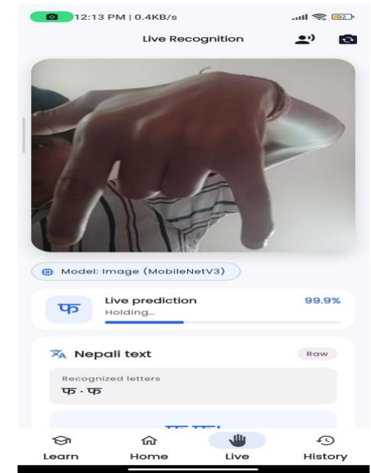
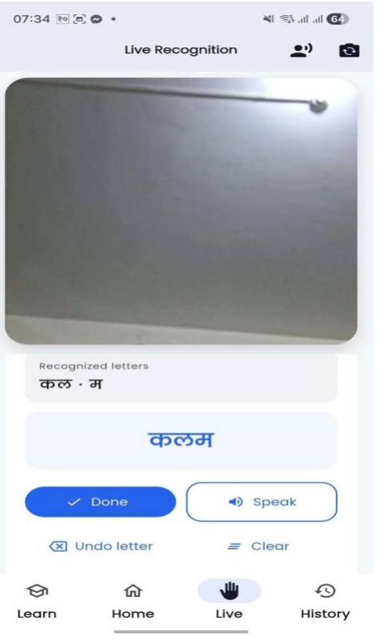
The app in action
What you see
Live prediction with confidence score
Hold-to-confirm progress bar
Letters collected into a word
Speak, Undo and Clear controls
Notes:
Left: single-character recognition with 99.9% confidence. Right: letters combined into a Nepali word, with Done, Speak, Undo and Clear controls.

Slide 9
Model performance
94.23%
test accuracy
across all 36 consonant classes. Training and validation curves stay close together, so the model generalises well.
Notes:
Accuracy 94.23%, precision 94.61%, recall 94.24%, F1 94.22% on the test set. Training and validation loss converge; best epoch around 63.

Slide 10
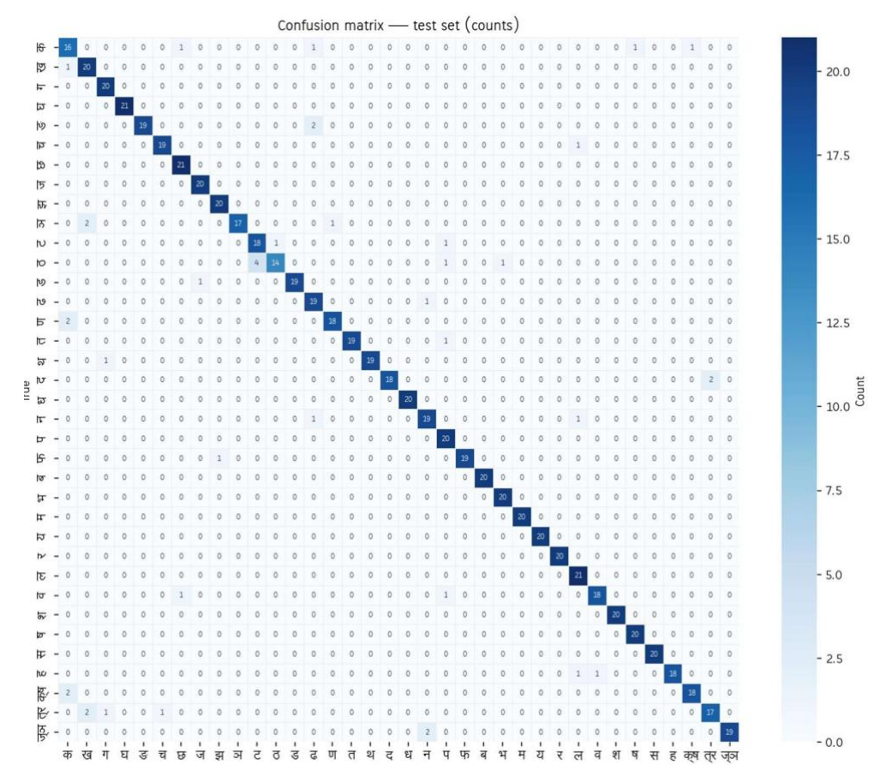
Where the model gets confused
Takeaways
Strong diagonal: most classes are recognised almost perfectly
Errors come from visually similar hand shapes
Largest confusion: ठ is sometimes read as ट
More samples and better features can close the gap
Notes:
Most mistakes are between signs that look alike; the clearest example is ठ predicted as ट. The class-wise matrix shows where extra data or features would help most.

Slide 11
Testing and results
60 / 60
17 / 17
unit tests passed
system tests passed
Collector app: capture, labels, export (28). Recognition app: camera, MediaPipe, MLP, stabilisation, speech (32).
Collector workflow (7) and recognition workflow (10), including permission denial, invalid hands and end-to-end speech.
Every core flow works end to end: start, sign, stabilise, form text, speak, stop.
Notes:
Unit tests: 28 on the data collector, 32 on the recognition app. System tests: 7 and 10. All passed.

Slide 12
Conclusion and future work
Conclusion
Limitations and next steps
Working Android app recognising 36 NSL consonants in real time
Fully on-device: text and speech without internet
94.23% test accuracy; all unit and system tests passed
Single-hand, static consonants only
Add vowels, numerals and word-level signs
Support dynamic and two-handed signs
Broader dataset: lighting, backgrounds, skin tones
Thank you.
Notes:
Wrap up: objectives met. Limitations and future work come straight from the report. Invite questions.

