Slide 1

Human-Computer Interaction for
Visualizing Convolution in 3D-Space
EE630T - Computer Vision and Digital Image Processing
Under Guidance of: Dr. Shashaank Aswatha Mattur, Dept. of EECE, IIT Dharwad
Nicholas Khumukcham
CS25DP007 | Dept. of CSE, IIT Dharwad
Arjun Ambekar
EE25DP007 | Dept. of EECE, IIT Dharwad

Slide 2
Content
01
Problem statement
The black box challenge
02
Related work
Existing visualization approaches
03
Our approach
Pipeline and methodology
04
System architecture
CNN structure with PCA
05
Live demo
Interactive demonstration
06
Dimensionality Reduction.
Scalability considerations
07
Limitation
Key takeaways
08
Conclusion

Slide 3
Problem statement
"
Neural networks act as invisible black boxes, creating a need for interactive 3D tools that make the hidden math visible and easy to learn.

Slide 4


The problem
The black box problem
The power of visualization
The increasing complexity of modern deep learning models creates significant barriers to understanding how they process information. Students and researchers alike struggle to build intuition about internal representations.
Interactive visual experimentation transforms abstract, high-dimensional mathematics into a concrete, playful, and observable space. Educational AI must keep the human in the loop and empower direct manipulation.
Kahng et al. (2019), IEEE TVCG
Alfredo et al. (2024), Computers and Education: AI
We need tools that let learners see, touch, and experiment with neural network internals.

Slide 5
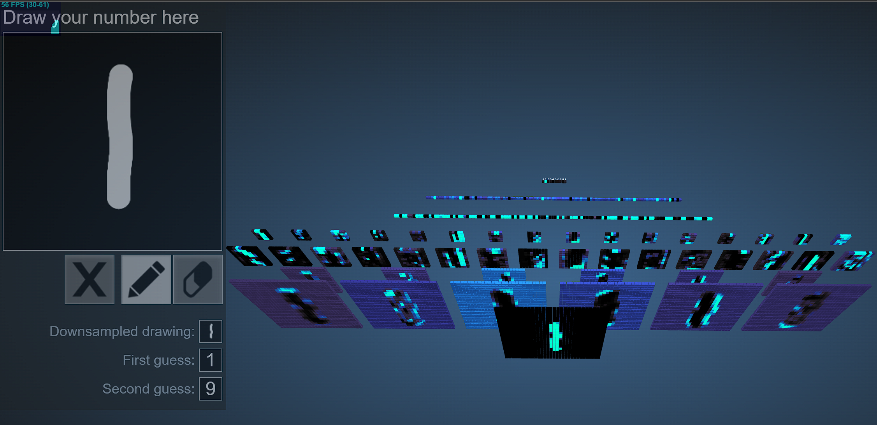
Related work
Harley's 3D visualization (2015)
Proved the value of spatial, node-link representations for MNIST, allowing users to draw digits and see network paths light up in 3D space. Established that interactive CNN visualization aids comprehension.
Harley, A. W. (2015). ISVC, pp. 867-877.
Gap: No existing tool combines real-time inference, full intermediate extraction, and 3D game-engine rendering.

Slide 6
Methodology
The pipeline
Train
Export
Visualize
PyTorch
ONNX
Unity + Sentis
Classic CNN trained on MNIST
(1 epoch, ~97% accuracy).
Explicit named layers for
intermediate access.
Model exported preserving
the full computational graph.
Open format bridging
Python and C#.
Real-time inference at 30+ FPS.
Intermediate layer extraction.
~12,500 cubes in 3D space.

Slide 7
CNN architecture
Data transformation through the network
Input
Conv1
+ ReLU
MaxPool
Conv2
+ ReLU
MaxPool
Flatten
Dense
1 x 28 x 28
8 x 28 x 28
8 x 14 x 14
16 x 14 x 14
16 x 7 x 7
784
10
Each layer's activations are extracted and rendered as 3D cube grids in real-time

Slide 8
System architecture
Key design decisions
Spawn once, update colors
All ~12,500 cubes created at startup. Only material colors change during inference.
Intermediate layer extraction
Sentis AddOutput() exposes layers at indices 10, 15, 25, 30 from the ONNX graph.
Wave propagation animation
Colors lerp layer-by-layer with SmoothStep easing for a natural data-flow feel.
PCA on flatten layer
784D vector projected to 3D space showing digit class clusters in real-time.

Slide 9

Live demo
Draw a digit and watch the network think

Slide 10


Dimensionality Reduction.
The challenge
PCA's answer
Find the 3 axes of maximum variance
784-D
Projecting the 784-D data onto the top principal axes allows us to compress and visualize it in 3D while retaining the most critical structural information.
An image with 28×28 pixels is a single point in a massive 784-dimensional space, impossible to visualize natively.

Slide 11







Principal Component Analysis
Center
Covariance
Eigen decompose
Project
Principal Component Analysis is a way of taking data that lives in a high-dimensional space and finding the handful of directions along which the data actually varies the most, then projecting onto those directions to get a low-dimensional view

Slide 12
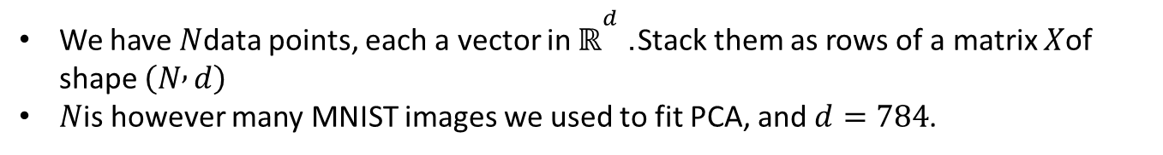
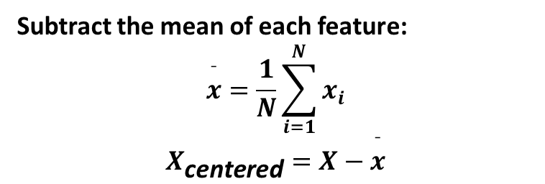
Step 1: Center the data
We have $N$data points, each a vector in $ℝ^{d}$. Stack them as rows of a matrix $X$of shape $\left(N , d\right)$
$N$is however many MNIST images we used to fit PCA, and $d=784$.
Subtract the mean of each feature:
$$\overset{ˉ}{x}=\frac{1}{N}\sum_{i=1}^{N}{x_{i}}$$
$$X_{\text{centered}}=X−\overset{ˉ}{x}$$

Slide 13
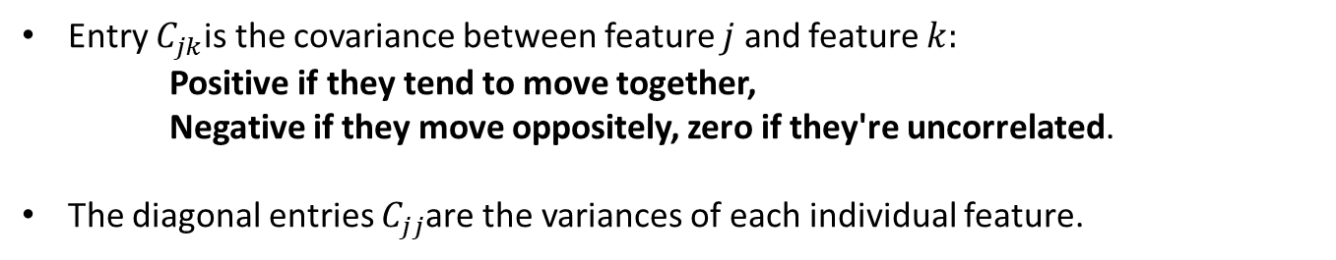

Step 2: Compute the covariance matrix
$$C=\frac{1}{N}X_{\text{c}}^{⊤}{ X}_{\text{c}}$$
Entry $C_{jk}$is the covariance between feature $j$ and feature $k:$
Positive if they tend to move together,
Negative if they move oppositely, zero if they're uncorrelated.
The diagonal entries $C_{jj}$are the variances of each individual feature.

Slide 14


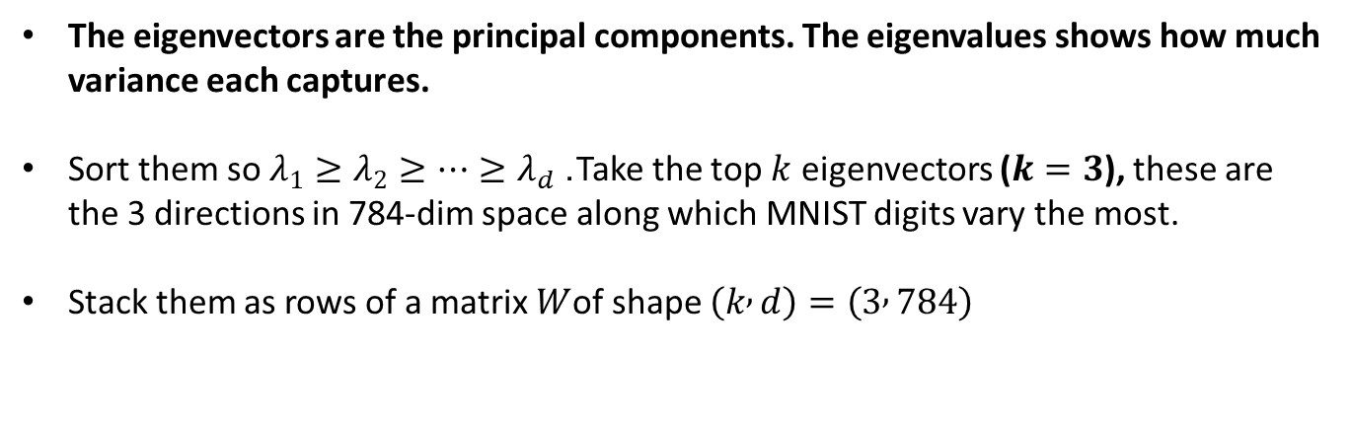
Step 3: Find the eigenvectors and eigenvalues of $C$
$$\text{Cv}\text{=}\text{λ}\text{v}$$
The eigenvectors are the principal components. The eigenvalues shows how much variance each captures.
Sort them so $λ_{1}≥λ_{2}≥…≥λ_{d}$. Take the top $k$ eigenvectors ($k=3$), these are the 3 directions in 784-dim space along which MNIST digits vary the most.
Stack them as rows of a matrix $W$of shape $\left(k , d\right)=\left(3 , 784\right)$

Slide 15
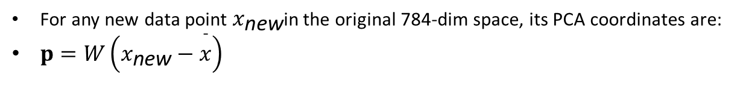
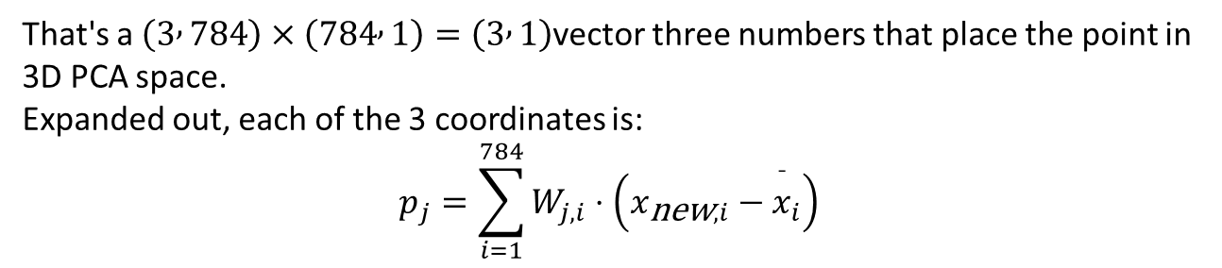
Step 4: Project new data onto the components
For any new data point $x_{\text{new}}$in the original 784-dim space, its PCA coordinates are:
$p=W\left(x_{\text{new}}−\overset{ˉ}{x}\right)$
That's a $\left(3 , 784\right)×\left(784 , 1\right)=\left(3 , 1\right)$vector three numbers that place the point in 3D PCA space.
Expanded out, each of the 3 coordinates is:
$$p_{j}=\sum_{i=1}^{784}{W_{j,i}}⋅\left(x_{\text{new},i}−{\overset{ˉ}{x}}_{i}\right)$$

Slide 16

Limitations
The scalability wall
The cube-per-neuron approach works perfectly for educational MNIST models but cannot scale to production networks. ResNet-152 has 60 million parameters — rendering each as an individual cube is computationally impossible. This is a fundamental trade-off: maximum visual clarity for small networks versus scalability.
Potential solutions for scale
Top-K filtering
GPU instancing
Level of detail
Saliency maps
Show only most active neurons
Render cubes without individual GameObjects
Distant layers as flat textures
Highlight which input pixels matter

Slide 17



Conclusion
From abstract
to tangible
Game engine
advantage
Architectural
discipline
Transformed the black box of neural networks into an explorable, physical 3D environment.
Combining ML pipelines (PyTorch/ONNX) with Unity/Sentis unlocks 30+ FPS interactive tools.
Strict separation of concerns ensures the system remains modular and extensible.

Slide 18
Thank you
Questions?
Nicholas Khumukcham | Arjun Ambekar
IIT Dharwad

