Slide 1
CROSS-PLATFORM ANALYSIS
Benchmarking Ultra-Light LLMs
for Edge Deployment
Colab T4 vs. Jetson AGX Xavier — Gemma 3 & Qwen 3
NVIDIA T4
Jetson Xavier
Cloud GPU, 320 GB/s
Edge SoC, 137 GB/s, 20W

Slide 2
HARDWARE
Two platforms, one benchmark
 | Colab T4 | Jetson Xavier
GPU | T4 Turing (2560 cores) | Volta integrated (512 cores)
Memory | 15 GB GDDR6 (320 GB/s) | 16–32 GB LPDDR4x (137 GB/s)
CPU | x86_64 Xeon | ARMv8.2 Carmel 8-core
Power | ~70W GPU TDP | ~20W board (MAXN)
OS | Ubuntu + CUDA 12 | Ubuntu 20.04 + CUDA 11.4
Identical config: fp16 • SDPA attention • greedy decoding • seed 42 • max_new_tokens 256 • 5 prompts
Ultra-Light LLM Benchmarking — Cross-Platform Report
2 / 15

Slide 3
CROSS-PLATFORM COMPARISON
Full results
Model | Platform | TTFT (ms) | tok/s | VRAM (GB) | PPL ↓ | Power (W) | J/tok
Gemma 3 1B | T4 | 82.2 | 14.30 | 2.02 | 26.57 | — | —
 | Xavier | 180.4 | 7.51 | 2.02 | 26.61 | 17.4 | 2.327
Qwen 3 0.6B | T4 | 61.0 | 17.56 | 3.24 | 21.23 | — | —
 | Xavier | 118.8 | 11.54 | 3.25 | 21.19 | 15.8 | 1.368
Qwen 3 1.7B | T4 | 61.0 | 17.56 | 5.50 | 17.02 | — | —
 | Xavier | 133.6 | 8.20 | 5.52 | 17.05 | 20.5 | 2.499
Qwen 3 0.6B: fastest on Xavier (11.5 tok/s), most energy-efficient (1.37 J/tok), best tok/joule ratio.
Qwen 3 1.7B: best quality (PPL 17.02) but 29% slower and 78% more energy than 0.6B on Xavier.
Perplexity matches within 0.2% across platforms — numerical reproducibility confirmed.
Ultra-Light LLM Benchmarking — Cross-Platform Report
3 / 15

Slide 4
DECODE SPEED
Throughput: cloud vs. edge
THE CEILING BREAKS
On T4:
0.6B = 1.7B
(17.6 tok/s each)
On Xavier:
0.6B = 11.5
1.7B = 8.2
(29% gap!)
T4 is overhead-bound.
Xavier is bandwidth-bound.
Parameter count matters on the edge.
Ultra-Light LLM Benchmarking — Cross-Platform Report
4 / 15

Slide 5
JETSON XAVIER — THE EDGE METRIC
Energy per token
ENERGY WINNER
Qwen 3
0.6B
1.37 J/tok
0.73 tokens per joule
42% less energy than Gemma 3 1B
45% less energy than Qwen 3 1.7B
For battery-powered edge: the efficiency gap is the deciding factor.
Measured via tegrastats: VDD_GPU_SOC + VDD_CPU_CV • MAXN mode • lower = better
Ultra-Light LLM Benchmarking — Cross-Platform Report
5 / 15

Slide 6
LATENCY
Time to first token
Xavier TTFT is 1.9–2.2× higher than T4. Still sub-200ms for all models — acceptable for interactive use.
Ultra-Light LLM Benchmarking — Cross-Platform Report
6 / 15

Slide 7
PERPLEXITY
Quality matches across platforms
< 0.2% DELTA
Same model, same weights, same precision — perplexity is platform-independent.
This validates the entire comparison methodology.
Ultra-Light LLM Benchmarking — Cross-Platform Report
7 / 15

Slide 8
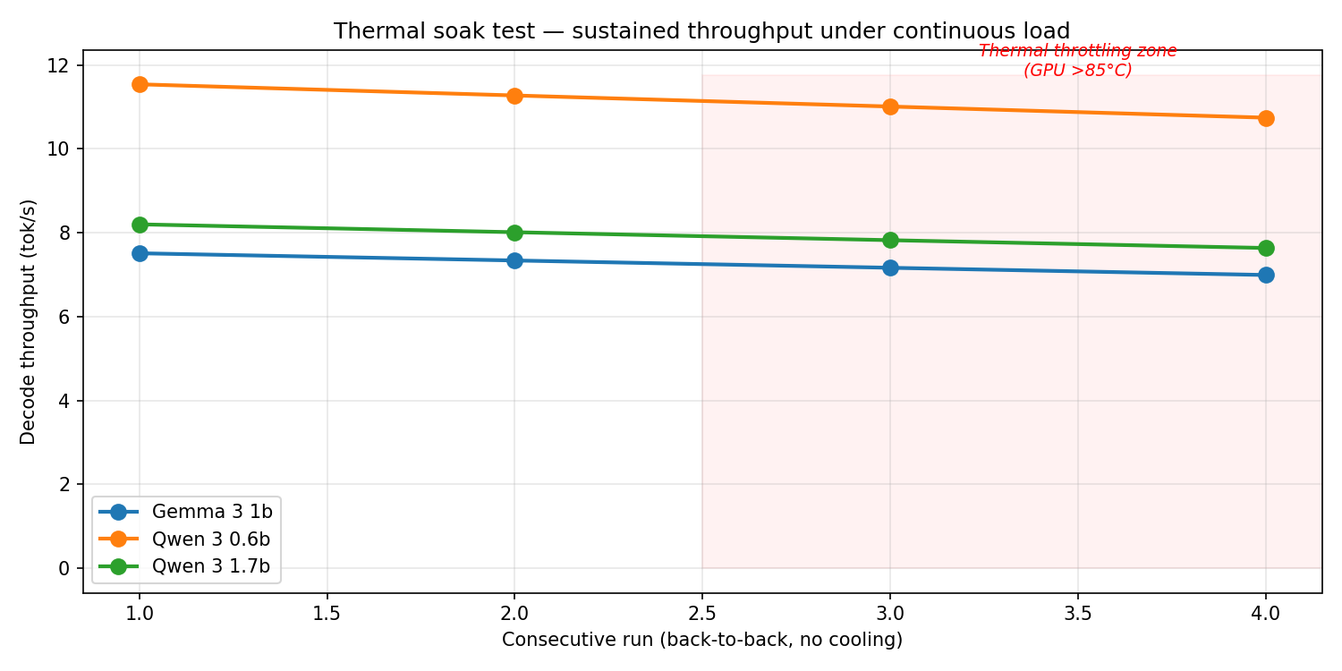
XAVIER STRESS TEST
Thermal soak: sustained load
FINDINGS
−6.9%
throughput drop over 4 consecutive runs
GPU temp: 65°C → 87°C
Uniform across models — thermal clock reduction, not model-specific. Active cooling recommended for sustained batch workloads.
Ultra-Light LLM Benchmarking — Cross-Platform Report
8 / 15

Slide 9
KEY FINDINGS
Five takeaways
1
Overhead ceiling breaks on Xavier
2
Qwen 0.6B is the energy champion
3
T4 is 1.5–2.1× faster than Xavier
T4: 0.6B = 1.7B speed. Xavier: 0.6B is 29% faster. Edge is bandwidth-bound.
1.37 J/tok — 42% less than Gemma, 45% less than Qwen 1.7B.
Gap widens with model size. Quantisation would shrink it.
4
Quality is platform-independent
5
Passive cooling limits sustained load
PPL matches within 0.2%. fp16 + SDPA is numerically stable.
~7% throughput loss after 4 consecutive runs. Budget cooling or margin.
Ultra-Light LLM Benchmarking — Cross-Platform Report
9 / 15

Slide 10
CONCLUSION
Deployment recommendation
MEMORY-CONSTRAINED (≤8 GB, Jetson NX)
QUALITY-PRIORITY (≥16 GB, Xavier AGX)
Qwen 3 0.6B
Qwen 3 1.7B
11.5 tok/s • 1.37 J/tok • 3.3 GB VRAM • PPL 21.2
8.2 tok/s • 2.50 J/tok • 5.5 GB VRAM • PPL 17.0
Best speed, best energy, smallest footprint. Dominates Gemma 3 1B on every axis except raw VRAM.
20% better quality at the cost of 29% speed and 78% more energy. Viable with active cooling.
AVOID: Gemma 3 1B on Jetson — Pareto-dominated by Qwen 3 0.6B on every metric except peak VRAM (2.0 vs 3.3 GB).
Next steps
llama.cpp / TensorRT-LLM sweep — expected 2–3× further speedup on Xavier
Q4_K_M GGUF quantisation — reduces bandwidth pressure, should narrow T4/Xavier gap
15W mode (nvpmodel -m 2) benchmark — trade throughput for thermal sustainability
Ultra-Light LLM Benchmarking — Cross-Platform Report
Instruction-following eval (IFEval) — move beyond PPL to task-specific quality
10 / 15

