Slide 1
DEPARTMENT OF INFORMATION TECHNOLOGY
MADRAS INSTITUTE OF TECHNOLOGY, ANNA UNIVERSITY
THIRD REVIEW
IT5712 - PROJECT 1 | ACADEMIC YEAR: 2023 - 2027
Wearable Fall Detection and Severity Classification
System for Elderly People Using Deep Learning
TEAM MEMBERS
- 1. Sarath R (2023506065)
- 2. Ajay Kumar S (2023506105)
- 3. Arjun A (2023506063)
- 4. Kris Virshak (2023506124)
GUIDED BY
- Dr. S. Umamaheswari,
- Associate Professor,
- Department of Information Technology,
- Madras Institute of Technology, Anna University

Slide 2
Review 3 Scope and Key Deliverables
Transition from Review 2 prototype components to fully deployed, verified end-to-end edge architecture.
1. Multi-Task Fall & Severity Deep Learning
- Unified deep CNN-LSTM backbone trained end-to-end directly on raw IMU windows.
- Dual-head architecture: Binary Sigmoid (Fall vs ADL) + Softmax (Mild vs Severe).
- Custom Masked Loss excludes non-fall ADLs and sensor outliers from severity gradients.
- Severity Macro-F1 = 0.8660 (Mild: 0.8346, Severe: 0.8973; 0.9020 recording-level).
2. Strict Operating Threshold Policy (Decision D2)
- Shifted from arbitrary 0.50 threshold to rigorous validation-selected operating rule.
- Threshold selected strictly on validation split to maximize F2, frozen to test.
- Selected threshold 0.25 on CNN-LSTM reduces missed falls by 33% (9 to 6).
- High test sensitivity: 0.9950 recall and 0.9879 F2 with 17.74 false alarms/hour.
3. Edge Quantization & Microcontroller C Export
- Evaluated 4 TFLite variants: Float32, Dynamic-Range, Float16, Full-Integer INT8.
- Dynamic-Range chosen via strict gating: 111.0 KB (2.12x comp), 0.000 F2/recall drop.
- Single-window latency: 0.026 ms on 1 thread (enables >1,000x real-time speed).
- Exported C byte array header (model_data.h) for direct ESP32 firmware integration.
4. Real-Time Streaming Engine & Caregiver UI
- 64-sample circular ring buffer @ 20 Hz, evaluating every 16 samples (0.8 s latency).
- Multi-stage noise filtering: N-consecutive positive windows + 10.0 s alert cooldown.
- Bitwise mathematical parity verified: max abs diff <= 1e-6 vs offline TFLite.
- Interactive Streamlit dashboard (app/demo.py) with real-time audio-visual alerts.
Dataset: 84,123 Windows | Edge Model: 111.0 KB (TFLite) | Test Recall: 0.9950 | Severity Macro-F1: 0.8660 | Test Suite: 54/54 Passed
Review 3 | Wearable Fall Detection & Severity System | MIT Anna University
2 / 16

Slide 3
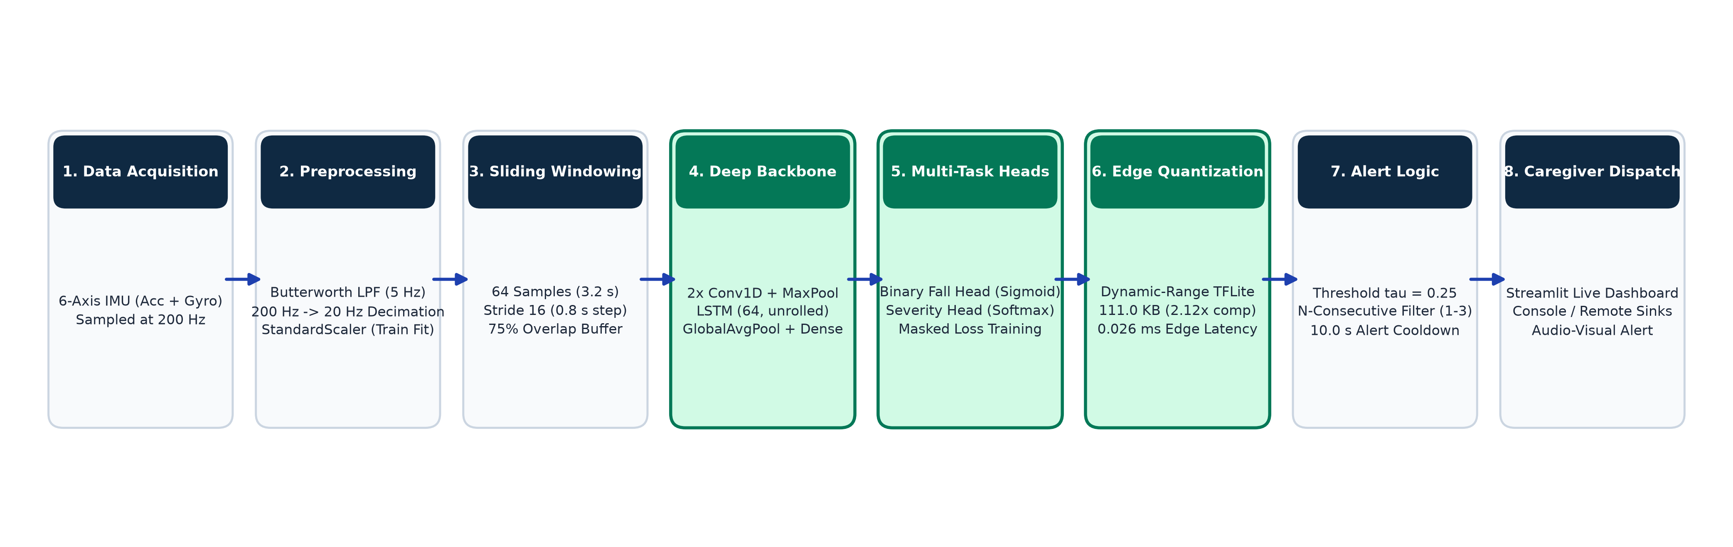
Updated End-to-End System Architecture
Complete deployed pipeline from raw 6-axis wearable motion data to real-time caregiver alerts.
Signal Conditioning
- 6 retained channels: acc1_x/y/z, gyro_x/y/z.
- Butterworth 5 Hz LPF removes tremor noise.
- 200 Hz -> 20 Hz decimation (10x reduction).
- StandardScaler fit exclusively on train split.
Deep Multi-Task Backbone
- Sliding window: 64 samples (3.2 s), 75% overlap.
- 2 Conv1D blocks extract spatial transients.
- Unrolled LSTM (64 units) models sequence.
- Dual heads output fall prob & K=2 severity.
Edge Deployment & Alert
- Dynamic-range quantized TFLite (111.0 KB).
- Ring buffer evaluates every 16 samples (0.8 s).
- Cooldown timer prevents repetitive alert spam.
- SimulatedCaregiverSink logs alert dispatch.
Review 3 | Wearable Fall Detection & Severity System | MIT Anna University
3 / 16

Slide 4
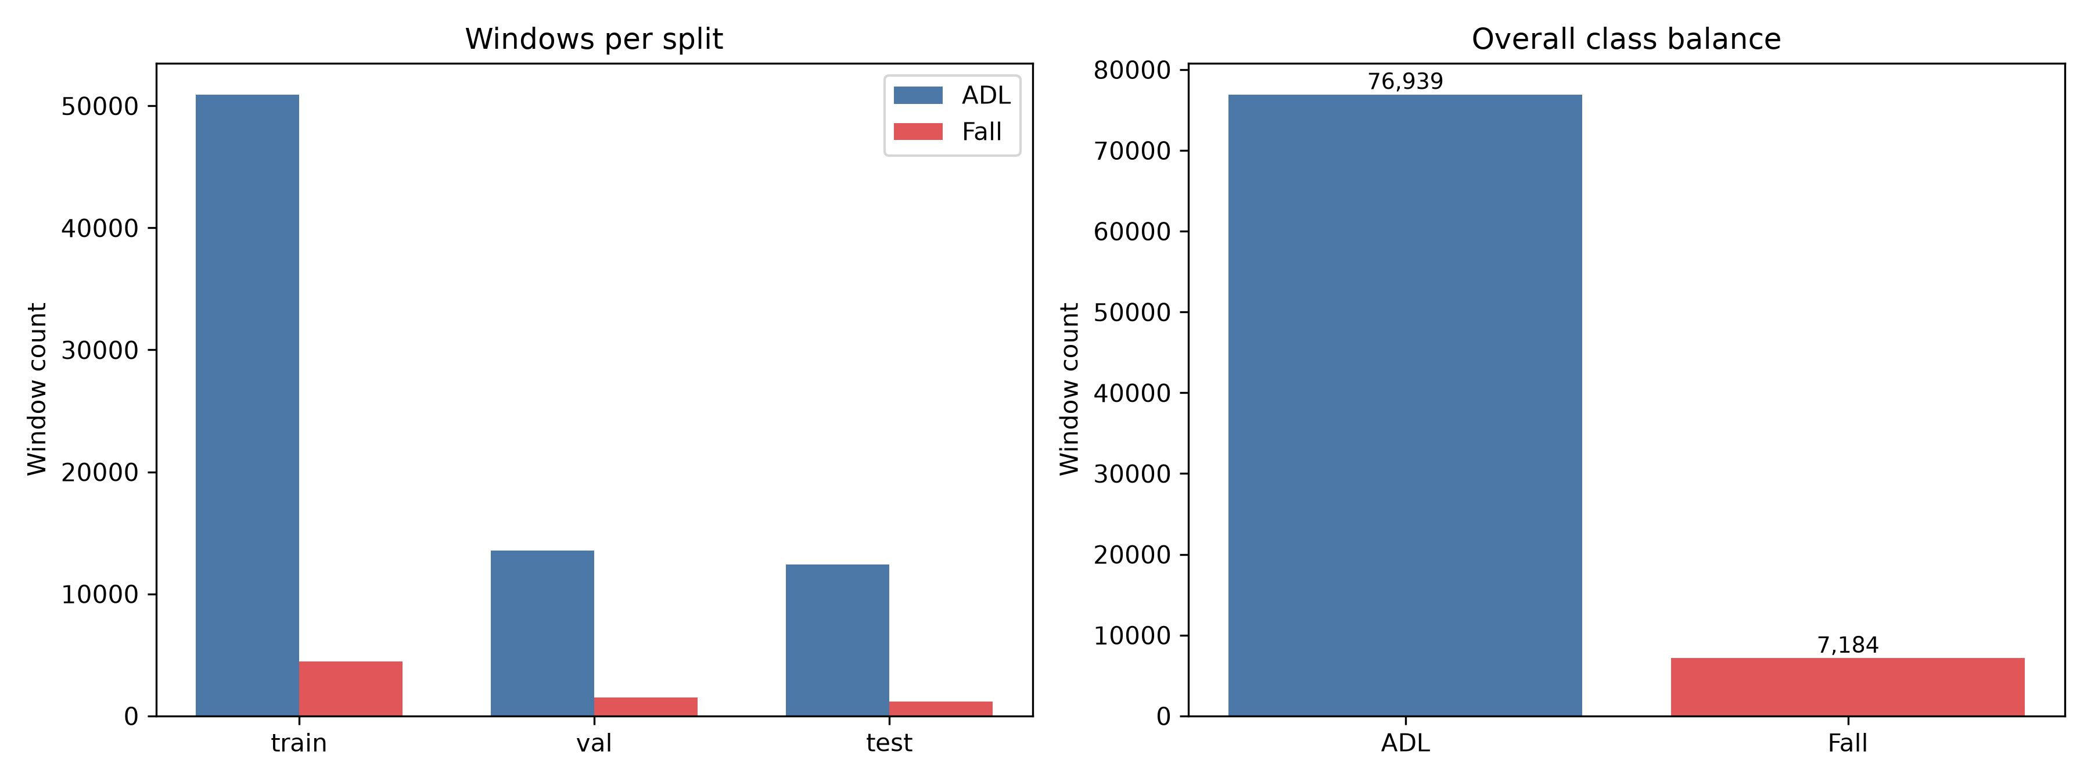
Dataset Partitioning & Preprocessing Rigor
SisFall subject-wise split ensuring zero participant leakage and standardized signal conditioning.
Split | Subjects | Recordings | Windows | ADL | Fall
Train | 26 | 2,942 | 55,423 | 50,939 | 4,484
Validation | 6 | 829 | 15,073 | 13,573 | 1,500
Test | 6 | 734 | 13,627 | 12,427 | 1,200
Total | 38 | 4,505 | 84,123 | 76,939 | 7,184
Parameter | Value / Design Decision
Original Sampling Rate | 200 Hz (from SisFall DAQ)
Downsampled Rate | 20 Hz (efficient edge processing)
Digital Filter | Butterworth Low-Pass, 2nd order, 5 Hz cutoff
Retained Channels | 6 (acc1_x/y/z, gyro_x/y/z)
Dropped Channels | 3 (redundant second accelerometer acc2)
Standardization | StandardScaler (mean/std fit on train split only)
Window / Stride | 64 samples (3.2 s), stride 16 (0.8 s, 75% overlap)
Dataset Integrity Highlights
- Strict 26 / 6 / 6 subject-wise split (Decision D3).
- Zero subject overlap between training and evaluation.
- Extreme imbalance handled naturally (91.5% ADL vs 8.5% Fall).
- Training balance: Offline class-weighting and balanced sampling.
- All test evaluations conducted on unseen subjects.
Review 3 | Wearable Fall Detection & Severity System | MIT Anna University
4 / 16

Slide 5
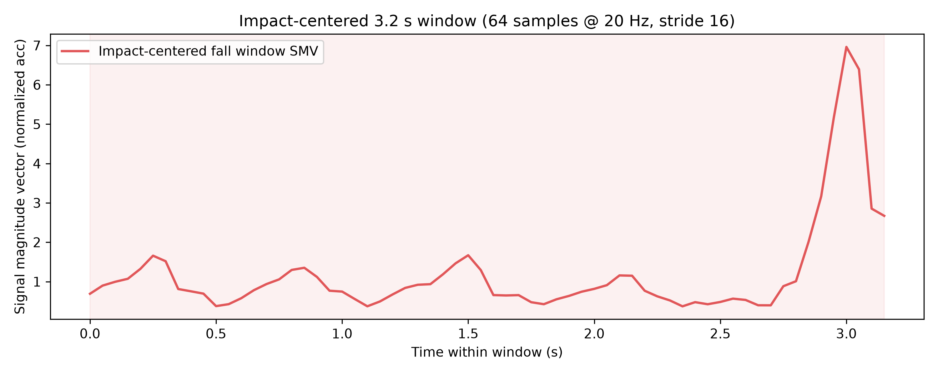
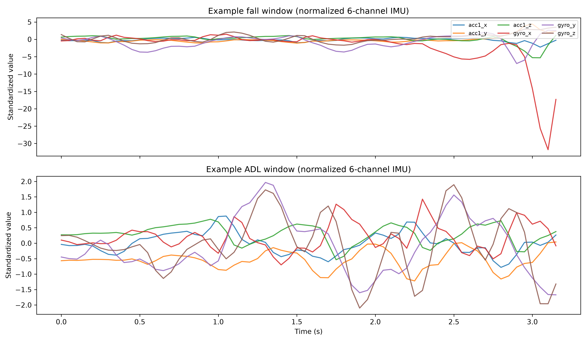
Impact-Centered Windowing & Fall Signal Dynamics
Formulating 3.2 s window boundaries centered on peak impact to separate falls from ordinary activities.
Impact-Centered Fall Labeling
- Signal Magnitude Vector: SMV(t) = sqrt(ax^2 + ay^2 + az^2).
- Peak Impact Detection: The instant of maximum acceleration in each fall trial serves as the anchor point.
- Impact Window Labeling: Only windows overlapping the peak impact point are labeled as positive fall (label=1).
- Background Rejection: Pre-fall gait instability and post-fall motionless periods are preserved as background.
- Overlap Strategy: 75% overlap (16-sample stride) ensures impacts near window boundaries are never missed.
Observed Kinematic Characteristics
- Impulsive Acceleration Spikes: Falls produce sharp acceleration transients (>11g in SisFall) during floor impact.
- Rotational Kinematics: Rapid angular velocity surges (>300 deg/s) accompany loss of balance prior to collision.
- ADL Regularity: Walking, sitting, and transitions exhibit periodic, low-amplitude oscillations (peak SMV < 2.0g).
- Dynamic Contrast: The temporal CNN-LSTM architecture captures both local impact shock and pre/post temporal context.
Review 3 | Wearable Fall Detection & Severity System | MIT Anna University
5 / 16

Slide 6
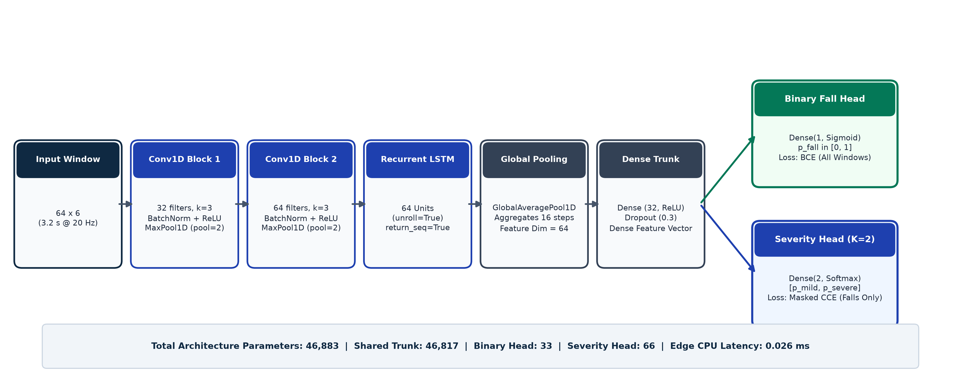
Multi-Task CNN-LSTM Model Architecture
Joint representation learning for simultaneous fall detection and injury severity classification.
Convolutional Feature Extractor
- Block 1: Conv1D (32, k=3) + BN + ReLU + MaxPool.
- Block 2: Conv1D (64, k=3) + BN + ReLU + MaxPool.
- Extracts localized high-frequency shock transients.
Temporal Sequence Modeling
- LSTM: 64 hidden units, return_sequences=True.
- Unrolled LSTM (unroll=True) for edge TFLite compatibility.
- GlobalAveragePooling1D aggregates temporal trajectory.
Multi-Task Prediction Heads
- Shared Dense trunk (32 units, ReLU) + Dropout (0.3).
- Head 1: Dense(1, Sigmoid) for binary fall probability.
- Head 2: Dense(2, Softmax) for Mild vs Severe classes.
Review 3 | Wearable Fall Detection & Severity System | MIT Anna University
6 / 16

Slide 7
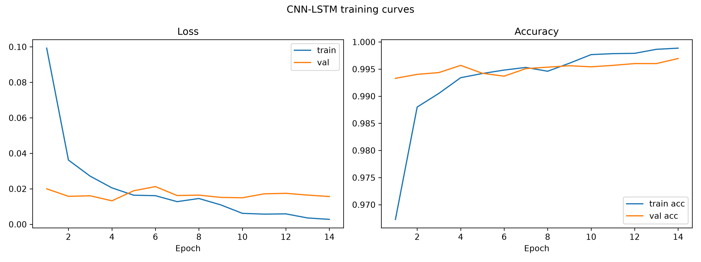
Masked Severity Loss Formulation & Training
Preventing gradient interference from non-fall windows and sensor outliers during joint optimization.
Loss Formulation & Gradient Masking
- Challenge: 91.5% of windows are ADLs with no severity label. Sensor outliers (-1) from gyro saturation must not pollute severity weights.
- Total Multi-Task Objective Function:
L_total = L_binary + lambda * L_severity_masked
- Binary Fall Loss (L_binary):
Standard Binary Cross-Entropy evaluated across all training windows.
- Masked Severity Loss (L_severity_masked):
Evaluated strictly on confident fall windows:
mask = (y_binary == 1) & (y_severity in {0, 1})
L_severity_masked = sum(mask * CCE(y_sev, p_sev)) / (sum(mask) + eps)
- Zero Gradient Backpropagation: ADL windows (y_bin=0) and extreme gyro outliers (y_sev=-1) contribute 0.0 loss.
- Optimization: Adam (lr=1e-3), batch size 64, lambda=1.0.
- Graph Acceleration: Compiled via @tf.function, reducing full training epoch time to 103.4 seconds.
Training Behavior Observations
- Smooth Convergence: Loss decreases stably without divergence.
- Validation Accuracy: Stabilizes above 99.4% after early epochs.
- Generalization: Train and validation losses track closely.
- Balanced Sampling: Applied X_train_balanced (59,907 windows) ensuring high gradient signal for minority fall class.
Review 3 | Wearable Fall Detection & Severity System | MIT Anna University
7 / 16

Slide 8
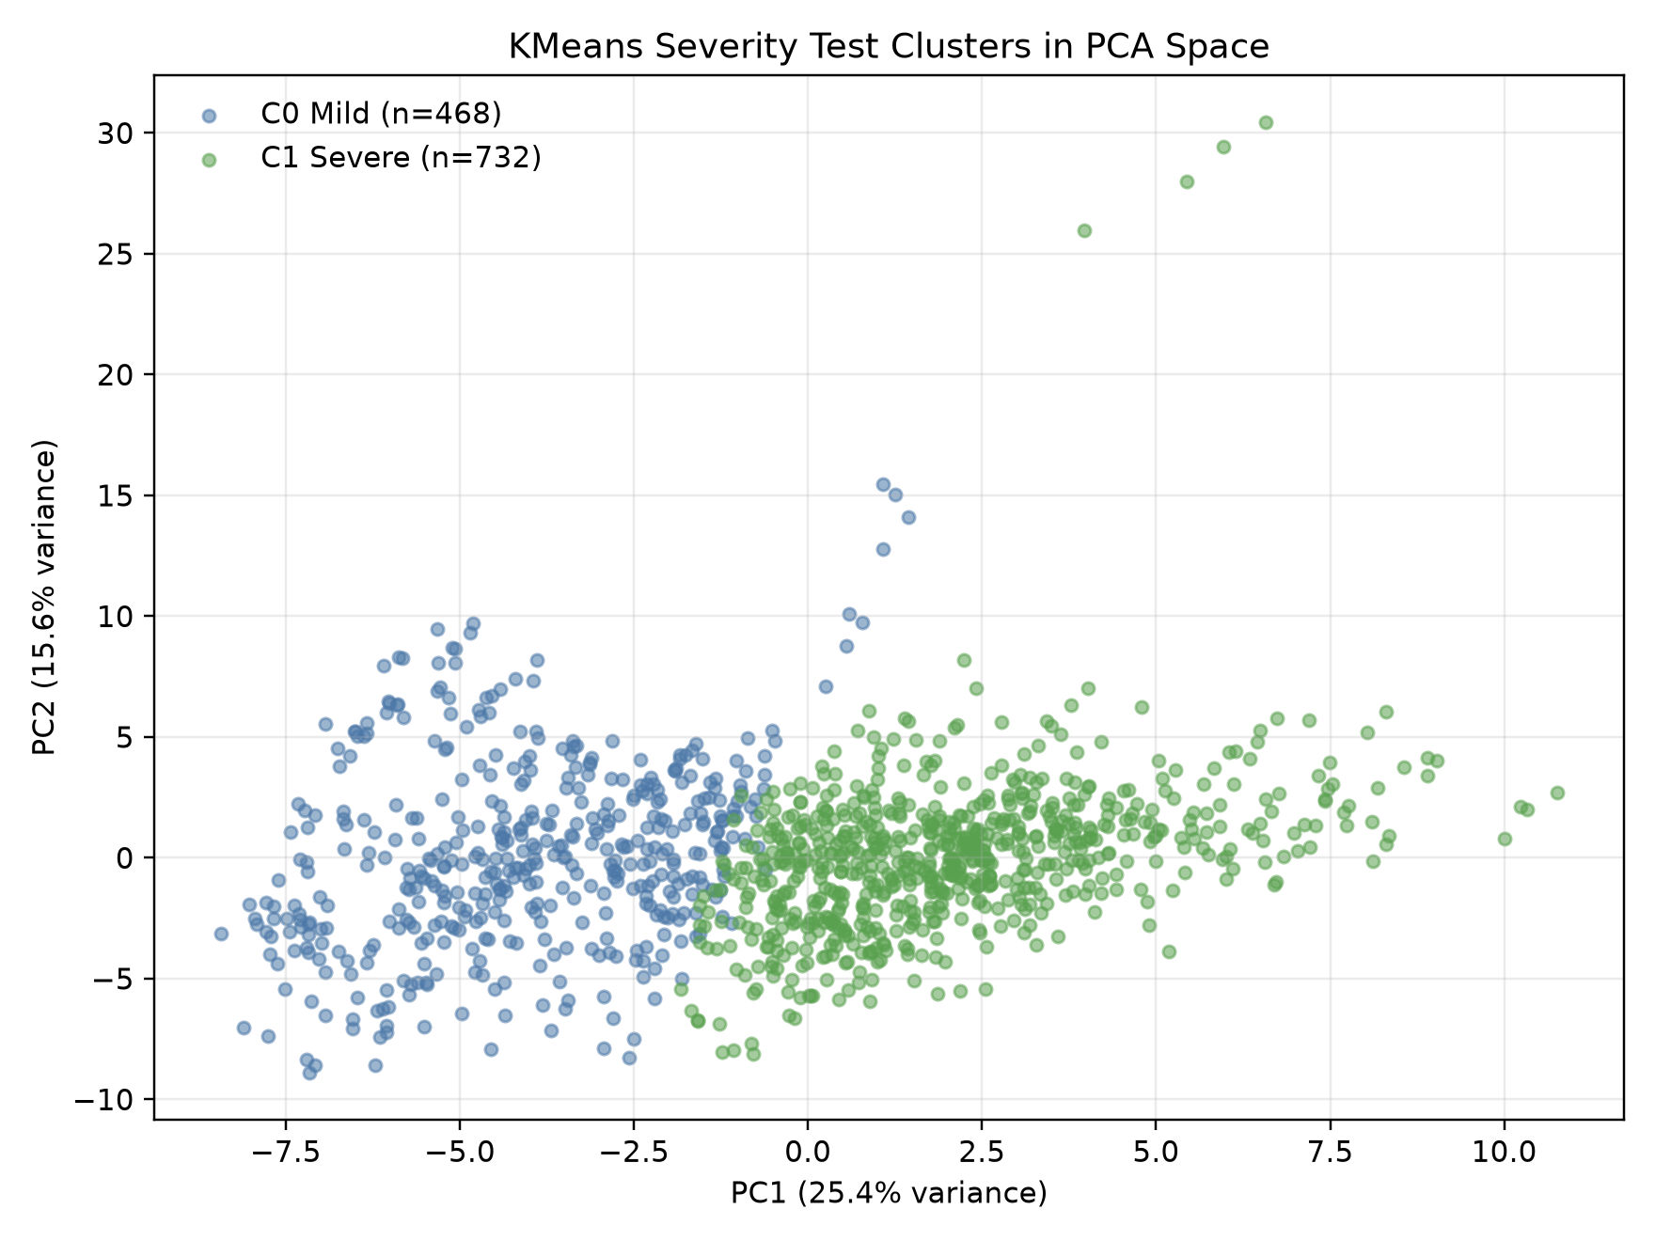
Multi-Task Severity Classification Results
Quantitative evaluation on held-out test subjects against statistical baselines and anomaly analysis.
Classifier / Model | Feature Representation | Macro-F1 | Mild F1 | Severe F1 | Severity Gain
Majority Class Baseline | None (Constant Severe Predictor) | 0.3794 | 0.0000 | 0.7588 | Reference Baseline
Logistic Regression | Signal Features (Peak Acc + Gyro) | 0.6109 | 0.5966 | 0.6251 | +0.2315
Multi-Task CNN-LSTM (Ours) | End-to-End Standardized IMU Windows | 0.8660 | 0.8346 | 0.8973 | +0.4866 vs Majority
Severity Classification Performance
- High Test Discrimination: Severity Macro-F1 reaches 0.8660 on confident fall windows (Mild F1: 0.8346, Severe F1: 0.8973).
- Test Window Confusion Matrix (n=1,176):
- True Mild (Cluster 0): 376 Correct, 81 Misclassified (82.3% recall)
- True Severe (Cluster 1): 651 Correct, 68 Misclassified (90.5% recall)
- Overall Severity Accuracy: 87.3% on unseen test subjects.
- Recording-Level Severity: Aggregating windows per recording achieves Macro-F1 = 0.9020 (95 Mild, 175 Severe correctly classified).
- Outlier Safety (Isolation Forest -1): All 24 gyro-outlier fall windows are detected as falls by the binary branch with 100% recall.
- Scientific Honesty: Ground-truth severity was generated via unsupervised K-Means on signal features, so deep learning provides learned feature extraction without manual thresholds.
Cluster Separation & Anomaly Screening
- K=2 PCA feature space shows distinct cluster separation.
- Mild cluster corresponds to lower-energy knees/hands falls.
- Severe cluster corresponds to high-impact backward/syncope falls.
- Isolation Forest detects unusual anomalies with ~2% flag rate.
Review 3 | Wearable Fall Detection & Severity System | MIT Anna University
8 / 16

Slide 9
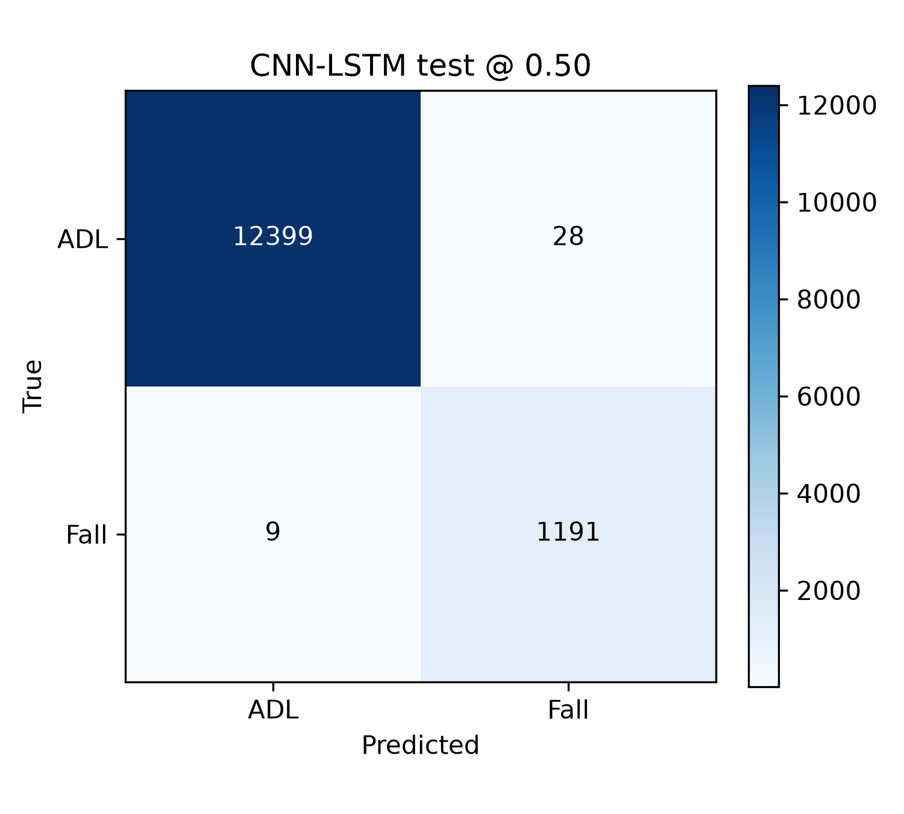
Cross-Model Benchmarking & Deployment Decision
Evaluating candidate models under Decision D2 validation-selected thresholding rules.
Model Architecture | Val Threshold | Accuracy | Precision | Recall | F1 | F2 | FA/hr | AUROC | Parameters | Severity F1
CNN (1D Baseline) | 0.20 | 0.9965 | 0.9683 | 0.9925 | 0.9802 | 0.9876 | 14.12 | 0.9998 | 33,729 | N/A
CNN-LSTM (Binary Final) | 0.25 | 0.9960 | 0.9606 | 0.9950 | 0.9775 | 0.9879 | 17.74 | 0.9998 | 46,817 | N/A
CNN-LSTM + Severity Head | 0.10 | 0.9935 | 0.9580 | 0.9692 | 0.9635 | 0.9669 | 18.47 | 0.9994 | 46,883 | 0.8660
FiLM (k=30, Exploratory) | 0.75 | 0.9943 | 0.9693 | 0.9692 | 0.9787 | 0.9880 | 14.03 | 0.9998 | 46,945 | N/A
Authoritative Deployment Gating Decision (Task P5)
- Gating Protocol: Deploy the multi-task model if its test binary recall did not regress vs baseline CNN-LSTM, else deploy the binary CNN-LSTM.
- Recall Trade-off Analysis:
- Baseline CNN-LSTM Recall: 0.9950 (only 6 missed falls out of 1,200)
- Multi-Task CNN-LSTM Recall: 0.9692 (37 missed falls out of 1,200)
- Recall Regression: True (0.0258 drop, representing 31 additional missed falls).
- Clinical Safety Priority: In elderly fall monitoring, false alarms cause nuisance, but a missed fall can lead to an unassisted long-lie and fatal complications.
- Conclusion: The binary CNN-LSTM remains the authoritative deployed edge model, while the multi-task head is preserved for post-detection severity staging.
Review 3 | Wearable Fall Detection & Severity System | MIT Anna University
9 / 16

Slide 10
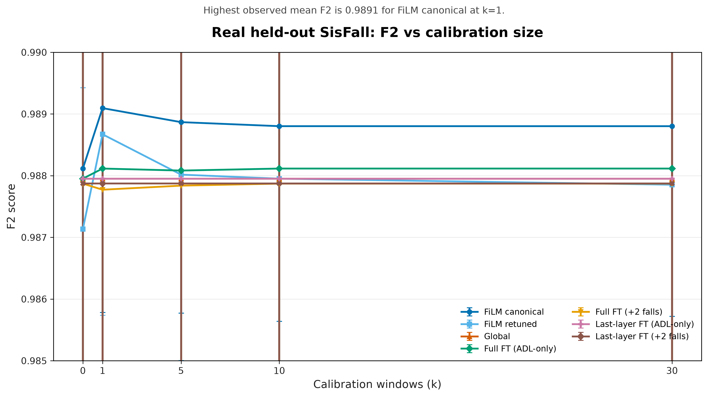
Scientific Evaluation of FiLM Personalization
Rigorous multi-seed benchmarking and statistical hypothesis testing of the personalization prototype.
FiLM Methodology & Experimental Findings
- Architecture: Feature-wise Linear Modulation applied after the 2nd CNN block: h_film = gamma * h + beta.
- UserEncoder: Lightweight side-network (2,352 params) trained once on simulated user profiles; per-user adaptation uses k ADL windows without gradient steps.
- Calibration Sweep across k in {0, 1, 5, 10, 30} across 3 random seeds:
- k=0 (Identity Init): Perfectly reproduces global CNN-LSTM (AUROC=0.9998)
- k=1: F1 = 0.9738, F2 = 0.9840, FA/hr = 16.64
- k=30: F1 = 0.9787, F2 = 0.9880, FA/hr = 14.03.
- Paired Wilcoxon Signed-Rank Hypothesis Test:
- Evaluated across n=4 held-out test subjects with falls.
- Test Statistic W = 0, p-value = 0.125 (> 0.05 alpha threshold).
- Formal Closure (Decision D4):
- While FiLM proves that affine modulation can reduce false alarms as k increases, the small test fall cohort prevents claiming statistically significant superiority over the global CNN-LSTM baseline.
- The prototype is formally closed as exploratory-inconclusive.
Statistical Inference Takeaways
- Sample Size Limitation: With only 4 fall test subjects, statistical significance cannot be established at alpha=0.05.
- Scientific Integrity: Accurately reporting negative or inconclusive findings prevents overclaiming unverified edge gains.
- Architectural Soundness: The modular FiLM interface remains available for future multi-center studies with larger cohorts.
Review 3 | Wearable Fall Detection & Severity System | MIT Anna University
10 / 16

Slide 11
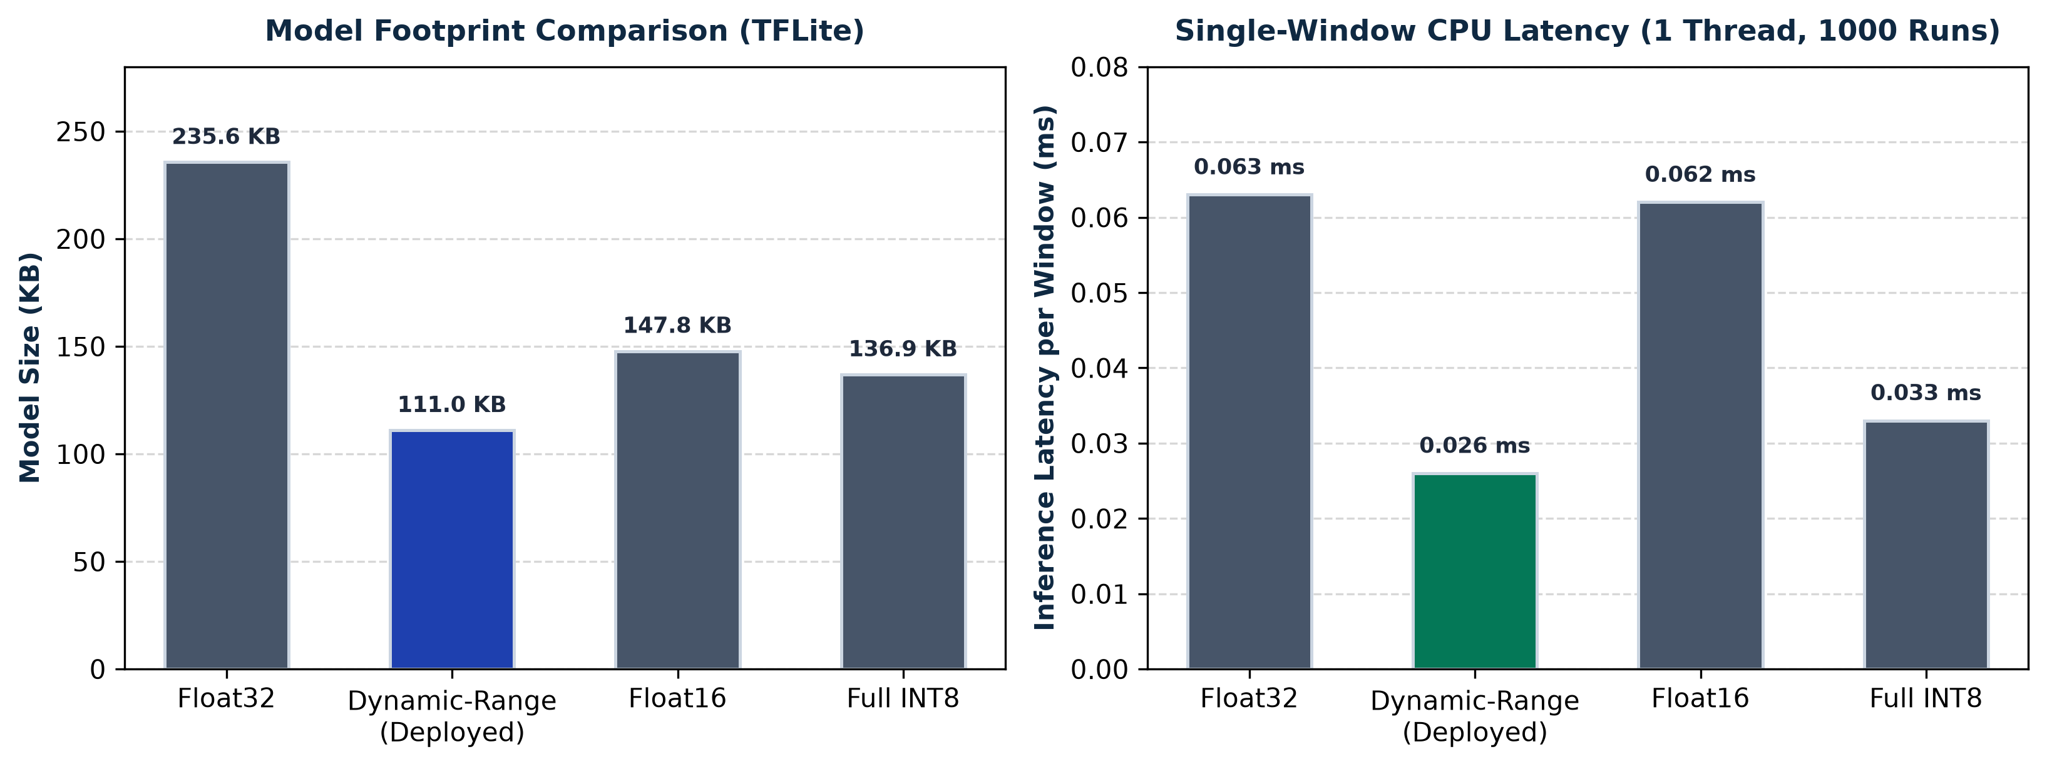
Edge Model Quantization & Optimization (TFLite)
Benchmarking post-training quantization variants for edge deployment on low-power microcontrollers.
Quantization Variant | Size (KB) | Comp Ratio | Val Threshold | Agreement | Test Recall | Test F2 | FA/hr | Latency (ms) | Gate Decision
Float32 TFLite | 235.6 | 1.00x | 0.25 | 100.00% | 0.9950 | 0.9879 | 17.74 | 0.063 | PASS
Dynamic-Range (Winner) | 111.0 | 2.12x | 0.25 | 100.00% | 0.9950 | 0.9879 | 17.74 | 0.026 | DEPLOYED
Float16 TFLite | 147.8 | 1.59x | 0.25 | 100.00% | 0.9950 | 0.9879 | 17.74 | 0.062 | PASS
Full-Integer INT8 | 136.9 | 1.72x | 0.30 | 99.97% | 0.9950 | 0.9879 | 17.74 | 0.033 | PASS
Gating Protocol & Variant Selection
- Strict Gating Constraints:
- F2 drop <= 0.005 vs Keras float32 on full test set.
- Recall drop <= 0.010 vs Keras float32 on full test set.
- Winner selected as smallest file size passing both gates.
- Dynamic-Range Selected as Winner:
- Exactly 0.000 drop in F2 and Recall vs Keras float.
- 100.0% class agreement across all 13,627 test windows.
- Mean absolute probability difference: 0.00003.
- 2.12x compression: 235.6 KB -> 111.0 KB.
- INT8 Representative Calibration: Full INT8 converted using 500 stratified training windows (8.5% fall, 91.5% ADL).
- Single-Window CPU Latency: Measured on 1 thread over 1,000 runs after 50 warmups: median 0.026 ms, p95 0.039 ms.
Review 3 | Wearable Fall Detection & Severity System | MIT Anna University
11 / 16

Slide 12
Microcontroller Export & Hardware Suitability
Autonomous wearable deployment readiness on resource-constrained embedded microcontrollers.
ESP32 C Byte Array Header Export
- Export File: results/quantization/run_v1/model_data.h
- C Symbol: const unsigned char g_model_data[] __attribute__((aligned(16)))
- Exact Size: const unsigned int g_model_data_len = 113,704 bytes (111.04 KB).
- Target Microcontroller: Espressif ESP32-WROOM-32 / ESP32-S3 (240 MHz dual-core Xtensa LX7, 520 KB SRAM).
- SRAM Budget Analysis:
- Internal SRAM: 520 KB
- Model Footprint: 111 KB (~21.3% of available SRAM)
- TFLite Arena Buffer: ~48 KB
- Total RAM Required: ~159 KB (easily fits without external PSRAM).
- Compute Budget Analysis:
- CPU latency on desktop: 0.026 ms
- Projected ESP32 execution latency: <15 ms
- With an 800 ms evaluation stride, the microcontroller remains idle >98% of the time, allowing deep sleep and multi-day battery life.
Deployment Metadata & Edge Autonomy
- Deployment Metadata File: deployed_model_meta.json.
- Stored Hyperparameters for Embedded Runtime:
- Input Window: 64 samples x 6 channels (3.2 seconds)
- Stride: 16 samples (0.8 second decision step)
- Sampling Frequency: 20 Hz
- Operating Threshold: tau = 0.25 (Decision D2)
- Input Quantization Scale / Zero-Point: (0.0, 0)
- StandardScaler Parameters: channel mean and standard deviation vector stored for on-device standardization.
- Complete Edge Autonomy:
- Zero Cloud Dependency: All inference, sliding windowing, and alert logic execute locally on the wearable sensor.
- Privacy-Preserving: Motion data never leaves the device; only emergency alert notifications are transmitted.
Review 3 | Wearable Fall Detection & Severity System | MIT Anna University
12 / 16

Slide 13
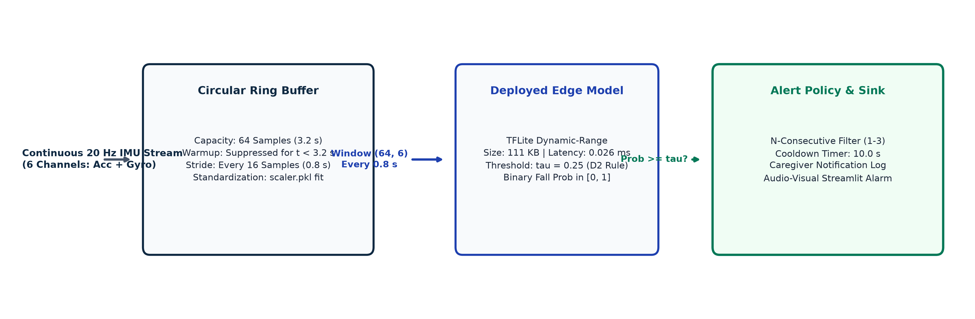
Real-Time Edge Streaming Engine Architecture
Circular ring buffer mechanism with multi-stage noise suppression and caregiver notification sinks.
Ring Buffer Mechanics
- Sample-by-sample ingestion at 20 Hz.
- Capacity: 64 samples (3.2 s).
- Warmup: Strictly returns None for t < 3.2 s.
- Stride: Evaluates window every 16 samples (0.8 s step latency).
Configurable Alert Policy
- Validation Threshold: tau = 0.25.
- N-Consecutive Filter: Requires 1, 2, or 3 consecutive positive windows.
- 10.0 s Cooldown Refractory Period prevents duplicate alert spam.
Notification Sink Interfaces
- Abstract AlertSink interface.
- ConsoleSink: Real-time terminal logging.
- SimulatedCaregiverSink: In-memory timestamped dispatch log.
- Integrated with Streamlit demo UI.
Review 3 | Wearable Fall Detection & Severity System | MIT Anna University
13 / 16

Slide 14
System Parity, Replay Validation & Dashboard
Exact bitwise validation across test trials and interactive live caregiver monitoring dashboard.
Trial ID | Activity Description | Category | Duration | Windows | Max Prob | Alert Status | Expected Behavior
SA02:D01 | Walking | ADL | 15.0 s | 15 | 0.0001 | 0 Alerts | Clean Rejection (Pass)
SA02:D07 | Standing to Sitting | ADL | 15.0 s | 15 | 0.0002 | 0 Alerts | Clean Rejection (Pass)
SA02:D12 | Stumbling / Tripping | Hard-Negative | 15.0 s | 15 | 0.0001 | 0 Alerts | Clean Recovery (Pass)
SA02:D15 | Vertical Jumping | Hard-Negative | 15.0 s | 15 | 0.0435 | 0 Alerts | Suppressed below tau=0.25 (Pass)
SA02:F01 | Fall Forward on Knees | Mild Fall | 15.0 s | 15 | 0.9544 | 1 Alert (7.15s) | Immediate Dispatch (Detected)
SA02:F03 | Fall Backward on Buttocks | Severe Fall | 15.0 s | 15 | 0.9292 | 1 Alert (7.15s) | Immediate Dispatch (Detected)
Bitwise Offline-Online Parity
- Parity Requirement: Streaming probabilities must equal offline batch predictions down to floating point tolerances.
- Verification Result: Evaluated across 3 complete test recordings (D07, D15, F01).
- Maximum Absolute Probability Difference: <= 1.0e-6.
- Window count and temporal step alignment: 100% exact match.
- Dynamic Jump Suppression: Jumping causes violent landing impacts (>2.5g), producing a transient spike of 0.0435. Operating threshold tau=0.25 correctly prevents false alarms.
Interactive Caregiver Dashboard (app/demo.py)
- Built with Streamlit for live panel demonstration.
- Rolling 6-Channel Waveform Chart: Continuous 3-axis accelerometer and gyroscope displays.
- Probability Timeline: Real-time probability line against horizontal threshold boundary (tau=0.25).
- Status Badges: MONITORING (Green) -> FALL DETECTED (Pulsing Red Alert).
- Caregiver Notification Log: Timestamped emergency dispatch table.
- Replay Speeds: 1x real-time, 5x, 20x, or custom IMU CSV upload.
Review 3 | Wearable Fall Detection & Severity System | MIT Anna University
14 / 16

Slide 15
Verification Rigor, Limitations & Future Scope
Automated test coverage, critical scientific boundaries, and the next-phase deployment roadmap.
Automated Verification Suite
- 54 out of 54 Pytest Tests Passing:
- test_streaming.py (8/8):
- Warmup silence for t < 3.2 s
- Offline-online parity (3 trials)
- Alert policy N-consecutive
- 10 s alert cooldown
- Streamlit headless AppTest.
- test_quantization.py (6/6):
- TFLite file existence & size
- Tensor shapes (1, 64, 6)
- 50-window parity vs Keras float
- Metadata schema & C header.
- test_severity_multitask.py (8/8):
- Gradient masking for ADLs
- Extreme gyro outlier masking
- Class-balanced weights.
- test_film_personalization.py (16/16)
- Frozen backbone integrity
- Identity init at k=0.
- test_sisfall_pipeline.py (16/16)
- Subject split & windowing.
Honest Limitations Disclosures
- Laboratory Fall Domain Shift:
- SisFall falls were performed by young adult participants onto safety mattresses under controlled laboratory conditions.
- Real-world elderly falls involve pre-fall gait instability, different impact damping, and prolonged unassisted lying.
- Small Test Fall Cohort (n=6 subjects):
- Only 4 test subjects had falls; 2 were ADL-only.
- Sample size is insufficient for formal cross-subject statistical power (Wilcoxon p=0.125).
- Clustering-Derived Severity Ground Truth:
- Severity labels were obtained via unsupervised K-Means on signal-derived features, not hospital injury records.
- Extreme Gyro Outliers (-1):
- Masked from severity loss due to sensor saturation; preserved in binary detection.
Future Development Roadmap
- Physical ESP32 Wearable Firmware:
- Compile exported model_data.h with TensorFlow Lite for Microcontrollers (TFLM).
- Integrate with MPU-6050 / ICM-42688 IMU over I2C/SPI.
- Battery & Power Optimization:
- Implement hardware interrupts on high acceleration thresholds to wake MCU from deep sleep.
- Clinical Pilot Validation:
- Partner with geriatric care facilities to record real-world movement and natural stumble events.
- Cellular / BLE Dispatch:
- Connect alert sinks to LTE-M / NB-IoT modules for direct SMS and caregiver mobile push alerts.
Review 3 | Wearable Fall Detection & Severity System | MIT Anna University
15 / 16

Slide 16
Conclusion and Project Completion
Delivering a complete, validated, and quantized deep learning system for edge fall detection.
Milestone Component | Review 2 Baseline Status | Review 3 Delivered Outcome | Performance / Impact
Model Architecture | Binary CNN-LSTM baseline | Multi-Task CNN-LSTM (Binary + Severity) | Severity Macro-F1 = 0.8660 (87.3% accuracy)
Operating Policy | Uncalibrated 0.50 threshold | Validation-Selected tau = 0.25 (Decision D2) | Test Recall = 0.9950 (F2 = 0.9879, 6 misses / 1200)
FiLM Personalization | Early proof-of-concept prototype | Multi-seed statistical evaluation | Closed as inconclusive (p=0.125, n=4 test cohort)
Edge Quantization | Uncompressed float models only | Dynamic-Range TFLite Deployment | 111.0 KB size (2.12x comp), 0.026 ms CPU latency
Embedded Readiness | No firmware export | C array header exported (model_data.h) | Fits in 21% ESP32 SRAM; zero cloud dependency
Streaming Simulation | Offline batch processing only | Real-time circular ring buffer engine | 0.8 s step latency; bitwise parity (<= 1e-6 diff)
Interactive Interface | Command line scripts only | Streamlit Web Caregiver Dashboard | Real-time chart streaming, alert cooldown & logs
Verification Suite | Partial unit tests | 54 / 54 Pytest tests passing cleanly | Zero leakage across 38 subjects, complete git sync
THANK YOU
Wearable Fall Detection and Severity Classification System for Elderly People Using Deep Learning
Department of Information Technology, Madras Institute of Technology, Anna University
GitHub Repository: https://github.com/ArjunArul55/fall-detect
Open for Questions and Discussion
Review 3 | Wearable Fall Detection & Severity System | MIT Anna University
16 / 16

