Slide 1
Walmart - Forecast of Sales 2012-13
Forecast of Sales 2012-13
By
Ankit Bagusetty
Arjun Babu
Ramnath Ramachandran
Vaishnavi Paramashivam

Slide 2
Assumptions
We have considered the following scenarios
The data of store 1 of all 45 stores for our forecast analysis
Holt Winters, ARIMA, Naïve, & Mean method are used for comparison
The demand values are the total demand of all departments combined for the week.
Assumptions

Slide 3
Model Prediction
In the given data, we have 45 stores and each stores have around 90 departments.
Since this is a huge data, model prediction is difficult.
To simplify, we started off with one department in one store.
This makes it easier to understand the trends in the demand values and also to measure the accuracy of the model.

Slide 4
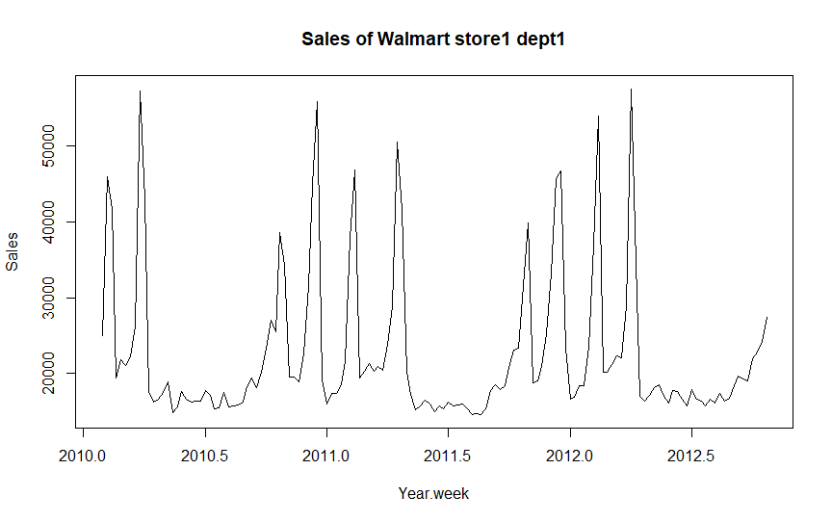
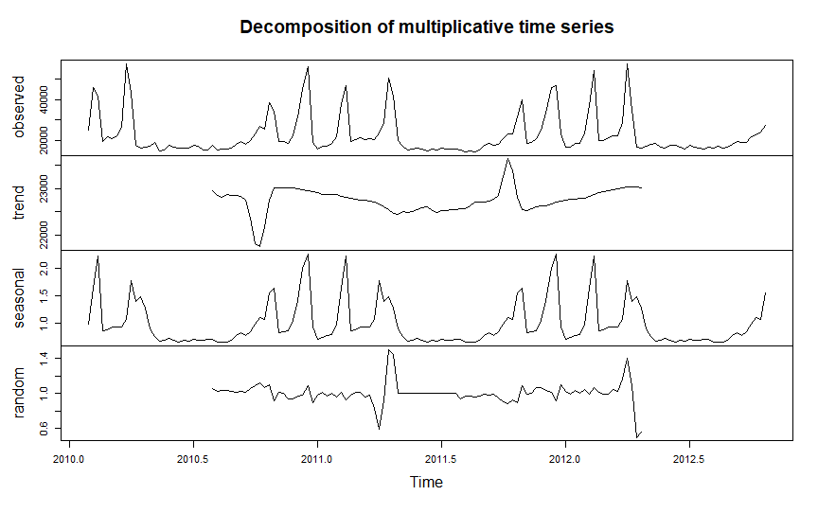
Time Series Plot
We understand from the above sales plot that there is a seasonality to the data which needs to be removed before proceeding for the Forecast

Slide 5
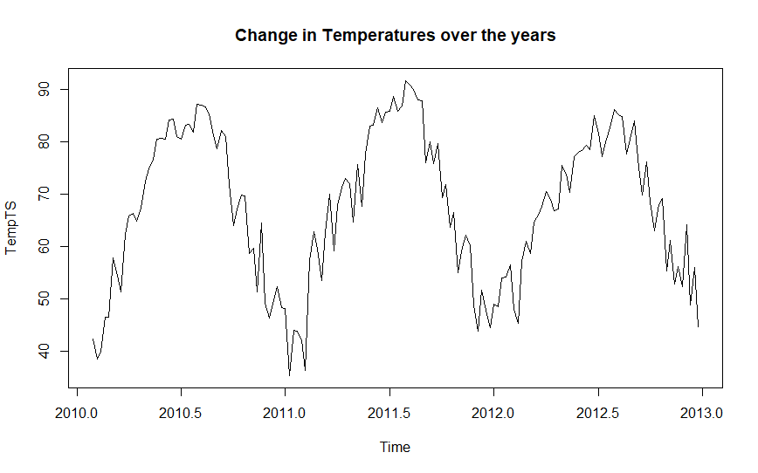
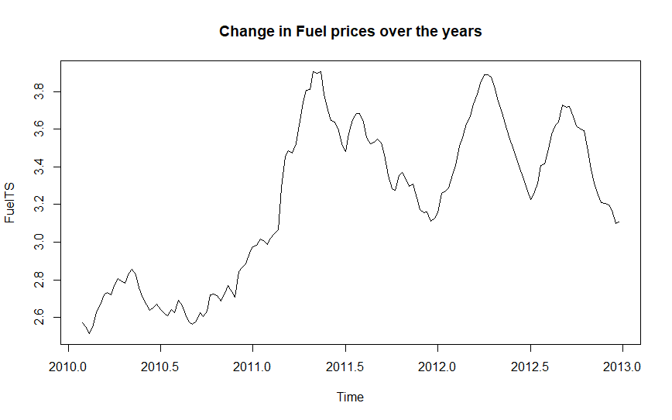
Effect of Features on Forecast
Comparing both these plots with the sales Plot, we can infer that Fuel prices doesn’t affect
the sales and as the temperature changes from season to season, it can be considered as part
of seasonality and can be de-seasonalised.

Slide 6
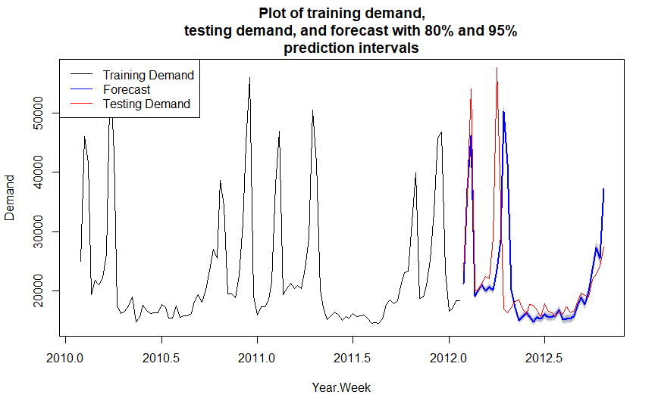
Holts Winter Model:
We can see that the demand is significantly high in the Q1 and Q4 in each year
This data also signifies that the demand values follow the same trend.
The forecast says that the Testing data follows the same trend.
But, 2012 Q1 & Q2 demand values shows that most of the predicted data lies outside the 80% & 95% confidence levels.

Slide 7
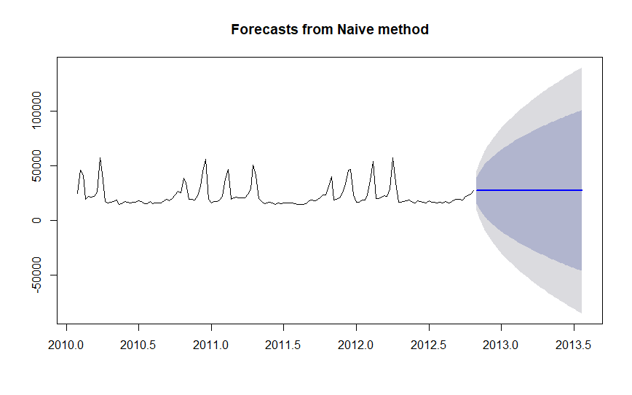
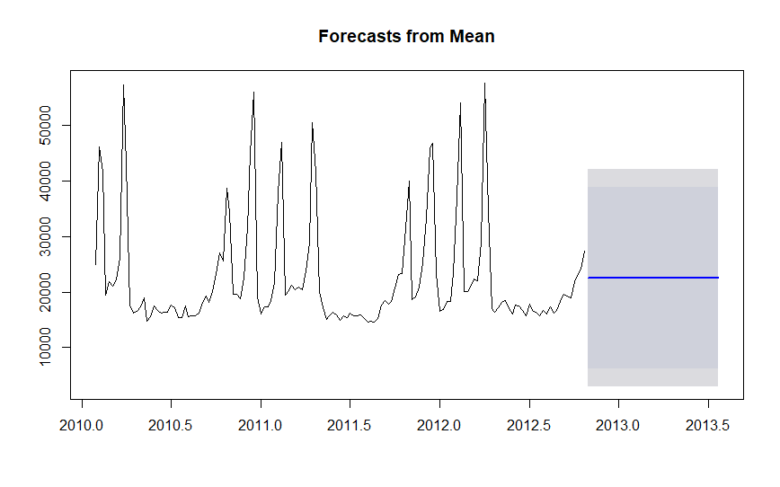
Naive Method & Mean Method
Both these methods infer that we get the forecast well within the confidence level, but the forecasted data did not show any trend and is flat throughout the period. Hence, these methods are not recommended for predicting the future sales

Slide 8
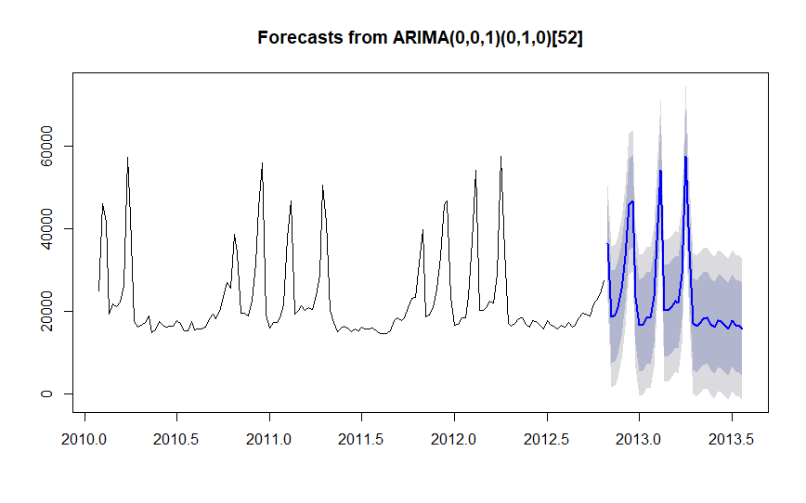
Forecast of Sales- ARIMA Method
cast of Sales- ARIMA Method
By look of the forecast plot, we can say that the data follows the previous period`s trend and is well within the confidence levels.
We need to find the accuracy of each plot in addition to the confidence levels and trend to determine the best model.

Slide 9
Forecast Value Analysis (FVA): Predicting the best Model
From all the 4 forecasting methods, we can see that the Forecast in the Increasing trend and inline with the testing data.
By calculating the MAPE of all these models we found that:
MAPE Naïve method: 28.91%
MAPE Mean method: 19.08%
MAPE ARIMA method: 1.81%
MAPE Holt Winters Method: 20.56%
ARIMA has the lowest error and hence the best method to forecast the Sales data

Slide 10
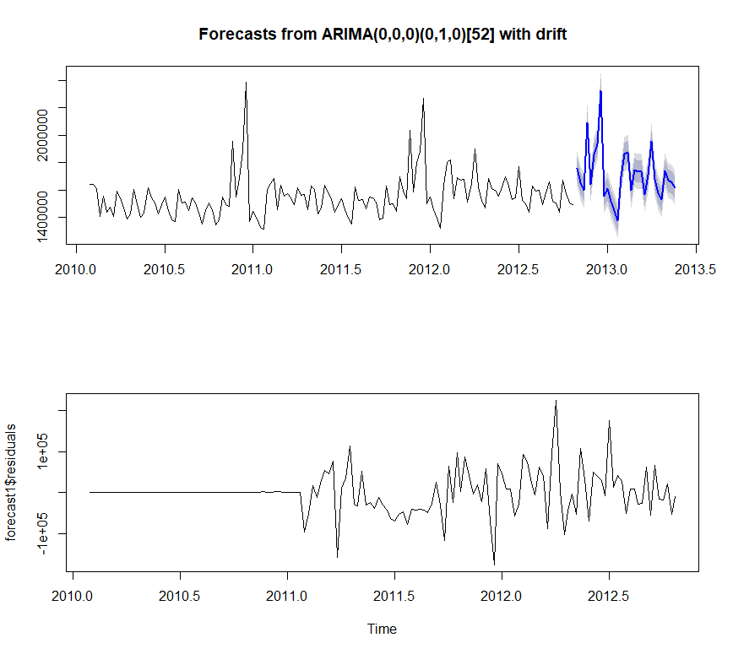
Forecast of Sales- ARIMA Method- One Store:

Slide 11
Forecast Data & Results
Forecast Data:
Accuracy Analysis:
Date | Forecast Lo 80 Hi 80 Lo 95 Hi 95
02-11-2012 | 1755919 1673137 1838701 1629315 1882523
09-11-2012 | 1653628 1570846 1736410 1527024 1780233
16-11-2012 | 1598173 1515391 1680955 1471569 1724777
23-11-2012 | 2092010 2009228 2174792 1965406 2218614
30-11-2012 | 1642773 1559991 1725555 1516169 1769378
07-12-2012 | 1858372 1775590 1941154 1731768 1984976
14-12-2012 | 1939866 1857084 2022648 1813262 2066470
21-12-2012 | 2328878 2246096 2411661 2202274 2455483
28-12-2012 | 1556152 1473370 1638934 1429548 1682756
ME | 539.8851
RMSE | 51245.22
MAE | 32322.96
MPE | -0.01987656
MAPE | 2.021818
MASE | 0.4725167
ACF1Training set | 0.08025631
* This is only a part of the whole data. This can be found in an excel sheet in the Zip file named “WEEKLY FORECAST FOR STORE 1”

Slide 12
Thank You!!!!!

