Slide 1
Walmart - Forecast of Sales 2012-13
Forecast of Sales 2012-13
By
Ankit Bagusetty
Arjun Babu
Ramnath Ramachandran
Vaishnavi Paramashivam

Slide 2
Assumptions
We have considered the following scenarios
The data of store 1 of all 45 stores for our forecast analysis
Holt Winters, ARIMA, Naïve, & Mean method are used for comparison
The demand values are the total demand of all departments combined for the week.
We simplified the data and assumed only one department to predict the model.
Assumptions & Model Prediction

Slide 3
Auto Regressive Integrated Moving Average Model (ARIMA) :
The AR part of ARIMA is the variable of interest that is regressed on its own lagged values. The MA part indicates that the regression error is actually a linear combination of error terms whose values occurred repeatedly and at various times in the past.
Steps followed in ARIMA Modelling:
Exploratory analysis
Fitting the model
Accuracy Measurement

Slide 4
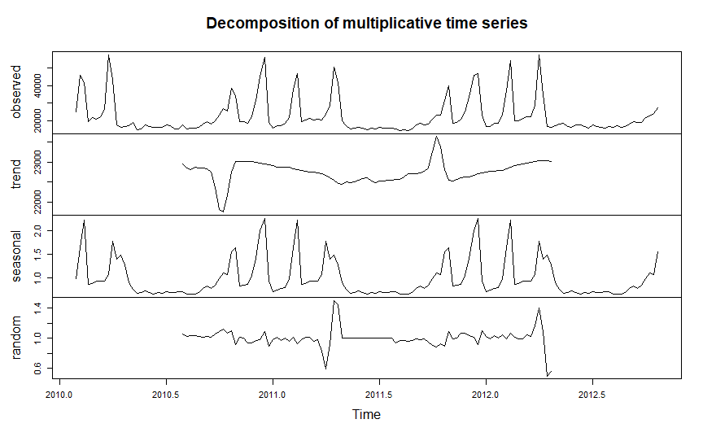
We need to observe four components of the decomposition graph to proceed any further
Observed – the actual data plot
Trend – the overall upward or downward movement of the data points
Seasonal – any monthly/yearly pattern of the data points
Random – unexplainable part of the data
By observing the graph, we can say that the data satisfies the assumptions of ARIMA modelling, mainly, seasonality and stationarity.

Slide 5
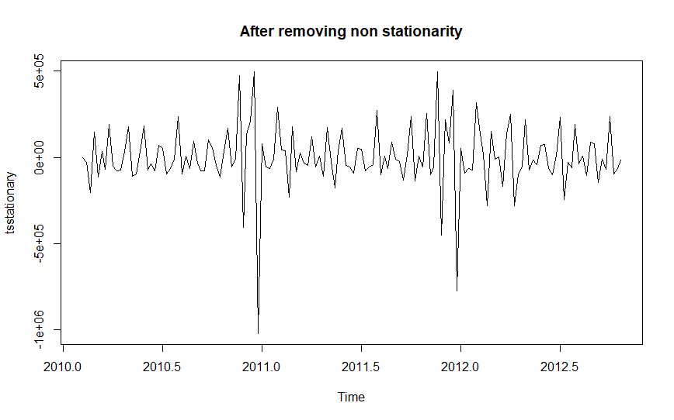
Achieving Stationarity:
To achieve the stationarity, we compute the difference between consecutive observations & Log or Sq Root of the series data to stabilize non constant variants.
This can be done by using unit root test and can be used on the trending data to make it stationary.

Slide 6
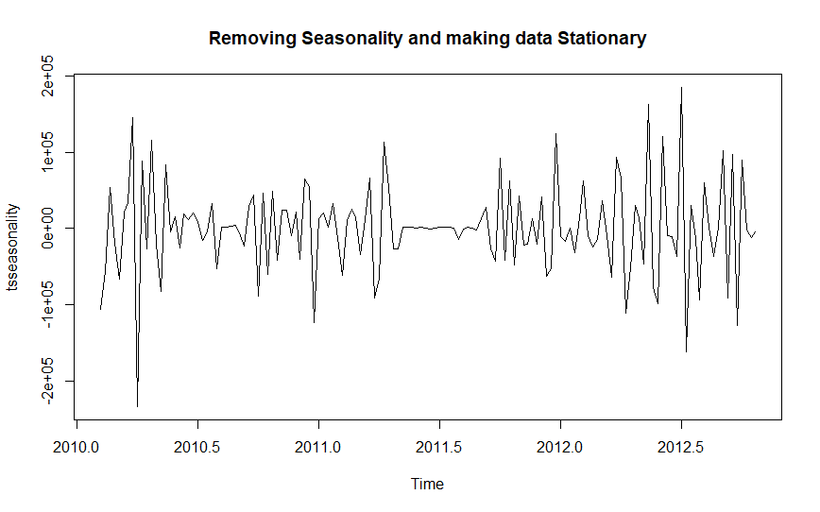
Removing Seasonality:
To remove seasonality from the data we have subtracted the seasonal component from the original series and then difference it to remove seasonality & to make it stationary.

Slide 7
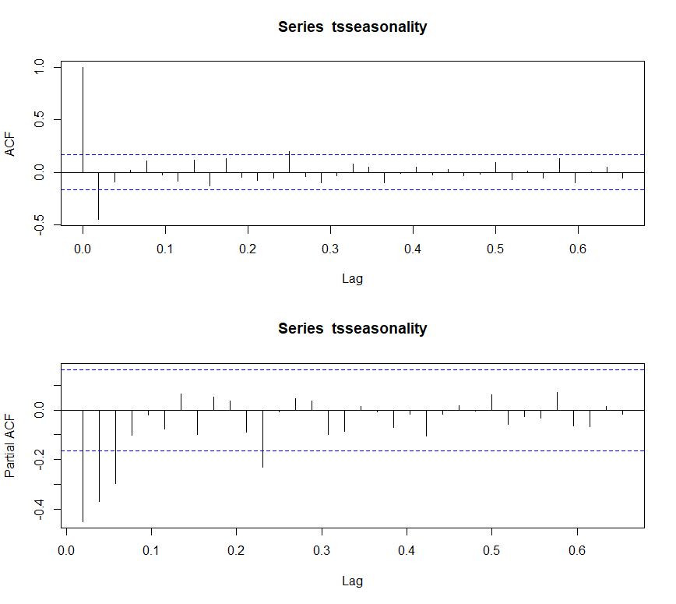
ACF & PACF Plots:
Shape of ACF defines the value of p & q
p- Order of Auto Regressive model
Q- Order of Moving Average Model
PACF at lag k describes the correlation between all data points

Slide 8
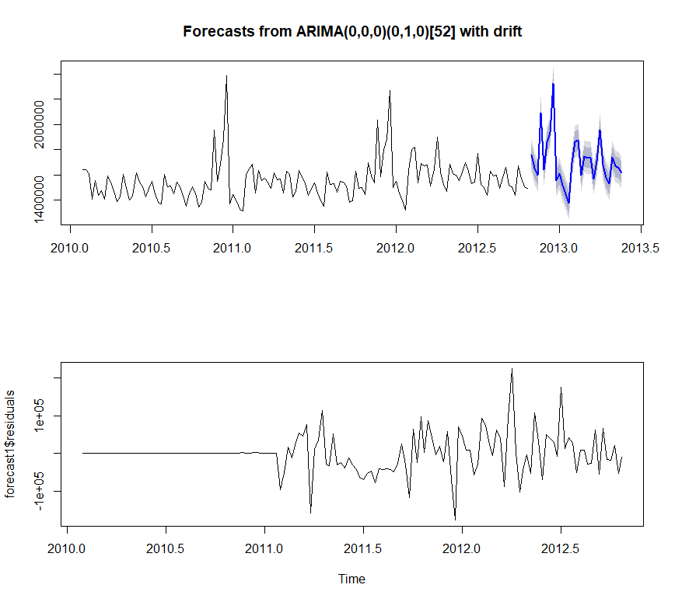
Forecast of Sales- ARIMA Method- One Store:
We use auto.arima() function in R which uses a combination of Unit Root Test to decide p, d, & q values and gets the optimal output. The model automatically predicts the future sales value with the 80% & 95% prediction intervals as shown in graph.

Slide 9
Forecast Data & Results
Forecast Data:
Accuracy Analysis:
Date | Forecast Lo 80 Hi 80 Lo 95 Hi 95
02-11-2012 | 1755919 1673137 1838701 1629315 1882523
09-11-2012 | 1653628 1570846 1736410 1527024 1780233
16-11-2012 | 1598173 1515391 1680955 1471569 1724777
23-11-2012 | 2092010 2009228 2174792 1965406 2218614
30-11-2012 | 1642773 1559991 1725555 1516169 1769378
07-12-2012 | 1858372 1775590 1941154 1731768 1984976
14-12-2012 | 1939866 1857084 2022648 1813262 2066470
21-12-2012 | 2328878 2246096 2411661 2202274 2455483
28-12-2012 | 1556152 1473370 1638934 1429548 1682756
ME | 539.8851
RMSE | 51245.22
MAE | 32322.96
MPE | -0.01987656
MAPE | 2.021818
MASE | 0.4725167
ACF1Training set | 0.08025631
* This is only a part of the whole data. This can be found in an excel sheet in the Zip file named “WEEKLY FORECAST FOR STORE 1”

Slide 10
Thank You!!!!!

