Slide 1

IMPACTAI FOUNDRY · SESSION 4
Bringing Your AI Into the World
Customize your AI with connectors and skills, then build your prototype.

Slide 2
AGENDA
Today's session
1:00
Session 3 Review
1:15
Customize Your AI: Connectors
2:00
Break
2:15
Customize Your AI: Skills
2:45
Build Your Prototype
4:30 — Share and Next Steps
IMPACTAI FOUNDRY · BANGALORE 2026
1

Slide 3
LEARNING PATH
Where we are
01
Discover
02
Define
03
Design
04
Refine
05
Deliver
IMPACTAI FOUNDRY · BANGALORE 2026
2

Slide 4
LEARNING PATH · 03 DESIGN
Design
FOCUS
GOALS
03
Building and testing the AI Prototype
• Build a reusable AI prototype aligned to the workflow
• Apply structured prompting and context-setting
• Test the prototype against real examples
• Compare outputs to defined success criteria and refine for reliability
IMPACTAI FOUNDRY · BANGALORE 2026
3

Slide 5
PAIR AND SHARE · 15 MIN
Pair and Share
Stand up, find someone you don't know, and share the AI project you're working on.
→ What's one new thing you learned about your workflows since our last session?
IMPACTAI FOUNDRY · BANGALORE 2026
4

Slide 6
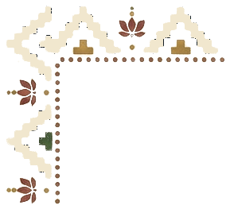
DEMO DAY
5-minute AI Solution Demos
A celebration of how you're enhancing impact and workflows — date, time & venue to be confirmed.
Notes:
TODO: set IAF's Demo Day date, time, and venue (source used the original program's own logistics).

Slide 7
RECAP
Reviewing Session 3

Slide 8
THE FOUR QUESTIONS
Answer these before you deploy
Answer these questions before you deploy and you’re ahead of 99% of social sector tech.
• What does success look like - for everyone?
• How will we know if it’s failing?
• Who can raise an issue, and what happens?
• Who can change it or turn it off?
IMPACTAI FOUNDRY · BANGALORE 2026
5

Slide 9
THE TRADEOFFS YOU'RE LIKELY MAKING
These are tough — there’s no right answer
ON ONE SIDE
ON THE OTHER
• Speed
• Serving more people
• Staff time saved
• Consistency
• Accuracy
• Serving fewer people better
• User experience
• Flexibility
IMPACTAI FOUNDRY · BANGALORE 2026
6
Notes:
These are tough! There’s no right answer, just what your organization cares about more.

Slide 10
THE NONPROFIT SUPERPOWER
What if your constituents could…
For-profits rarely let customers change the product. But you serve your community. You have flexibility they don't!
• Opt out?
• Raise an issue?
• Override the AI?
IMPACTAI FOUNDRY · BANGALORE 2026
7

Slide 11
ENHANCING YOUR AI
Adding the right tools for the job

Slide 12
TRAPPED IN THE CHAT
Up until now, almost all interaction with Claude has been in the chat
Trigger
You, opening a chat
→
Actor
You, typing the prompt
→
Input
Whatever you can drag into Claude
→
Steps
Claude can only do whatever it can do out of the box
→
Success
A response in the chat window
Invoking Session 2, that means the chat is the trigger, the actor, the input, and the output all at once.
Notes:
Merged the 'Trapped in the chat' progressive-reveal build (slides 12–14) into one record using the fullest slide (14). Trigger/Actor subs inferred from the node-anatomy layout where source text was unlabeled.

Slide 13
TRAPPED IN THE CHAT
But what about everything outside the chat?
Trigger
You start the chat manually
→
Actor
You, in the chat
→
Input
Connecting to your own data?
→
Steps
Teaching Claude to do something your way consistently?
→
Success
Putting results in your systems?
Up until now, almost all interaction with Claude has been in the chat: whatever you can drag in, whatever it can do out of the box, output that stays in the chat.
Notes:
(merged animation-build slides)

Slide 14
IMPACTAI FOUNDRY
Upskilling Claude: Revisiting the tool bench

Slide 15
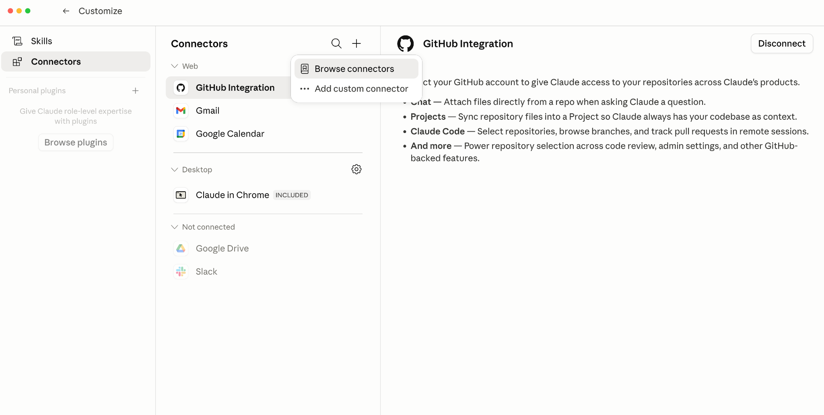
GETTING DATA INTO CLAUDE
Connectors let Claude read and write to the tools you already use - found under Customize Claude.
Notes:
(merged animation-build slides)

Slide 16
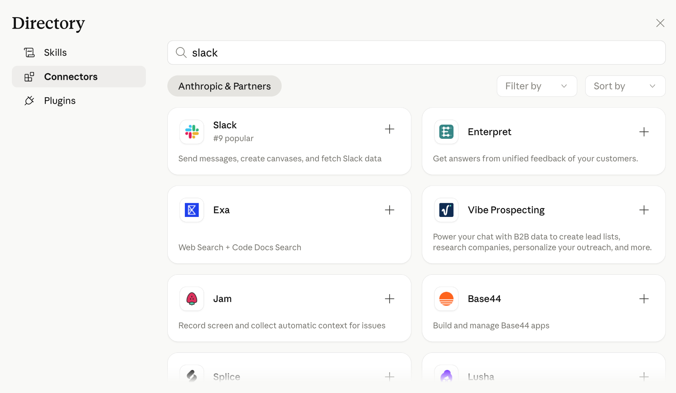
GETTING DATA INTO CLAUDE
Connect Claude to your tools
• You can connect to tools.
• These become data Claude can use as input / context!
• This will also allow Claude to create outputs, with your permission!
• Note: This will allow Claude to see data you share with it…
IMPACTAI FOUNDRY · BANGALORE 2026
8
Notes:
Merged the 'Getting Data Into Claude' build (slides 22–23) into one record using the fuller slide 23. Slide 22 was the partial reveal (connectors screenshot only) and was skipped.

Slide 17
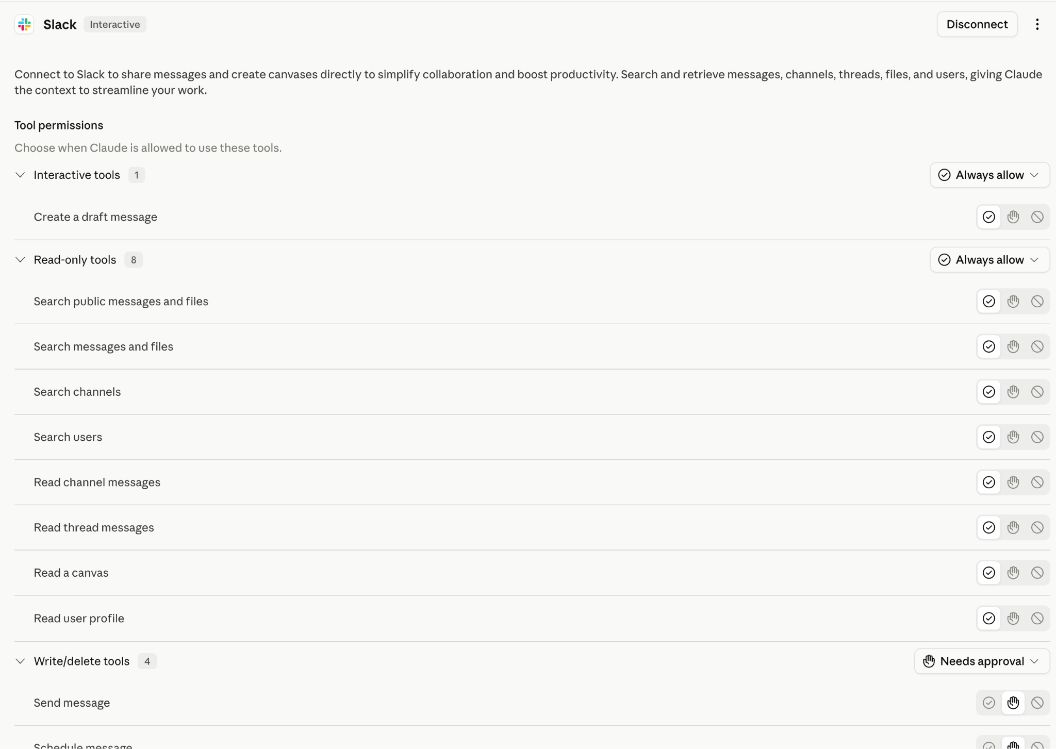
GETTING DATA INTO CLAUDE
…but you have control over that!
Tool permissions let you choose when Claude is allowed to use each tool — always allow, ask each time, or require approval.
IMPACTAI FOUNDRY · BANGALORE 2026
9

Slide 18
GIVING CLAUDE TOOLS: SLACK
Connect Claude to Slack to read the latest ImpactAI Foundry messages!
01
Add Slack in your Connectors
02
Ask Claude for a summary of the cohort conversation
03
Ask for anything else you might want to know!
IMPACTAI FOUNDRY · BANGALORE 2026
10

Slide 19
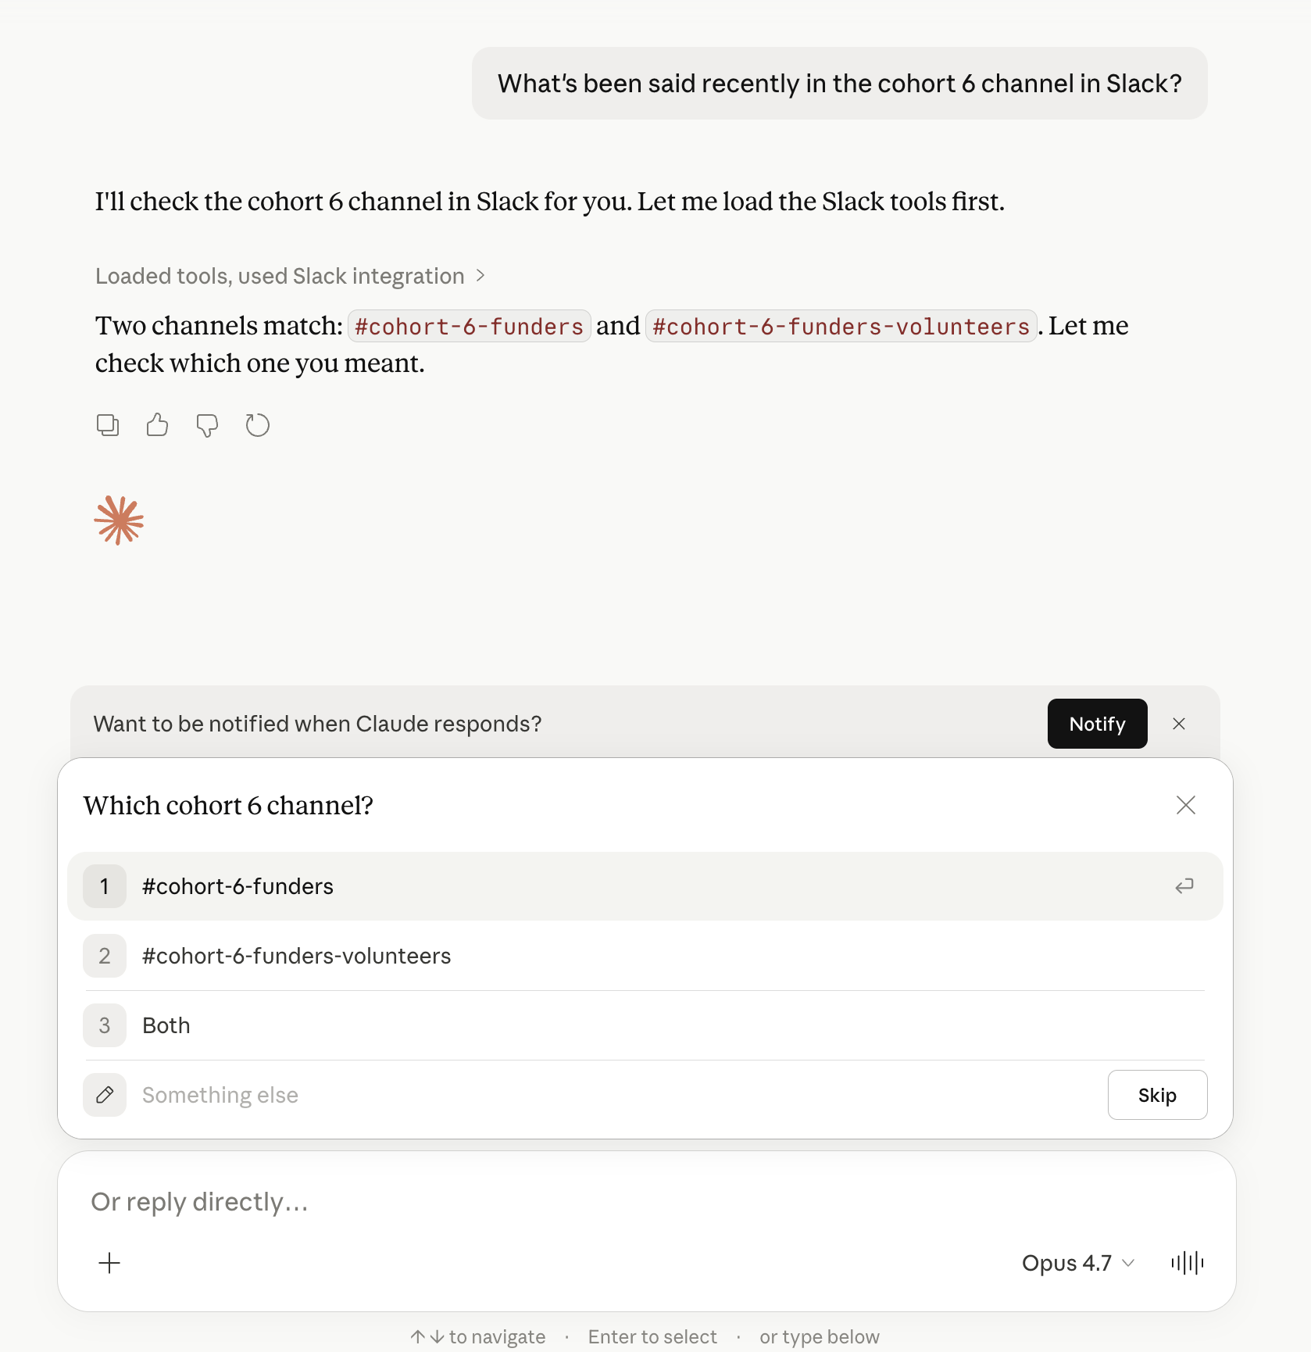
GIVING CLAUDE TOOLS: SLACK
Claude reads the cohort Slack channel and returns a summary of recent activity — confirming the channel, loading the messages, then writing it up.

Slide 20
TRAPPED IN THE CHAT
But what about everything beyond the chat?
Trigger
What kicks the work off
→
Actor
Who or what runs it
→
Input
Connectors connect to your data sources ✅
→
Steps
Teaching Claude to do something your way consistently?
→
Success
Putting results in your systems?
Slide 27 was the partial reveal and was skipped.
Notes:
(merged animation-build slides)

Slide 21
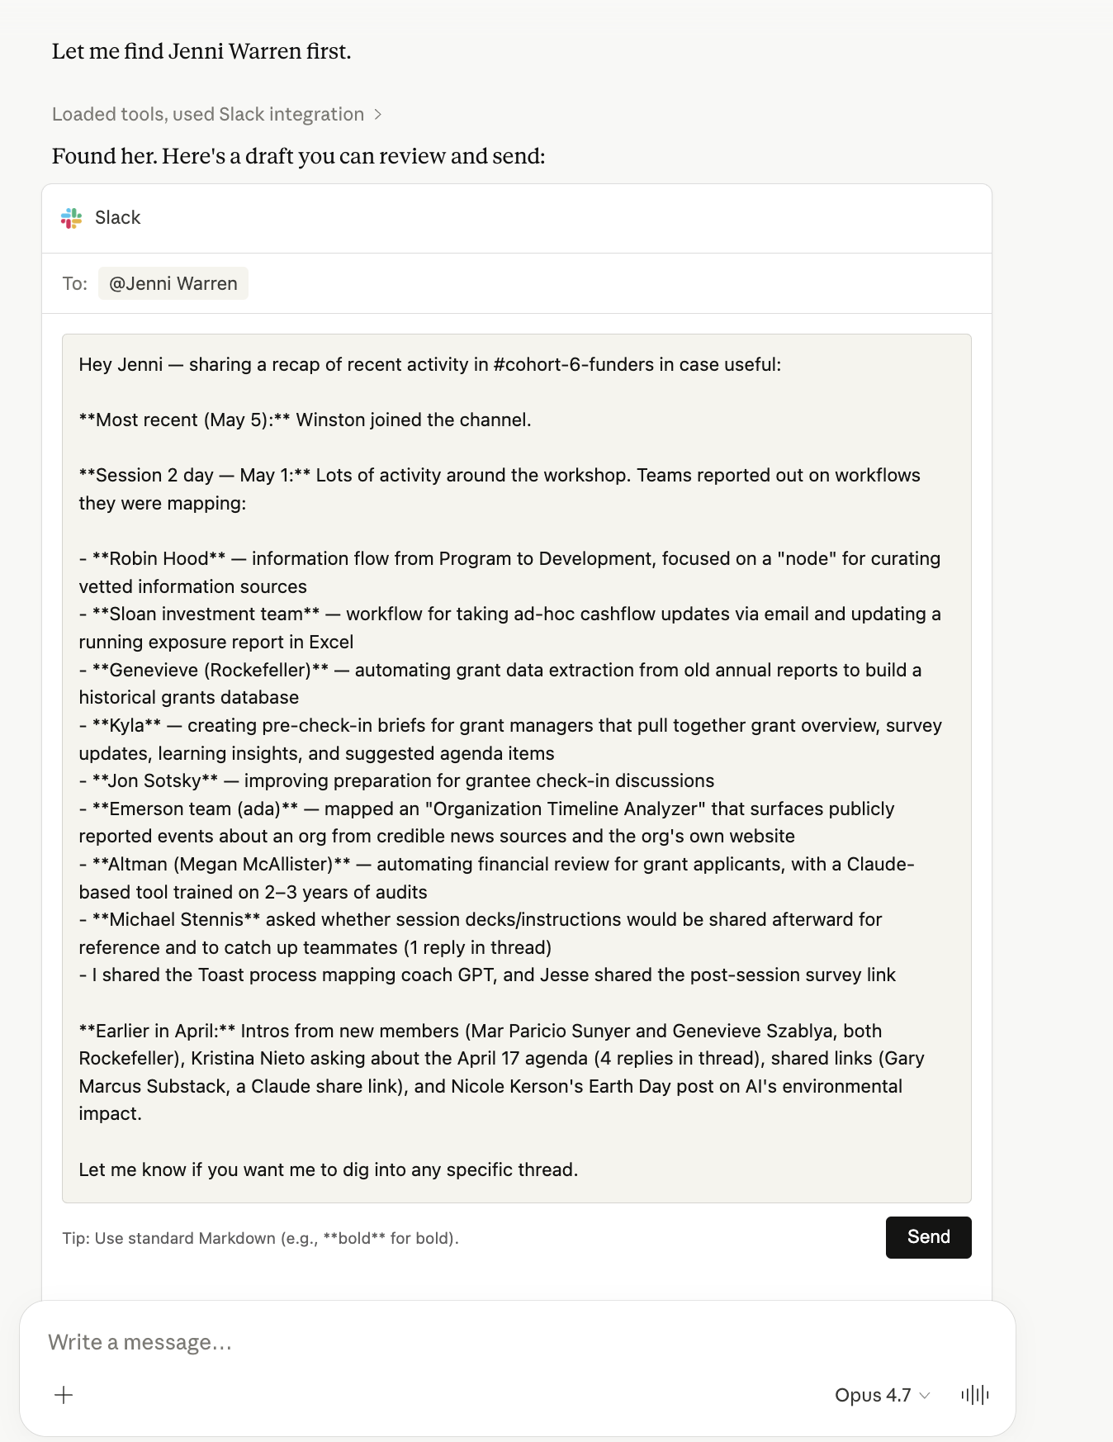
CONNECTORS
Getting Data Out of Claude
Of course connectors work the same way in reverse. “Can you send the Slack summary to a teammate in my DMs?” Safety first!
IMPACTAI FOUNDRY · BANGALORE 2026
11
Notes:
Slack-send screenshot; body keeps verbatim teaching lines plus the example prompt and the 'Safety first!' callout. RESHOOT — The Slack/DM draft screenshot is a long, dense block of tiny grey text (a multi-paragraph email-style draft) that is completely unreadable at projection size. It is illustrative context only and the teaching body fully carries the point, but at this scale it just reads as a grey wall. Note the screenshot still shows the specific name 'Jenni Warren' even though the body copy was rebranded to the generic 'a teammate' (not a banned term, just an inconsistency between image and body).

Slide 22
TRAPPED IN THE CHAT
But what about:
Trigger
→
Actor
→
Input
Connectors connect to your data sources ✅
→
Steps
Teaching Claude to do something your way consistently?
→
Success
Putting results in your systems? ✅ Connectors connect to your data sources
Earlier partial duplicate (slide 30) skipped.
Notes:
Node-anatomy reveal of the Trigger/Actor/Input/Steps/Success spectrum. Collapsed slides 30+31. (merged animation-build slides)

Slide 23
Break
15 min
Notes:
Break interstitial (image27.jpg full-bleed kilim/loom photo); rendered as a dark section divider.

Slide 24
SKILLS
Skills: Teaching Claude Some New Tricks
Jake’s grant writing Claude project
→
Jenni’s case study publishing Claude project
→
Brenda’s one-off blog post
→
ImpactAI Foundry branding skill
Skills are actions your Claude can take any time you or anyone calls it.
Notes:
Three separate Claude projects all converge on one shared skill. Rebranded the diagram's 'Decoded Futures branding skill' box to 'ImpactAI Foundry branding skill'.

Slide 25
SKILLS
Skills: Teaching Claude Some New Tricks
Why use skills? From Anthropic themselves:
• Improvement in Claude’s performance of specific tasks
• Organizational knowledge capture
• Easy customization
• Centralized management for organizations
IMPACTAI FOUNDRY · BANGALORE 2026
12

Slide 26
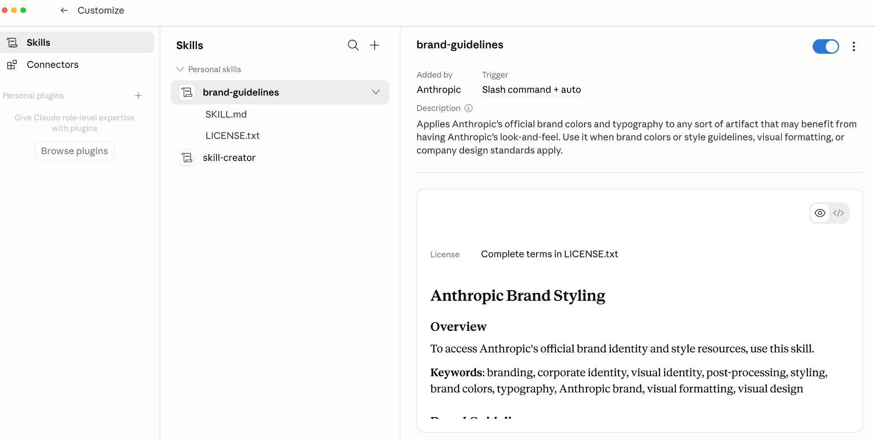
SKILLS
The Skills settings panel: a 'brand-guidelines' skill (Trigger: slash command + auto) applies official brand colors and typography to any artifact.
Notes:
Full-bleed product screenshot of the Claude Skills customization UI showing the brand-guidelines skill.

Slide 27
SKILLS
Skills: Teaching Claude Some New Tricks
But how do I make new skills? Great news, Anthropic thought of that: you just ask! Claude has a skill-creator skill! (so meta)
IMPACTAI FOUNDRY · BANGALORE 2026
13

Slide 28
GIVING CLAUDE SKILLS: BRAND GUIDELINES
Create a brand-guidelines skill for your actual brand.
01
Ask Claude
“Create me a brand guidelines skill that is based off of the real brand guidelines of my foundation”
02
Answer its questions
03
Try it out!
IMPACTAI FOUNDRY · BANGALORE 2026
14

Slide 29
SKILLS
Skills Summary
• Useful for small, contained workflows that you and your organization would use a lot
• Smaller than a project - you could imagine a project to write social media communications using your brand guidelines tool.
• Called with either a “/” or by Claude’s choice.
IMPACTAI FOUNDRY · BANGALORE 2026
15

Slide 30
TRAPPED IN THE CHAT
But what about…
Trigger
→
Actor
→
Input
Connectors connect to your data sources
→
Steps
Skills provide extra abilities / consistency
→
Success
Connectors connect to your data sources
Teaching Claude to do something your way consistently? Skills close the gap on the node anatomy.
Notes:
Merged the TRAPPED IN THE CHAT node-anatomy build (slides 39–40) into one record using the fullest/last slide (40); slide 39 is an earlier partial reveal and was skipped.

Slide 31
THE PIVOT
Any problem that can be solved by computing is arguably “solvable” by LLMs.
PRIOR TO LANGUAGE MODELS
NOW
People had to “speak computer” to build software.
Computers understand how people speak, and will build software as described.
IMPACTAI FOUNDRY · BANGALORE 2026
16

Slide 32
FINAL WORK BLOCK
Final Work Block (90 min)
01
Continue working on your prototype with your technologist
02
Flag any technical issues or new challenges you’re facing
it’s our last time in the group to talk about it!
03
If you’re at a testing stage, develop your ‘practical ethics’ testing plan
We’ll meet again at 4:30
IMPACTAI FOUNDRY · BANGALORE 2026
17

Slide 33
IMPACTAI FOUNDRY · SESSION 4
We Did It!
Bringing Your AI Into the World

Slide 34
LEARNING PATH
Discover to Deliver
01
Discover
02
Define
03
Design
04
Refine
05
Deliver
IMPACTAI FOUNDRY · BANGALORE 2026
18

Slide 35
WHAT WE'RE LEARNING ABOUT AI
What We're Learning About AI
01
Building Fluency Takes Time
02
You Learn Best By Doing
03
The Fun Comes in Iterating
IMPACTAI FOUNDRY · BANGALORE 2026
19

Slide 36
TOOLKIT
Your AI Tool Kit
CLAUDE CHAT
CLAUDE COWORK
46
• ChatGPT
• Gemini
• Copilot
• OpenAI Browser Agent
• Gemini in Chrome
• Copilot in Edge
IMPACTAI FOUNDRY · BANGALORE 2026
20

Slide 37
TOOLKIT
Claude Code
Codex · Gemini Code

Slide 38
ETHICS GUIDELINES
Ethics Guidelines
01
Personally Identifiable Information
Free AI tools aren't private - don't share information unless it's a secure platform.
02
Keep a Human in the Loop
Until you fully understand how AI behaves, always review its outputs before relying on them.
03
Customize for Your Community
Out-of-the-box AI models don't reflect every culture or experience - adapt them to truly serve your audience.
…but don't let these get in the way of getting started
IMPACTAI FOUNDRY · BANGALORE 2026
21

Slide 39
PROMPTING
Prompting
01
Give a Role and Goal
"You are a [add an expert, such as a "social media expert"] and your objective is to [add goal, such as "create LinkedIn posts about events"]"
02
List the Steps and Context
"To complete these instructions, follow these steps: Step 1, Step 2, Step 3 (etc)"
03
Describe the Final Product (Output)
"When you are done, write your final response": a summary paragraph of the work done, and 3 bullet points, one per next step
IMPACTAI FOUNDRY · BANGALORE 2026
22

Slide 40
SOLUTION TYPES
The 5 AI Solution Types
01
Answer & Assist
"I get a lot of questions and can't keep up with answering them all."
02
Automate the Admin
"I keep doing the same tasks over and over and it's taking time away from more important work."
03
Create & Communicate
"I need to write or create something to share with others."
04
Sort & Scan
"I spend too much time reviewing information that follows a pattern."
05
Learn & Decide
"I want to learn something new or need better insight to make smarter choices."
IMPACTAI FOUNDRY · BANGALORE 2026
23

Slide 41
AI DESIGN WORKFLOW
AI Design Workflow
01
Define the Problem (the friction)
02
Describe the Current Workflow
03
Clarify the Output
04
Define Success
05
Prototype, Test, and Iterate!
IMPACTAI FOUNDRY · BANGALORE 2026
24

Slide 42
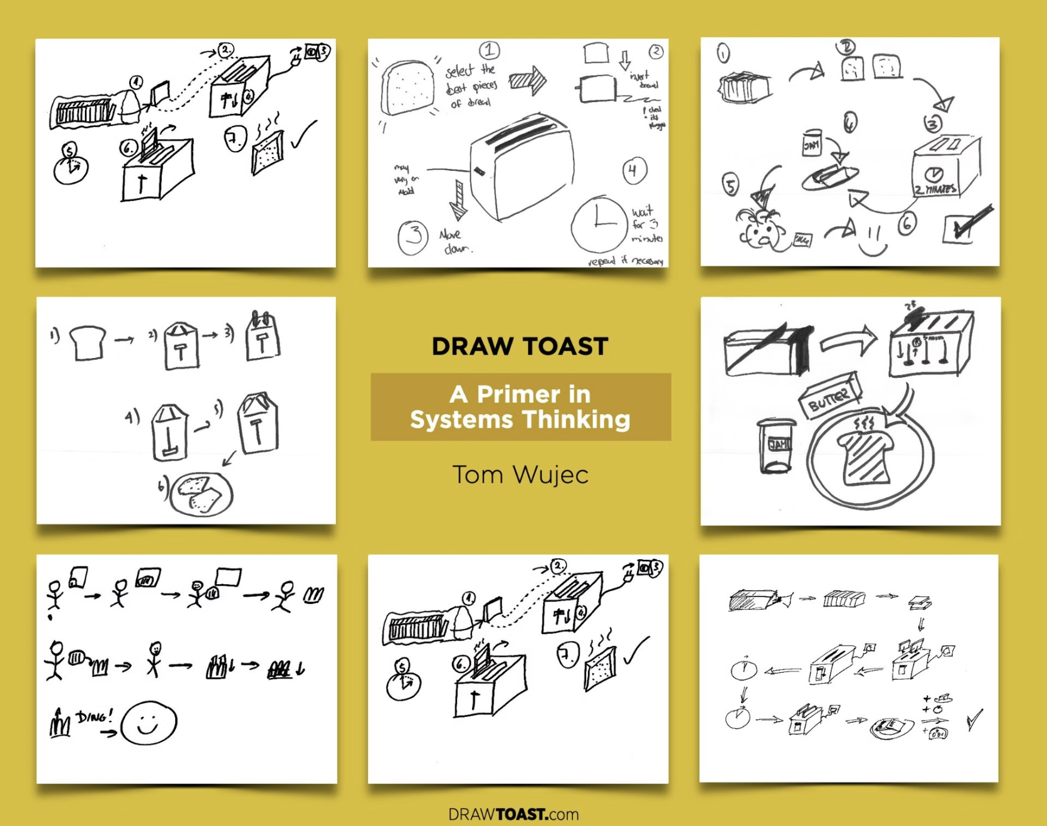
WORKFLOWS
We learned to make toast (aka workflows)
A workflow is a chain of steps. Each box in the chain is a node.
IMPACTAI FOUNDRY · BANGALORE 2026
25

Slide 43
NODE ANATOMY
Zoom in on one step (node)
Trigger
The signal to start the step
→
Actor
The person or thing that completes the step
→
Inputs
Info or data needed to complete the step (this is optional!)
→
Action
The actions the actor does to complete the step
→
Success
The result of the step and how you know it's successful
For any single step in a workflow, you can break it down into:

Slide 44
THE FOUR QUESTIONS
The Four Questions
Answer these questions before you deploy and you're ahead of 99% of social sector tech.
• What does success look like - for everyone?
• How will we know if it's failing?
• Who can raise an issue, and what happens?
• Who can change it or turn it off?
IMPACTAI FOUNDRY · BANGALORE 2026
26

Slide 45
WHAT TEAMS GO ON TO BUILD
What teams go on to build
Outcomes from the program model ImpactAI Foundry is built on:
• Build Policy — an AI policy for a 600-person organization
• Create Apps — an app to support nonprofits nationwide
• Lead Learning — an AI curriculum for a statewide network of Entrepreneurs Assistance Centers
• Get Funded — $500,000 in follow-on funding for AI tools
• Get Published — published on training the workforce for an AI era
• Scale — using AI to scale programming nationally
IMPACTAI FOUNDRY · BANGALORE 2026
27
Notes:
These are illustrative outcomes from the program model (IAF is cohort one). Swap for IAF's own alumni results once available.

Slide 46
POST-SURVEY
Take 5 minutes and reflect on today.
TODO: set real post-survey link (ImpactAI Foundry)

Slide 47
WHAT'S NEXT
What's Next
01
Demo Day!
See you at Demo Day — date, time & venue to be confirmed.
02
Between now and then
Share your final prototypes in Slack! They can be screenshots, code, or whatever you can show.
03
Questions?
Chat on Slack or reach out to the ImpactAI Foundry team. TODO: set real contact email.
IMPACTAI FOUNDRY · BANGALORE 2026
28
Notes:
TODO: set IAF Demo Day logistics.

Slide 48
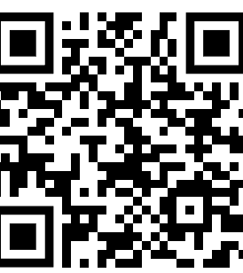
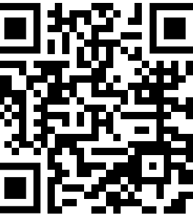
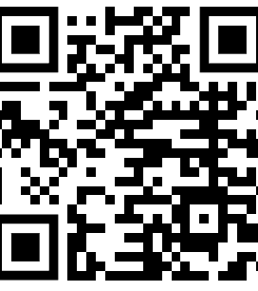
IMPACTAI FOUNDRY · SESSION 4
Follow along!
IMPACTAI FOUNDRY · BANGALORE 2026
29
Notes:
Three QR codes (Substack, Case Studies, LinkedIn) over a decorative background; dropped the '‹#›' slide-number chrome and the full-bleed background tile (image73.png). QR images point to ImpactAI Foundry properties. TODO: set real ImpactAI Foundry QR codes / links for Substack, Case Studies, and LinkedIn.

