Slide 1

IMPACTAI FOUNDRY · SESSION 2
AI Workflows
Session 2: AI Workflows

Slide 2
WELCOME BACK
Share your problem statement(s) with your table
• My pain point at work is that I spend time (doing a specific task).
• If I could reduce or change this by (specific improvement),
• I would gain (time, quality, or clarity impact).
IMPACTAI FOUNDRY · BANGALORE 2026
1

Slide 3
AGENDA
Today's schedule
9:00
Discovery Day Review
9:30
Making Toast: Workflows and Nodes
10:35
Define Your Workflow and Problem
11:35
Check In and Share
12:30
Close and Next Steps
Breaks at 10:20 and lunch at 12:00.
IMPACTAI FOUNDRY · BANGALORE 2026
2

Slide 4
LEARNING PATH
Five phases
01
Discover
02
Define
03
Design
04
Refine
05
Deliver
IMPACTAI FOUNDRY · BANGALORE 2026
3

Slide 5
LEARNING PATH · 02 DEFINE
Define
FOCUS
GOALS
02
Problem Scoping and Workflow Design
• Narrow to one clear workflow (MVP)
• Break work into steps
• Define inputs, constraints, and stakeholders
• Explicitly describe what success looks like and how it will be evaluated
IMPACTAI FOUNDRY · BANGALORE 2026
4

Slide 6
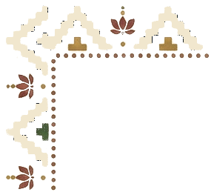
SECTION
Reviewing Discovery Day

Slide 7
PROMPTING
Structure a strong prompt
01
Give a Role and Goal
You are a [add an expert, such as a "social media expert"] and your objective is to [add goal, such as “create LinkedIn posts about events”]
02
List the Steps and Context
“To complete these instructions, follow these steps”: Step 1, Step 2, Step 3 (etc)”
03
Describe the Final Product (Output)
“When you are done, write your final response”: A summary paragraph of the work done; 3 bullet points, one per next step
IMPACTAI FOUNDRY · BANGALORE 2026
5

Slide 8
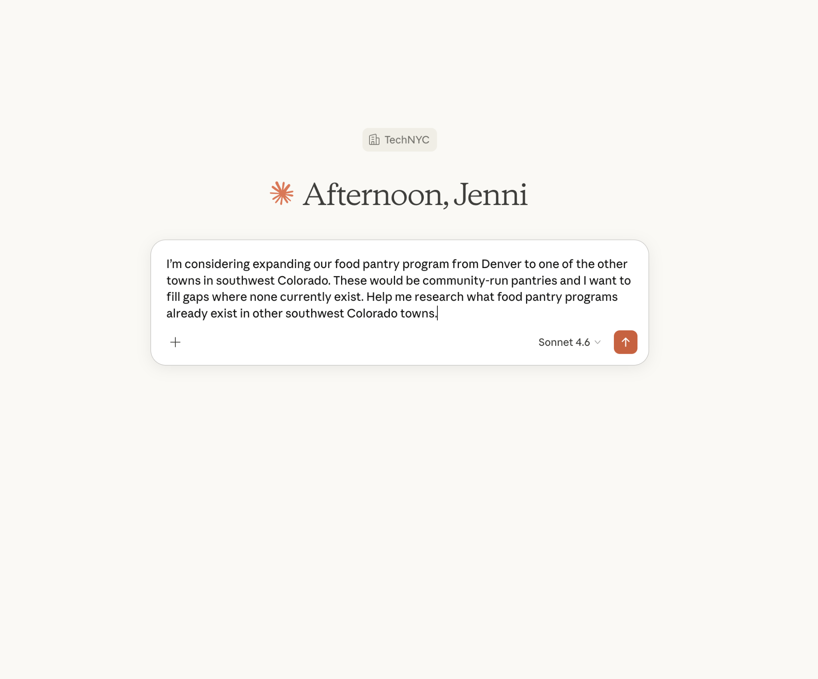
BUILDING A PROJECT
Use the + menu to add files, projects, and connectors — then turn on Research to investigate a question.

Slide 9
BUILDING A PROJECT · 15 MIN
Build a Claude Project to answer user questions about material.
Start a new project and add some content you want people to know (e.g. your website's FAQ)
Write a set of instructions telling the Project to respond to user questions only using the materials you gave it.
Try it out!
IMPACTAI FOUNDRY · BANGALORE 2026
6

Slide 10

PROJECT EXAMPLE
Coach / Librarian
• “I want an AI that answers my and my team's questions about our company materials.”
• Prompt: Describe how it should interact with your team and your materials.
• Files: Share the materials you want it to pull from.
IMPACTAI FOUNDRY · BANGALORE 2026
7

Slide 11
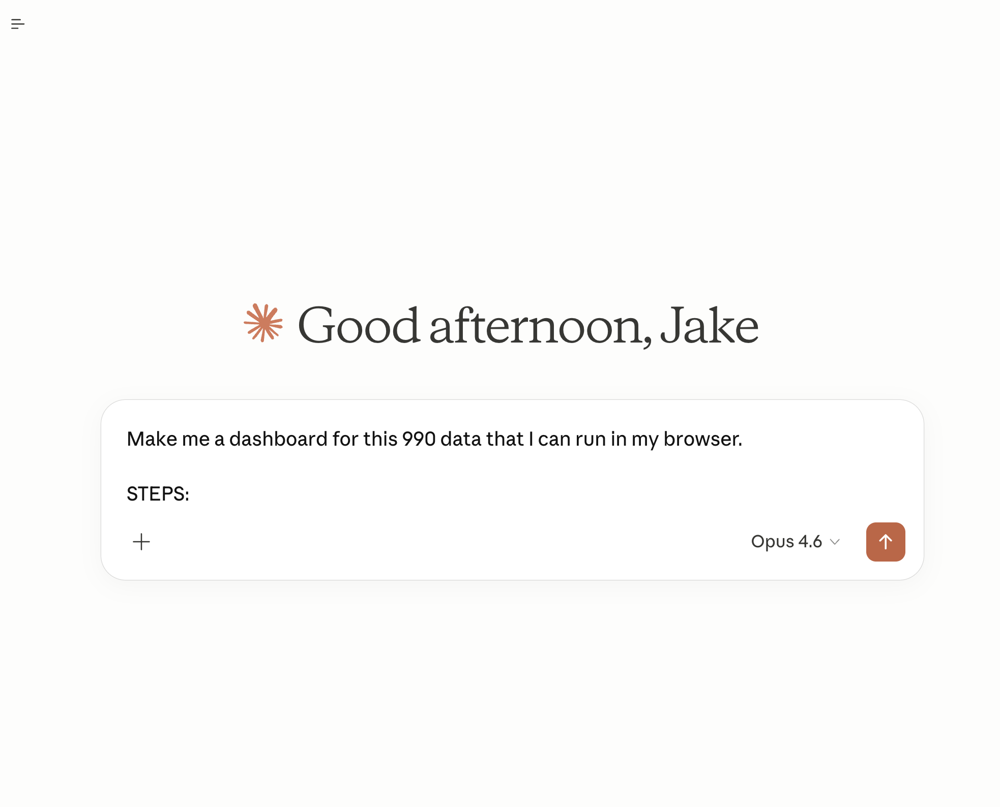
CODE(ISH)!
Code(ish)!
• Vanilla Claude Chat can write simple code for you!
• Don't think about it as “coding” - you are merely asking for a computer to do something annoying for you.
• The mad lib to start with: “Make me __________ that can run in my browser” / “Make me an HTML file that…”
• It's very helpful to be very specific about the STEPS section of your prompt if your task is specific or complex.
IMPACTAI FOUNDRY · BANGALORE 2026
8

Slide 12
CODE · BUILDING A WEBSITE
Have Claude make you a new website
Open a new chat
Ask Claude to “recreate the website at <URL>”
Optional: Give it any requests for style, features you want
IMPACTAI FOUNDRY · BANGALORE 2026
9

Slide 13
CODE · BUILDING A WEBSITE
Recreate a site from its URL
Ask Claude to recreate a site at a URL — it reads the front-end design for best practices, fetches details, and rebuilds the page.
Notes:
Original slide showed a live website-recreation screenshot of the source org's own site (off-brand for IAF). On reshoot, drop in a screenshot of an IAF or brand-neutral site being rebuilt.

Slide 14
AI DESIGN WORKFLOW
AI Design Workflow
01
Define the Problem (the friction)
02
Describe the Current Workflow
03
Clarify the Output
04
Define Success
05
Prototype, Test, and Iterate!
IMPACTAI FOUNDRY · BANGALORE 2026
10

Slide 15
IMPACTAI FOUNDRY · SESSION 2
Making Toast: Workflows and Nodes

Slide 16
LET'S MAKE TOAST (5 MIN)
Grab a piece of paper and draw the steps of how you make toast.
When you're finished, share your steps with your team.
Notice what you had the same/different.
IMPACTAI FOUNDRY · BANGALORE 2026
11

Slide 17
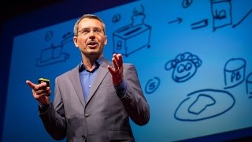
Drawing how you make toast — the classic systems-thinking warm-up.

Slide 18
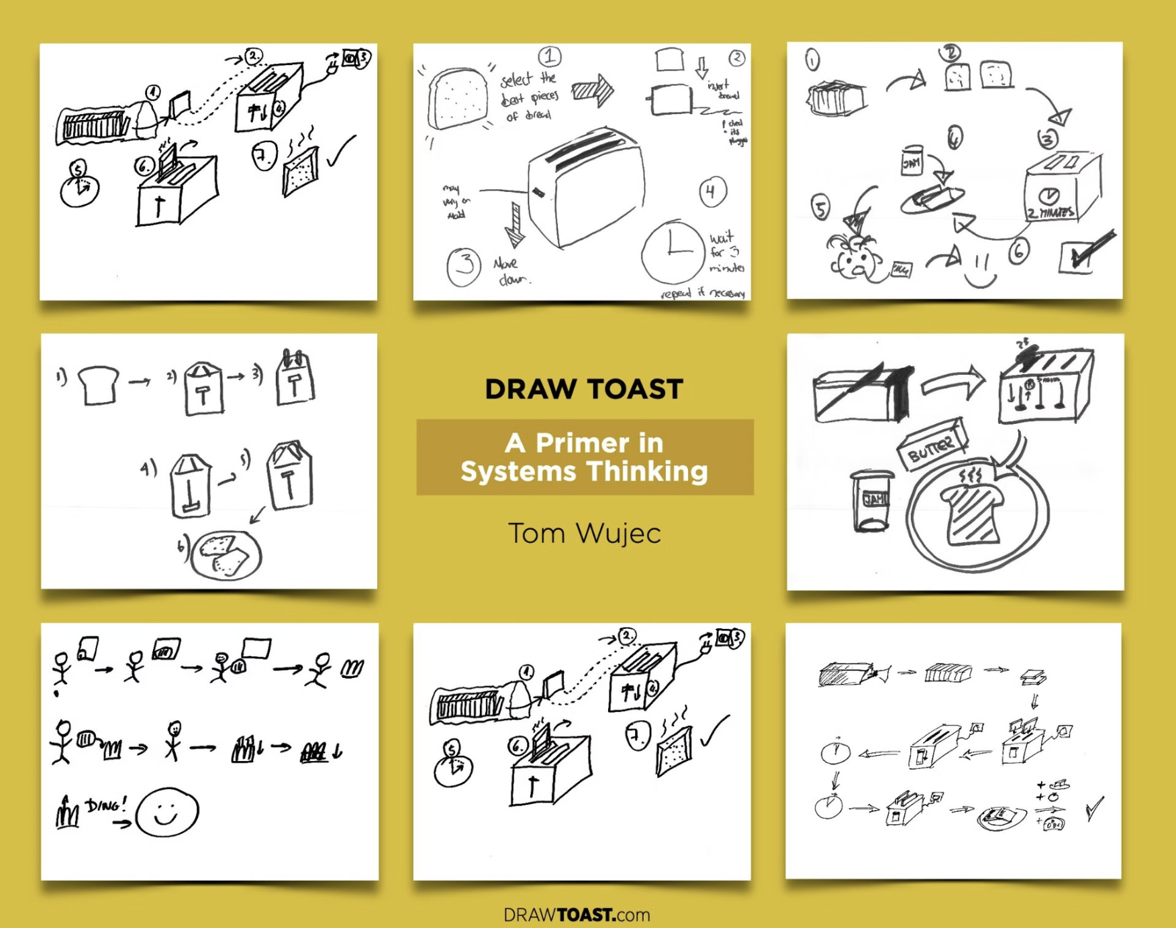
THIS IS A WORKFLOW
A workflow is a chain of nodes. Each box is a node; the arrows are the flow between them.

Slide 19
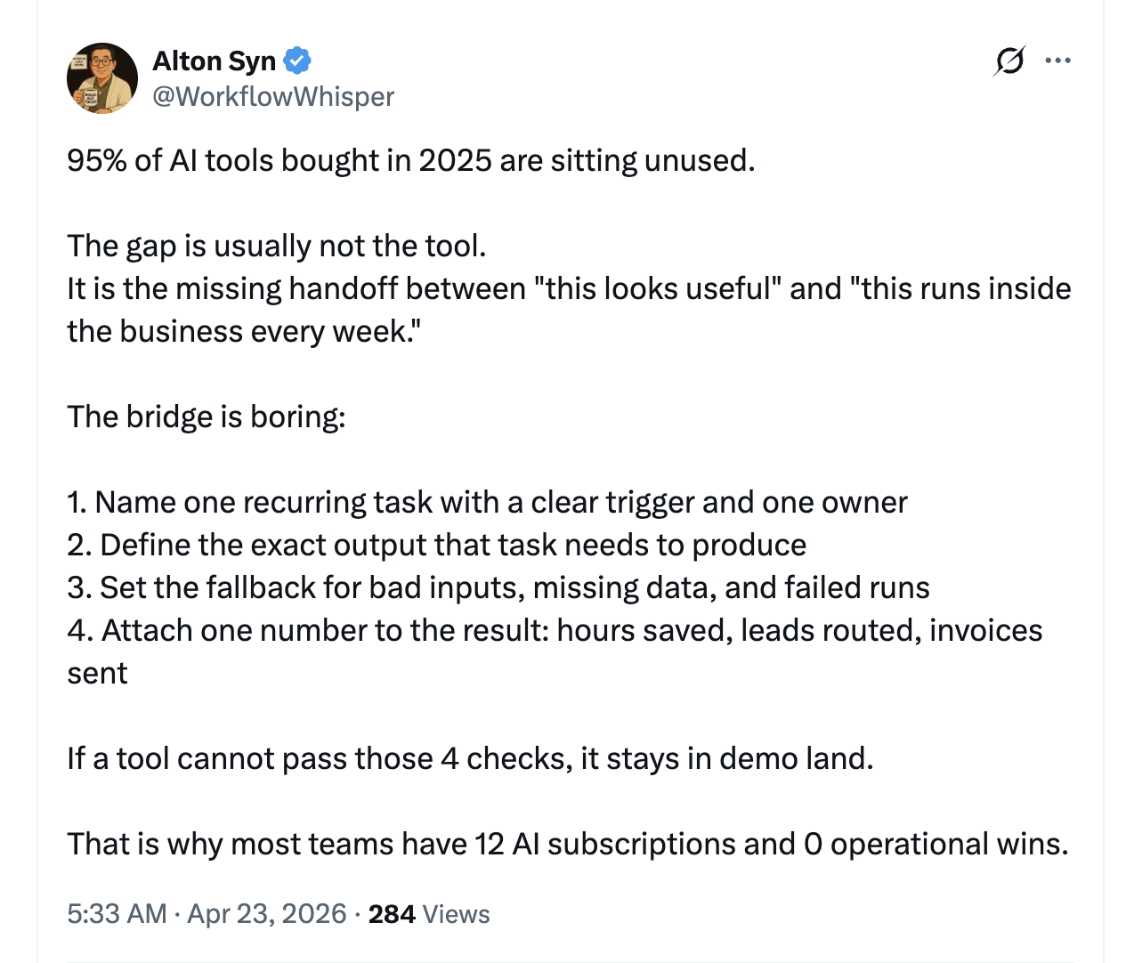
The gap is usually not the tool — it is the missing handoff between "this looks useful" and "this runs inside the business every week."

Slide 20
10 MIN
Break

Slide 21
ZOOM IN ON ONE STEP (NODE)
For any single step in a workflow, you can break it down into:
Trigger
The signal to start the step
→
Actor
The person or thing that completes the step
→
Inputs
Info or data needed to complete the step (this is optional!)
→
Action
The actions the actor does to complete the step
→
Success
The result of the step and how you know it's successful

Slide 22
TRY IT: ZOOM IN ON ONE STEP (NODE)
Apply the Steps to this Node: Getting Toast Out of the Toaster
Trigger
You hear the toaster ding
→
Actor
The person grabbing toast
→
Inputs
None needed, just hunger! (Maybe some jam)
→
Action
You reach out your hand and pick up the toast
→
Success
The toast is out of the toaster!
The five components of a node: Trigger, Actor, Inputs (optional), Action, Success.
Notes:
Merged slides 22 (generic definitions) and 23 (toast example applied); 23 is the fullest applied version. Generic defs: Trigger = the signal to start the step; Actor = the person or thing that completes the step; Inputs = info or data needed to complete the step (optional); Action = the actions the actor does to complete the step; Success = the result of the step and how you know it's successful.

Slide 23
AI PROCESS MAPPING & WORKFLOW
“I want AI to match our graduates to the best jobs.”
A real ask we'll map into a workflow.
Notes:
Merged slides 24 and 25 (identical; 25 is a struck-through animation build). Used src 25 = last slide of group.

Slide 24
A SIMPLE WORKFLOW EXAMPLE
Problem: How to Match Our Graduates to the Best Job
Node 1
“I search five job sites for new jobs since my last search”
→
Node 2
“I save the jobs that match my students’ interests
→
Node 3
“I present the matches to each student. If they are interested we apply.
A workflow is a chain of nodes, each handing off to the next.

Slide 25
TRY IT: ZOOM IN ON ONE STEP (10 MIN)
Map out the aspects of Node 1 in the job search workflow
“I search five job sites for new jobs since my last search”
Apply the five components: trigger, actor, inputs, action, success
Share with your table
→ What are the trigger, actor, inputs, action, and success for Node 1?
IMPACTAI FOUNDRY · BANGALORE 2026
12

Slide 26
SESSION 2
Connecting to AI Implementation

Slide 27
HUMAN → AI
The node model maps to how you design your AI to run that step!
Trigger
What starts your AI process (e.g. opening ChatGPT, a notification)
→
Actor
The AI
→
Inputs
What data/ context does it need? Role and goal
→
Action
The steps you laid out in your prompt
→
Success
The output and how we know it did a good enough job

Slide 28
NODE 1
The node model maps perfectly to how you design your AI to run that step!
01
PROCESS TODAY
PROCESS WITH AI (YOUR PROMPT SECTIONS)
• TRIGGER — You need more jobs
• ACTOR — Human
• INPUT — List of Sites
• STEPS — Go to website; Input key words; Add job links to a list with a description
• SUCCESS — List of jobs
• TRIGGER — A calendar notification goes off
• ACTOR — Claude Project
• INPUT — Role, Goal, and Context
• STEPS — Search the sites; Get new jobs (with context on what a good, new job is)
• SUCCESS — Output: 5-10 jobs based on all the sites, the URLs
IMPACTAI FOUNDRY · BANGALORE 2026
13
Notes:
Merged slides 30 & 31 (near-identical node-anatomy table; 31 only relabels the 'Process with AI' column with prompt-section names Role/Goal/Context, Steps, Output). Combined the fullest content from both into one record at the last slide number (31).

Slide 29
MAP YOUR WORKFLOW
Map your workflow
Choose one specific workflow you want to improve based on your Mad Lib
Map the workflow as it happens today (draw it out!):
Identify one step that feels repetitive, slow, or unclear. Break down trigger, actor, inputs, action, success
→ (45 min) We’ll check back in here at 12:00. If you finish early, you can try creating the prompt that would run this part of the workflow.
IMPACTAI FOUNDRY · BANGALORE 2026
14

Slide 30
SHARE OUT (10 MIN)
Share the workflow you’re mapping.
What feels easy? Hard?

Slide 31
AI DOSAGE
Fully human → Fully automated
Fully Human
All nodes are performed manually by a human without any AI assistance.
→
AI-Assisted Human
Human performs some nodes with support from AI tools that handle some of the more repetitive or time consuming nodes.
→
Fully Automated
AI performs all or most of the nodes with minimal or no human intervention, handling tasks from start to finish.
The spectrum of AI involvement across your workflow nodes.

Slide 32
IF YOU FEEL STUCK BECAUSE…
If you feel stuck because…
01
You don’t have a clear process
Make some decisions about how it could work just for today
02
The system seems too complex
Pick a smaller subsection of it
03
“Steps” are insufficient to capture all the info to do the activity
Add a little “context” list of info you’d want to give someone
IMPACTAI FOUNDRY · BANGALORE 2026
15

Slide 33
MAP YOUR WORKFLOW (40 MIN)
Finalize your workflow
01 Finalize your workflow
02 If you're ready, write this into a prompt and try it!
We'll wrap up at 12:45
→ Try Toast Bot if you're stuck (or curious!) — https://bit.ly/toastbot
IMPACTAI FOUNDRY · BANGALORE 2026
16

Slide 34
SHARING IS CARING
Share what you built
Post in the cohort channel, or email the ImpactAI Foundry team.
• In a few sentences, describe the workflow you worked on today
• Snap a pic if you drew it!
• (Optional) Make a note of 1-2 other problems you're considering working on, whether directly AI implementation or not, if you've got 'em.
IMPACTAI FOUNDRY · BANGALORE 2026
17
Notes:
TODO: set the real cohort channel + team email.

Slide 35
SHOW AND TELL
Reflections
3 Minute Share Out:
• Introduce yourself and your org
• What workflow you worked on today
• What went well? What was a challenge?
• Any other reflections?
IMPACTAI FOUNDRY · BANGALORE 2026
18

Slide 36
WEEKLY SURVEY
Take 5 minutes and reflect on today.
Find this week's survey link in your cohort channel.
Notes:
TODO: add IAF's own weekly-survey link.

Slide 37
WHAT'S NEXT
What's next
01
Session 3
See you here in two weeks — [insert date and time]!
02
For Next Time
Prepare your inputs (data, decisions, documents).
03
Questions?
Chat on the cohort channel or reach out to the ImpactAI Foundry team.
IMPACTAI FOUNDRY · BANGALORE 2026
19
Notes:
TODO: set the real cohort channel + team contact for questions.

Slide 38
FOLLOW ALONG!
Follow along
Substack · Case Studies · LinkedIn

