Slide 1

DISCOVERY DAY · BANGALORE · JUNE 2026
ImpactAI Foundry
Welcome — find a seat, grab some snacks.
WiFi ImpactAI-Guest Password foundry2026

Slide 2
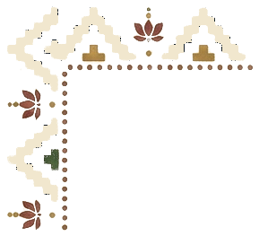
SESSION ONE · 10:00 AM
Prompting and design
The shortest path from a blank prompt to useful output.

Slide 3
01
PHASE 01 · DISCOVER
Ideation & foundational learning
FOCUS
GOALS
Explore where AI can help and build hands-on fluency before committing to a problem.
• Explore high-impact AI use cases
• Build fluency with prompting and core tools
• Understand AI's strengths and limits
• Spot workflows that feel unclear or manual
IMPACTAI FOUNDRY · BANGALORE 2026
20

Slide 4
THREE GUARDRAILS
Build with care, but build
01
Protect personal information
Free AI tools aren't private by default. Beneficiary and donor data stays out unless the platform is secure and configured for it.
02
Keep a human in the loop
Until you fully understand how a tool behaves on your work, review its outputs before relying on them.
03
Customise for your community
Out-of-the-box AI doesn't reflect every context. Adapt it to truly serve the people you serve.
…but don't let these get in the way of getting started.
IMPACTAI FOUNDRY · BANGALORE 2026
30

Slide 5
EXERCISE · 15 MIN
Ask AI to solve a real work problem
You're a 10th-grade English teacher. You just hired a teaching assistant to grade essays.
→ With your team: what do you do to make sure they do the right thing?
IMPACTAI FOUNDRY · BANGALORE 2026
36

Slide 6
“
You know your work better than anyone in this room. Our job isn't to tell you what to build — it's to help you put AI to the work you already do.
THE PREMISE OF THE FOUNDRY
IMPACTAI FOUNDRY · BANGALORE 2026
16

Slide 7
THE LEARNING PATH
Five phases across four sessions
01
DISCOVER
Build prompting fluency; spot AI-shaped problems in your work.
02
DEFINE
Narrow to one workflow; map inputs, steps, and success.
03
DESIGN
Build a reusable prototype with your mentor; test on real work.
04
REFINE
Stress-test edge cases; add validation; fit it to your team.
05
DELIVER
Demo Day, August 1 — share what you built and what's next.
IMPACTAI FOUNDRY · BANGALORE 2026
19

