Slide 1

IMPACT AI FOUNDRY
AUTOMATE THE ADMIN · GOING FURTHER
Claude Code — when chatting isn’t enough
The same Claude you know, now working directly inside your files, folders and tools.

Slide 2

IMPACT AI FOUNDRY
TWO WAYS TO WORK WITH CLAUDE
Claude Chat vs. Claude Code
Claude Chat
Claude Code
It talks you type, it replies in the chat window.
You move the work copy text in, copy the answer back out by hand.
Best for thinking, drafting, summarising, answering questions.
Great for words — you still do the doing.
It acts reads and edits your real files and runs the task itself.
It moves the work opens folders, edits many documents at once.
Best for repetitive, multi-file, “just change it” jobs.
Great for doing — it works where your files live.

Slide 3
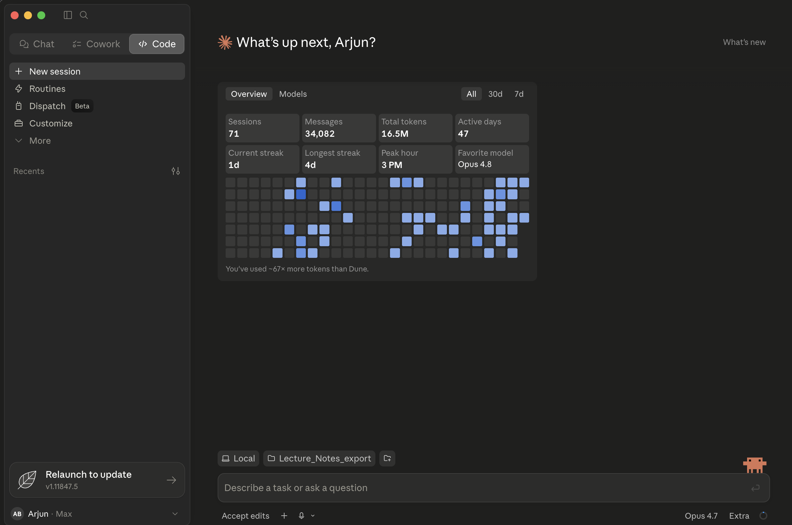

Slide 4
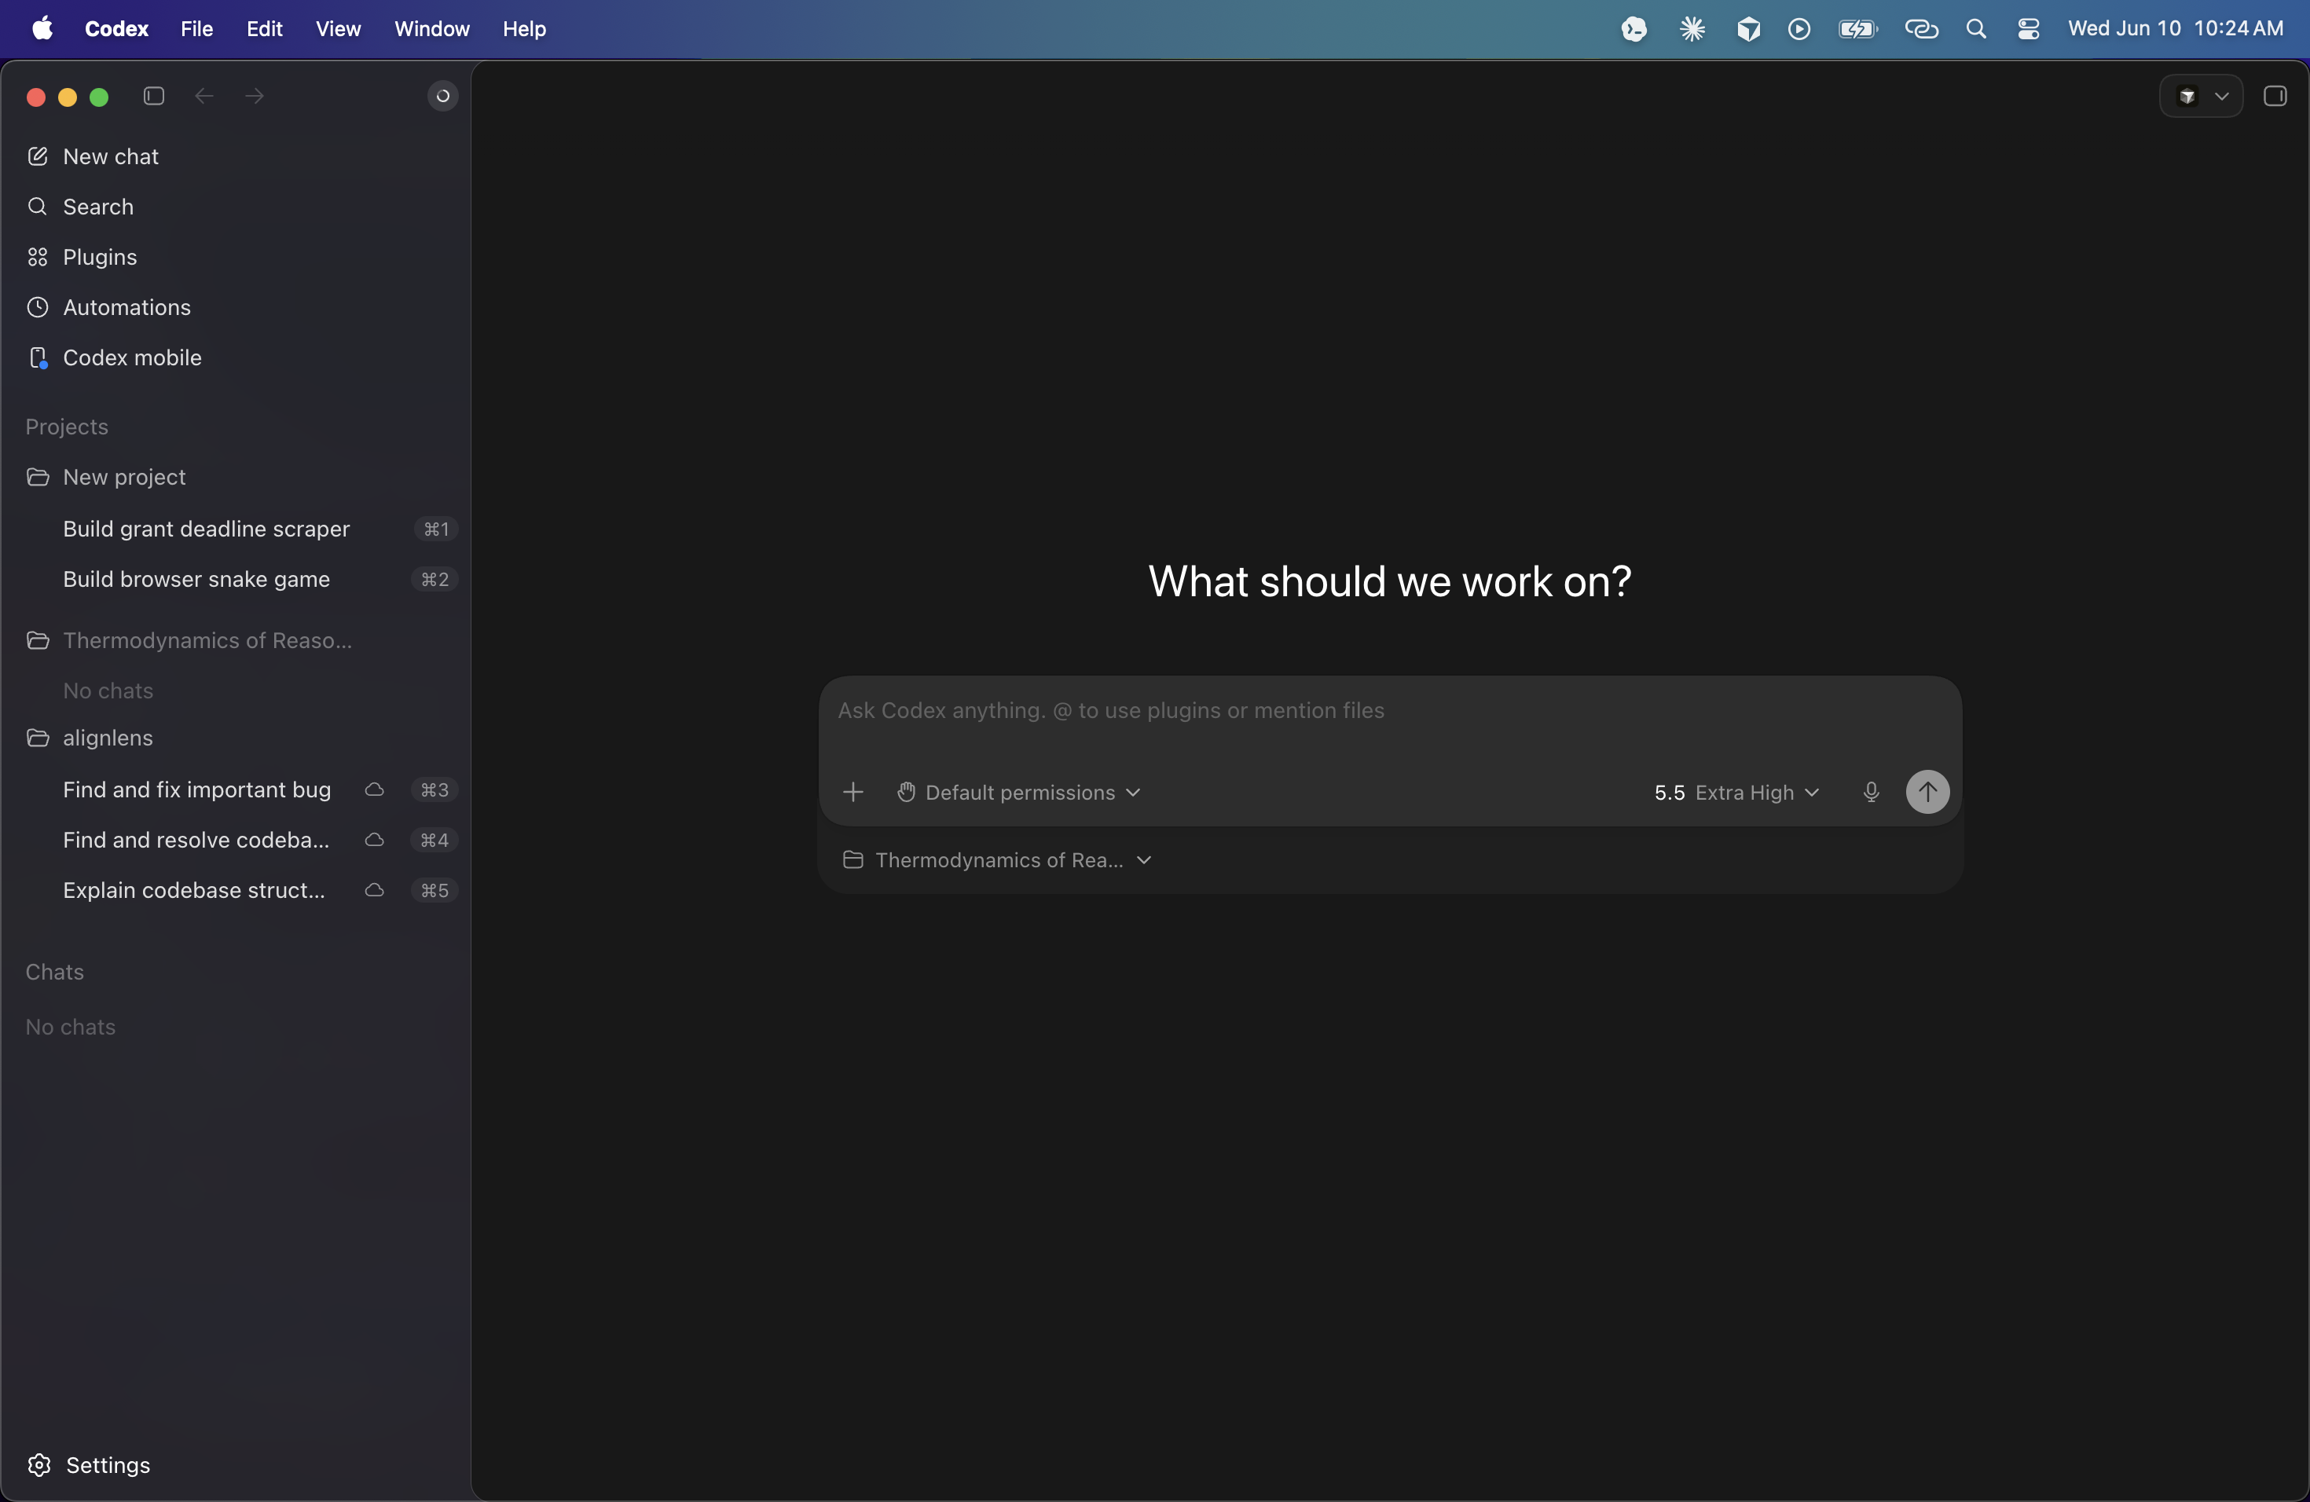

Slide 5
IMPACT AI FOUNDRY
GETTING STARTED WITH CLAUDE CODE
How to use it — and where it fits
Point it at a folder — open Claude Code where the files you want to work with already live.
Ask in plain English — “rename these by date,” “pull the totals into one sheet,” “draft a report from these notes.”
Watch and approve — it shows each change before it makes it — nothing happens without your okay.
Use it where you work — on your desktop (Mac or Windows), in the editor, in the terminal, or on the web.
Connect your tools — link Google Drive, Gmail and more so it works with the data you already have.
Start with one repetitive, file-heavy task — let it prove itself there first.

