Slide 1

IMPACT AI FOUNDRY
WORKING SUSTAINABLY
Make your credits last
Match the model to the task — and spend tokens like the budget they are.

Slide 2

IMPACT AI FOUNDRY
RIGHT-SIZE THE MODEL
Big model, or small model?
Reach for the powerful one
Default to the fast one
Use it for hard reasoning, ambiguous problems, gnarly code, the tricky first draft.
Such as Claude Opus · ChatGPT’s deep-reasoning mode.
Powerful models cost more per message — save them for when they earn it.
Use it for everyday drafting, summaries, reformatting, repetitive Q&A, quick edits.
Such as Claude Sonnet or Haiku · ChatGPT’s fast mode.
Most of your day-to-day work never needs the expensive model.

Slide 3
IMPACT AI FOUNDRY
HABITS THAT SAVE TOKENS
Spend less, get more
Start a fresh chat for a new task — long histories re-send every earlier message, and you pay for them each time.
Be specific, not verbose — a clear, short prompt beats a long, rambling one.
Don’t paste the whole document — give the one section the model actually needs.
Reuse your saved prompts — don’t re-explain the same setup from scratch.
Turn off tools you’re not using — web search and extras add tokens you may not need.
Every token you don’t spend is budget for another month of building.

Slide 4
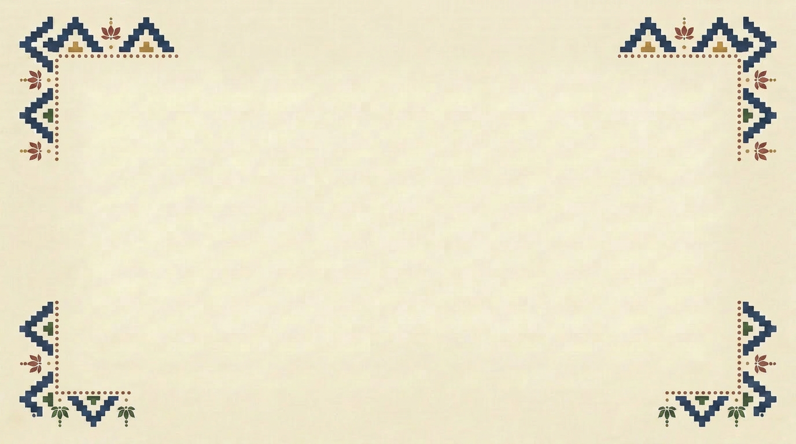
IMPACT AI FOUNDRY
THE RULE OF THUMB
“
Start with the smallest model that could do the job. Escalate only when it visibly struggles — most everyday work never needs the expensive one.
Right-sizing is the cheapest habit you’ll build

