Slide 1
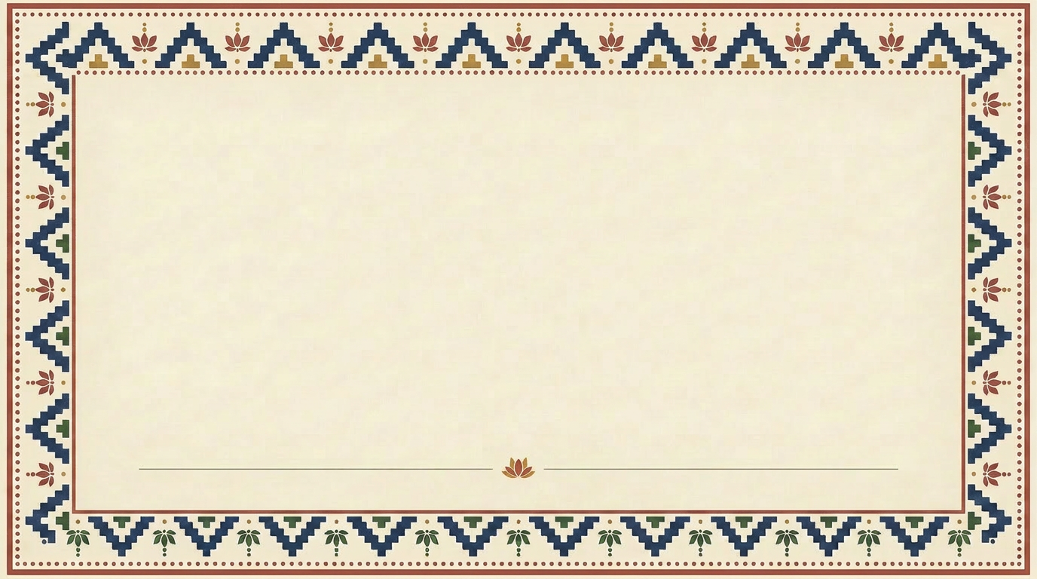
IMPACT AI FOUNDRY
01
VARIANT ONE
Full ornamental border
All four sides framed in block-print motifs

Slide 2
IMPACT AI FOUNDRY
02
VARIANT TWO
Horizontal bands only
Click to add body copy. This variant keeps ornament only at the top and bottom, leaving the sides open. Good for paragraph-heavy slides where horizontal whitespace lets the text breathe across the full width.

Slide 3
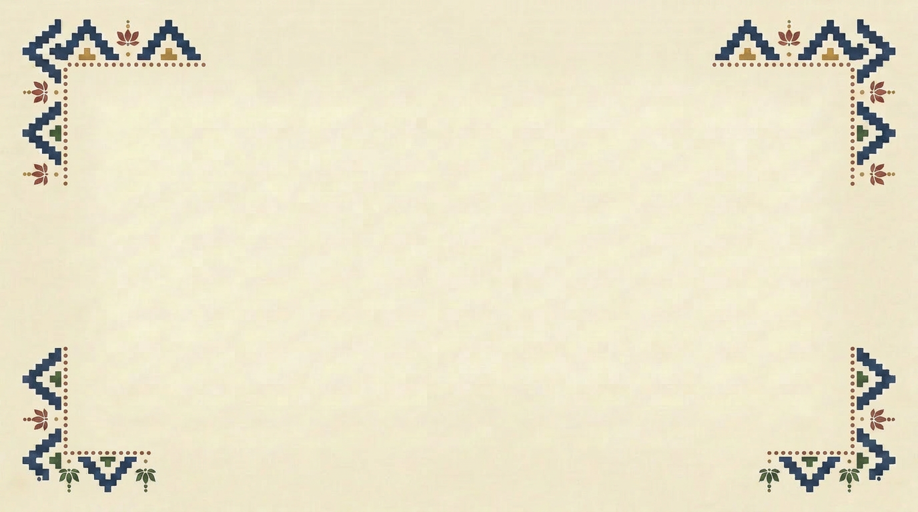
IMPACT AI FOUNDRY
03
VARIANT THREE
“
Click to add a featured quote, statistic, or single powerful idea that anchors this slide.
— Attribution or source

Slide 4
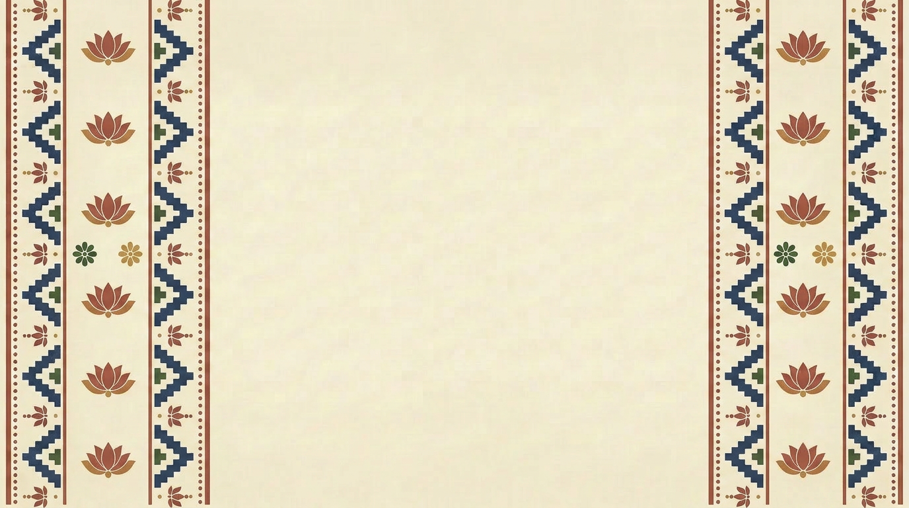
IMPACT AI FOUNDRY
04
VARIANT FOUR
Vertical side panels
Column one heading
Column two heading
Click to add supporting text. The vertical block-print bands on the left and right edges frame the slide like a textile selvage.
Mirror the structure on the right for a balanced, symmetric pairing of ideas.

