Slide 1

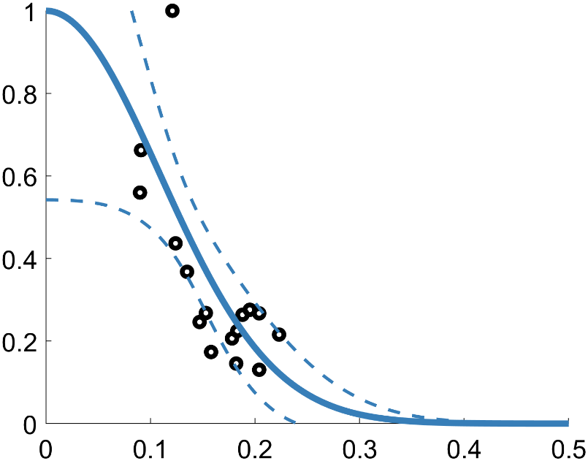


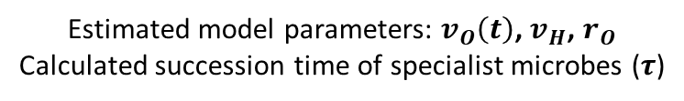


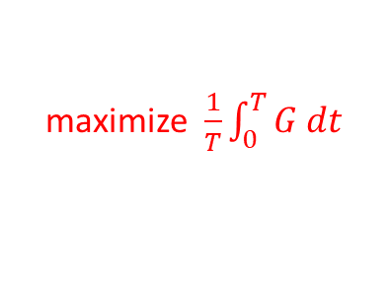



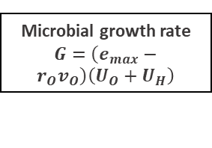





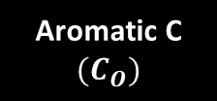


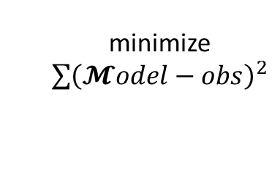
(a) Litter decomposition model
(b) p-function
$$\left(1−μ_{O}\right)G$$
Non-aromatic C $(C_{H})$
$$U_{H}=v_{H}C_{H}p\left(l\right)$$
Microbial growth rate
$G=\left(e_{max}−r_{O}v_{O}\right)\left(U_{O}+U_{H}\right)$
$$p\left(l\right)$$
Aromatic C
$$(C_{O})$$
$$U_{O}=v_{O}C_{O}$$
$$μ_{O}G$$
$$l=\frac{C_{O}}{C_{O}+C_{H}}$$
(c) Model Parametrization
1. Eco-evolutionary approach: maximization of mean growth rate
maximize $\frac{1}{T}\int_{0}^{T}{G dt}$
(subject to litter mass loss
as dynamic constraint)
$$v_{O}(t)$$
$$τ$$
Time (days)
Simulated $C_{H}(t)$ and $C_{O}(t)$
$v_{H}$, $r_{O}$
2. Least-square approach: find time invariant parameters
minimize
$\sum{{\left(𝓜odel−obs\right)}^{2}}$
$v_{H}$, $r_{O}$
Time (days)
Estimated model parameters: $v_{O}\left(t\right)$, $v_{H}$, $r_{O}$
Calculated succession time of specialist microbes ($τ$)
(d) Model result analysis
Statistical inference:
$τ,r_{O},v_{H},{\overline{v}}_{O}\sim$climate + litter chemistry +…

