Slide 1
CDM information decay
2026-2027

Slide 2
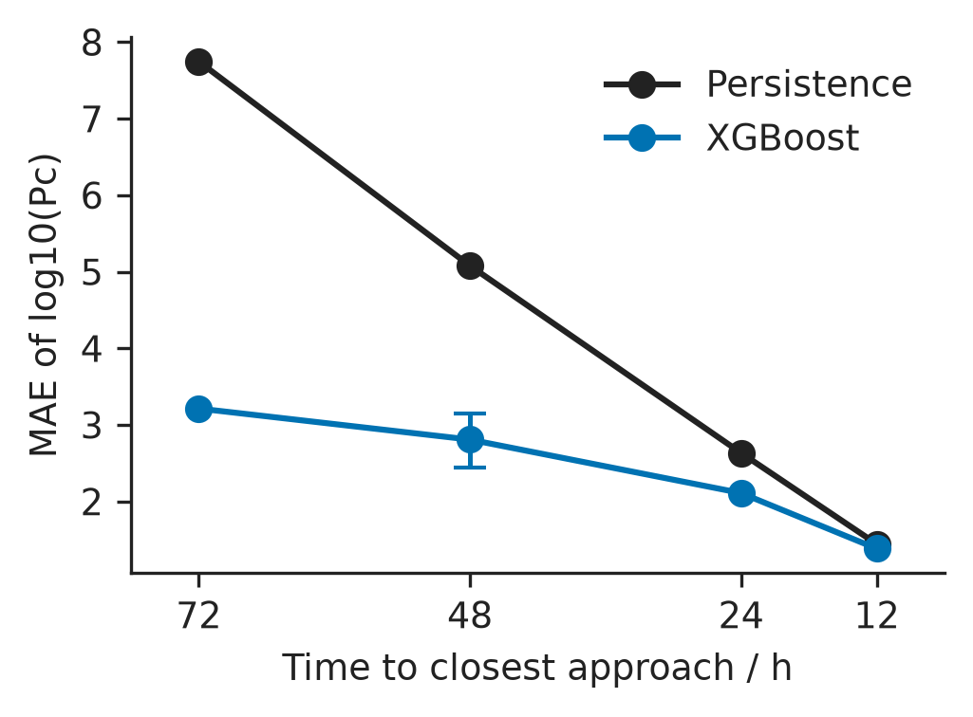
Figure 1. Horizon MAE: extra information is largest at 72 h and nearly gone at 12 h.

Slide 3
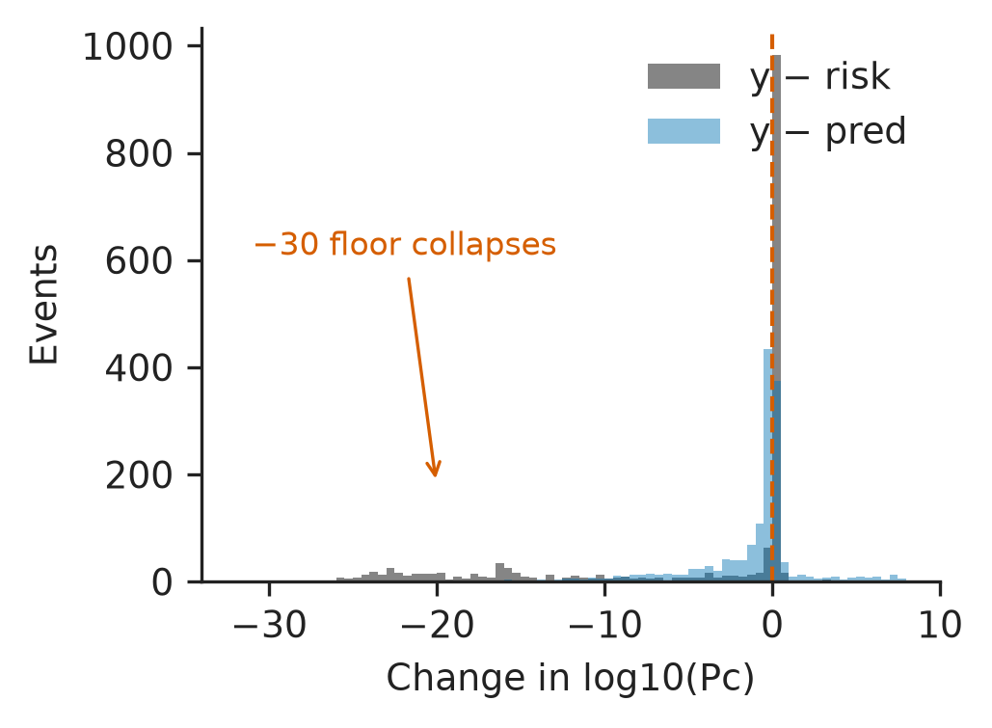
Figure 2. Later movement versus residual. Spike at 0: no movement. Left tail: floor collapse.

Slide 4
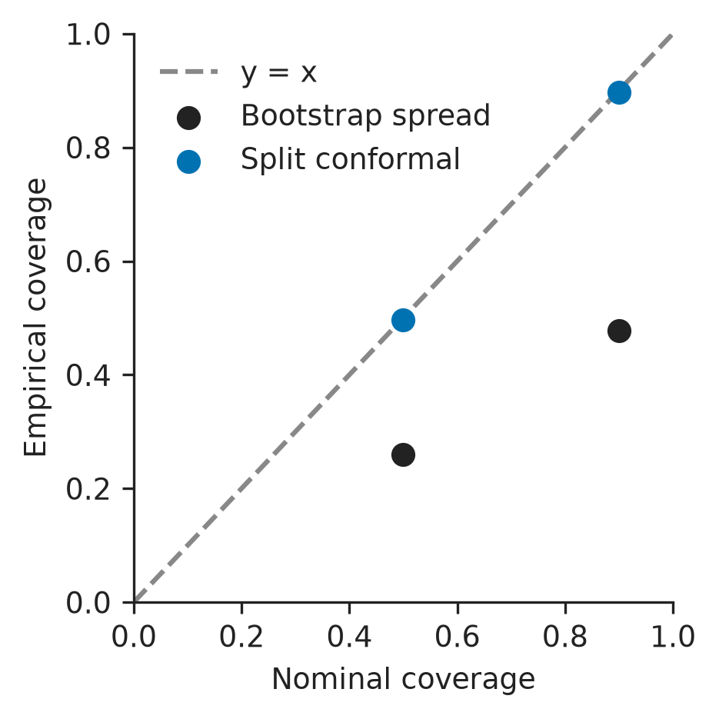
Figure 3. Nominal versus empirical coverage for bootstrap spread and split conformal.

Slide 5
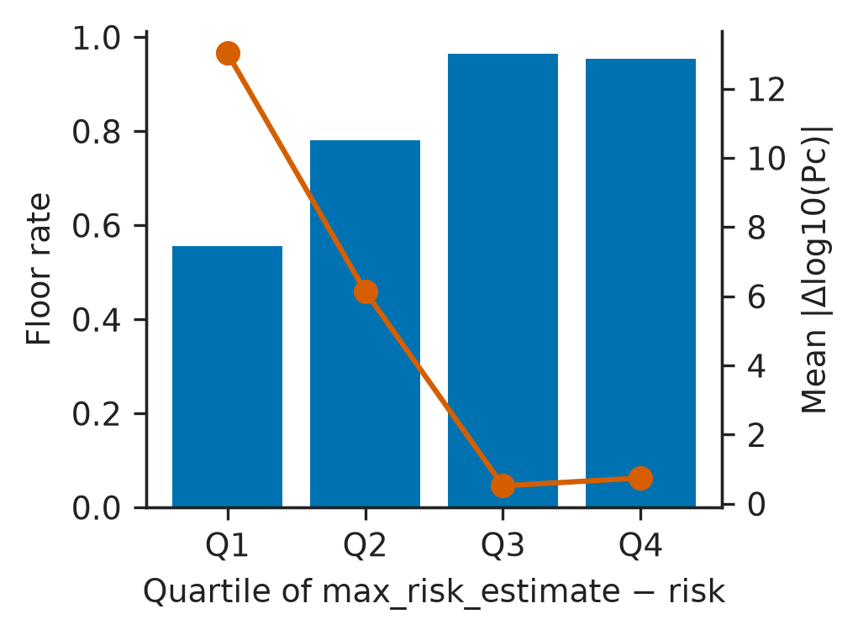
Figure 4. Floor rate and mean |y − risk| by max-risk-gap quartile. Large gaps track the floor.

