Slide 1

SRM INSTITUTE OF SCIENCE AND TECHNOLOGY
FACULTY OF ENGINEERING AND TECHNOLOGY
DEPARTMENT OF NETWORKING AND COMMUNICATIONS
MAJOR PROJECT
HICON AI: Higher Education Counseling Bot
By Arjun Dev Singla (RA2011031010074) and Shashank Tripathi (RA2011031010096) Under the guidance of
Dr. Helen Victoria A Asst. Professor, NWC

Slide 2
Table of contents
Abstract
Introduction
Problem Statement
Motivation
Objectives
Literature Review
Existing Challenges
UML Diagram
Proposed Modules
Modules Description and Implementation
Result and Discussion
Conclusion and Future Scope
Coding Screenshots
References

Slide 3
Abstract
As more and more students are seeking counseling services to help them pursue higher education opportunities abroad, it has become apparent that there is a lack of automation and a monopolization of counseling agencies, which presents a challenge for these students. To address this issue, we have developed HICON AI: Higher Education Counselor. This innovative application offers personalized college selection and preparation recommendations to students. By asking a set of defined questions, the bot gets to know the user and provides tailored guidance based on the information provided, utilizing refined Machine Learning models and Retrieval Augmented Generation. We have specifically used Llama 2 LLM by meta for our use case, because of its excellent performance and financial viability. Our new product builds on the success of our previous work, "COUNSELOR AI: REVOLUTIONIZING COUNSELING SYSTEM," and ensures the highest level of accuracy and reliability.

Slide 4
Introduction
HICON AI: Guiding Your Future
1. Aim to reduce the dependence of students on external counsellors when everything can be readily available on the Internet.
2. With the boost of LLMs, AI can even furnish this work with a more practical and individual approach to every person.
3. Audio prompting is more effortless than text prompting, making “HICON AI" more efficient.
4. Category-wise division makes an extra point for Student Oriented Guidance.

Slide 5
Problem Statement
In today's environment, kids face numerous questions while determining what to do after school. They question which subjects are relevant to their interests, which universities offer decent courses, and how to navigate the application process. The main goal is to ensure that their academic investment leads to a successful career. A higher education counselor can address these questions and provide the finest guidance. To make things easier for students, we created the ‘HICON AI' chatbot, which offers straightforward, accessible, and tailored counseling sessions.

Slide 6
Motivation
1. After a successful paper publication for this product, we are eager to add new and beneficiary elements to our product.
2. The unavailability of any such tool in the market makes us pursue our research on this topic. Moreover, we can use the right tools and knowledge to build such a product.
3. To ensure the best results, the model will take proper information about the person and be further processed to choose the category. A further approach will be to generate category-wise prompts based on personal information.
4. Data for this category deduction is also self-made, which makes us go deeper in the field. This time, we will extend our boundaries by fine-tuning to data on some colleges as well.

Slide 7
Objectives
Dataset: Own Data Created with many parameters. A prompt and Completion set for fine-tuning model.
2. Categorization: There are four classes/categories. Category 1 represents people with absolutely no knowledge of the whole process. Category 2 represents people who just started exploring the field. Who may have some things in their resume - projects, internships, or research papers. Category 3 represents people with the required knowledge, but some things still need to be added, which they need to take care of. Category 4 represents people with everything necessary in their resume but still want to gain extra knowledge of the process to ensure they stay in everything.
3. LLM: After the categorization, LLMs will generate responses based on 10-15 prompts for each category. The LLMs may be GPT-3 or Llama. These responses will be very structured and entirely in the context of the class and the person asking.
4. Retrieval Augmented Generation: We can get the context of the Prompt based on real time by extracting information from online sources and use it to give even better solutions.

Slide 8
Literature Review
PAPER NAME | OBJECTIVES | METHODOLOGY | ADVANTAGES | LIMITATIONS/ FUTURE SCOPE
EduChat: A Large-Scale Language Model-based Chatbot System for Intelligent Education (2023) | Using LLM, it has 2 objectives Retrieval-Augmented Open Question Answering(QA) Socratic Teaching | Collection of data using books, journals, etc. Feeding the model the data by pre-processing; Fine-tuning the model for the desired tasks.; RA method to remove hallucinations.; | Fine-grained Essay Assessment Socratic Teaching Psychology-based Emotional Support | 1. Expanding to major functions such as career planning, course guidance, question generation, etc.
Chatbot to Increase the Effectiveness of the «Flipped Classroom» Technology (2022) | Information and Communication Technology to Support the Flipped Classroom. Bots to Automate the Components of the Educational Process | Python programming; A database with questions on the studied discipline, answers to them, information about the time of seminars, course materials, test questions. | Providing material or links to material. Control of whether work was carried out with the material. Testing to assess learning and understanding of the material. | 1. Add deep learning technologies for the bot to be able to more efficiently answer questions and maintain a dialogue.

Slide 9
PAPER NAME | OBJECTIVES | METHODOLOGY | ADVANTAGES | LIMITATIONS/ FUTURE SCOPE
AI-Based Deep Learning Chatbot for Career and Personal Mentorship (2023) | Able to provide the correct advised to the user by acting as a professional counsellor. Generate responses based on the dataset used to trained the model. | Tensorflow, Keras to train and run deep neural networks; Use of HTML CSS to build a User friendly GUI for better interaction with the user. | Generalized dataset that has cover up various sets of queries. Fair and unbiased set of responses to the user. | Reinforcement learning can be applied instead of providing the model with a predefined dataset. Having an updated response and the truthfulness of the response.
Therapy Chatbot: A Relief From Mental Stress and Problems (2021) | This paper introduces a Therapy Chatbot that may assist and check with the person regarding his mental state. The user gets to share his feelings, reducing the number of deaths because of depression. | Dialogflow by google to create the chatbot; Flutter/Dart for the UI designing | The bot is successful in detecting a user’s problem. The user can feel better and get out of depression, where the user is not in a zone to be judged by anyone. User-friendly design. | The bot has been trained on only four basic user cases and needs to be constantly updated to keep up with the emerging problems.

Slide 10
PAPER NAME | OBJECTIVES | METHODOLOGY | ADVANTAGES | LIMITATIONS/ FUTURE SCOPE
Benchmarking LLM powered Chatbots: Methods and Metrics. (2023) | 1. Use of Novel Benchmark in order to assess LLM model performance. 2. The E2E benchmark can be used to evaluate accuracy and usefulness of the answers provided by chatbots, especially ones powered by LLMs. | Novel Benchmark was incorporated to assess the model performance. Uses cosine similarity performed well in evaluating chatbots. | Used to evaluate accuracy and usefulness of the answers provided by chatbots. While some metrics proved to be unpredictable, the metric associated with the E2E benchmark, which uses cosine similarity performed well in evaluating chatbots. | Reinforcement learning can be applied instead of providing the model with a predefined dataset.
Large Language Models: A Comprehensive Survey of its Applications, Challenges, Limitations, and Future Prospects (2023) | This survey paper provides a comprehensive overview of LLMs, including their history, architecture, training methods, applications, and challenges. | 1. Study revolved around the Large-scale Language Model. 2. Concepts of generative AI and the architecture of generative pre- trained transformers (GPT). | Covers all the things revolving around the Large-scale Language Model. Generative AI and the GPT. | Need for higher advancements in the development and utilization of LLMs for a wide range of real-world applications.

Slide 11
Existing Challenges
Existing products have some challenges, which ‘HICON AI' hopes to solve.
1. Lack of Structured Dataset: The internet has a lot of unstructured data in this domain, but a proper structured data is not available.
2. Generalized approach: Every other chatbot, using LLM has a general set of prompts for all the people. A personalized touch is still missing.
3. Not specific domain: There are no other chatbots, limited to this very specific domain. There may be the ones, for higher education study help, or they will connect you with physical counselors, but not specific.

Slide 12
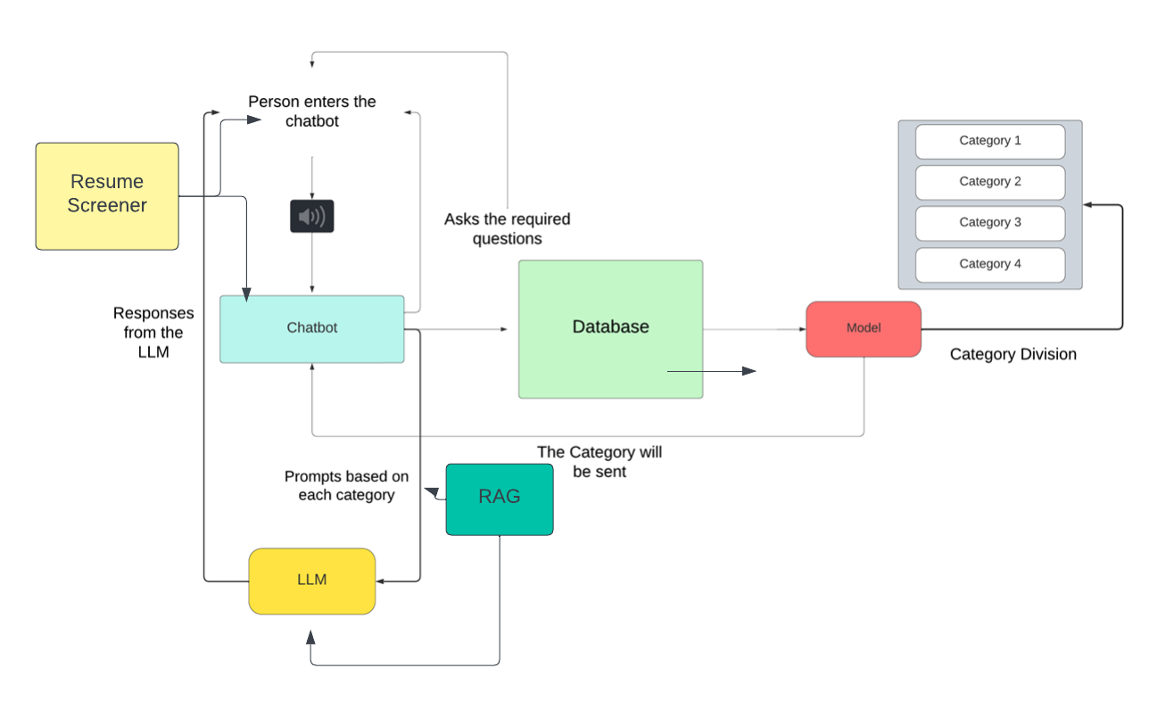
Architecture Diagram

Slide 13
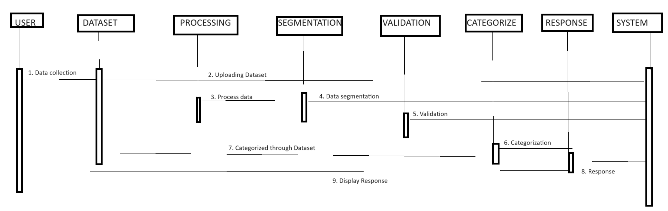
Sequence Diagram

Slide 14
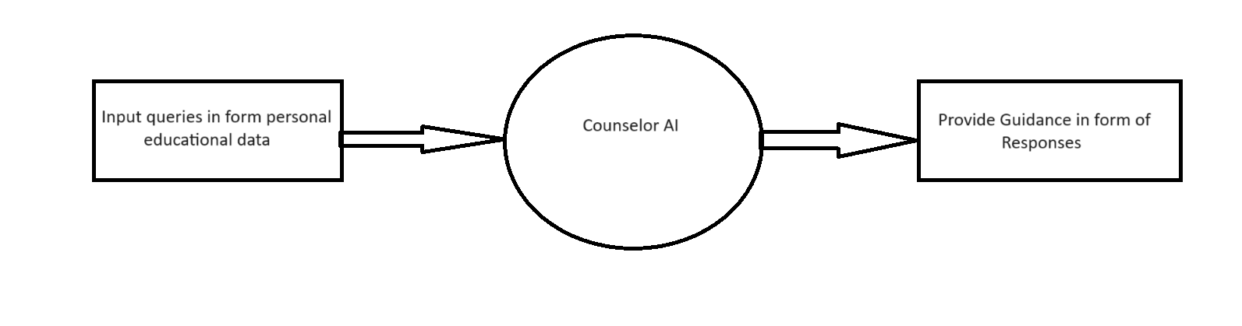
Data Flow Diagram
DFD Level 0 Diagram

Slide 15
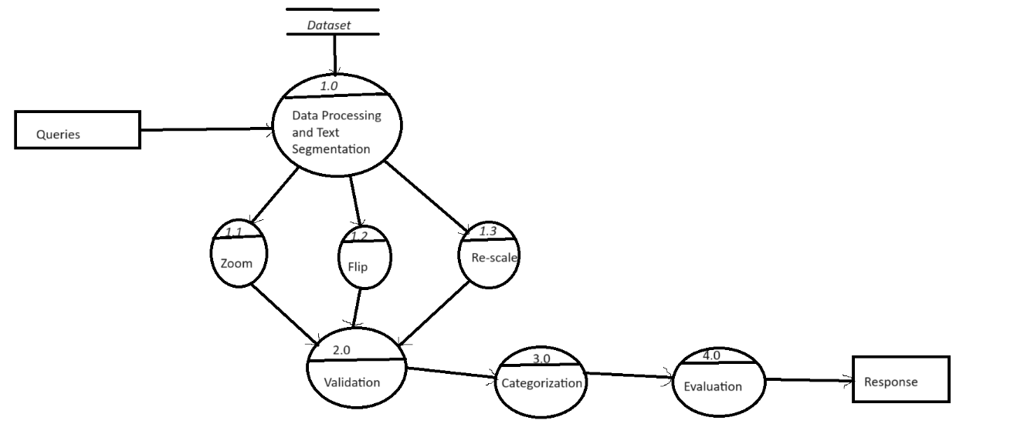
Data Flow Diagram
DFD Level 1 Diagram

Slide 16
Proposed Modules
Collection of Data: At the starting of the process, model requires the user to answer a number of questions to know about the student. His work experiences, projects, research papers, social works, volunteering experience and positions of responsibility.
Resume Screening: From the Resume and any other documents, extracting the data which can be extracted and proceeding further
Prompts for Each Category: Prompts for each category based on a particular category use cases are formed and
tweaked using the personal data of the user for personalized responses.
4. Responses Generation: The Response for each of the prompt in the category is given by LLMs. LLMs makes it easier and efficient to provide resources and the advises. These Responses will be fine-tuned using RAG.

Slide 17
Modules Description and Implementation
Data Pre-processing: Before categorization, extensive data pre-processing was carried out. Data items were organized into respective parameter classes, and data mapping of binary parameters was performed. Data dictionaries were converted into pandas DataFrames, making it suitable for the model's categorization process.
Category Division: To categorize users, a random forest model was developed. Random forest was chosen due to its efficiency with limited data, as the dataset created for this unique model was relatively small. Random forest combines multiple decision trees, reducing overfitting and increasing robustness to noise. This is important because overfitting can lead to less accurate predictions on new data.

Slide 18
Modules Description and Implementation
Resume Screener: HICON AI goes beyond academic guidance by incorporating a resume screener feature. This tool streamlines the process of evaluating resumes, utilizing advanced algorithms to identify key qualifications, skills, and experiences relevant to the user's career goals.
Language Model Integration: The chatbot incorporated the Llama 2 language model by Meta-AI for generating responses. Llama 2 was chosen for its accessibility and extensive training on a vast range of parameters, making it highly efficient in generating responses tailored to the user's needs.
RAG: RAG combines information retrieval with natural language generation, enabling swift data retrieval and the generation of contextually appropriate responses. This ensures that the advice provided to students remains current and accurate in the dynamic landscape of higher education.

Slide 19
Result
Data Collection:
The initial phase involves collecting information from the user, including their preferred universities, personal details such as name, age, and current year of study. We'll also gather data on their academic background, encompassing the number of internships, projects completed, and research papers authored. Furthermore, we aim to capture details regarding the user's involvement in social activities, including volunteering experiences and held positions of responsibility.
Categorizing:
After, getting the required data from the user, we will be using our categorizer model to predict the Category, based on the above data dictionary.

Slide 20
Result
Responses:
Once we determine the category, we'll incorporate prompts tailored to each category along with user-specific parameters obtained from the user data to ensure personalized responses. Subsequently, by executing the model, we'll generate our responses.
Accuracy Metrices:
The Accuracy metrics for the categorizer, outline the performance across four categories. Utilizing a random forest algorithm, the metrics include Precision, Recall, and F1 Score for each category.

Slide 21
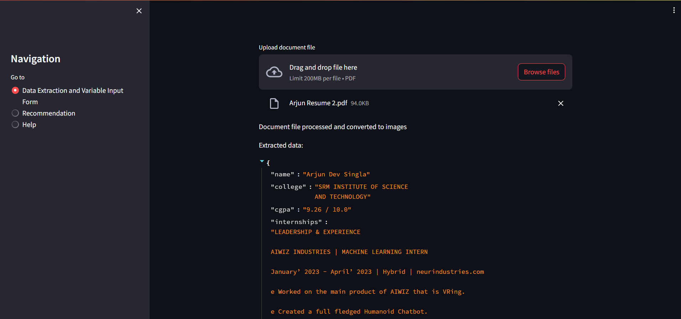
RESULTS
Resume Screener

Slide 22
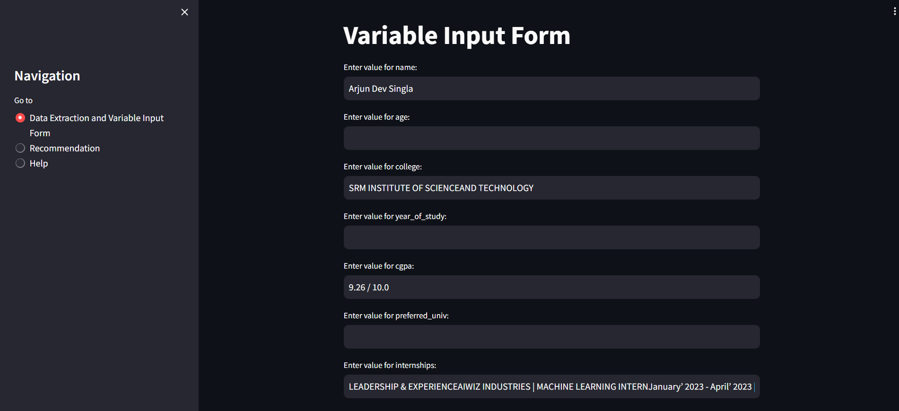
RESULTS
Variable Input Form

Slide 23
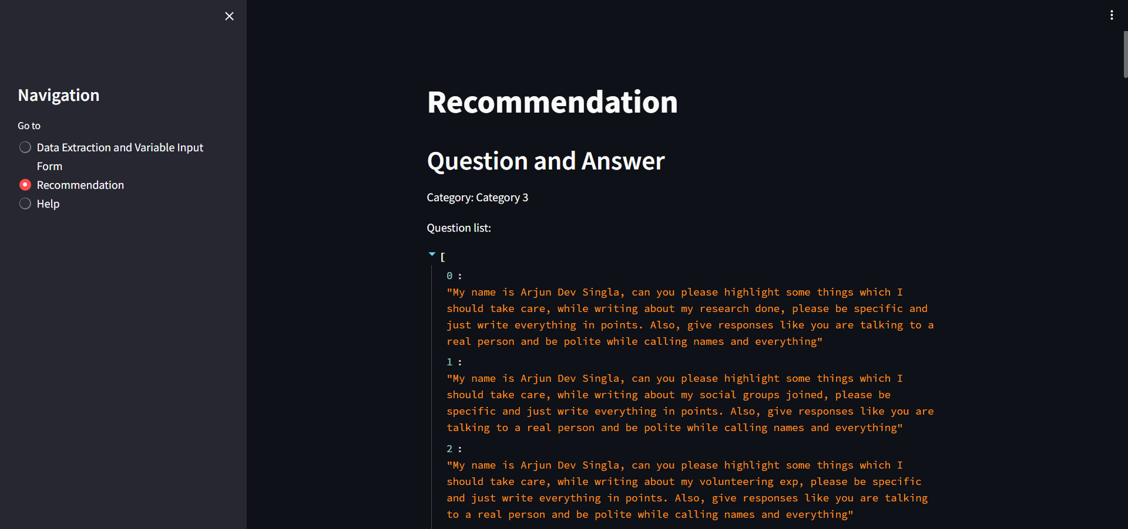
RESULTS
Question List

Slide 24
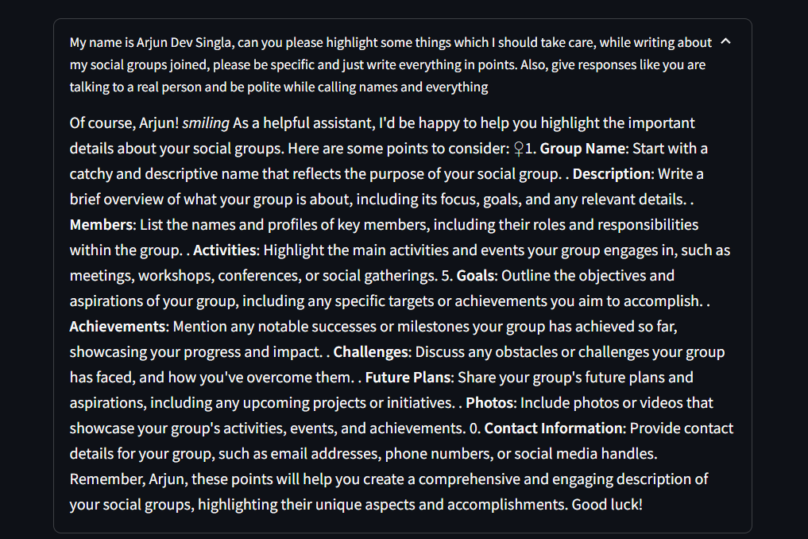
RESULTS
Detailed Response

Slide 25
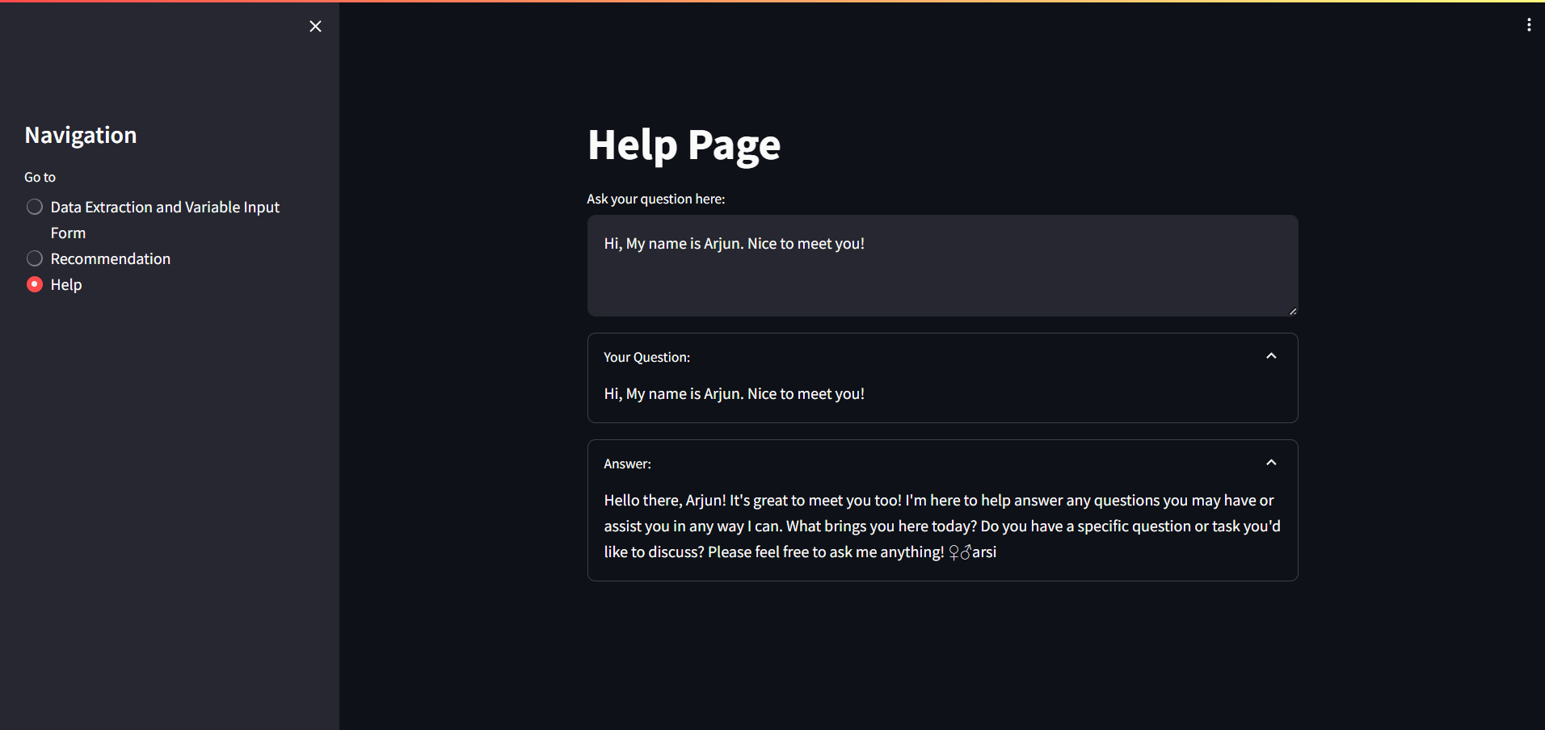
RESULTS
Personalized Advice

Slide 26
Conclusion
'HICON AI' represents a cutting-edge model poised to serve as a valuable resource for students aspiring to study abroad. With its focus on user-centricity, it offers an effective solution for various industries. Leveraging large language models and Natural Language Processing techniques, 'HICON AI' delivers personalized guidance to students preparing for higher education. By reducing reliance on costly external counselors through targeted advice and support, it aims to democratize access to higher education, making it more affordable. While HICON AI is still in its nascent stages, advancements in technology promise to revolutionize the student experience, reshaping the landscape of higher education counseling. Moreover, there is untapped potential within the AI counseling domain. Strategies such as fine-tuning the model with college-specific data and implementing a peer review system for LLM-generated responses can enhance efficiency. Additionally, incorporating various score predictors for evaluating components like Statements of Purpose and Letters of Recommendation could further enrich the model's capabilities.

Slide 27
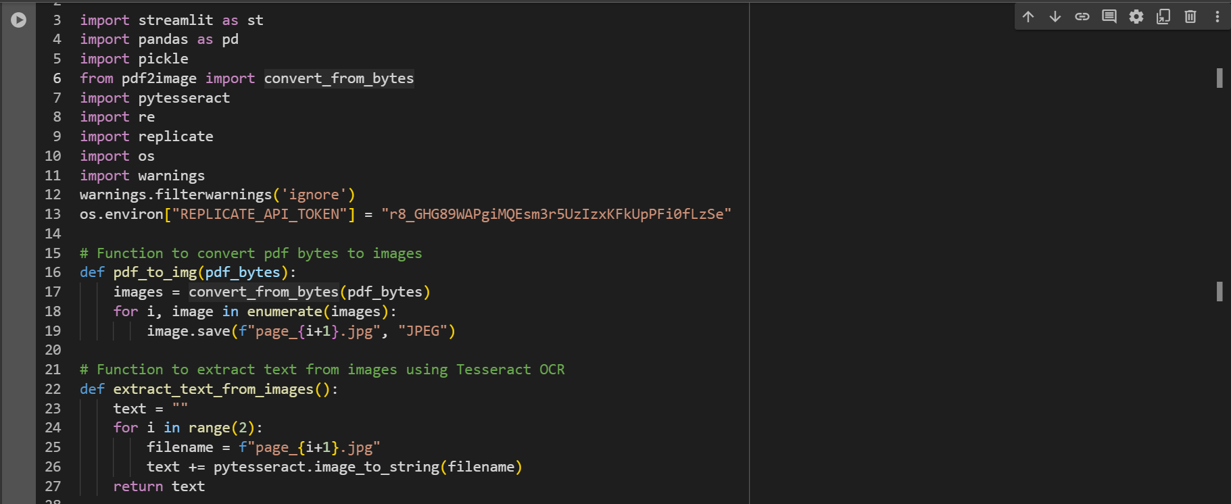
Coding Screenshots

Slide 28
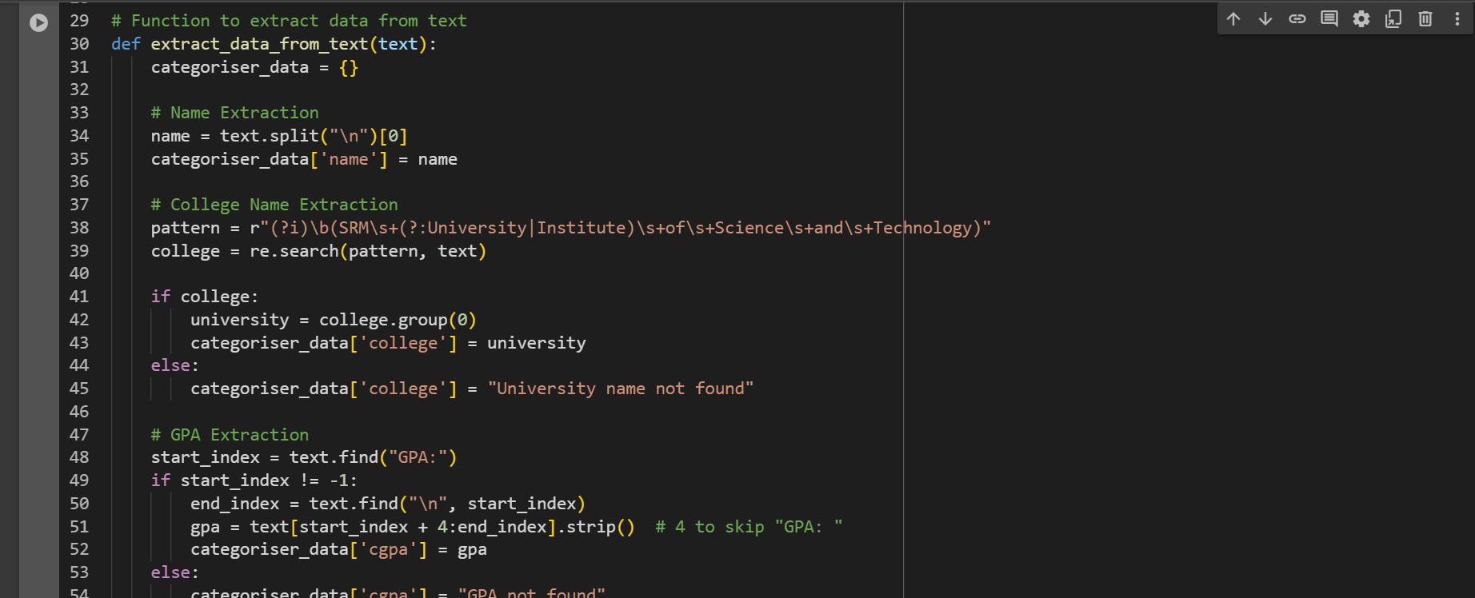
Coding Screenshots

Slide 29
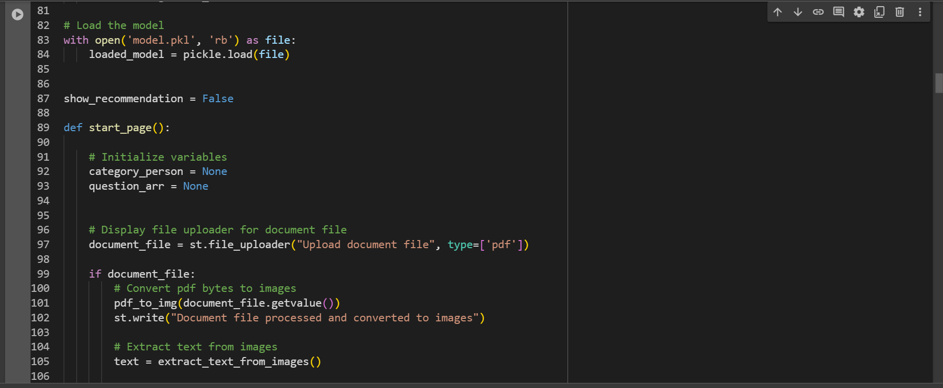
Coding Screenshots

Slide 30
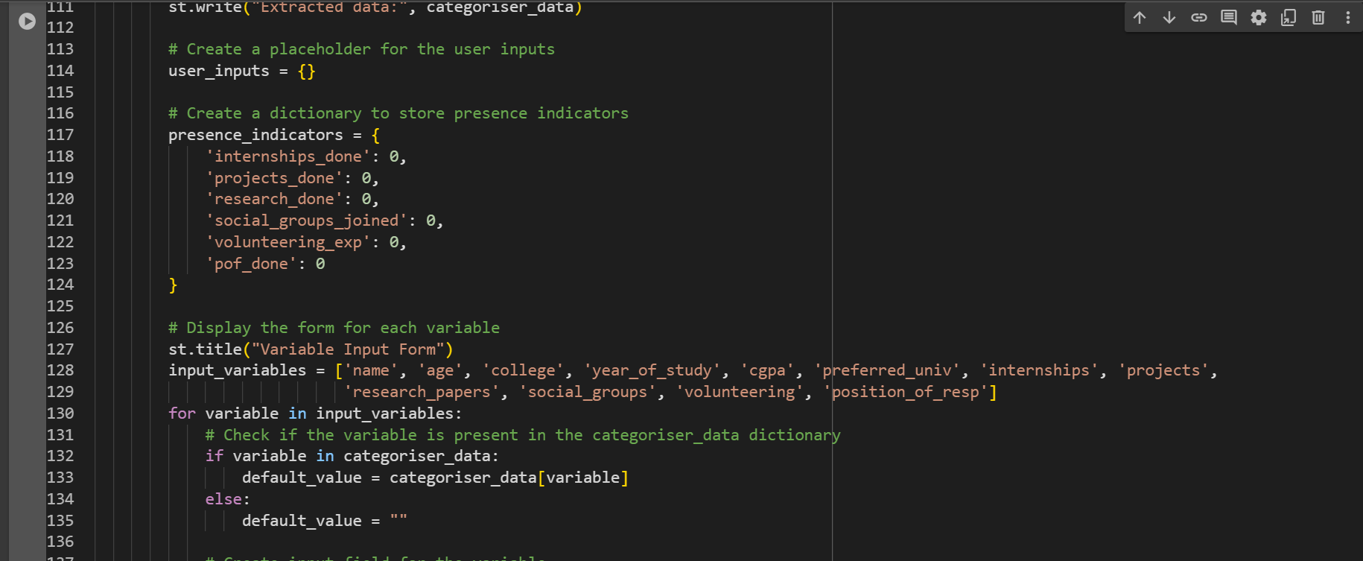
Coding Screenshots

Slide 31
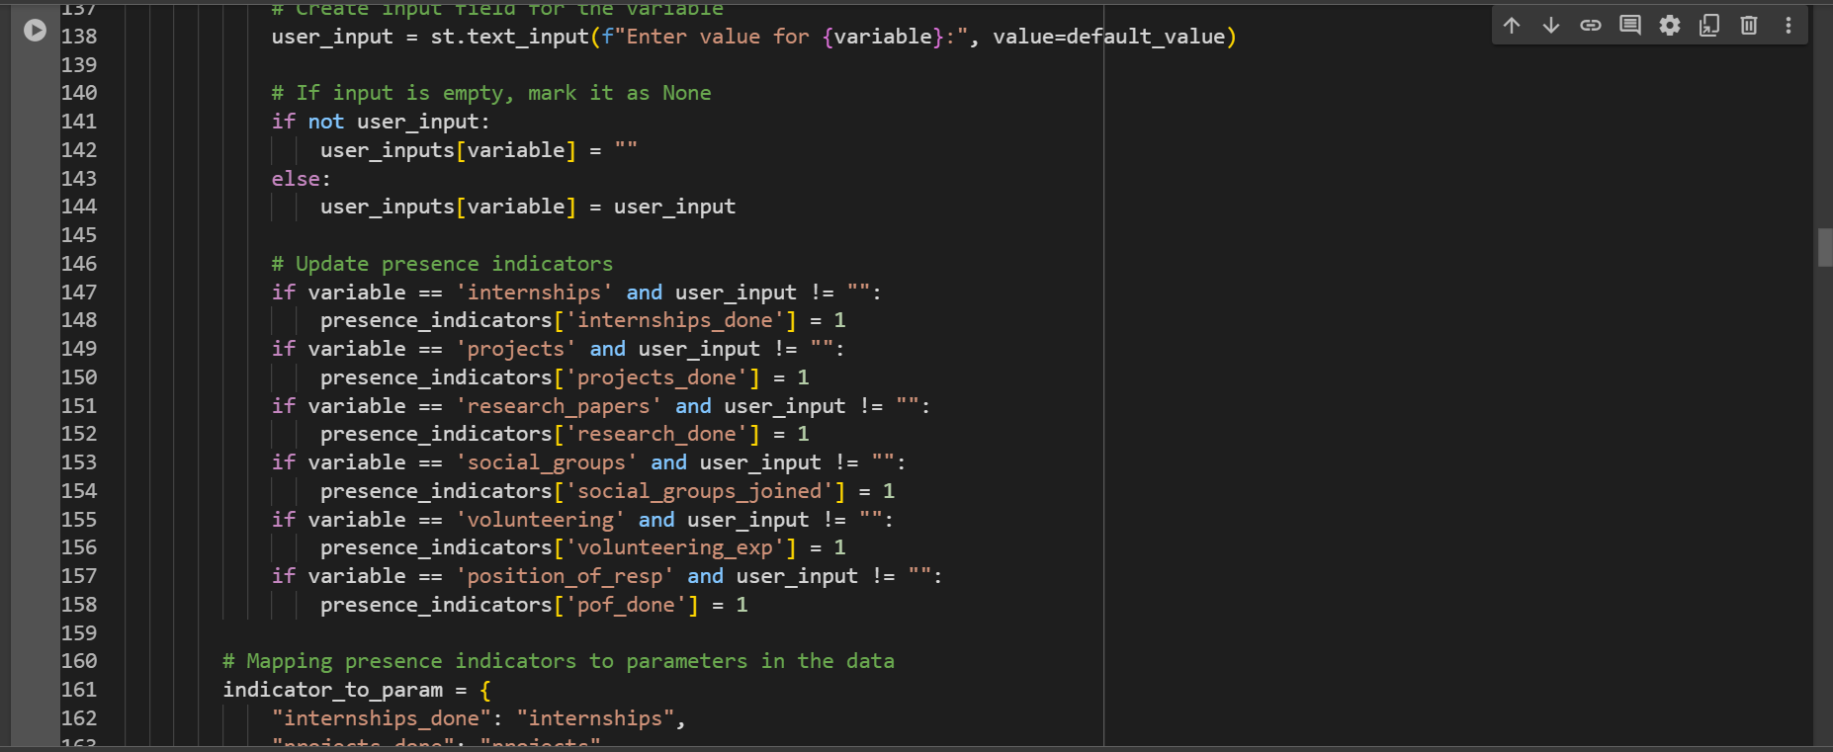
Coding Screenshots

Slide 32
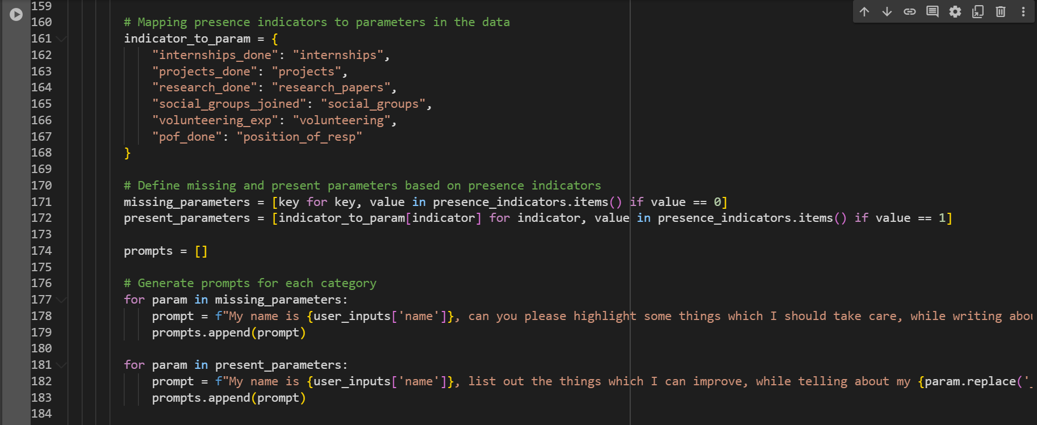
Coding Screenshots

Slide 33
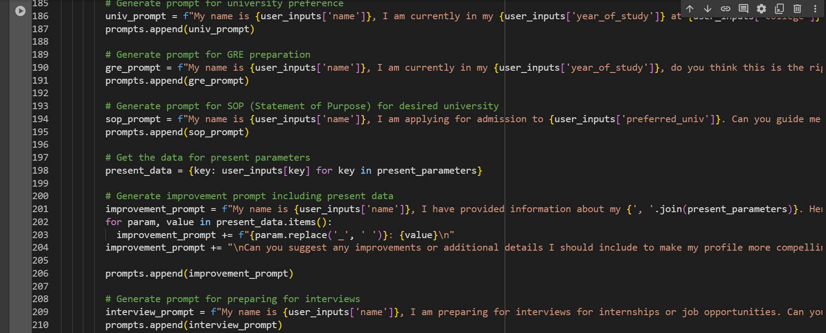
Coding Screenshots

Slide 34
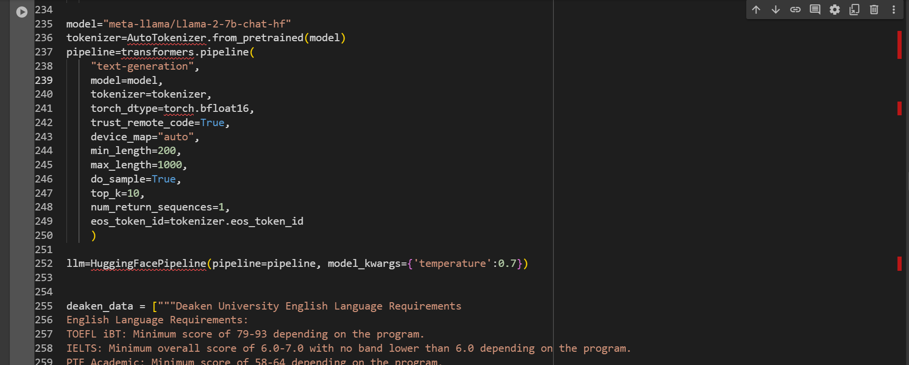
Coding Screenshots

Slide 35
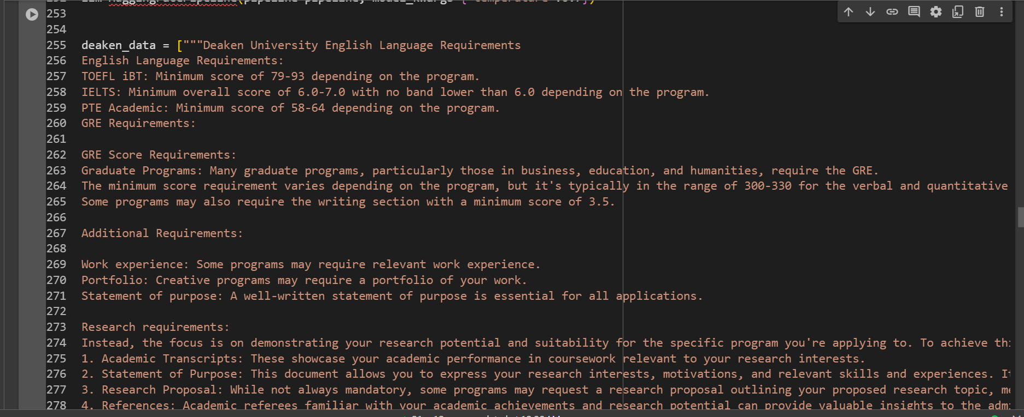
Coding Screenshots

Slide 36
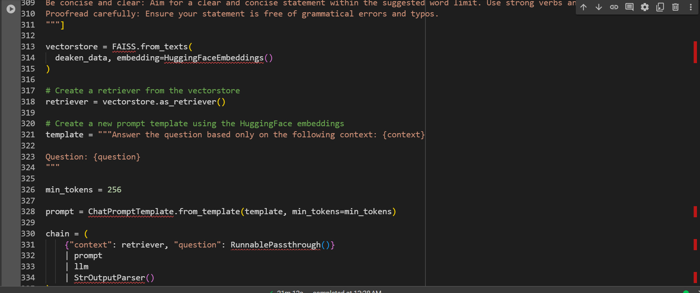
Coding Screenshots

Slide 37
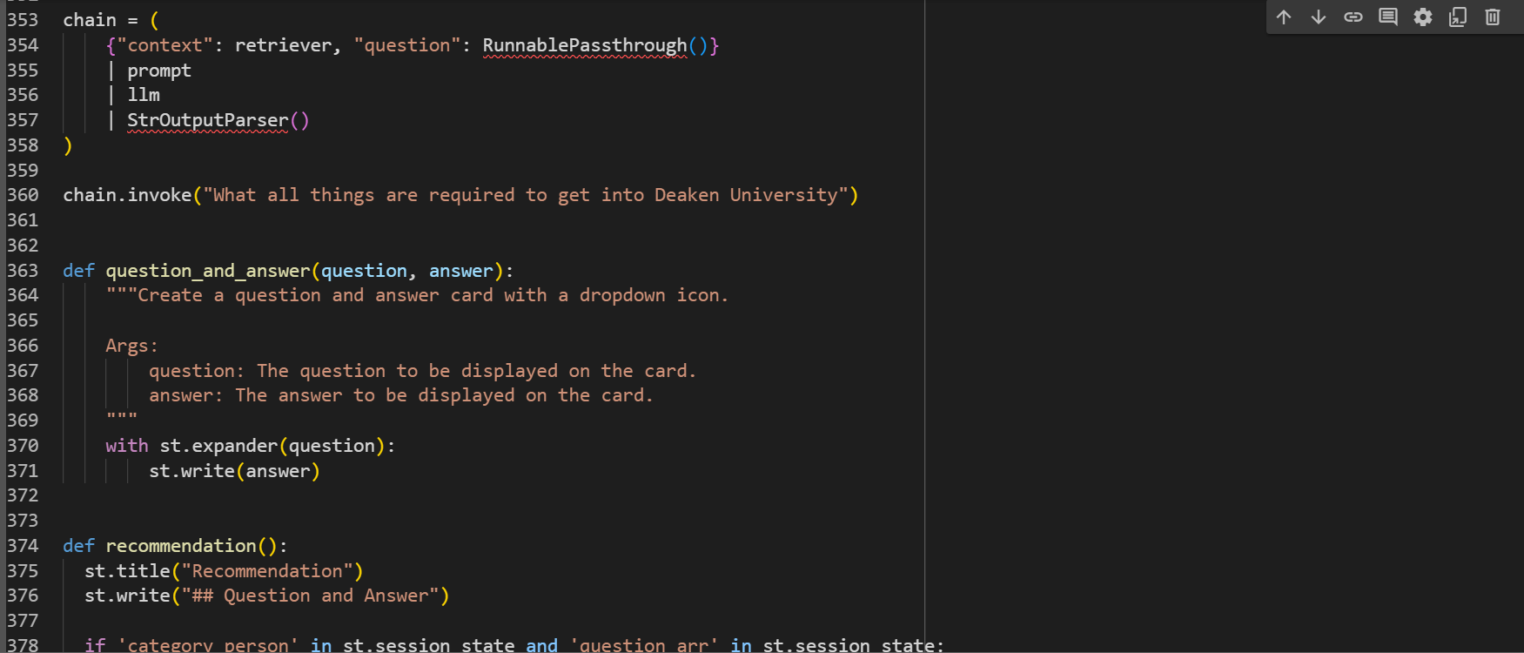
Coding Screenshots

Slide 38
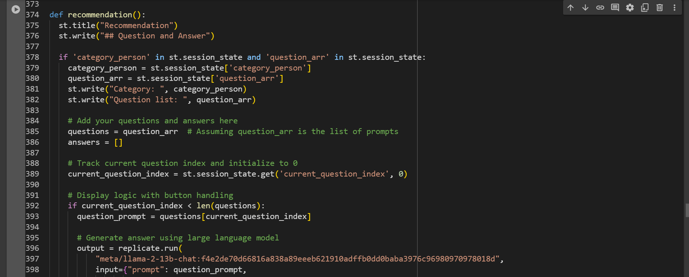
Coding Screenshots

Slide 39
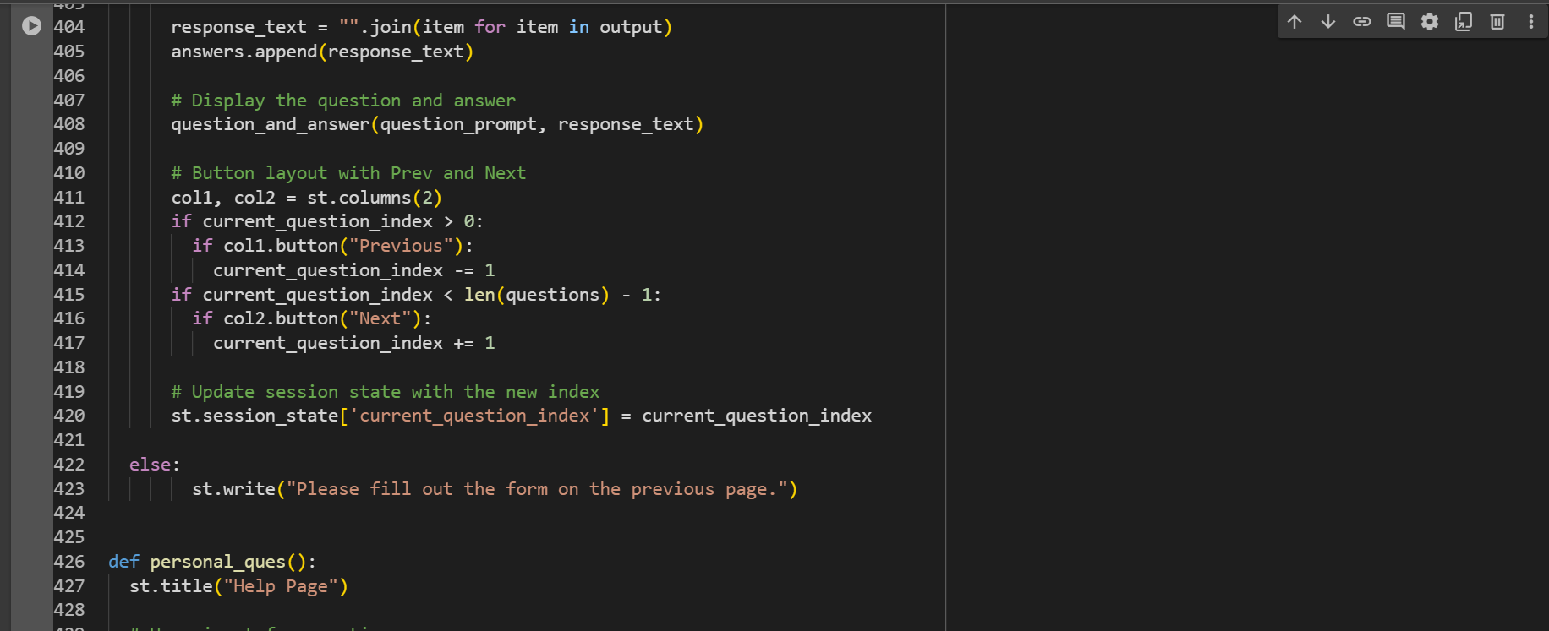
Coding Screenshots

Slide 40
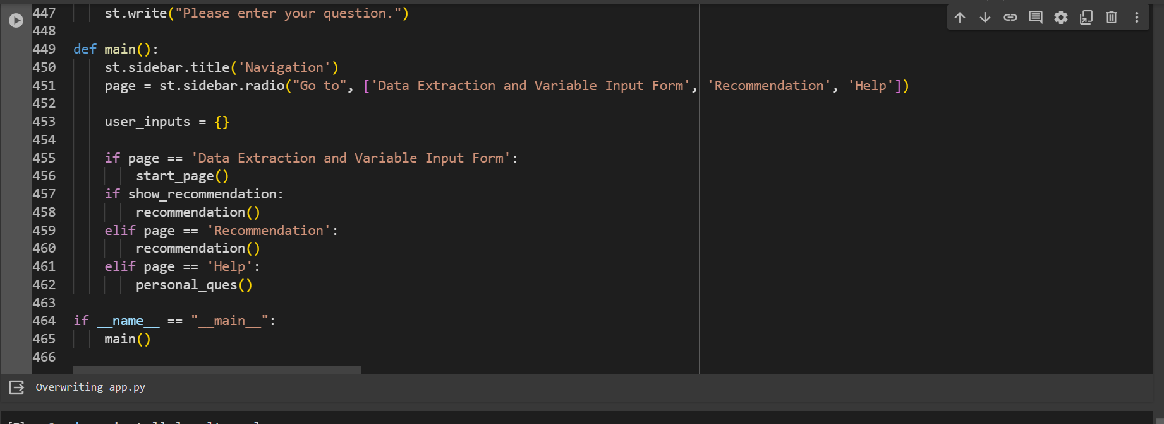
Coding Screenshots

Slide 41
References
Philip Feldman, James R. Foulds, and Shimie Pan: RAGged Edges: The Double-Edged Sword of Retrieval-Augmented Chatbots, 2024
Bongsu Kang, Jundong Kim, Tae-Rim Yun, Chang-Eop Kim: Prompt-RAG: Pioneering Vector Embedding-Free Retrieval-Augmented Generation in Niche Domains, Exemplified by Korean Medicine,2024
Jaewoong Kim, Moohong Min: From RAG to QA-RAG: Intergrating Generative AI for Pharmaceutical Regulatory Complaince Process, 2023
Debarag Banerjee, Pooja Singh, Arjun Avadhanam, and Saksham Srivastava. Benchmarking llm powered chatbots: Methods and metrics. arXiv preprint arXiv:2308.04624, 2023.
Yuhao Dan, Zhikai Lei, Yiyang Gu, Yong Li, Jianghao Yin, Jiaju Lin, Linhao Ye, Zhiyan Tie, Yougen Zhou, Yilei Wang, Aimin Zhou, Ze Zhou, Qin Chen, Jie Zhou, Liang He, and Xipeng Qiu. Educhat: A large-scale language model-based chatbot system for intelligent education, 2023.

Slide 42
References
IBM Documentation. Socket programming. 2021.
Muhammad Usman Hadi, Rizwan Qureshi, Abbas Shah, Muhammad Irfan, Anas Zafar, Muhammad Bilal Shaikh, Naveed Akhtar, Jia Wu, Seyedali Mirjalili, et al. Large language models: A comprehensive survey of its applications, challenges, limitations, and future prospects. 2023.
Ministry of Education. Ministry of education releases all India survey on higher education (AISHE) 2020-2021. 2023.
Hao Li Siddharth Misra. Non invasive fracture characterization based on the classification of sonic wave travel times. 2020.

