Slide 1
Viterbi Encoder/Decoder
Arjun Haritsa Krishnamurthy
Nilabhra pathra
Ahmed yasSer

Slide 2
Encoder: designing the system
Driver
Encoder
Monitor
The blocks are represented as SystemC classes.
Sensitive to clock.
Waveform

Slide 3
Viterbi encoder
3 bit shift register
Sensitive to input (from the driver) to the shift register.
Two polynomials (given) used to produce the outputs.

Slide 4
Decoder : Designing the system
3 classes : Functional, Test bench, System
Functional class provides all necessary algorithm to realize Viterbi decoder for a given n,k,m combination
Test bench class has test cases to prove functional class
System class provides binding between test bench and functional class
Parametric approach
Traceable

Slide 5
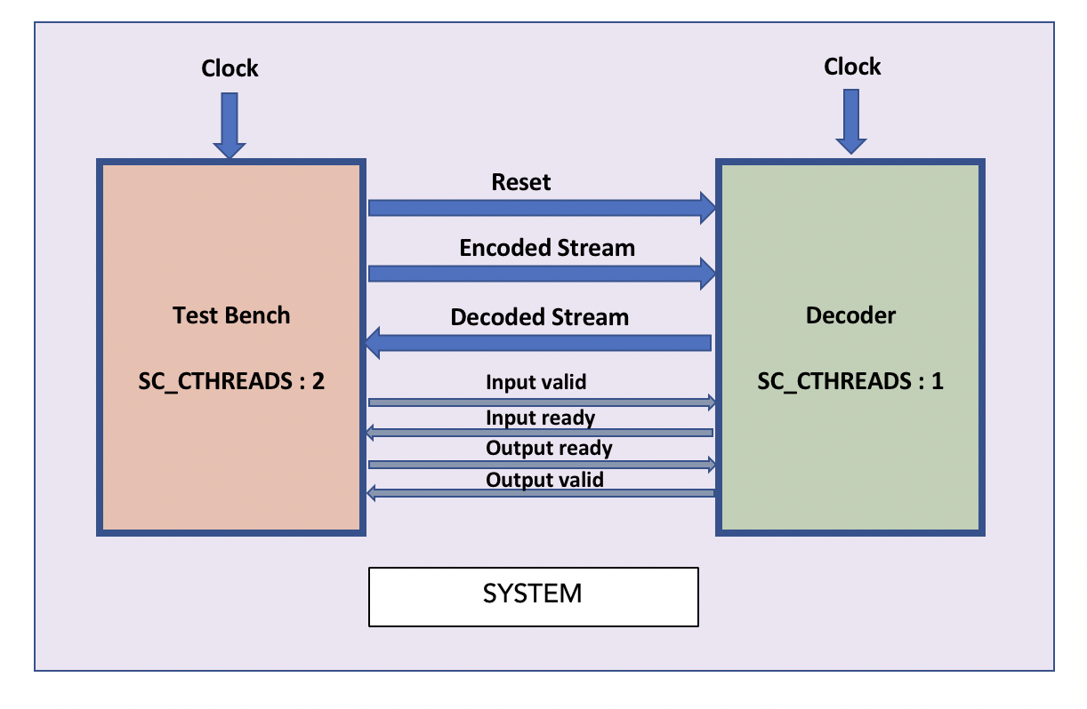
SYSTEM OVERVIEW
SC_TIME will be used for timestamps
SC_CLOCK configured at 1000NS

Slide 6
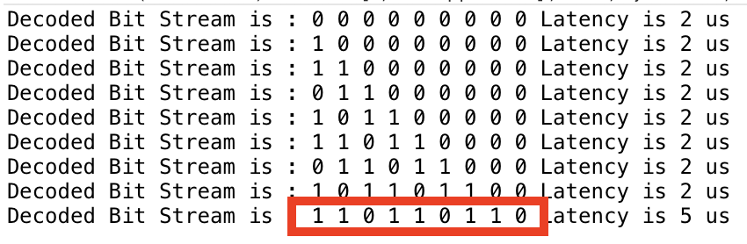
AN Example
For a ½ encoder with given output value
Decoded Values

Slide 7
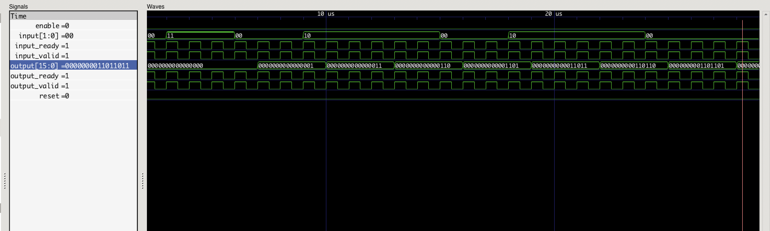
AN Example contd..
Waveform view of the execution (sc_trace to vcd)

Slide 8
Algorithm used
Calculate the state diagram for given n,k,m
At given time, calculate all possible previous states for a current state
Calculate hamming distance from each possible states from step 2 along with their outputs
Eliminate all other paths except for the “lowest hamming distance” path
Store the hamming distance for all of these nodes and add them respectively for the possible next states (at step 3, in other ways) carrying along the output at every stage
Atlast ,consider the minimum hamming distance’s state from step 5 and send out its output.

Slide 9
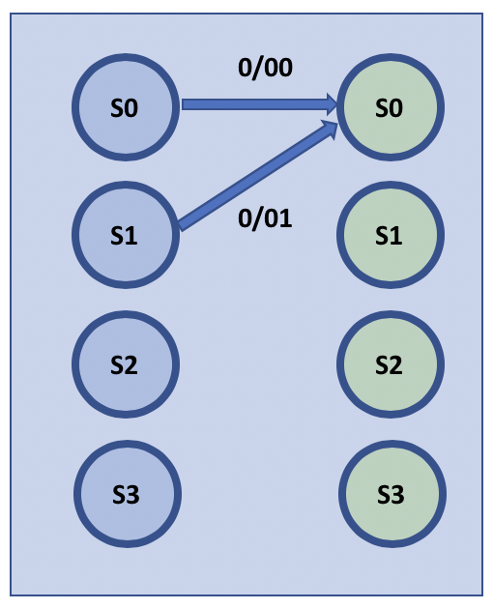
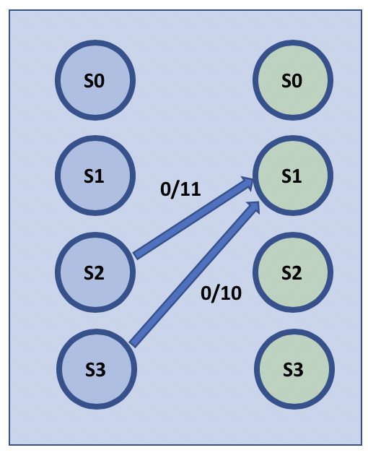
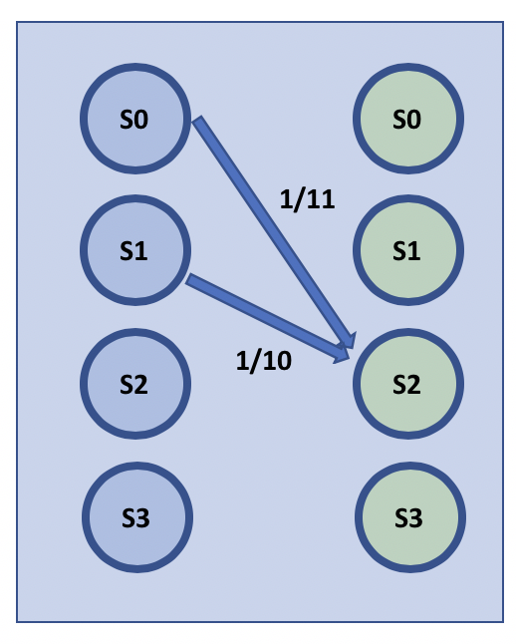
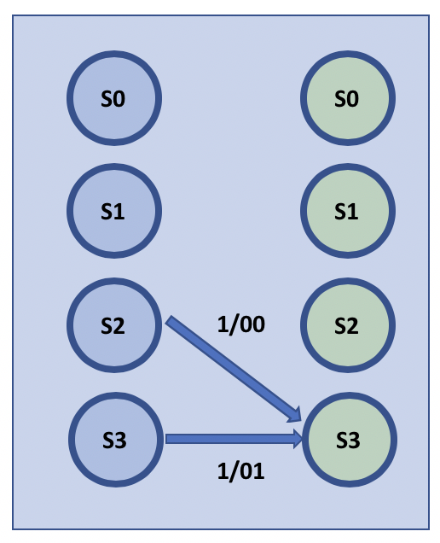
Algorithm explained contd..
Store Hamming distance
Store Values of each path’s input
Fig. INPUT / OUTPUT Relation for ½ decoder with memory 3 bits (2 buffer, hence 4 states)
Transitions of possible previous states to achieve current state

Slide 10
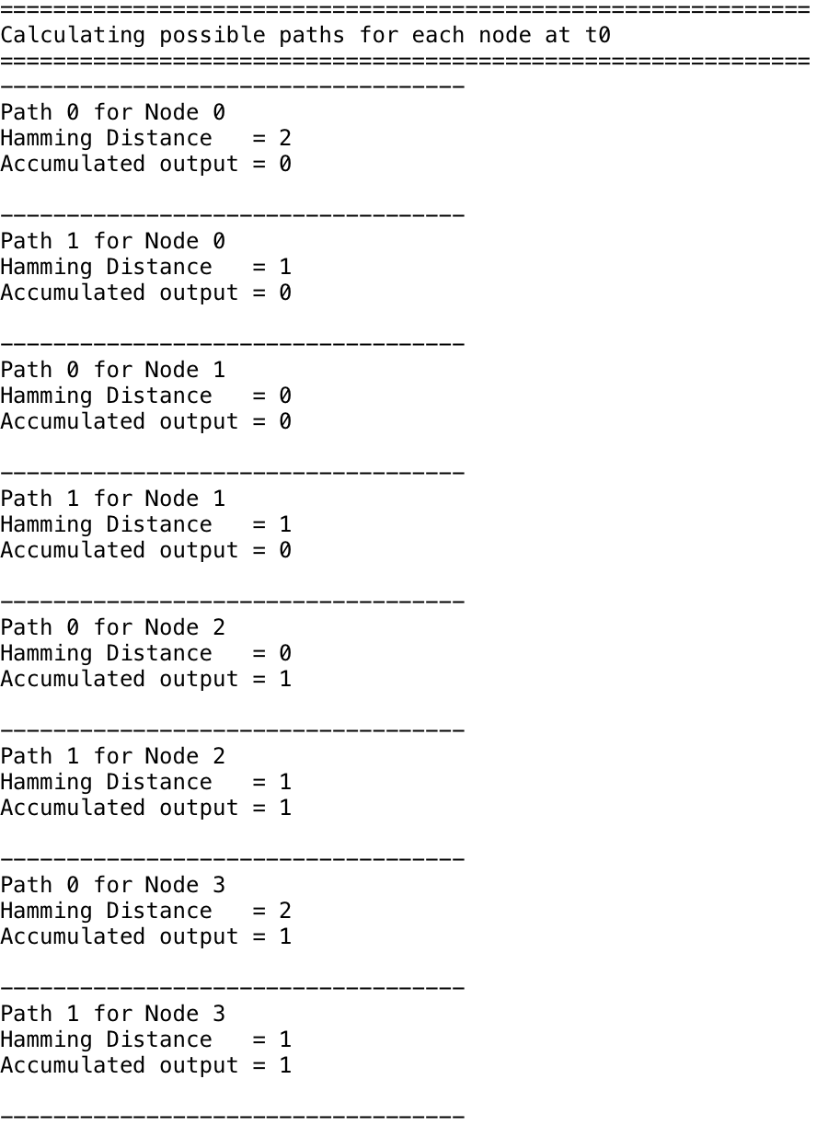
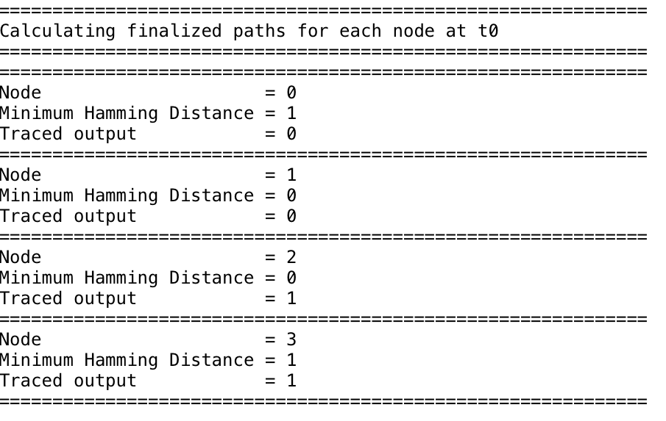
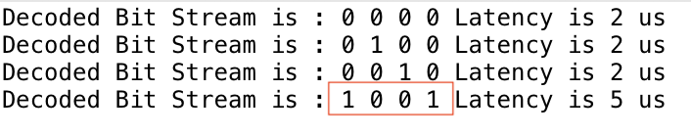
Algorithm explained contd..
FIG. A – possible state paths
FIG.B – Finalized paths
Encoded stream:
11 11 01 11
Expected Output:
1 0 0 1
FIG. B
FIG. C – Decoded Values
FIG. A
FIG. C

Slide 11
Features
Debugging - Trace enable/disable function switches
viterbi_decoder_functions.h has C_DEBUGTRACE ENABLE/DISABLE functionality which provides tracing of the each node's possible incoming calls and their hamming distance and consolidated output value, as well as minimum value traced node
viterbi_decoder_testBench.h shows output decoded at every iterations and the latency.
Doxygen complient

Slide 12
Q and A!
Thanks for your time..

