Slide 1

ICT Academy of Kerala
Building the Nation’s Future
JavaScript

Slide 2
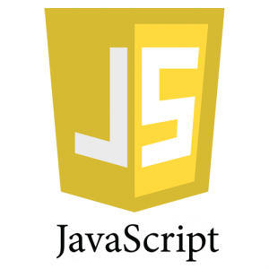
UNIT 2
Basic Syntax

Slide 3
Primitive Datatypes
JavaScript supports following primitive datatypes.
Numbers
Strings
Boolean
Rather than these primitive datatypes, JavaScript also supports a composite datatype called as “object”
Notes:
Primitive Datatypes
JavaScript supports following primitive datatypes.
Numbers
Ex: 22, 22.1 etc
Strings
Ex: “Hai”
Boolean
Ex: true or false
Rather than these primitive datatypes, JavaScript also supports a composite datatype called as “object”

Slide 4
Variables
Variables are named containers where we can place data.
We can refer these data further by naming these containers.
A variable can be declared with the keyword var.
Ex: var name;
Notes:
Variables
Variables are named containers where we can place data.
We can refer these data further by naming these containers.
A variable can be declared with the keyword var.
Ex: var name;

Slide 5
Variable Initialization
Variables can be initialized as follows,
name = “abc”;
Variables can also be initialized at the time of declaration.
Ex: var name = “abc”;
JavaScript variables can hold data of any type (untyped).
Notes:
Variable initialization
Assigning value to a variables is called as initialization.
Variables can be initialized as follows,
name = “abc”;
Variables can also be initialized at the time of declaration.
Ex: var name = “abc”;
JavaScript variables can hold data of any type – JavaScript is untyped language.

Slide 6
Program with variables
<html>
<body>
<p id="sum"></p>
<script>
var a, b, c;
a = 1; b = 2; c = a + b;
document.getElementById("sum").innerHTML = c;
</script>
</body>
</html>
Notes:
Program with Variables
<html>
<body>
<p id="sum"></p>
<script>
var a, b, c;
a = 1; b = 2; c = a + b;
document.getElementById("sum").innerHTML = c;
</script>
</body>
</html>
document.getElementById("sum").innerHTML = c; // this statement place the data in “c” in to the html element with id “sum”.

Slide 7
Variable Scope
Global - Declared outside the function
Local - Declared inside the function
Notes:
Variable Scope
Local Variables
Variables declared within a JavaScript function, become LOCAL to the function.
Local variables have local scope: They can only be accessed within the function.
Global Variables
A variable declared outside a function, becomes GLOBAL.
A global variable has global scope: All scripts and functions on a web page can access it.
If you assign a value to a variable that has not been declared, it will automatically become a GLOBAL variable.

Slide 8
Variable Scope
Write a program to test the local and global scope of variables.
Notes:
Write a program to test the local and global scope of variables.
<html>
<body>
<script>
var num = 1; // variable is global
function showGlobal() {
alert(num); // uses the global num
}
showGlobal(); // => 1
function showLocal(){
var num = 2; // num is local, hides the global num
alert(num);
}
showLocal(); // => 2
function showArgument(num) {
alert(num); // arguments are locally scoped
}
showArgument(3); // => 3
</script>
</body>
</html>

Slide 9
Constants and Assignments
JavaScript constants are declared with const keyword and it is defined at the time of declaration.
We cannot change the value of a constant.
Ex: const country = “India”;
Notes:
Constants and Assignments
JavaScript constants are declared with const keyword and it is defined at the time of declaration.
We cannot change the value of a constant.
Ex: const country = “India”;

Slide 10
Arithmetic Operators & BODMAS
Arithmetic Operators
+, -, *, /, %, ++, --
Notes:
Arithmetic Operators & BODMAS
Addition(+)
Subtraction(-)
Multiplication(*)
Division(/)
Modulus(%)
Increment(++)
Decrement(--)
Operator Precedence

Slide 11
Arithmetic Operators & BODMAS
Operator Precedence - Operator precedence in JavaScript is as follows(high to low)
Bracket
Power
Division/Multiplication
Addition/Subtraction
Notes:
Operator precedence in JavaScript from high to low is listed below.
Bracket
Power
Division/Multiplication
Addition/Subtraction

Slide 12
BODMAS
Bracket, Of, Division, Multiplication , Addition and Subtraction
Ex: Math.pow(2, 4) / 2 + 1 – 5 + ( 2 * 12) ;
Step 1 : Math.pow(2, 4) / 2 + 1 – 5 + 24 ;
Step 2: 16 / 2 + 1 – 5 + 24
Step 3: 8 + 1 – 5 + 24
Step 4: 9 – 5 + 24
Step 5: 4 + 24
Step 6: 28
Notes:
BODMAS
Bracket, Of, Division, Multiplication , Addition and Subtraction
Ex: Math.pow(2, 4) / 2 + 1 – 5 + ( 2 * 12) ;
Step 1 : Math.pow(2, 4) / 2 + 1 – 5 + 24 ;
Step 2: 16 / 2 + 1 – 5 + 24
Step 3: 8 + 1 – 5 + 24
Step 4: 9 – 5 + 24
Step 5: 4 + 24
Step 6: 28

Slide 13
Arithmetic Operators & BODMAS
Write a program for demonstrate BODMAS for the example discussed.
Notes:
Arithmetic Operators & BODMAS
Write a program for demonstrate BODMAS for the example discussed.
<html>
<body>
<script>
document.write(Math.pow(2, 4) / 2 + 1 -5 + ( 2 * 12)); //Math.pow() returns base to the exponent power.
</script>
</body>
</html>

Slide 14
Assignment Operators
Simple Assignment(=)
Increment and Assignment(+=)
Decrement and Assignment(-=)
Multiply and Assignment(*=)
Divide and Assignment(/=)
Modulus and Assignment(%=)
Notes:
Assignment Operators
Simple Assignment(=)
Increment and Assignment(+=)
Decrement and Assignment(-=)
Multiply and Assignment(*=)
Divide and Assignment(/=)
Modulus and Assignment(%=)

Slide 15
Code Editors and Debugging

Slide 16
Code Editors
Sublime Text
Visual Studio Code
Brackets
Atom
Komodo Edit
Notepad++
BBEdit
TextMate
Notes:
Code Editors and Debugging
Following are some of the highly rated editors for JavaScript
Sublime Text
Visual Studio Code
Brackets
Atom
Komodo Edit
Notepad++
BBEdit
TextMate

Slide 17
Code Debugging
A program may contains number of syntax or logical errors.
Searching for the errors in the programming is called as debugging.
All modern browsers have inbuilt javascript debugger.
We can set breakpoints with debuggers and examine the variables and their values.
Debugger activation key in browser - F12
Notes:
Code Editors and Debugging
Code Debugging
A program may contains number of syntax or logical errors.
Searching for the errors in the programming is called as debugging.
All modern browsers have inbuilt javascript debugger.
We can set breakpoints with debuggers and examine the variables and their values.
Debugger activation key in browser - F12

Slide 18
console.log() method
Used to display javascript values in the console.
<script>
s = 4+5*3
console.log(s);
</script>
Notes:
Code Editors and Debugging
console.log() method
Used to display javascript values in the console.
<script>
s = 4+5*3
console.log(s);
</script>

Slide 19
Breakpoints
we can set breakpoints in JavaScript code.
Breakpoint breaks the program execution and we can check the values of variables in that point in console.
after examining the values we can resume the execution with a play button.
Notes:
Code Editors and Debugging
Breakpoints
we can set breakpoints in JavaScript code.
Breakpoint breaks the program execution and we can check the values of variables in that point in console.
after examining the values we can resume the execution with a play button.

Slide 20
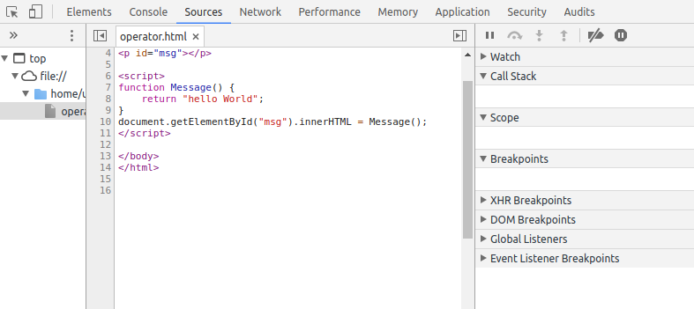
Setting Breakpoints
Notes:
Code Editors and Debugging
Setting Breakpoints
press F12 key and take the source tab. where we can see the source code. Each line of code has a line number. we can set the breakpoint by clicking on the line number.

Slide 21
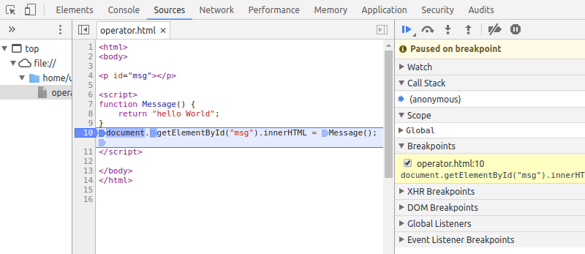
Setting Breakpoints
click on the line number to set the breakpoint.
press ctrl+R and then play button.
Notes:
Code Editors and Debugging
Setting Breakpoints
After setting the breakpoint press ctrl+R for refresh and press the play button.

Slide 22
Functions or Subroutines

Slide 23
Functions or Subroutines
Function is a block of code which performs a particular task.
Syntax :
function function_name(parameter-list)
{
Statements;
}
Notes:
Functions or Subroutines
Function is a block of code which performs a particular task.
we can eliminate the repeated code blocks by using functions.
functions improves code reusability.
Syntax :
function functionname(parameter-list)
{
Statements;
}

Slide 24
Functions or Subroutines (Contd..)
Calling a Function
A function can be called simply by using its name.
Function with parameters
function function_name(param1, param2, ...)
{
statements;
}
Notes:
Calling a Function
To invoke a function somewhere later in the script, you would simply need to write the name of that functio.
Function with parameters
function function_name(param1, param2, ...)
{
statements;
}

Slide 25
Functions or Subroutines (Contd..)
write a program to demonstrate function call in JavaScript.
Inspect the control flow of the JavaScript code by setting breakpoints.
Notes:
Functions or Subroutines
write a program to demonstrate functions in JavaScript.
<html>
<head>
<script type="text/javascript">
function display(name, age)
{
document.write (name + " is " + age + " years old.");
}
</script>
</head>
<body>
<p>Click the following button to call the function</p>
<form>
<input type="button" onclick="display('Ram', 20)" value="Say Hello">
</form>
</body>
</html>

Slide 26
Objects and Arrays

Slide 27
Objects
javascript variables are objects too.
object has name:value pair, called as it’s properties.
Creating an Object
Ex: var car = {type:"Fiat", model:500, color:"white"};
Accessing Object Properties
Syntax: objectName.propertyName
Ex: car.type
Notes:
Objects
javascript variables are objects too.
Example
var car = {type:"Fiat", model:500, color:"white"};
The values are written as name:value pairs (name and value separated by a colon).
Object Property
The name:values pairs (in JavaScript objects) are called properties.
Eg:
var person = {firstName:"John", lastName:"Doe", age:50, eyeColor:"blue"};
Here firstname,lastname,age,eveColor are property
And John,Doe,50,blue are property value

Slide 28
Objects
write a program for object creation and accessing its properties
Notes:
Objects
write a program for object creation and accessing its properties
<html>
<body>
<p id="info"></p>
<script>
var person = {
firstName: "David",
lastName : "John"
};
document.getElementById("info").innerHTML =
person.firstName + " " + person.lastName;
</script>
</body>
</html>

Slide 29
Arrays
Array object.
To create an array of N elements, you can write
var myArray = new Array(N);
Ex: var Car = new Array(3);
Car[0] = "Ford";
Car[1] = "Toyota";
Car[2] = "Honda";
(OR)
var Car2 = new Array("Ford", "Toyota", "Honda");
Notes:
Array
An array is represented by the Array object. To create an array of N elements, you can write
var myArray = new Array(N);
Index of array runs from 0 to N-1.
Example :
var Car = new Array(3);
Car[0] = "Ford";
Car[1] = "Toyota";
Car[2] = "Honda";
// Create an array of three elements with initial
// values
var Car2 = new Array("Ford", "Toyota", "Honda");

Slide 30
Arrays
Write a program to find the length of an array and print all of its elements.
Notes:
Arrays
Write a program to find the length of an array and print all of its elements.
<html>
<body>
<p id="info"></p>
<script>
var numbers = [10, 20, 30];
// Print the array elements.
document.write("Array: " + numbers + "; ");
// Get length of array.
var length = numbers.length;
document.write("Length: " + length);
</script>
</body>
</html>

Slide 31
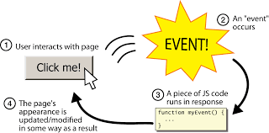
Events
Events are actions or occurrences that happen to the html elements.
javaScript can react on these events.
Ex: clicking a button, loading a webpage, closing a window etc..
Notes:
Events
Events are actions or occurrences that happen to the html elements. We can write JavaScript code for react to these events.
For example, if we want to perform a particular action for an event like clicking a button, we can write the JavaScript code for that.
Example for events: clicking a button, loading a webpage, closing a window etc..

Slide 32
Events
Common HTML Events
onchange - An HTML element has been changed
onclick - The user clicks an HTML element
onmouseover - The user moves the mouse over an HTML element
onmouseout - The user moves the mouse away from an HTML element
onkeydown - The user pushes a keyboard key
onload - The browser has finished loading the page
Notes:
Common HTML Events
Below are the list of some html events.
onchange - An HTML element has been changed
onclick - The user clicks an HTML element
onmouseover - The user moves the mouse over an HTML element
onmouseout - The user moves the mouse away from an HTML element
onkeydown - The user pushes a keyboard key
onload - The browser has finished loading the page

Slide 33
Events
Write a JavaScript code for “mouseover” and “mouseout” for an html button element.
Notes:
Arrays
<html>
<head>
<script type="text/javascript">
function over() {
alert("onmouseover alert");
}
function out() {
alert("onmouseout alert");
}
</script>
</head>
<body>
<script type="text/javascript">
document.write("Hello World")
</script>
<input type="button" onmouseover="over()"
onmouseout="out()" value="Event Button" />
</body>
</html>

Slide 34
Thank you

