Slide 1

Grocery Store Data Analysis
using SQL
Presented By:
Arjun Naluvala

Slide 2
Introduction
Grocery Store Management System (SQL Project)
This project focuses on designing and analysing a relational database for a grocery store.
It integrates key business entities such as customers, products, suppliers, employees, and orders to simulate real-world retail operations.
The project leverages SQL to manage data efficiently and extract meaningful business insights.

Slide 3
Objectives:
This project analyzes a grocery store database focusing upon:
Identify top customers
Analyze best-selling products
Understand revenue trends
Evaluate employee performance
Identify top suppliers

Slide 4
Tools & Technologies
MySQL
SQL Queries
Database Design (EER Model)

Slide 5
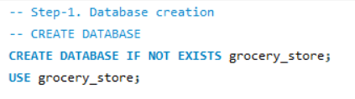
Database Creation
Created database: grocery store
Used SQL commands:
CREATE DATABASE
USE
Fig. SQL code snippet showing creation of
grocery store database

Slide 6
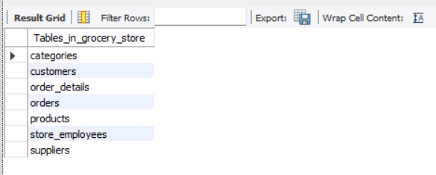
Tables Created
Suppliers
Categories
Customers
Products
Store Employees
Orders
Order Details
Fig. Showing the created tables in grocery store database

Slide 7
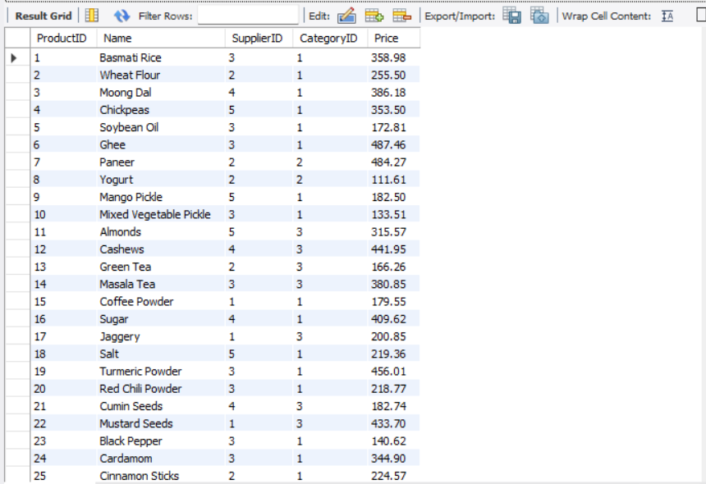
Table Structure
Primary Keys
Foreign Keys
Relationships
Fig. Preview of a table (Products Table)

Slide 8
EER Diagram
Customers → Orders : connected using CustomerID as a foreign key.
Store Employees → Orders : connected using EmployeeID as a foreign key.
Suppliers → Products : connected using SupplierID as a foreign key.
Categories → Products : connected using CategoryID as a foreign key.
Orders → Order Details : connected using OrderID as a foreign key.
Products → Order Details : connected using ProductID as a foreign key.
Note: all the above tables are connected as one to many relationships

Slide 9
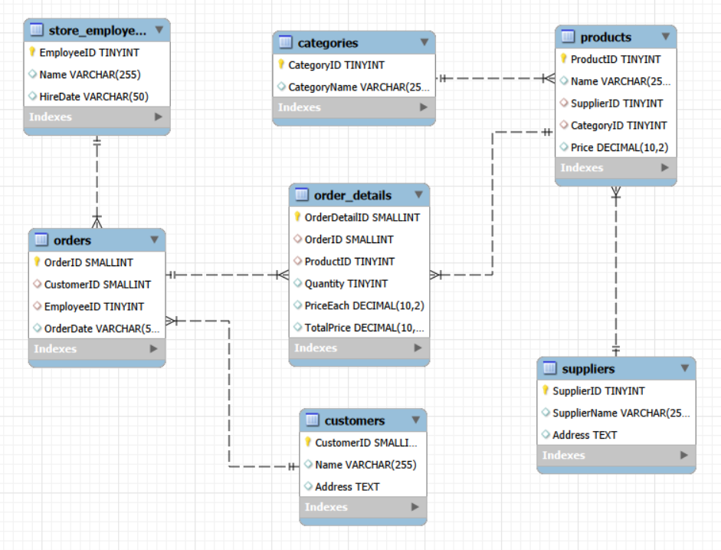
EER Diagram
Fig. This EER Diagram shows how tables are inter-related

Slide 10
ANALYSIS SECTION

Slide 11

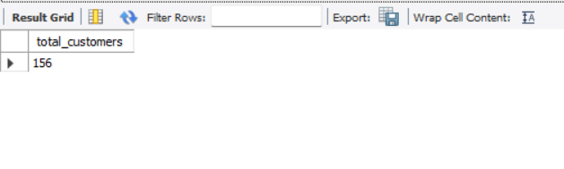
1. Customer Insights Q1. How many unique customers have placed orders?
Fig. Displaying the total number of customers
Observation: Total Unique Customers: 156

Slide 12
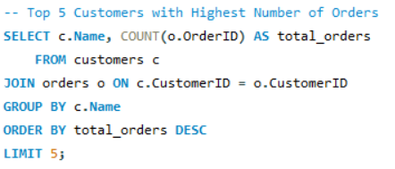
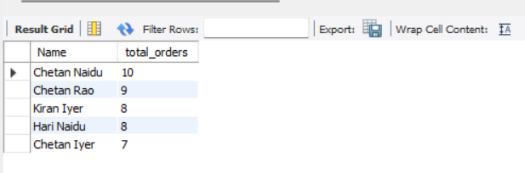
Q2. Which customers have placed the highest number of orders?
Observation:
The top 5 customers are led by Chetan Naidu with 10 orders. Customers named “Chetan” dominate the list, showing they are the most frequent buyers.
Fig. Displaying the top 5 customers based on number of orders placed

Slide 13
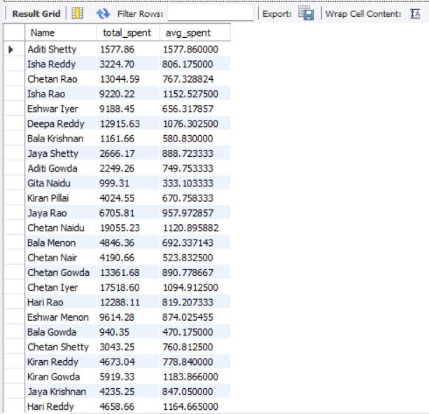
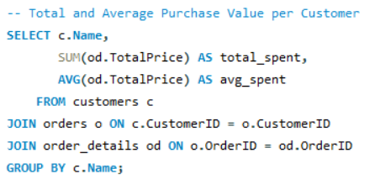
Q3. What is the total and average purchase value per customer?
Observation:
The data shows that Chetan Naidu and Gita Menon are the top spenders overall, while Isha Menon and Deepa Menon have the highest average spend per order. Spending patterns vary widely, with some customers placing fewer but higher-value orders.
Fig. Displaying the Total and Average Purchase value per Customer

Slide 14
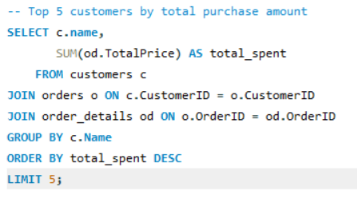
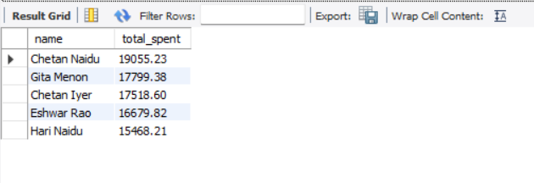
Q4. Who are the top 5 customers by total purchase amount?
Fig. Displaying the Top 5 Customers based on Total Purchase Amount
Observation:
The data shows that Gita Menon and Eshwar Rao are the top spenders overall

Slide 15
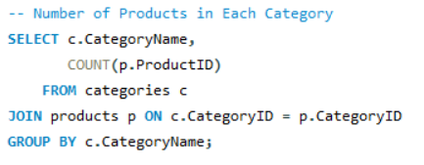
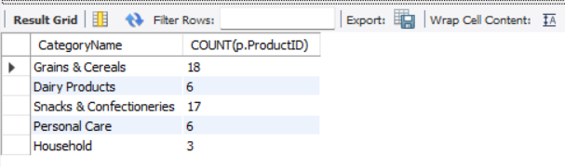
2. Product Performance Q1. How many products exist in each category?
Fig. Displaying Number of products existing in each category
Observation:
Grains & Cereals and Snacks & Confectioneries have the most products, while Household has the fewest, showing product distribution is concentrated in food-related categories.

Slide 16
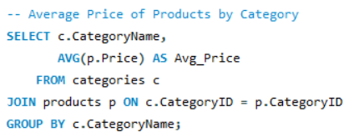
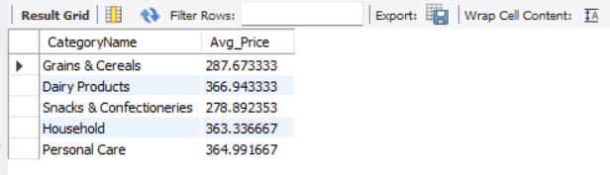
Q2. What is the average price of products by category?
Fig. Displaying the Average price of products for each Category
Observation:
Dairy Products and Personal Care have the highest average prices, while Snacks & Confectioneries and Grains & Cereals are more affordable, indicating price variation across categories.

Slide 17
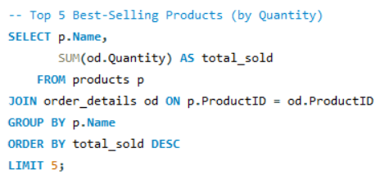
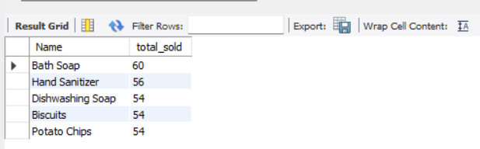
Q3. Which products have the highest total sales volume
(by quantity)?
Fig. Displaying the Top 5 best-selling products (by quantity)
Observation:
The top sellers are Bath Soap (60 units) and Hand Sanitizer (56 units), followed closely by Dishwashing Soap, Biscuits, and Potato Chips (54 units each), showing both hygiene and snack items are highly popular.

Slide 18
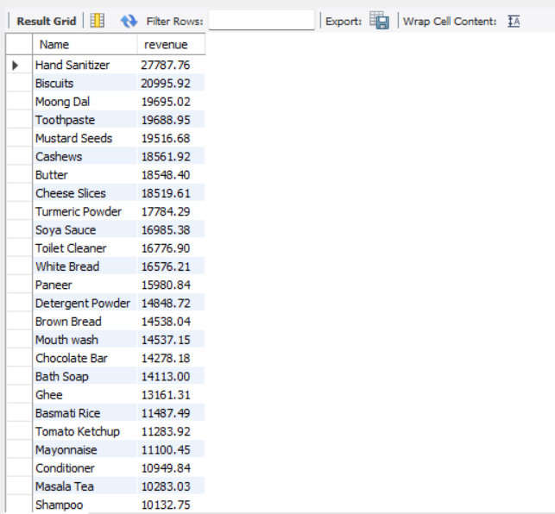
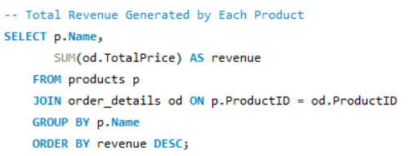
Q4. What is the total revenue generated by each product?
Observation:
Hand Sanitizer leads in revenue (₹27,787.76), followed by Biscuits, Moong Dal, and Toothpaste, showing that both hygiene and staple/snack items generate the highest sales value.
Fig. Total Revenue Generated by each Product

Slide 19
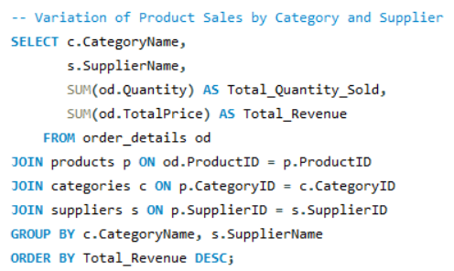
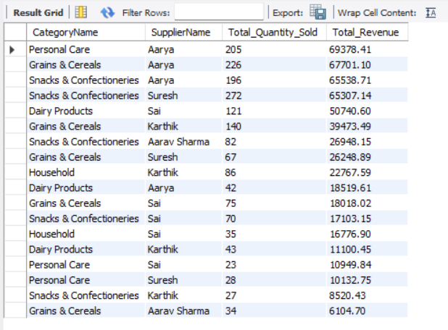
Q5. How do product sales vary by category and supplier?
Observation:
It shows the total quantity sold and revenue generated for each category–supplier combination, helping identify which ones contribute the most to sales. Here, Supplier Aarya sold 205 Personal Care products generating the highest revenue of Rs. 69378.41
Fig. variation in Product sales by category and supplier

Slide 20


3. Sales and Order Trends Q1. How many orders have been placed in total?
Fig. Displaying the total number of Orders placed
Observation:
The total number of orders in the dataset is 300.

Slide 21

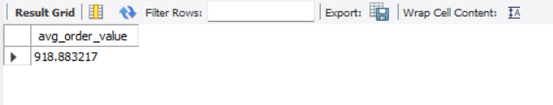
Q2. What is the average value per order?
Observation:
The average order value across all orders is approximately ₹918.88, indicating the typical spending per order.
Fig. Displaying the Average Order Value

Slide 22
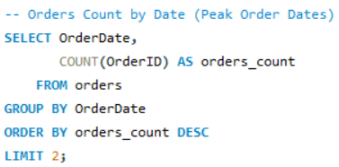
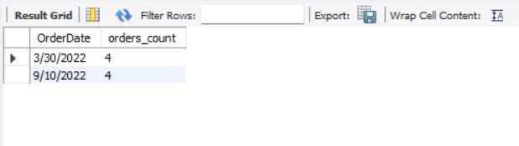
Q3. On which dates were the most orders placed?
Observation:
The peak order dates are March 30, 2022 and September 10, 2022, each with 4 orders, indicating these days saw the highest customer activity.
Fig. Displaying the Peak Order Dates based on Order Count

Slide 23
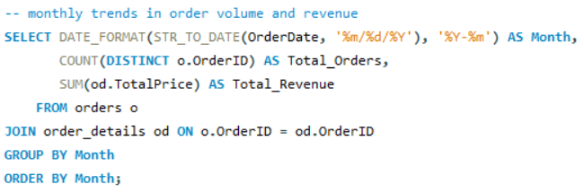
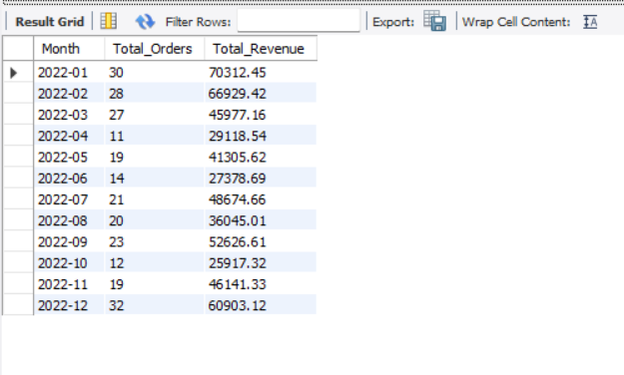
Q4. What are the monthly trends in order volume and revenue?
Observation:
Helps identify peak and low sales months based on order count and revenue.
Useful for understanding seasonal patterns and growth trends in the business.
Here, the months of January and October are the highest and lowest sales months respectively.
Fig. Displaying the Monthly Trends in Order volume and Revenue Generated

Slide 24
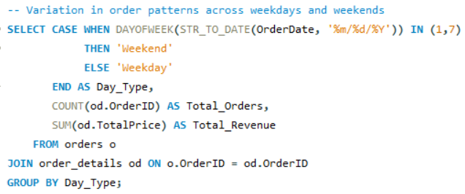
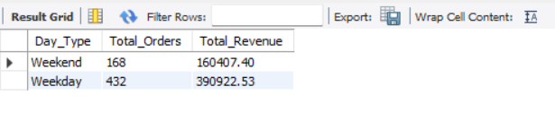
Q5. How do order patterns vary across weekdays and weekends?
Observation:
Orders and Revenue per day is quite similar:
Weekday ≈ 86 orders/day (432 ÷ 5) : 78K/day Revenue
Weekend ≈ 84 orders/day (168 ÷ 2) : 80K/day (slightly higher)
While total sales are higher on weekdays, weekends perform equally well (or slightly better) on a per-day basis.
Fig. Displaying the Order Trends – Weekdays and Weekends

Slide 25

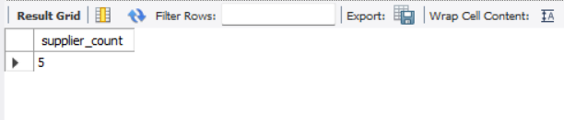
4. Supplier Contribution Q1. How many suppliers are there in the database?
Fig. Displaying the total number of Suppliers in the database
Observation:
The dataset contains a total of 5 suppliers.

Slide 26
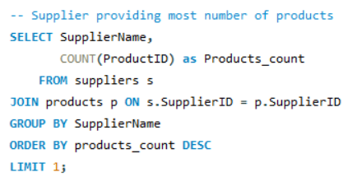
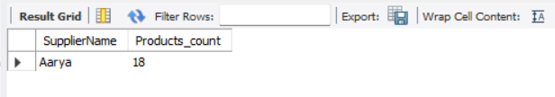
Q2. Which supplier provides the most products?
Observation:
Aarya is the Supplier who provides the maximum number of products (18)
Fig. Displaying the Supplier providing most Products

Slide 27
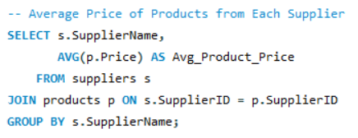
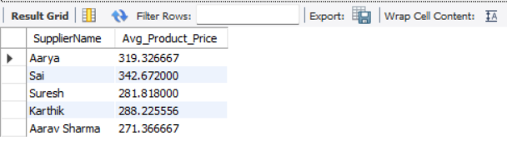
Q3. What is the average price of products from each supplier?
Observation:
Sai supplies the highest-priced products on average (₹342.67), while Aarav Sharma provides the lowest-priced products (₹271.37), showing variation in pricing among suppliers.
Fig. Displaying the Average Price of Products from each Supplier

Slide 28
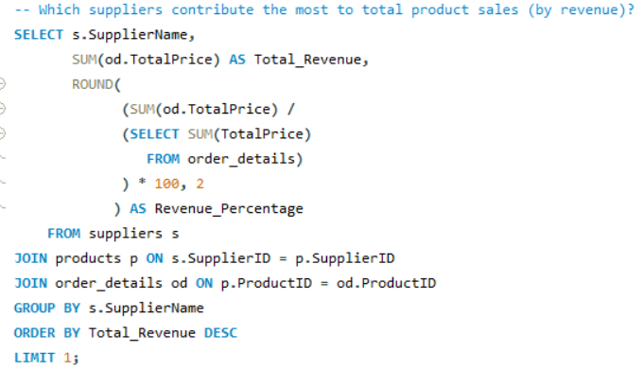
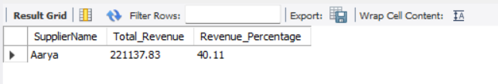
Q4. Which suppliers contribute the most to total product sales
(by revenue)?
Fig. Displaying the Supplier contributing the most to total Product Sales and the Revenue Percentage
Observation:
Aarya is the top supplier, contributing 40.11% of total product sales revenue.

Slide 29

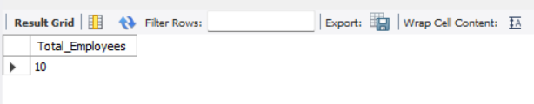
5. Employee Performance Q1. How many employees have processed orders?
Fig. Displaying the total number of Employees who have processed Orders
Observation:
A total of 10 employees have processed orders in the dataset.

Slide 30
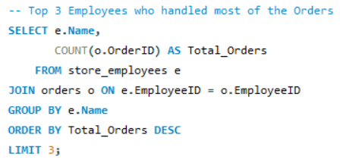
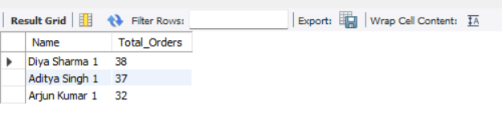
Q2. Which employees have handled the most orders?
Fig. Displaying the Top 3 Employees who handled maximum number of Orders
Observation:
The top three employees handling the most orders are Diya Sharma (38 orders), Aditya Singh (37 orders), and Arjun Kumar (32 orders), highlighting their high contribution to order processing.

Slide 31
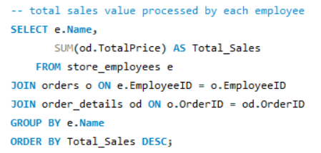
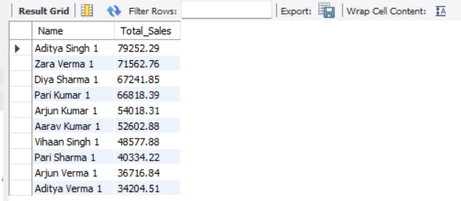
Q3. What is the total sales value processed by each employee?
Observation:
Aditya Singh has processed the highest sales (₹79,252.29), followed by Zara Verma and Diya Sharma, showing that a few employees contribute significantly to total sales.
Fig. Displaying the Total Sales processed by each Employee

Slide 32
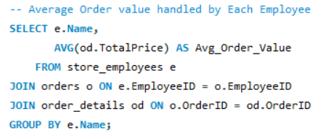
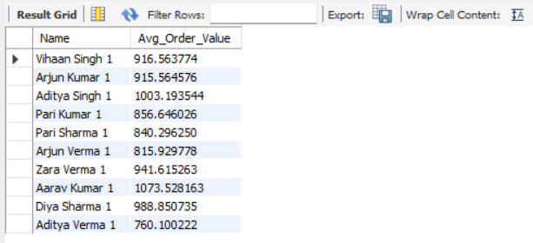
Q4. What is the average order value handled per employee?
Fig. Displaying the Average Order value handled by each Employee
Observation:
Aarav Kumar has the highest average order value (₹1,073.53), followed by Aditya Singh (₹1,003.19) and Diya Sharma (₹988.85), indicating they handle higher-value orders on average.

Slide 33
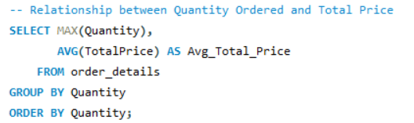
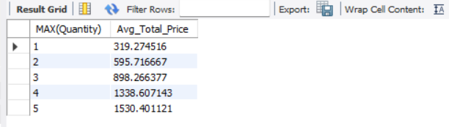
6. Order Details Deep Dive Q1. What is the relationship between quantity ordered and total price?
Observation:
Total Price increases with increasing Quantity
Fig. Displaying the relationship between quantity ordered and total price

Slide 34
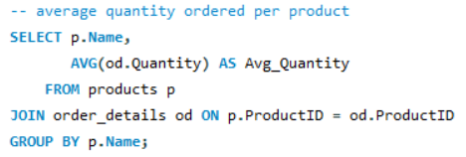
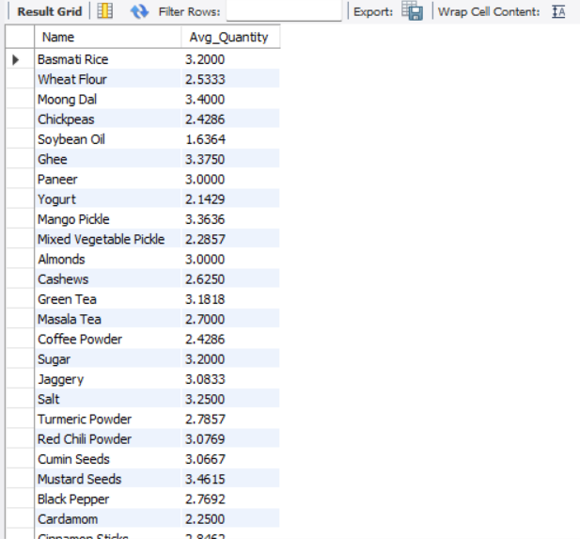
Q2. What is the average quantity ordered per product?
Observation:
Products like Butter (4.56 units), Potato Chips (3.6), and Toothpaste (3.67) have the highest average quantities per order, while items like Soybean Oil (1.64) and Cardamom (2.25) are ordered in smaller quantities on average.
Fig. Displaying the Average quantity ordered for each product

Slide 35
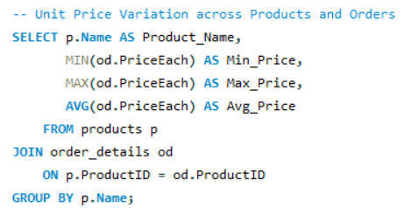
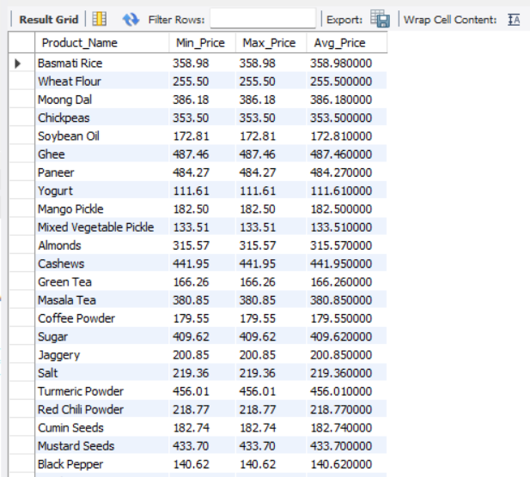
Q3. How does the unit price vary across products and orders?
Observation:
Since the minimum, maximum and Average Price are same across all the Products, there is no variation in Orders.
Fig. Displaying the unit price across products and orders

Slide 36
Key Insights:
A small group of customers contributes largely towards total orders count.
Certain products have consistently higher sales, making them top performing products.
Sales increase as the quantity ordered increases.
Some suppliers contribute significantly more to total revenue than others.
Employee performance varies, with a few employees handling most of the orders.
Sales patterns don’t differ much on weekdays and weekends, showing consistency in customer behaviour.

Slide 37
Challenges faced:
Handling date formats and converting them for analysis.
Writing complex SQL queries involving multiple joins.
Managing aggregations like SUM, AVG, and GROUP BY correctly.
Ensuring data consistency using primary and foreign keys.
Understanding relationships between tables while building queries.

Slide 38
Conclusion:
This project demonstrates how SQL can be used to transform raw data into meaningful business insights.
Through structured queries, important aspects like customer behaviour, product performance, sales trends, supplier contribution, and employee efficiency were analysed.
The analysis helped in identifying top customers, best-selling products, and key revenue drivers.
It also highlighted patterns in sales and operational performance that support better decision-making.
Overall, this project strengthened our practical knowledge of SQL, especially in joins, aggregations, and real-world data analysis.

Slide 39

THANK YOU

