Slide 1
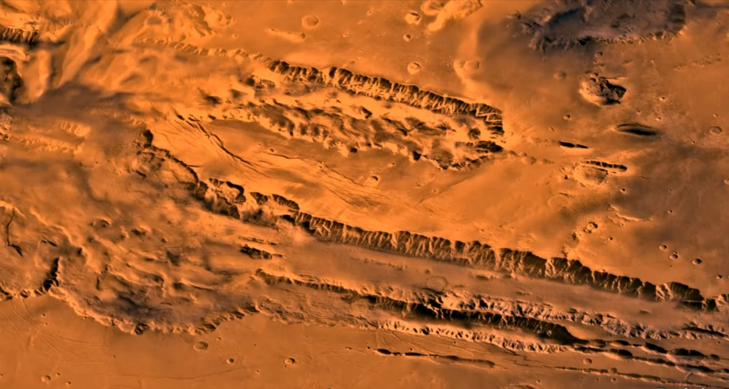
SIH-2020
Organization : Indian Space Research Organization ( ISRO ) PS Id : NM392
Team Name: Neural Architects Team Leader : Akash Khamkar
College Code : 1-3508334364
PS Title:
Depth Estimation of Valles Marineris using ISRO’s Mars Color Camera (MCC) images.
PS Overview:
Generation of Depth map of corresponding images of Valles Marineris using Pix2pix-Wloss, Pix2pixBCE
Marineris Valles
It’s a system of canyons that runs along the Martian Surface.

Slide 2
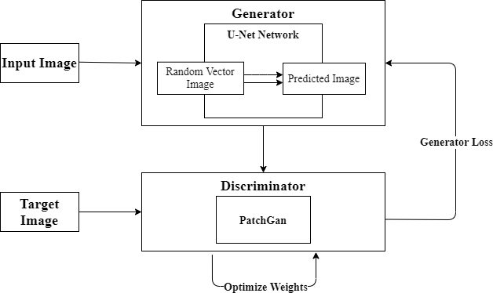
Proposed Methodology

Slide 3
Continued...
Pix2pix(BCE):
In this model we used Binary Cross Entropy to calculate Generator and Discriminator Loss.
We Trained the model for 120 epochs.
We used Patch-GAN as discriminator network.
Pix2pix(Wloss):
In this model we used wasserstein loss to calculate Generator and Discriminator loss.
We trained the model for 120 epochs.
We update the Discriminator (5) times for every Generator iteration.
We used Patch-GAN as discriminator network

Slide 4
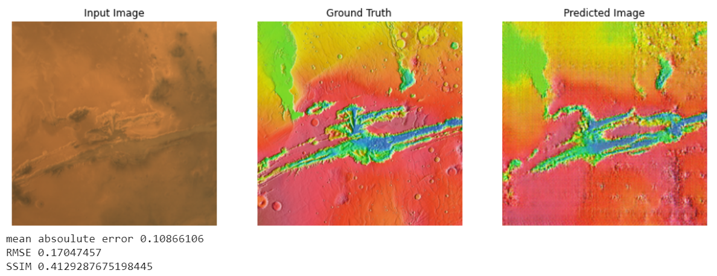
Comparison of Model: (Pix2pix-Wloss) - 120 ep

Slide 5
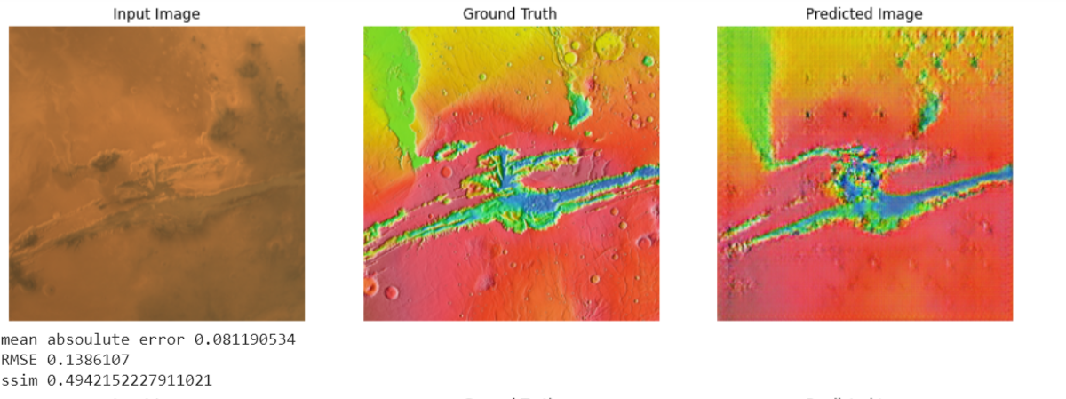
Comparison of Models: (pix2pixBCE) - 120 ep

Slide 6
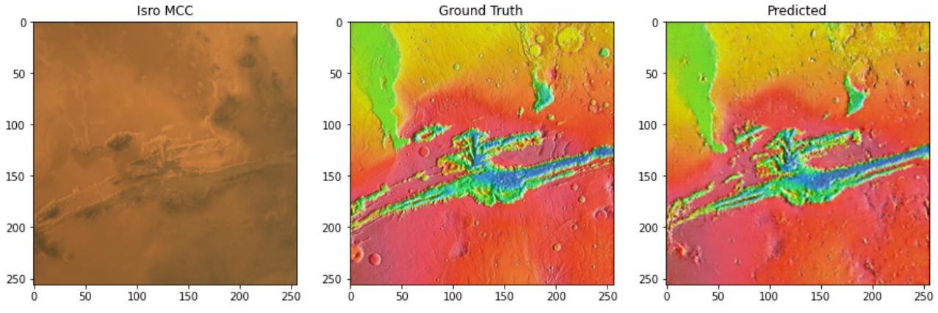
Comparison of Model : (Sat2map) - 120 ep
MAE: 0.07445519141901552
RMSE: 0.1284334645916696
SSIM : 0.57
Pretrained Model Credits: Jun-Yan Zhu

Slide 7
Comparative Analysis of Pix2pix-Wloss ,Pix2pixBCE, Sat2map after 120 epochs
Note:
[1] The Sat2map is a pre-trained model (Credits: Jun-Yan Zhu) which is further trained on ISRO’s dataset.
Basis for Comparison | Pix2pix-Wloss | Pix2pixBCE | Sat2map [1]
Mean Absolute Error | 0.10866106 | 0.081190534 | 0.07445519141901552
RMSE | 0.17047457 | 0.1386107 | 0.128433645916696
SSIM | 0.4129287975198445 | 0.4942152227911021 | 0.57

Slide 8
Conclusion
It is concluded from the comparison that Pix2pix where Wassestein Loss is used trains slower than the Pix2pix model which uses Binary Cross Entropy.
Using Transfer Learning approach (Sat2Map) gave us better results.
If we train the Pix2pix (Wloss) model for twice the number of epochs we may achieve higher accuracy for the model and comparable result .
Future Scope
To implement Gradient Penalty in Pix2pix(Wloss) model.
To use ResNet as generator network in Pix2pix(Wloss) model.

Slide 9
Thank You…!!!
Team Leader:
Akash Khamkar (akashskhamkar99@gmail.com)
Team Members:
Arjun Pukale (arjunpukale@gmail.com)
Prathamesh Joshi (prathameshjoshi1499@gmail.com)
Jenil Jain (jeniljain13.jj@gmail.com)
Kavya Negi (kavya.negi107@gmail.com)
Omkar Nehete (omkar.nehete@gmail.com)

