Slide 1
MongoDB Operators
By Arjun Raj

Slide 2
Various indexe operations in MongoDB
Create index
Get index
Drop index
Single index
Compound index
Unique index

Slide 3
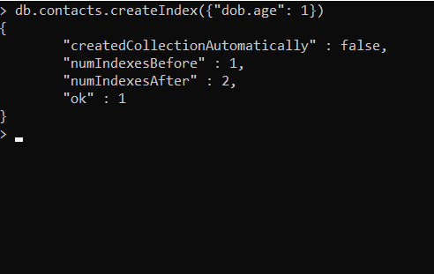
Create Index

Slide 4
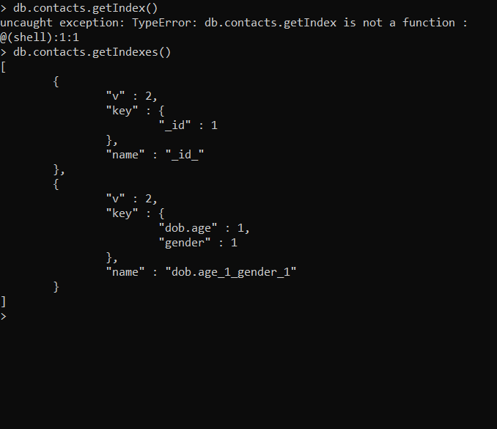
Get Index

Slide 5

Drop Index

Slide 6
Single Index

Slide 7
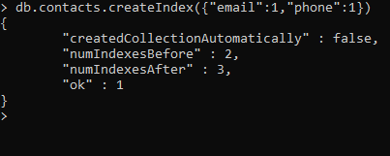
Compound Index

Slide 8
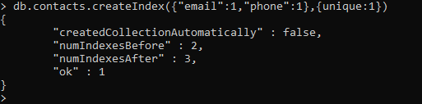
Unique Index

Slide 9
Thank You!

