Slide 1
Scans
In MongoDB
By Arjun Raj

Slide 2
SCANS – COLLSCAN & IXSCAN
Each stage passes its results (i.e. documents or index keys) to the parent node. The leaf nodes access the collection or the indices. The internal nodes manipulate the documents or the index keys that result from the child nodes. The root node is the final stage from which MongoDB derives the result set.

Slide 3
COLLSCAN
IXSCAN
Scans the each document in the collection for processing query.
Process the queries based on the indexes and scans the indexes for results.

Slide 4
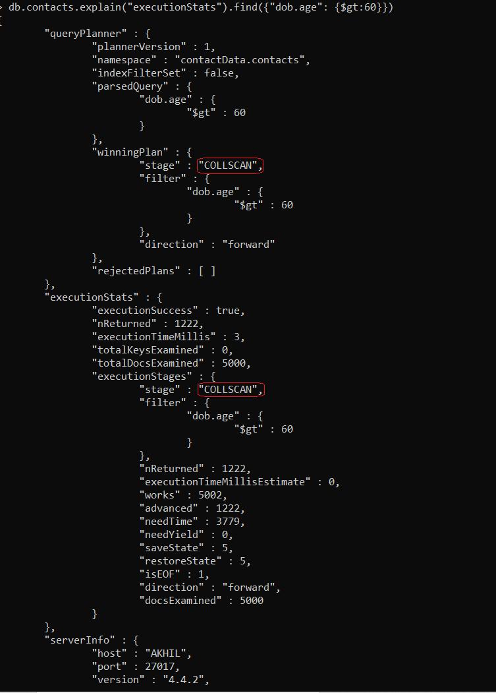
COLLSCAN

Slide 5
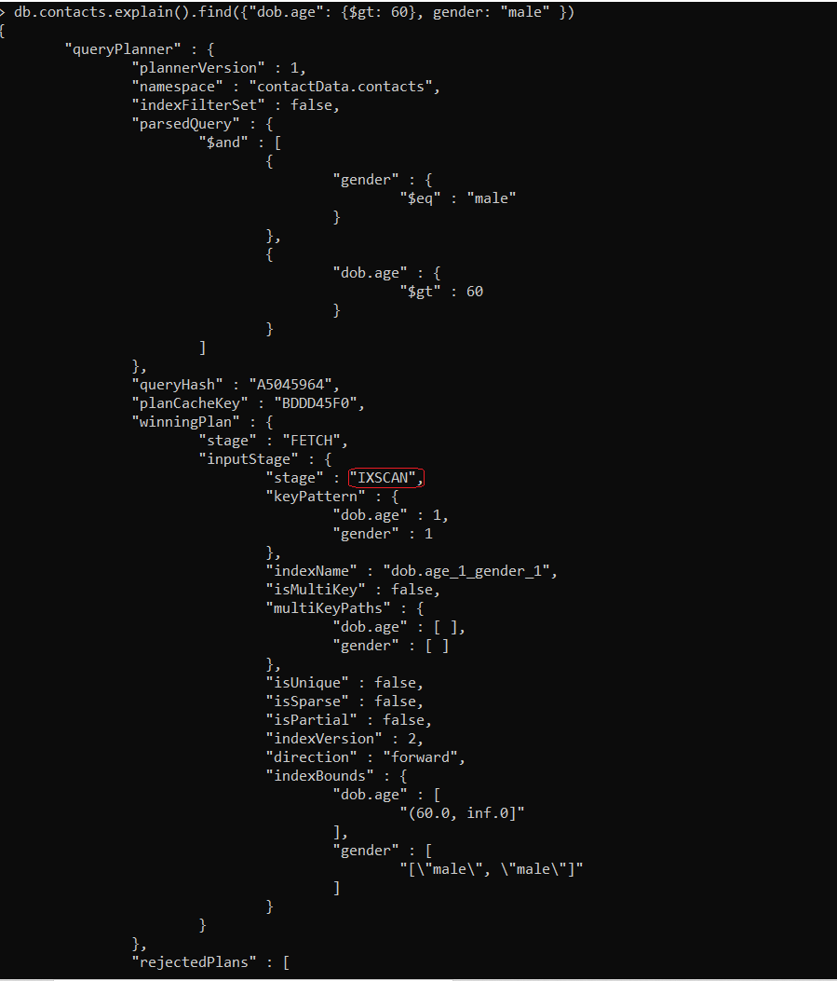
IXSCAN

Slide 6
Thank You!

