Slide 2



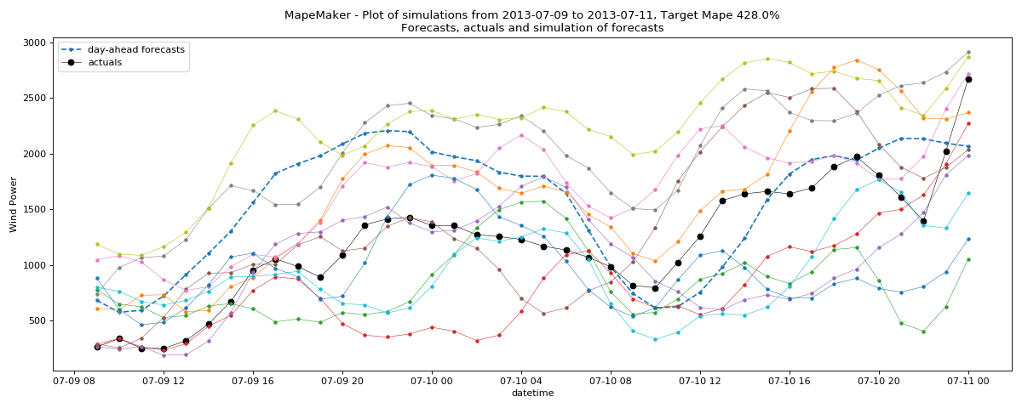


MapeMaker Guide
User
ARMA_fit.py
3)
5)
curvature_correction.py
1)
df_utilities.py
main.py
MapeMaker.py
2)
6)
fitting_distribution.py
4)
A) Estimation | 1) Preprocessing
 | 2) Estimating distributionsand weights
 | 3) Estimating Base Process
B) Simulation | 4) Assigning weights and adjusting
 | 5) Simulating
 | 6) Optimizing Curvature
5)
simulation.py

