Slide 1
Basics I (Overview) CMSC 14300: System Programming I 1st Lecture
Instructor:
Prof. Adam Shaw
Prof. Junchen Jiang

Slide 2
What will you learn?
We will learn C programming language
C is the basic programming language for computer programmers, and one of the historic and ongoing successes in the design of practical system programming.
14100
(Python)
14200
(Advanced Python)
14300
(C programming)
Python vs. C Just a different language?

Slide 3


Python vs C: How to run the code
lec1.py
Python
sum = 0
N = 100000000
for i in range(N):
sum += 1
print(sum)
Python runs in one step with Python interpreter
lec1.c
Same logic in C
#include <stdio.h>
int main()
{
int sum = 0;
int N = 100000000;
for (int i = 0; i<N; i++)
sum += 1;
printf(“%u\n”, sum);
return 0;
}
Two steps: (more on this later)
1. compile C code
2. run the machine code

Slide 4
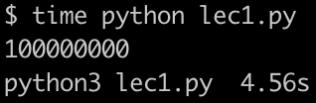

Python vs C: Speed
lec1.py
Python
sum = 0
N = 100000000
for i in range(N):
sum += 1
print(sum)
lec1.c
Same logic in C
#include <stdio.h>
int main()
{
int sum = 0;
int N = 100000000;
for (int i = 0; i<N; i++)
sum += 1;
printf(“%u\n”, sum);
return 0;
}
C is more than 60x faster
(can be even faster with optimized compilation)

Slide 5
Python vs C: How to declare variable type
lec1.py
Python
sum = 0
N = 100000000
for i in range(N):
sum += 1
print(sum)
No need to declare type of variables
lec1.c
Same logic in C
#include <stdio.h>
int main()
{
int sum = 0;
int N = 100000000;
for (int i = 0; i<N; i++)
sum += 1;
printf(“%u\n”, sum);
return 0;
}
Compulsory to declare type of variables

Slide 6
Python vs C: Access to low-level details (memory)
lec1.py
Python
sum = 0
N = 100000000
for i in range(N):
sum += 1
print(sum)
Can’t see where the variables are in memory.
Low-level details are invisible to programmers.
lec1.c
Same logic in C
#include <stdio.h>
int main()
{
int sum = 0;
int N = 100000000;
for (int i = 0; i<N; i++)
sum += 1;
printf(“%u\n”, sum);
return 0;
}
We can see where the variables are in (virtual) memory!
(We will learn pointers and how to do this in future lectures!)
Content in memory (hex of 1000000)
…
05
f5
e1
00
…
Memory address of sum
printf("%p\n", &sum);
0x16f173498

Slide 7
C: System Programming
Applications
Gap too large to
bridge in one step
Physics

Slide 8
C: System Programming
Applications
Algorithms
Operating System/Virtual Machines
Instruction Set Architecture
Microarchitecture
Register-Transfer Level
Gates & Circuits
Physics

Slide 9
C: System Programming
Applications
Python: popular in applications (esp. data analytics & ML)
Algorithms
Operating System/Virtual Machines
Instruction Set Architecture
Microarchitecture
Register-Transfer Level
Gates & Circuits
Physics

Slide 10
C: System Programming
Applications
C programming: de-facto systems language
(this class)
Algorithms
Operating System/Virtual Machines
Instruction Set Architecture
Machine language (assembly language)
Microarchitecture
Register-Transfer Level
Gates & Circuits
Learning C helps you understand and visualize the inner workings of a computer.
Physics

Slide 11
C: System Programming
Applications
C programming: de-facto systems language
(this class)
Algorithms
Operating System/Virtual Machines
Instruction Set Architecture
Widely used in low-level systems for speed and control!
Operating systems (e.g., UNIX is mostly in C)
Compilers (e.g., the Python Interpreter)
Scientific computing (e.g., MATLAB, Mathematica)
Popular applications (e.g., Browsers, Video player)
…
Microarchitecture
Register-Transfer Level
Gates & Circuits
Physics

Slide 12
C: System Programming
Applications
Algorithms
C programming: de-facto systems language
(this class)
Operating System/Virtual Machines
Instruction Set Architecture
Next class: CS 144 Intro to computer systems
Microarchitecture
Register-Transfer Level
Gates & Circuits
Physics

Slide 13
“C is quirky, flawed, and an enormous success.”
-- Dennis M. Ritchie (Inventor of C and UNIX)
C’s “influence on Python is considerable.”
-- Guido van Rossum (Inventor of Python)

Slide 14
Overview
Course theme
Example C code
Setting up environment
Logistics
Getting help

Slide 15
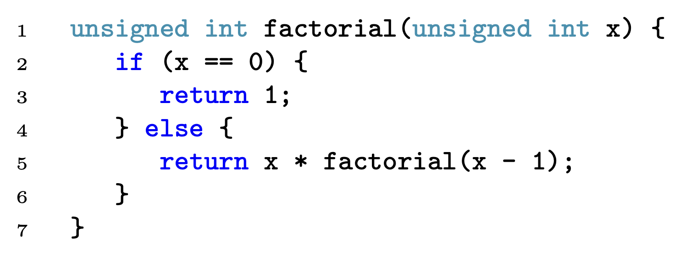
Example: Implementation of Factorial Function in C
factorial is the function name
factorial takes an argument x
x has type unsigned int
factorial returns a value of type unsigned int
unsigned int is a data type (designates non-negative integer)
if else is a conditional (exactly one branch taken)
== is an equality test (checks value of variable x)
Semicolon ; terminates each statement (required)
return exits the function with a result value
Braces {} encloses a block of statements

Slide 16
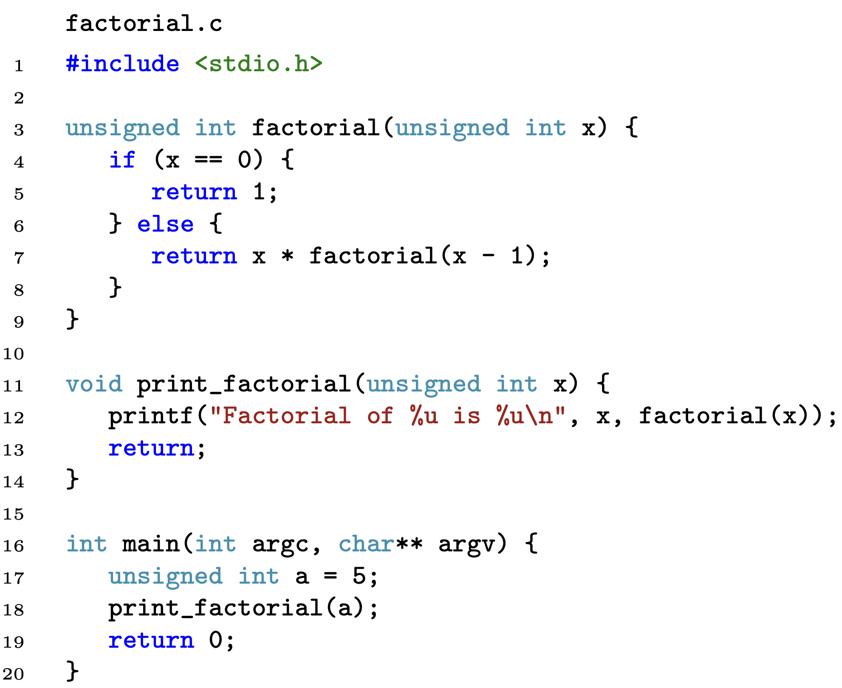
Example: Factorial Program
<stdio.h> is a header file for the standard library input/output functions
including <stdio.h> allows use of printf
"%__"
to be replaced by subsequent argument
2nd character denotes argument type, e.g., u denotes unsigned int
“\n” denotes new line, any additional output would appear on the next line
printf(…)
performs output to screen
takes variable number of arguments
first argument is a format string
main is a special function name
main runs when you run the program
convention:
main has int return type
returns 0 to denote success
returns non-zero to denote an error
arguments: int argc, char** argv
supports commend-line input (we’ll cover these much later)
can optionally declare without
void return type indicates no return value a return statement is optional in this case

Slide 17
Overview
Course theme
Example C code
Setting up environment
Logistics
Getting help

Slide 18
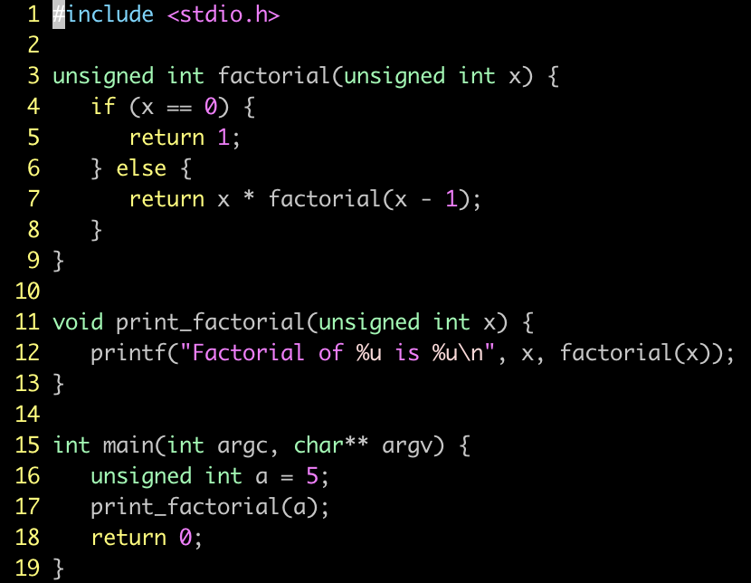
Setting up a working environment
Type this in terminal
Editor: Vim
Compiler: Clang
Command line interface: Bash
(part of Lab 1 on Tuesday)

Slide 19
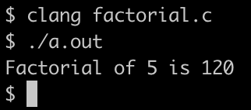
Example: Running “Factorial” Program
Compiling (specifying executable name):
Running:

Slide 20

Example: Running “Factorial” Program
Compiling (specifying executable name):
Running:

Slide 21
Command line interface: Bash
Bash (default shell in unix) is much more powerful than opening, compiling and executing C programs.
Example: counting unique values in a specific column of a csv file

Slide 22
Overview
Course theme
Example C code
Setting up environment
Logistics
Getting help

Slide 23
Course information
Course site on Canvas: https://canvas.uchicago.edu/courses/49727
Course document on Canvas
including syllabus, grading, homework, labs, policy, …
Lecture slides will be put on Canvas.
Textbook: The C Programming Language (Second Edition), Kernighan, Ritchie.
The book is an excellent technical reference.
Exams are covered by Lectures, HWs and Labs

Slide 24
Homework
Weekly assignments
Writing C code to enhance your understanding of the programming concepts
Also makes you a better programmer
Due every Monday 11:59pm, Chicago time
Late policy:
No late extension
For everyone: we drop the lowest Homework grade

Slide 25
Lab
Learn necessary tools of coding, testing, debugging, …
Very helpful for coding homework questions
STRONGLY encouraged to attend!
May appear in Exam and Quiz questions
Three sessions on Tuesdays in CSIL
Tues 3:30pm–4:50pm, 5:00pm–6:20pm, 6:30pm–7:50pm

Slide 26
Quiz and Exam
Quiz:
Monday, April 17
In-class
Exam:
about May 23 (time and location announced later)
Grading
Homework | 60%
Quiz | 15%
Exam | 25%

Slide 27
Overview
Course theme
Example C code
Setting up environment
Logistics
Getting help

Slide 28
Help
I need help on lectures and HWs, where should I go?
ED: https://edstem.org/us/courses/38041/discussion/
We will response as fast as possible
If not, re-post – We actively monitor this
TAG your posts properly (e.g., “hw1”)
Office hours (TAs, instructors): To be announced soon

Slide 29
Help, Help, Help!!! … Start early
Deadline is less than 24 hr, but I’m not getting enough help.
We will try out best, but … please start early!
We cannot help 180+ students who start late
How to ask for help?
Use details – “it doesn’t work” vs. “I tried X, but got Y, then tried Z…”

Slide 30
Academic Misconduct
Well … don’t cheat!
Involve department and university level, and potentially a Fail
Don’t ruin your good reputation
Never copy work from any other source and submit it as your own.
Never allow your work to be copied or seen by another student.
No screenshot when posting your question or answer on ED
Document all collaboration & cite sources

Slide 31
Special Accommodation Requests
https://disabilities.uchicago.edu.
links up for accommodation requests
We follow recommendations and guidelines from SDS
Also send a separate email to the instructors and TA (Zhengxu Xia zxxia@uchicago.edu)

Slide 32
Conclusion
Getting a deeper understanding of low-level computer programming
Learn, enjoy, don’t stress, and don’t hesitate to ask for help!
We are also experimenting, so bear with us and provide feedback

Slide 35
Example: Implementation of Factorial Function in C
factorial is the function name
factorial takes an argument x
x has type unsigned int
factorial returns a value of type unsigned int
unsigned int is a data type (designates non-negative integer)
== is an equality test (checks value of variable x)
if else is a conditional (exactly one branch taken)
Semicolon ; terminates each statement (required)
return exits the function with a result value
Braces {} encloses a block of statements

Slide 36
1 #include <stdio.h>
2
3 unsigned int factorial(unsigned int x){
4 if (x == 0) {
5 return 1;
6 } else {
7 return x * factorial(x-1);
8 }
9 }
10
11 void print_factorial(unsigned int x) {
12 printf(“Factorial of %u is %u\n”, x, factorial(x));
13 }
14
15 int main(int argc, char** argv) {
16 unsigned int a = 5;
17 print_factorial(a);
18 return 0;
19 }

Slide 37
Python vs C: Access to low-level details (memory)
lec1.py
sum = 0
N = 1000000
for i in range(N):
sum += 1
print(sum)
Can’t see where the variables are in memory.
Low-level details are invisible to programmers.
Can see where the variables are in (virtual) memory
(We will learn how to do this in future lectures!)
lec1.c
#include <stdio.h>
int main()
{
int sum = 0;
int N = 1000000;
for (int i = 0; i<N; i++)
sum += 1;
printf(“%u\n”, sum);
return 0;
}
…
Content in memory (hex of 1000000)
00
0f
42
40
…
Memory address of sum
printf("%p\n", &sum);
16f3a7488
char* a = (char*)&sum;
printf("%02x", *(a+3));
printf("%02x", *(a+2));
printf("%02x", *(a+1));
printf("%02x", *(a));
00
0f
42
40
Notes:
Show python and c code side-by-side, with the same output
Diff 1: different ways of running (screenshots of how they are run)
Diff 2: different speeds
Diff 3: specifying the types
Diff 4: pointers

Slide 38
Command line interface: Bash
Examples:
ls –lha | grep xxx
cat roster.txt | ??
STILL DEVELOPING

