Slide 1
Basics II CMSC 14300: System Programming I 2nd Lecture
Instructor:
Prof. Adam Shaw
Prof. Junchen Jiang

Slide 2
Overview
Basic C constructs
Variable Declaration
Function Definition
Function Declaration

Slide 3
Variable Declaration
Syntax:
type varname [= value];
type is the variable type (e.g., char, int, float)
varname is the variable name = value (optionally) initializes the variable with a value
Examples:
int a = 2;
float pi = 3.1416; // a float approximation of pi
char x = 'q'; /* single quotes around character literals */
Comments:
// this is a single line comment
/* this can be a single or
multi-line comment */

Slide 4
Variable Declaration
Can declare and initialize multiple variables:
int x = 0, y = 1;
float pi = 3.1416, e = 2.7183;
int b = x + 1 - y; // initialization from expression
long z = f(x); // ok, assuming function f is defined
double r, s = 5.0; // only initializes s
Important:
Do not declare a variable more than once.
int x = 0, y = 1;
int x = f(x); // BAD: redefining 'x'

Slide 5
Variable Declaration
Can declare and initialize multiple variables:
int x = 0, y = 1;
float pi = 3.1416, e = 2.7183;
int b = x + 1 - y; // initialization from expression
long z = f(x); // ok, assuming function f is defined
double r, s = 5.0; // only initializes s
Important:
Do not declare a variable more than once.
Do not use a variable before initializing or assigning to it!
What value does r have?
Could be anything because we did not initialize it!
double r, s = 5.0; // only initializes s
f(r); // BAD: using r before assigning it a value

Slide 6
Variable Declaration
Can declare and initialize multiple variables:
int x = 0, y = 1;
float pi = 3.1416, e = 2.7183;
int b = x + 1 - y; // initialization from expression
long z = f(x); // ok, assuming function f is defined
double r, s = 5.0; // only initializes s
Important:
Do not declare a variable more than once.
Do not use a variable before initializing or assigning to it!
What value does r have?
Could be anything because we did not initialize it!
double r, s = 5.0; // only initializes s
r = -3.4; // assigns r a value
f(r); // OK: assigned r a value before use

Slide 7

C Pointers
Pointers are powerful features of C and C++ programming.
Addresses in C programming
e.g., &x is the address of variable x
1 #include <stdio.h>
2
3 int main() {
4 int x = 10; // initialize int variable x
5 printf("x is %d\n", x);
6 printf("address of x is %p\n", &x);
7 // &x is the memory address of x
8
9 int *q; // declare pointer q
10 q = &x; // assign address of x to pointer q
11 printf("address assigned to pointer q is %p\n", q);
12 printf("the value of thing pointed by q is %d\n", *q);
13 }
Output

Slide 8
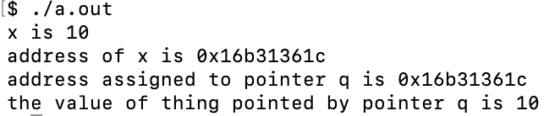
C Pointers
Pointers are powerful features of C and C++ programming.
Addresses in C programming
e.g., &x is the address of variable x
Pointers are special variables that are used to store addresses rather than values
e.g., int *q is a pointer of int type (q can point to an int variable)
1 #include <stdio.h>
2
3 int main() {
4 int x = 10; // initialize int variable x
5 printf("x is %d\n", x);
6 printf("address of x is %p\n", &x);
7 // &x is the memory address of x
8
9 int *q; // declare pointer q
10 q = &x; // assign address of x to pointer q
11 printf("address assigned to pointer q is %p\n", q);
12 printf("the value of thing pointed by q is %d\n", *q);
13 }
Output

Slide 9
Output format in printf
Type | Range | printf specifier
char | [-128, 127] | c
int | [-2^31, 2^31-1] | d
unsigned int | [0, 2^32-1] | u
float | [-3.4x10^38, 3.4x10^38] | f
string |  | s
pointer |  | p
Example:
1 #include <stdio.h>
2
3 int main() {
4 int x = 3;
5 float y = 0.5;
6 int *z = &x;
7 char w = 'w';
8 printf("x is %d, y is %.4f, z is %p, and w is %c\n", x, y, z, w);
9 }

Slide 10
Overview
Basic C constructs
Variable Declaration
Function Definition
Function Declaration

Slide 11
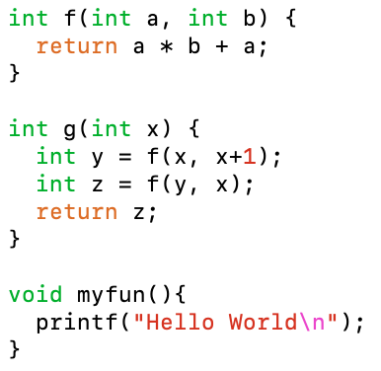
Function Definition
Syntax: return_type function_name ([parameter_list]) {
body
}
return_type type of value function returns (e.g., char, int, float)
OR void to denote the function does not return a value
parameter_list comma-separated list with type and variable name of each argument body sequence of statements
Examples
When a function returns void, a return statement is optional

Slide 12
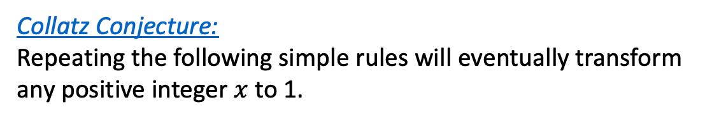



Example: Collatz Program
Collatz Conjecture:
Repeating the following simple rules will eventually transform any positive integer $x$ to 1.
$3x + 1$, if $x$ is odd
$$x⟵$$
, then repeat.
$x/2$, if $x$ is even
Example:
12
-> 6
-> 3
-> 10
-> 5
-> 16
-> 8
-> 4
-> 2
-> 1
42
-> 21
-> 64
-> 32
-> 16
-> 8
-> 4
-> 2
-> 1
27
-> 82
-> 41
-> 124
… (103 steps in between!)
-> 8
-> 4
-> 2
-> 1
The conjecture is still unsolved, but we can test it!

Slide 13
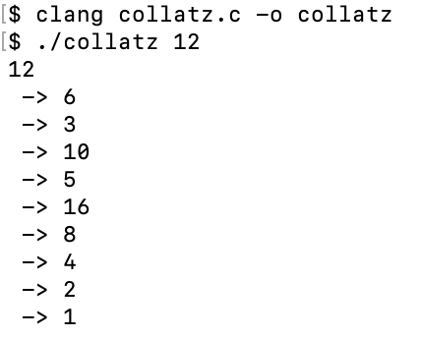



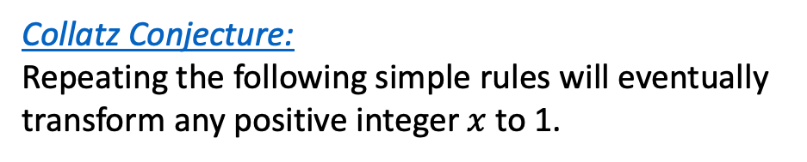
Example: Collatz Program
1 #include <stdio.h>
2 #include <stdlib.h>
3
4 void print_value(int x) {
5 printf(" -> %d\n", x);
6 }
7
8 int rule(int x) {
9 if (x % 2 == 0) {
10 x = x / 2;
11 } else {
12 x = 3 * x + 1;
13 }
14 return x;
15 }
16
17 void test(int x) {
18 x = rule(x);
19 print_value(x);
20 if (x != 1) {
21 test(x);
22 }
23 }
24
25 int main(int argc, char *argv[]) {
26 int N = atoi(argv[1]);
27 printf("%d\n", N);
28 test(N);
29 return 0;
30 }
Collatz Conjecture:
Repeating the following simple rules will eventually transform any positive integer $x$ to 1.
printf prints x value on screen
$3x + 1$, if $x$ is odd
Operations of the rule
$$x⟵$$
, then repeat.
$x/2$, if $x$ is even
Output:
Applying rule on x repeatedly
main function: take an argument input
e.g., ./collatz 12
where string "12" is argv[1]

Slide 14
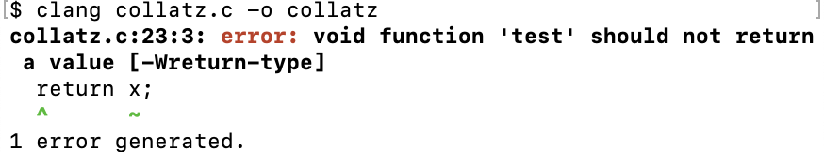
Collatz Program with Syntax Error
1 #include <stdio.h>
2 #include <stdlib.h>
3
4 void print_value(int x) {
5 printf(" -> %d\n", x);
6 }
7
8 int rule(int x) {
9 if (x % 2 == 0) {
10 x = x / 2;
11 } else {
12 x = 3 * x + 1;
13 }
14 return x;
15 }
16
17 void test(int x) {
18 x = rule(x);
19 print_value(x);
20 if (x != 1) {
21 test(x);
22 }
23 return x;
24 }
25
26 int main(int argc, char *argv[]) {
27 int N = atoi(argv[1]);
28 printf("%d\n", N);
29 test(N);
30 return 0;
31 }
Output during clang compilation
Example of syntax error:
The function test is defined to return nothing (void)
Contradicts the return x statement.
Errors vs. warnings (e.g., use %f to print int in printf)
When does the executable change? (when compilation succeeds)
Should you fix all the errors at once? (start from the first one)
If clang prints nothing, does it mean it's correct? NO

Slide 15
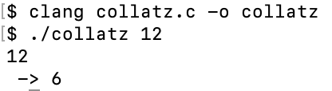
Example: Collatz Program w/ Logical Mistakes
1 #include <stdio.h>
2 #include <stdlib.h>
3
4 void print_value(int x) {
5 printf(" -> %d\n", x);
6 }
7
8 int rule(int x) {
9 if (x % 2 == 0) {
10 x = x / 2;
11 } else {
12 x = 3 * x + 1;
13 }
14 return x;
15 }
16
17 void test(int x) {
18 x = rule(x);
19 print_value(x);
20 if (x == 1) {
21 test(x);
22 }
23 }
24
25 int main(int argc, char *argv[]) {
26 int N = atoi(argv[1]);
27 printf("%d\n", N);
28 test(N);
29 return 0;
30 }
Output
Example of logical mistake:
No compilation errors when running clang.
But wrong output.
test(x) is run only when x == 1

Slide 16
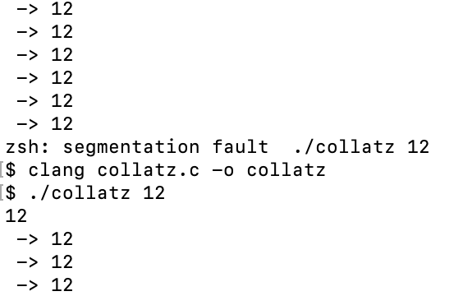
Example of Logical Mistake: “Useless” Function
1 #include <stdio.h>
2 #include <stdlib.h>
3
4 void print_value(int x) {
5 printf(" -> %d\n", x);
6 }
7
8 void useless_rule(int x) {
9 if (x % 2 == 0) {
10 x = x / 2;
11 } else {
12 x = 3 * x + 1;
13 }
14 }
15
16 void test(int x) {
17 useless_rule(x);
18 print_value(x);
19 if (x != 1) {
20 test(x);
21 }
22 }
23
24 int main(int argc, char *argv[]) {
25 int N = atoi(argv[1]);
26 printf("%d\n", N);
27 test(N);
28 return 0;
29 }
Example of logical mistake:
Function arguments are pass-by-value
It doesn't change x seen by function test
➔ Infinite recursion
…
Why not useful?
Why does program exit with error message?

Slide 17
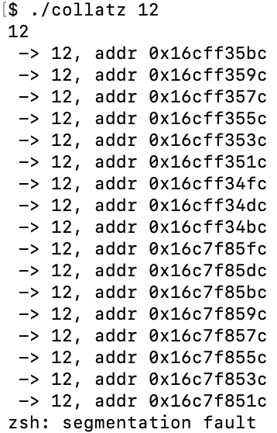
Example of Logical Mistake: “Useless” Function
1 #include <stdio.h>
2 #include <stdlib.h>
3
4 void print_value(int x) {
5 printf(" -> %d, addr %p\n", x, &x);
6 }
7
8 void useless_rule(int x) {
9 if (x % 2 == 0) {
10 x = x / 2;
11 } else {
12 x = 3 * x + 1;
13 }
14 }
15
16 void test(int x) {
17 useless_rule(x);
18 print_value(x);
19 if (x != 1) {
20 test(x);
21 }
22 }
23
24 int main(int argc, char *argv[]) {
25 int N = atoi(argv[1]);
26 printf("%d\n", N);
27 test(N);
28 return 0;
29 }
Example of logical mistake:
Function arguments are pass-by-value
It doesn't change x seen by function test
➔ Infinite recursion
Why not useful?
Why does program exit with error message?
A: function calls consume resources
each function call allocation memory
finite available memory
…
Segmentation fault → program tried to access unavailable resources (e.g., out-of-memory)

Slide 18
Overview
Basic C constructs
Variable Declaration
Function Definition
Function Declaration

Slide 19
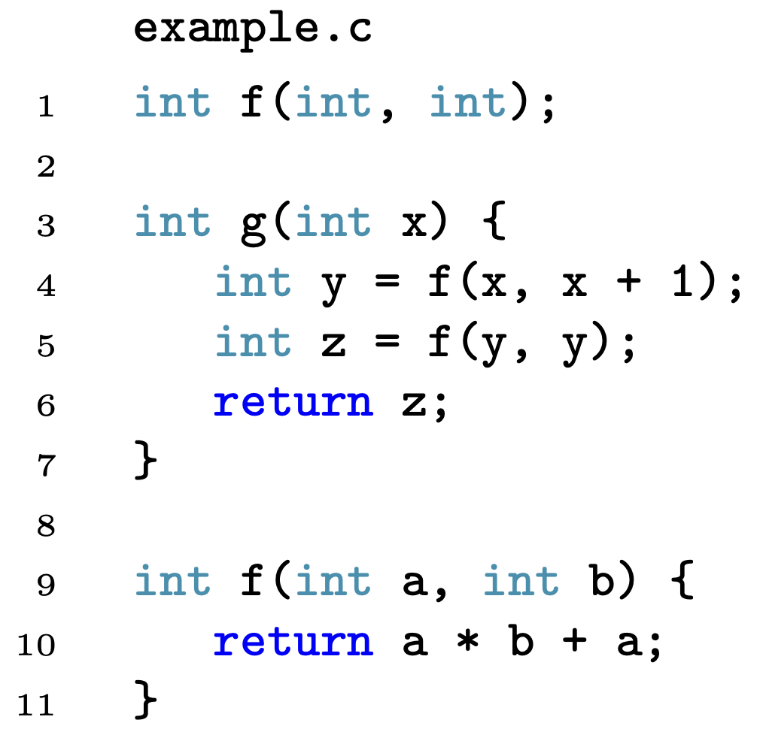
Function Declaration
Syntax: return_type function_name ([parameter_list]);
return_type type of value function returns (e.g., char, int, float)
OR void to denote the function does not return a value
parameter_list comma-separated list with type of each argument body sequence of statements
Declare and use f before definition

Slide 20
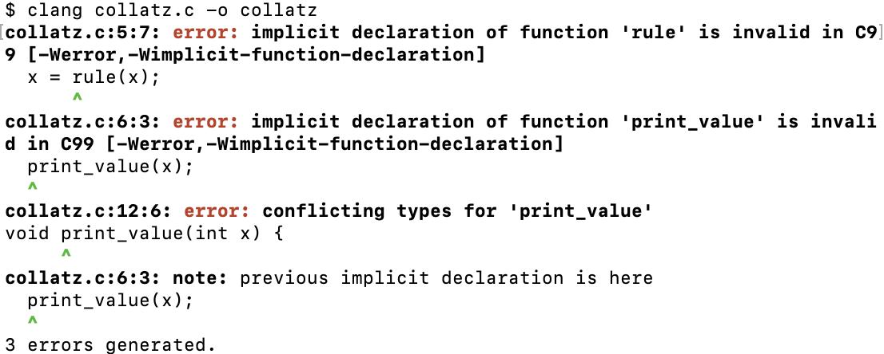
Example: Collatz Program
1 #include <stdio.h>
2 #include <stdlib.h>
3
4 void test(int x) {
5 x = rule(x);
6 print_value(x);
7 if (x != 1) {
8 test(x);
9 }
10 }
11
12 void print_value(int x) {
13 printf(" -> %d\n", x);
14 }
15
16 int rule(int x) {
17 if (x % 2 == 0) {
18 x = x / 2;
19 } else {
20 x = 3 * x + 1;
21 }
22 return x;
23 }
24
25 int main(int argc, char *argv[]) {
26 int N = atoi(argv[1]);
27 printf("%d\n", N);
28 test(N);
29 return 0;
30 }
What if we define test(x) first?
Fail to compile:
printvalue(x) and rule(x) are used before they are declared or defined.

Slide 21
Example: Collatz Program w/ Function Declaration
1 #include <stdio.h>
2 #include <stdlib.h>
3
4 int rule(int);
5 void print_value(int);
6
7 void test(int x) {
8 x = rule(x);
9 print_value(x);
10 if (x != 1) {
11 test(x);
12 }
13 }
14
15 void print_value(int x) {
16 printf(" -> %d\n", x);
17 }
18
19 int rule(int x) {
20 if (x % 2 == 0) {
21 x = x / 2;
22 } else {
23 x = 3 * x + 1;
24 }
25 return x;
26 }
27
28 int main(int argc, char *argv[]) {
29 int N = atoi(argv[1]);
30 printf("%d\n", N);
31 test(N);
32 return 0;
33 }
Solution:
Adding function declaration of printvalue(x) and rule(x) before using them in test

Slide 22
Example: Header files
test.c
test.h
1 #include <stdio.h>
2 #include <stdlib.h>
3 #include "test.c"
4
5 int main(int argc, char *argv[]) {
6 int N = atoi(argv[1]);
7 printf("%d\n", N);
8 test(N);
9 return 0;
10 }
1 #include "test.h"
2
3 void test(int x) {
4 x = rule(x);
5 print_value(x);
6 if (x != 1) {
7 test(x);
8 }
9 }
10
11 void print_value(int x) {
12 printf(" -> %d\n", x);
13 }
14
15 int rule(int x) {
16 if (x % 2 == 0) {
17 x = x / 2;
18 } else {
19 x = 3 * x + 1;
20 }
21 return x;
22 }
1 void test(int);
2
3 void print_value(int);
4
5 int rule(int);
Header files (.h) separates interface from implementation
A header file contains C function declarations and macro definitions
It can be shared between several source files.
Not that useful in small projects, but can be very useful in large projects

Slide 23
Recap
How to declare and initialize variables?
How to define a function?
How to declare a function?
More on pointers in about a week

Slide 26
Example of Logical Mistake: “Useless” Function
#include <stdio.h>
#include <stdlib.h>
void print_value(int x) {
printf(" -> %d\n", x);
}
void useless_rule(int x) {
if (x % 2 == 0) {
x = x / 2;
} else {
x = 3 * x + 1;
}
}
void test(int x) {
useless_rule(x);
print_value(x);
if (x != 1) {
test(x);
}
}
int main(int argc, char *argv[]) {
int N = atoi(argv[1]);
printf("%d\n", N);
test(N);
printf("\n");
return 0;
}
Why not useful?
Function arguments are pass-by-value, and return no value
What would happen?
int rule(int x) {
if (x % 2 == 0) {
x = x / 2;
} else {
x = 3 * x + 1;
}
return x;
}

Slide 27
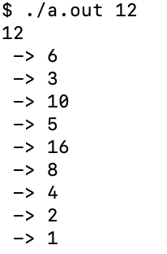
Not all void functions are useless
#include <stdio.h>
#include <stdlib.h>
void print_value(int x) {
printf(" -> %d\n", x);
}
int rule(int x) {
if (x % 2 == 0) {
x = x / 2;
} else {
x = 3 * x + 1;
}
return x;
}
void test(int x) {
x = rule(x);
print_value(x);
if (x != 1) {
test(x);
}
}
int main(int argc, char *argv[]) {
int N = atoi(argv[1]);
printf("%d\n", N);
test(N);
return 0;
}
Output:
Not all void functions are useless

Slide 28
Example of Logical Mistake: Infinite recursion
#include <stdio.h>
#include <stdlib.h>
void print_value(int);
int rule(int);
void test(int x) {
rule(x);
print_value(x);
test(x);
}
void print_value(int x) {
printf(" -> %d\n", x);
}
int rule(int x) {
if (x % 2 == 0) {
x = x / 2
} else {
x = 3 * x + 1;
}
}
int main(int argc, char *argv[]) {
int N = atoi(argv[1]);
printf("%d\n", N);
test(N);
return 0;
}
No compilation errors
Seg fault
Mistake: infinite recursion
Why does program exit with error message?
A: function calls consume resources
Function call stack:
region of memory for local variables
each function call allocation memory
finite available memory
Seg fault → program tried to access unavailable resources (e.g., out-of-memory)

Slide 29
Overview
Variable Declaration
Function Definition
Function Declaration
Glimpse into Pointers (we will learn it in a week)

Slide 30
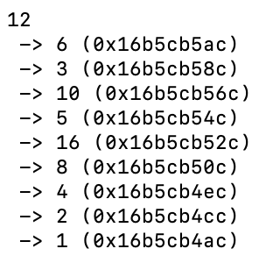
Example: Print out variable address
#include <stdio.h>
#include <stdlib.h>
void test(int x) {
rule(x);
print_value(x);
if (x != 1) {
test(x);
}
}
void print_value(int x) {
int *addr = &x;
printf(" -> %d (%p)\n", x, addr);
}
int rule(int x) {
if (x % 2 == 0) {
x = x / 2;
} else {
x = 3 * x + 1;
}
}
int main(int argc, char *argv[]) {
int N = atoi(argv[1]);
printf("%d\n", N);
test(N);
return 0;
}
Output
addr is a pointer => address of x
Address of x changes in each recursion

Slide 31
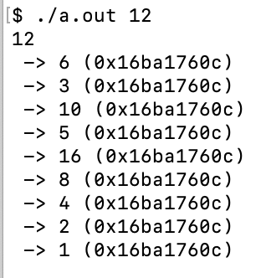
Example: Collatz Program with Pointers
#include <stdio.h>
#include <stdlib.h>
void test(int *x) {
rule(x);
print_value(x);
if (x != 1) {
test(x);
}
}
void print_value(int *x) {
printf(" -> %d (%p)\n", *x, x);
}
int rule(int *x) {
if (*x % 2 == 0) {
*x = *x / 2;
} else {
*x = 3 * (*x) + 1;
}
}
int main(int argc, char *argv[]) {
int *N = atoi(argv[1]);
printf("%d\n", N);
test(N);
return 0;
}
Output
x is a pointer, *x is the value
directly manipulate on value *x
Address of x changes remains the same

Slide 32
A “Useful” Function
#include <stdio.h>
#include <stdlib.h>
void print_value(int x) {
printf(" -> %d\n", x);
}
int rule(int x) {
if (x % 2 == 0) {
x = x / 2;
} else {
x = 3 * x + 1;
}
return x;
}
void test(int x) {
x = rule(x);
print_value(x);
if (x != 1) {
test(x);
}
}
int main(int argc, char *argv[]) {
int N = atoi(argv[1]);
printf("%d\n", N);
test(N);
return 0;
}

Slide 33
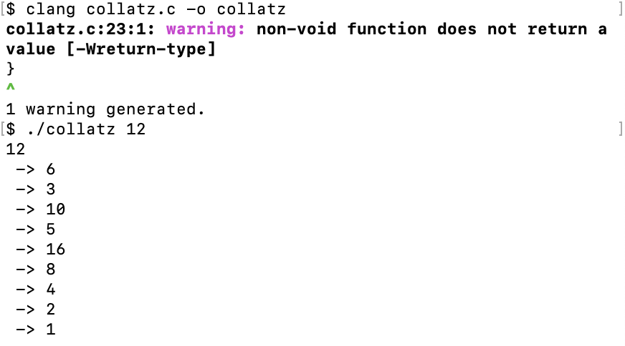
Collatz Program with Syntax Warning
1 #include <stdio.h>
2 #include <stdlib.h>
3
4 void print_value(int x) {
5 printf(" -> %d\n", x);
6 }
7
8 int rule(int x) {
9 if (x % 2 == 0) {
10 x = x / 2;
11 } else {
12 x = 3 * x + 1;
13 }
14 return x;
15 }
16
17 int test(int x) {
18 x = rule(x);
19 print_value(x);
20 if (x != 1) {
21 test(x);
22 }
23 }
24
25 int main(int argc, char *argv[]) {
26 int N = atoi(argv[1]);
27 printf("%d\n", N);
28 test(N);
29 return 0;
30 }
Errors vs. warnings
When does the executable change?
Should you fix all the errors at once?
What if it prints nothing?

Slide 34
Collatz Program with Syntax Error
1 #include <stdio.h>
2 #include <stdlib.h>
3
4 void print_value(int x) {
5 printf(" -> %d\n", x);
6 }
7
8 int rule(int x) {
9 if (x % 2 == 0) {
10 x = x / 2;
11 } else {
12 x = 3 * x + 1;
13 }
14 return x;
15 }
16
17 void test(int x) {
18 x = rule(x);
19 print_value(x);
20 if (x != 1) {
21 test(x);
22 }
23 }
24
25 int main(int argc, char *argv[]) {
26 int N = atoi(argv[1]);
27 printf("%f\n", N);
28 test(N);
29 return 0;
30 }
Output during clang compilation
Syntax error:
The function test is defined to return nothing (void)
Contradicts the return x statement.
Errors vs. warnings
When does the executable change? (when compilation succeeds)
Should you fix all the errors at once? (start from the first one)
If clang prints nothing, does it mean it's correct? NO

Slide 35
Not all functions that return void are useless
#include <stdio.h>
#include <stdlib.h>
void print_value(int x) {
printf(" -> %d\n", x);
}
int rule(int x) {
if (x % 2 == 0) {
x = x / 2;
} else {
x = 3 * x + 1;
}
return x;
}
void test(int x) {
x = rule(x);
print_value(x);
if (x != 1) {
test(x);
}
}
int main(int argc, char *argv[]) {
int N = atoi(argv[1]);
printf("%d\n", N);
test(N);
return 0;
}
Output:
Not all void functions are useless

