Slide 1
Basics III CMSC 14300: System Programming I 3rd Lecture
Instructor:
Prof. Adam Shaw
Prof. Junchen Jiang

Slide 2
Overview
Basic C operators
Conditionals: If and Switch
Loops: For and While

Slide 3
C Operators: Arithmetic
Examples
Binary Operators
+ add two operands
- subtracts second operand from the first
* multiplies both operands
/ divides numerator by de-numerator
% modulus (remainder after integer division)
int x = 1, y = 3;
printf("%d\n", x + y); // 4
printf("%d\n", x - y); // -2
printf("%d\n", y/2); // 1
printf("%d\n", y % 2); // 1
float a = 1.5, b = 3.0;
printf("%.1f\n", a + b); // 4.5
printf("%.1f\n", a * b); // 4.5
printf("%.1f\n", a/b); // 0.5
printf("%.1f\n", x + a); // 2.5
printf("%.1f\n", b % y); //error
y -= x; // x = 1, y = 3
printf("%d, %d\n", x, y); // 1, 2
x += y;
printf("%d, %d\n", x, y); // 3, 2
y *= x;
printf("%d, %d\n", x, y); // 2, 6
?
?
?
?
?
Notes:
/ , *, +, - are context-dependent
(work for integers and floats)
with ints, / is truncated integer division
with floats, / is normal division
?
?
?
?
?
Assignment Operators
= assignment, e.g., x = y;
+= x += y; equivalent to x = x + y;
-= x -= y; equivalent to x = x - y;
?
?

Slide 4
C Operators: Arithmetic
Unary Operators
++ increment (increases value by one)
-- decrement (decreases value by one)
Notes:
prefix (++x): update x, expression evaluates to new value
postfix (x++): update x, expression evaluates to old value
Examples
x = 3, y = 3;
printf("%d\n", x--); // 3
printf("%d\n", x); // 2
printf("%d\n", ++y); // 4
printf("%d\n", y); // 4
int p = x++;
printf("p = %d, x = %d\n", p, x); // p = 2, x = 3
int q = --y;
printf("q = %d, y = %d\n", q, y); // q = 3, y = 3
x *= y--;
printf("x = %d, y = %d\n", x, y); // x = 9, y = 2
?
?
?
?
?
?

Slide 5
Overview
Basic C operators
Loops: For and While
Conditionals: If and Switch

Slide 6
While Loops
Syntax:
while (expression) {
statement(s);
}
...
Loop Execution:
Check expression
If false (zero): Resume execution after closing brace
If true (nonzero):
Execute statements in loop body
Repeat (check expression again)

Slide 7
While Loops: Example
Equivalent transformations
#include <stdio.h>
int factorial(int x) {
if (x == 0) {
return 1;
} else {
return x * factorial(x - 1);
}
}
void print_factorial(int x) {
printf("Factorial of %u is %u\n", x,
factorial(x));
}
int main(int argc, char** argv) {
int a = 5;
print_factorial(a);
return 0;
}
int factorial(int x) {
int result = 1;
while (x > 0) {
result = result * x;
x = x - 1;
}
return result;
}
int factorial(int x) {
int result = 1;
while (x > 0) {
result *= x;
x--;
}
return result;
}
Factorial program using while loop
OR
int factorial(int x) {
int result = 1;
while (x > 0) {
result *= x--;
}
return result;
}
What if we change x-- to --x?
Result is always 0. Why?

Slide 8
break and continue in loops
break;
exit the loop early (skipping all remaining iterations)
continue;
jump to the next iteration of the loop (skipping remaining of the current iteration)
int i = 0;
while (i < 10) {
if (++i == 5)
break;
printf("%d", i);
}
int i = 0;
while (i < 10) {
if (++i == 5)
continue;
printf("%d", i);
}
int i = 0;
while (i < 10) {
if (i == 5)
continue;
printf("%d", i);
i++;
}
Output:
1234
Output:
1234678910
Output:
01234[infinite loop]
?
?
?

Slide 9
Example: Finding m^th prime number
// returns the m^th prime number
int find_prime(int m) {
int count = 0, n = 1;
while (1) {
++n;
if (! is_prime(n)) {// ! means not true
continue;
}
if (++count == m) {
break;
}
}
return n;
}
Example
Input: m=7
Output: 19 (the 7th prime number)

Slide 10
Example: Finding m^th prime number
// returns the m^th prime number
int find_prime(int m) {
int count = 0, n = 1;
while (1) {
++n;
if (! is_prime(n)) {// ! means not true
break;
}
if (++count == m) {
break;
}
}
return n;
}
Input: m=7
Output: 4
?
Why?
4 is the first composite number
What if we change continue to break?

Slide 11
Example: Finding m^th prime number
// returns the m^th prime number
int find_prime(int m) {
int count = 0, n = 1;
while (1) {
++n;
if (! is_prime(n)) {// ! means not true
continue;
}
if (++count == m) {
continue;
}
}
return n;
}
Input: m=7
Output: stuck in infinite loop
?
Why?
nowhere to break the while loop.
What if we change break to continue?

Slide 12
Example: Finding m^th prime number
// returns the m^th prime number
int find_prime(int m) {
int count = 0, n = 1;
while (1) {
++n;
if (! is_prime(n)) {// ! means not true
continue;
}
if (++count == m) {
break;
}
}
return n;
}
Input: m=7
Output: 23 (the 8th prime number)!
?
Why?
++count is evaluated before comparing with m
What if we change ++count to count++?

Slide 13
Do-While Loops
Syntax:
do {
statement(s);
} while (expression);
Loop Execution:
Run statements in the loop body
Check expression
If false (zero): Resume executing rest of program
If true (nonzero): Repeat (execute loop body again)
Syntax:
while (expression) {
statement(s);
}
Difference from while loop:
The do loop body always runs at least once
The while expression ends with ;

Slide 14
Do-While Loops: Example
int factorial(int x) {
int result = 1;
while (x > 0) {
result *= x;
x--;
}
return result;
}
while loop
int factorial(int x) {
int result = 1;
do {
result *= x;
x--;
} while (x > 0);
return result;
}
do-while loop

Slide 15
Example: getchar and putchar
Reading and printing a single char from command line
char input;
while (1) {
printf("Enter a char, or Q to quit: ");
input = getchar();
putchar(input);
if (input == 'Q') {
break;
}
}
while loop
getchar() reads one char from standard input stream (stdin)
putchar(a) prints one char to standard output stream (stdout)
char input;
do {
printf("Enter a char, or Q to quit: ");
input = getchar();
putchar(input);
} while (input != 'Q');
do-while loop (fewer lines of code)

Slide 16
For Loops
Syntax:
for (init_statement; test_expression; update_statement){
statement(s);
}
...
Loop Execution:
Run init_statement
Check test_expression
If false (zero): Resume executing rest of program (after closing brace)
If true (nonzero):
Run statement(s) in loop body
Run update_statement
Repeat (check test_expression again)

Slide 17
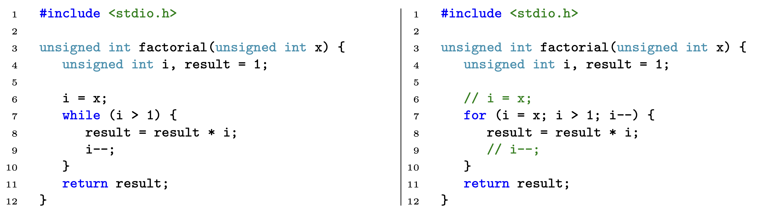
For Loops: Example

Slide 18
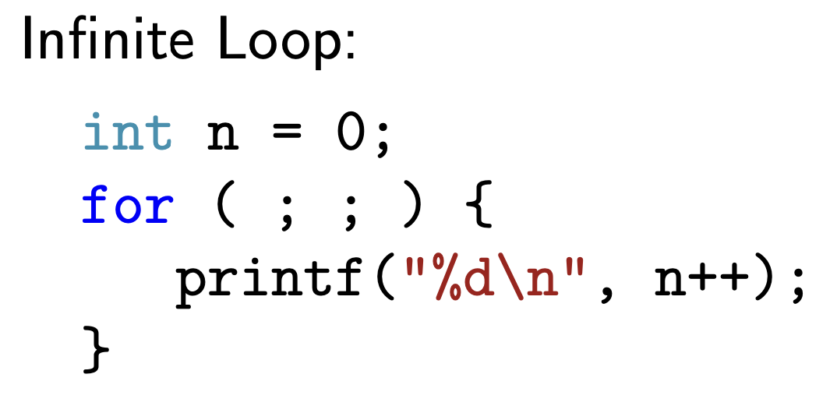
For Loops
Syntax:
for (init_statement; test_expression; update_statement){
statement(s);
}
...
All three are optional
E.g.,
If test_expression is absent, the condition check always passes

Slide 19
Overview
Basic C operators
Loops: For and While
Conditionals: If and Switch

Slide 20
If Statements
Syntax:
if (expression1) {
statementA;
statementB;
…
} else if (expression2) {
statement(s);
} else if (expression3) {
statement(s);
} else if (expressionN) {
statement(s);
} else {
statement(s);
}
Any number of else if branches (including none)
Branch taken is the first whose expression evaluates to true (nonzero); subsequent expressions are not evaluated
At most one else branch (optional)
else branch taken if no expression evaluates to true (nonzero) value
In an if statement without an else, it is possible that no branch is taken

Slide 21
Switch Statements
Syntax:
switch (expression) {
case valueA:
statement(s);
break;
case valueB:
statement(s);
case valueC:
statement(s);
break;
default:
statement(s);
}
expression must evaluate to an integral type (e.g., int, long, but not float).
Any number of case statements
Execution jumps to the first case that matches …
… and continues until break is reached
This means control flow can fall through in absence of a break
Example: if valueB is a match, then statements beneath both valueB and valueC execute
Optional default case runs if nothing else matches
Like the "match case" conditionals in Python

Slide 22
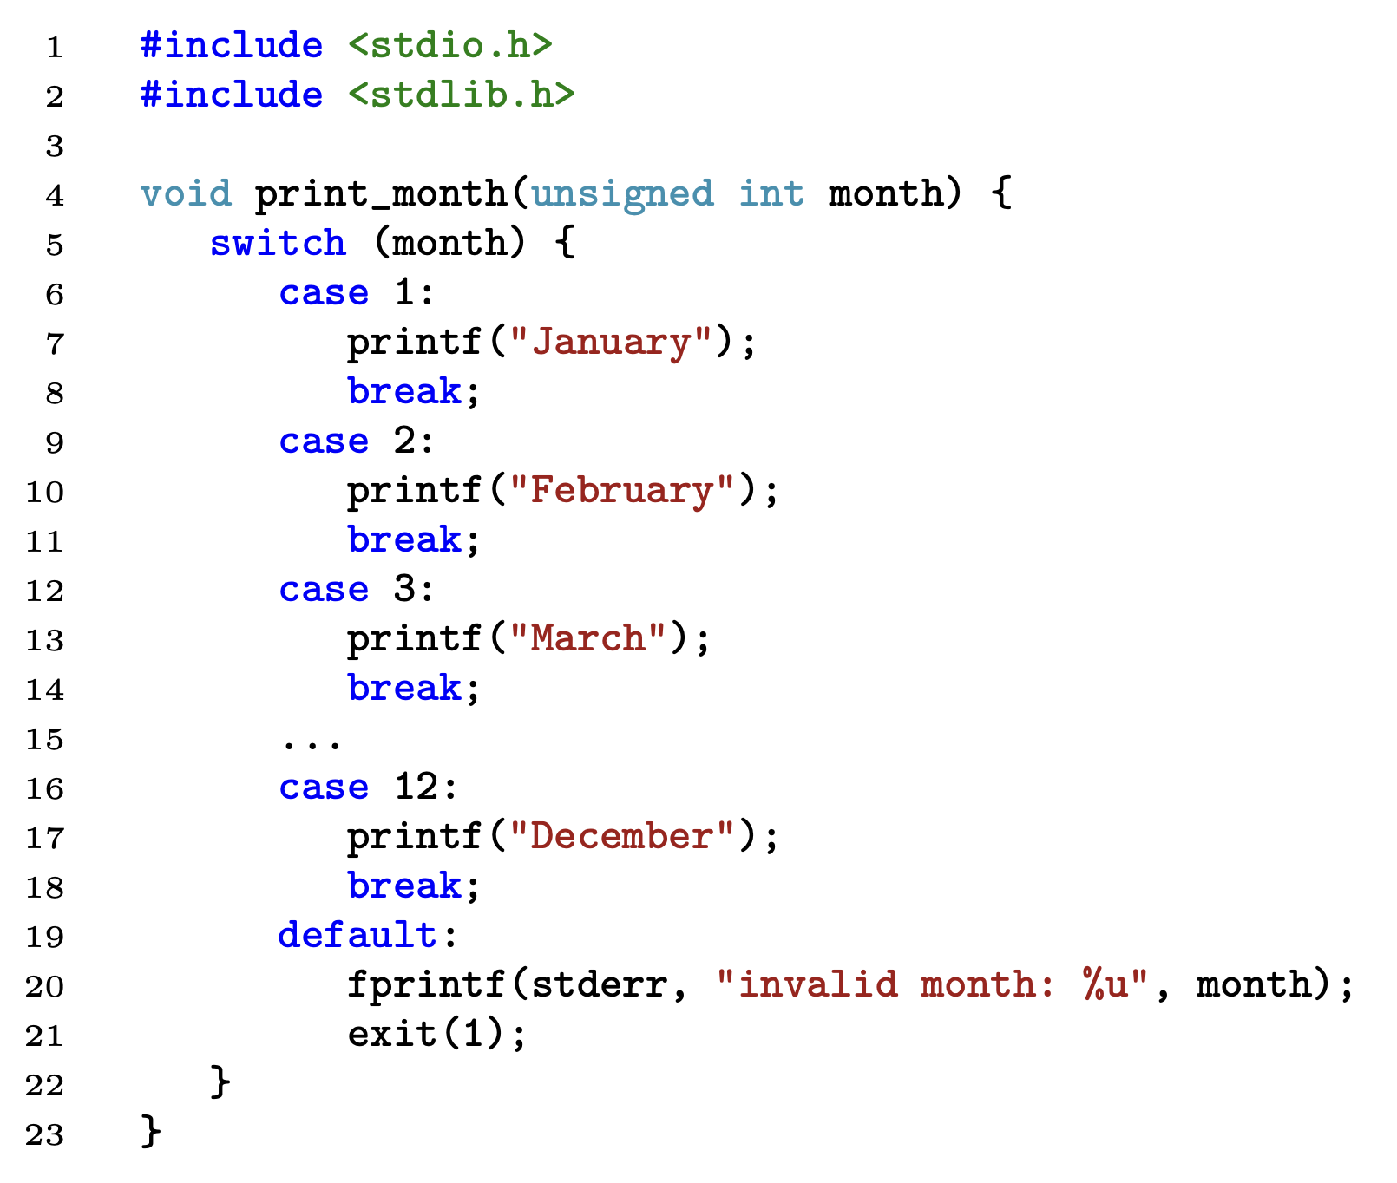
Example of Switch Statements using break

Slide 23
Example of Switch Statements
#include <stdio.h>
#include <stdlib.h>
int is_leap_year(int year) {
return !(year % 400) || ((year % 100) && !(year %4));
}
unsigned int days_in_month(int year, unsigned int month) {
switch (month) {
case 2:
if (is_leap_year(year))
return 29;
else
return 28;
case 9:
case 4:
case 6:
case 11:
return 30;
default:
if ((month == 0) || (month > 12)) {
fprintf(stderr, "invalid month: %u", month);
// fprintf(stderr, ...) print to stderr
exit(1); /* exit program with value 1,
nonzero value indicating an error) */
}
return 31;
}
}
Q: Why no break statements?
A: Because we return instead

Slide 24
Recap
C Arithmetic Operators
x++ vs. ++x?
While loops & For loops
How to use break & continue?
How use switch statements + break?

Slide 28
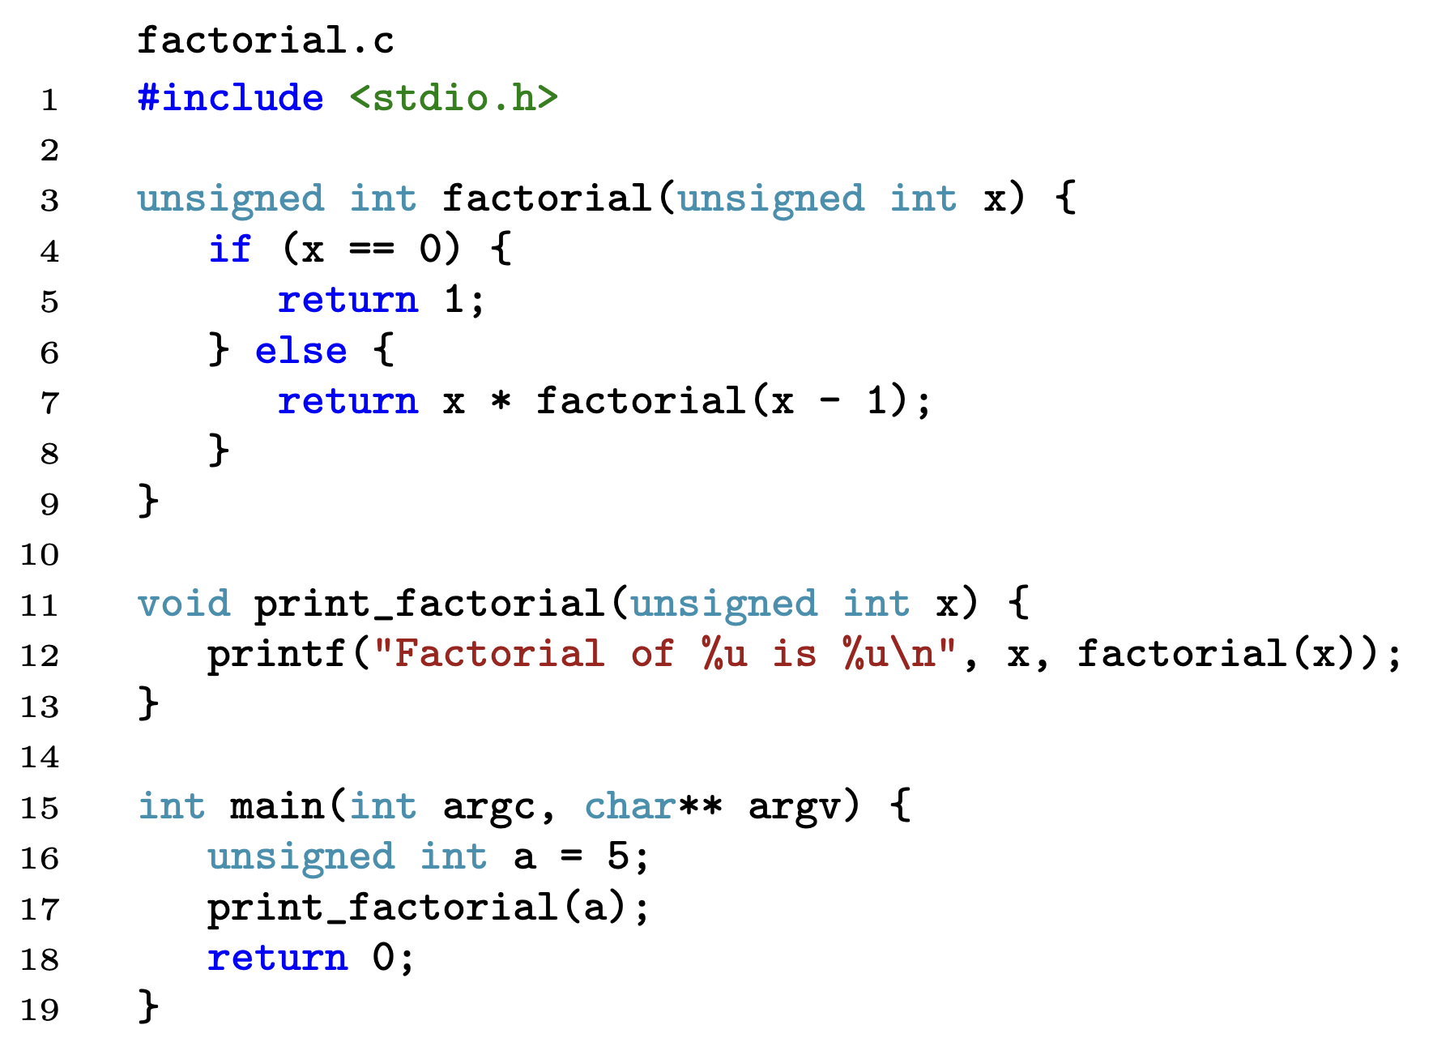
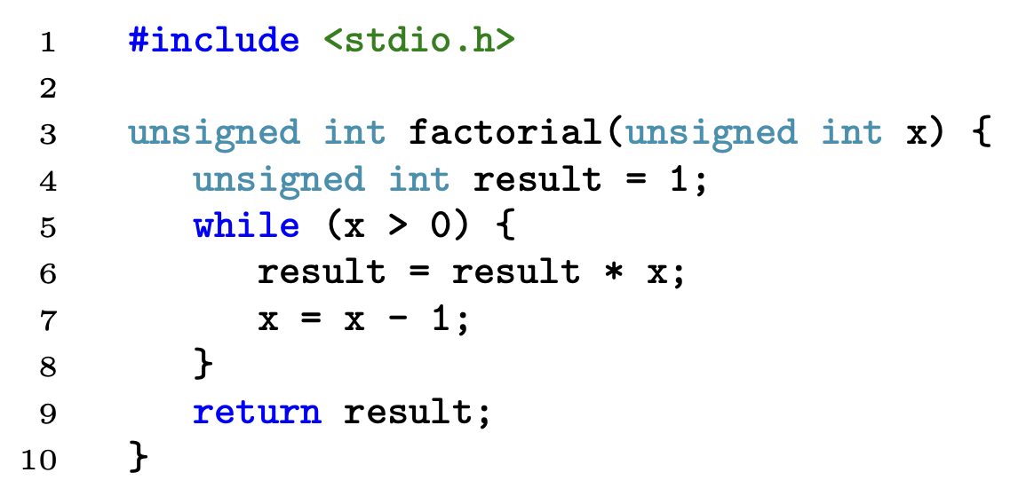
While Loops: Example
Factorial program using while loop

Slide 29
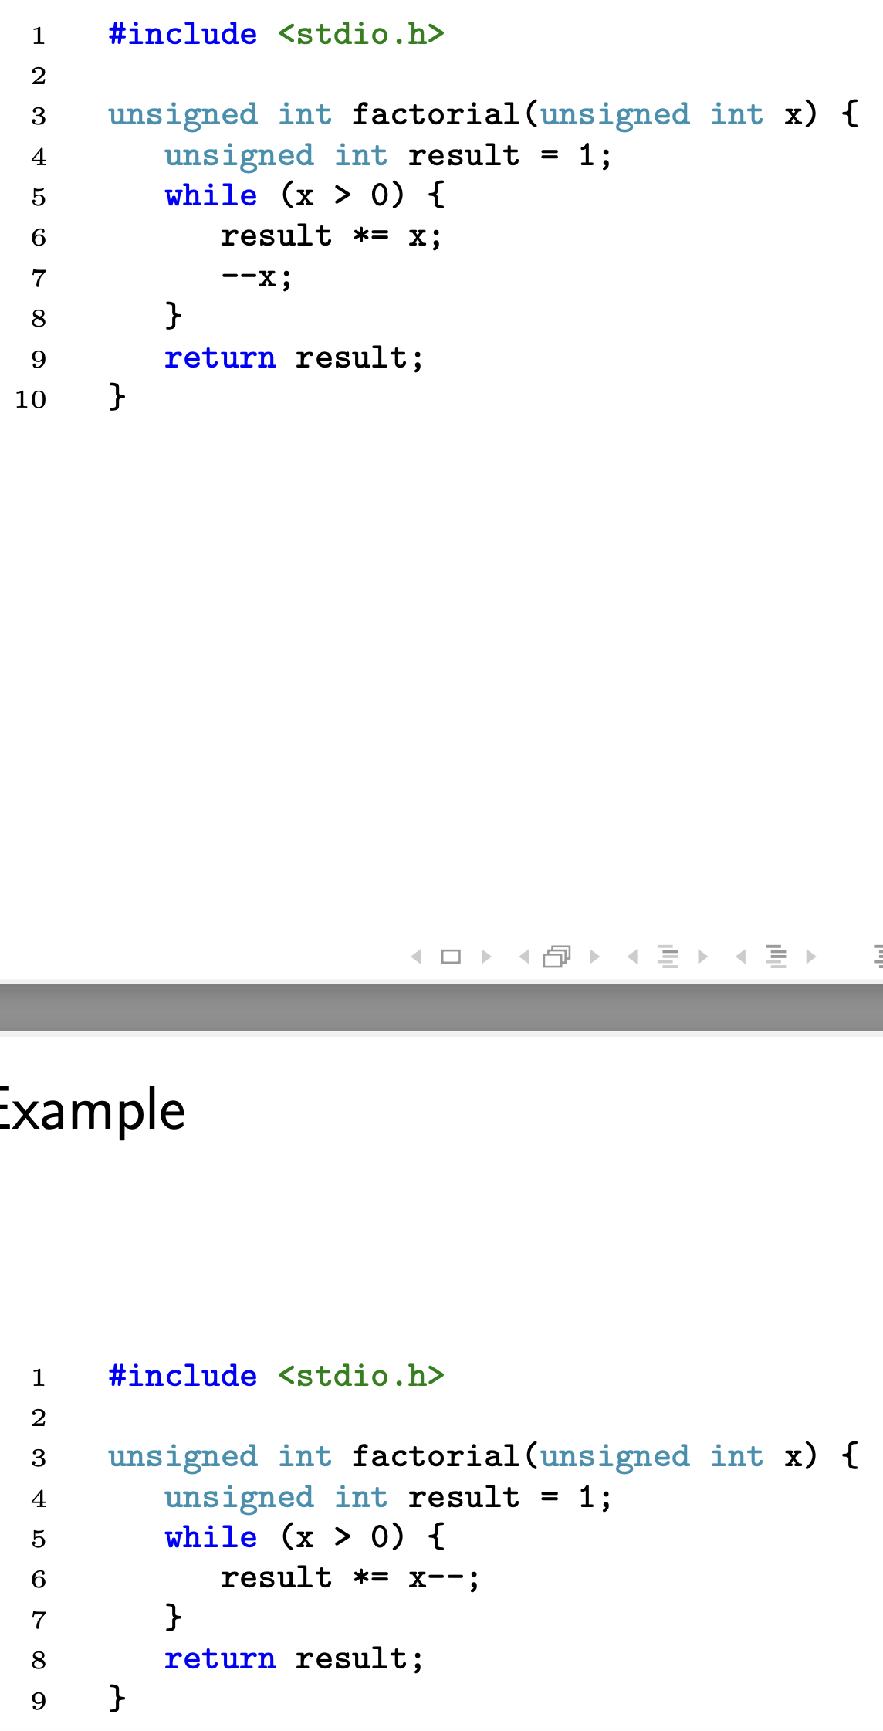
While Loops: Example
result *= x is equivalent to result = result * x
--x is equivalent to x = x-1
(more on this later)

Slide 30
While Loops: Example

Slide 31
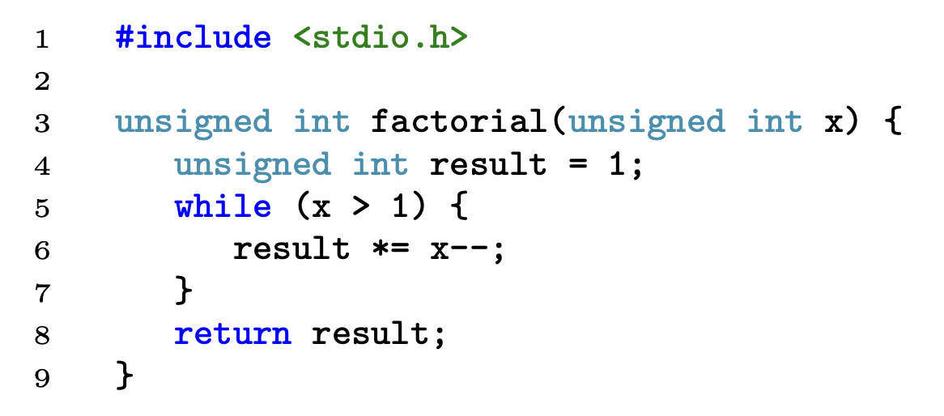
While Loops: Example
(x > 1) instead of (x > 0) saves a loop iteration

Slide 32
While Loops: Example
Factorial program using while loop
result *= x is equivalent to result = result * x
--x is equivalent to x = x-1 (more on this later)
(x > 1) instead of (x > 0) saves a loop iteration

Slide 33
While Loops: Example
Factorial program using while loop
result *= x is equivalent to result = result * x
--x is equivalent to x = x-1

Slide 34
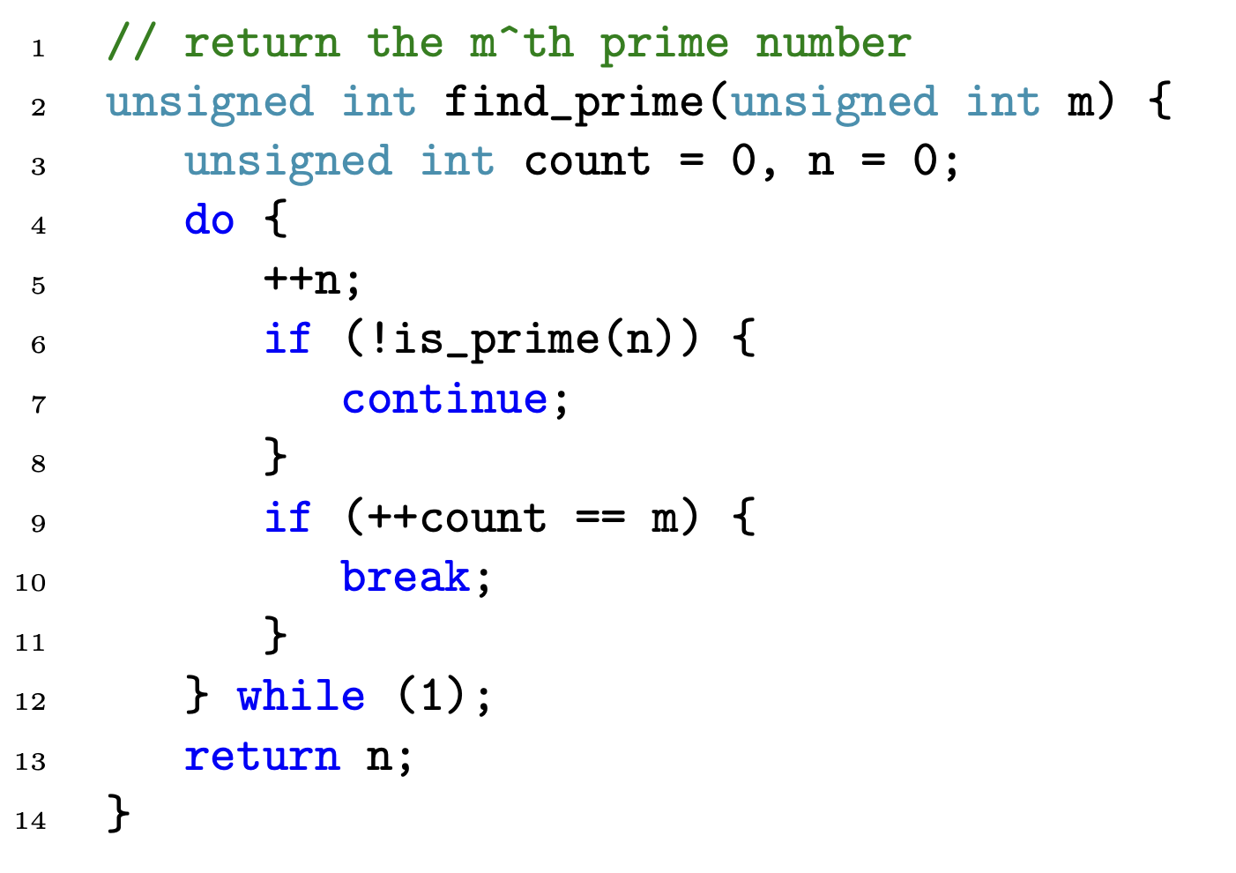
break and continue in loops: Example

Slide 35
getchar and putchar
Reading and printing a single char from command line
1 #include <stdio.h>
2
3 int main() {
4 char a;
5 do {
6 a = getchar();
7 putchar(a);
8 }
9 return 0;
10 }
getchar() reads one char from standard input stream (stdin)
putchar(a) prints one char to standard output stream (stdout)

Slide 36
getchar and putchar
Reading and printing a single char from command line
1 #include <stdio.h>
2
3 int main() {
4 char a;
5 while (1) {
6 a = getchar();
7 putchar(a);
8 }
9 return 0;
10 }
getchar() reads one char from standard input stream (stdin)
putchar(a) prints one char to standard output stream (stdout)

Slide 37
Example: Finding m^th prime number
// returns the m^th prime number
int find_prime(int m) {
int count = 0, n = 1;
while(1){
++n;
if (! is_prime(n)) {// ! means "not true"
continue;
}
if (++count == m) {
break;
}
}
return n;
}
Input: 5
Output: 13 (same correct answer)
What if we change do loop to while loop?
Why?
do loop and while loop have the same behavior

Slide 38
Example: Finding m^th prime number
// returns the m^th prime number
int find_prime(int m) {
int count = 0, n = 1;
do {
++n;
if (! is_prime(n)) {// ! means "not true"
break;
}
if (++count == m) {
break;
}
} while(1);
return n;
}
Input: 5
Output: 6
(try to answer it as a practice!)
What if we change continue to break?

Slide 39
Example: Finding m^th prime number
// returns the m^th prime number
int find_prime(int m) {
int count = 0, n = 1;
do {
++n;
if (! is_prime(n)) {// ! means "not true"
continue;
}
if (++count == m) {
continue;
}
} while(1);
return n;
}
Input: 5
Output: stuck in infinite loop
(try to answer it as a practice!)
What if we change break to continue?

Slide 40
Example: Finding m^th prime number
// returns the m^th prime number
int find_prime(int m) {
int count = 0, n = 1;
do {
++n;
if (! is_prime(n)) {// ! means not true
continue;
}
if (++count == m) {
break;
}
} while (1);
return n;
}
Input: 5
Output: 13 (the 5th prime number)

Slide 41
Example: Finding m^th prime number
// returns the m^th prime number
int find_prime(int m) {
int count = 0, n = 1;
do {
++n;
if (! is_prime(n)) {// ! means "not true"
continue;
}
if (++count == m) {
break;
}
} while(1);
return n;
}
Input: 5
Output: 11 (the 6th prime number)!
Why?
++count is evaluated before comparing with m
What if we change ++count to count++?

