Slide 1
Bits I CMSC 14300: System Programming I 4th Lecture
Instructor:
Prof. Adam Shaw
Prof. Junchen Jiang

Slide 2
Decimal (base 10) Representation
42 in base 10 is $42 =(4)10 +(2)1 =\left(4\right){10}^{1} +(2){10}^{0}$
How do memory store integers?

Slide 3
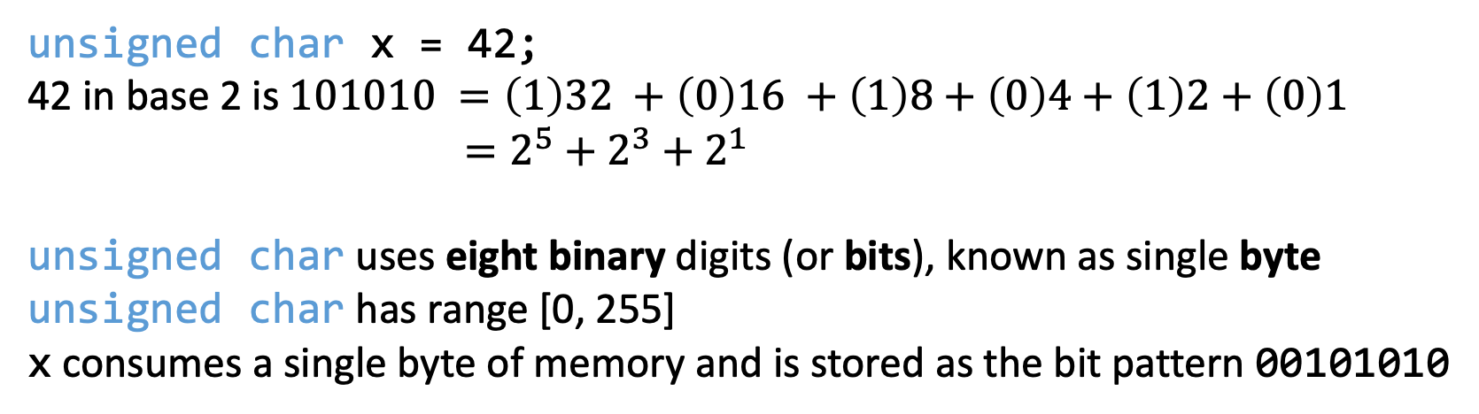
Binary (base 2) Representation
42 in base 10 is $42 =(4)100 +(2)10 =\left(4\right){10}^{2} +(2){10}^{1}$
unsigned char x = 42;
42 in base 2 is $101010 =\left(1\right)32 +\left(0\right)16 +\left(1\right)8+\left(0\right)4+\left(1\right)2+\left(0\right)1$
$=2^{5}+2^{3}+2^{1}$
unsigned char uses eight binary digits (or bits), known as single byte
unsigned char has range [0, 255]
x consumes a single byte of memory and is stored as the bit pattern 00101010
unsigned int y = 42;
unsigned int uses 4 bytes (32 bits)
y is stored as the bit pattern 00000000000000000000000000101010

Slide 4
Overview
Data representation
Integer types

Slide 5
Binary, Octal, and Hexadecimal
Decimal: Base 10
digits: 0, 1, 2, 3, 4, 5, 6, 7, 8, 9
Binary: Base 2
digits: 0, 1
Octal: Base 8
digits: 0, 1, 2, 3, 4, 5, 6, 7
Hexadecimal: Base 16
digits: 0, 1, 2, 3, 4, 5, 6, 7, 8, 9, A, B, C, D, E, F
10
11
12
13
14
15

Slide 6
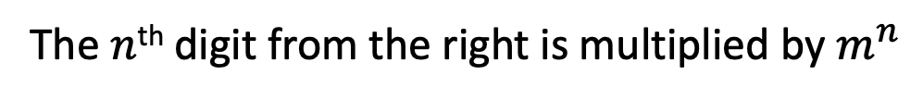
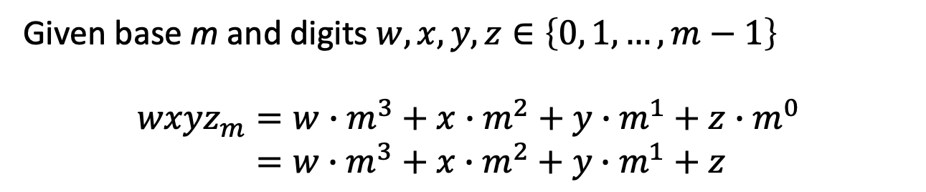
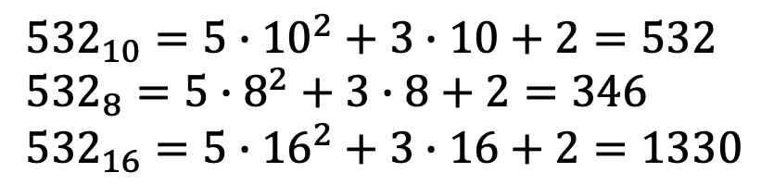
Binary, Octal, and Hexadecimal
Given base m and digits $w,x,y,z∈\left\{0, 1,…,m−1\right\}$
$$wxyz_{m}=w∙m^{3}+x∙m^{2}+y∙m^{1}+z∙m^{0}$$
$=w∙m^{3}+x∙m^{2}+y∙m^{1}+z$
The $n$^{th} digit from the right is multiplied by $m^{n}$
Examples (octal or hexadecimal → decimal):
${532}_{10}=5∙{10}^{2}+3∙10+2=532$
${532}_{8}=5∙8^{2}+3∙8+2=346$
${532}_{16}=5∙{16}^{2}+3∙16+2=1330$

Slide 7
Decimal → Octal
Convert 532 to octal (532₁₀=???₈)
1024₈
/ is truncated division
(working with integers)
532
% is remainder after
integer division
/8
%8
66
4
/8
%8
8
2
/8
%8
1
0

Slide 8
Decimal → Hexadecimal
Convert 532 to hexadecimal (532₁₀=???₁₆)
214₁₆
532
/16
%16
33
4
/16
%16
2
1

Slide 9
Decimal → Hexadecimal
Convert 675817 to hexadecimal ($\text{675817}$₁₀=???₁₆)
A4FE9₁₆
675817
/16
%16
42238
9
/16
%16
2639
E(14)
/16
%16
164
F (15)
/16
%16
A (10)
4

Slide 10
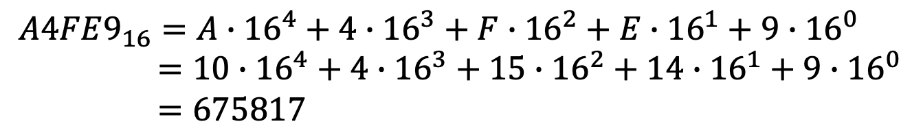
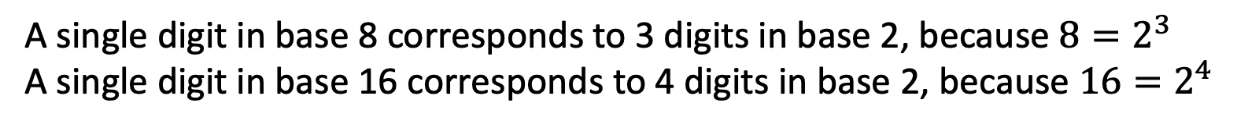
Hexadecimal → Binary?
More examples
$A4FE9_{16}=A∙{16}^{4}+4∙{16}^{3}+F∙{16}^{2}+E∙{16}^{1}+9∙{16}^{0}$
$=10∙{16}^{4}+4∙{16}^{3}+15∙{16}^{2}+14∙{16}^{1}+9∙{16}^{0}$
$=675817$
$${10100100111111101001}_{2}=1∙2^{19}+0∙2^{18}+1∙2^{17}+…+0∙2^{2}+0∙2^{1}+1$$
$=675817$
Is there a quicker way to recognize that $A4FE9_{16}={10100100111111101001}_{2}$?
A single digit in base 8 corresponds to 3 digits in base 2, because $8=2^{3}$ A single digit in base 16 corresponds to 4 digits in base 2, because $16=2^{4}$

Slide 11
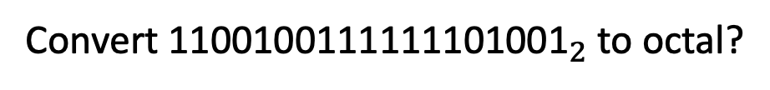
Octal Binary
Octal | Binary
0 | 000
1 | 001
2 | 010
3 | 011
4 | 100
5 | 101
6 | 110
7 | 111
Convert ${\text{1100100111111101001}}_{2}$ to octal?
Group bits into sets of three
1 100 100 111 111 101 001
Pad leading zero(s)
001 100 100 111 111 101 001
Replace with corresponding octal digits:
1 4 4 7 7 5 1

Slide 12
Hexadecimal Binary
Octal | Binary
0 | 000
1 | 001
2 | 010
3 | 011
4 | 100
5 | 101
6 | 110
7 | 111
Hexadecimal | Binary
0 | 0000
1 | 0001
2 | 0010
3 | 0011
4 | 0100
5 | 0101
6 | 0110
7 | 0111
8 | 1000
9 | 1001
A | 1010
B | 1011
C | 1100
D | 1101
E | 1110
F | 1111
Convert ${\text{1100100111111101001}}_{2}$ to hexadecimal?
Group bits into sets of four
110 0100 1111 1110 1001
Pad leading zero(s)
0110 0100 1111 1110 1001
Replace with corresponding octal digits:
6 4 F E 9
For hexadecimal (or octal) to binary conversion, simply reverse these processes, replacing each hexadecimal (or octal) digit with 4 (or 3) binary digits.

Slide 13
Octal and Hexadecimal Values in C
Can use octal and hexadecimal in C code:
Leading 0 denotes an octal integer constant
Leading 0x denotes a hexadecimal integer constant
unsigned int a = 0736; // octal value
unsigned int y = 0x5E2; // hexadecimal value
unsigned int p = 0x12; // hexadecimal value
unsigned int q = 0xa8b; // A,B,C,D,E,F can be uppercase or lowercas
printf("Octal: %o Hex: %x Decimal: %u\n", a, a, a);
printf("Octal: %o Hex: %x Decimal: %u\n", q, q, q);
Octal: 736 Hex: 1de Decimal: 478
Octal: 5213 Hex: a8b Decimal: 2699

Slide 14
Overview
Data representation
Integer types

Slide 15
Integer: Non-negative integers
unsigned char
non-negative integer represented by 8 bits
Examples:
Binary representation in memory
unsigned char a = 3;
… | 0 | 0 | 0 | 0 | 0 | 0 | 1 | 1 | …
8 bits = 1 Byte (B)
unsigned char a = 200;
… | 1 | 1 | 0 | 0 | 1 | 0 | 0 | 0 | …
(128+64+8)
ASCII:
'0' -> 0x30
'1' -> 0x31
…
'A' -> 0x41
'B' -> 0x42
…
'a' -> 0x61
'b' -> 0x62
…
unsigned char a = 030;
… | 0 | 0 | 0 | 1 | 1 | 0 | 0 | 0 | …
3
0
unsigned char a = 0x30;
… | 0 | 0 | 1 | 1 | 0 | 0 | 0 | 0 | …
3
0
unsigned char a = 'C';
… | 0 | 1 | 0 | 0 | 0 | 0 | 1 | 1 | …
67 in decimal or 0x43
4
3

Slide 16
Limitations of char
unsigned char
non-negative integer represented by 8 bits
Value range
from 0 to 255 (2^8-1)
In hex
from 0x00 to 0xFF
Two limitations of unsigned char:
What about negative integers?
What about values greater than 256?
A: Two's complement representation
A: More integer types: int, long

Slide 17



Representing negative integers: Two's complement
Q: Can we use this binary represent a negative value?
A: Two's complement --- Interpret the leading bit differently
unsigned char a = 200;
$$2^{7}+2^{6}+2^{3}= 200$$
Normal (unsigned interpretation): leading bit means $2^{7}$
1 | 1 | 0 | 0 | 1 | 0 | 0 | 0
$${−2}^{7}+2^{6}+2^{3}=−56$$
Two's complement: leading bit means $−2^{7}$
Value in two's complement: -56

Slide 18
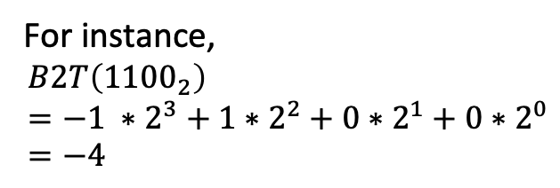
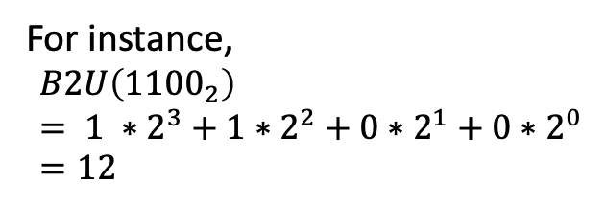
Representing negative integers: Two's complement
Let integer X be a bit vector of width w
How to determine its value?
X = [ x_{w-1} x _{w-2} … x₁ x₀]
Unsigned
Two’s Complement (Signed)
Sign bit (most significant bit)
0: nonnegative
1: negative
For instance,
$$B2U\left({1100}_{2}\right)= 1 ∗2^{3}+1∗2^{2}+0∗2^{1}+0∗2^{0}=12$$
For instance,
$$B2T\left({1100}_{2}\right)=−1 ∗2^{3}+1∗2^{2}+0∗2^{1}+0∗2^{0}=−4$$

Slide 19
Examples
Binary | Unsigned | Signed (two's complement)
00000000 | 0 | 0
00000001 | 1 | 1
00000010 | 2 | 2
00000011 | 3 | 3
… | … | …
01111101 | 125 | 125
01111110 | 126 | 126
01111111 | 127 | 127
10000000 | 128 | -128
10000001 | 129 | -127
10000010 | 130 | -126
10000011 | 131 | -125
… | … | …
11111101 | 253 | -3
11111110 | 254 | -2
11111111 | 255 | -1
w = # of bits (8 for char)
Same for both signed and unsigned
Signed and unsigned are just two interpretations of the same bit vector.
Each signed/unsigned value has only one bit-vector representation
Exact 2^w away from each other

Slide 20
Examples
Binary | Unsigned | Signed (two's complement)
00000000 | 0 | 0
00000001 | 1 | 1
00000010 | 2 | 2
00000011 | 3 | 3
… | … | …
01111101 | 125 | 125
01111110 | 126 | 126
01111111 | 127 | 127
10000000 | 128 | -128
10000001 | 129 | -127
10000010 | 130 | -126
10000011 | 131 | -125
… | … | …
11111101 | 253 | -3
11111110 | 254 | -2
11111111 | 255 | -1
Tmax (2^{w-1}-1): max value for signed
Range asymmetric!
Tmin (-2^{w-1}): min value for signed
All 1’s in binary: -1 for signed,
Max value for unsigned
Umax (2^{w}-1)

Slide 21
Representing more data
 | # of bits | Signed | Value range (in hex) | Unsigned | Value range (in hex)
char | 8 bits (1 byte) | char | -128 to 127 (2^7-1) (-0x80 to 0x7F) | unsigned char | 0 to 255 (2^8-1) (0x00 to 0xFF)

Slide 22
Representing more data
 | # of bits | Signed | Value range (in hex) | Unsigned | Value range (in hex)
char | 8 bits (1 byte) | char | -128 to 127 (2^7-1) (-0x80 to 0x7F) | unsigned char | 0 to 255 (2^8-1) (0x00 to 0xFF)
short | 16 bits (2 bytes) | short | -32,768 to 32,767 (2^15-1) (-0x8000 to 0x7FFF) | unsigned short | 0 to 65,535 (2^16-1) (0x0000 to 0xFFFF)

Slide 23
Representing more data
 | # of bits | Signed | Value range (in hex) | Unsigned | Value range (in hex)
char | 8 bits (1 byte) | char | -128 to 127 (2^7-1) (-0x80 to 0x7F) | unsigned char | 0 to 255 (2^8-1) (0x00 to 0xFF)
short | 16 bits (2 bytes) | short | -32,768 to 32,767 (2^15-1) (-0x8000 to 0x7FFF) | unsigned short | 0 to 65,535 (2^16-1) (0x0000 to 0xFFFF)
int | 32 bits (4 bytes) | int | -2^31 to 2^31-1 (-0x80…00 to 0x7F…FF) | unsigned int | 0 to 2^32-1 (0x00…00 to 0xFF…FF)

Slide 24
Representing more data
 | # of bits | Signed | Value range (in hex) | Unsigned | Value range (in hex)
char | 8 bits (1 byte) | char | -128 to 127 (2^7-1) (-0x80 to 0x7F) | unsigned char | 0 to 255 (2^8-1) (0x00 to 0xFF)
short | 16 bits (2 bytes) | short | -32,768 to 32,767 (2^15-1) (-0x8000 to 0x7FFF) | unsigned short | 0 to 65,535 (2^16-1) (0x0000 to 0xFFFF)
int | 32 bits (4 bytes) | int | -2^31 to 2^31-1 (-0x80…00 to 0x7F…FF) | unsigned int | 0 to 2^32-1 (0x00…00 to 0xFF…FF)
long* | 64 bits (8 bytes) | long | -2^63 to 2^63-1 (-0x80…00 to 0x7F…FF) | unsigned long | 0 to 2^64-1 (0x00…00 to 0xFF…FF)
*this depends on the machine type. On most modern machines, this is 64 bits (8bytes), but older so-called 32-bit machine, long is 32 bits

Slide 25
Representing more data
 | # of bits | Signed | Value range (in hex) | Unsigned | Value range (in hex)
char | 8 bits (1 byte) | char | -128 to 127 (2^7-1) (-0x80 to 0x7F) | unsigned char | 0 to 255 (2^8-1) (0x00 to 0xFF)
short | 16 bits (2 bytes) | short | -32,768 to 32,767 (2^15-1) (-0x8000 to 0x7FFF) | unsigned short | 0 to 65,535 (2^16-1) (0x0000 to 0xFFFF)
int | 32 bits (4 bytes) | int | -2^31 to 2^31-1 (-0x80…00 to 0x7F…FF) | unsigned int | 0 to 2^32-1 (0x00…00 to 0xFF…FF)
long* | 64 bits (8 bytes) | long | -2^63 to 2^63-1 (-0x80…00 to 0x7F…FF) | unsigned long | 0 to 2^64-1 (0x00…00 to 0xFF…FF)
float | 32 bits (4 bytes) | float | -3.4x10^38 to 3.4x10^38
double | 64 bits (8 bytes) | double | -1.7x10^208 to 1.7x10^308
*this depends on the machine type. On most modern machines, this is 64 bits (8bytes), but older so-called 32-bit machine, long is 32 bits

Slide 26
Check the size of a variable: sizeof()
sizeof(Expression) returns the size (in # of bytes) of the result of the expression
Return type is size_t. printf specifier is %zu.
printf("%zu, %zu, %zu, %zu\n", sizeof(char), sizeof(short), sizeof(int), sizeof(long));
1, 2, 4, 8
char u;
short v;
int w;
long x;
printf("%zu, %zu, %zu, %zu\n", sizeof(u), sizeof(v), sizeof(w), sizeof(x));
1, 2, 4, 8
int a = 10;
printf("%zu, %d \n", sizeof(a++), a); /* sizeof is compile-time operator
--> it doesn't run the expression
4, 10

Slide 27
Recap
Data representation
Binary, octal, hex
Integer types
Two's complement
char, short, int, long
sizeof

Slide 30
Representing greater integers
Type | unsigned or signed | # of bits | value range (hex)
unsigned char | unsigned (non-negative) | 8 (1 byte) | 0 to 255 (2^8-1) (0x00 to 0xFF)
char | signed (two's complement) | 8 (1 byte) | -128 to 127 (2^7-1) (-0x80 to 0x7F)
unsigned short | unsigned (non-negative) | 16 (2 bytes) | 0 to 65,536 (2^16-1) (0x0000 to 0xFFFF)
short | signed (two's complement) | 16 (2 bytes) | -32,768 to 32,767 (2^15-1) (0x8000 to 0x7FFF)
unsigned int | unsigned (non-negative) | 32 (4 bytes) | 0 to 2^32-1 (0x00000000 to 0xFFFFFFFF)
int | signed (two's complement) | 32 (4 bytes) | -2^31 to 2^31-1 (0x80000000 to 0x7FFFFFFF)

Slide 31
Representing greater integers
 | # of bits | Unsigned | Value range (in hex) | Signed | Value range (in hex)
char | 8 bits (1 byte) | unsigned char | 0 to 255 (2^8-1) (0x00 to 0xFF) | char | -128 to 127 (2^7-1) (-0x80 to 0x7F)
short | 16 bits (2 bytes) | unsigned char | 0 to 65,536 (2^16-1) (0x0000 to 0xFFFF) | short | -32,768 to 32,767 (2^15-1) (0x8000 to 0x7FFF)
int | 32 bits (4 bytes) | unsigned int | 0 to 2^32-1 (0x00…00 to 0xFF…FF) | int | -2^31 to 2^31-1 (0x80…00 to 0x7F…FF)
long* | 64 bits (8 bytes) | unsigned long | 0 to 2^64-1 (0x00…00 to 0xFF…FF) | int | -2^63 to 2^63-1 (0x80…00 to 0x7F…FF)
*this depends on the machine type. On most modern machines, this is 64 bits (8bytes), but older so-called 32-bit machine, long is 32 bits

Slide 32
Representing more data
 | # of bits | Unsigned | Value range (in hex) | Signed | Value range (in hex)
char | 8 bits (1 byte) | unsigned char | 0 to 255 (2^8-1) (0x00 to 0xFF) | char | -128 to 127 (2^7-1) (-0x80 to 0x7F)
short | 16 bits (2 bytes) | unsigned char | 0 to 65,536 (2^16-1) (0x0000 to 0xFFFF) | short | -32,768 to 32,767 (2^15-1) (0x8000 to 0x7FFF)
int | 32 bits (4 bytes) | unsigned int | 0 to 2^32-1 (0x00…00 to 0xFF…FF) | int | -2^31 to 2^31-1 (0x80…00 to 0x7F…FF)
long* | 64 bits (8 bytes) | unsigned long | 0 to 2^64-1 (0x00…00 to 0xFF…FF) | int | -2^63 to 2^63-1 (0x80…00 to 0x7F…FF)
float | 32 bits (4 bytes) |  |  | float | -3.4x10^38 to 3.4x10^38
double | 64 bits (4 bytes) |  |  | double | -1.7x10^208 to 1.7x10^308
*this depends on the machine type. On most modern machines, this is 64 bits (8bytes), but older so-called 32-bit machine, long is 32 bits

Slide 33
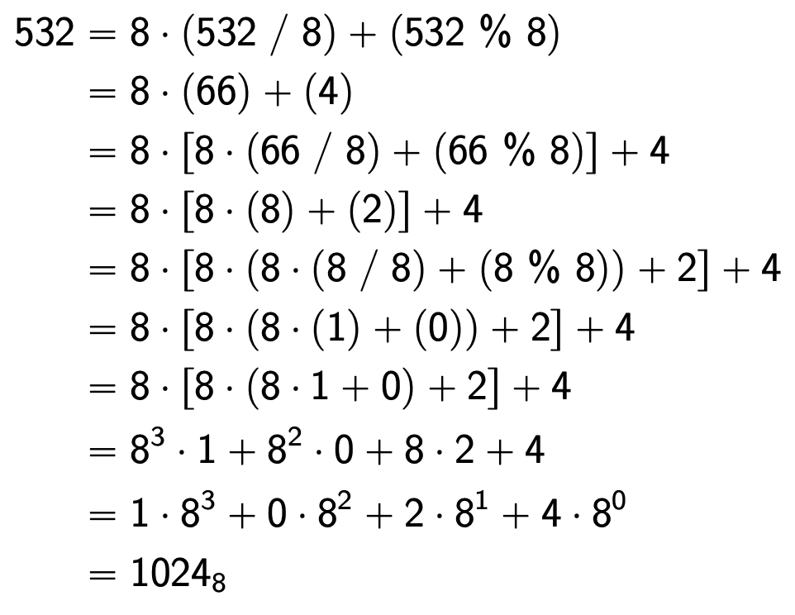
Binary, Octal, and Hexadecimal
Convert 532 to octal (532₁₀=???₈)
/ is truncated division
(working with integers)
% is remainder after
integer division

Slide 34
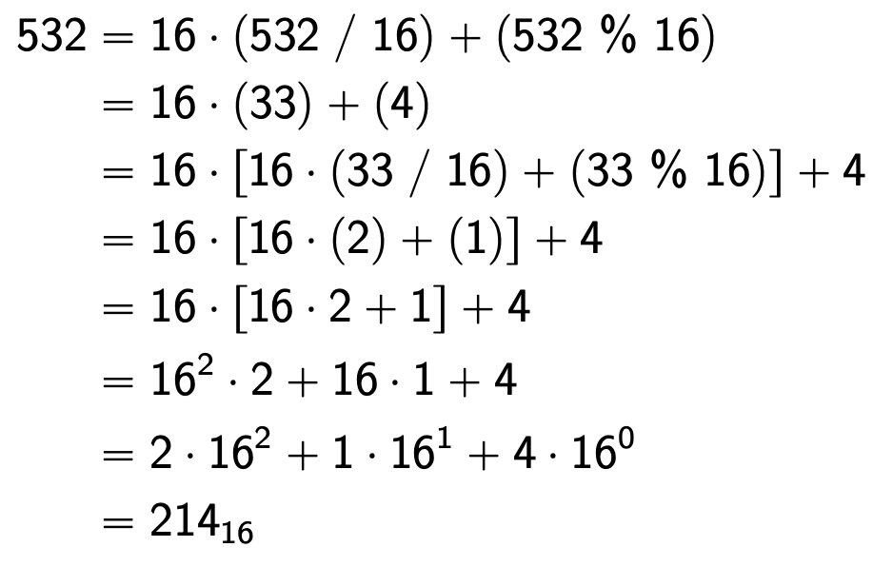
Binary, Octal, and Hexadecimal
Convert 532 to octal (532₁₀=???₁₆)
/ is truncated division
(working with integers)
% is remainder after
integer division

Slide 35
Datatype in Python vs C
sum = 0
N = 100000000
for i in range(N):
sum += 1
print(sum)
#include <stdio.h>
int main()
{
int sum = 0;
int N = 100000000;
for (int i = 0; i<N; i++)
sum += 1;
printf("%u\n", sum);
return 0;
}

Slide 36
Decimal (base 10) Representation
456 in base 10 is $456 =(4)100 +(5)10 +(6)1 =\left(4\right){10}^{2} +(5){10}^{1} +(6){10}^{0}$

Slide 37
unsigned char vs. char
unsigned char
non-negative integer represented by 8 bits
Value range
from 0 to 255 (2^8-1)
In hex
from 0x00 to 0xFF
char
Signed integer represented by 8 bits
Value range
from -128 to 127
unsigned short
non-negative integer represented by 16 bits
Value range
from 0 to 65,535 (2^16-1)
In hex
from 0x0000 to 0xFFFF
short
Signed integer represented by 8 bits
Value range
from -32,768 to 32,767

