Slide 1
Bits II CMSC 14300: System Programming I 4th Lecture
Instructor:
Prof. Adam Shaw
Prof. Junchen Jiang

Slide 2
Overview
Bit-wise operations
Addition& subtraction
Hexdump a file

Slide 3
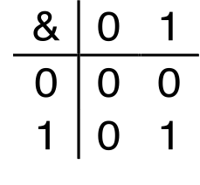
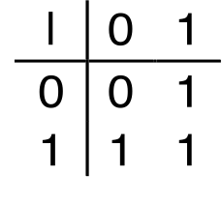
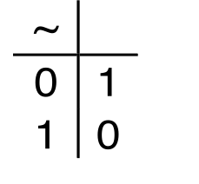
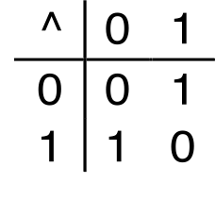
Boolean Algebra
Algebraic representation of logic
Developed by George Boole in 19th Century
Encode “True” as 1 and “False” as 0
And
A&B = 1 when both A=1 and B=1
Or
A|B = 1 when either A=1 or B=1
Not
~A = 1 when A=0
Exclusive-Or (Xor)
A^B = 1 when either A=1 or B=1, but not both

Slide 4
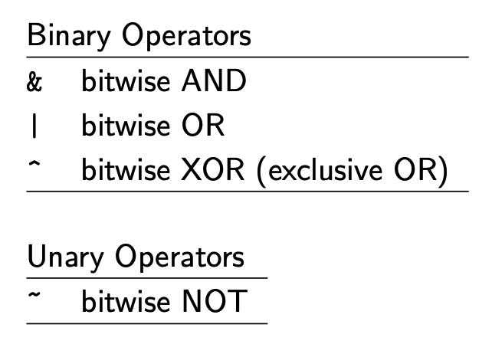
Bitwise Operators
unsigned char x = 0xC8, y = 0x7B;
x
11001000 (0xC8)
y
01111011 (0x7B)
x & y
01001000 (0x48)
x | y
11111011 (0xFB)
x ^ y
10110011 (0xB3)
Apply to any integer data types:
long, int, short, char, signed or unsigned
View arguments as bit vectors
Operations applied bit-wise
~x
00110111 (0x37)
~y
10000100 (0x84)

Slide 5
Bitwise Operations vs. Logic Operations in C
Bitwise Operations: &, |, ~, ^
View arguments as bit vectors
Operations applied bit-wise
Logical Operators: &&, ||, !
View 0 as "False"
Anything nonzero as "True"
Always return 0 or 1
~0xC8 ➙ 0x37
0xC8 & 0xB9 ➙ 0x88
0xC8 | 0xB9 ➙ 0xF9
!0xC8 ➙ 0x00 (false)
!!0xC8 ➙ 0x01 (true)
(!! converts any non-zero values to 1)
0xC8 && 0x7B ➙ 0x01 (true)
0xC8 || 0x7B ➙ 0x01 (true)
Watch out for && vs. & (and || vs. |)…
one of the more common oopsies in C programming

Slide 6
Shift Operations
Left Shift: x << y
Shift bit-vector x left y positions
Keep bit-vector length (throw away extra bits)
Fill with 0’s on right
Right Shift: x >> y
Shift bit-vector x right y positions
Keep bit-vector length (throw away extra bits)
Logical Shift:
Fill with 0's on left
Arithmetic Shift:
Replicate most significant bit on left
x
11001000
y
01111011
// left shift
x = x << 2
y = y << 2
00100000
11101100
// logical right shift
x = x >> 3
y = y >> 3
00011001
00001111
// arithmetic right shift
x = x >> 3
y = y >> 3
11111001
00001111
Almost all C compiler/machines use arithmetic right shifts for signed data. Why?

Slide 7
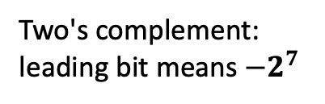



Recap: Representing Signed Integers with Two's complement
Binary | Unsigned | Signed (two's complement)
00000000 | 0 | 0
00000001 | 1 | 1
00000010 | 2 | 2
00000011 | 3 | 3
… | … | …
01111101 | 125 | 125
01111110 | 126 | 126
01111111 | 127 | 127
10000000 | 128 | -128
10000001 | 129 | -127
10000010 | 130 | -126
10000011 | 131 | -125
… | … | …
11111101 | 253 | -3
11111110 | 254 | -2
11111111 | 255 | -1
A: Two's complement --- Interpret the leading bit differently
unsigned char a = 200;
Unsigned: leading bit means $2^{7}$
$$2^{7}+2^{6}+2^{3}= 200$$
1 | 1 | 0 | 0 | 1 | 0 | 0 | 0
$${−2}^{7}+2^{6}+2^{3}=−56$$
Two's complement: leading bit means $−2^{7}$
Value in two's complement: -56

Slide 8
Why Arithmetic Shift?
Logical shift x >> n
Equivalent to integer division by 2^n if x is interpreted as an unsigned integer.
Arithmetic shift x >> n
Preserves sign of x if interpreted as a two's complement signed integer
Right shift always means division by 2^n
unsigned char x = 200, y = 123;
x
11001000
y
01111011
// logical right shift
x = x >> 3
y = y >> 3
00011001 (25 = 200/8)
00001111 (15 = 123/8)
char x = -56, y = 123;
x
11001000
y
01111011
// arithmetic right shift
x = x >> 3
y = y >> 3
11111001 (-7 = -56/8)
00001111 (15 = 123/8)

Slide 9
What's the Meaning of Left Shift
Hint: Right shift x = x >> 3 means divide x by 8 (2^3)
Q: How to multiply x by 16 using only bitwise operators?
A: x = x << 4;
Unsigned
Signed
unsigned char x = 3, y = 10, z = 123;
char x = 3, y = 10;
x
00000011
x
00000011
y
00001010
y
00001010
z
01111011
x = x << 4
00110000 (48 = 3*16)
x = x << 4
00110000 (48 = 3*16)
y = y << 4
10100000 (160 = 10*16)
y = y << 4
10100000 (-96 != 10*16)
z = z << 4
10110000 (176 != 123*16)
Overflow: if true sum > 2^{w}-1 or 255
Overflow: if true sum > 2^{w-1}-1 or 127

Slide 10
More uses of bitwise operations
Exercise: Check if the nth bit is set.
int check_bit(int x, unsigned char n) {
return (x >> n) & 1;
}
Exercise: Set the nth bit.
int set_bit(int x, unsigned char n) {
return x | (1 << n);
}

Slide 11
More uses of bitwise operations
Exercise: count the number of 1s
unsigned int count_ones(unsigned int x) {
unsigned int count = 0;
while (x) {
count += (x & 1);
x = x >> 1;
}
return count;
}

Slide 12
Overview
Bit-wise Operations
Addition & Subtraction
Hexdump a file

Slide 13
Bitwise Operations: Unsigned Addition
u
Operands: w bits
• • •
+
v
• • •
True Sum: w+1 bits
u + v
• • •
Discard Carry: w bits
UAdd_{w}(u , v)
• • •
Standard Addition Function, but Ignores carry output
Implements Modular Arithmetic: s = UAdd_{w}(u , v) = u + v mod 2^{w}
unsign char x = 18, y = 12, u = 82, v = 102, s = 200, t = 176;
x
00010010 (18)₁₀
u
01010010 (82)₁₀
s
11001000 (200)₁₀
y
00001100 (12)₁₀
v
01100110 (102)₁₀
t
10110000 (176)₁₀
x+y
00011110 (30)₁₀
u+v
10111000 (184)₁₀
s+t
101111000 (120)₁₀
Overflow: if true sum > 2^{w}-1 or 255

Slide 14
Bitwise Operations: Signed Addition
u
Operands: w bits
• • •
+
v
• • •
True Sum: w+1 bits
u + v
• • •
Discard Carry: w bits
TAdd_{w}(u , v)
• • •
Two's complement (signed) addition and unsigned addition have Identical Bit-Level Behavior.
char x = 18, y = 12, u = 82, v = 102, s = -56, t = -80;
x
00010010 (18)₁₀
u
01010010 (82)₁₀
s
11001000 (-56)₁₀
y
00001100 (12)₁₀
v
01100110 (102)₁₀
t
10110000 (-80)₁₀
x+y
00011110 (30)₁₀
u+v
10111000 (-72)₁₀
s+t
101111000 (120)₁₀
Overflow: if true sum > 2^{w-1}-1 or 127
Overflow: if true sum < -2^{w-1} or -128

Slide 15
Bitwise Operations: Addition
u
Operands: w bits
• • •
+
v
• • •
True Sum: w+1 bits
u + v
• • •
Discard Carry: w bits
TAdd_{w}(u , v)
• • •
Two's complement (signed) addition and unsigned addition have Identical Bit-Level Behavior.
unsigned char a = (unsigned char) u + (unsigned char) v;
char b = (char) u + (char) v;
a and b have the same binary representation, but different interpretation

Slide 16
Bitwise Operations: Negation of signed integers
Binary | Unsigned | Signed (two's complement)
00000000 | 0 | 0
00000001 | 1 | 1
00000010 | 2 | 2
00000011 | 3 | 3
… | … | …
01111101 | 125 | 125
01111110 | 126 | 126
01111111 | 127 | 127
10000000 | 128 | -128
10000001 | 129 | -127
10000010 | 130 | -126
10000011 | 131 | -125
… | … | …
11111101 | 253 | -3
11111110 | 254 | -2
11111111 | 255 | -1
For any given signed integer x (except Tmin), -X = ~X + 1
Exercise:
-5 => ??
-(-5) => ??
This also means subtraction can be also done using only bitwise operations
A - B = A + (-B)
Tmin (-2^{w-1}):
min value for signed

Slide 17
Overview
Bit-wise Operations
Addition & Subtraction
Hexdump

Slide 18
Hexdump
hexdump - display file contents in hexadecimal, decimal, octal, or ascii
Demo
C source file
CSV file
Image
Binary
Run $ man hexdump to read more information
Notes:
hexdump -b factorial.c
hexdump -C factorial.c
hexdump -n 1000 -C logo.png
clang factorial.c -o factorial
hexdump -C factorial
objdump -t factorial
objdump -D factorial

Slide 19
Recap
Bitwise operations are powerful
4 Boolean operations
Shifts
Addition
Signed vs. Unsigned

